Slide 1
GBT Project Status
Paulo Moreira
On behalf of the GBT team
10 October 2013
CERN, Switzerland

Slide 2
Outline
Radiation Hard Optical Link Architecture
The GBT System
GBLD Status
GBTIA Status
GBTX:
  Data Bandwidth
  Functionality
  ASIC Status
  Testing Status
  GBTX Future
GBT-SCA Status
GBT Building Blocks Status
GBT-FPGA Status

Slide 3
Radiation Hard Optical Link Architecture
GBT
GBT
Versatile Link
FPGA
Timing & Trigger
GBTX
PD
Timing & Trigger
GBTIA
DAQ
DAQ
GBLD
LD
Slow Control
Slow Control
Custom ASICs
On-Detector
Radiation Hard Electronics
Off-Detector
Commercial Off-The-Shelf (COTS)

Slide 4
The GBT System
FE
Module
Clock[7:0]
External clock reference
E – Port
e-Link
GBTX
Phase - Shifter
CLK Reference/xPLL
FE
Module
E – Port
E – Port
ePLLRx
GBTIA
DEC/DSCR
E – Port
CDR
data-down
data-up
Phase – Aligners + Ser/Des for E – Ports
CLK Manager
clock
80, 160 and 320 Mb/s ports
GBLD
SCR/ENC
SER
FE
Module
E – Port
ePLLTx
E – Port
E – Port
One 80 Mb/s port
Control Logic
Configuration
(e-Fuses + reg-Bank)
GBT – SCA
E – Port
JTAG
I2C Slave
I2C Master
I2C (light)
data
JTAG
Port
I2C
Port
control
clocks

Slide 5
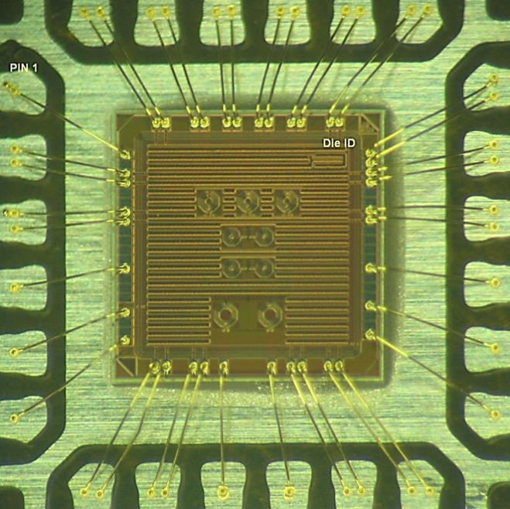
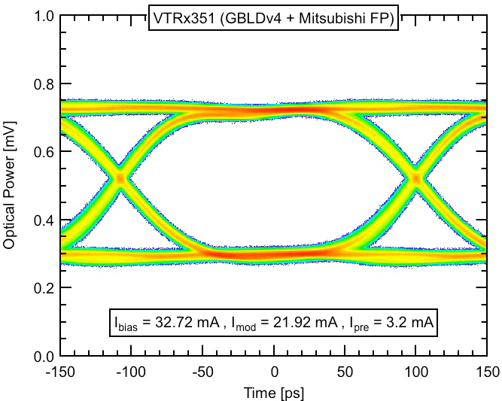
GBLD Status
GBLD V4.1
Main Specs
  Bit rate 5 Gb/s (min)
  Modulation:
    Current sink
    Single-ended/differential
  Laser modulation current: 2 to 24 mA
  Laser bias: 2 to 43 mA
  Equalization:
    Pre-emphasis/de-emphasis
    Independently programmable for rising/falling edges
  Supply voltage: 2.5 V
  Die size: 2 mm × 2 mm
  I2C programming interface
Status
  Available in small quantities
    Integrated in the VTRx and VTTx
  Fully functional
  Excellent performance
  Radiation hardness proved (total dose)
  Final SEU tests to be done October 2013
  Technology: 130 nm DM metal stack
  Device is production ready
4.8 Gb/s, pre-emphasis on
Total jitter: ≈ 25 ps

Slide 6
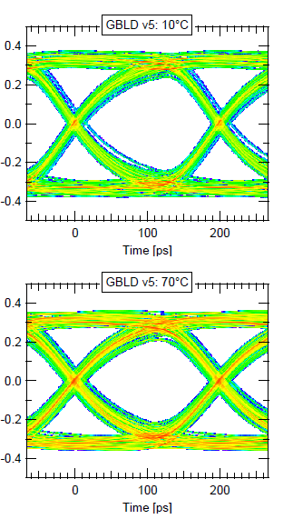
LpGBLD Status
Low power GBLD (LpGBLD)
Main Specs, mostly as for GBLD V4 but:
  VCSEL driver only:
    Lower modulation current:
      12 mA max
  Power consumption reduced by 40%
    VCSEL choice is determinant
      Min: 138 mW
      Max: 325 mW
  Uses the LM stack:
    It can be fabricated with GBTIA and GBTX
Status:
  Devices available in small quantities
  Electrically characterization done
  Performance is good at ambient temperature:
    Slower that GBLD V4 as expected
    At high temperatures (> 70) the electrical performance degrades slightly
    When convolved with the laser response at high temperatures the performance falls behind specs:
      Further studies require to evaluate performance with multiple VCSEL devices

Slide 7
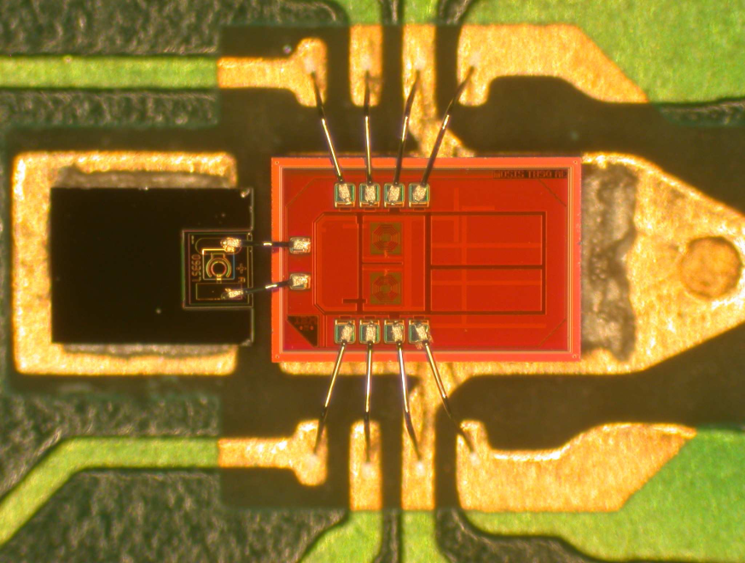
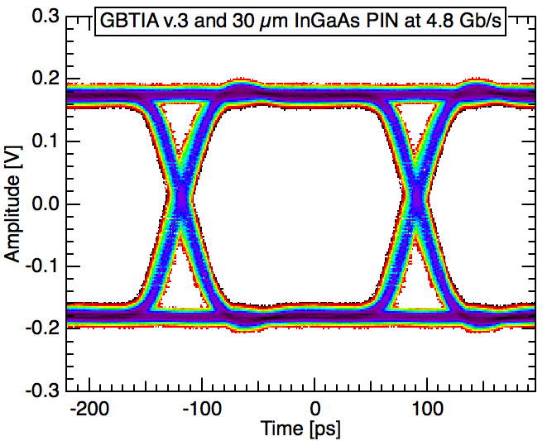
GBTIA Status
GBTIA V2.0 / V2.1
Main specs:
  Bit rate 5 Gb/s (min)
  Sensitivity: 20 μA P-P (10⁻¹² BER)
  Total jitter: < 40 ps P-P
  Input overload: 1.6 mA (max)
  Dark current: 0 to 1 mA
  Supply voltage: 2.5 V
  Power consumption: 250 mW
  Die size: 0.75 mm × 1.25 mm
Status:
  Fully functional
  Excellent performance
  Radiation hardness proved
    Tested up to 200 Mrad (SiO₂)
  Device is production ready
    LM metal stack

Slide 8
GBTX Data Bandwidth
The GBTX supports three frame types:
  “GBT” Frame
  “Wide Bus” Frame
  “8B/10B” Frame
“GBT” Mode
  User bandwidth: 3.28 Gb/s
    Up/down-links
“Wide Bus” and “8B/10B”frames are only supported for the uplink
  The downlink always uses the “GBT” frame.
“8B/10B” Mode
  Downlink data 8B/10B encoded
  No FEC
  User bandwidth: 3.52 Gb/s
“Wide Bus” Mode:
  Uplink data scrambled
  No FEC
  User bandwidth: 4.48 Gb/s
GBTX
Phase - Shifter
CLK Reference/xPLL
E – Port
ePLLRx
DEC/DSCR
E – Port
CDR
Phase – Aligners + Ser/Des for E – Ports
CLK Manager
SCR/ENC
SER
E – Port
ePLLTx
E – Port
Control Logic
Configuration
(e-Fuses + reg-Bank)
JTAG
I2C Slave
I2C Master

Slide 9
GBTX Functionality (1/4)
e-Links
40 bi-directional e-Links
  Up to 40 @ 80 Mb/s
  Up to 20 @ 160 Mb/s
  Up to 10 @ 320 Mb/s
e-Port data rate can be set independently for:
  each group
  Input / output ports
1 bi-directional e-Link:
  80 Mb/s
40 e-Link clocks (fixed phase) programable in frequency:
  40/80/160/320 MHz (per group)
  (independently of the bit rate)
Automatic, semi-automatic or user controlled phase alignment of the incoming serial data embedded in the e-Ports
  Automatic alignment
    Tracks temperature and voltage variations
    Transparent to the user
    Works on any type of data:
      DC balanced / un-balanced
      A few “occasional” transition enough to ensure correct operation
GBTX
Phase - Shifter
CLK Reference/xPLL
E – Port
ePLLRx
DEC/DSCR
E – Port
CDR
Phase – Aligners + Ser/Des for E – Ports
CLK Manager
SCR/ENC
SER
E – Port
ePLLTx
E – Port
Control Logic
Configuration
(e-Fuses + reg-Bank)
JTAG
I2C Slave
I2C Master

Slide 10
GBTX Functionality (2/4)
e-Links Special cases
8B/10B mode:
  44 input (max @ 80 Mb/s)
  36 output (max @ 80 Mb/s)
    (Four outputs reused as inputs)
Wide-Bus mode:
  56 input (max @ 80 Mb/s)
  24 output (max @ 80 Mb/s)
    (16 outputs reused as inputs)
e-Links electrical characteristics
Drivers:
  SLVS signaling
Receivers:
  SLVS/LVDS signaling
GBTX
Phase - Shifter
CLK Reference/xPLL
E – Port
ePLLRx
DEC/DSCR
E – Port
CDR
Phase – Aligners + Ser/Des for E – Ports
CLK Manager
SCR/ENC
SER
E – Port
ePLLTx
E – Port
Control Logic
Configuration
(e-Fuses + reg-Bank)
JTAG
I2C Slave
I2C Master

Slide 11
GBTX Functionality (3/4)
Phase-Shifter
8 independent clocks
Programable in frequency:
  40 / 80 / 160 / 320 MHz
Programable in phase:
  0 to 360◦
  Phase resolution: 50 ps
    (for all frequencies)
Clock driver electrical levels:
  SLVS
Reference clock:
On package crystal
Built-in crystal oscillator
Built-in VCXO based PLL (xPLL)
External reference can used as well
GBTX
Phase - Shifter
CLK Reference/xPLL
E – Port
ePLLRx
DEC/DSCR
E – Port
CDR
Phase – Aligners + Ser/Des for E – Ports
CLK Manager
SCR/ENC
SER
E – Port
ePLLTx
E – Port
Control Logic
Configuration
(e-Fuses + reg-Bank)
JTAG
I2C Slave
I2C Master

Slide 12
GBTX Functionality (4/4)
Chip Control
e-Fuse register bank for burn in configuration
  Standalone operation
  Ready at power up
Dynamic configuration and control
  I2C Slave interface
  IC control channel trough the optical link
Watchdog circuit for chip operation supervision.
GBLD Control
GBLD dedicated I2C master interface
  Copies configuration burned in in the GBTX into the GBLD at start-up
  Allows to program the GBLD either through the IC channel or through the I2C slave port
GBTX
Phase - Shifter
CLK Reference/xPLL
E – Port
ePLLRx
DEC/DSCR
E – Port
CDR
Phase – Aligners + Ser/Des for E – Ports
CLK Manager
SCR/ENC
SER
E – Port
ePLLTx
E – Port
Control Logic
Configuration
(e-Fuses + reg-Bank)
JTAG
I2C Slave
I2C Master

Slide 13
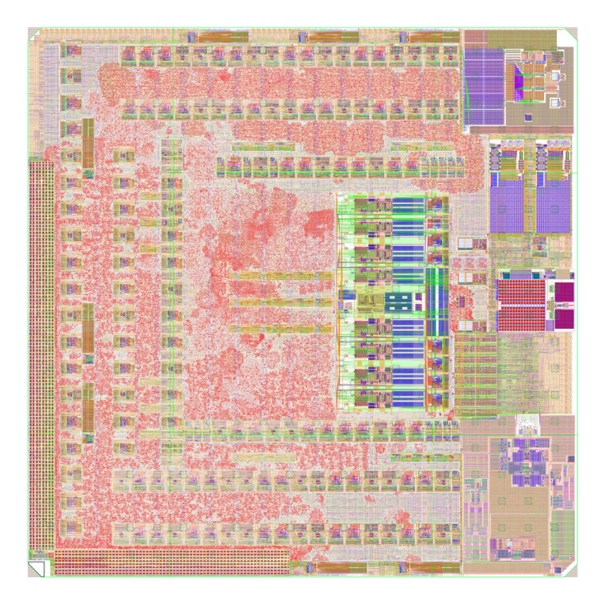
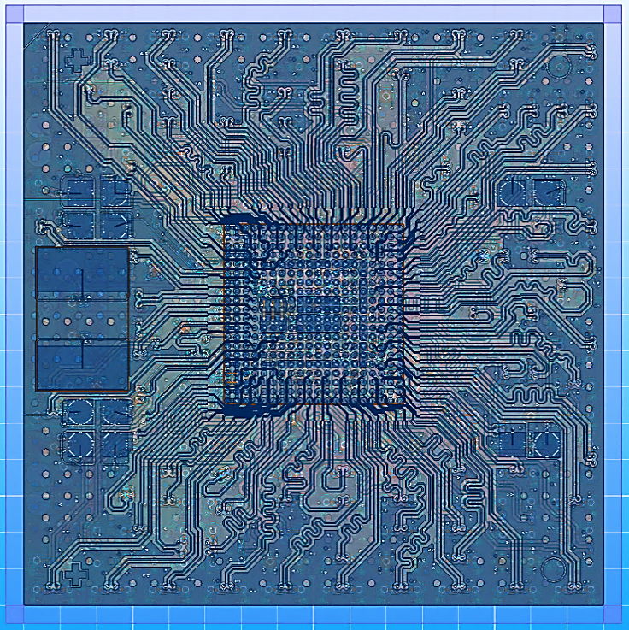
GBTX Status
GBTX submitted for fabrication on the 6th of August 2012
Prototypes:
  120 ASICs (bare die) available since December 2012
  First packaged chips available May 2013
    Long design/production cycle!
    Due to a manufacturing error the package presented a short-circuit between the power and ground planes
    This caused the loss of 60 die and testing delays
    “Preliminary testing” could nonetheless be done by drilling the short-circuit in a few packages at the loss of a few connections!
  Fully functional packaged chips were finally delivered September 2013

Slide 14
GBTX Testing Status
Function | Status | Comment
SER | Done | Tested up to 5.4 Gb/s
CDR | Done | Tested up to 5.4 Gb/s
e-Port Tx | Done
e-Port Rx | Done
e-Port Phase Aligner | Done
Phase-Shifter | Done
xPLL | Done | Functional but VCXO "gain" must be increased for reliable start when in the PLL mode
e-Fuses | Done
I2C Master | Done
I2C Slave | Done
IC control channel | TBD
JTAG | TBD

Slide 15
GBTX Future
Q4 – 2013
  Two SEU test runs: October / November
  Total dose irradiation tests: December
  Chip characterization: October – December
  Samples available for prototyping: December
    Only small quantities available
    (Remember that we have lost a substantial fraction due to the packaging problem)
Q1 – 2014
  Depending on the SEU test results small changes might be required to improve the robustness of the circuit
  Although the circuit is fully functional a “a few small corners need to be rounded” to make it “plug-and-play” for the users
Q2 – 2014
  Split Engineering Run to produce in quantities:
    GBTX
    GBTIA
    GBLD V4/V5
Q3 – 2014
  Chips available from the foundry
  ASIC Packaging
Q4 – 2014
  ASIC production testing
  First production ASICs distributed to the users

Slide 16
GBT-SCA Status
Analog Circuitry
  ADC block
    Design development outsourced to an IP vendor.
    Design is based on the DCU ADC architecture.
    Integration work of the IP block is on going.
DAC
  Building block borrowed from the MEDIPIX-3 project.
  Integration work is on going.
Digital Circuitry
  RTL code extensively redesigned during last year. Level of completeness 95%
  Development of a test bench based on System Verilog
  Development of a hardware test benched based on an FPGA development board.
ePort (with HDLC transmission protocol)
  Level of completeness 100%
  Functionality checks are O.K. and code is synthesizable
Chip Assembly and prototype submission
  Floor planning, Place & Route work is on going.
  Target tape out date:
    MOSIS MPW run in November 2013

Slide 17
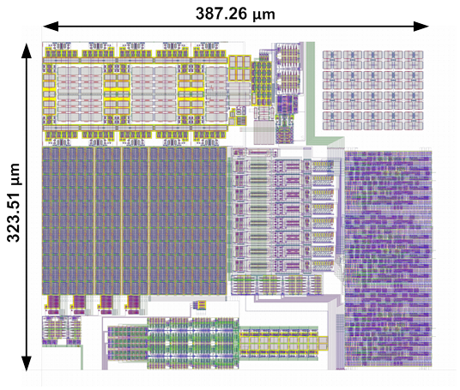
GBT Building Blocks (IP) Status
Available “IP” to facilitate the implementation of
e-Link transceivers in the frontend ASICs:
SLVS Receiver
  Wire-bond, DM metal stack
  C4, LM metal stack
SLVS Driver
  Wire-bond, DM metal stack
  C4, LM metal stack
SLVS Bi-directional
  C4, LM metal stack
HDLC transceiver
  Synthesizable Verilog
7B/8B CODEC
  Synthesizable Verilog
ePLL-FM
  Frequency Multiplier PLL
  Radiation Hard
  130 nm CMOS technology with the DM metal stack (3-2-3).
  Input frequencies: 40/80/160 MHz
  Output frequencies: 160/320 MHz regardless the input frequency
  Programmable phase of the output clocks with a resolution of 11.25° for the 160 MHz clock and 22.5° for the 320 MHz clock
  Programmable charge pump current, loop filter resistance and capacitance to optimize the loop dynamics
  Supply voltage: 1.2 V - 1.5 V
  Nominal power consumption: 20 mW @ 1.2 V - 30 mW @1.5 V
  Operating temperature range: -30°C to 100°C
ePLL-CDR (currently under testing)
  Data rate: 40/80/160/320 Mbit/s
  Output clocks: data clock + 40/80/160/320 MHz with programmable phase
  Internal or external calibration of the VCO frequency
  Possibility to use it as a frequency multiplier PLL without applying input data
  Programmable charge pump current, loop filter resistance and capacitance to optimize the loop dynamics
  Supply voltage: 1.2 V - 1.5 V
  Operating temperature range: -30°C to 100°C
  Prototype fabrication: May 2013
ePLL- FM

Slide 18
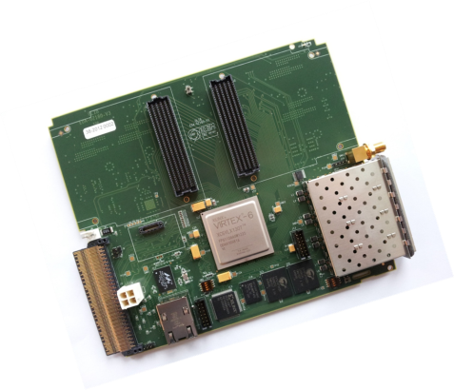
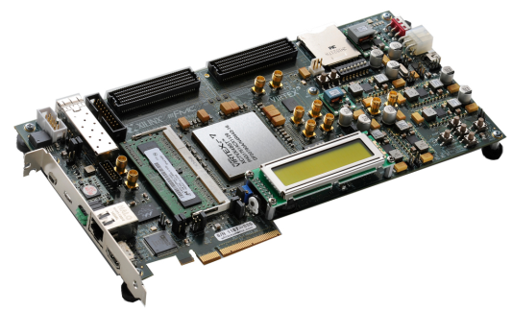
GBT – FPGA Status
Aim:
  Implement the GBT serial link in all its flavours as an IP core for most of the current FPGAs used on Back-End boards for upgrades
  Propose an emulation of the E-links for Front-End chip emulation on FPGA
On-going firmware updates
  Serial link encoding schemes
    Reed-Solomon (used in GBT frame operation mode),
    8b/10b (using hardIP if possible to reduce resources)
    Wide-bus
  Fixed latency version
  E-links modes
    GBT modes x2, x4 and x8
    Wide bus mode
    8b/10b mode
  IC channel protocol (not yet started)
Available or targeted FPGA
  Altera:
    Stratix II and IV (tested with the GBT-SerDes ASIC)
    Cyclone V GT (tested with the real GBTx ASIC)
    Stratix V (to be done)
  Xilinx:
    Virtex 5 and 6 (tested with the GBT-SerDes ASIC)
    Kintex 7 (on-going)
    Virtex 7 (on-going)
Available or targeted Reference designs
  Xilinx:
    Virtex 5: ML523
    Virtex 6: ML605 and GLIB
    Kintex 7: KC705
    Virtex 7: VC705
  Altera:
    Stratix II Gx:PCIe evaluation kit
    Stratix IV: PCIe evaluation kit
    Cyclone V GT: evaluation kit and GBTx Stand Alone Tester (SAT board)
Project Resources
  50% of one Fellow since this summer
  More than 70 users registered
  A sharepoint site: https://espace.cern.ch/GBT-Project/GBT-FPGA/default.aspx
A SVN repository:
  https://svnweb.cern.ch/cern/wsvn/ph-ese/be/gbt_fpga
Contact us:
  Sophie.baron@cern.ch
  manoel.barros.marin@cern.ch
GLIB board (Virtex 6)
KC705 (Kintex 7)

