Slide 1
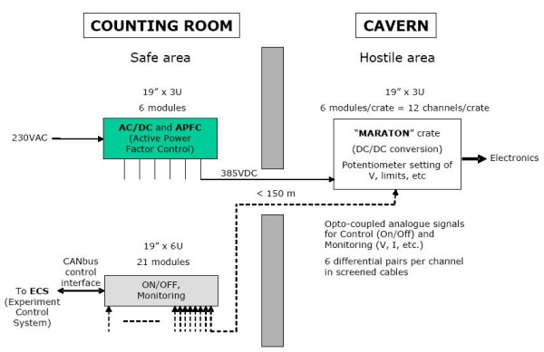
Power supplies
On-going maintenance procedure works well
Statistics compiled by PH-ESE:
Very few ‘front-end’ power supplies have required repairs.
PFCs have highest failure-rate
(but easily accessible in counting room, we have many spares)
Example:
Maraton LV system
PFC
RCM
Water
cooling

Slide 2
Potential Problems
Mechanical issues:
Solder joints
Fans (already replaced)
Connectors (eg oxidation?)
Electrical components:
Electrolytic caps
(lose electrolyte, R goes up, efficiency goes down):
temperature dependent!

Slide 3
Treat them with care!
We must take care of the power supplies we have!!!!
Maintain cooling
=> component degradation is very temperature dependent
=> triggered ‘pipe-cleaning’ campaign at pit
(Laurent et al)
Analysis of components in power supplies
=> recommendation from suppliers for fan replacement
=> triggered replacement campaign (on-going)

Slide 4
Power supplies - sharing
VELO
Pile-Up
VELO
RICH
RICH
UT
TT
IT
OT
SciFi
ECAL & HCAL
PS & SPD
Calo
Muons
Muons

Slide 5
Urgent issues
Does each sub-detector have enough power supplies for the upgrade????
If not, do they need:
More of the existing supplies?
New types of supply?
Beware of obsolescence (eg CAEN SY1527)
Purchase/maintenance contract until 2018
Will be extended (somehow…….)

