Slide 1
Preliminary vacuum pressure distribution for the beam gas imaging for the LHC
Proposed design specification
Example of pressure distribution
  Different gas types
Preliminary conclusions & Outlook

Slide 2
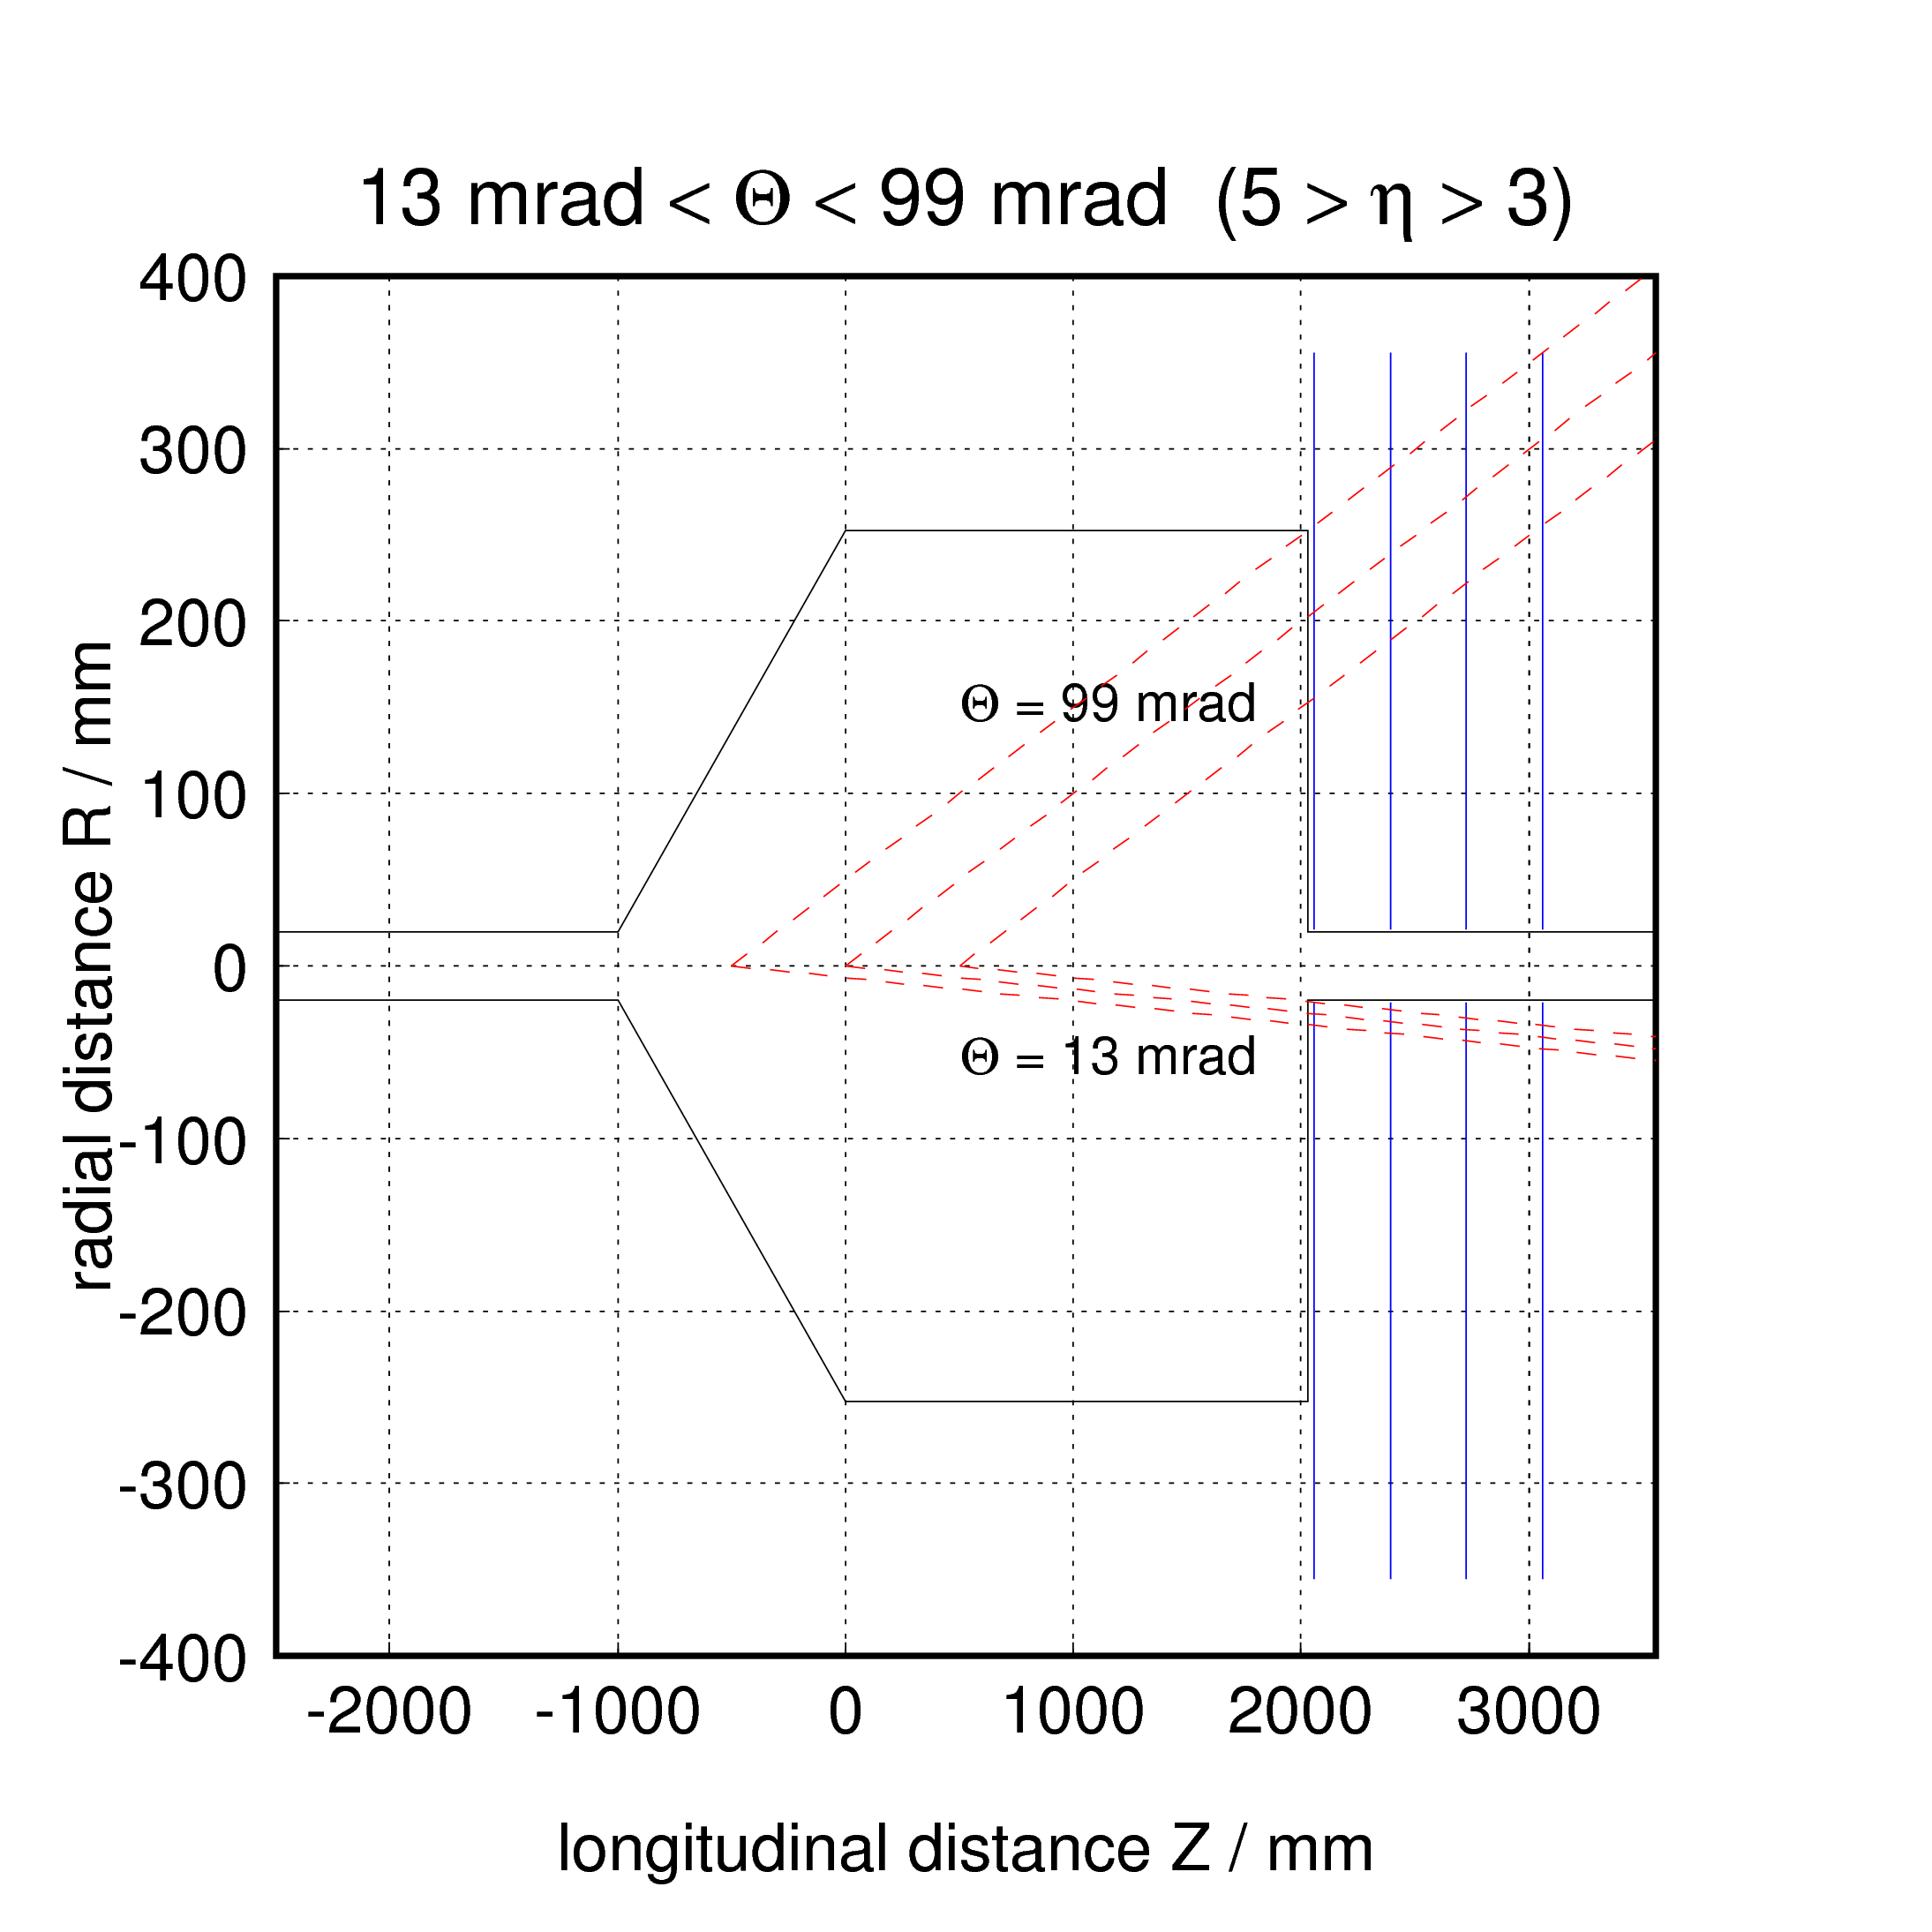
Proposed design for the BGV for LHC
From M. Ferro- Luzzi

Slide 3
Required densities
Densities (averaged over 1m) that would be needed for the BGV to work adequately for some representative gas types.
    Notes: since we only simulated H, O and Xe, we did this:
    * A and F_{good} for CO₂ approximated by O₃
    # F_{good} for Ne assumed same as for O (should be slightly better)
Can estimate performance of any other gas by estimating the F_{good} from the gas with the closest A and by scaling the density with A^{2/3} (larger A, smaller density needed).
Reminder 1: ρ is the molecular density, while the rate scales with the number of nuclei per cm³ !
Reminder 2: what really counts is the target thickness (ρ integrated along the useful z range)
Gas type | A | F_{good} | ρ [10⁷ cm⁻³] | p at 293 K [10⁻⁹mbar]
Hydrogen | 1 | 0.002 | 5800 | 2300
Neon | 20 | ~0.020# | 160 | 64
CO₂ | 16* | 0.020* | 60 | 25
Xenon | 131 | 0.140 | 7 | 2.6
From M. Ferro- Luzzi

Slide 4
Example of a Possible Vacuum Layout
Case of the BGV installed in 1 beam pipe
For integration reasons the total length of the installed system is fixed to 7 m
φ 8 cm
NEG Coating
2 x NEG Cartridges
φ 8 cm
NEG Coating
0.5 m
0.25 m
1 m
2 m
1.25 m
Standard vacuum chamber
Conical transition
φ 8 cm → φ 4 cm
NEG Coating
φ 4 cm + NEG Coating
Reduced aperture
Gas Injection
7 m

Slide 5
Preliminary results and outlook
Gas | Mean Pressure in BGV | <Qinj> | Pmax/Pmin in BGV | P @ 1 m | P@ 2.5 m
H2 | 1E-7 | 5E-5 | ≈ 1.5 | 5E-9 | 1E-11
CO | 5E-8 | 1E-5 | ≈ 1.5 | 5E-11 | 1E-11
CO2 | 2E-8 | 1E-6 | ≈ 1.5 | 5E-11 | 1E-11
Investigation of favorable case
Limitation due to long term injection must be investigated
    Implies BGV performance reduction
    Implies possible LHC performance reduction (lifetime, vacuum instability, radiation …)
Reduced diameter aperture of 4 cm must be validation by optics team

