Slide 1
Optimization of timing performance of large-area FBK SiPMs in the scintillation light readout.
A. Gola, A. Ferri, C. Piemonte, A. Picciotto, T. Pro, N. Serra, A. Tarolli, N. Zorzi
http://srs.fbk.eu

Slide 2
Overview of the
SiPM technology at FBK

Slide 3
FBK technology evolution
Original technology
2006
2010-11
2012
RGB-SiPM
(Red-Green-Blue SiPM)
excellent breakdown voltage uniformity
low breakdown voltage temperature
dependence (gain variation < 1%/C)
higher efficiency
lower noise
NUV-SiPM
(Near-UV SiPM)
excellent breakdown voltage uniformity
low breakdown voltage temperature
dependence (gain variation < 1%/C)
high efficiency in the near-ultraviolet
very low dark noise
2012
RGB-SiPM_HD
(Red-Green-Blue SiPM – high density)
small cell size with high fill factor:
- high dynamic range
- low excess noise factor
3

Slide 4
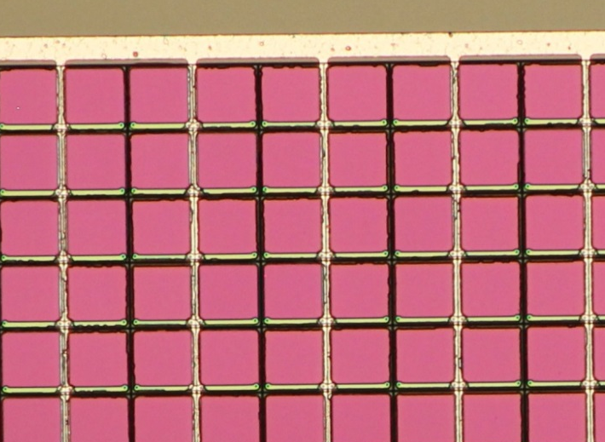
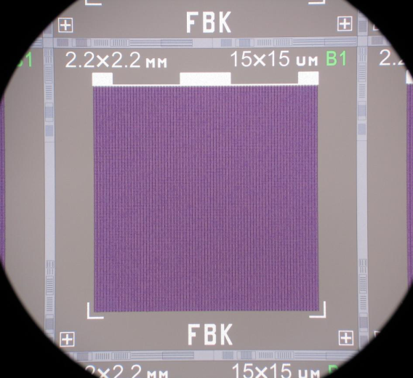

RGB-SiPM HD
Redesigned cell border, for obtaining small cells with high Fill Factor (FF).
The 15 um cell RGB-HD has the same FF of the 50 um cell RGB technology.
SiPM:
size: 4x4mm²
cell size: 30x30um²
# cells: ~17000
SiPM:
size: 2.2x2.2mm²
cell size: 15x15um²
# cells: 21316
Fill factor = 74%
Fill factor = 48%
4

Slide 5
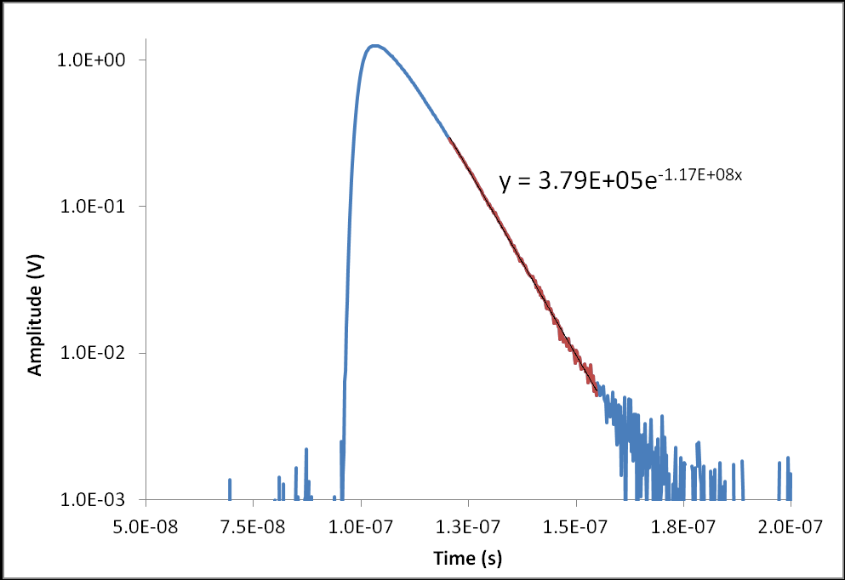
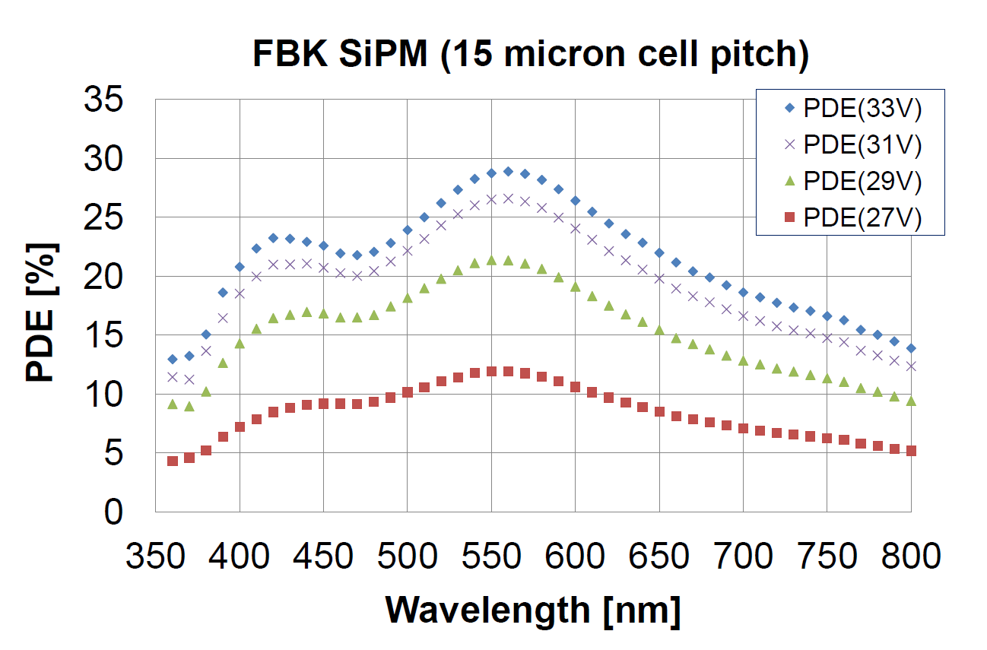
RGB-SiPM HD
2.2x2.2mm² 15um
Response to fast light
pulse from LED
Photo-detection efficiency
τ = 9ns
measurement by Musienko @ CERN
very short decay!!
5

Slide 6
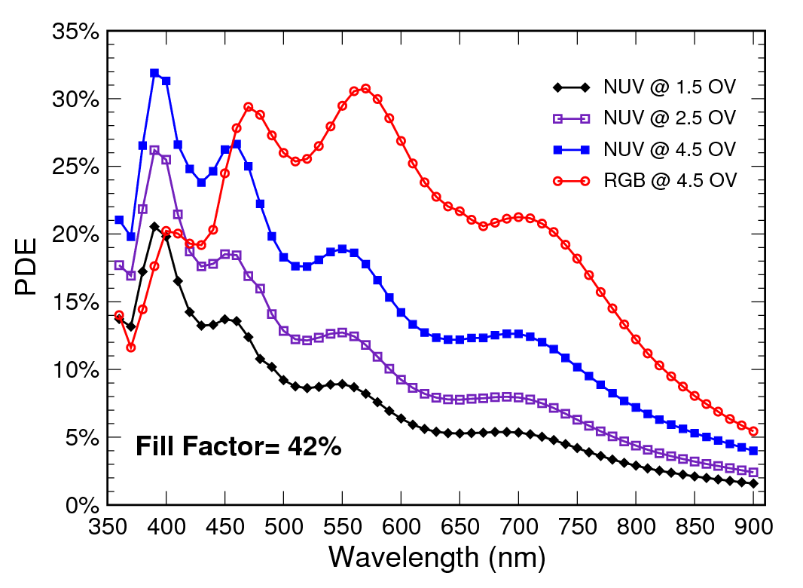
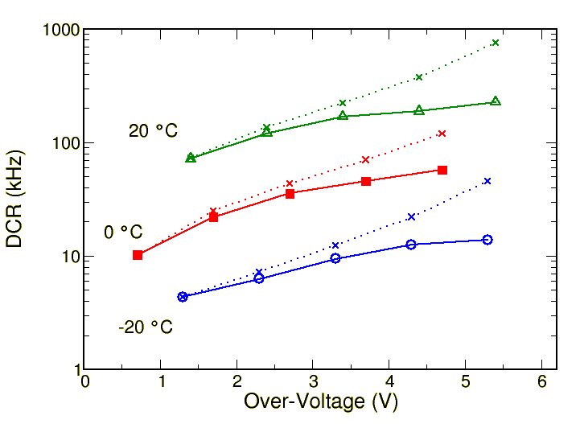
NUV-SiPM
The NUV SiPM is based on a p-on-n junction, for increased PDE at short wavelengths.
Increased PDE at low λ
Very low primary DCR
PDE vs. wavelength for a NUV-SiPM and RGB-SiPM with 50x50um² cell, 42% fill factor.
NUV-SiPM: 1x1mm² 50x50um².Total and primary dark count rate at 0.5 phe.
6

Slide 7
Effects of the SiPM noise:
Dark Count Rate

Slide 8
Effect of dark noise in LED
Leading Edge Discriminator (LED) is commonly used for time pick-off with PMTs.
long tail of the
dark events
high dark rate
baseline fluctuation
➔ time jitter
high LED threshold
➔ worse photon stat.
In large area SiPMs the dark rate can be quite high and consequently also the effect described above.

Slide 9
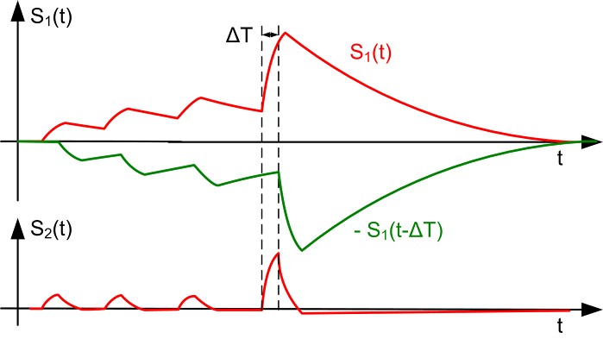
SiPM Signal filtering: DLED
Original signal
We exploit the difference
between rise time and
decay time to obtain a
signal:
“free” from baseline
fluctuations
identical initial part
of the gamma signal
Delayed replica
Differential signal
Then, we use the LED on the differential signal s₂(t).
Important: electronic noise is ~ √2 higher in differential
signal so its effect must be negligible for DLED to be effective

Slide 10
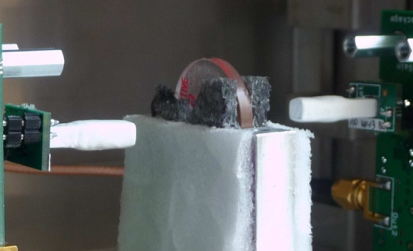
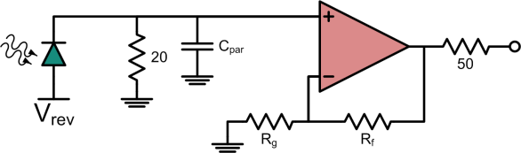
Experimental set-up
current
feedback
amplifier
Na²² source
current
feedback
amplifier
SiPM + LYSO
Digital scope (1GHz, 10GSa/s, 8 bit ADC)
Energy channels
Timing channels
for energy eval
same signals
in a very expanded
scale to reduce
quantization noise
dark events
4ns delay
Ch1
1MΩ
Ch2
Ch3
50Ω
Ch4

Slide 11
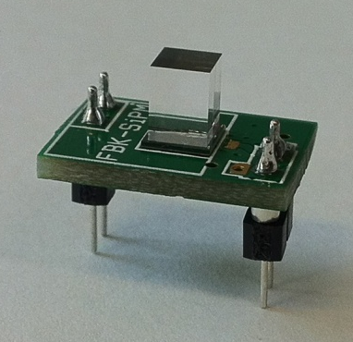
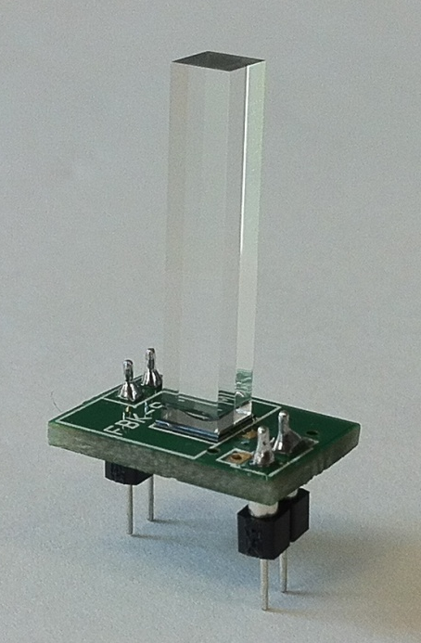
Detectors tested
Detector “cube”
LYSO crystal 3x3x5mm³
height ~ side
to test ultimate SiPM
performance
SiPMs used
3x3mm²
4x4mm²
67um cell-size
produced by FBK, Trento
Detector “PET”
LYSO crystal 3x3x15mm³
height ~ 5 x side
real PET configuration
(timing affected by light
propagation in crystal)

Slide 12
DLED vs. LED performance
Detector cube,
3x3mm² SiPM
Low over-voltage:
low gain, low dark rate
➔ electronic noise dominates
➔ DLED slightly worse than LED
T=20C
Medium over-voltage:
gain increases
dark noise ampl. > elect. noise
LED is flat (increase of PDE is compensated by increase of noise)
DLED improves following PDE
LED
DLED
High over-voltage:
high dark noise/rate
LED starts deteriorating
DLED still improves
for high PDE and
good noise compensation
DLED ΔT=500ps
good up to 1ns

Slide 13
CRT vs. Temperature
Detector cube
3x3mm² SiPM
LED
DLED
20C
0C
20C
0C
-20C
-20C
LED strongly improves with
temperature because of noise
(DCR) reduction.
DLED improves less with temperature
and only at high over-voltages.
LED@-20C is almost equivalent to DLED@20C

Slide 14
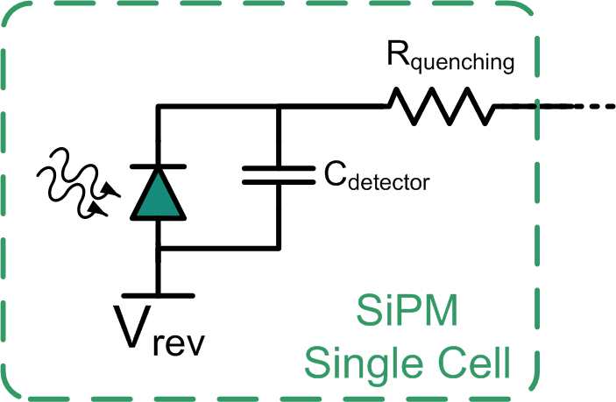
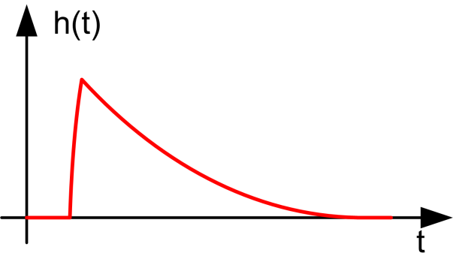

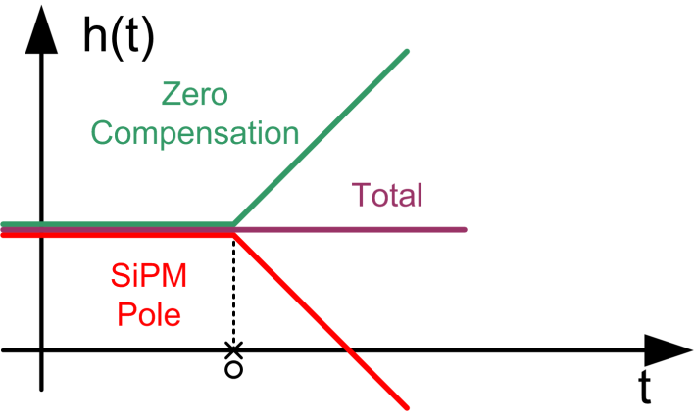
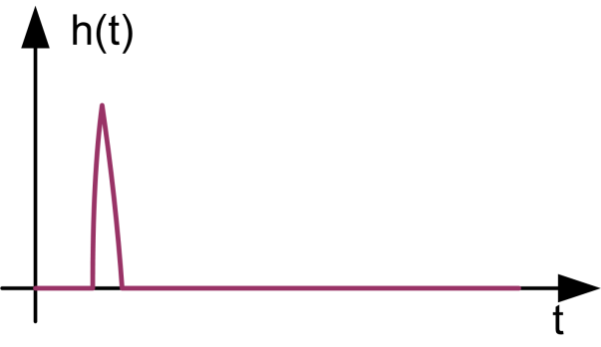
Hardware Implementation
The DLED is difficult to integrate in an ASIC → Pole-Zero Compensation.
The passive recharge of the cells of the SiPM corresponds to a single real pole in the pulse response of the detector in the frequency domain.
→ Pole cancellation through a zero at the same frequency in the front end.
Non Compensated
Compensated

Slide 15
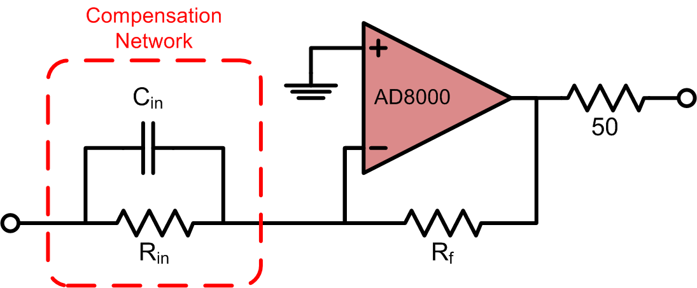

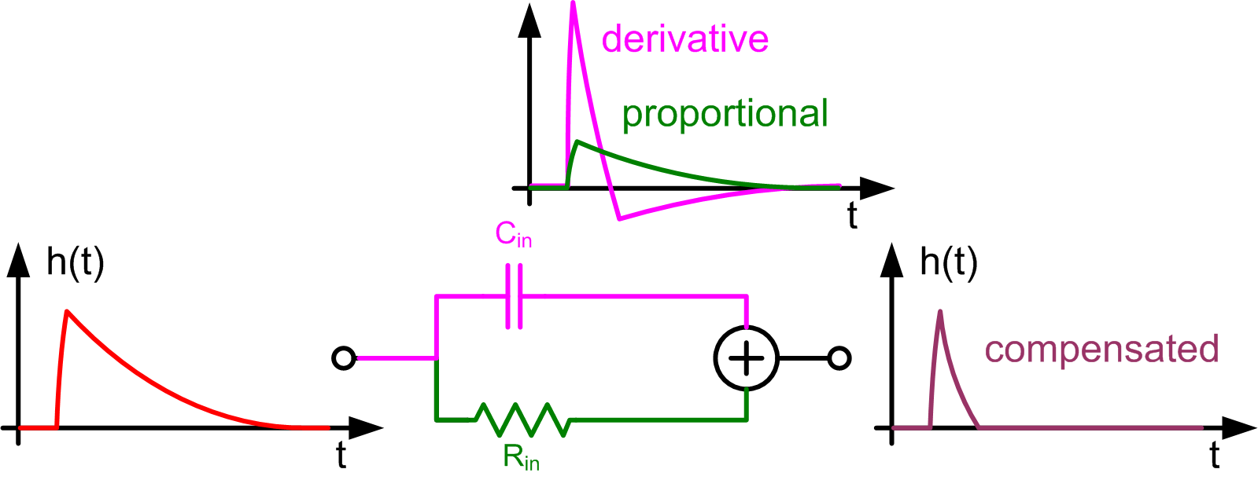
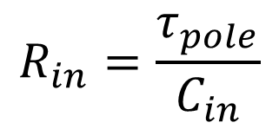
The PZ in the Time Domain
Simple circuit implementation of the PZ method.
The tails have equal amplitudes and cancel each other if:

Slide 16
CRT with PZ
The results are comparable or slightly better with the PZ method than with DLED → less noise without numerical differentiation.
Detector cube
3x3mm² SiPM
DLED sw
PZ hw
20C
-20C

Slide 17
Effects of the SiPM noise:
Optical Cross-talk Amplification

Slide 18
CRT limit at high over-voltage
With Pole-Zero noise compensation and smaller detectors we observe almost no dependence of the measured CRT on the DCR of the detector → timing resolution should be limited by PDE of the device only.
PZ method
1.8x1.8x2 mm³ LYSO
2x2 mm² SiPM
CRT limited by the front-end electronic noise.
CRT divergence at high over-voltages.
CRT limited by the SiPM PDE (light collection statistics).
Very good value!

Slide 19
CRT limit at high over-voltage
The optimum CRT value is not obtained at maximum PDE.
There is some other effect that prevents to operate the device at higher over-voltage and PDE.

Slide 20
Optical Cross-talk Amplification
The scintillator reflects the photons emitted by the hot carriers during the avalanche.
Increase in the collection efficiency of the optical cross-talk photons.

Slide 21
Reverse SiPM Current
The phenomenon can be easily observed from the reverse current of the device, measured with and without the scintillator.
3 cases:
No scintillator
2x2x2 mm³ LYSO
2x2x10 mm³ LYSO
3 temperatures: 20°C, 0°C, -20°C
The current increase is larger for the shorter scintillator.

Slide 22
DCR amplification
It is possible to define a DCR amplification coefficient due to the scintillator enhanced cross-talk.
There is no amplification if the LYSO top face is covered with black paint.
Extremely high values!
The process rapidly diverges.

Slide 23
Correlation with Timing
The γ coefficient shows an almost perfect correlation with the CRT.
The PZ filter can no longer compensate for the detector noise.
Reduction of the effective PDE, due to cells busy with DCR.
Basically, the SiPM stops working.

Slide 24
Possible Solutions
For reaching higher over-voltage and PDE, it is necessary to reduce the amount of cross-talk:
Color filters in the scintillator
  Suppression of external cross-talk
Optical Trenches and Double Junction
  Suppression of internal cross-talk (total CT is determined by both internal and external components)
Smaller cells with smaller gain but same fill-factor
  Updated fabrication technology and cell-edge layout

Slide 25
Conclusion
We have demonstrated that the effect of dark noise on timing measurements with SiPM coupled to LYSO crystal can be largely compensated.
The baseline compensation can be implemented with a simple, ASIC compatible, analog circuit.
Once the effects of the DCR are removed, we can observe a different phenomenon, limiting the timing resolution of the SiPM, related to the optical cross-talk, increased by the scintillator.
Possible solutions are under investigation, however the HD technology seems a very promising option.

Slide 26


Acknowledgments
HyperImage project
SUBLIMA project
FBK-INFN MEMS2 agreement

Slide 27
Back-up slides

Slide 28
In the next slides:
CRT vs Temperature
Threshold level
crystal height
SiPM size

Slide 29
Optimum Threshold level
Detector cube
3x3mm² SiPM
DLED
LED
20C
0C
20C
0C
-20C
-20C
20C
0C
-20C
20C
0C
-20C

Slide 30
Leading Edge Discriminator
LED is widely used in PMT-based systems
What is the effect of noise on timing?
signal
distortion
forced to use a
higher threshold
HF noise
furthermore
jitter
baseline
fluctuation
LF noise
jitter for worse
photon statistics
jitter

Slide 31
First approach: SiPM signal shape
SCR of a 4x4mm² SiPM
In this case we increase both
the quenching resistor and the
quenching capacitor in order
to enhance the fast component
and decrease the slow one.
fast component
slow tail
- SiPM 4x4mm²
- LYSO 3x3x5mm³
- LED
Steeper rising edge of the
gamma pulse and lower
baseline fluctuation

Slide 32
Example
original
gamma
signals
+ initial part of gamma ray
signal preserved
differential
gamma
signals
expanded y scale
+ baseline compensated;
+ electronic noise increased;

Slide 33
SiPM 3x3mm²
DLED – comparison
Detector cube
Detector PET
SiPM 4x4mm²
20C
20C
-20C
-20C
20C
20C
-20C
-20C

