Slide 1





Charged Particle Generated Electromagnetic Fields and Radiation
CPGEM
P. Karataev – The co-ordinator
John Adams Institute for Accelerator Science at
Royal Holloway, University of London, Egham, UK
7th Framework Programme
Marie Curie Initial Training Network

Slide 2
7th Framework Programme
7th Framework Programme was set-up by European Community for Research, Technological Development and Demonstration Activities within four types of activities:
trans-national cooperation on policy-defined themes - the ‘Cooperation’ programme;
investigator-driven research based on the initiative of the research community - the ‘Ideas’ programme;
support for individual researchers - the ‘People’ programme;
support for research capacities - the ‘Capacities’ programme.

Slide 3
Marie Curie Actions - ‘People’ Programme
The People programme has been designed to bring education, research and innovation closer to each other to attract, train and retain in Europe the next generation of researchers who will be able to address major societal challenges.
Marie Curie Actions is a major part of the People programme designed to
Train-through-research
  Early Stage Researchers (Doctoral Level)
  Experienced Researchers (Post-Doctoral-Level)
Involvement of Industry, including SMEs;
International Cooperation;
Knowledge sharing, dissemination and open access.

Slide 4
Marie Curie – Initial Training Network!
Charged Particle Generated Electromagnetic Fields and Radiation
CPGEM
This action aims in training-through-research the Early Stage Researchers and improve their carrier perspectives in both public and private sectors.
Participants:
Level 1: Full Partners contribute directly to implementation of the network, i.e. recruitment of ESRs and SRs, lead the researchers, assess the outcome and appraisal of the trainees;
Level 2: Associate Partners help with implementation of the network and benefit from the knowledge exchange, joint research and development.

Slide 5
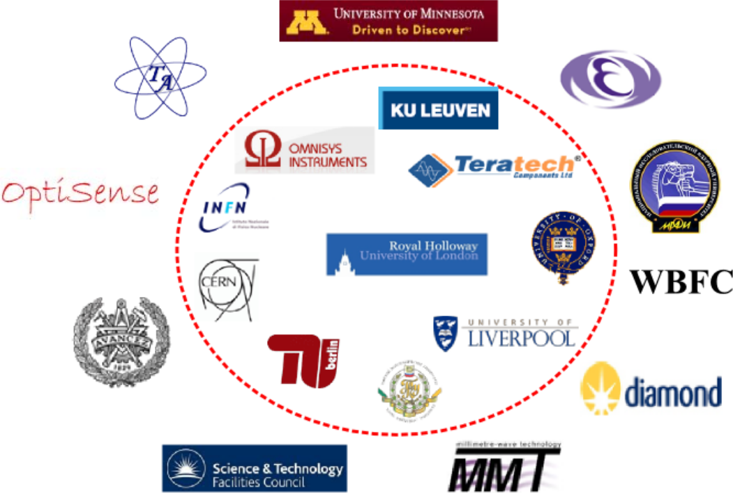
CPGEM partners

Slide 6










10 - Full Network Partners from 6 countries
RHUL | UK | Pavel Karataev Vladimir Antonov
CERN | Switzerland | Thibaut Lefevre Anne Dabrowski
TCL | UK | Byron Alderman
TUB | Germany | Rolf Schuhmann
KUL | Belgium | Herbert De Gersem
INFN | Italy | Enrica Ciadroni Sultan Dabagov
UOXF | UK | Riccardo Bartolini
TPU | Russia | Alexander Potylitsyn
ULIV | UK | Carsten Welsch
OI | Sweden | Anders Emrich

Slide 7









9 - Associate Network Partners
KEK | Japan | Junji Urakawa
RAL/STFC | UK | Peter Huggard
Diamond | UK | Guenther Rehm
WBFC | Germany | Warner Bruns
MEPhI | Russia | Alexey Tishchenko
CTH | Sweden | Sergey Cherednichenko
OptiSense | UK | Michael Andreo
TA | Kazakhstan | Alexander Verigin
UM | USA | Roger Rusack

Slide 8
Summary
19 partners
10 countries
5 private sector companies including SMEs
9 Universities
5 Research laboratories
€ 3.3 million budget

Slide 9
Network Content
WP
  6 Work Packages;
Trainees
  13 Early Stage Researchers;
Events
  3 International Schools;
  6 Topical Workshops;
  1 CPGEM conference
Meetings
  Kick-off Meeting
  Mid-term review meeting
  Final conference
  7 Steering Committee Meetings

Slide 10
Work Package 1: Management
Leader: Dr. Pavel Karataev, RHUL (UK)
  Overall co-ordination;
  Organization of events: Schools, Topical Workshops, Secondments, meetings, etc;
  Provide specialised and transferable skills training;
  Dissemination of the results, collating newsletters;
  Financial management;
  Preparation of Midterm and Final reports;
  Monitor the milestones and achieving deliverables;

Slide 11
Management Structure of the Network
Steering Committee
Industry Advisory Board
European Commission
CPGEM Coordinator
Management Team
Supervisory Board
CPGEM
Participant 1
CPGEM
Participant 2
CPGEM
Participant 8
CPGEM
Participant 9

Slide 12
Work Package 2: Novel Radiation Sources
Leader: Professor Alexander Potylitsyn, TPU (Russia)
  Development of intense THz and soft X-ray source (RHUL, P. Karataev)
  Development and Application of Advanced Linac based THz Radiaiton Sources (INFN, E. Chiadroni)
  Coherent Smith-Purcell Radiation as an intense THz radiation source and potential tool for non-invasive chaged particle beam diagnostics (TPU, A. Potylitsyn)
  Micro- and Nano- focusing X-ray optics (INFN, S.Dabagov)

Slide 13
Work Package 3: Detectors and Detection Systems
Leader: Dr. Anders Emrich, OI (Sweden)
  Sensitive far- and mid-infrared semiconductor detectors (RHUL, V. Antonov)
  Ultra-fast broadband THz detectors (TCL, B.Aldermann)
  Development of non-cryogenic detectors and detector systems (OI, A. Emrich)

Slide 14
Work Package 4: Advanced Simulations
Leader: Professor Rolf Schuhmann, TUB (Germany)
  Enhanced simulation of EM fields and secondary effects in open cavities in the THz regime (TUB, R.Schuhmann)
  Hybrid multiscale algorithms for high frequency or optical simulations of accelerator devices (KUL, H.DeGersem)
  Optimization of the performance of the radiation sources (ULIV, C. Welsch)

Slide 15
Work Package 5: Short Wavelength Diagnostics
Leader: Dr. Thibaut Lefevre, CERN (Switzerland)
  Non-invasive diagnostics of proton beams using diffraction Cherenkov radiation (CERN, T. Lefevre)
  Development of fast, directional, single particle counting detector using Cherenkov radiation (CERN, A.Dabrowski)
  Conceptual design and realization of compact THz FEL source based on short undulator, metallic gratings and corrugated pipes (UOXF, R. Bartolini)

Slide 16
Work Package 6: Outreach Activity
Leader: Dr. Pavel Karataev, RHUL (UK)
  Improve wikipedia web-pages
  A web-page on the CPGEM website
  A poster for a non-physics community to support the web-pages
  Organize or join an open day event to disseminate the information about the network

Slide 17
Schools for young researchers
Accelerator Physics School:
  CERN Accelerator School – Elementary Level;
School on EM fields and radiation – Elementary Level (INFN, Italy):
  Basics, Classical Optics, Electromagnetism, Introduction to Radiation Physics and Overview of Applications, Introduction to RF theory and technology; etc.;
Transferable Skills Training (RHUL, UK):
  Presentation Skills, Entrepreneurship, Project Management, Time Planning, Grant Applications, CV Writing, Scientific Writing, etc.;
School on EM fields and radiation – Intermediate Level (MEPhI, Russia):
  Overview of Radiation Processes, Synchrotron Radiation, Transition Radiation, Diffraction Radiation, Smith-Purcell Radiation, Introduction to X-ray radiation processes, RF cavities, Higher-Order Modes, Advanced diagnostics; etc;

Slide 18
6 Topical Workshops:
We plan a series of 2 day Topical Workshops
A list is
  EM radiation for beam diagnostics (CERN, Switzerland)
  Smith-Purcell Radiation: theory, simulations, experiment (UOXF, UK)
  EM simulations (TUB, Germany)
  THz radiation generation and measurements (KEK, Japan)
  Detectors and Detection systems (OI, Sweden)
  Novel X-ray sources (INFN, Italy)

Slide 19
Summary
We are setting up a multinational network to combine Research, Training, Industrial Applications and Outreach Activity;
We shall organize a set of International events, including 3 schools, 6 Topical Workshops; and a CPGEM conference
The first evaluation results of the bid will be known later this month

Slide 20
Summary (cont.)
The network events are opened to a wide international community; all members of the radiation physics network (especially researchers at early stage of their career) are welcome
A mechanism will be setup to include more partners in the network;

