Slide 1
Quantum Beam program at LUCX and STF
Overview and prospects
2013.3.18-19, at KEK, Junji Urakawa
Contents :
1. Introduction
2. LUCX and QBT project
3. Necessary technologies for high brightness
4. High reflective mirror development
5. New plans and prospects

Slide 2

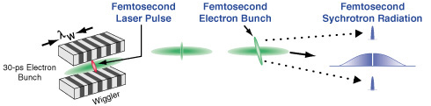
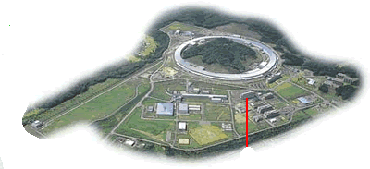
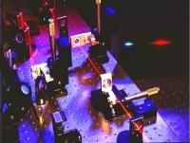
Evolution of photon source：X-ray source based on accelerator and laser
2011, ~mJ X-ray pulse is realized
DESY-XFEL
SPring8-XFEL,SCLA 2011
Next Generation Photon Source
Coherent
Ultra-short Pulse,
Compact X-ray source
SLAC-XFEL
2010
Ato-sec. Science
Bunch Slice
2000
ERL proposal
Third Generation Photon Factory
Ultra-high field Science
XFEL proposal
Plasma X-ray
1990
Higher harmonic wave
: Coherent soft-X-ray
Femto-sec Science
Chirped Pulse Amplification(1985)
Second Generation Photon Factory
1980

Slide 3
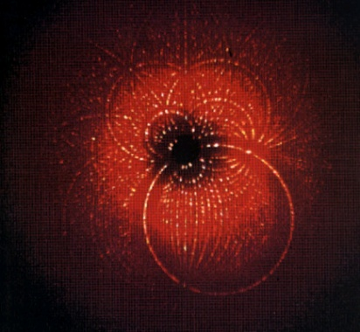
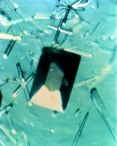
To stronger and brighter photon beam
10μm photon source is considered, which means 0.2 mmmrad normalized emittance.
1mrad angular spread collimation means small energy spread.
Diffraction pattern
Low brightness X-ray
Large sample
Smaller source is
realized by focusing
laser beam and
electron beam at IP.
We have to supply
low emittance and
high intensity
electron beam.
Our target is
Brightness 10¹⁷
Photons/sec/mm²/mrad²
in 0.1%b.w.
Diffraction
High brightness X-ray
Small sample (< 1mm)
Protein crystal

Slide 4
Development of Brightness of Light Sources

Slide 5
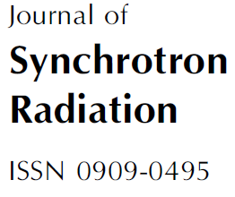
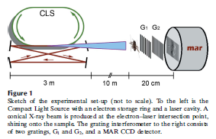

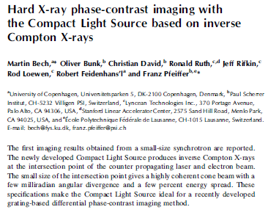
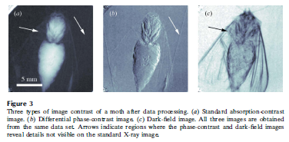
Brightness 10¹³
Photons/sec/mm²/mrad² in 0.1%b.w.
Photon Flux :
~10¹⁰ photons/sec1%bw
Reduce electron beam emittance by 100.
Reduce the energy spread of electron beam by 10.
Reduce electron bunch length at IP , we select high power electron Linac
and optical cavity to generate X-ray based on ICS.
Then, we have a possibility to get 10¹⁷and
one shot measurement for X-ray imaging.
X-ray exposing time more
than 100sec
5
5
January 2009

Slide 6
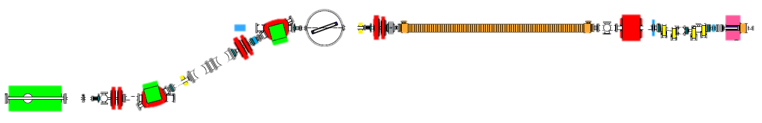
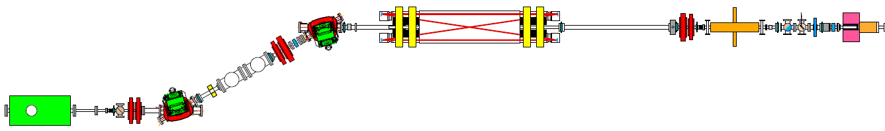
2. LUCX and QBT project
To downsize the accelerator, we have installed a 3.6cell rf-gun and a 12cell booster.
  3.6cell rf-gun
    Beam test has been started from Jan 2012.
  12cell booster
    This booster was installed in last June.
3m accelerating tube
1.6cell
Rf-gun
Microwave resonator cavity
for soft X-ray generation
12cell booster
3.6cell
RF-gun
New optical cavity for
hard X-ray generation

Slide 7
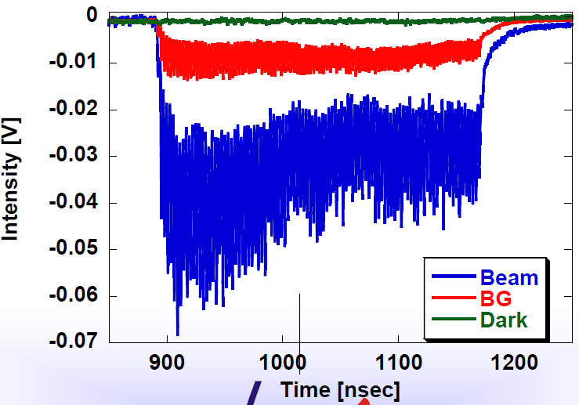
From 2011,
Normal C. Linac
0.4mJ/pulse
X-ray yield
334 photons/train at detector on July 2011 same as 2007.
357MHz mode-locked laser
2～3 times
X-ray yield
1447photons/train
at detector on Oct.
2011
2.1x10⁵photons/sec
at 12.5Hz operation

Slide 8
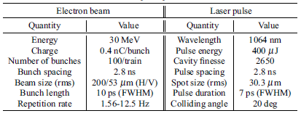
The mirror of two mirror cavity had the surface damage around 2 to 6mJ/pulse.

Slide 9
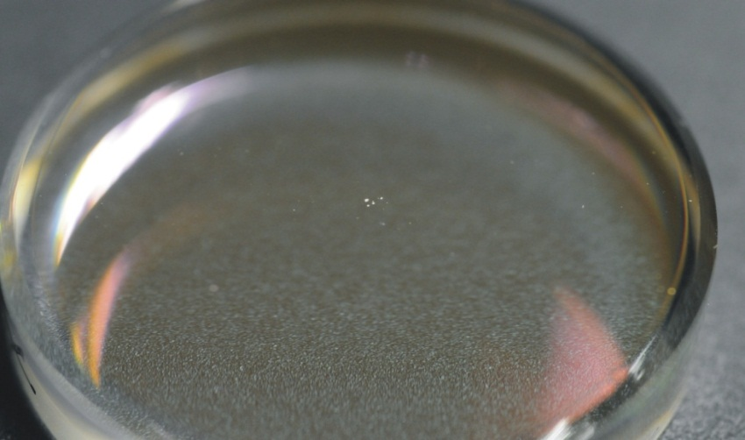
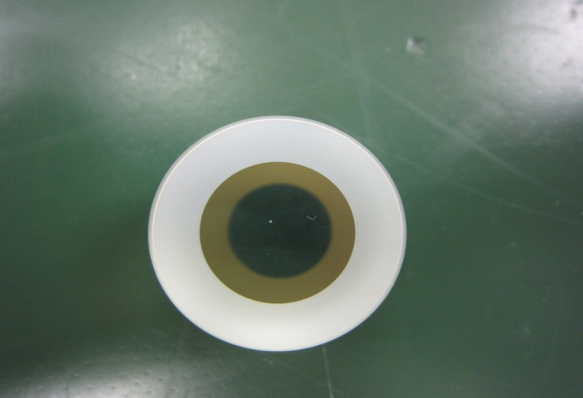
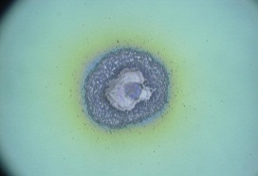
We destroyed the mirror coating two times. First occurred when the waist size was ~100μm with burst amplification and 42cm two mirror cavity. Second occurred when the waist size was 30μm with the burst amplification and the 42cm two mirror cavity. Now we are using 4 mirror cavity with smaller waist size at IP. From our experience, we have to reduce the waist size to increase the laser size on the mirror and need precise power control for the burst amplification. I guess about storage laser pulse energy from 2mJ to 4mJ destroyed the mirror coating with the waist size of 30μm. Also, we found the damaged position was not at the center.
2008
2011

Slide 10
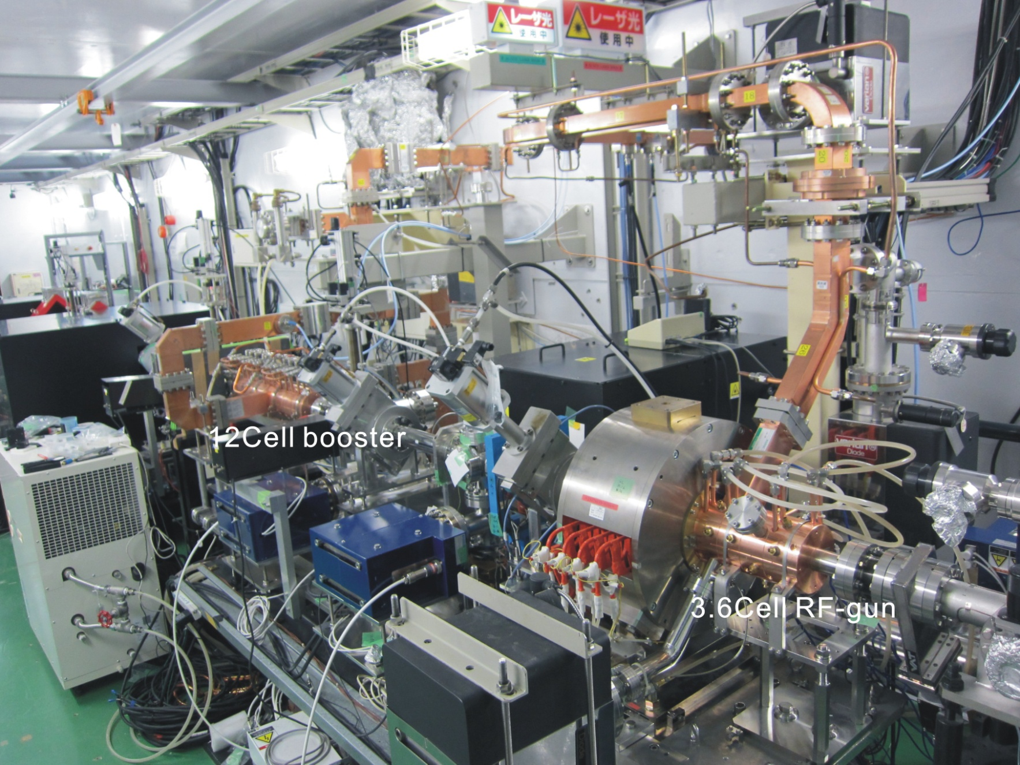
LUCX accelerator

Slide 11
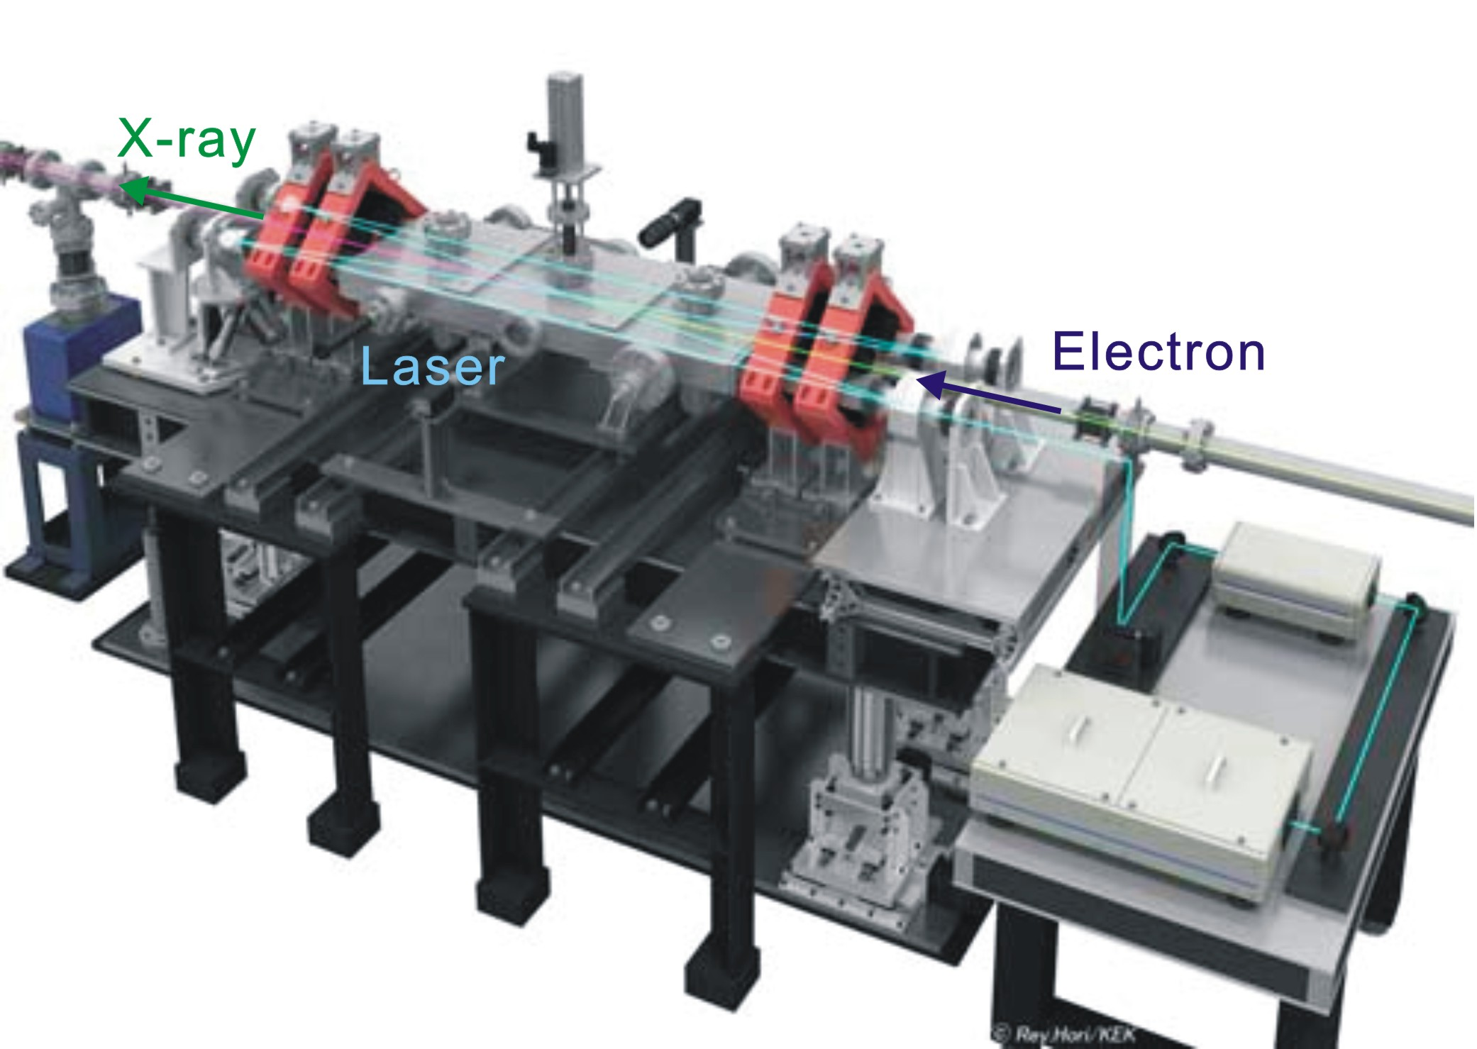
LUCX 4-mirror optical super-cavity

Slide 12
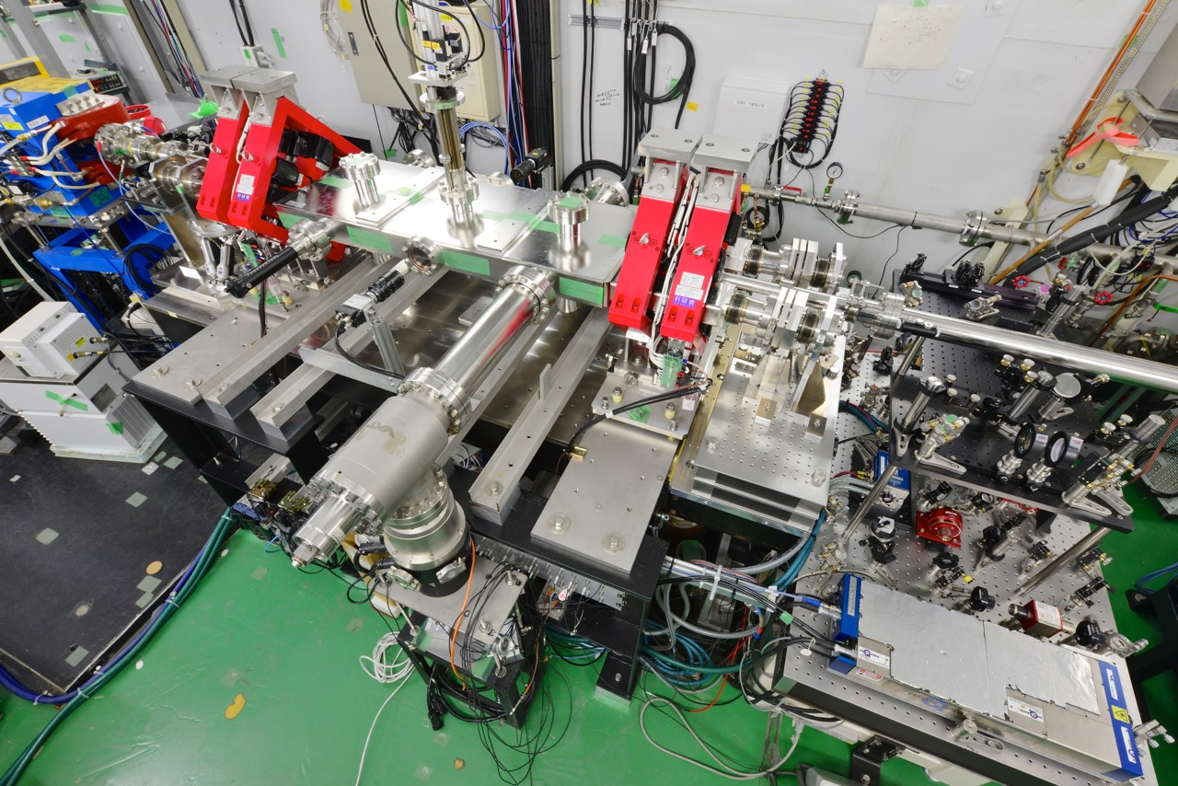
LUCX 4-mirror optical super-cavity

Slide 13
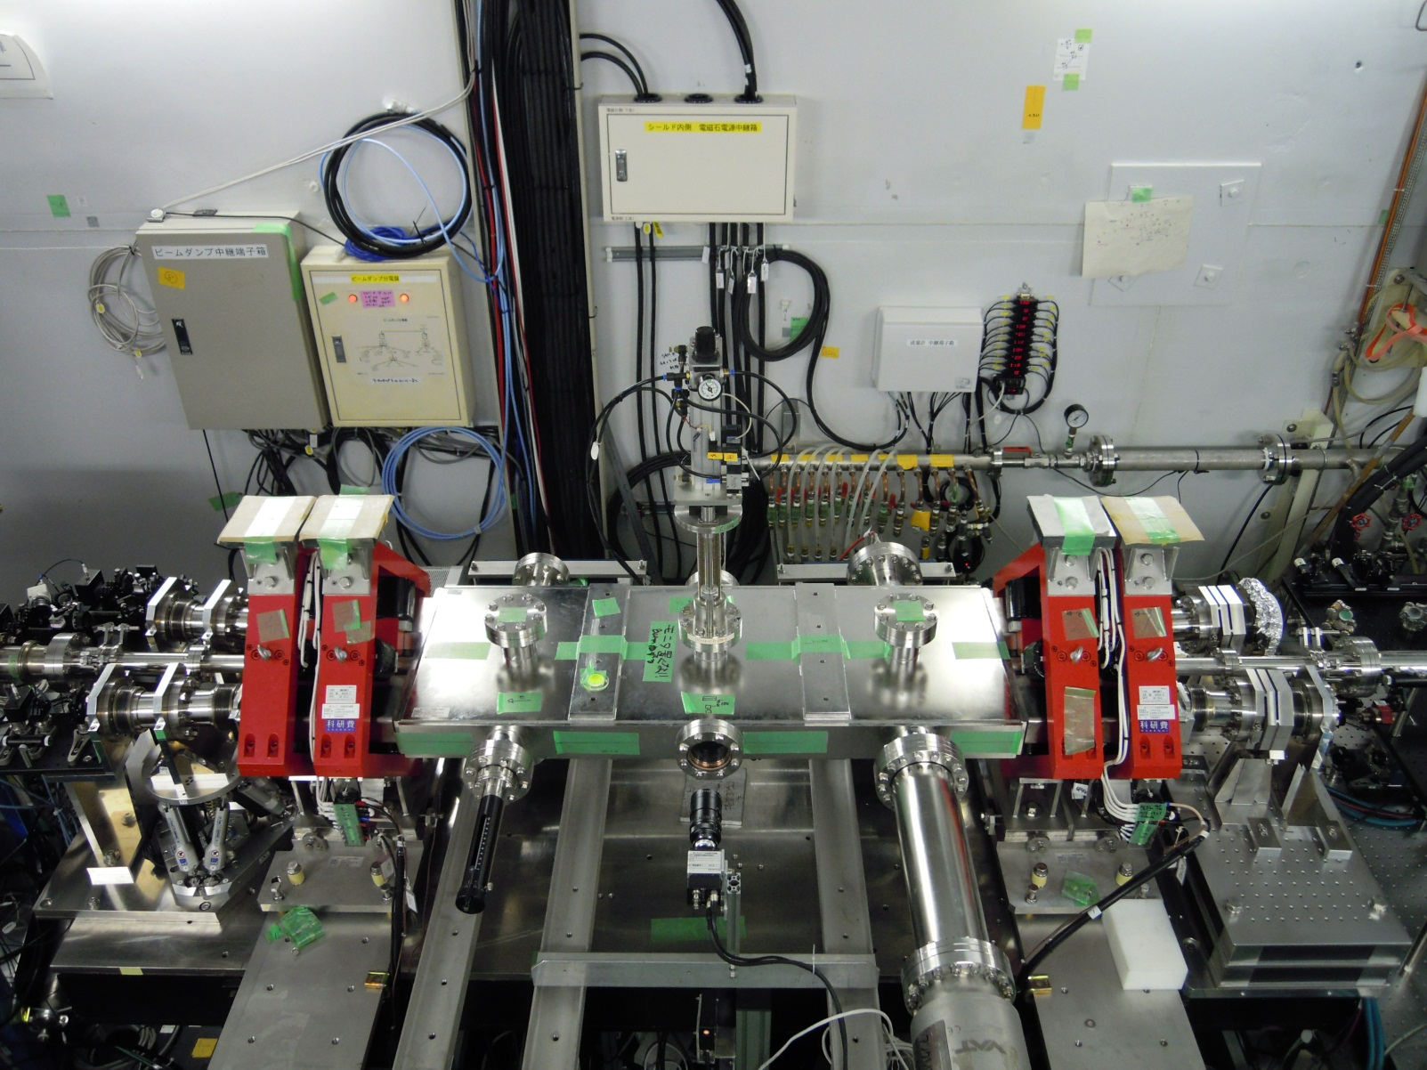
LUCX 4-mirror optical super-cavity

Slide 14
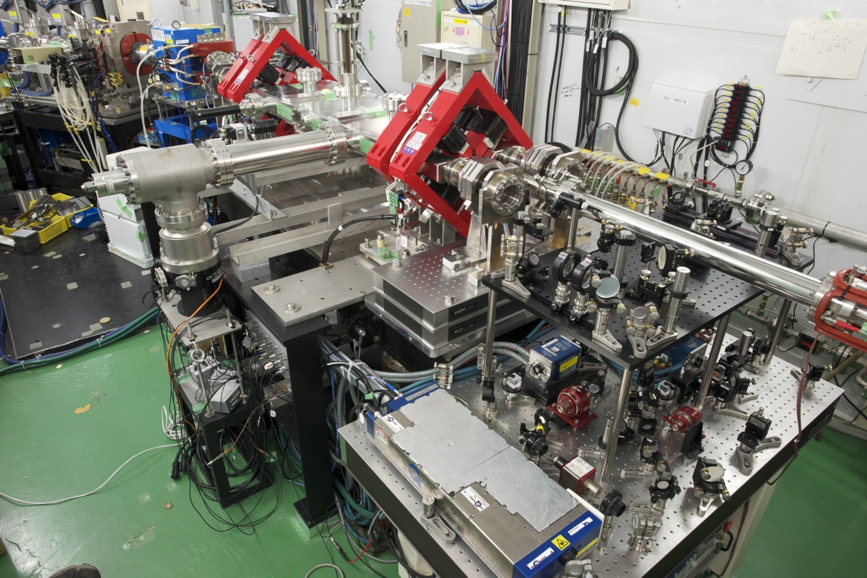
LUCX 4-mirror optical super-cavity

Slide 15
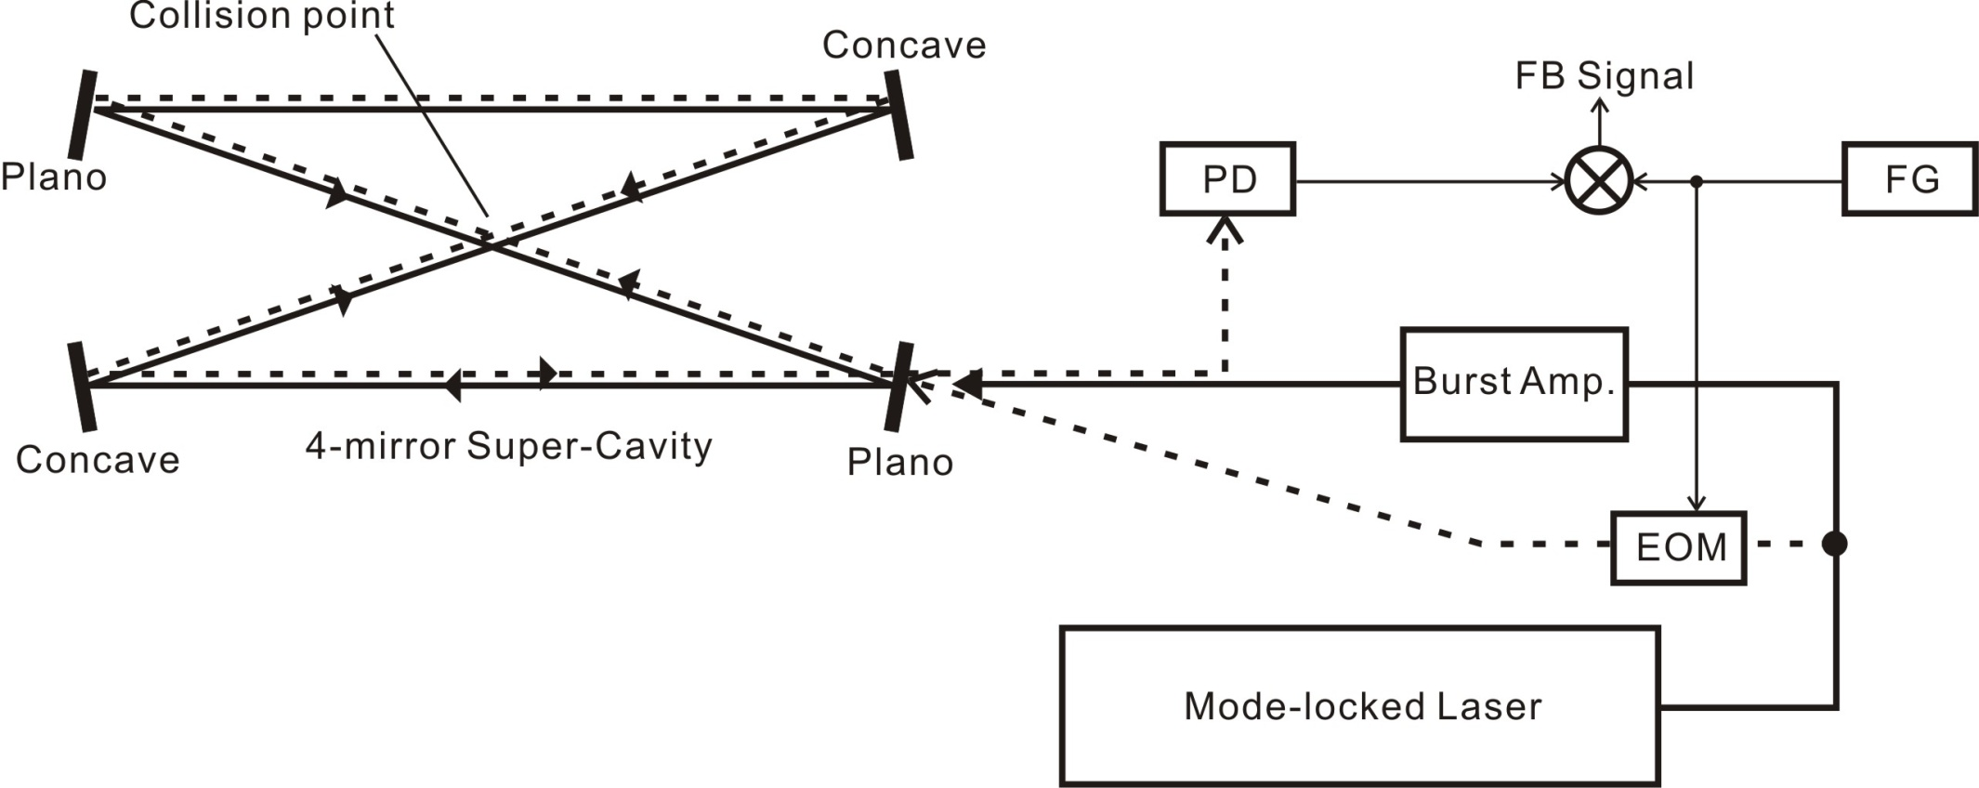
Diagram of optical setup
Super-cavity enhances the power inside the cavity by accumulating the laser radiation more than thousands of times at the same phase.
>the accuracy of cavity length > less than nano-meter
R. W. P. Drever et al., Appl. Phys. B, 1(1983)97.
Main laser (CW)
CCW circulate

Slide 16
Stabilization of stored energy
The result of stored power stabilization by opposite circulating laser
Before After

Slide 17
Laser-Beam parameters at CP
Laser-Electron Beam parameters at LCS Collision point
Laser (inside the Super Cavity)
Electron Beam
Wavelength | Repetition | Power | Pulse energy
1064nm | 357MHz | 100kW | 300uJ
Size(H) | Size(V) | Pulse duration | Col. angle
89um | 85um | 7ps | 7.5°
Energy | Repetition | Charge | N. bunch
22.8MeV | 357MHz | 900pC | 150
Size(H) | Size(V) | Bunch length | Emi (H) | Emi (V)
85um | 95um | 15ps | 10πmmmrad | 7πmmmrad

Slide 18
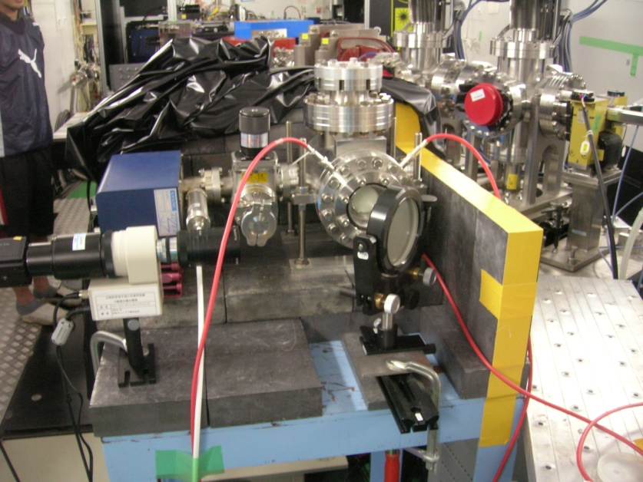
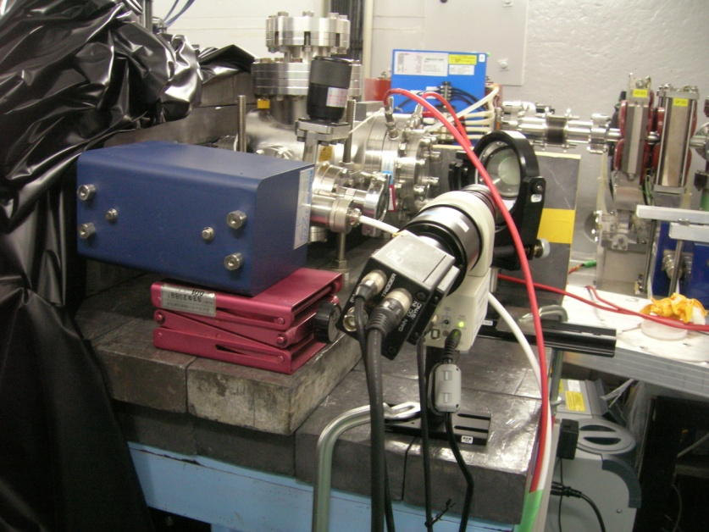
X-ray detector -MCP-
As X-ray detector,
MCP (Micro-Channel Plate) was used
for detecting LCS X-ray and achieving the X-ray image

Slide 19
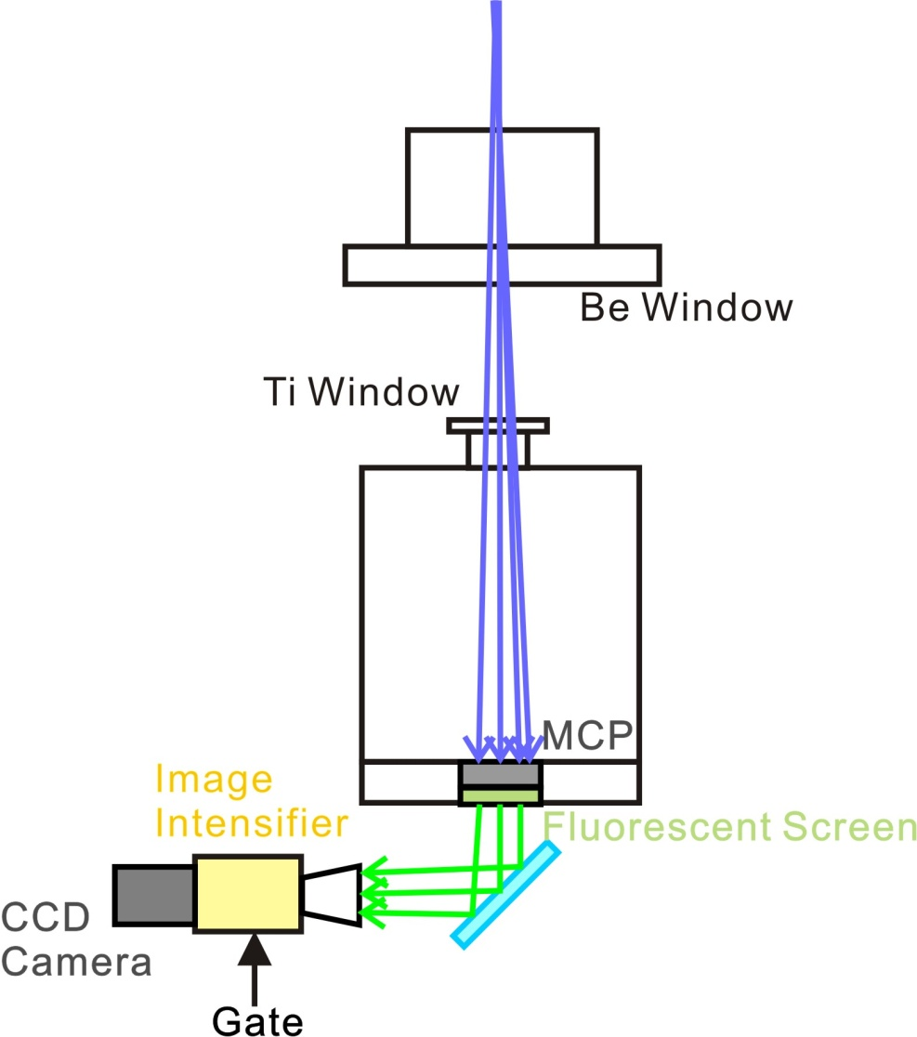
X-ray detector -MCP-
Diagram of Imaging Setup
○MCP is the largest S/N detector
for LCS
○I.I. for gating the LCS from BG
○Large gain with MCP (~10^7)
and I.I. (~10^4)
＞Spatial resolution will be bad
but suitable for first detection

Slide 20
Timing search
Timing Scan

Slide 21
Position search
Position Scan
Horizontal Vertical

Slide 22
Intensity dependence
Intensity

Slide 23
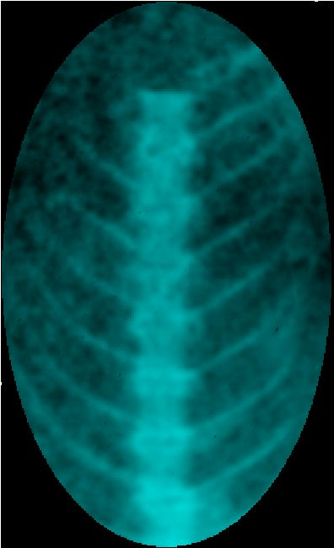
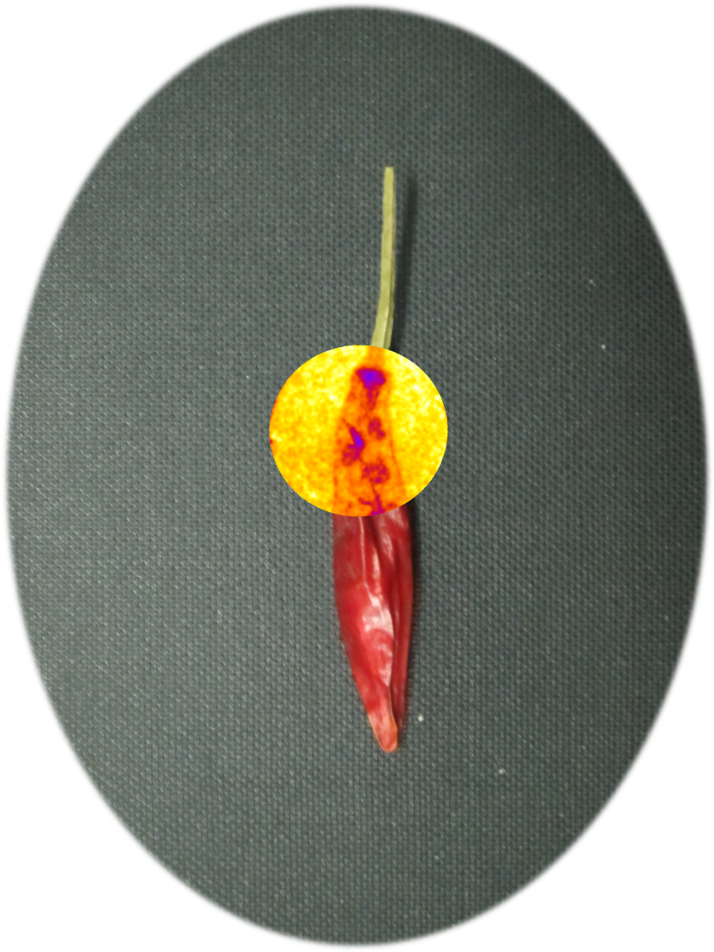
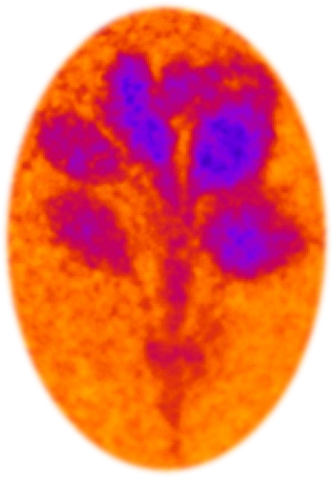
X-ray image by MCP
Imaging test by 9keV LCS X-ray
Fish backbone Chile pepper
Small flower

Slide 24
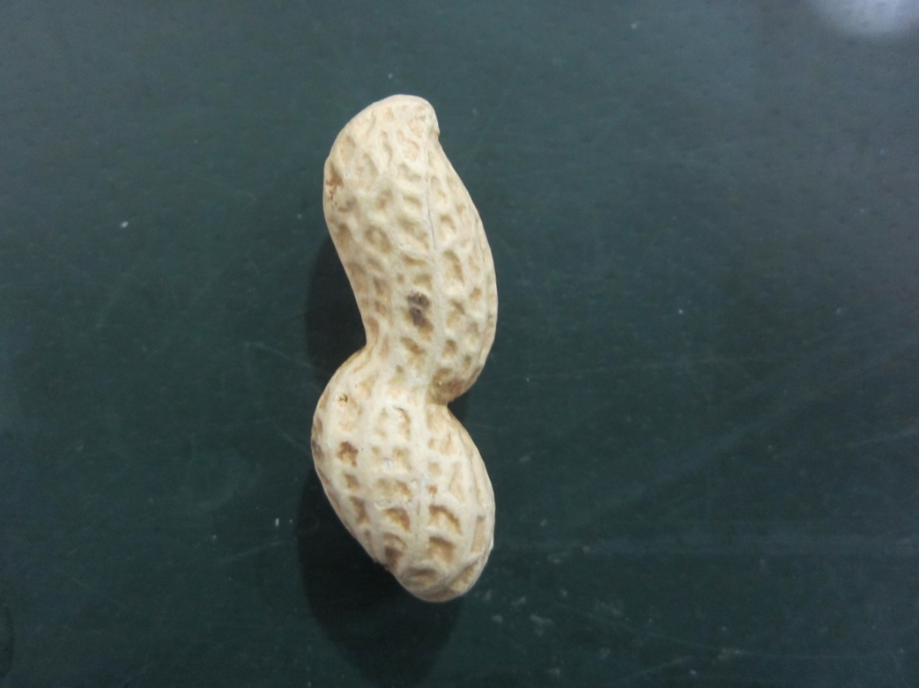
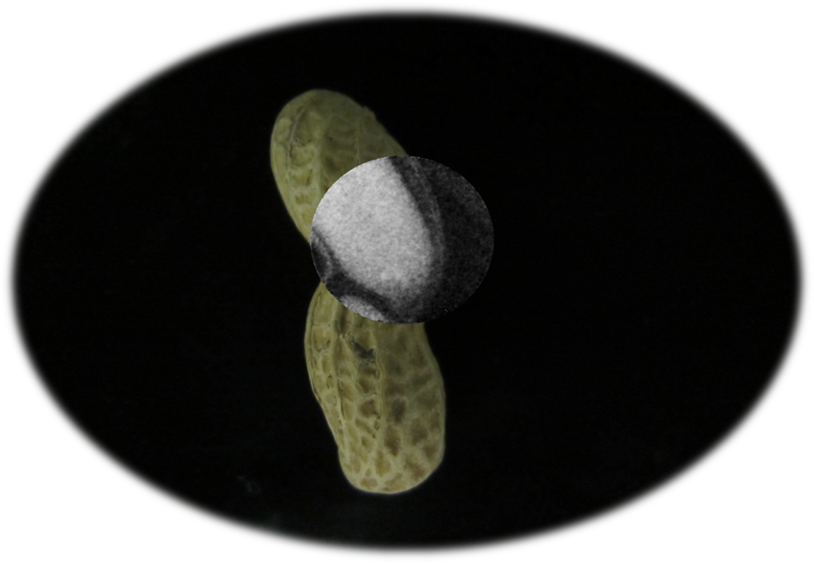
X-ray image by MCP
Imaging test by 9keV/15keV LCS X-ray
Peanut
9keV
15keV

Slide 25
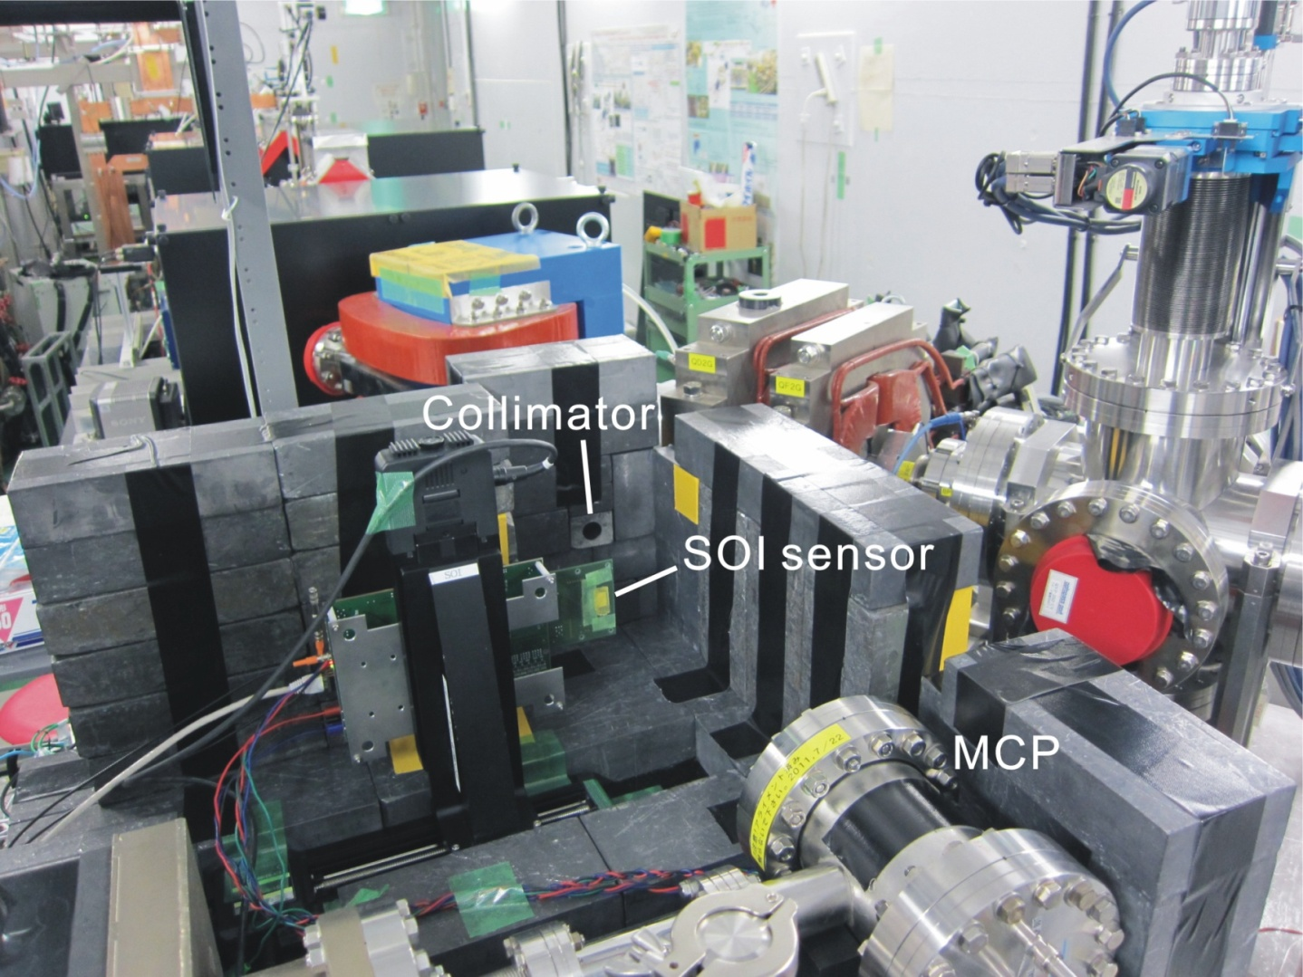
X-ray detector -SOI pixel sensor-
SOI pixel sensor is the semiconductor detector using SOI (Silicon-On-Insulator) technique
>detection and read out are on same board.
>high S/N and high spatial resolution
Y. Arai et al., Nucl. Instrum. Meth., A636(2011)S31-S36

Slide 26
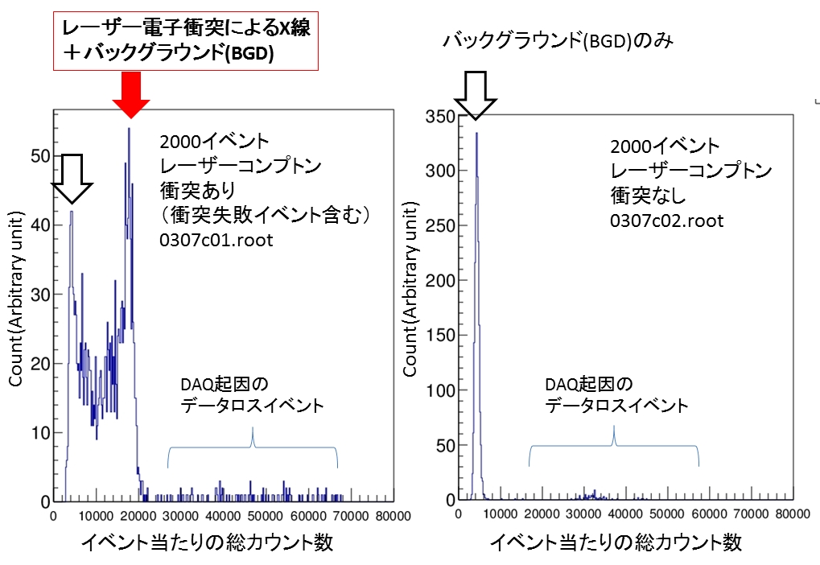
X-ray evaluation by SOI sensor
LCS X-ray and
Beam Background
Beam Background
DAQ Data Loss
DAQ Data Loss
Counts/event
Counts/event

Slide 27
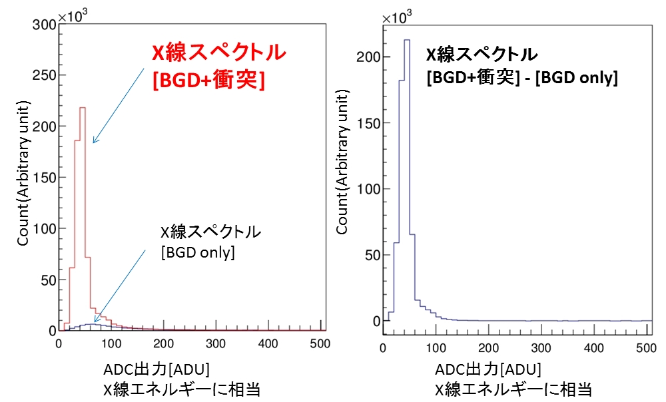
X-ray evaluation by SOI sensor
X-ray Spectrum
(quasi-monochromatic)
X-ray Spectrum
(quasi-monochromatic)
BG subtracted
Beam BG Spectrum
ADC Count
i.e. X-ray Energy
ADC Count
i.e. X-ray Energy

Slide 28
LCS X-ray specification at LUCX
Energy | Bandwidth (within collimator) | X-ray / pulse (SOI)
8~9keV | 8% b.w. | 36.4 ph/pulse
X-ray/train (SOI) | X-ray/train (Total) | X-ray/sec (Total)
5460 ph/train | 5.1×10⁵ ph/train | 6.38×10⁶ ph/sec (12.5Hz)
CAIN Simulation results
1Train (SOI) | 1Train (Total)
7015 | 8.2×10⁶

Slide 29
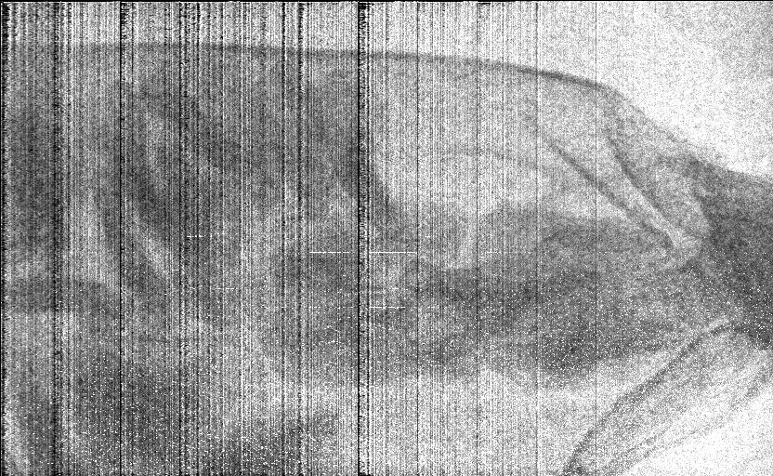
X-ray image by SOI sensor
SOI pixel sensor imaging by 9keV LCS X-ray
Chile pepper (Preliminary)

Slide 30
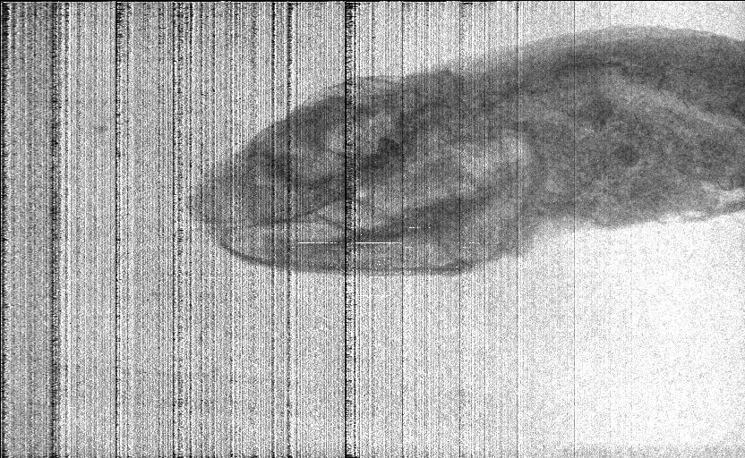
X-ray image by SOI sensor
SOI pixel sensor imaging by 9keV LCS X-ray
Small fish (Preliminary)

Slide 31
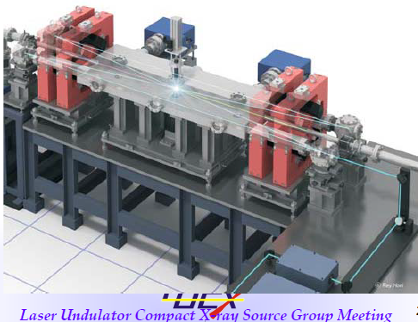
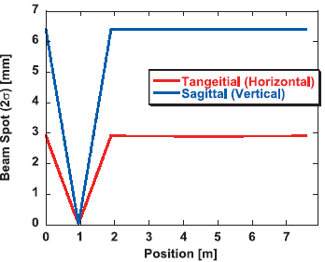
One turn length : 7.56m, horizontal laser waist size : 109μm in 2σ,
Crossing angle : 7.5 degrees, vertical laser waist size : 50μm in 2σ,
Horizontal laser size on laser injection plane mirror : 2.92mm,
Vertical laser size on laser injection plane mirror : 6.4mm
Laser pulse energy in cavity : 8mJ, distance between concave mirrors :
1.89m, 7.56m means this cavity has 9 laser pulses.
Use two inch mirrors and increase the threshold damage energy.
Completed this device in this September last year and start the generation
of X-ray from mid. of Feb.. We will confirm the performance soon.

Slide 32
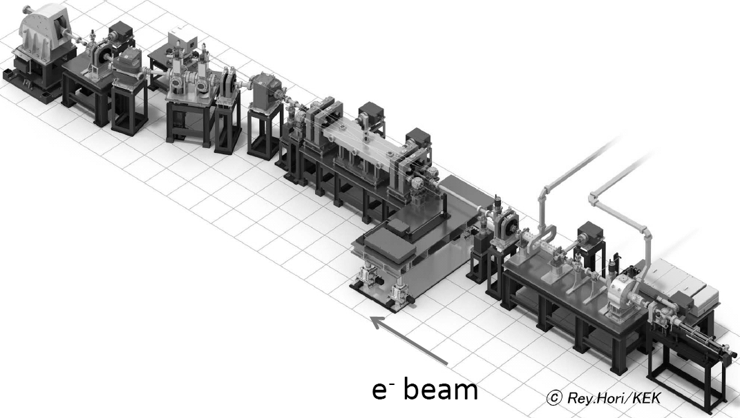
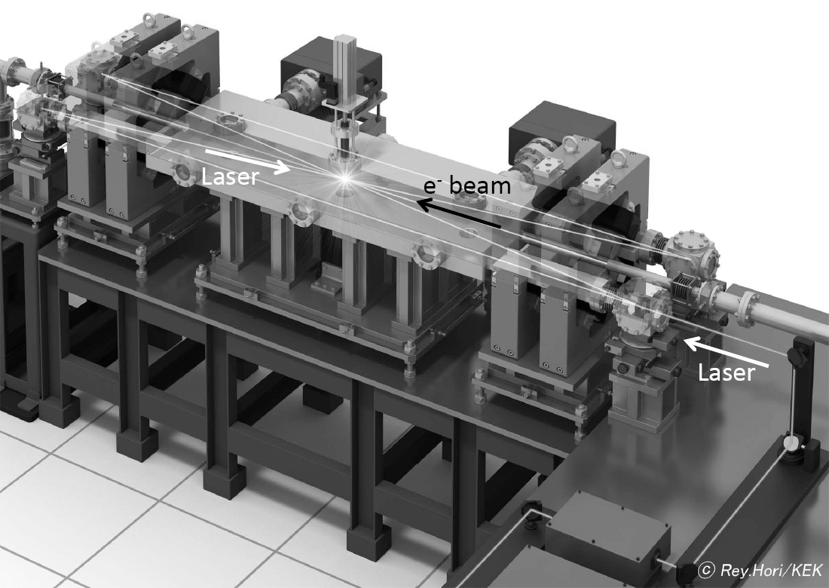
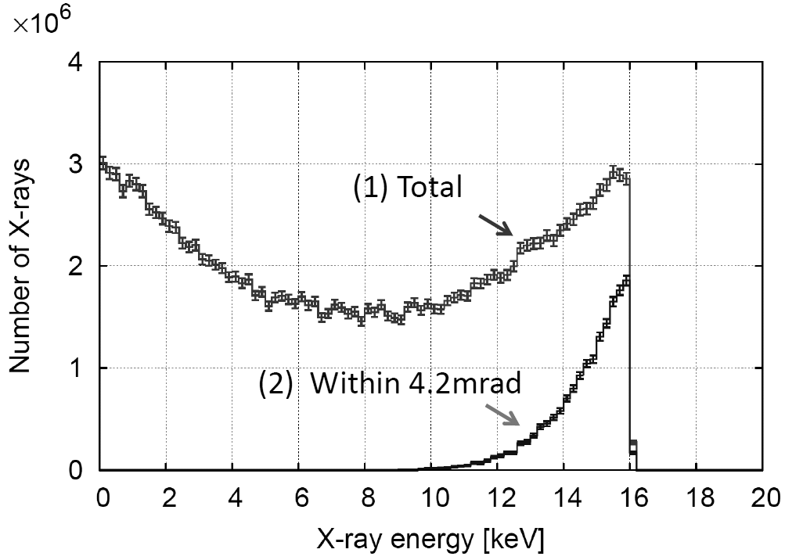
My colleagues got the X-ray
Flux of 10⁶ at 12.5Hz.
Energy | 30MeV
Intensity | 0.4nC/bunch
Number of bunch | 1000
Beam size at the collision point (1σ) | 33μm ×33μm
Bunch length | 10ps
Bunch spacing | 2.8ns
Still we have problem
on cavity rigidity.
We need the improvement
of table and installation of
high reflectivity mirrors.
Energy | 1.17eV(1064nm)
Intensity | 8mJ/pulse
Waist size(1σ) | 55μm ×25μm
Pulse length | 7ps
Photon flux more than 10⁸ per second

Slide 33
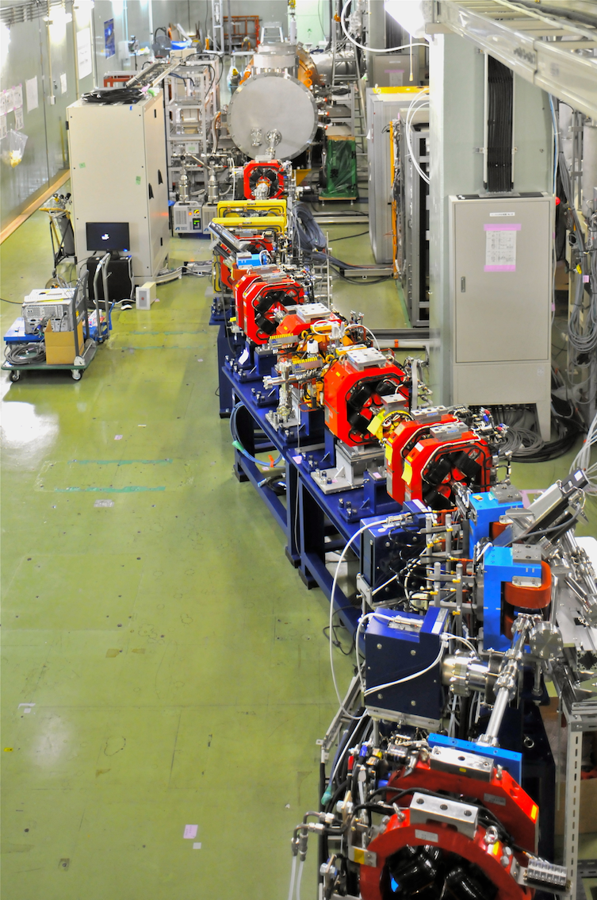
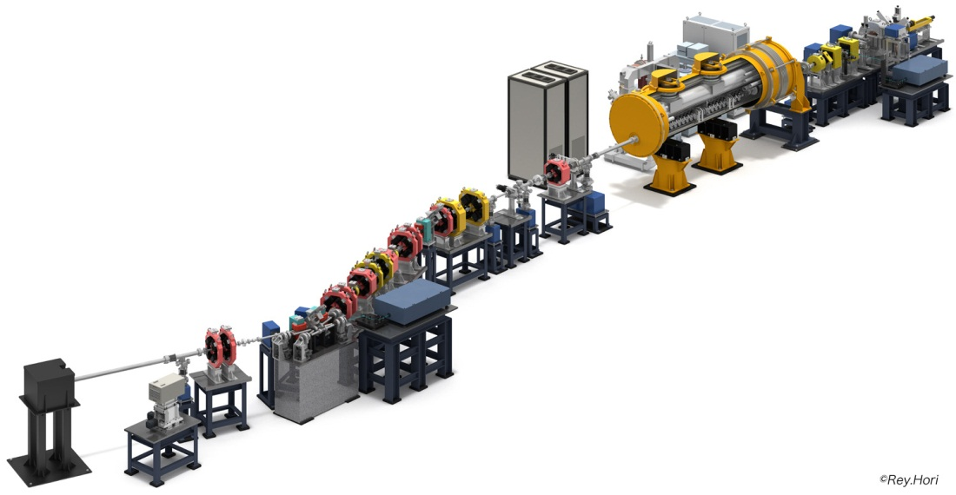
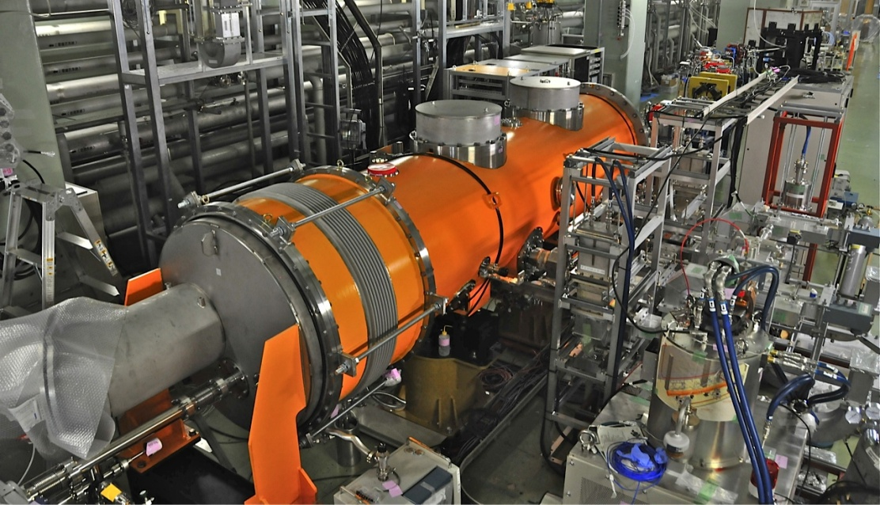
Development for Next Generation Compact High Brightness X-ray
Source using Super Conducting RF Acceleration Technique
View of QBTP from Beam Dump
RF Gun Laser
Beam Dump
X-ray Detector
To contribute the development for
life science innovation and
green innovation
Quantum Beam Technology Program:
Beam commissioning started from mid.
of February 2012.

Slide 34
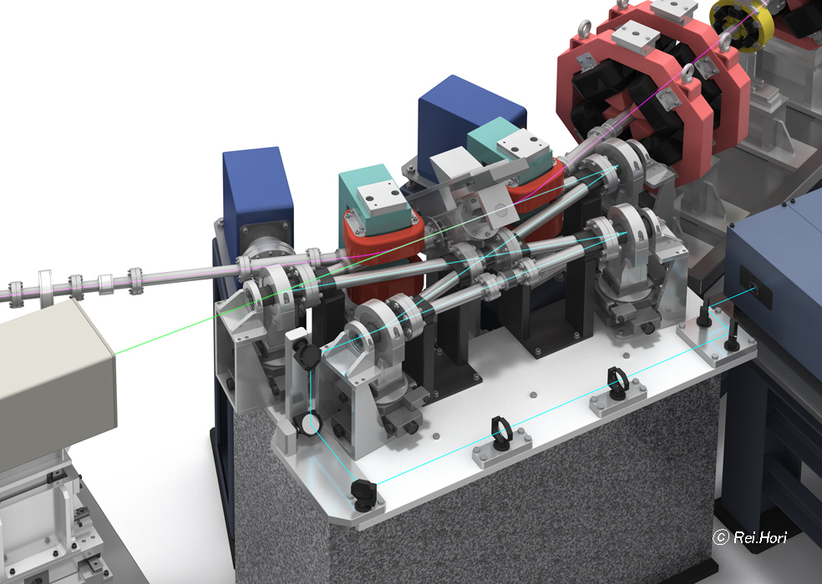
2D four mirror cavity to generate
X-ray with two cylindrical lenses

Slide 35
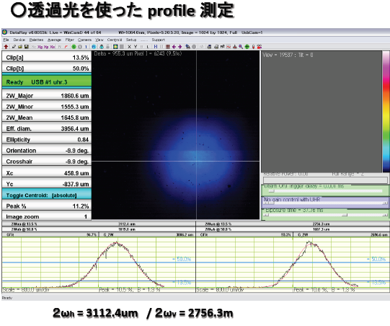
profile of Transmitted laser from cylindrical mirrors.
We confirmed the effect of the cylindrical mirrors.
Laser evolution is
same in tangential
and sagittal plane.
Two laser pulses are circulating with the spacing of 6.15ns in a ring
optical cavity.
Laser waist size in μm
10 20 30 40 50 60 70 80 90
Change to 2D 4-
mirror optical
cavity with two
cylindrical lenses
instead of two
plane mirrors.
Stable
Region
Stable
Region

Slide 36
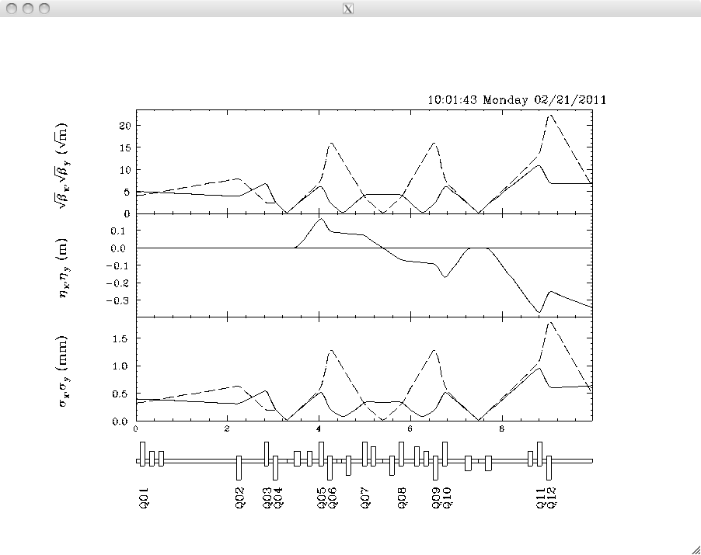
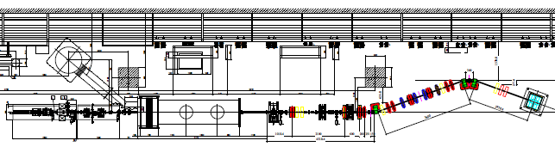
Change to head collision scheme to get another enhancement of 5 and
to increase laser pulse duration ~20ps.
Quantum project
at STF
Beam size 10μm

Slide 37
We have a big problem about mirror
support table rigidity.
Figure shows ideal case but real
system has complicated
connections between movers
and table. It was bad selection
which we had. R&D is still under way.
Brightness 10¹⁷
Photons/sec/mm^{2/}mrad² in 0.1%b.w.
Equivalent to 2.5 Generation
Synchrotron Radiation.

Slide 38
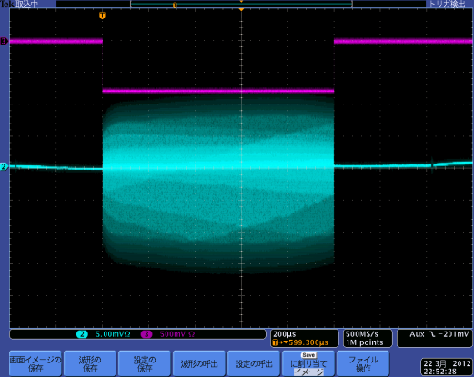
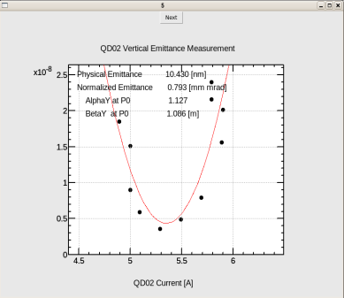
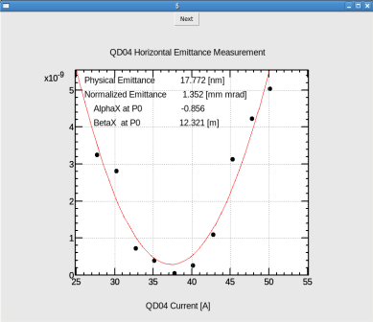






Achieved beam at STF for QBT project 07132012 Hayano V1.0
1ms beam from L-band RF Gun
Min. emittance so far
Min. beam size＠WM-PRM-05
WM-PRM-05
WM-PRM-05で一番小さく
絞れた時。
ただし、WM-PRM-07では
大きかった。
WM-PRM-05
σx: 17.5[µm]
σy: 25.3[µm]
このとき、
WM-PRM-07
σx: 55.8[µm]
σy: 29.3[µm]
(ログブックのデータのみ
画像データなし)
σx: 17.5[µm]
2012/07/04測定
σy: 25.3[µm]
(RF feedback ON) 03.22.2012
50pC/bunch
Measurement of beam emittance by wire
scanner 06.13.2012
07.04.2012
Accelerated 1ms beam
Min. beam size＠WM-PRM-07
Dispersion measurement
@WM-PRM—05, -07, dispersion measurements
SC phase 240deg 40.58 MeV/c (B1 150.20A)
SC phase 250deg 40.02MeV/c (B1 148.10A)
⊿x ηx ⊿y ηy
WS-PRM-05 85um 6.2mm 14um 1.0mm
WS-PRM-07 42um 3.1mm 14um 1.0mm
(07.04.2012）
σx: 36.2[µm]
σy: 36.1[µm]
07.04.2012
1ms beam acceleration (15pC/bunch)
(Gun/SCRF RF feedback ON) 06.08.2012
Swap
Target size : 10μm
07.04.2012
WM-PRM-05
WM-PRM-07
Laser beam size : about 80μm
Target : less than 20μm
Background level is acceptable.
X-ray signal does not detected so far.
This experiment is under going.

Slide 39


3. Necessary technologies for high bright
Generation of ultra low emittance electron beam by photo-cathode DC electron source
Ceramic tube for
High voltage isolation
anode
normalized emittance
＝0.054mm-mrad
cathode
550kV achieved and 10mA beam generation test
started. Target value of the emittance is 1.0mm-mrad
as first stage.
500kV-DC Gun
Since we achieved 500kV DC gun technology,
we are going to develop cryo photo-cathode RF gun from 2013 hopefully.
39

Slide 40



3.6 cell RF Gun Installation
In last year
Two years ago
9.6MeV beam in
a week RF aging
with ~20.3MW RF
input power
PARMELA SIMULATION
3.6 cell RF-Gun
Start of beam acceleration test from 1/11,2012.
11MeV beam at 120MV/m, from 100bunches/pulse
to 1000bunches/pulse beam generation

Slide 41



Manufactured and Tested four 9-cell super conducting cavities
Recently, we operated the 9-cell cavity
with 38MV/m.
CW operation
41
Pulse operation

Slide 42

2-Mirror Cavity --> 4-Mirror Cavity
Ca. Finesse 4850, design gain ~2000 was confirmed by generation of
gamma-ray last year. Also, laser waist size was less than 13μm.

Slide 43

14th Feb 2013
Recent Compton activities at KEK
Detail explanation of optical cavity technology
Experiments at the KEK ATF
Laser cavity
γ
detector
ATF parameter
1.3GeV
1×10¹⁰ electron/bunch
Up to 10 bunch/train
2.16×10⁶ turn/s

Slide 44

14th Feb 2013
Recent Compton activities at KEK
laser cavity
Plane mirror
Plane mirror
Concave mirror
IP
Concave mirror

Slide 45


14th Feb 2013
Recent Compton activities at KEK
Finesse measurement
Airy Function
Decay time measurement
Pockels cell
PD
PBS
Finesse: 4040±420 4040±110
Both Consistent but smaller than expected one, 4850from
mirror reflectivity (99.99%) due to mirror surface
contamination.

Slide 46

14th Feb 2013
Recent Compton activities at KEK
Polarization property
  geometric phase due to twisted pass
  cavity only resonates with circular polarization state
  Different resonance points of left and right polarization
L-pol
R-pol
Cavity length

Slide 47


14th Feb 2013
Recent Compton activities at KEK
Control method using Polarization property
Different slope in left and right pol.

Slide 48



14th Feb 2013
Recent Compton activities at KEK
Cavity control
Stack power
L-pol
R-pol
110pm
control
1.4% fluctuation
->4pm
Laser power = 2.6kW
Timing jitter = 8ps
Rough enhancement 1800
or less due to mirror
contamination and injection coupling.
Stacking power [W]

Slide 49

14th Feb 2013
Recent Compton activities at KEK
Gamma-ray yield
5 bunch/train (7.7mA)
2970±20 MeV
⇒ ~120γs/train
Count
~2.6×10⁸/sec
This is very high brightness
because of high quality
electron beam (1nm
horizontal and 10pm
vertical emittance).
Gamma energy [GeV]

Slide 50


14th Feb 2013
Recent Compton activities at KEK
Gamma-ray yield each bunch
5bunches/train
laser
e-
γ
5.6ns
Gamma yield [A.U.]
Bunch current [A.U.]
time [ns]
time [ns]
no bunch dependence ( yield is proportional to e- current)

Slide 51




More than 20,000 times
in the case of low power
Fiber laser system developments and
pulse laser storage
100mW mode-locked
Oscillator
162.5MHz mode-locking
2D 4-mirror optical cavity
Fiber Amp
100nJ/pulse
163 times
Burst Amp
100 times
30mJ/pulse
10uJ/pulse
Input power to injection coupling
mirror :
Burst mode operation : a few kW
Operation (pulsed peak power)
CW mode operation : 200W

Slide 52







X-ray Imaging by I-MCP+I.I. and SOI
Phase contrast X-ray imaging is next step at LUCX.
～30keV
～15keV
X-ray Imaging by SOI Pixel Detector

Slide 53

High resolution X-ray detector
monolithic silicon pixel detector based on SOI
(Silicon On Insulator) technology.
Circuit
Insulator(SiO2)
Energy spectrum &
High-resolution X-ray image
can be measured in one detector!
Almost inactive with g-ray more than 100 keV

Slide 54
4. Mirror development
We made the contract to manufacture 99.999% reflective mirrors
with LMA in Lion France. I requested the transmissivity more 2ppm.
It means the scattering and absorptive loss are less than 6ppm.
We bought many mirror substrates from American companies, 1 inch,
2 inch and special sized mirror with sub-A micro-roughness.
In this Feb., we will make the coating at LMA. Before this,
we can use ordered mirrors to Japanese company ,which has about
(99.99+0.005) % with the transmissivity more than 8ppm.
LIGO developed big mirror with loss under 1ppm many years ago.
We have a plan the development of thin thickness of concave mirror
will start to realize X-ray high transmission.

Slide 55
We destroyed the mirror coating two times. First occurred when the waist size was ~100μm with burst amplification and 42cm two mirror cavity. Second occurred when the waist size was 30μm with the burst amplification and the 42cm two mirror cavity. Now we are using 4 mirror cavity with smaller waist size at IP. From our experience, we have to reduce the waist size to increase the laser size on the mirror and need precise power control for the burst amplification. I guess about storage laser pulse energy from 2mJ to 4mJ destroyed the mirror coating with the waist size of 30μm. Also, we found the damaged position was not at the center.
2008
2011
From experimental results at LUCX X-ray generation based on ICS.

Slide 56


Development for stronger mirror : I want to start the collaboration with NAO (Gravitational
Wave Observatory group), Tokyo University (Ohtsu Lab.), Japanese private Co., LMA and LAL
hopefully.
Enlarge mirror size : we started the change from one inch to two inch mirror.
LMA is preparing mirrors with reflectivity of 99.999% and loss (absorption and scattering)
less than 6ppm.
We ordered many substrates with micro-roughness less than 1 A to approach low loss mirror.
We understood the necessity of good clean room to handle the high reflective mirrors
in the case of the mirror which has high reflectivity more than 99.9%.
5. We have to develop how to make the stronger surface which has higher damage threshold.
Measurement of
surface roughness
for super-polish.
Reduce the loss
,which means low
absorption and
scattering.
Photo-chemical
etching occurred
by dressed photon.
We learnt a lot of things which humidity in Japan is high and makes OH contamination to
increase the mirror absorption. 50% humidity is suitable to handle the mirrors, especially high
quality mirrors. We confirmed this problem. Hear next talk.

Slide 57

5. New plans and schedule
High brightness X-ray generation at c-ERL
as a demonstration through beam experiment
2015 experiment
Pulse laser optical cavity
X-ray
-
E-bunch
Laser
SPring-8
World highest
Av. Brightness 10²¹
Photons/sec/mm²/mrad² in 0.1%b.w.
from 27m undulator at
SPring8
Beam dump
Energy recovery
Injector
Super-conducting linac
Realize the Brightness 10¹⁹Photons/sec/mm²/mrad² in 0.1%b.w.
10¹³ photons/(sec・1%b.w.)
35MeV electron beam x 1μm laser = 23keV X-ray

Slide 58

Energy | 30MeV
Intensity | 0.4nC/bunch
Number of bunch | 1000
Beam size at the collision point (1σ) | 33μm ×33μm
Bunch length | 10ps
Bunch spacing | 2.8ns
Energy | 1.17eV(1064nm)
Intensity | 8mJ/pulse
Waist size(1σ) | 55μm ×25μm
Pulse length | 7ps
Brightness 10¹⁵
Photons/sec/mm^{2/}mrad² in 0.1%b.w.
Exposure time less than several second.
Photon flux more than 10⁸ per second

Slide 59


Demonstration experiment for ERL
Detector facility for
Gamma-ray detection
Compact ERL is to use laser Compton γ-ray
generation and it’s application
High voltage DC electron source
Super conducting cavities
Second phase of
cERL plan in ~2018.
Four mirror optical
cavity for Gamma-ray
generation
60MeV Electron Beam, 532nm (green laser)
1.3GHz collision, X-ray 130keV
Number of photons per 1% width
5x10¹³
130keVx5x10¹³=1.04J/s
330 kGy (X-ray size 0.2mm diameter)
Illustration by Rey Hori
59
Notes:
This viewgraph shows the principle nuclear material detection by laser Compton gamma-rays.
Laser Compton scattering is a scheme to generate monochromatic gamma-rays by collision of a high-energy electron beam and a laser beam. The gamma-ray energy can be easily tunable by changing electron energy or laser wavelength.
If we irradiate a gamma-ray beam tuned at an energy specific to Pu 239, 2143 keV, nucleus of Pu-239 is excited by gamma-ray absorption and re-emitt another gamma-ray instantaneously. Observing this re-emitted gamma-ray, we can detect Pu-239.
This is nuclear resonance fluorescence.
The combination of laser Compton gamma-ray and nuclear resonance fluorescence has several advantages. First, nondestructive detection of radioactive and stable nuclides is possible. Second, We have excellent signal-to-noise ratio in the energy resolved gamma-ray detection. Third, detecting many kind of nuclides by scanning gamma-ray energy is also available. Fourth, we can detect materials through a thick shield. Finally, this is full utilization of high-power lasers and high-brightness electron beams, which show tremendous progress continuously.

Slide 60

New Quantum Beam Technology Program(QBTP) will be supported by MEXT from 2013.7? to 2018.3 (~5 years project), I hope.
Approved project should include two Japanese Companies at least and the development for CW super conducting acceleration technologies. Normal conducting accelerator system and super conducting accelerator system for compact high brightness X-ray source should be realized by joint research with Japanese companies.
Normal conducting accelerator system for compact high
brightness X-ray
Thank you for your attention.
Downsizing
to 6m x 8m
～８ｍ
～１２ｍ
Add 4k refrigerator to use superconducting
cavity keeping compactness in future.

