Slide 1
Coherent Smith-Purcell Radiation Generated by Tilted Grating
A.P. Potylitsyn, L.G. Sukhikh
Tomsk Polytechnic University, Tomsk, Russia

Slide 2
Overview
Introduction
Smith-Purcell Radiation theoretical formalism for a tilted grating
Smith-Purcell Radiation from a grating infinite in transverse direction
Smith-Purcell Radiation from a finite grating

Slide 3
introduction

Slide 4
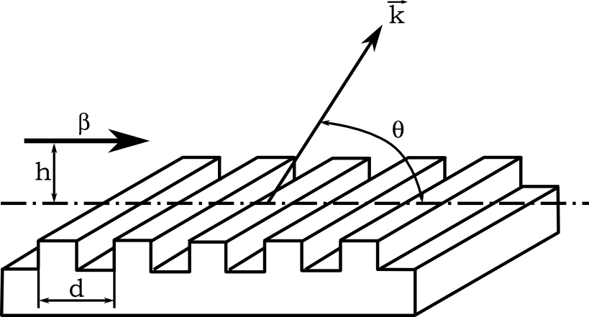
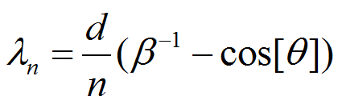
Smith-Purcell Radiation

Slide 5
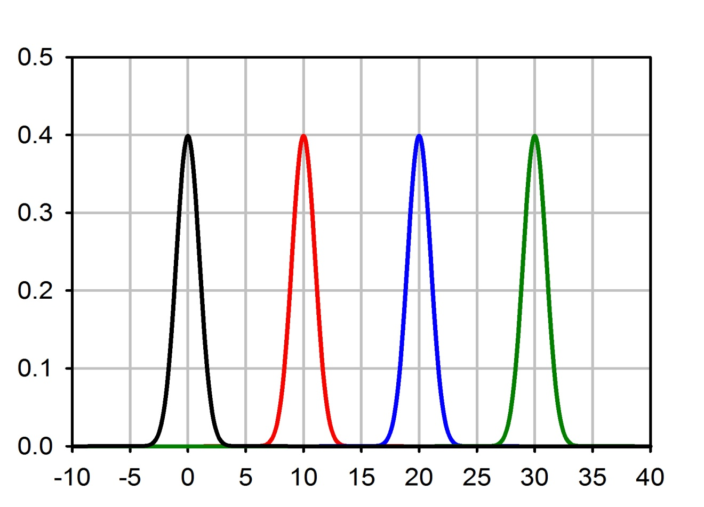
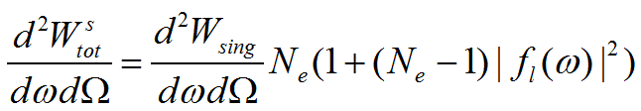
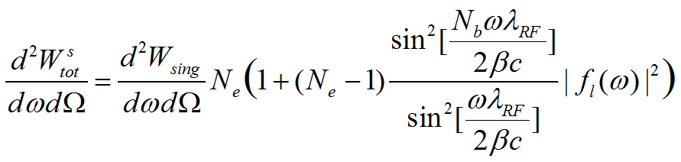
Coherent Radiation from a train of bunches
~0.2ps
~1ps

Slide 6
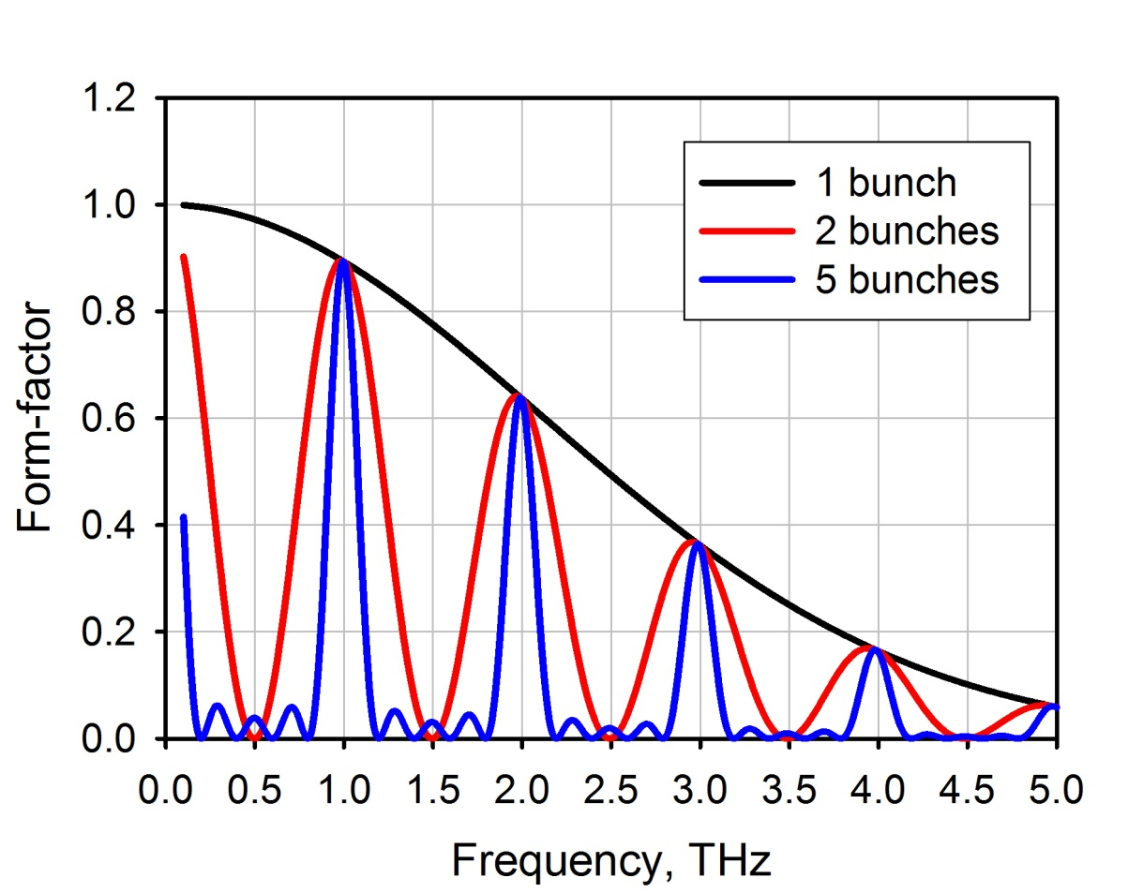
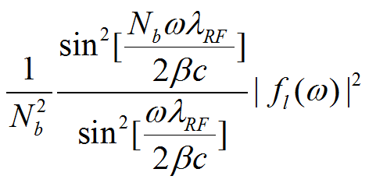

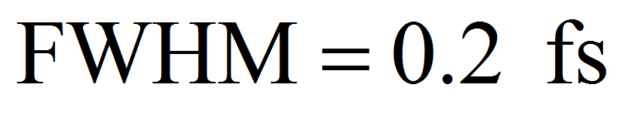
Spectrum of Frequency Locked Coherent Radiation
Radiation line width is proportional to N_{b}⁻¹

Slide 7
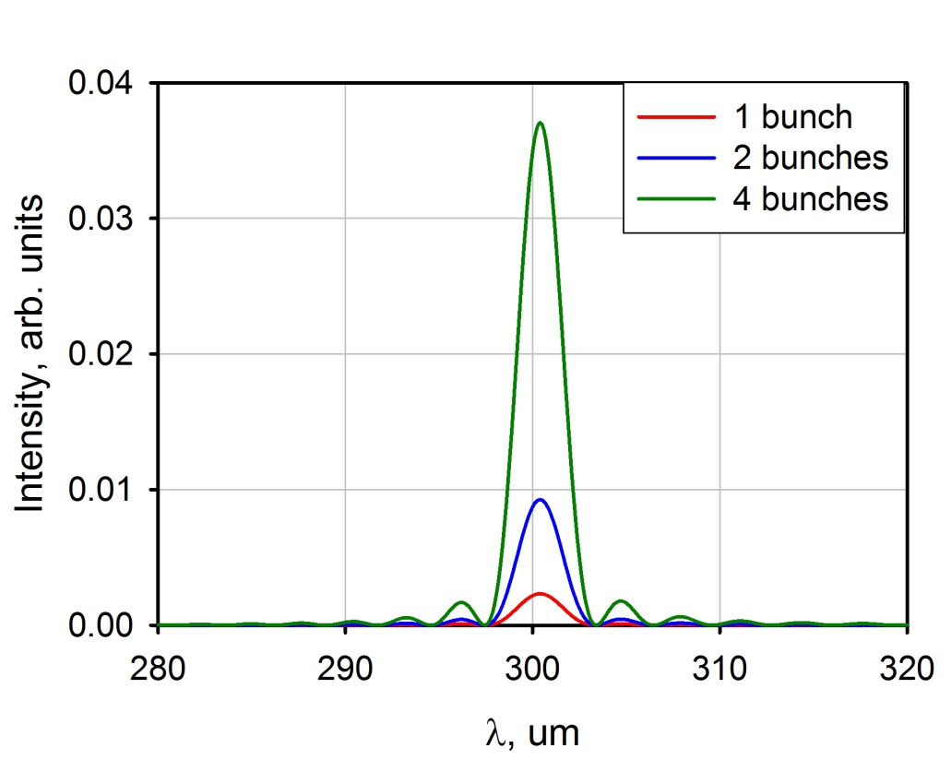
Smith-Purcell radiation gain due to several microbunches
Smith-Purcell radiation spectrum
Parameter | Value
Electron energy, E_{e} | 10 MeV
Grating period, d | 300 um
Number of strips, N | 101
Impact-parameter, h | 1 mm
Observation angle, θ | 90 degree
Microbunch length, σ | 0
# of microbunches, N_{b} | On the figure
Distance between microbunches, λ_{rf} | 300 um

Slide 8
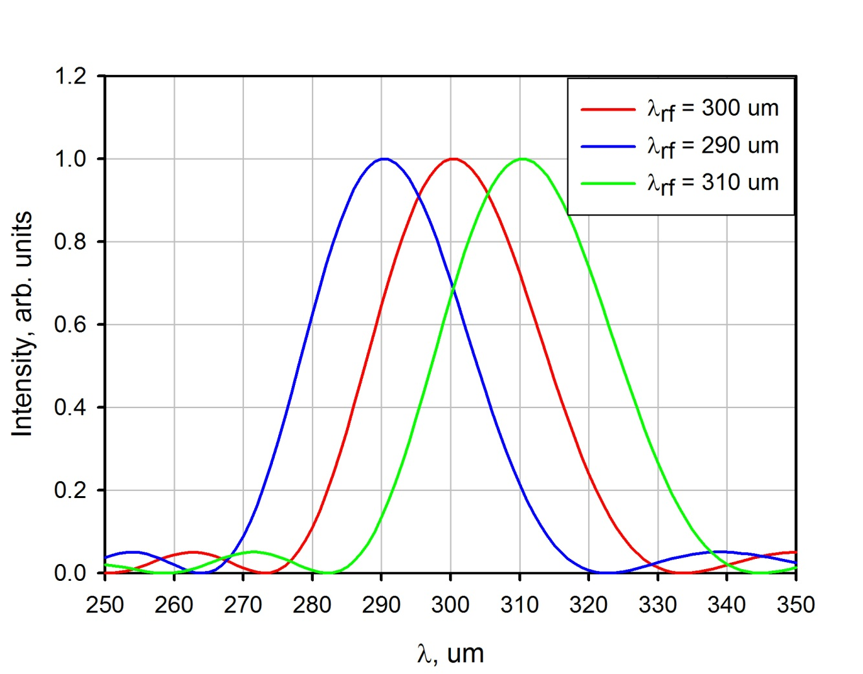
Possible Issue
In the case of frequency-locked coherent radiation a spacing between radiation lines in the spectrum strongly depends on the microbunch spacing.
Parameter | Value
Electron energy, E_{e} | 10 MeV
Microbunch length, σ | 0
# of microbunches, N_{b} | 1

Slide 9
One may need a way to adjust the SPR wavelength to actual microbunch spacing
One can change observation angle θ
One can change grating period d
Tilt the grating

Slide 10
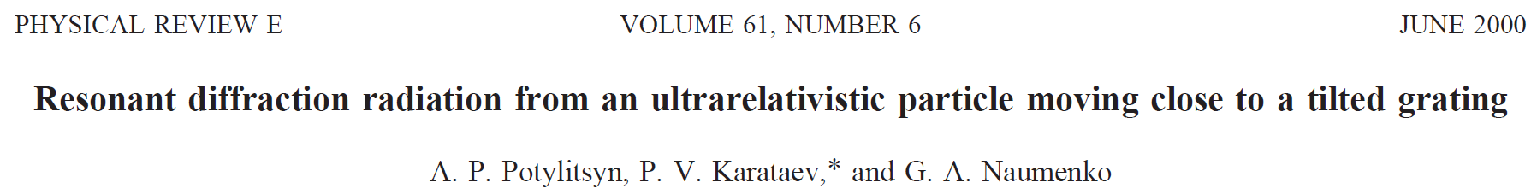
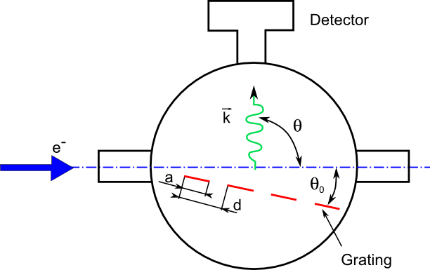
Tilted grating
For the first time was calculated by P. Karataev et al.

Slide 11
Smith-Purcell Radiation theoretical formalism for a tilted grating

Slide 12
Assumptions
The grating under consideration is an infinitely-thin one with vacuum gaps.
The grating material is an ideal conductor.
Calculations are made for using single electron approach

Slide 13
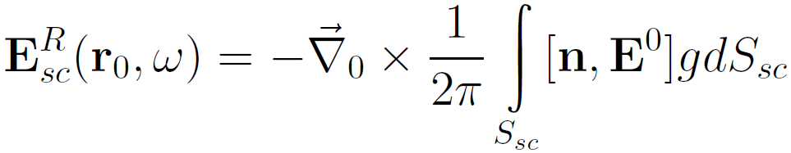
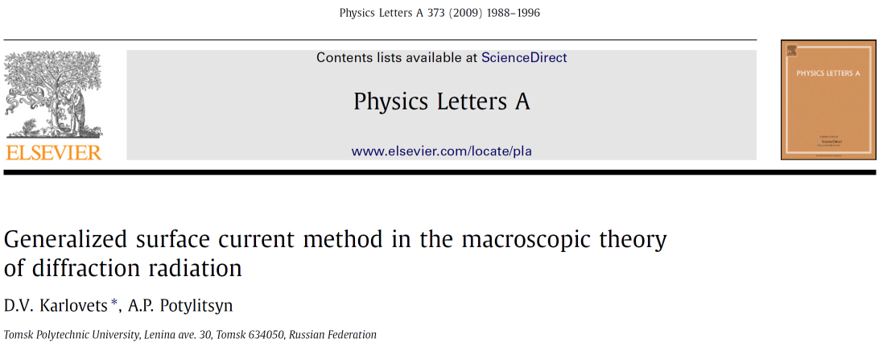
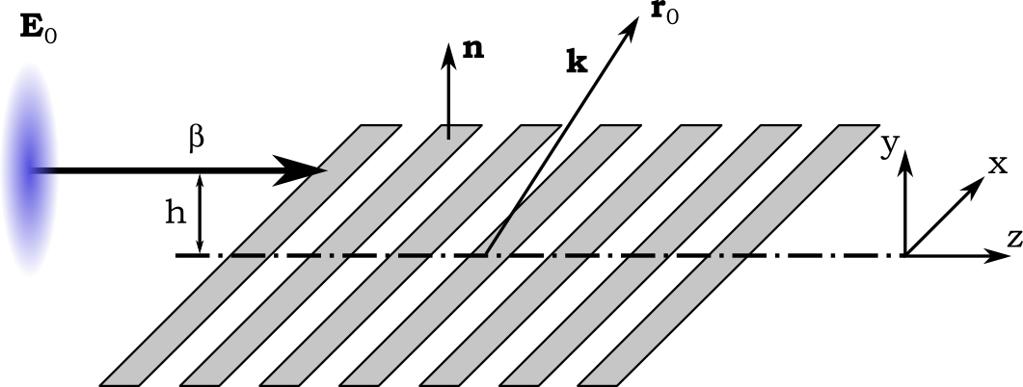
Smith-Purcell radiation model
Radiation field
Symbol | Meaning
r₀ | Observer coordinates
n | Normal to the grating surface
E⁰ | Electron field
g | Free space Green function
S_{sc} | Grating surface (sum of all strips)

Slide 14
Infinite grating vs. finite grating
In the case of infinite grating (in transverse direction) and far-field zone one can obtain nice analytical solution of the problem.
In the case of finite grating one needs to perform numerical double integration but this case is closer to real life. In this case one can also take into account the finite distance between the grating and the detector.

Slide 15
SPR from the infinite grating

Slide 16
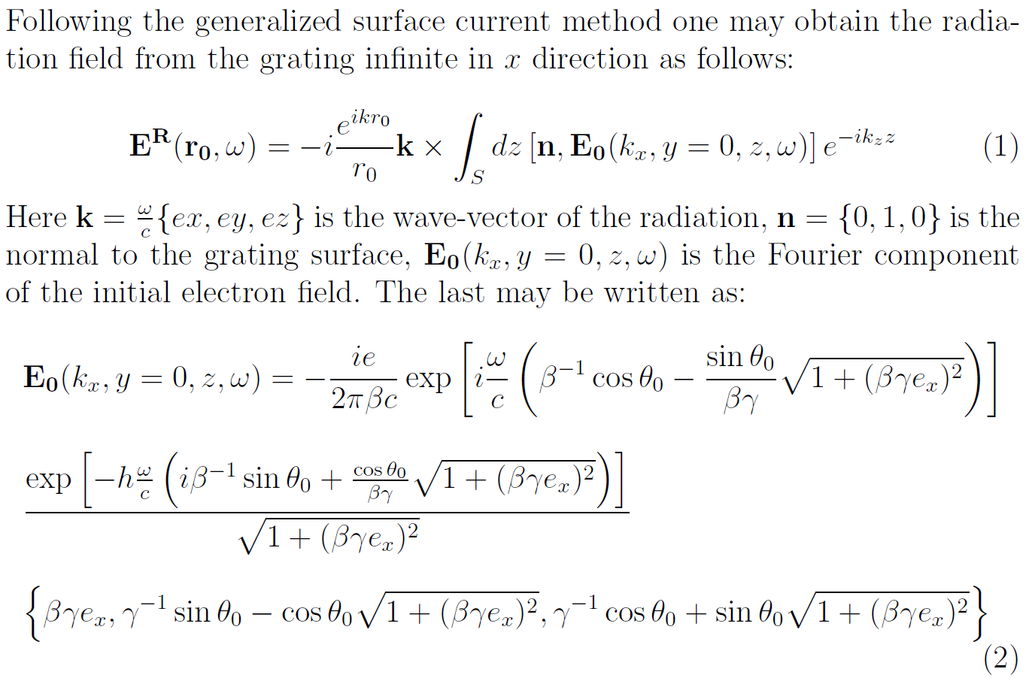
Theoretical model

Slide 17
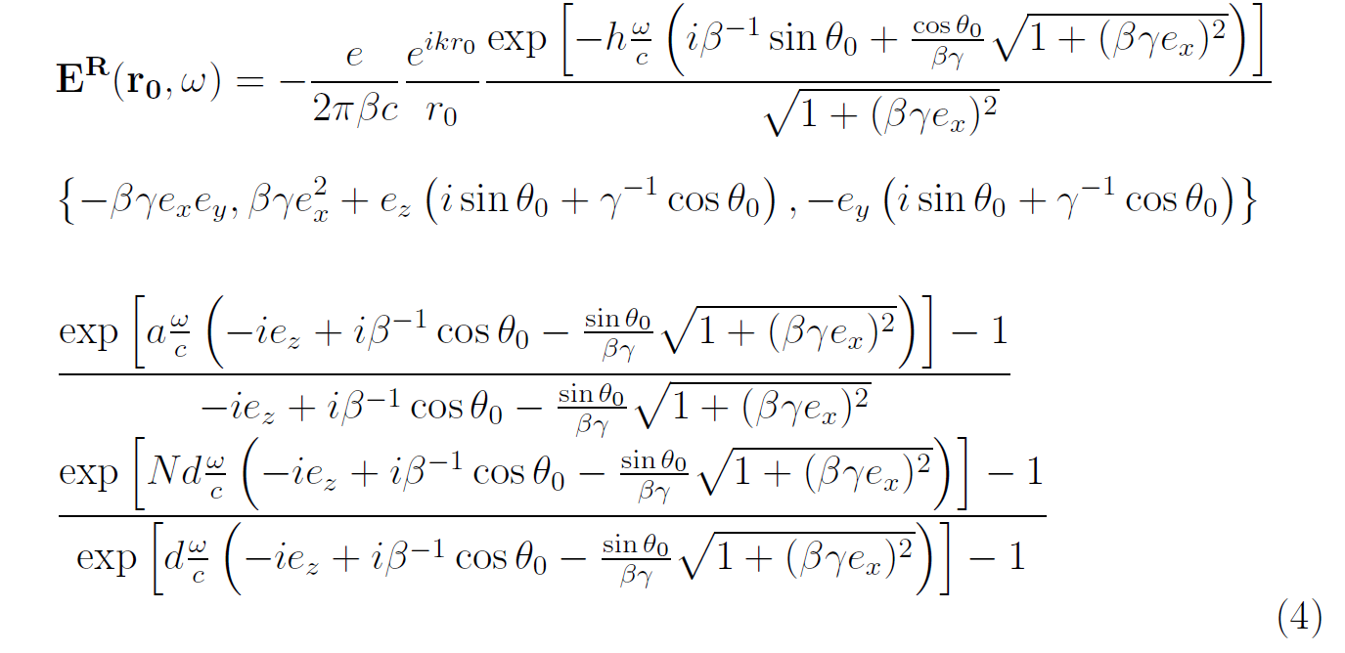
Theoretical model
The integration can be carried out analytically, over all grating strips resulting in the following radiation field:

Slide 18
Calculation parameters
Parameter | Value
Electron energy, E_{e} | 10 MeV
Grating period, d | 300 um
Number of strips, N | 21
Impact-parameter, h | 1 mm
Observation angle, θ | 90 deg
Microbunch length, σ | 0
# of microbunches, N_{b} | 1

Slide 19
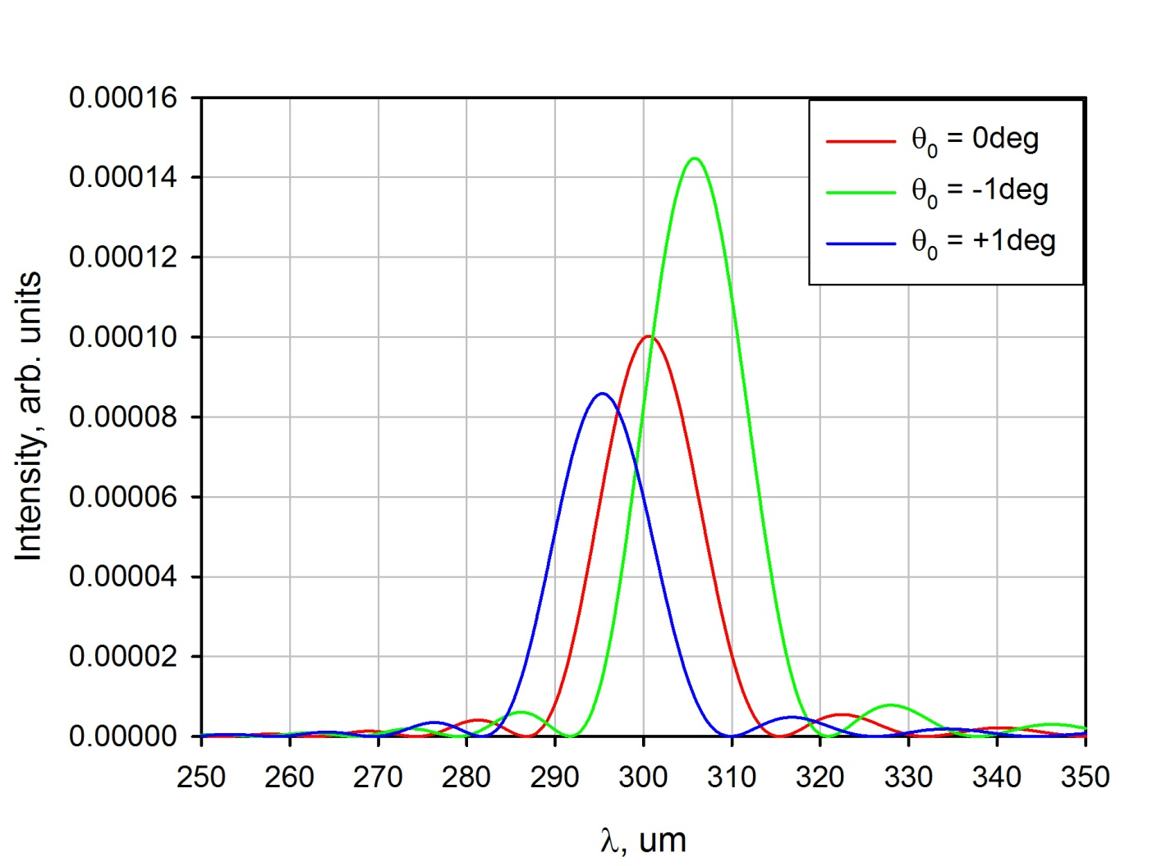
Example of Line Shift
Radiation is polarized in xz plane

Slide 20
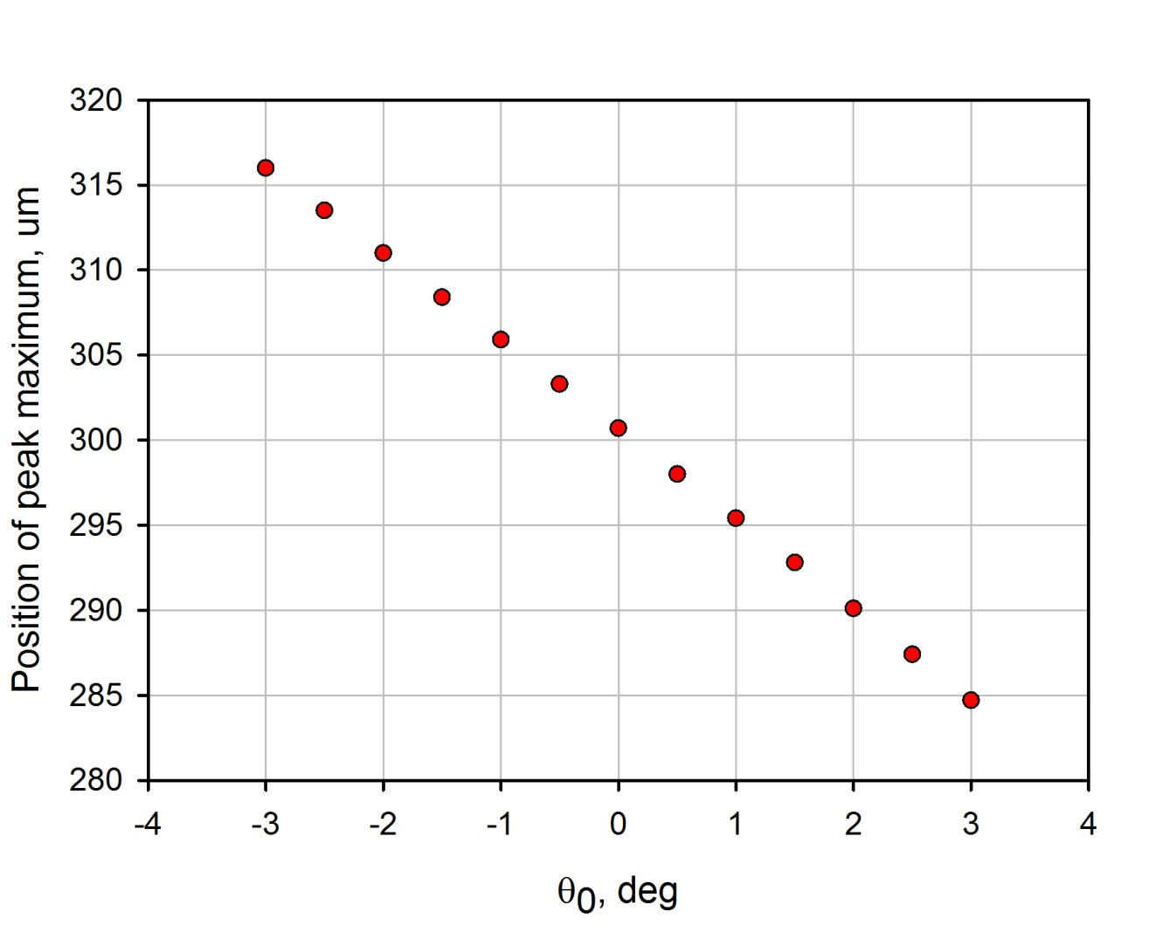
Line Position
Radiation is polarized in xz plane

Slide 21
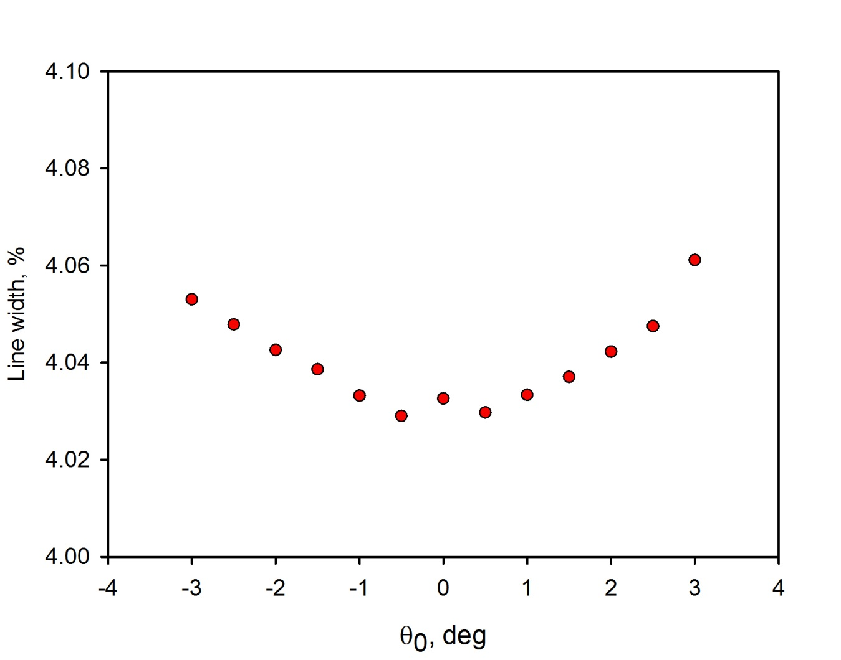

Line Width
$$Line width= \frac{∆λ}{λ}\sim \frac{1}{N}$$
Radiation is polarized in xz plane

Slide 22
SPR from the finite grating

Slide 23
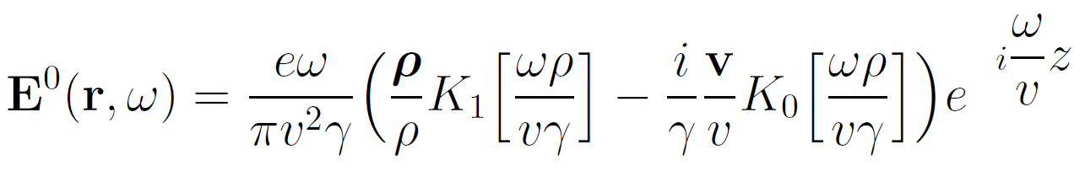
Theoretical model
In the case of finite grating one needs to carry out numerical integration of the equation

Slide 24
Calculation parameters
Parameter | Value
Electron energy, E_{e} | 10 MeV
Grating period, d | 300 um
Grating width | 15 mm
Number of strips, N | 21
Impact-parameter, h | 1 mm
Observation angle, θ | 90 deg
Microbunch length, σ | 0
# of microbunches, N_{b} | 1

Slide 25
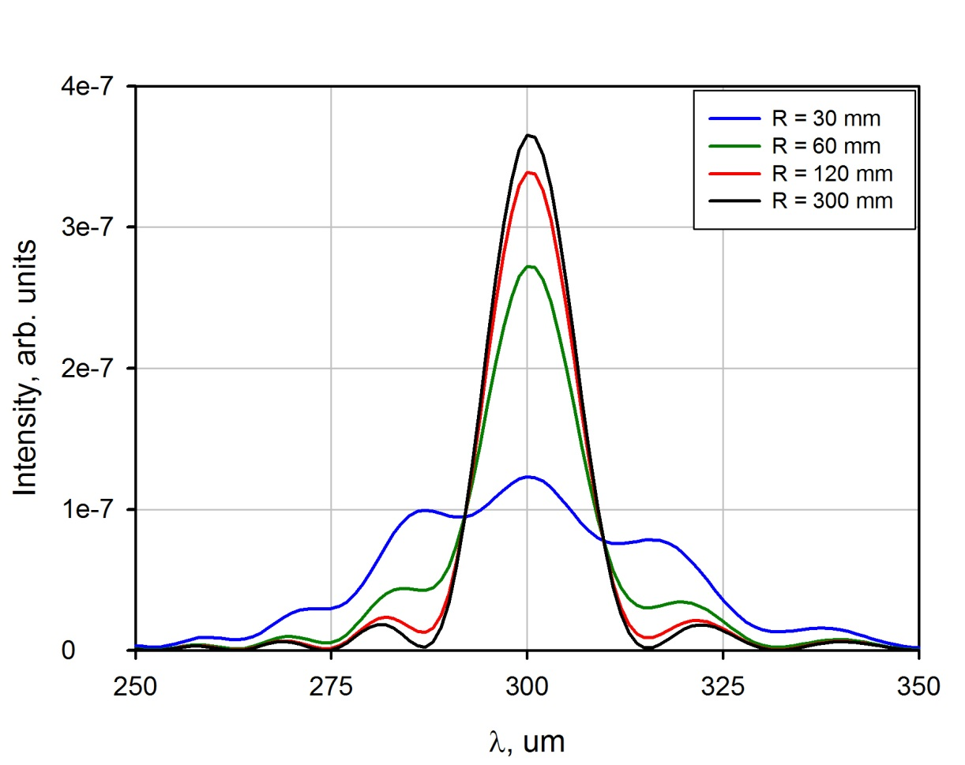
Grating – detector distance
Parameter | Infinite grating | Finite grating (R = 300 mm)
Line position | 300.7 um | 300.5 um
Line width | 4.03% | 4.06%

Slide 26
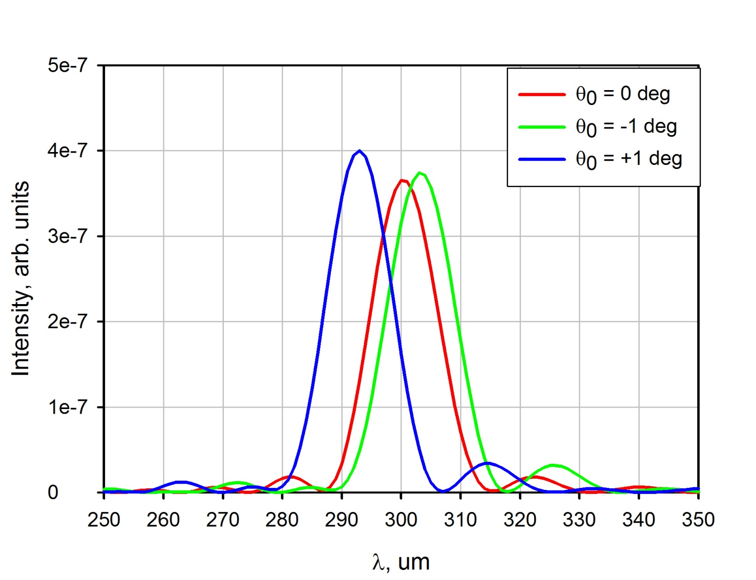
Line shift
Radiation is polarized in xz plane

Slide 27
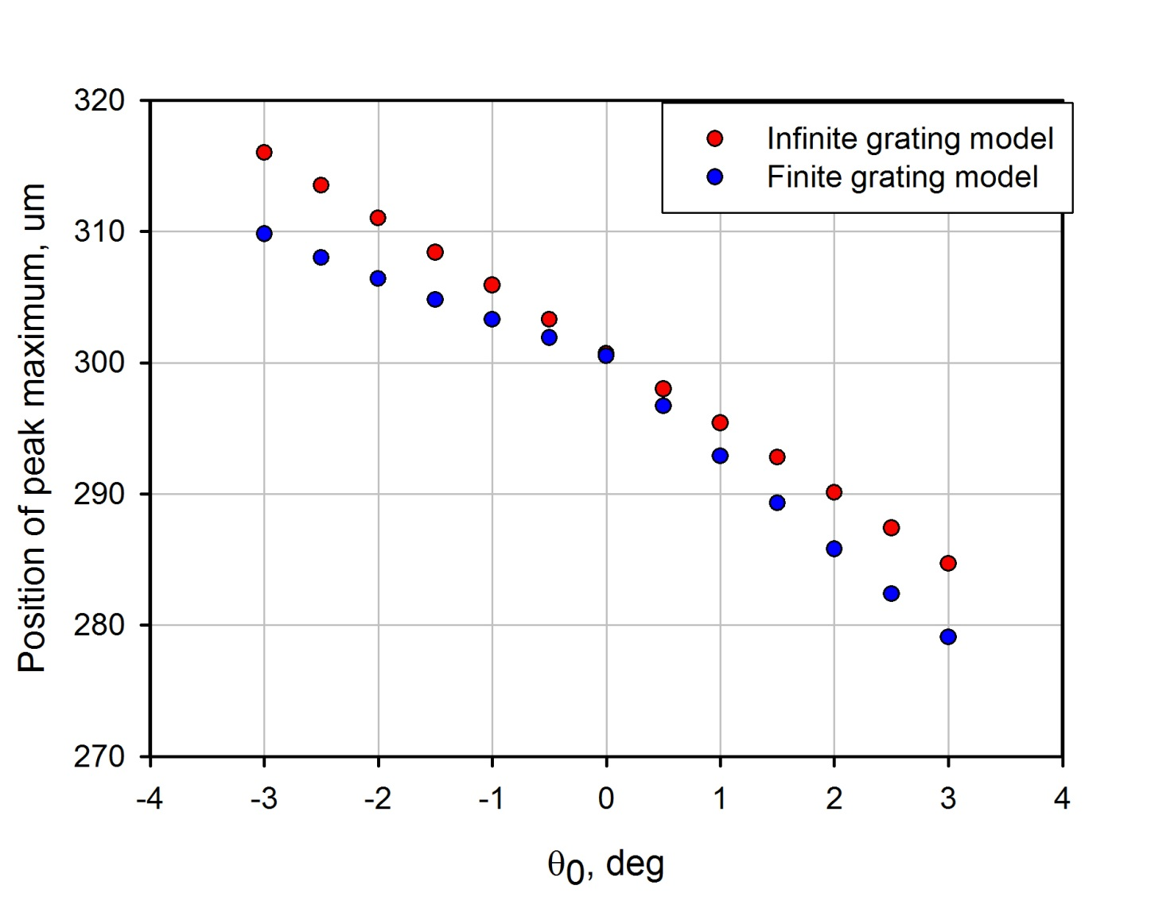
Line position
Radiation is polarized in xz plane

Slide 28
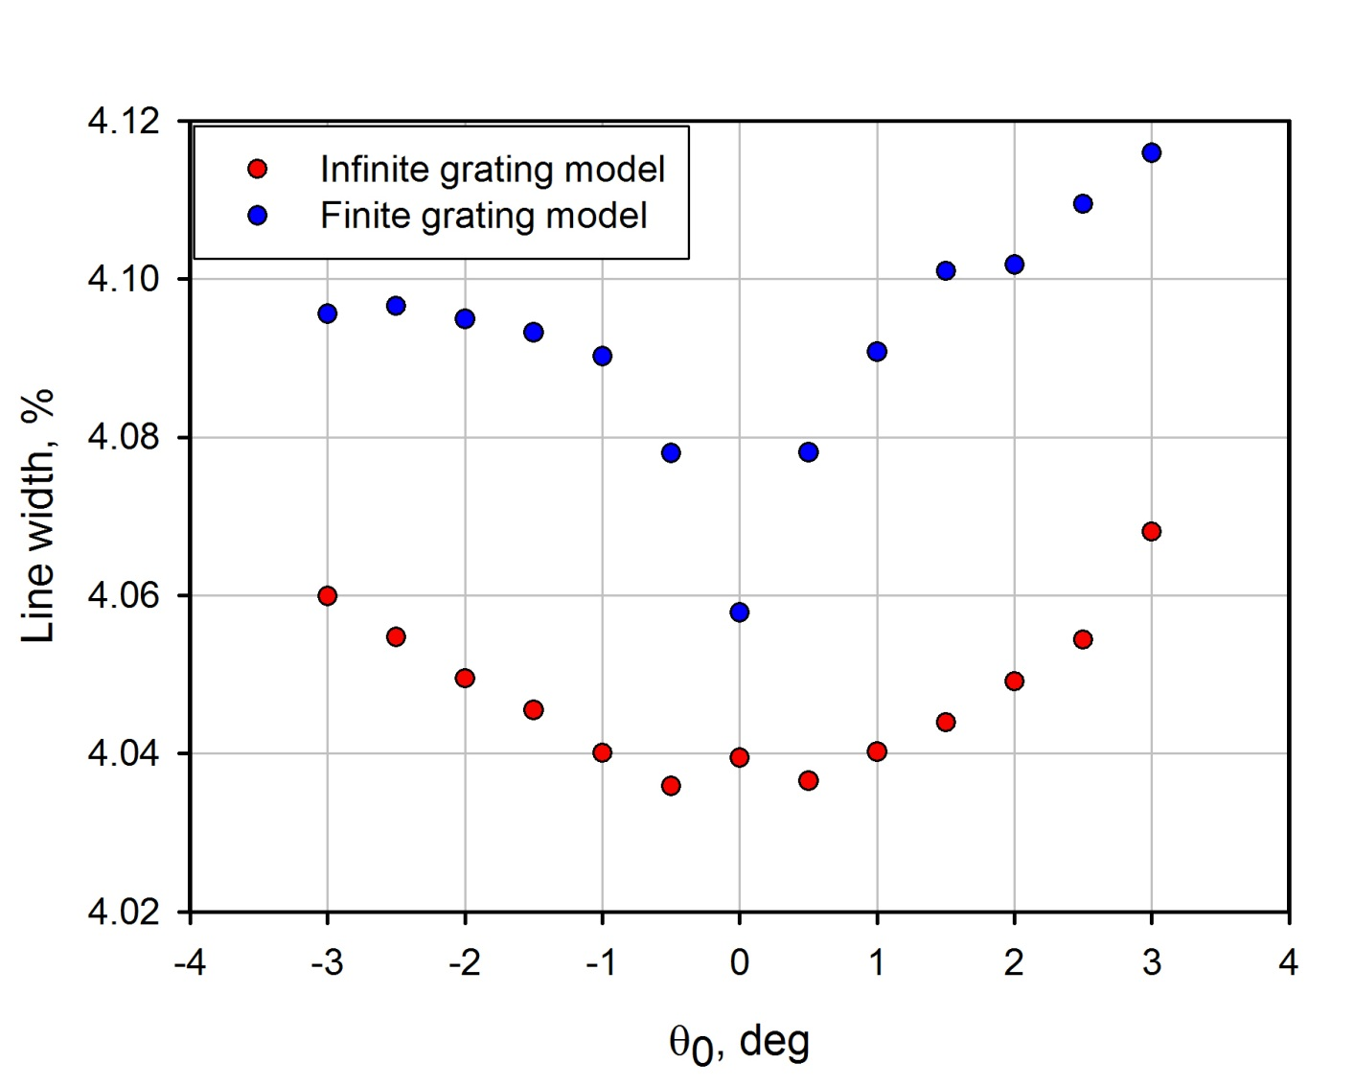

Line width
$$Line width= \frac{∆λ}{λ}\sim \frac{1}{N}$$
Radiation is polarized in xz plane

Slide 29
Conclusion
Tilt of the grating changes the SPR line position. This effect may be used for radiation spectrum adjustment or beam diagnostics.
There are some differences between infinite grating model and finite grating model that are not really understood now.

Slide 30
Thank you for your attention

