Slide 1


Cabling and Connectivity of the IBL detector
Laura Franconi
TALENT project - ESR 12
University of Oslo

Slide 2
Outline
The Pixel detector in ATLAS
Reasons for inserting the IBL
The IBL detector
The ATLAS data flow
My qualification task
The ROD output
  In the Pixel detector
  In the IBL
Summary and outlook

Slide 3
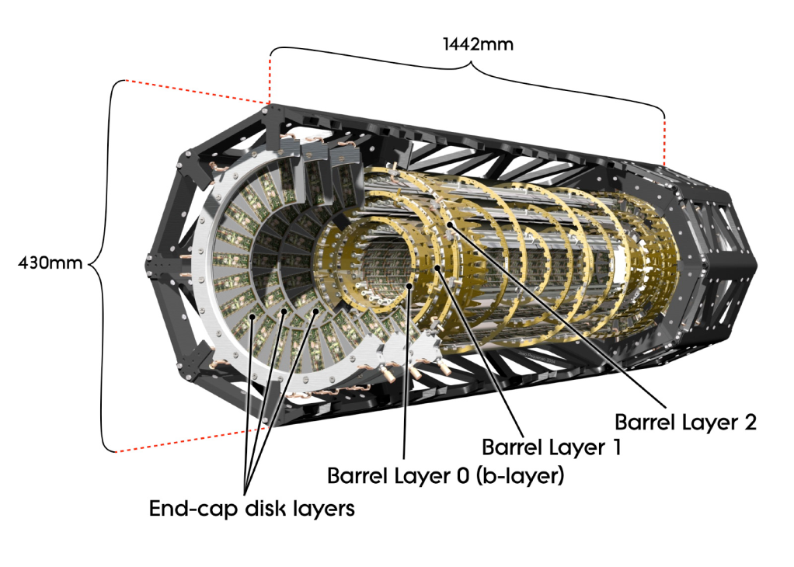
The ATLAS Pixel detector
3 barrel layers at radius:
  r_{(B-layer)} = 50.5 mm (22 staves)
  r_{(L1)} = 88.5 mm (38 staves)
  r_{(L2)} = 122.5 mm (52 staves)
3 forward/backward disks
48 sectors
1744 modules
  16 FE-I3 chip module with a Module Chip Control (MCC)
Planar silicon pixels: (50x400) μm²
Designed for 1 x 10¹⁵ 1MeV fluence and 50 MRad
80 million channels

Slide 4
Reasons for inserting the Insertable B-Layer
The IBL will be the 4th layer inserted inside the present pixel detector
Preserve physics performance of existing pixel system
  Radiation damage after 300-500 fb⁻¹ is significant at inner layer
  At high Luminosity present inner layer is inefficient
  Additional degradation due to accumulated failures may have big impact on physics
Improve performance of existing pixel system
  Improve the b-tagging and reconstruction of secondary vertices
Insertion of a new beam pipe with smaller radius (12.9 mm →12.5 mm)
Represents a technology step towards sLHC:
  Radiation hardness 5x10¹⁵ neq/cm² or 250 MRad (2.5 MGy)
  New Front-end (FE-I4) improves readout architecture
  Readout system & optolink: 160 Mbit/s for data transmission
  CO₂ cooling system & carbon foam mechanics: develop light-weight support

Slide 5
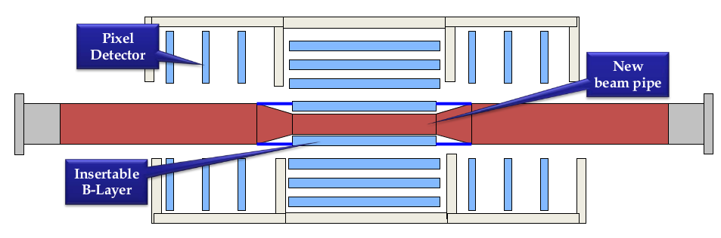
The IBL
F. Hügging

Slide 6
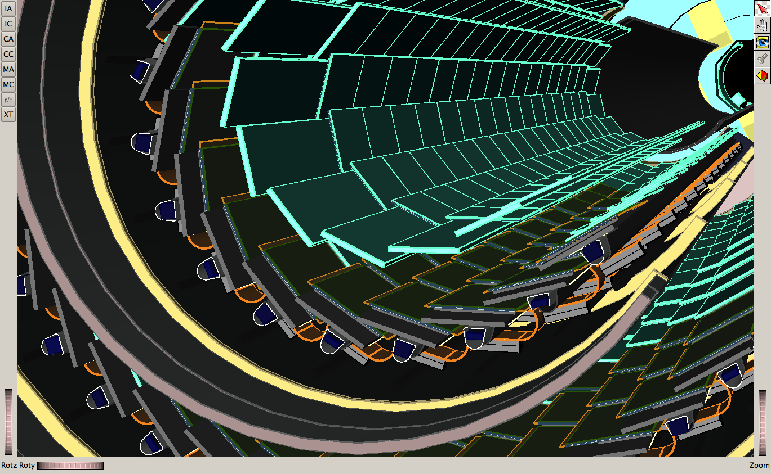
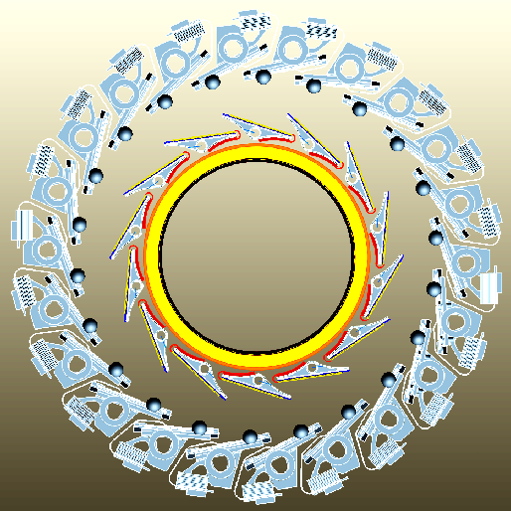
The IBL (cont.)
New beam pipe
14 staves in φ direction
Tilt angle between staves fixed by space constraints
Planar and 3D sensors
32 FE-I4 chips per stave
IBL detector
B-layer

Slide 7
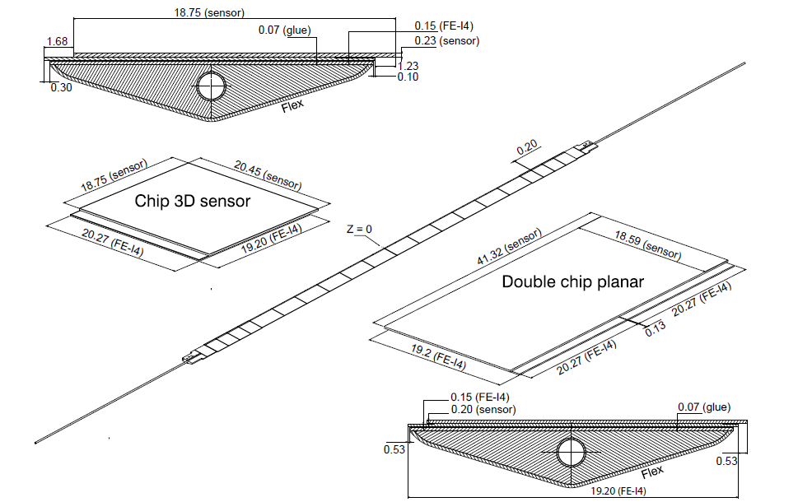
Planar and 3D sensor pixels
Planar sensors:
  Double chip
  (80+80)x366 pixel matrix
  Each pixel: (250x50) μm²
3D sensors:
  Single chip
  80x336 matrix
  Same area of the pixel
  → FE electronics architecture indipendent on sensor technology

Slide 8
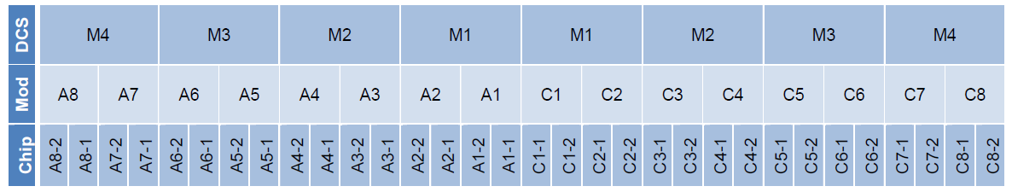
IBL Stave naming
A-side
C-side
3D sensor
Planar sensor
3D sensor

Slide 9
Comunication between
Read Out Driver (ROD) and FE chips
A-side
C-side
Rx
Tx
Rx
Rx
Tx
Rx
Rx
Tx
Rx
Rx
Tx
Rx
Rx
Tx
Rx
Rx
Tx
Rx
Rx
Tx
Rx
Rx
Tx
Rx
Tx = Transmission of data to the FE modules
  L1 trigger, Event Counter reset, Bunch Crossing reset, Calibrations
Rx = Reception of the byte stream data from FE modules
  Event data

Slide 10
Initial (and semplified) ATLAS data flow
Detector sees something
Data sent through ROD to CPT¹ and saved in the ROB²
CTP makes decision
Within
3.5 μs
Decision is sent back to LTP³
Decision sent to ROD
¹ CPT = Central Trigger Processor
² ROB = Read Out Buffer
³ LTP = Local Trigger Processor
⁴ ROS = Read Out System
⁵ EB = Event Builder
The detector is read out
Data are collected and sent through the ROB to the ROS⁴, the EB⁵ and finally to the Tier-0

Slide 11
My qualification task
Cabling:
  Adapt the mapping of the Pixel cabling to include the IBL connections
Connectivity:
  Modify the tool for the coding and decoding of data coming from the Pixel detector to take into account the data flow from the IBL

Slide 12
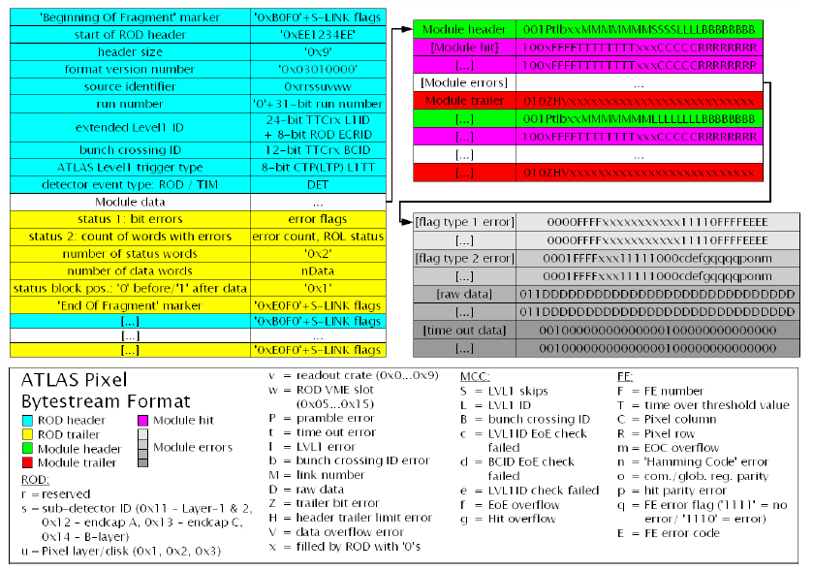

Slide 13
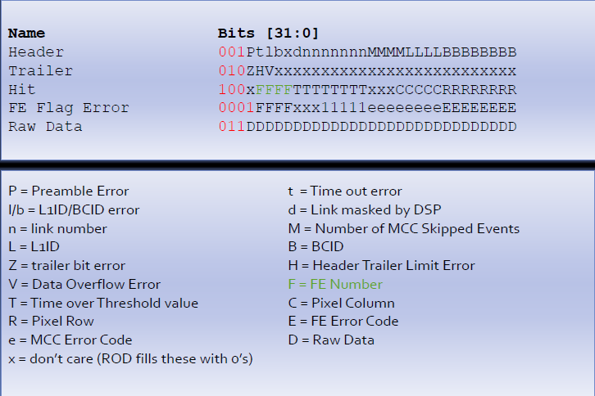
Pixel ROD output format
32-bit words
First 3-4 bits are the signature of the word type

Slide 14
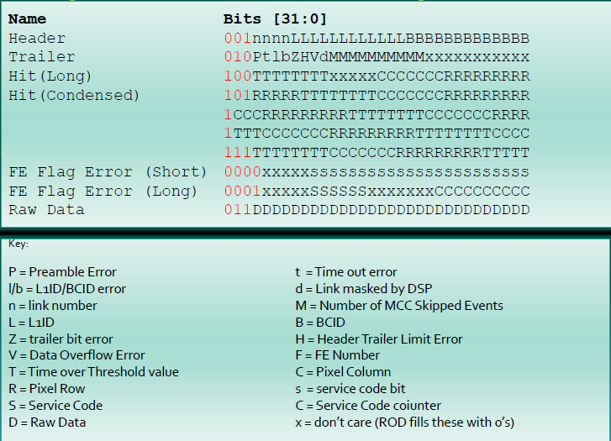
Proposed IBL ROD output format

Slide 15
Practical work to be done
2 packages to be modified:
  InnerDetector/InDetDetDescr/PixelCabling:
    Mapping of the origin of data read from the ROD
    Table with all the mapping needs to be completed
  InnerDetector/InDetEventCnv/PixelRawDataByteStreamCnv:
    Encoder tool
    Decoder tool

Slide 16
Summary and Outlook
The new IBL is required to
  Preserve the efficiency of the present Pixel detector
  Improve the physics performance of the Pixel detector
  Improve the b-tagging capabilities
It has a similar but different structure w.r.t. the Pixel detector
The proposed ROD output Bytestream for the IBL is to be implemented inside the Pixel offline SW by modifying the Cabling and the Bytestream converter packages

Slide 17
Back-up

Slide 18
My Ph.D. program at UiO
Software tasks
  Simulation of the performance of the real IBL detector
  Simulation of the performance of an ideal IBL detector, made only of 3D silicon pixels
  Estimation of expected performance of the IBL when simulated (and real?) data are applied to the physics channel WH→lνbb
Hardware tasks
  R&D and quality assurance tasks on 3D sensor prototypes
Qualification task
  Cabling and connectivity → 2 packages to be modified

Slide 19
New Front End chip: FE-I4
New Front End chips: FE-I4
  Large format pixel readout chip for cheaper large area pixels (biggest chip in HEP to date)
  Lower power (→ don't move the hits around unless triggered)
  Able to take higher hit rate (→ store the hits locally and distribute the trigger)
  Still able to resolve the hits at higher rate (→ smaller pixels and faster recovery time)
  No need for extra module control chip (→ significant digital logic blocks on array periphery) [see next slide]

Slide 20
MCC with FE-I3 vs FE-I4
Present pixel detector
IBL
Rx
Tx
Rx
Tx
Rx
Rx
Tx
Rx
MCC
FE_1
(A8_2)
FE_1
(A8_1)
…
FE_31
(C8_1)
FE_31
(C8_1)
FE_1 ... … … FE_8
FE_16 … … … FE_9

Slide 21
ROD Functions
Tx = Transmission of data
  L1 trigger, Event Counter reset, Bunch Crossing reset, Calibrations, Module Register
Rx = Reception of byte stream data from FE module
  Event data, Register data
ROD
  Detects format errors in event data
  Builds event fragment
  Transmits event fragments to ROB (Read Out Buffer) through ROL (Read Out Driver)

Slide 22
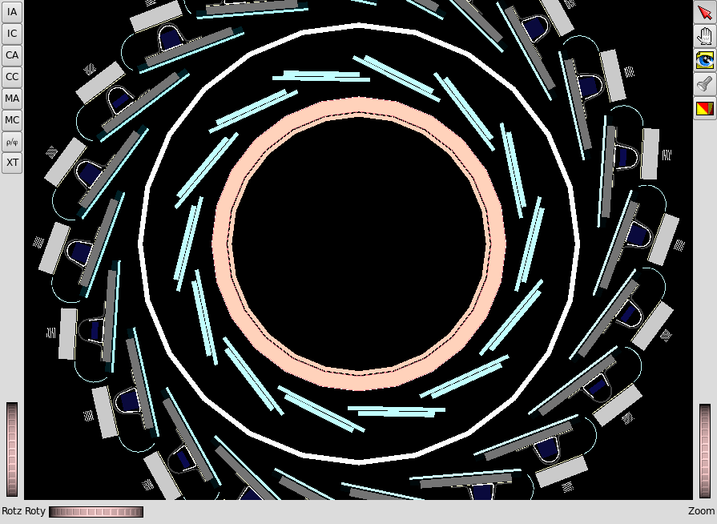
3D model of the IBL

Slide 23
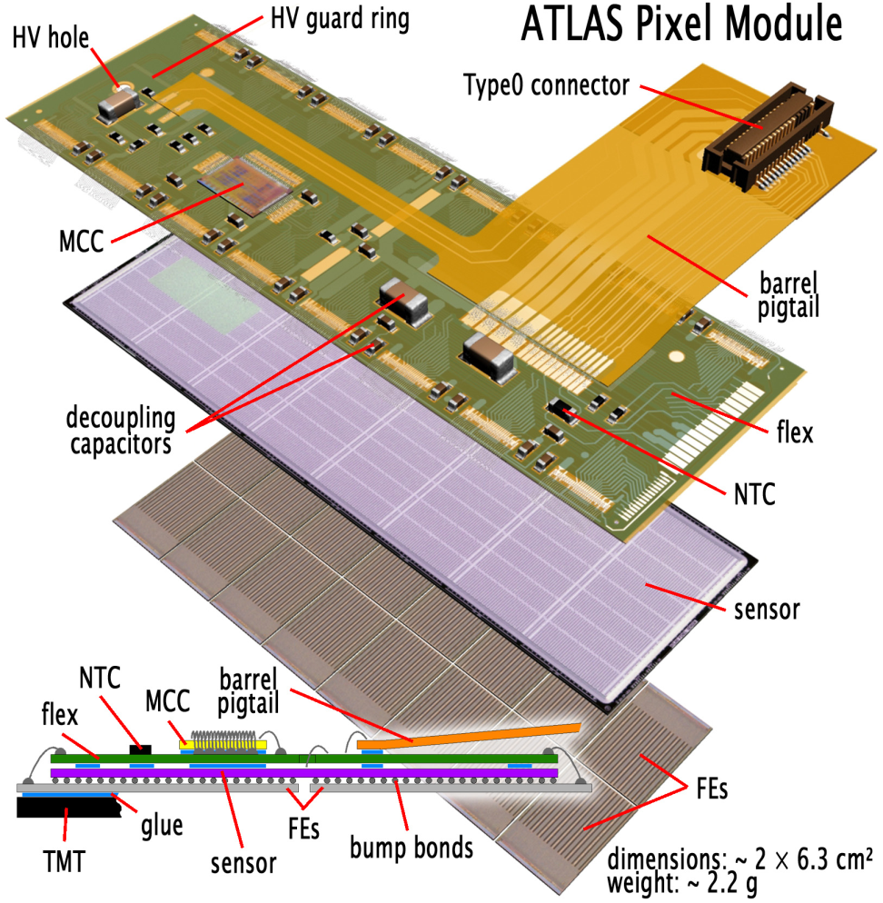
The ATLAS Pixel Module
16 front-end chips (FE-I3) module with a Module Controller Chip (MCC)
46080 R/O channels (50x400) μm² (50 x 600) μm² for edge pixel columns between neighbour FE-I3 chips)
Designed for 1 x 10¹⁵ 1MeV fluence and 50 MRad
Optolink R/O: 40÷80 Mb/link

