Slide 1
Introduction, Past Work and Future Perspectives:
A Concise Summary
CERN, 18.02.2013
Arno E. Kompatscher
CiS Forschungsinstitut für Mikrosensorik und Photovoltaik GmbH
Erfurt, Germany

Slide 2
Contents
Personal Introduction
Diploma Thesis
  General outline
  Crystallography
  Martensite
  Preparation
  Analysis and results
    TEM bright field
    TEM selected area diffraction (SAD)
    DSC
  Conclusions

Slide 3
Contents
Present Work and Future
  4’’ wafer layout
  6’’ wafer layout
  Comparison
    Quad vs. FE-I4 vs. FE-I3
    Ganged & long pixels (Quad, center)
    With and without long pixels (edge)
    Bias grid variations
  Prospects

Slide 4
Personal
Introduction
Arno E. Kompatscher
Born June 4, 1984 in Hall in Tirol
Hometown: Feldkirch, Vorarlberg
Studied physics at University of Vienna
Thesis: Electron microscopy of Ni-Mn-Ga alloys
Mag.rer.nat. (= M.Sc.) on August 28, 2012

Slide 5
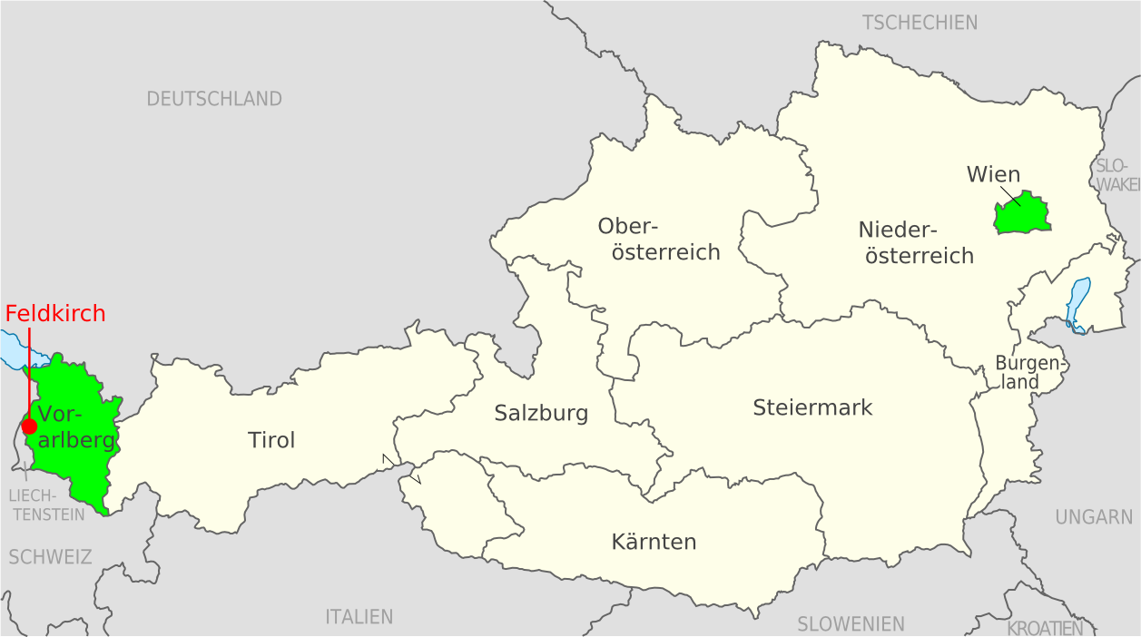
Personal Introduction
Home & Education

Slide 6
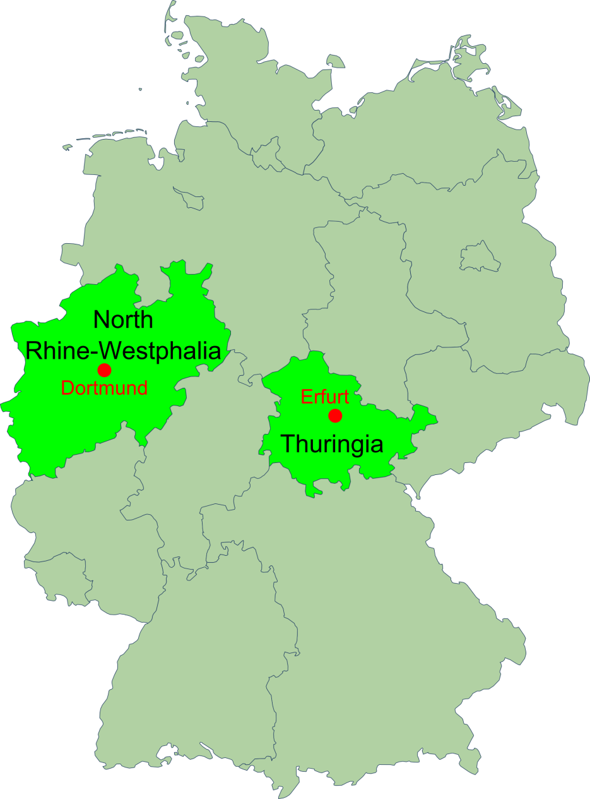
Personal Introduction
Current Work
Since November 1, 2012:
Early Stage Researcher
  CiS Forschungsinstitut für Mikrosensorik und Photovoltaik GmbH
  Erfurt, Thuringia
Ph.D. via
  Prof. Claus Gößling
  Lehrstuhl Experimentelle Physik IV
  TU Dortmund, North Rhine-Westphalia

Slide 7

Diploma Thesis
“Phase transformations in Ni-Mn-Ga shape memory alloys subjected to severe plastic deformation”
Supervisor:
Prof. Thomas Waitz
Group:
Physics of Nanostructured Materials (PNM)
Faculty of Physics, University of Vienna
physnano.univie.ac.at

Slide 8
Diploma Thesis
General Outline
Material:
  Ni₅₄Mn₂₅Ga₂₁
  Tetragonal martensite (2M) in initial state
Preparation:
  High pressure torsion (HPT)
  Annealing (heat treatment)
Analysis
  Transmission electron microscopy (TEM)
  Differential scanning calorimetry (DSC)
  X-ray diffractometry (XRD)

Slide 9
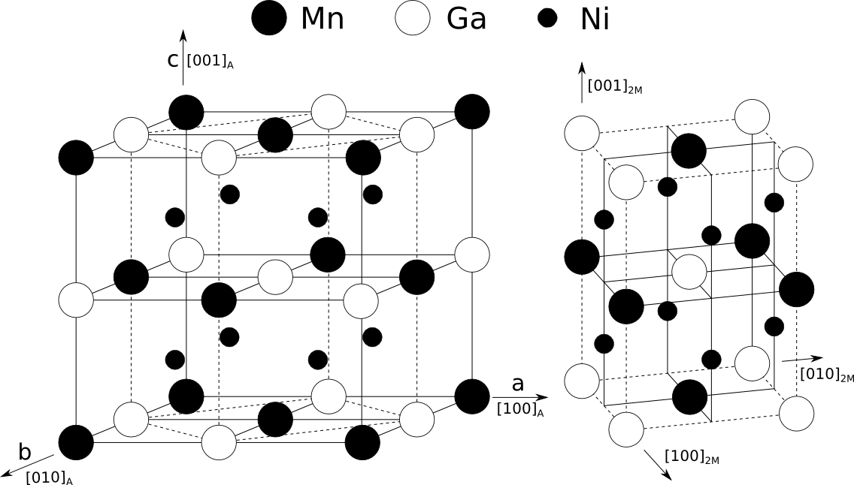
Diploma Thesis
Crystallography
Austenite
(L2₁ Heusler)
Martensite
(I4/mmm, bct)

Slide 10
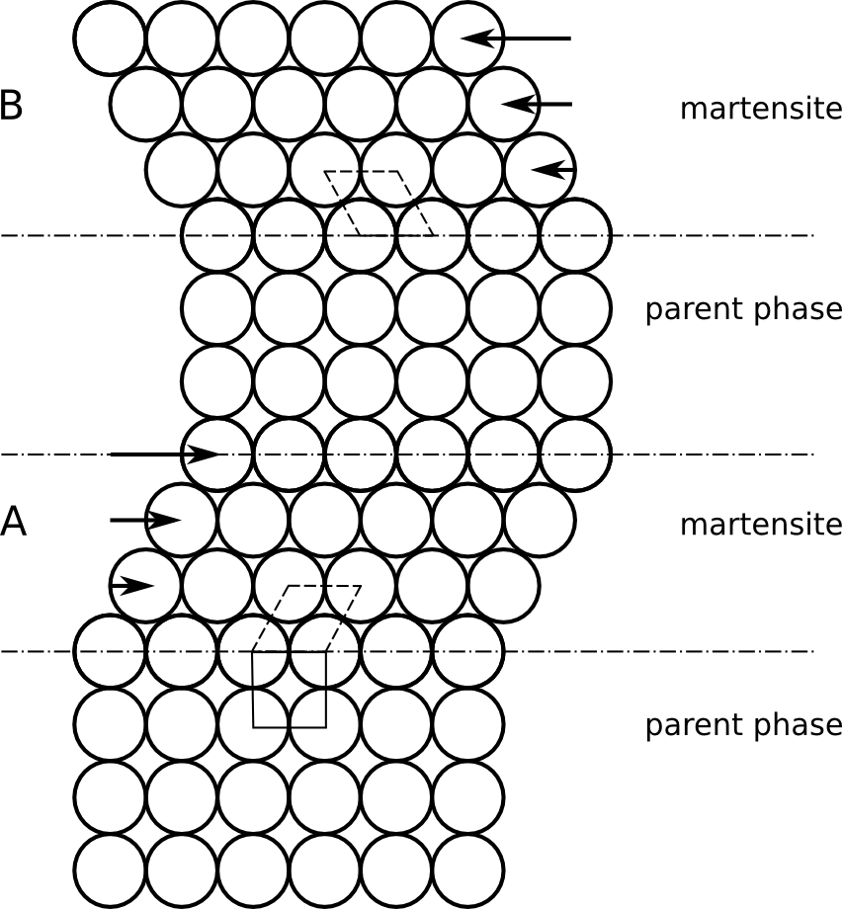
Diploma Thesis
Martensite
Martensitic phase transformation
Displacive, diffusionless, 1st order
Low temperature martensite
High temperature austenite

Slide 11
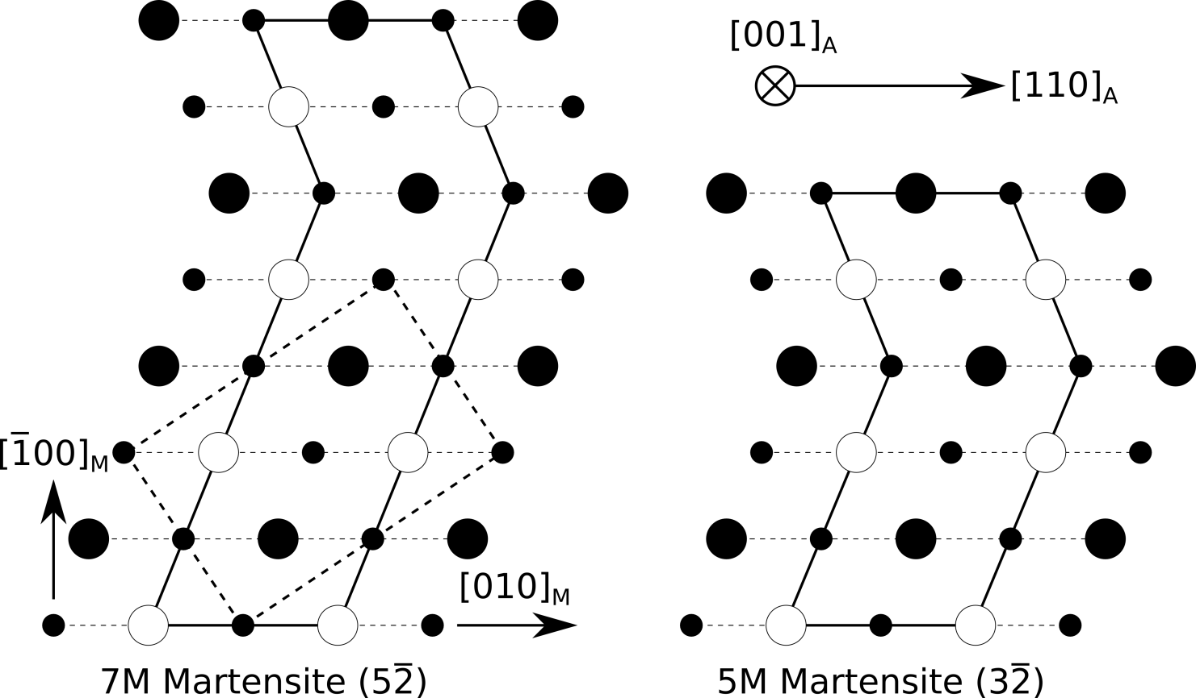
Diploma Thesis
Martensite
Different variants of martensite
Unmodulated (2M, initial state), Modulated (7M and 5M)

Slide 12
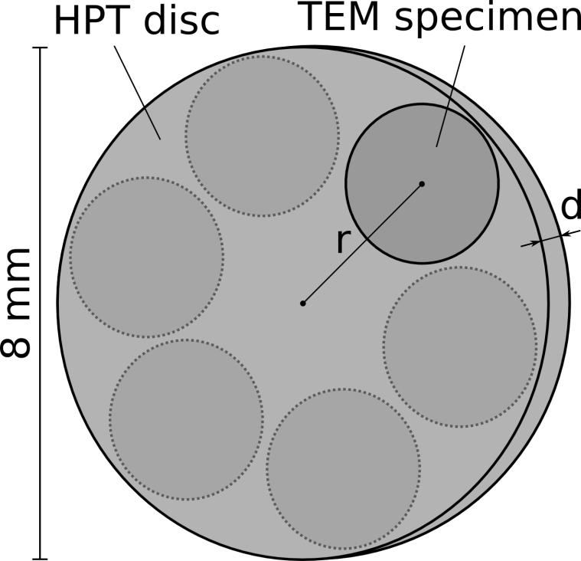
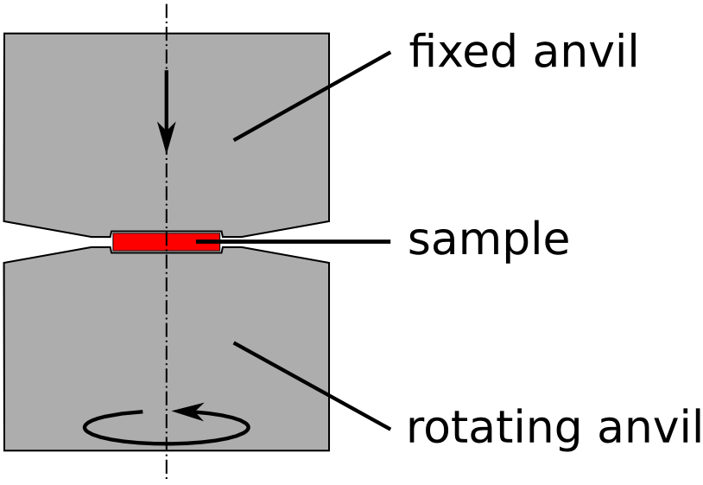
Diploma Thesis
Preparation
High pressure torsion (HPT):
8 GPa, 50 and 100 turns
d = 0.4±0.1
Degree of deformation γ:
2.2 · 10⁵ % and 6.5 · 10⁵ %

Slide 13
Diploma Thesis
Analysis
Transmission electron microscopy (TEM)
  Microstructure, grain size, lattice structure, lattice parameters
Differential scanning calorimentry (DSC)
  Heat treatment, ID of phase transitions and respective enthalpies
X-Ray diffractometry (XRD)
  Confirmation of lattice structures and parameters

Slide 14
Diploma Thesis
Analysis
Initial Material: w/o HPT, w/o heat treatment
As deformed: after HPT, w/o heat treatment
After HPT, heat treatment to 420°C
After HPT, heat treatment to 500°C

Slide 15
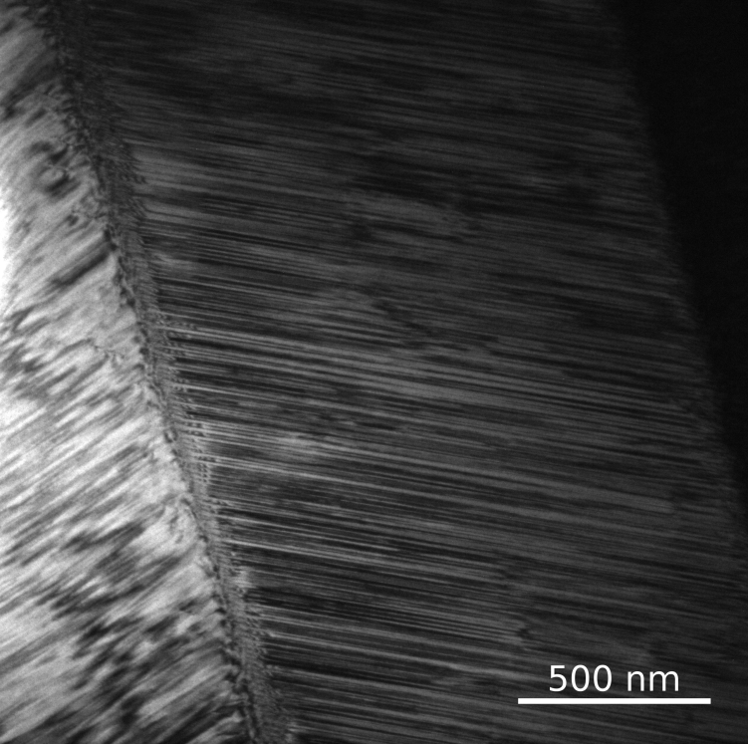
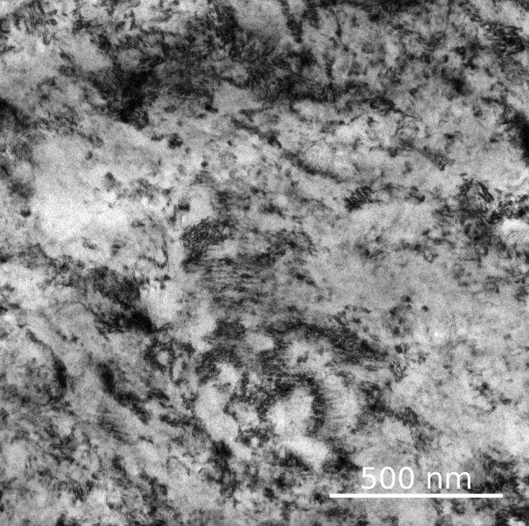
Diploma Thesis
TEM bright field
Initial state
As deformed
Each martensitic variant is internally twinned; grain size several hundreds of μm
Strong grain fragmentation due to severe plastic deformation (SPD)

Slide 16
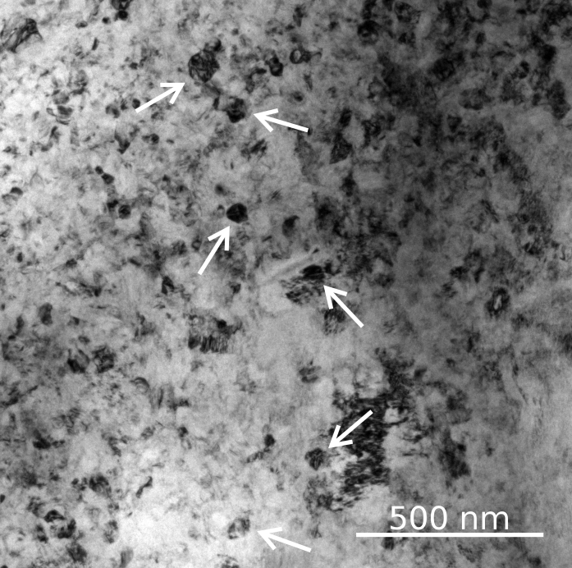
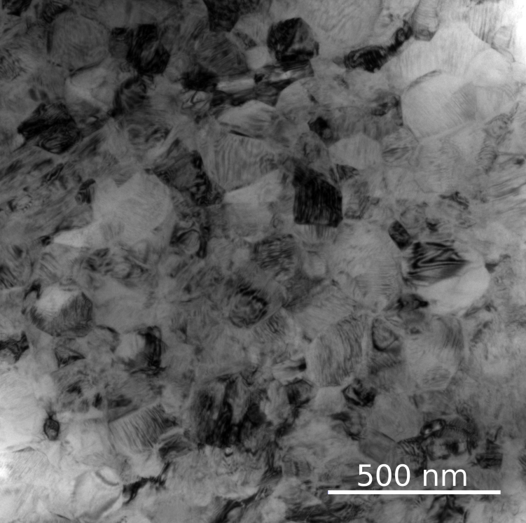
Diploma Thesis
TEM bright field
HT 420°C
HT 500°C
Beginnings of grain nucleation; small polygonized grains start to form due to heat treatment (arrows)
Grain nucleation completed, clearly identifyable polygonized grains; grain size 140±6 nm

Slide 17
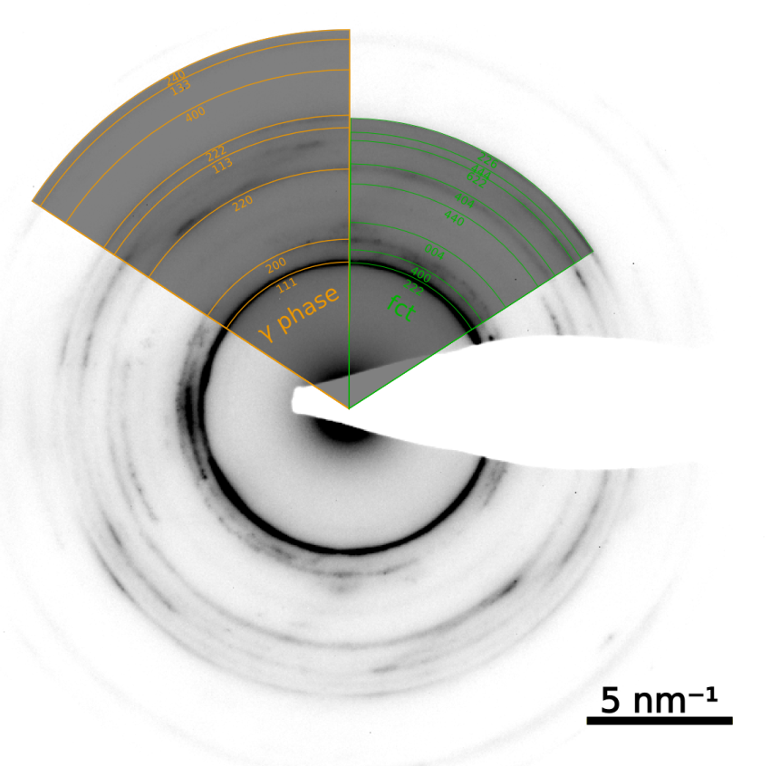
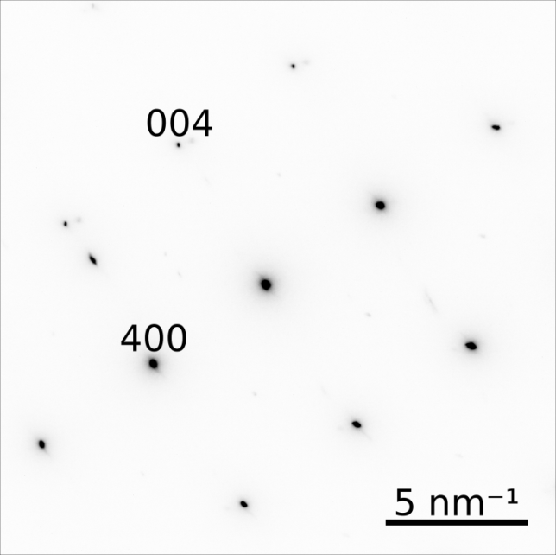
Diploma Thesis
TEM SAD
Initial state
As deformed
Tetragonal martensite
Disordered tetragonal (fct), face centered cubic (fcc), no martensite

Slide 18
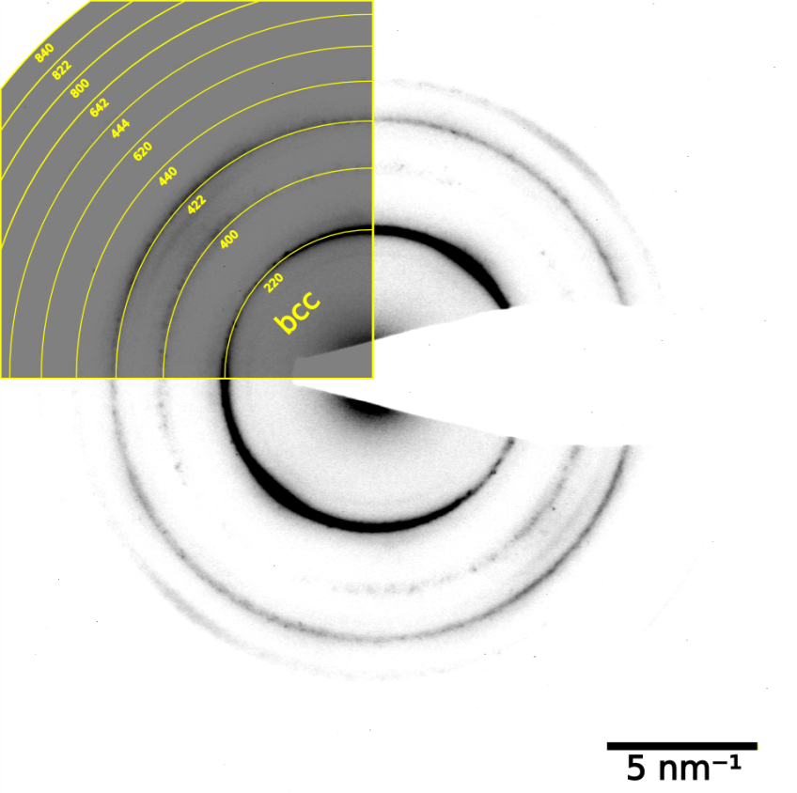
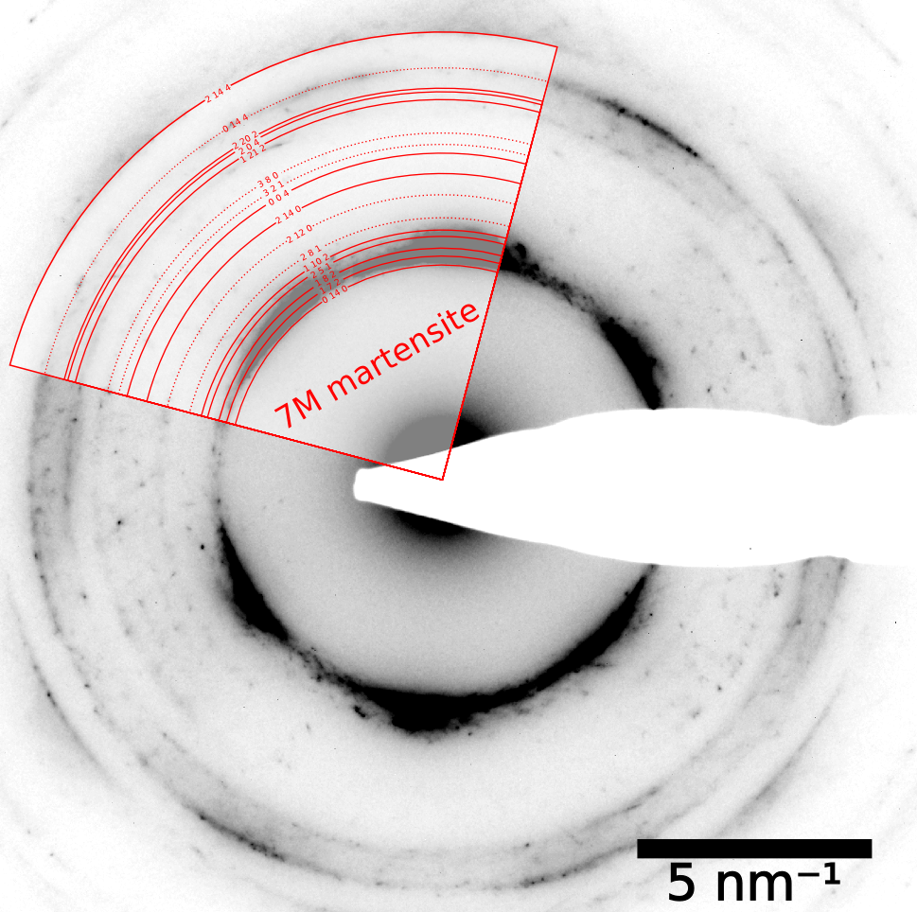
Diploma Thesis
TEM SAD
HT 420°C
HT 500°C
Intermediade structure detected: disordered body centered cubic (bcc)
7M martensite observed to be predominant

Slide 19
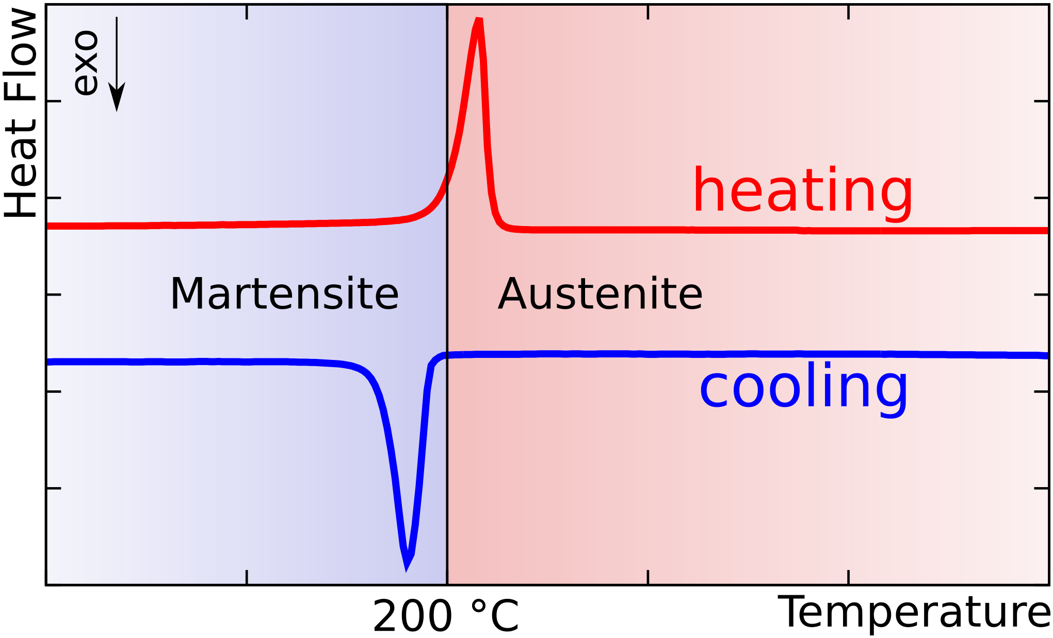
Diploma Thesis
DSC, initial state
A_{P} = 208 °C
M_{P} = 190 °C

Slide 20
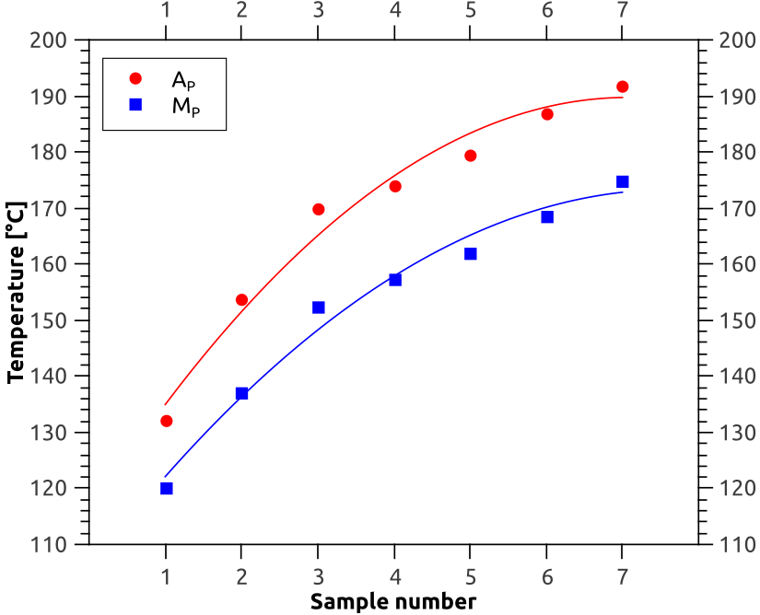
Diploma Thesis
DSC, progression
Change of martensite and austenite peak temperatures (A_{P}, M_{P}) due to heat treatment
Sample 1: short annealing time (10 min at 500 °C, almost directly after HPT)
Sample 7: long annealing time (505 min at temperatures from 500 to 675 °C)

Slide 21
Diploma Thesis
Conclusions
HPT induces strong grain refinement
  Hundreds of μm before HPT
  140±6 nm after HPT
HPT causes disordering and suppression of martensitic transformation
Upon heat treatment to 500 °C the adaptive 7M martensitic structure forms

Slide 22
Diploma Thesis
Acknowledgement
Prof. Thomas Waitz, supervisor
Dr. Clemens Mangler, assistant supervisor
Physics of Nanostructured Materials (PNM) Group
Faculty of Physics, University of Vienna
Materials Center Leoben (MCL)
Fonds zur Förderung der wissenschaftlichen Forschung (FWF)

Slide 23



Present Work and Future

Slide 24
Present Work & Future
Motivation
Past: development of new sensors for insertable B-layer (ATLAS Upgrade Phase I, happening now)
Development of new detectors for
ATLAS Upgrade Phase II (2022)

Slide 25
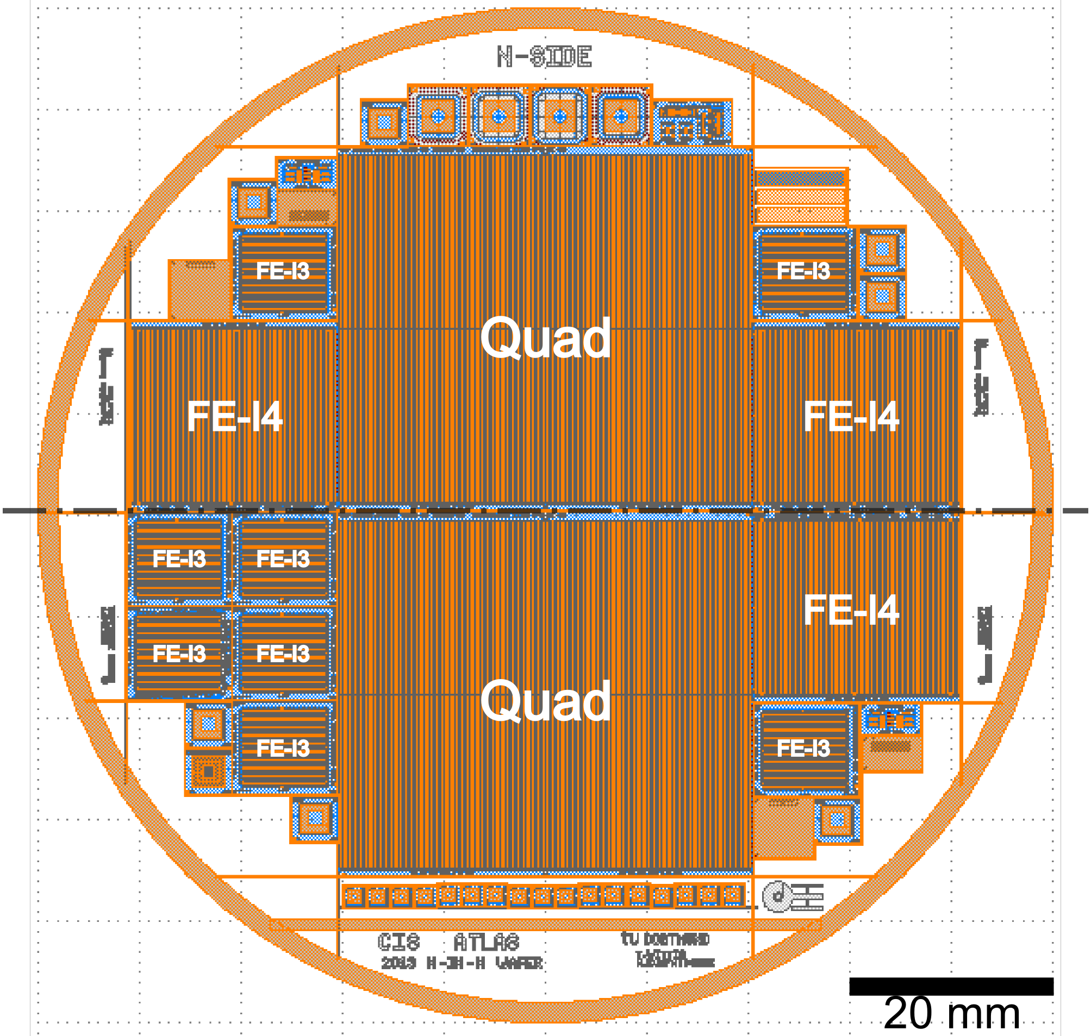
Present Work & Future
4‘‘ Wafer
2 x Quad
3 x FE-I4
  Bias grid variants
  Long pixels (old)
  No long pixels (new)
8 x FE-I3
  Several variants
  Special: w/o bias grid
Test structures
  Diodes
  Temp. resistors
  etc.

Slide 26
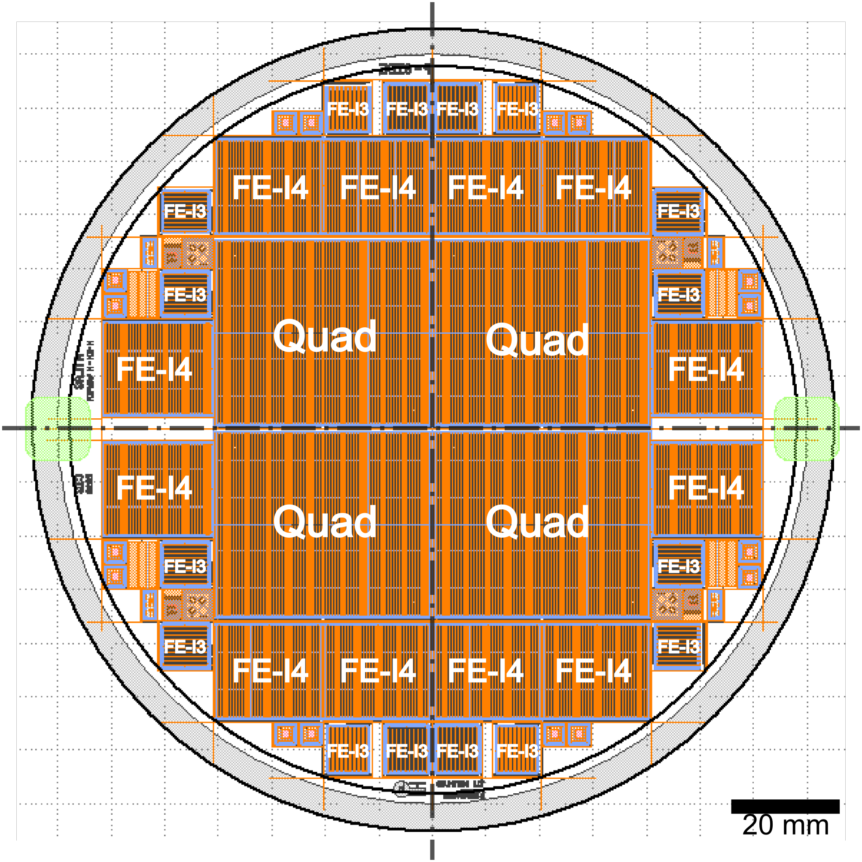
Present Work & Future
6‘‘ Wafer
4 x Quad
12 x FE-I4
  Bias grid variants
  Long pixels (old)
  No long pixels (new)
16 x FE-I3
  Several variants
  Special: w/o bias grid
Test structures
  Diodes
  Temp. resistors
  etc.

Slide 27
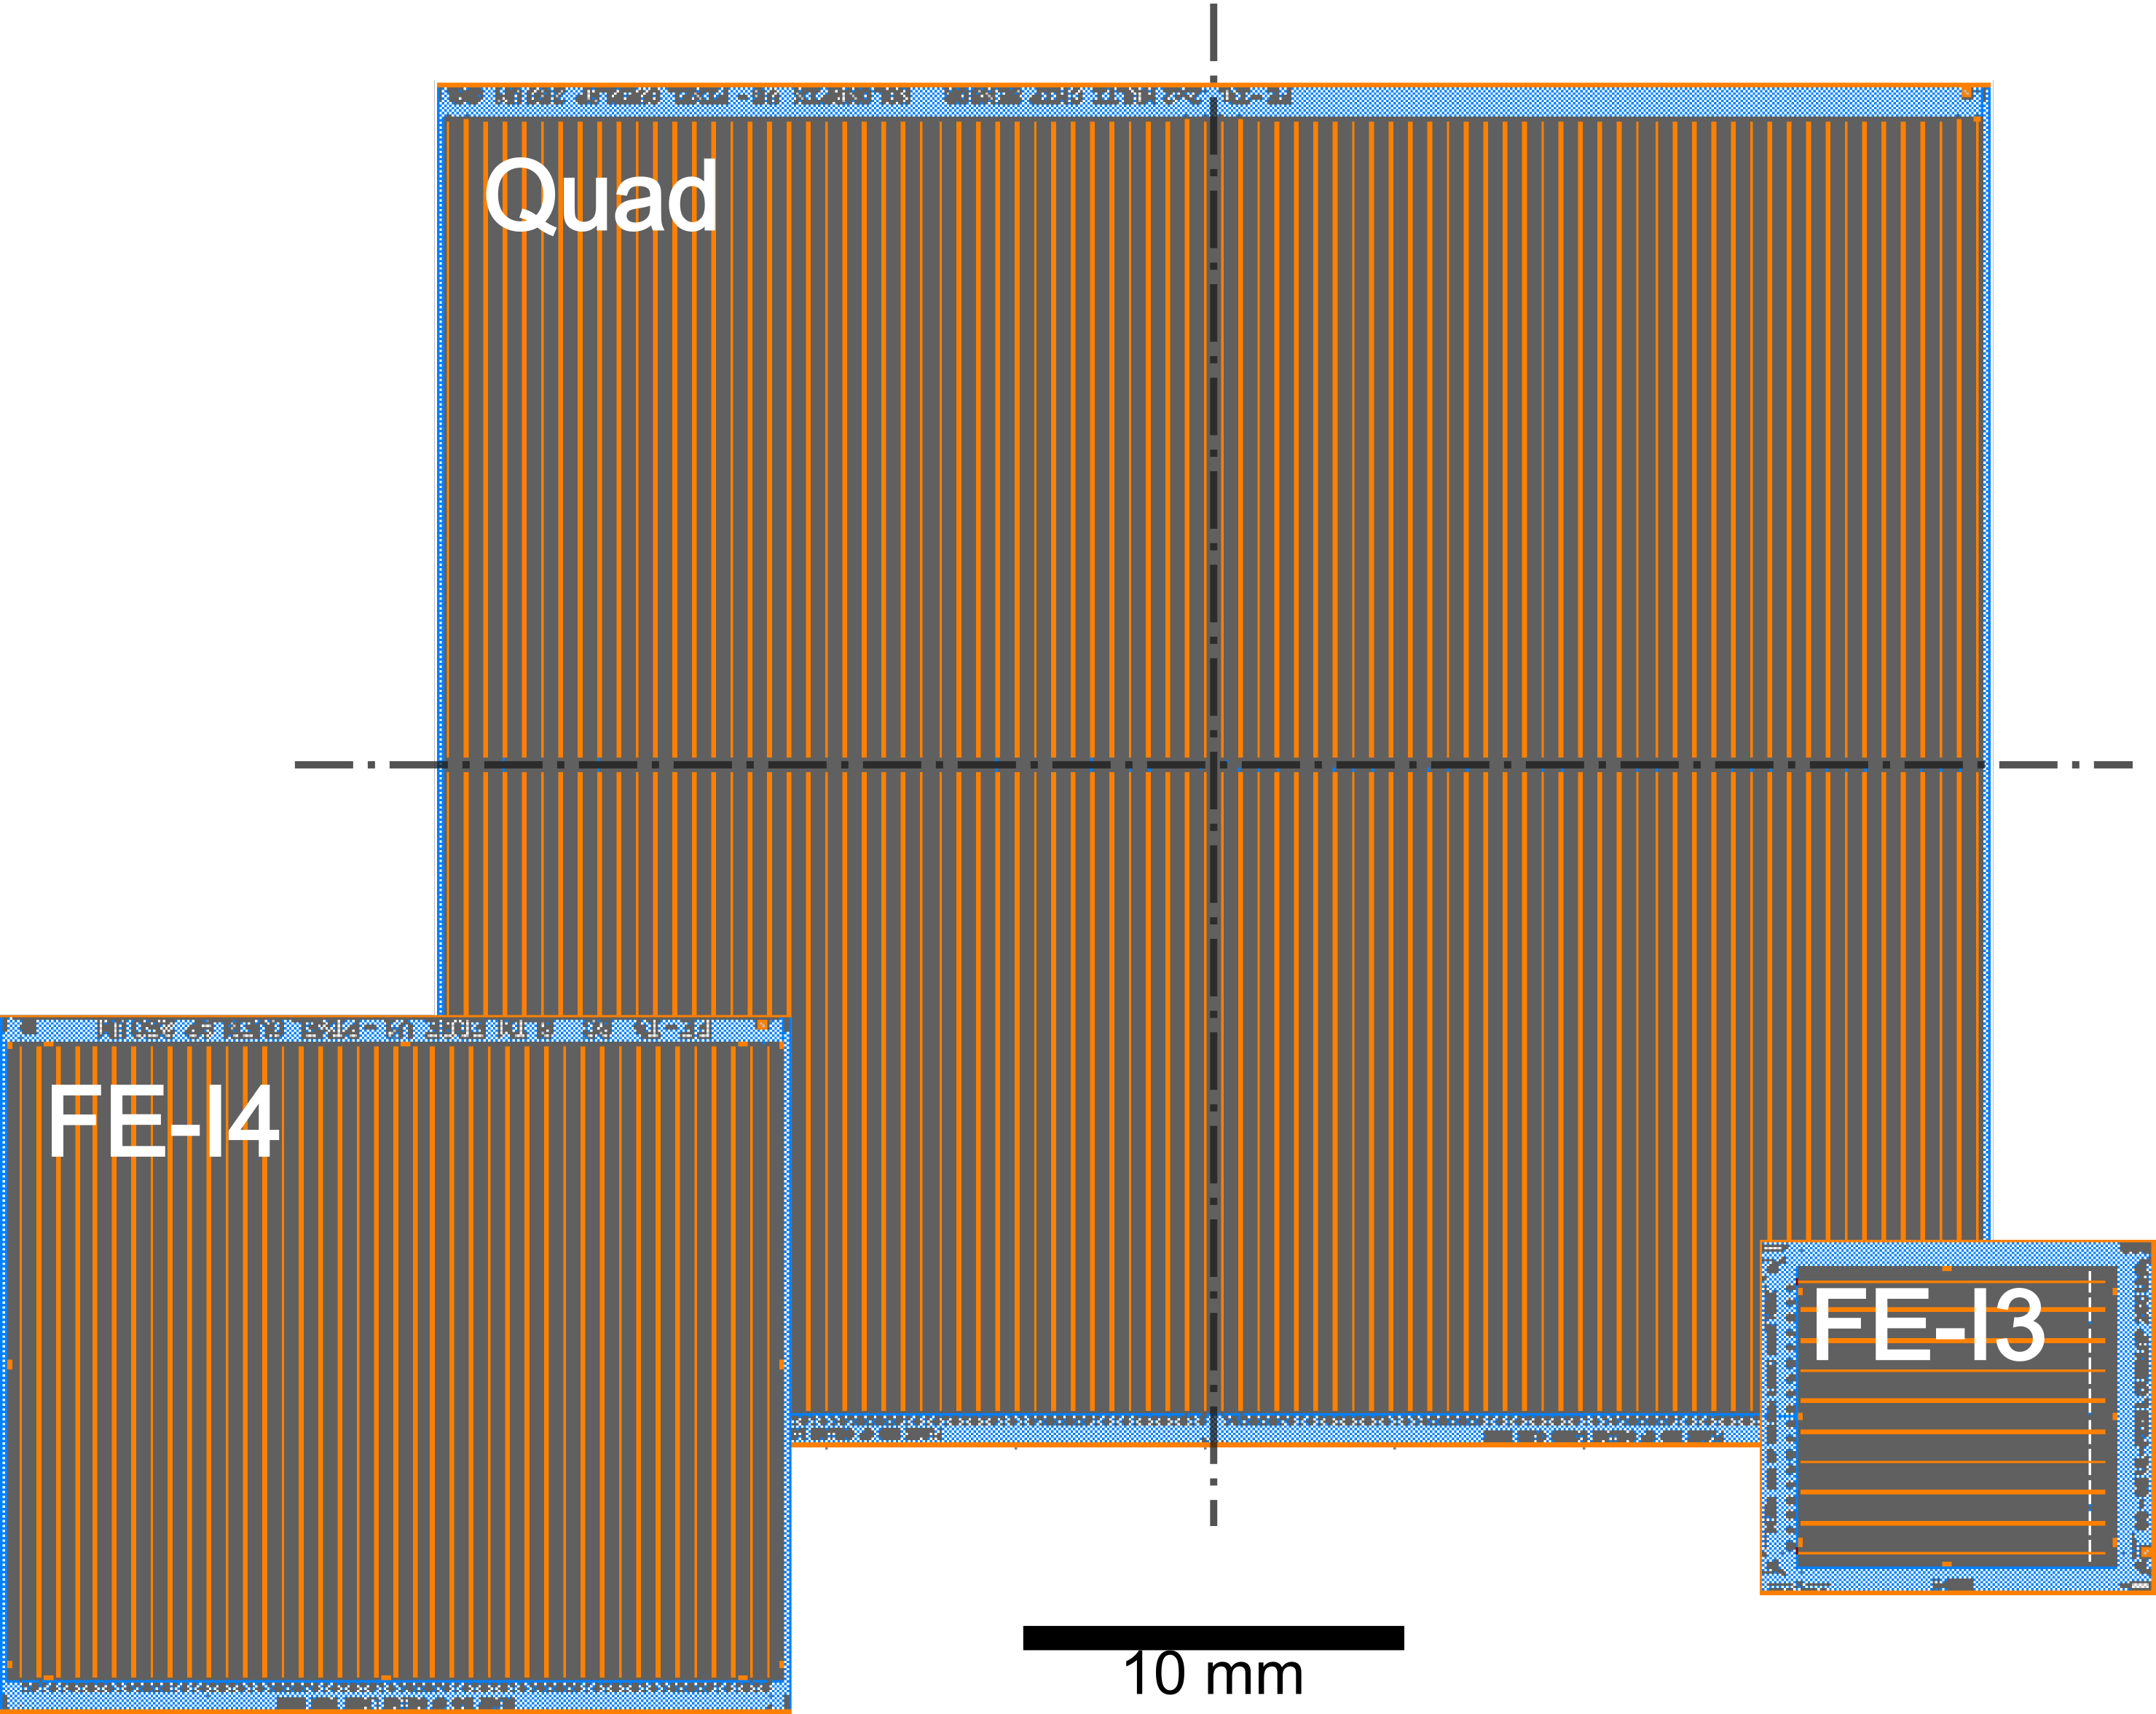
Present Work & Future
Comparison

Slide 28
Present Work & Future
Comparison
 | Columns | Rows | No. of Pixels
Quad | 160 | 680 | 108.800
FE-I4 | 80 | 336 | 26.880
FE-I3 | 18 | 164 | 2.952
+
–
Benefit:
Larger area of active pixels
Problem:
Higher risk of fracture

Slide 29
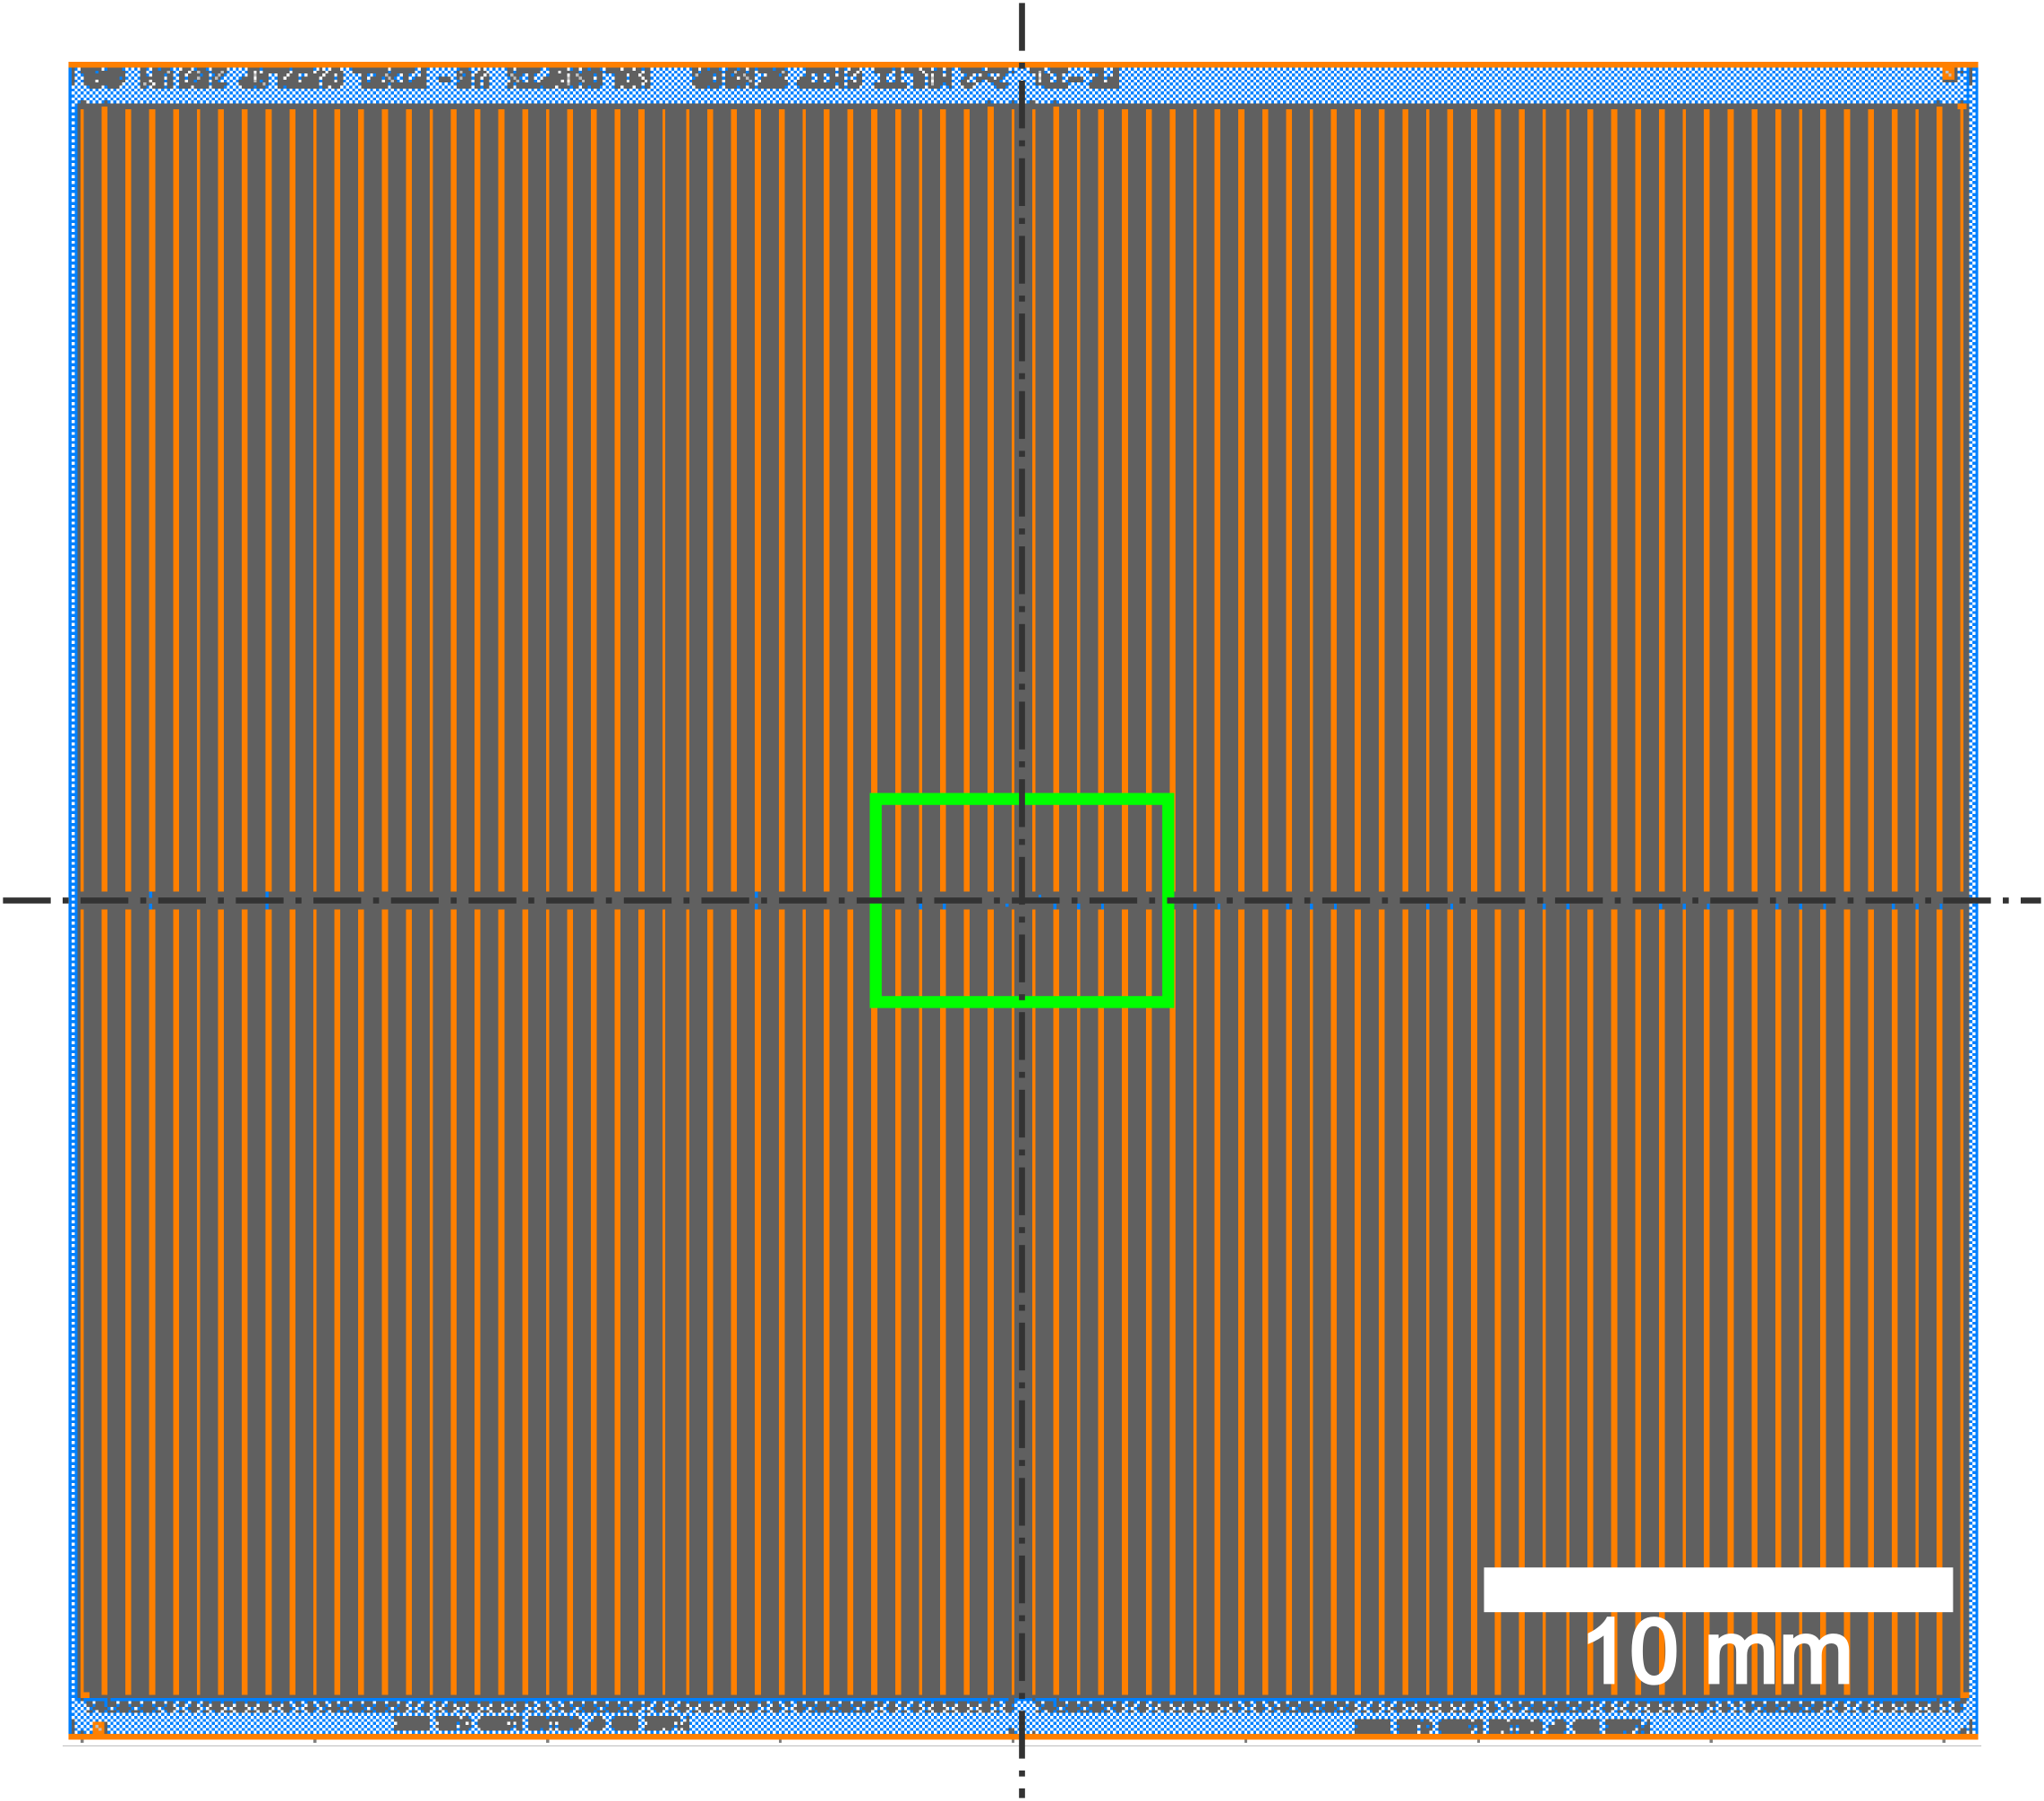
Present Work & Future
Ganged & long pixels

Slide 30
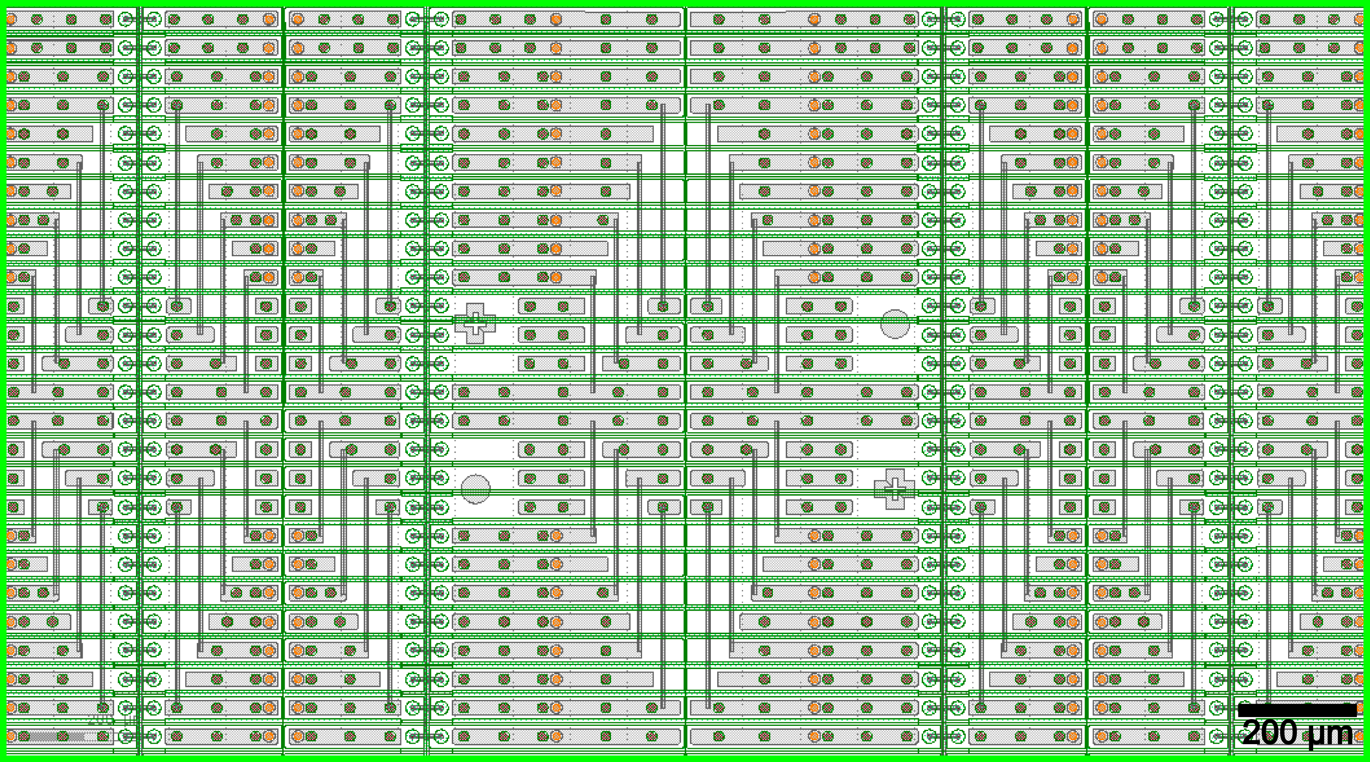
Present Work & Future
Ganged & long pixels

Slide 31
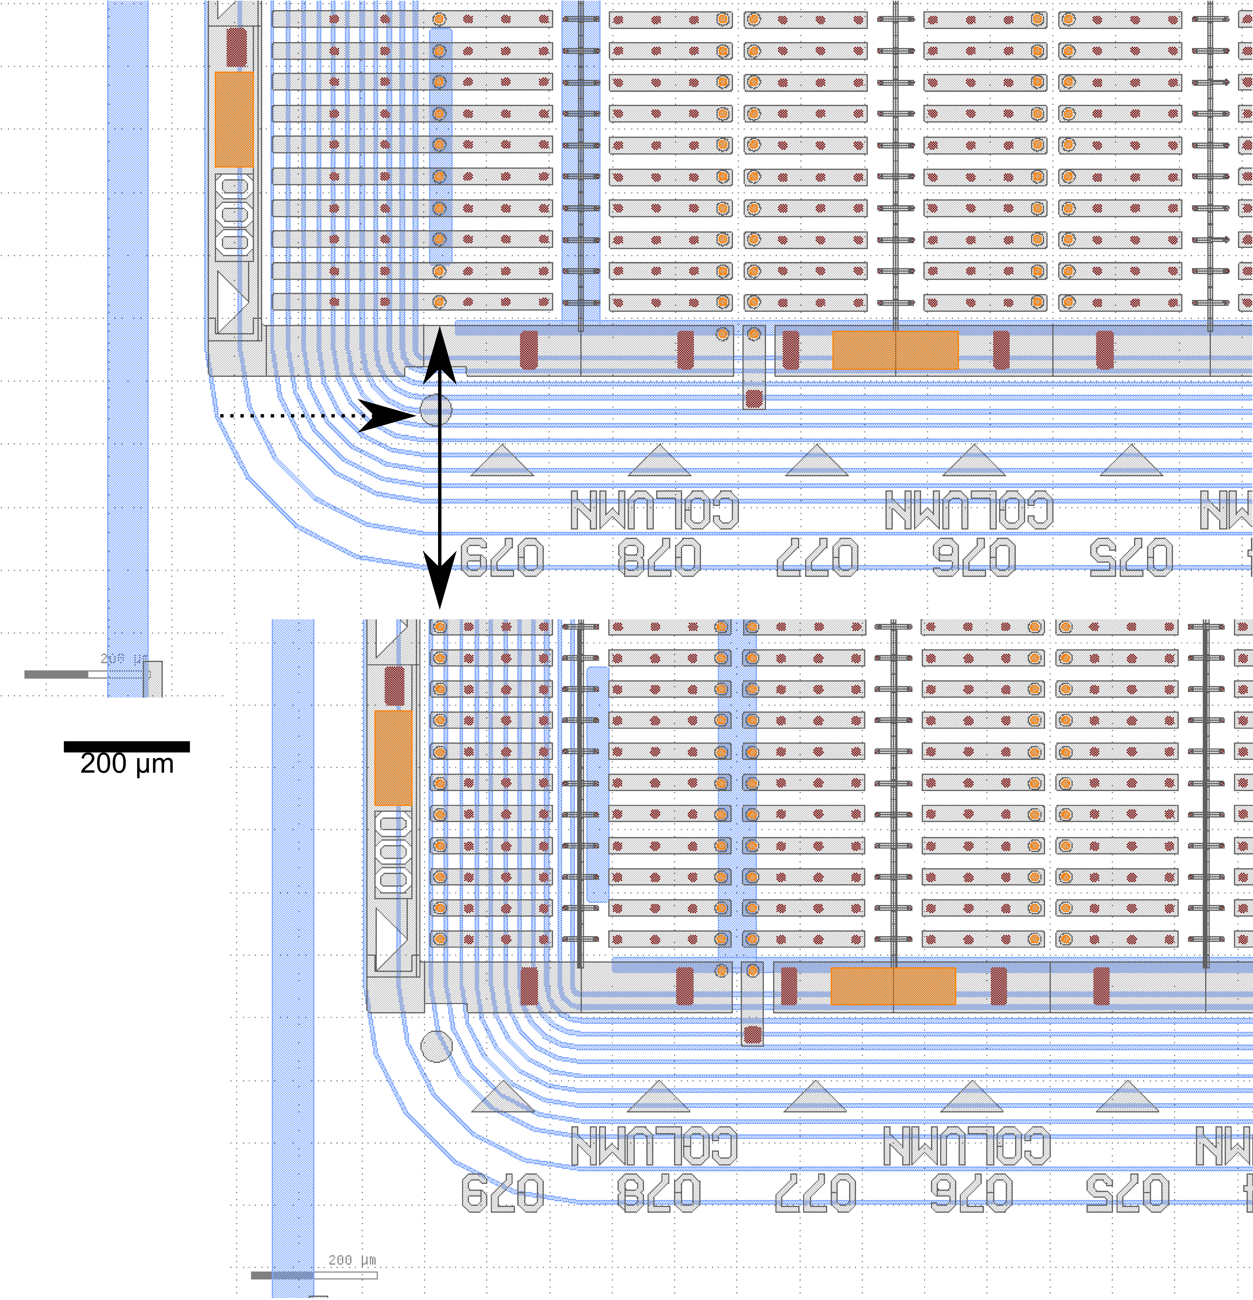
Present Work & Future
Comparison
w/ and w/o long pixels
Long pixels
  Removed
Guard rings
  Readjusted
  Now below standard pixels
Benefits:
  Slimmer design
  Precision to the very edge

Slide 32
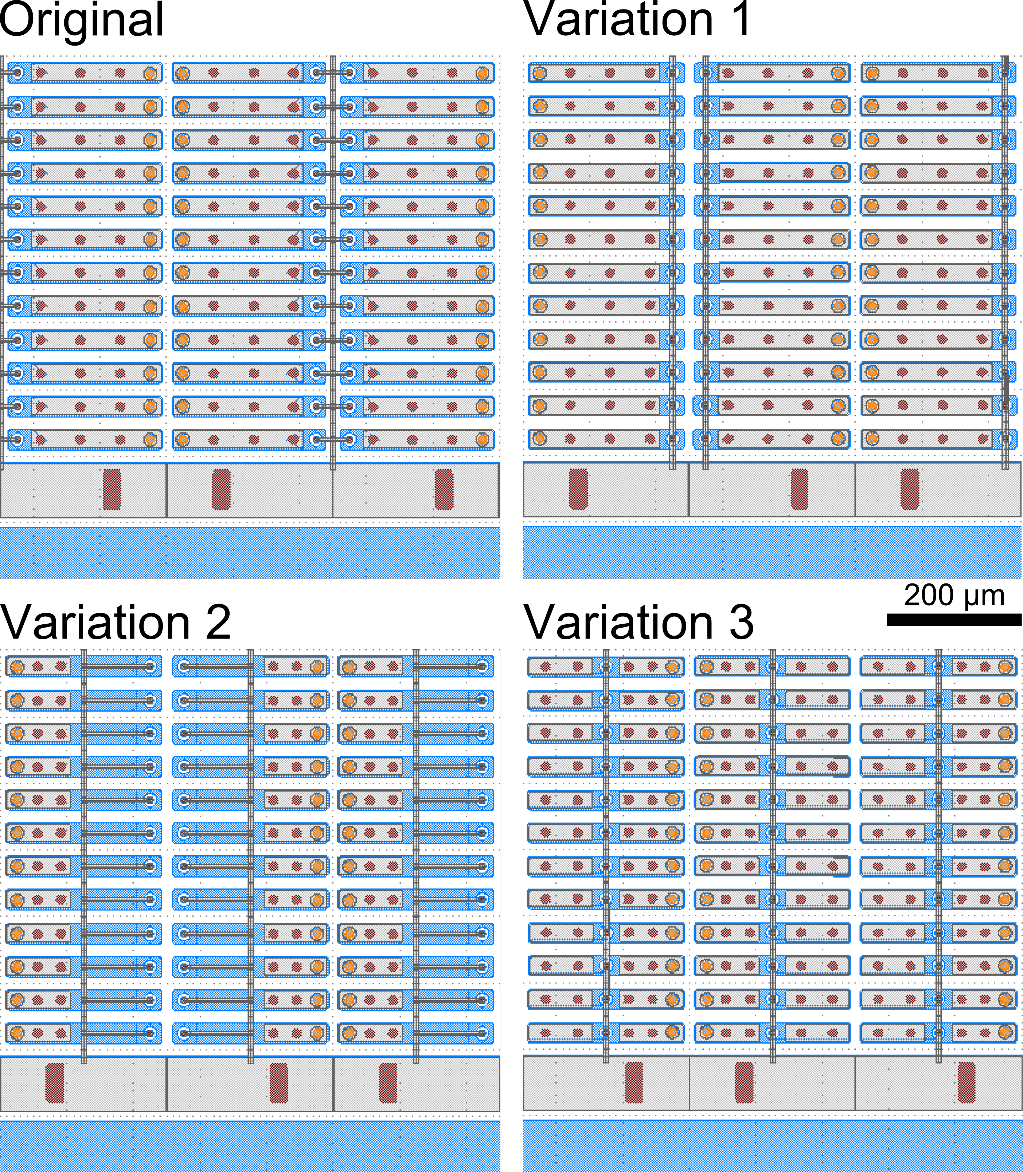
Present Work & Future
Bias grid variations
Problem:
High leakage currents at HV
Possible Source:
Bias grid (dots)
Proposed Solution:
Varying bias grid layout
Var. 1: bias dots unchanged, grid per column
Var. 2: bias dots unchanged, grid at pixel center
Var. 3: bias dots and grid at pixel center
Control: no bias grid

Slide 33
Present Work & Future
Prospects
Processing of 6‘‘ Wafers (CiS)
Characterization and Analysis (TU Dortmund)
Test beam (DESY, Hamburg)
Increasing radiation hardness

Slide 34

Thank You for your attention

