Slide 1
EVM update of LIU-PS (1/2)
# | Work package
LIU-PS01 | Management |  |  | 600 | 
LIU-PS02 | Beam dynamics |  |  | 140
LIU-PS03 | Magnets |  |  | 1000 | 
LIU-PS04.1 | Low-level RF |  |  | 1395
LIU-PS04.2 | High-power RF |  |  | 5200
LIU-PS04.3 | Transverse damper |  |  | 395
LIU-PS04.4 | RF controls | No WP
LIU-PS05 | Power converters |  |  | 2640
LIU-PS06 | Beam instrumentation |  |  | 1012
LIU-PS07 | Beam intercepting devices |  |  | 600
LIU-PS08 | Vacuum system |  |  | 682 | 
LIU-PS09 | Injection |  |  | 2765
LIU-PS10 | Extraction and transfer | No WP
Budget [kCHF]
Unchgd.
Updated
Confirm.

Slide 2
EVM update of LIU-PS (2/2)
# | Work package
LIU-PS11 | Controls |  |  | 121 | 
LIU-PS12 | Electrical systems |  |  | 75
LIU-PS13 | Cooling and ventilation | No WU
LIU-PS14 | Installation, transport, etc. |  |  | 1470
LIU-PS15 | Civil engineering |  |  | 3100
LIU-PS16 | Radiation protection |  |  | 560
LIU-PS17 | Interlock systems | No WU
LIU-PS18 | Alarms | No WU
LIU-PS19 | Access system doors | No WU
LIU-PS20 | Survey |  |  | 50
LIU-PS21 | Commissioning, operation |  |  | 230
LIU-PS22 | Dismantling | No WU
Budget [kCHF]
Unchgd.
Updated
Confirm.
Next step: Move from ‘draft4’ status to baseline in EVM (end of Jan.)

Slide 3
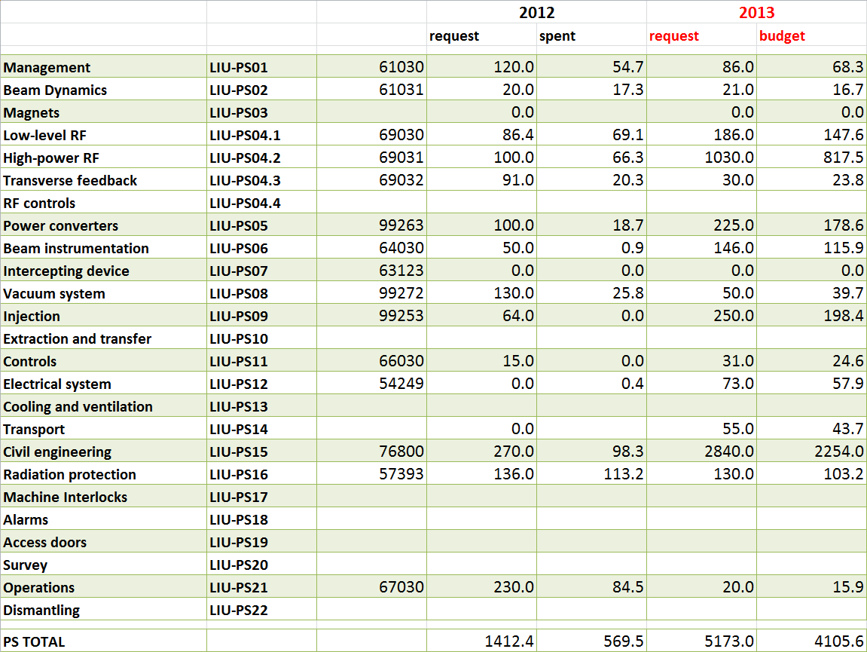
LIU-PS budget 2013
Global cut by 26 % (all machines) → Adjustments according to needs during year

