Slide 1
RE+4 gas tubes routing
Proposal 01
3 December 2012
Wojciech Szczęsny

Slide 2
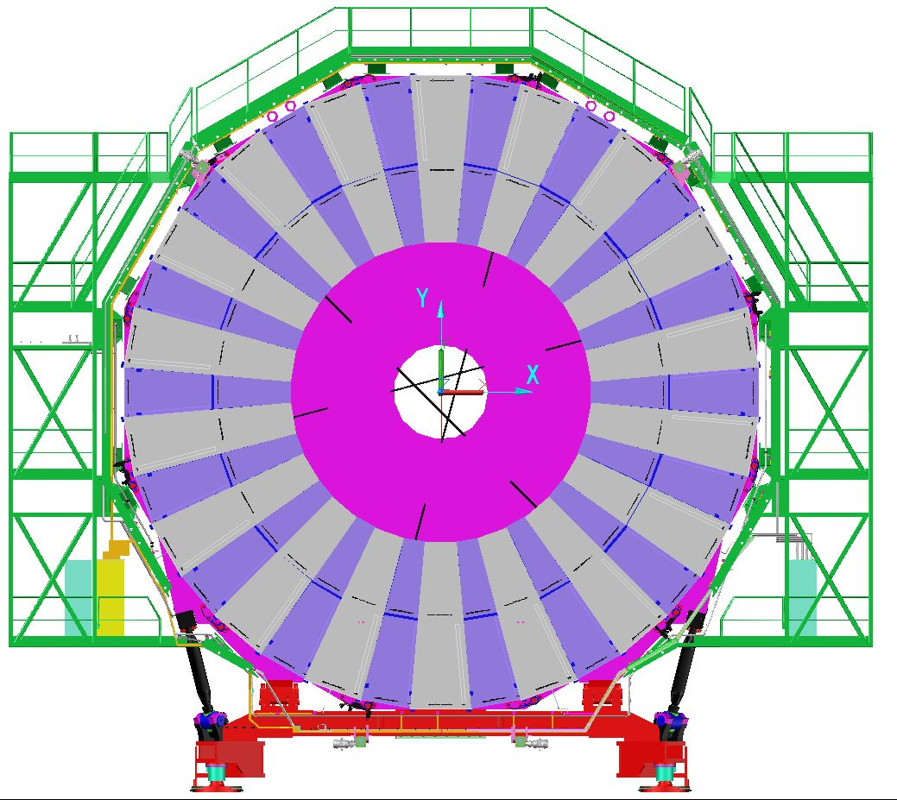
YE+3. View toward IP.
RE+3 gas rack
ME+4 gas rack
New, RE+4 gas rack

Slide 3
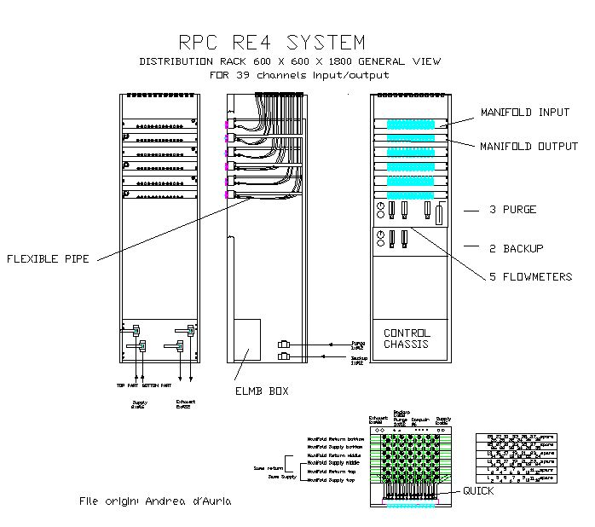
RE+4 gas rack

Slide 4
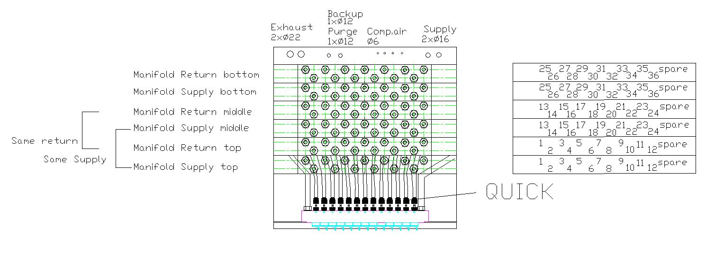
RE+4 gas rack
39 channels on the gas rack (supply and return)
We use 36 channels 72 x 8mm OD copper tubes

Slide 5
YE+3. View toward IP.
RE+3 gas rack
ME+4 gas rack
New, RE+4 gas rack

Slide 6
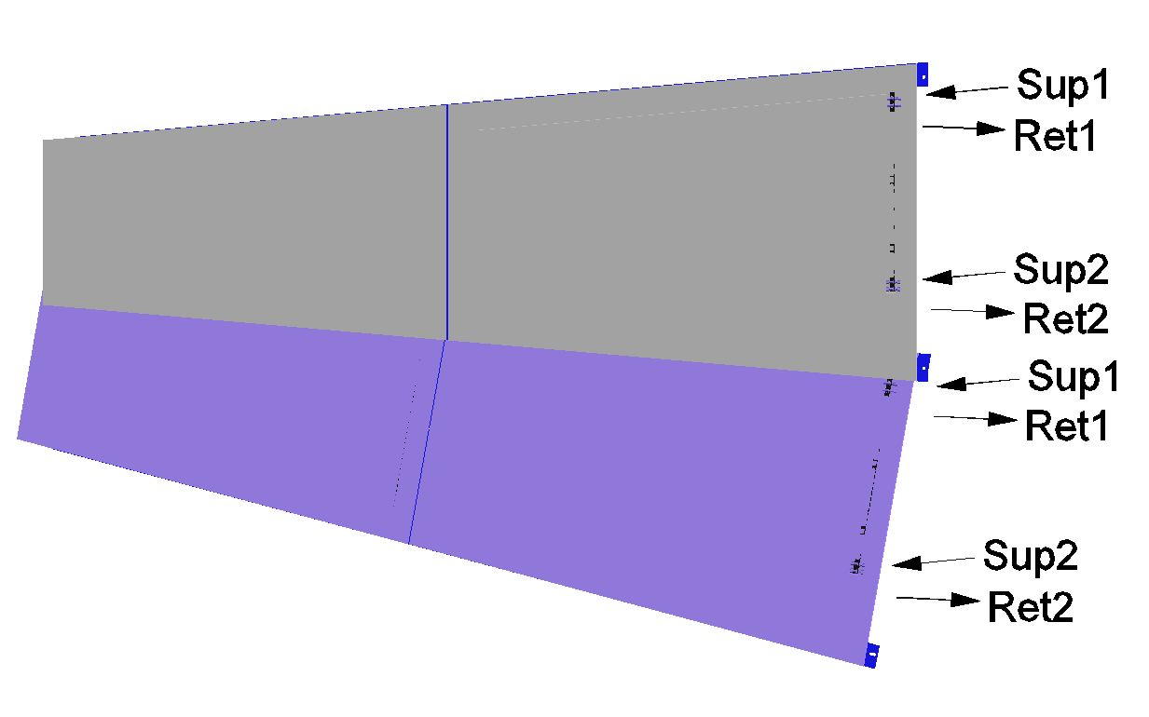
RE+4 super-modules
Each channel supplies 2 gas gaps in 2 different super-modules

Slide 7
YE+3. View toward IP.
RE+3 gas rack
ME+4 gas rack
New, RE+4 gas rack

Slide 8
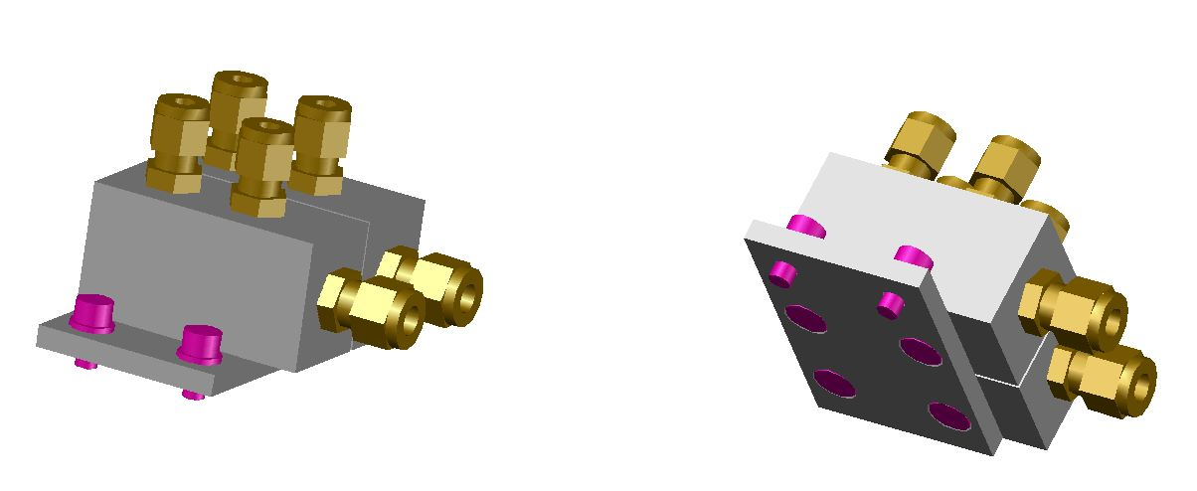
RE+4 gas patch panel
36 patch panels around the green structure
Sup1 (To a super-module)
Ret1 (From a super-module)
Ret1 (From a super-module)
Sup1 (To a super-module)
Sup1 (From the rack)
Ret1 (To the rack)

Slide 9
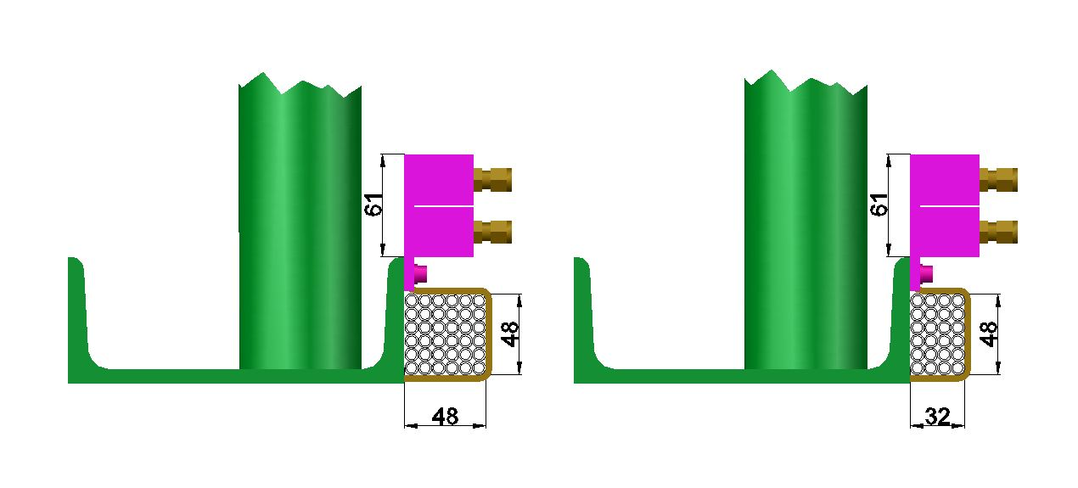
RE+4 gas tubes routing

Slide 10
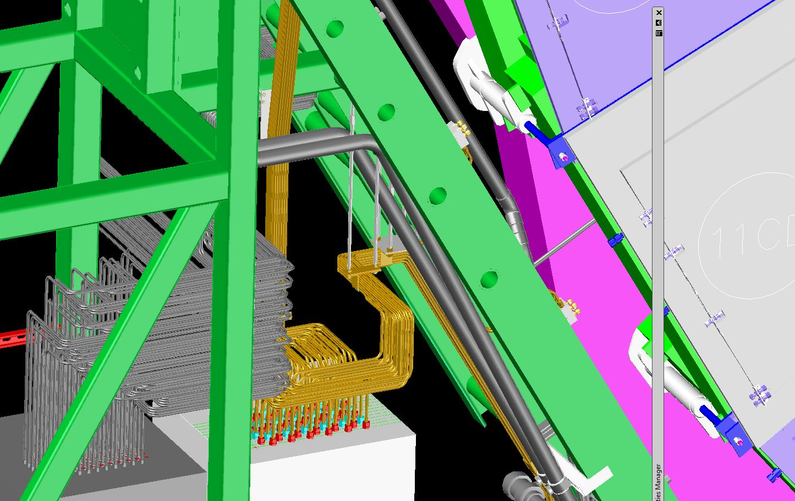
RE+4 gas tubes routing

Slide 11
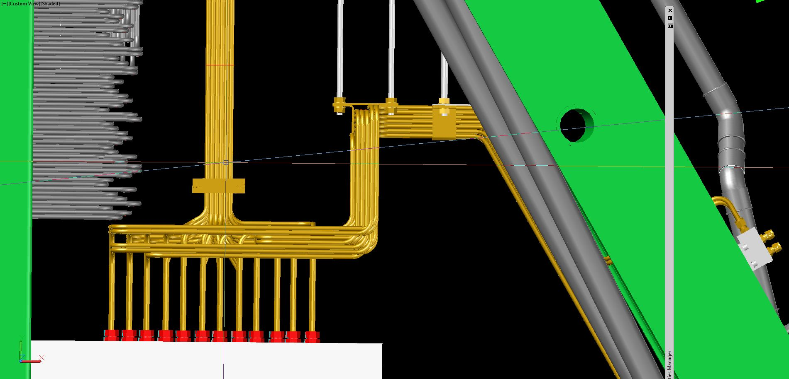
RE+4 gas tubes routing

Slide 12
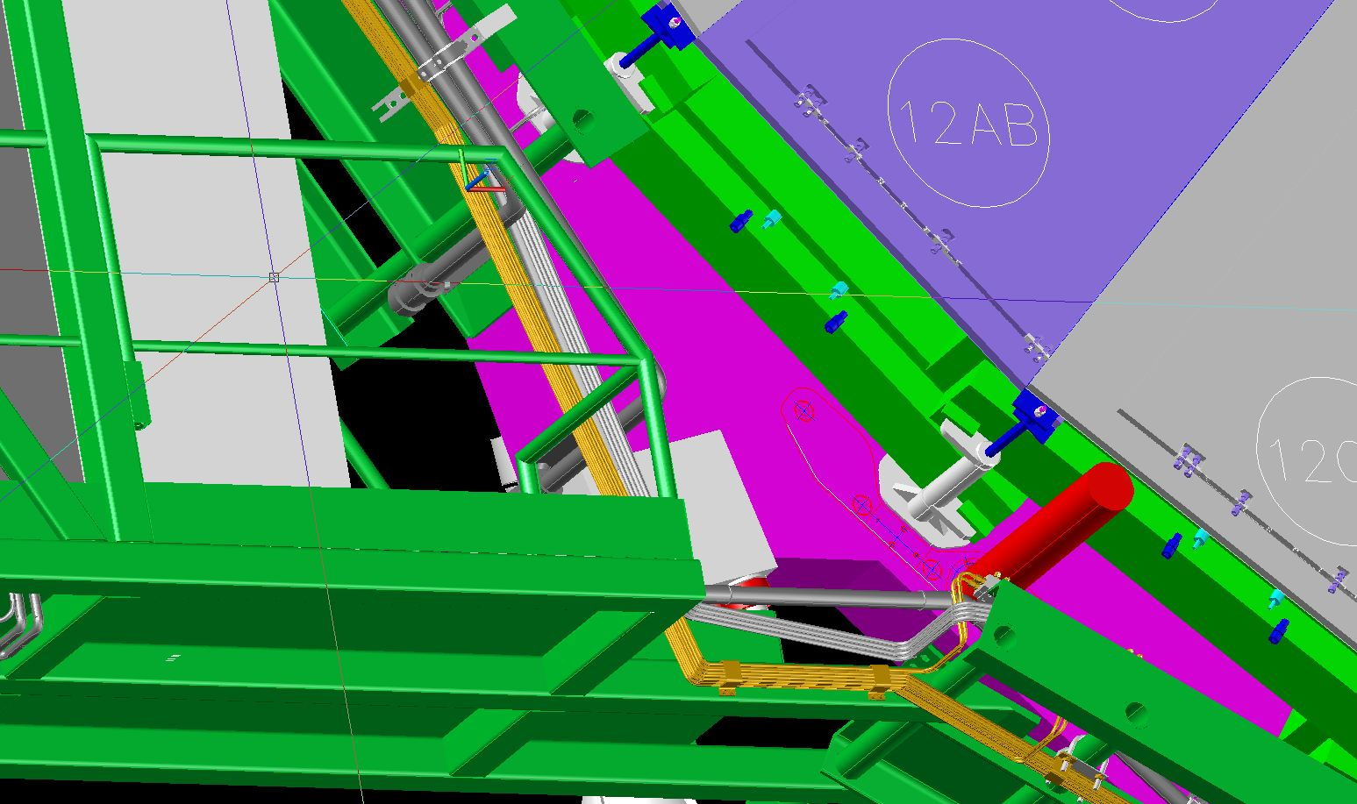
RE+4 gas tubes routing

Slide 13
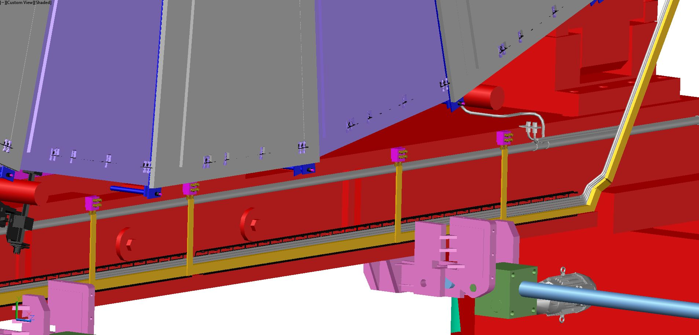
RE+4 gas tubes routing (previous proposal)

Slide 14
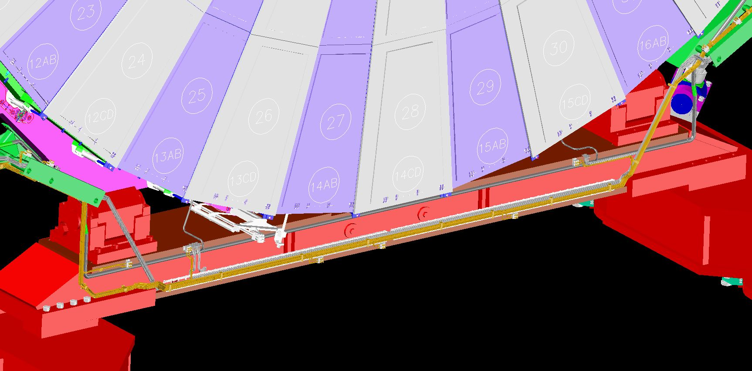
RE+4 gas tubes routing

Slide 15
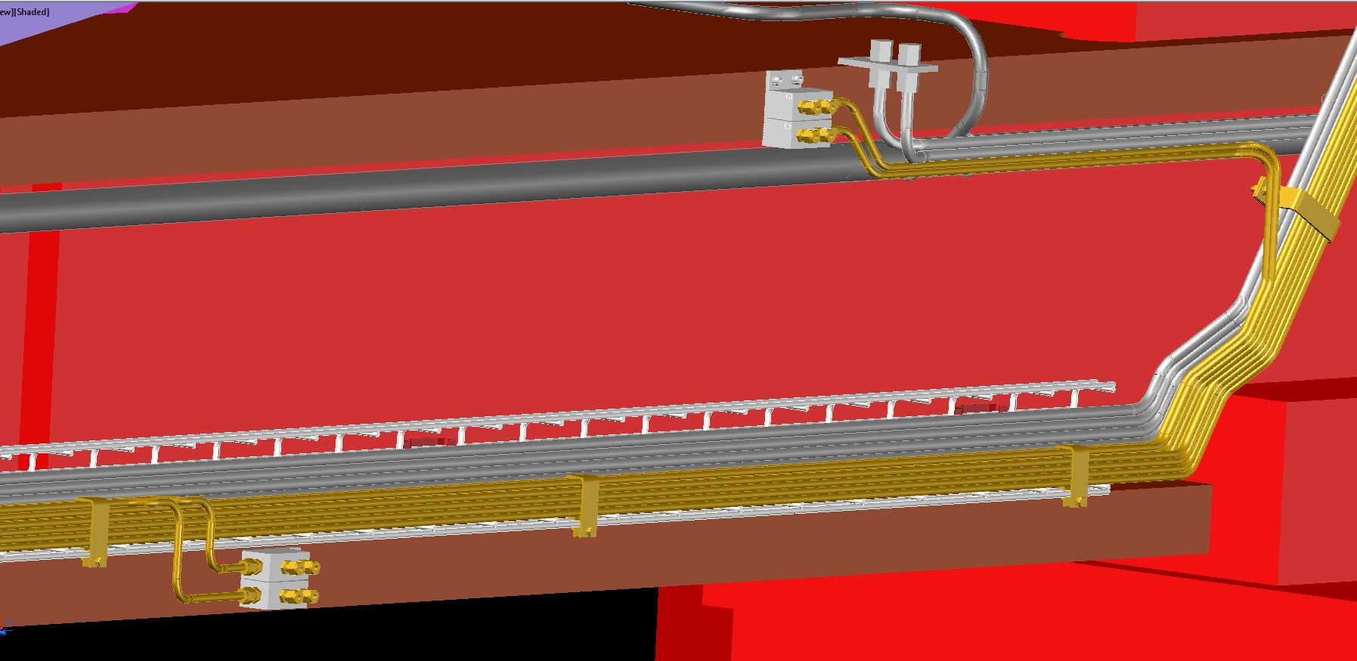
RE+4 gas tubes routing

Slide 16
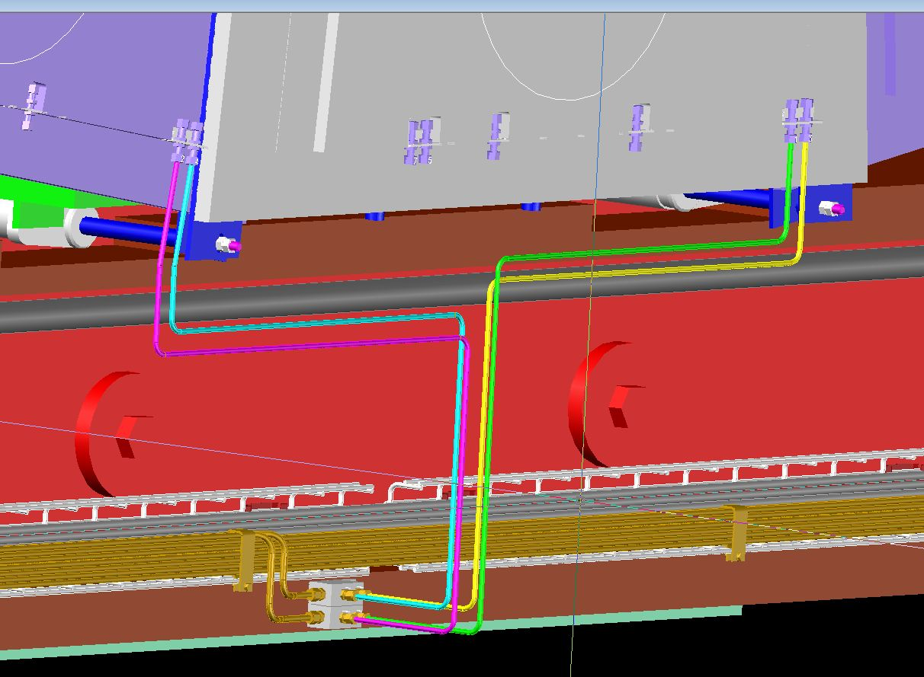
RE+4 gas tubes routing

Slide 17
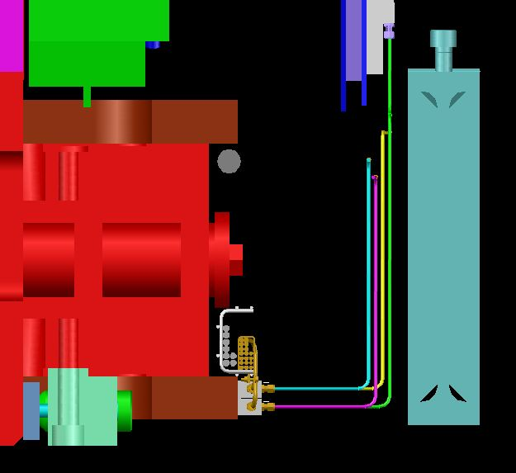
RE+4 gas tubes routing
YE+4
ME+4
tubes
YE+3 cart
RE+4
tubes
Y
Z

Slide 18
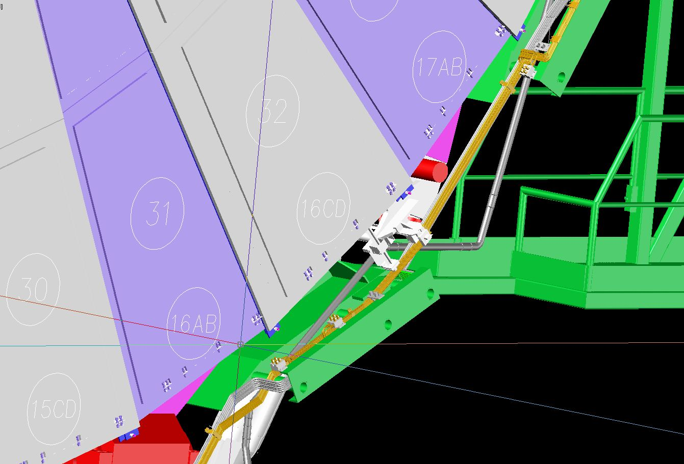
RE+4 gas tubes routing

Slide 19
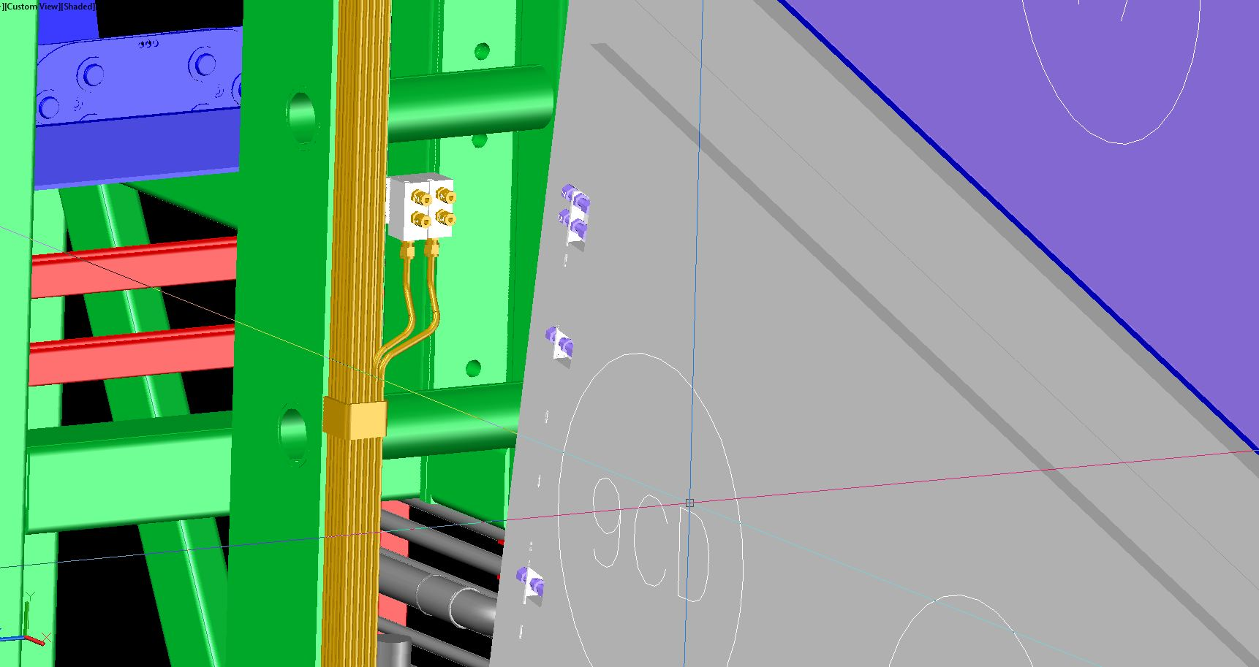
RE+4 gas tubes routing

Slide 20
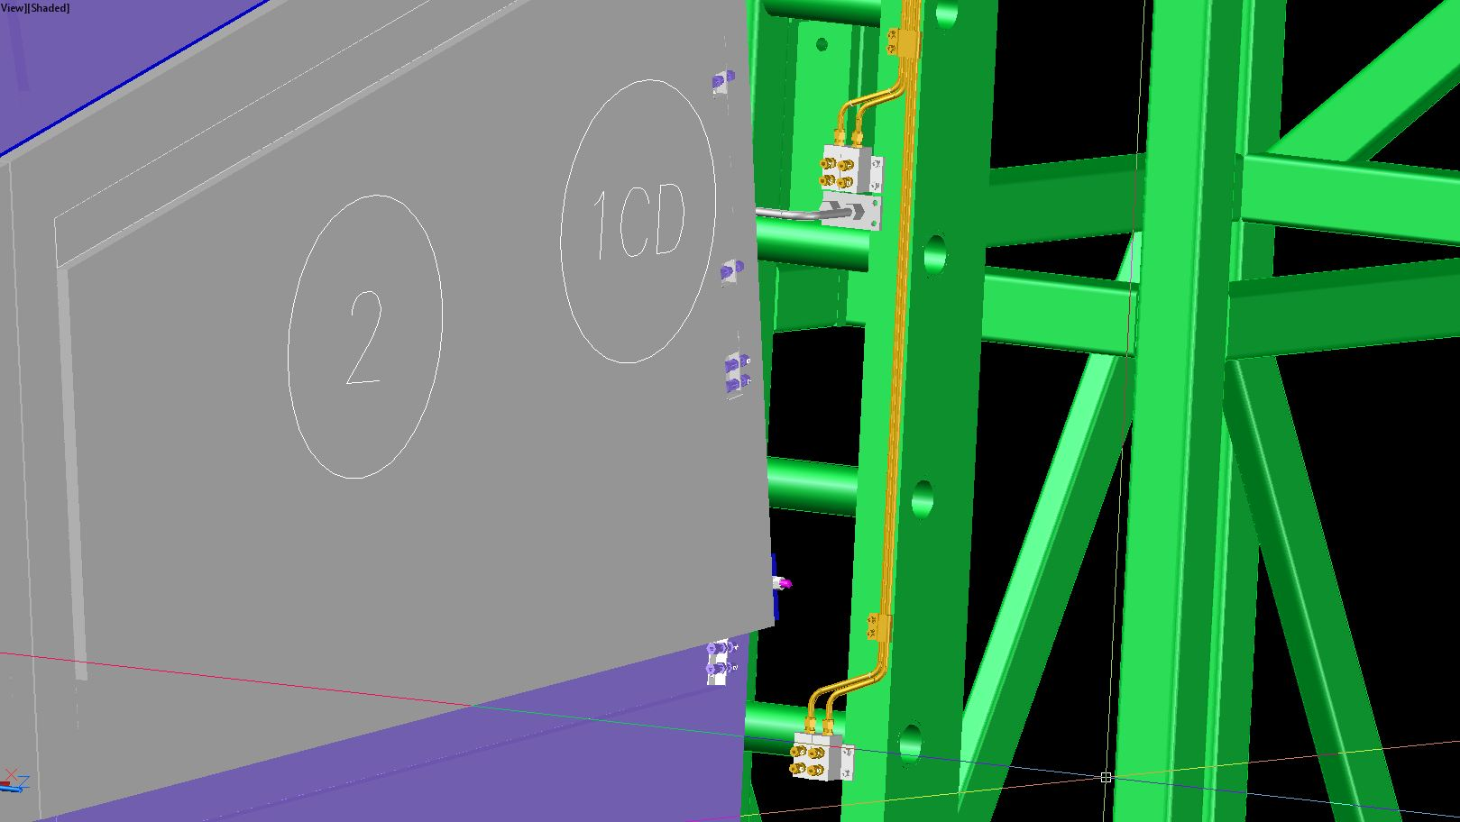
RE+4 gas tubes routing

Slide 21
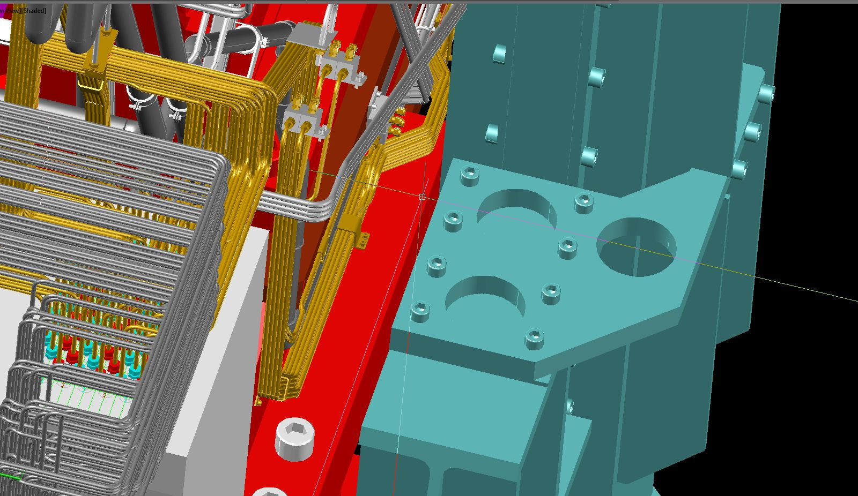
RE+4 gas tubes routing
Alignment system
RE+4 tubes
Y
X

