Slide 1

New Experimental
Higgs Results
Tim Adye
Rutherford Appleton Laboratory
NExT Meeting
Rutherford Appleton Laboratory
20th March 2013

Slide 2
New Higgs Results
Higgs results from the Tevatron
LHC Higgs measurements
  H → γγ
  H → ZZ^{(*)} → 4l
  H → WW^{(*)} → lνlν
Low mass Higgs searches
  H → Zγ
  WH → WWW^{(*)} → lνlνlν (CMS)
  H → μ⁺μ⁻ (ATLAS)
  H → τ⁺τ⁻ (CMS update)
  (VH → bb not updated)
  (ttH → bb not updated)
Higgs mass
Combined cross-section, production, and decay
Higgs couplings
Higgs spin and parity

Slide 3


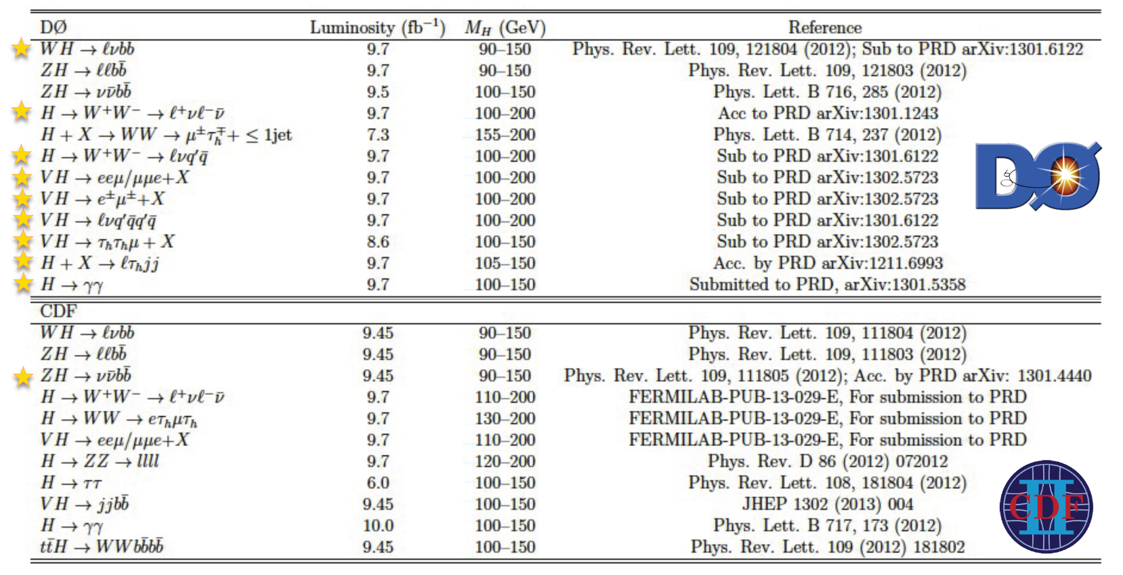

Tevatron Higgs measurements
Updated since June 2012

Slide 4
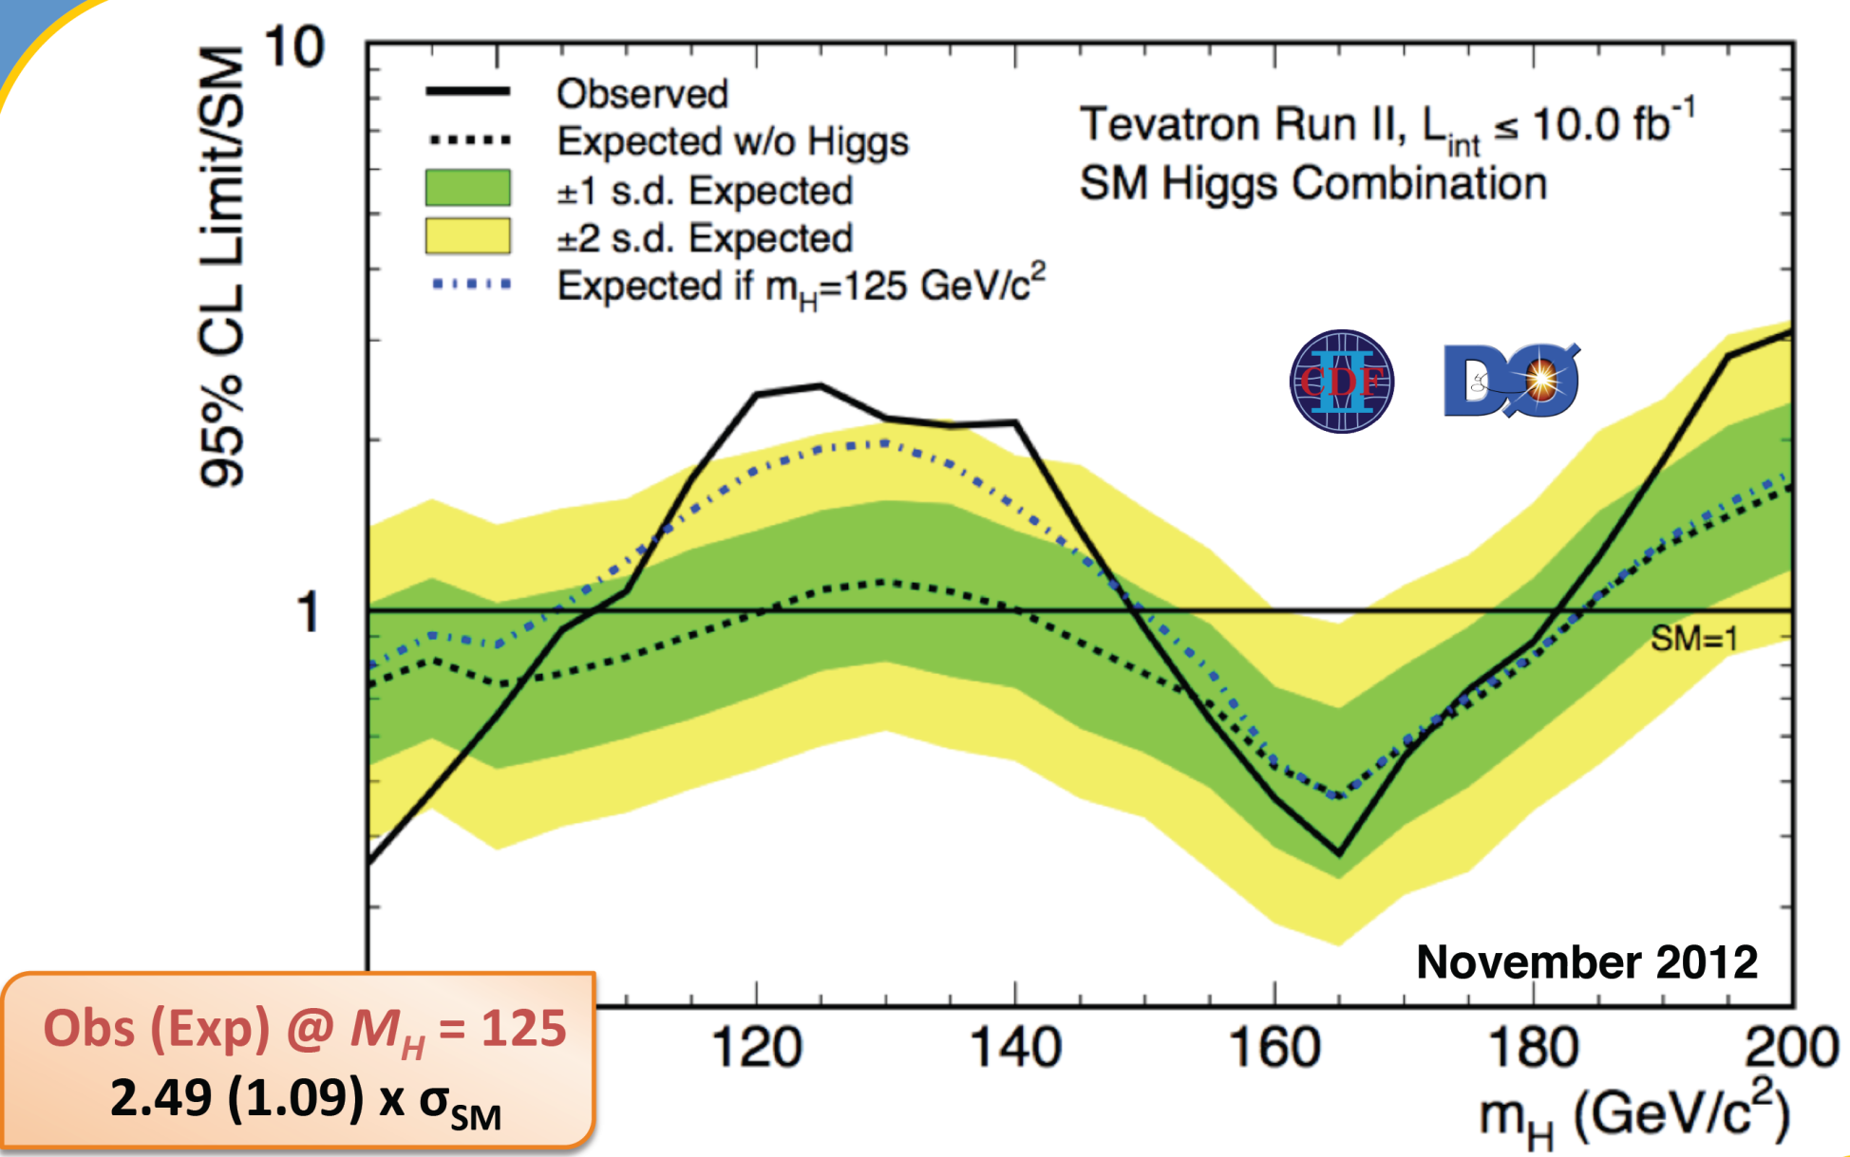
Combined Tevatron limits

Slide 5
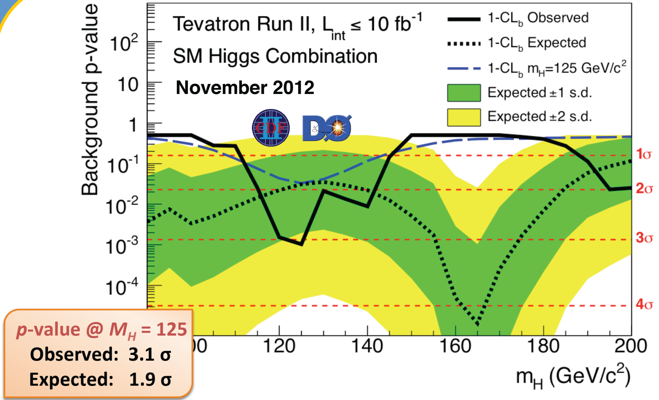
Combined Tevatron significance

Slide 6


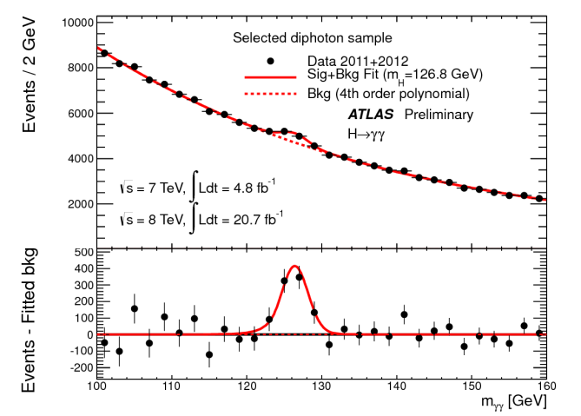
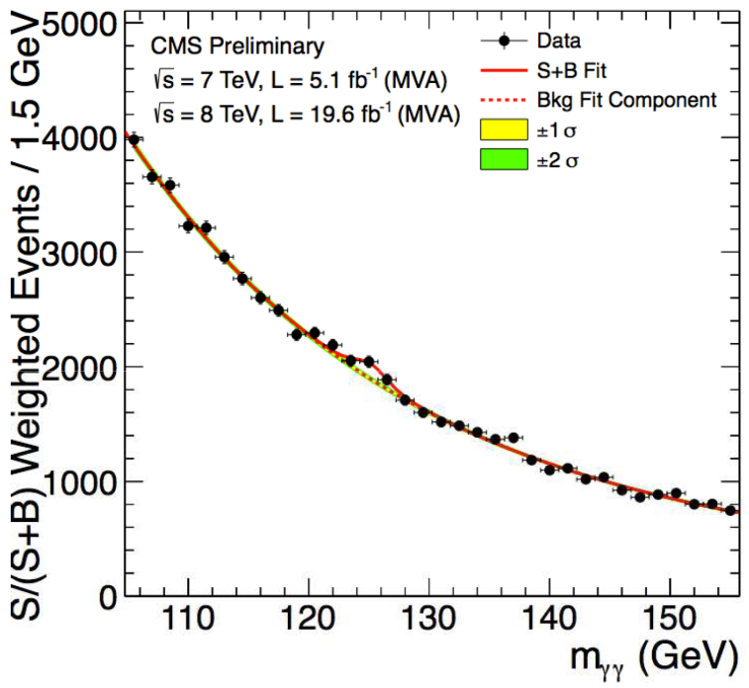
  H → γγ
Search for a narrow mass peak from two high-E_{T} isolated photons
Events separated into categories according to S/B, resolution, and production mode tags
  increase sensitivity and measure ggF, VBF, and VH contributions
ATLAS (unweighted)
CMS (weighted)

Slide 7
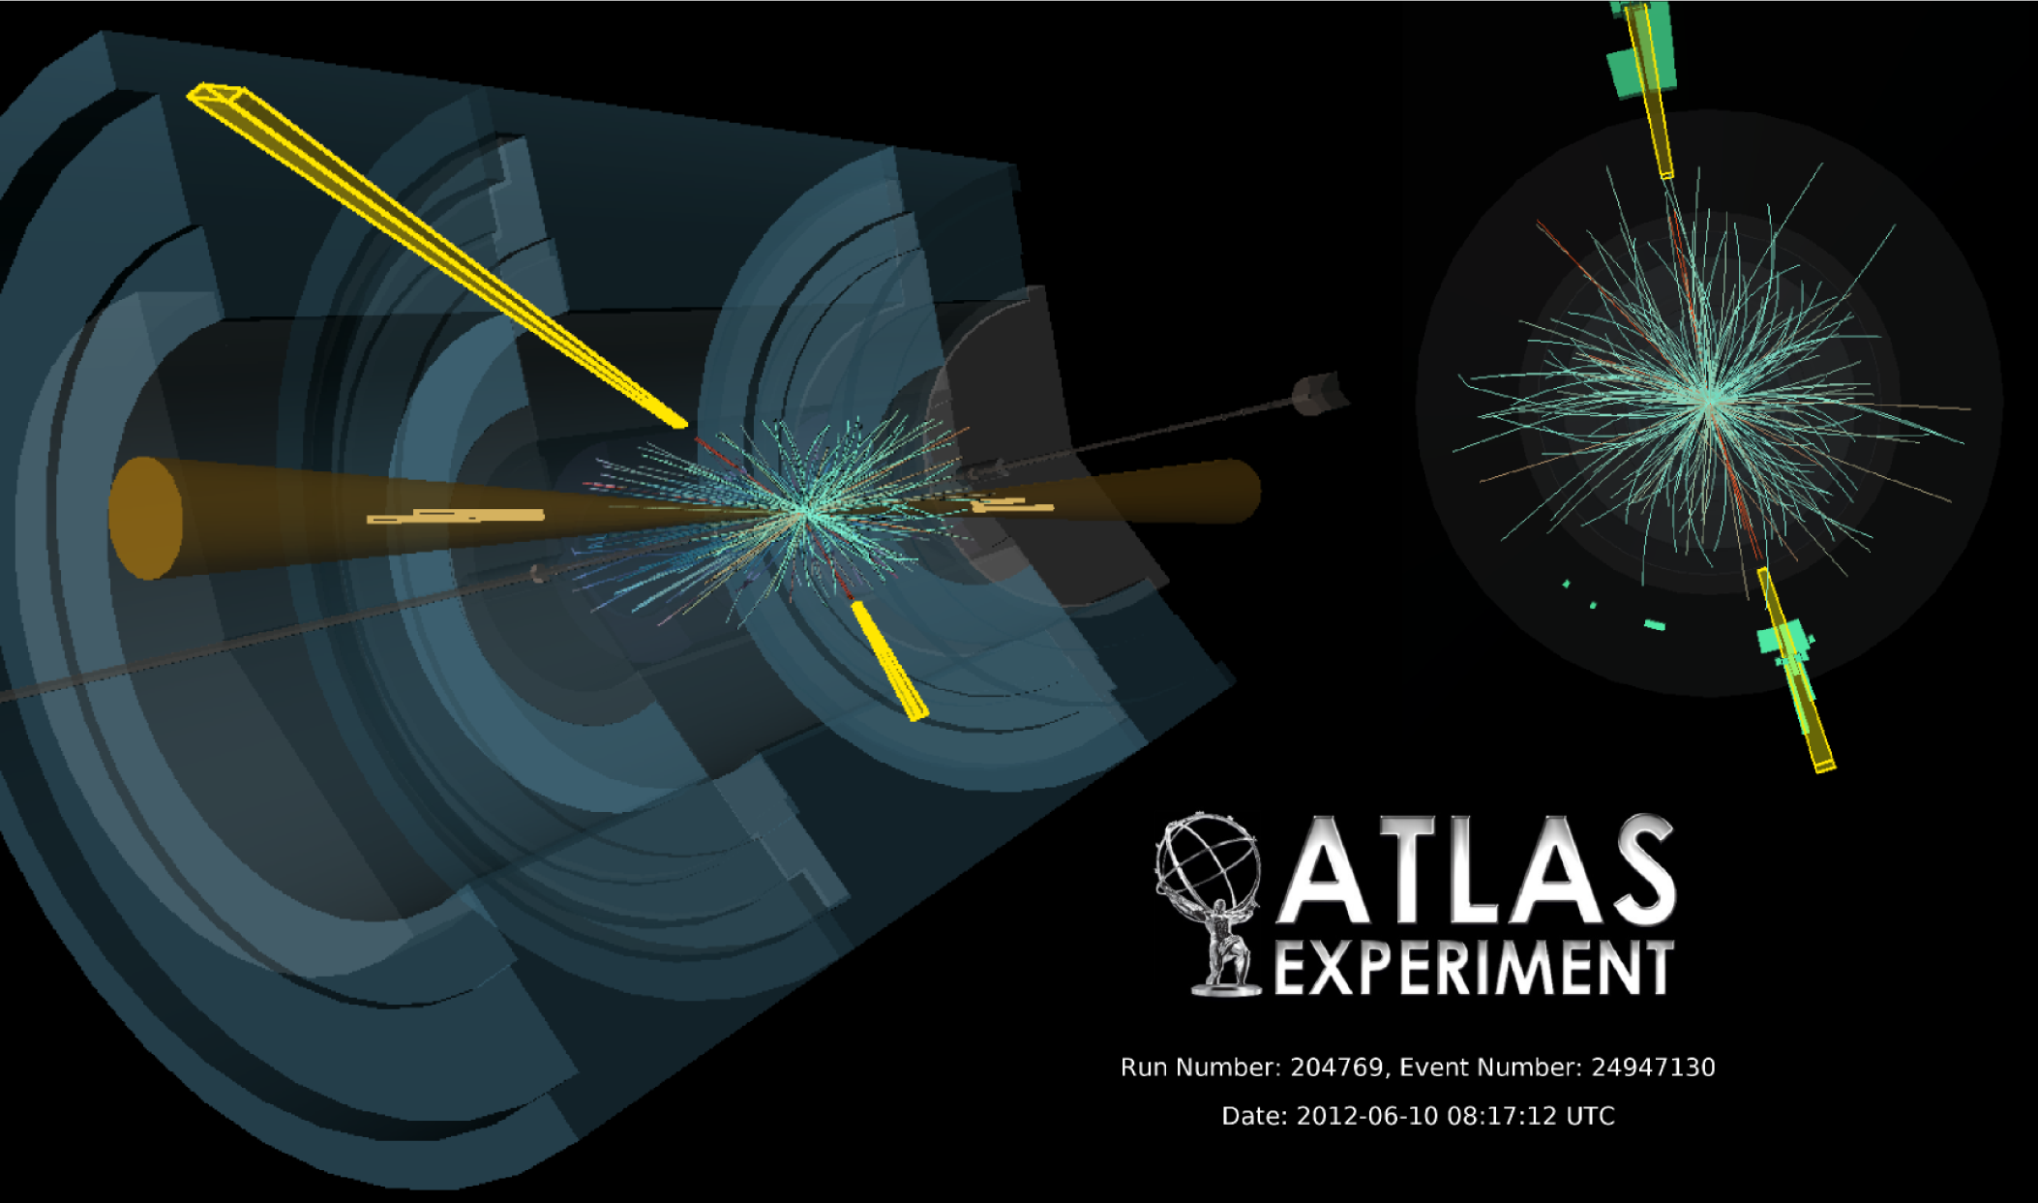
qqH → γγ + 2jets candidate (VBF)
  m_{γγ} = 126.9 GeV E_{T}(γγ) = 80.1, 36.2 GeV
  m_{jj} = 1.67 TeV E_{T}(jets) = 121.6, 82.8 GeV

Slide 8
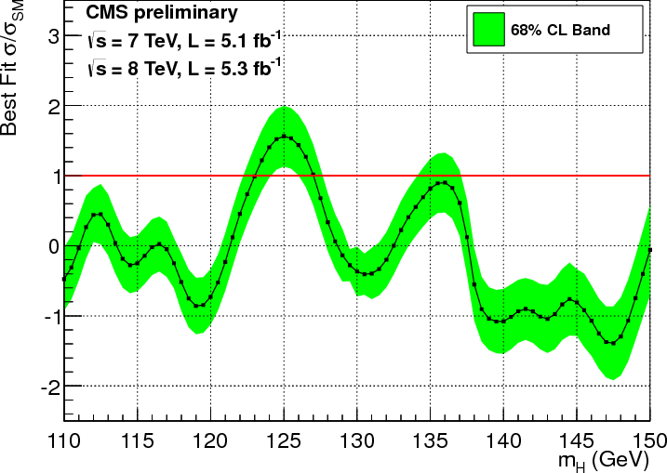
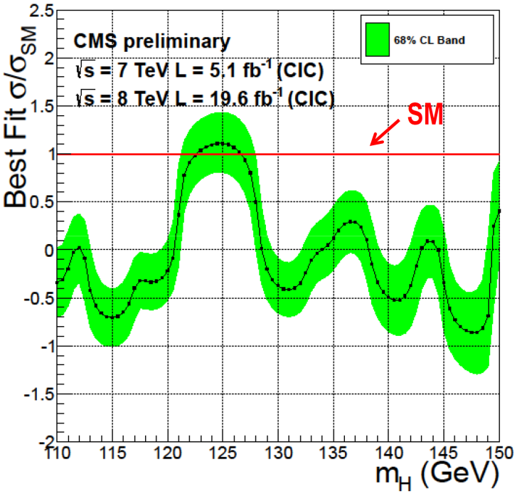
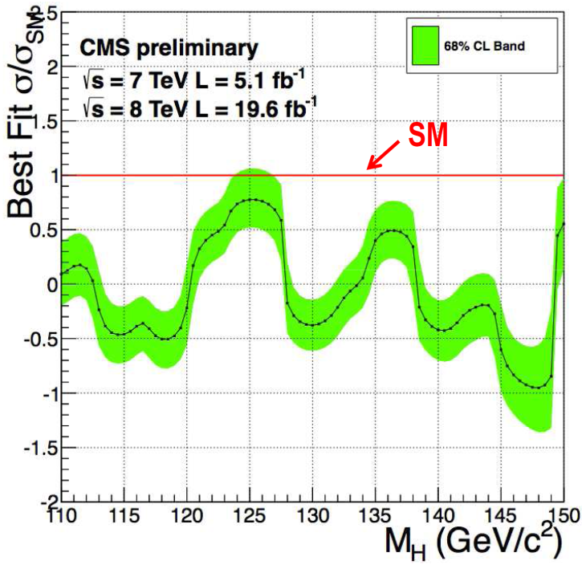
CMS H → γγ updates
CMS use two different event selection and categorisation techniques
  Cut-based – similar to old ICHEP method (and ATLAS untagged categories)
  Multivariate – select and categorize events using a BDT
CMS baseline result
Old ICHEP result
σ/σ_{SM} = 1.56 ± 0.43
New cut-based result
σ/σ_{SM} = 1.11 ± 0.31
New multivariate result
σ/σ_{SM} = 0.78 ± 0.27
Compatibility = 0.5σ
(for common data)
Compatibility = 1.5σ
(including correlation from common events)

Slide 9
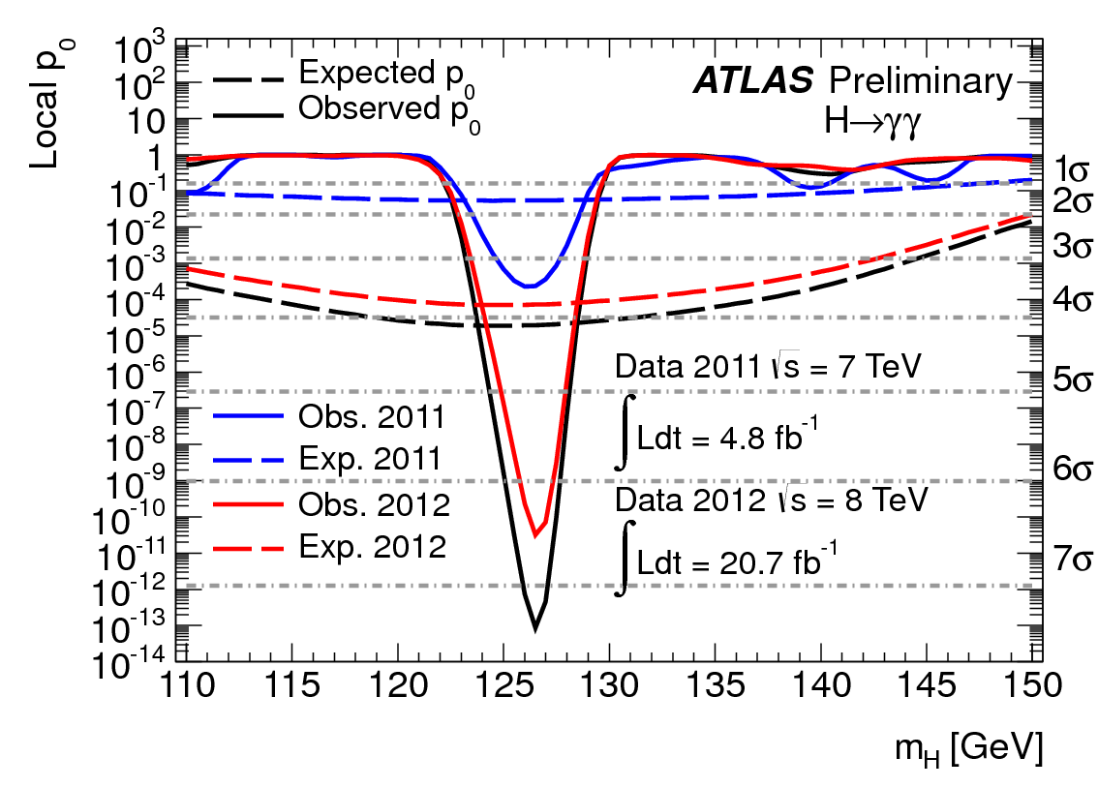
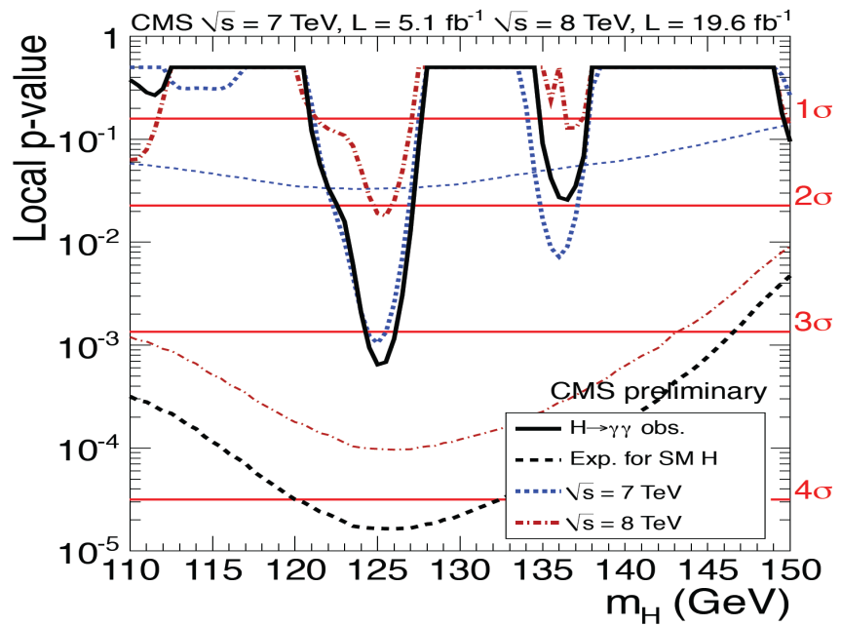
  H → γγ significance
ATLAS
Significance: 7.4σ
(4.1σ expected SM)
CMS
Significance: 3.2σ
(4.2σ expected SM)

Slide 10
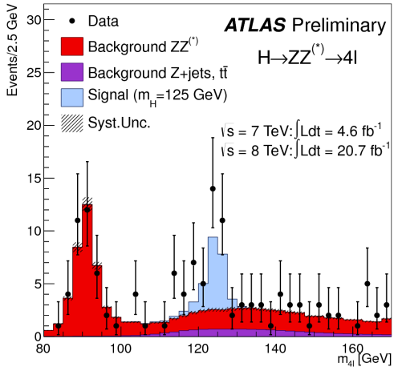
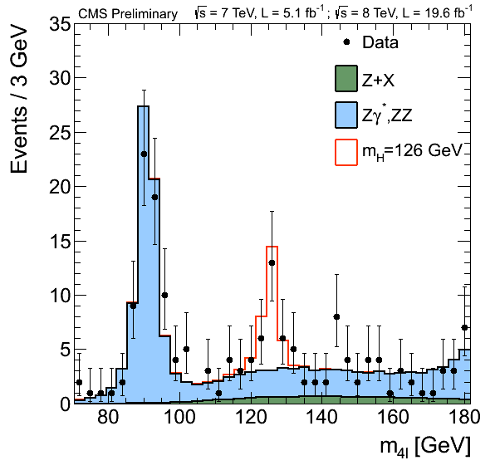
  H → ZZ^{(*)} → 4l
Reconstruct H → Z(ll) Z(l’l’) with 2 opposite-sign, same-flavour isolated lepton pairs (4μ, 2μ2e, 2e2μ, 4e)
  Additional categories for VBF and VH (ATLAS)
  CMS also use kinematic discriminants in fits for improved sensitivity
ATLAS m_{4l}
CMS m_{4l}

Slide 11
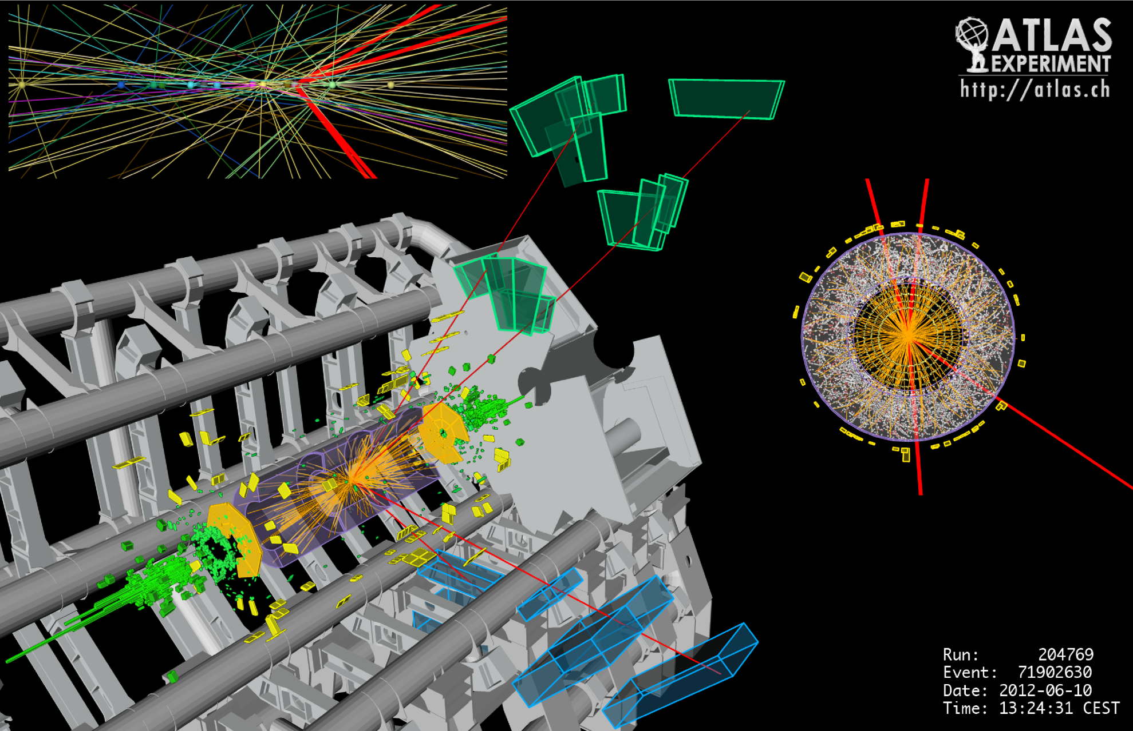
H → ZZ^{(*)} → 4μ candidate
  m_{4μ} = 127.4 GeV m₁₂,m₃₄ = 86.6, 31.6 GeV

Slide 12
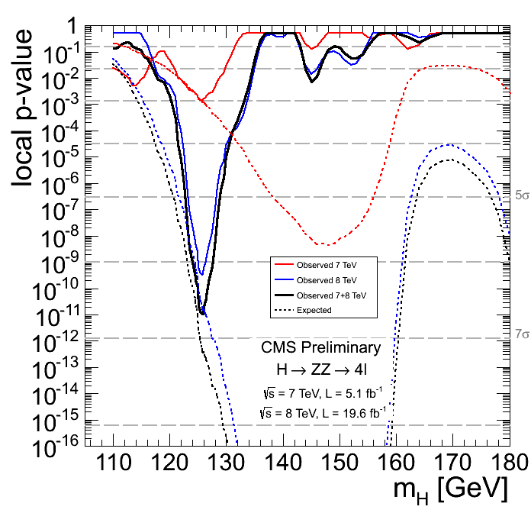
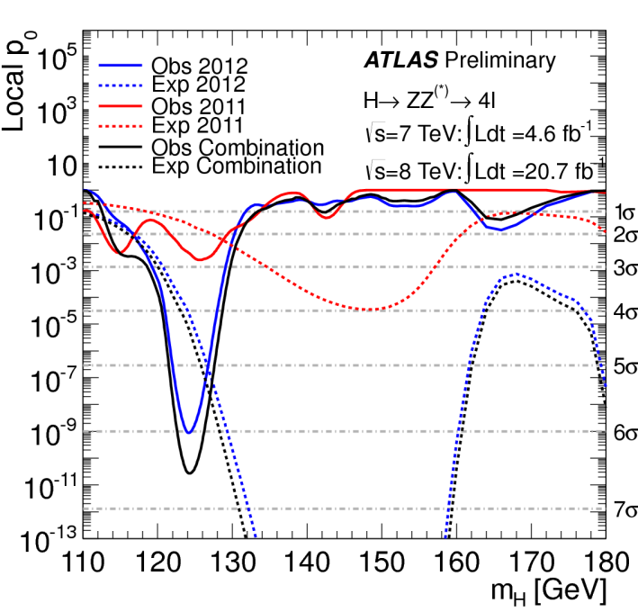
  H → ZZ^{(*)} → 4l significance
ATLAS
Significance: 6.6σ
(4.4σ expected SM)
CMS
Significance: 6.7σ
(7.2σ expected SM)

Slide 13
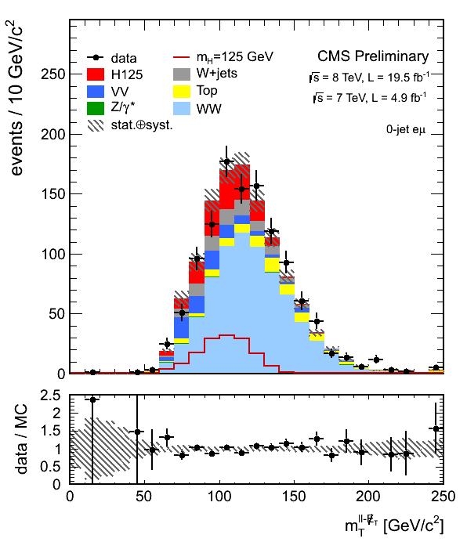
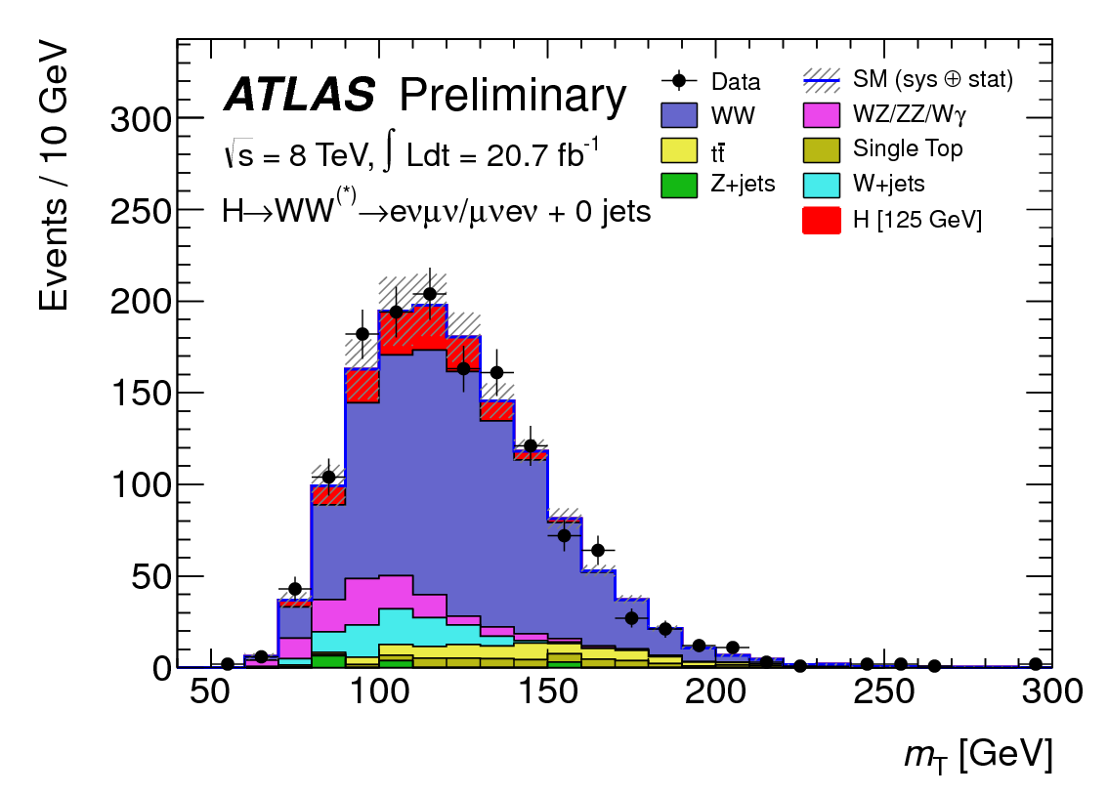
  H → WW^{(*)} → lνlν
Search for an excess of events in the m_{T} (and m_{ll}) spectrum with
  two high-p_{T} opposite-sign isolated leptons (ee,eμ,μe,μμ) and
  missing E_{T}
VBF tag (ATLAS)
ATLAS (8TeV 0-jet eμ sample)
CMS (0-jet eμ sample)

Slide 14
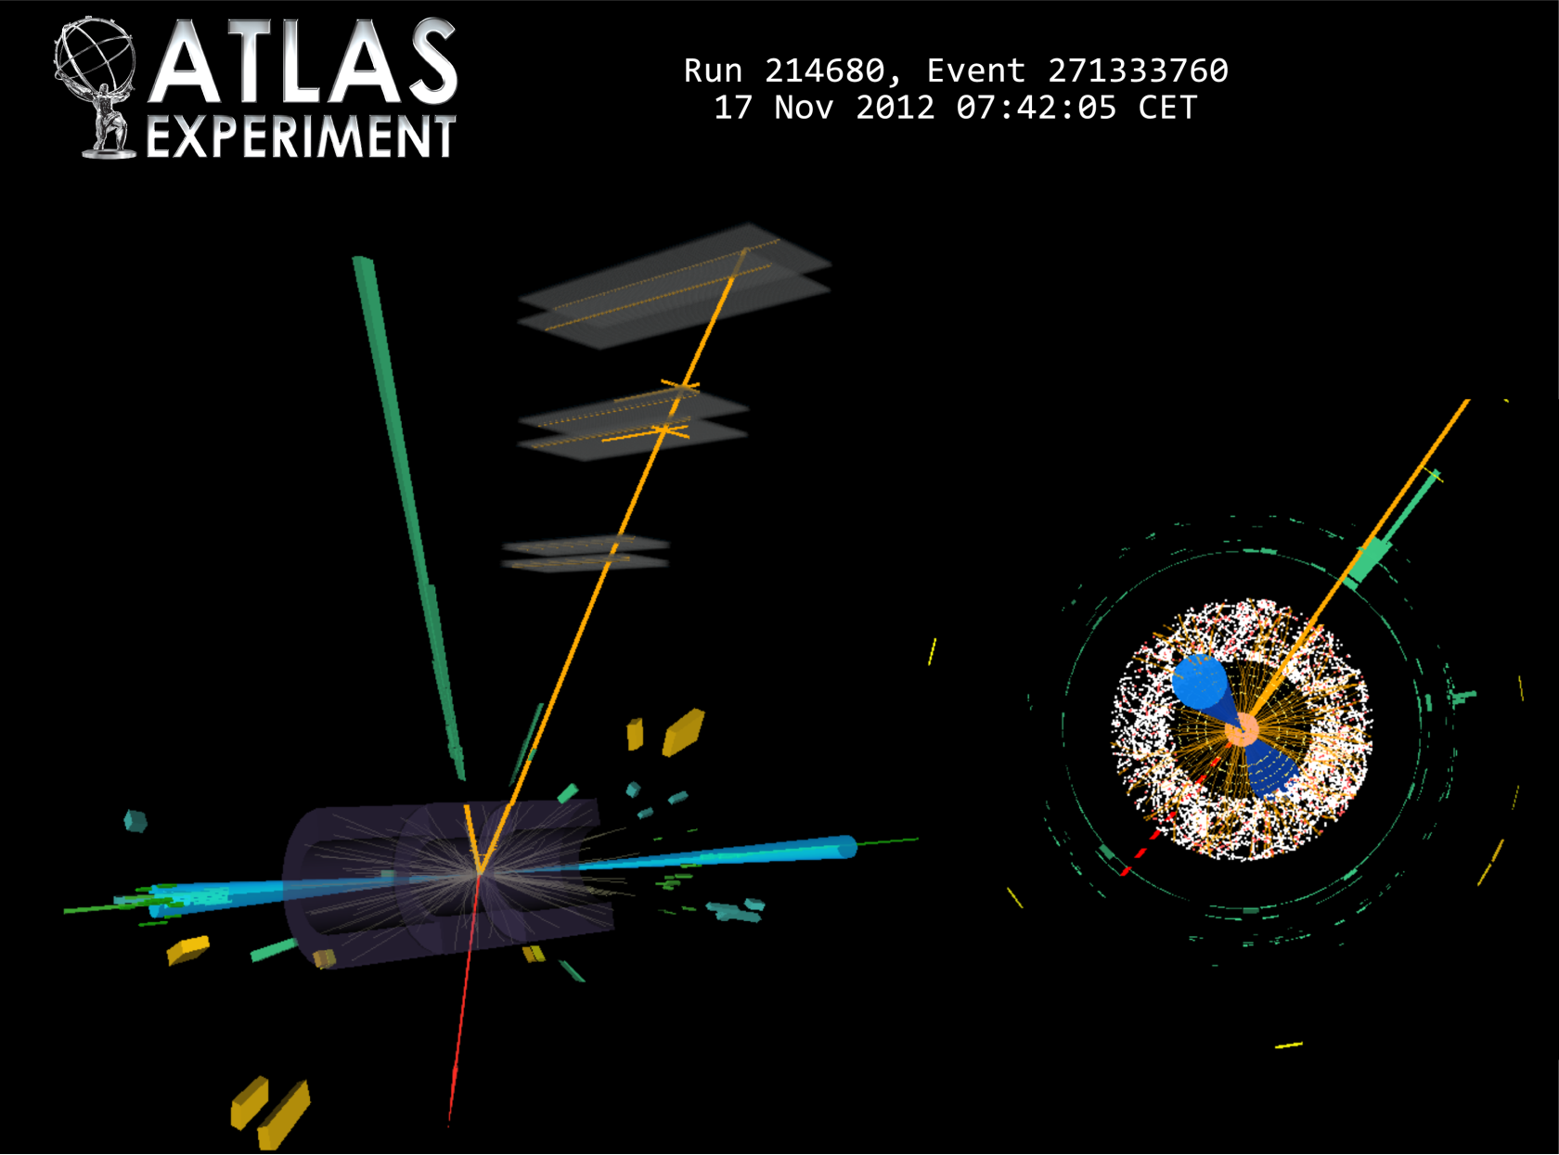
qqH → WW^{(*)} → eνμν + 2jets candidate (VBF)
  m_{T} = 95 GeV E_{T}^{miss} = 33 GeV
  m_{jj} = 1.5 TeV

Slide 15
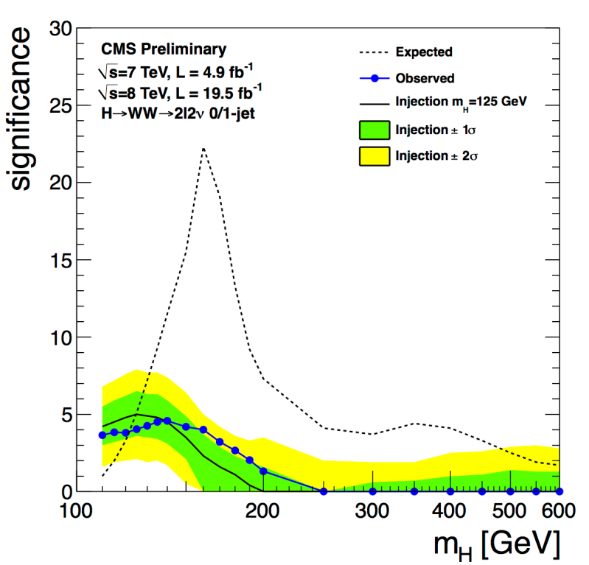
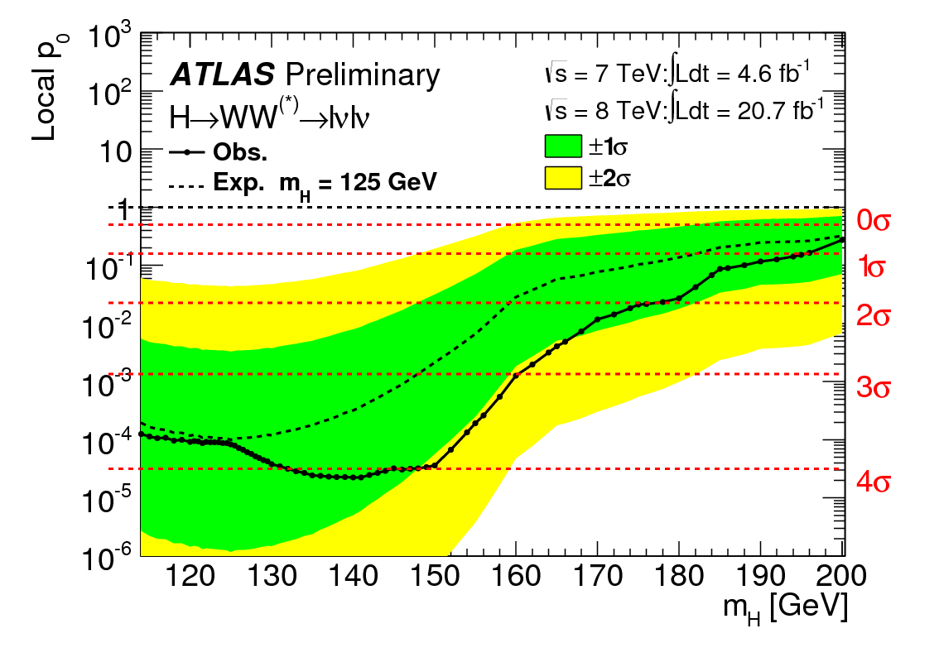
  H → WW^{(*)} → lνlν significance
ATLAS
Significance @125 GeV: 3.8σ
(3.7σ expected SM)
CMS
Significance @125 GeV: 4.0σ
(5.1σ expected SM)

Slide 16
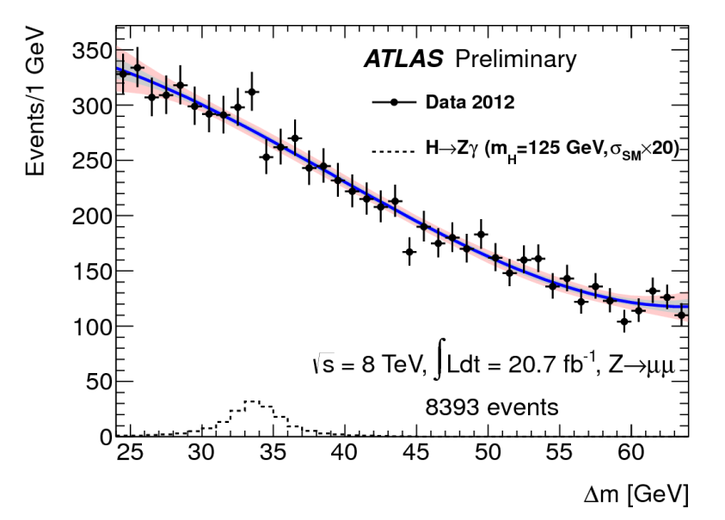
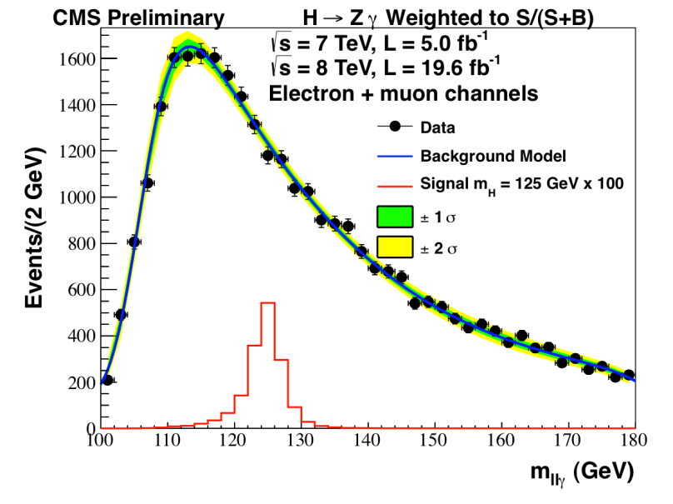
H → Zγ
Select H → Z(ll) γ and measure m_{llγ} (CMS) or Δm=m_{llγ}-m_{ll} (ATLAS)
  2 opposite-sign, same-flavour isolated leptons (e⁺e⁻, μ⁺μ⁻) and
  1 isolated photon
ATLAS (8TeV Z→μμ sample)
CMS (all events, weighted)

Slide 17
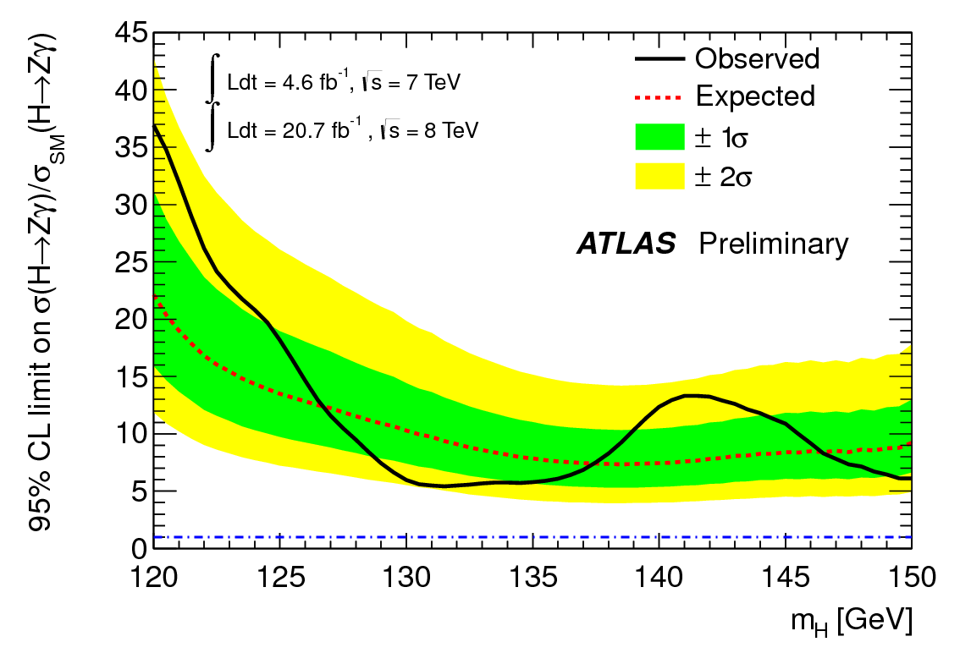
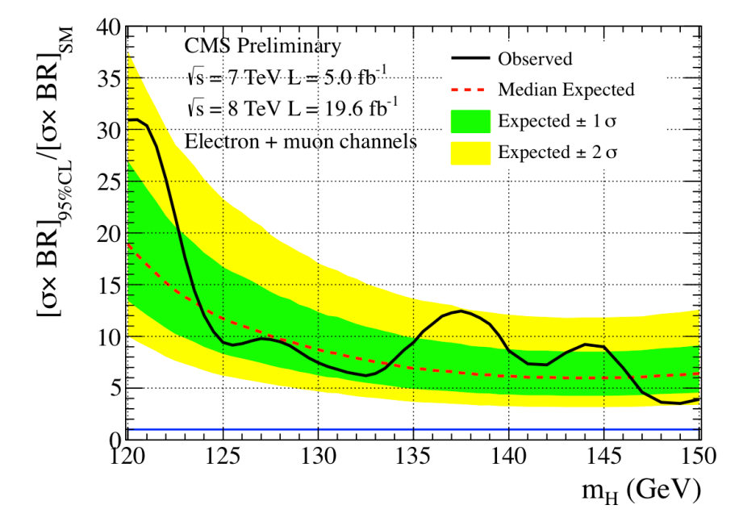
H → Zγ limits
ATLAS
σ/σ_{SM} < 18.2 @95%CL, 125GeV
(13.5 expected SM)
CMS
σ/σ_{SM} < 9 @95%CL, 125GeV
(12 expected SM)

Slide 18
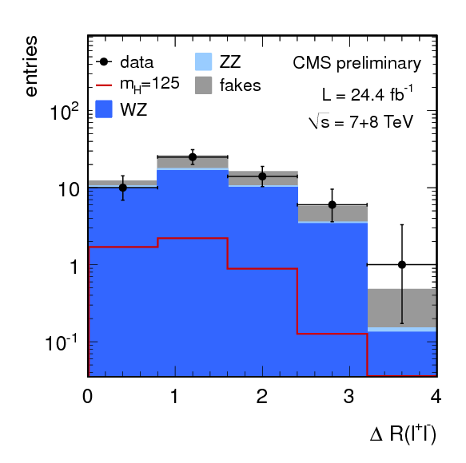
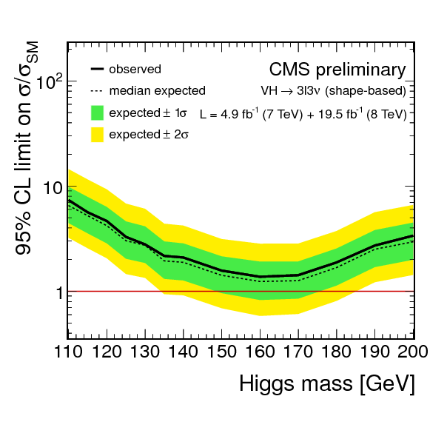
WH → WWW^{(*)} → lνlνlν (CMS)
Select
  3 high-p_{T} isolated leptons
  Missing E_{T}
  Z veto (reject WZ)
  Anti b-tag (reject top)
σ/σ_{SM} < 3.3 @95%CL, 125GeV
(3.0 expected SM)

Slide 19
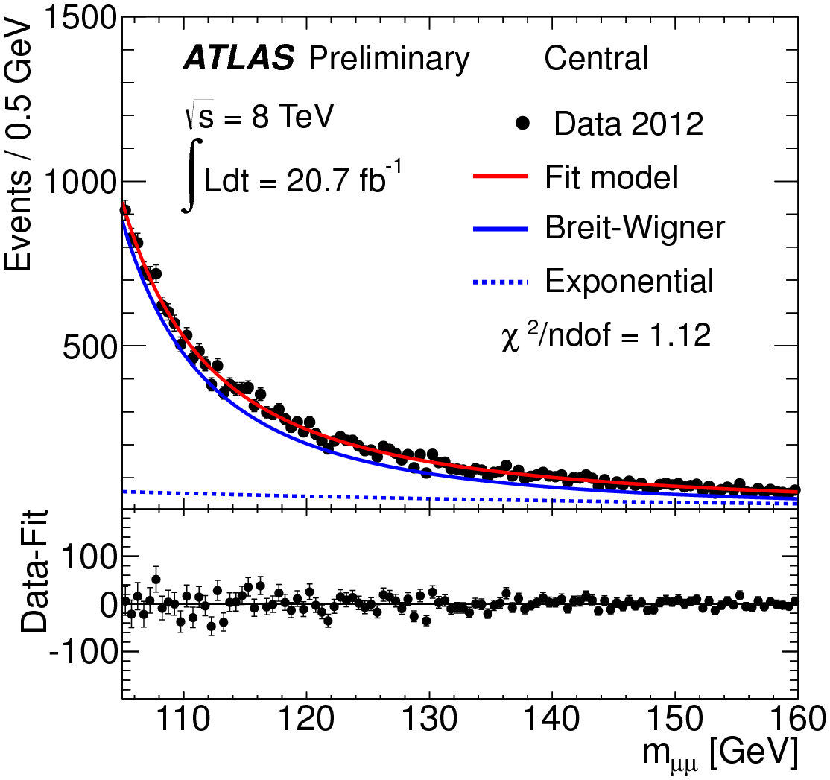
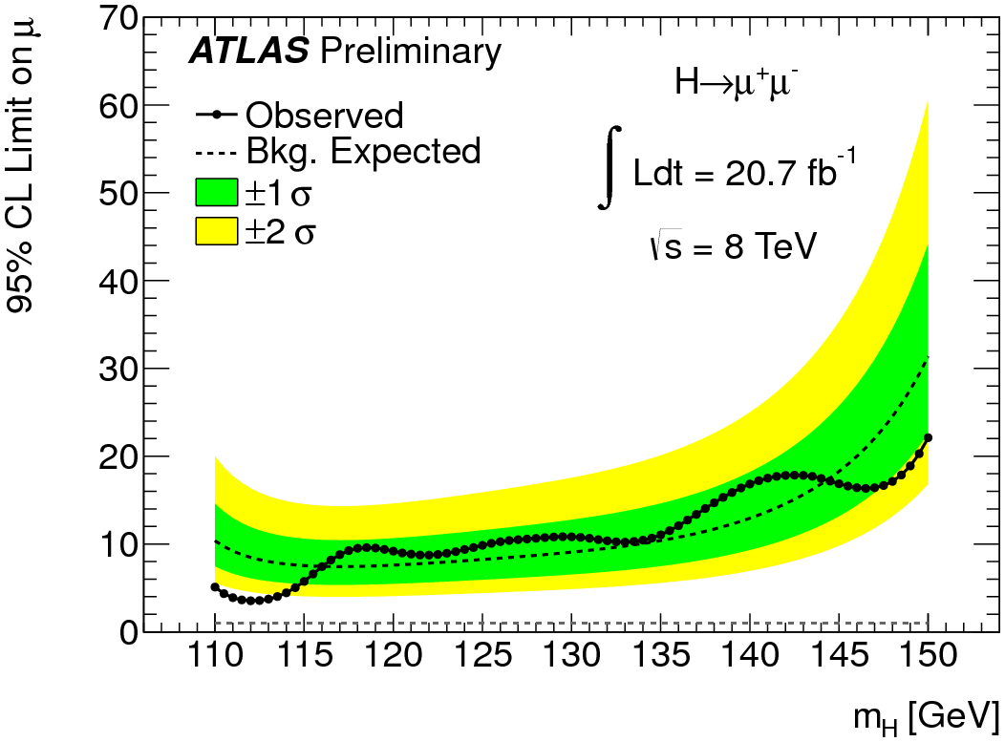
  H → μ⁺μ⁻ (ATLAS)
Select 2 high-p_{T} opposite-signed isolated muons
σ/σ_{SM} < 9.8 @95%CL, 125GeV
(8.2 expected SM)

Slide 20
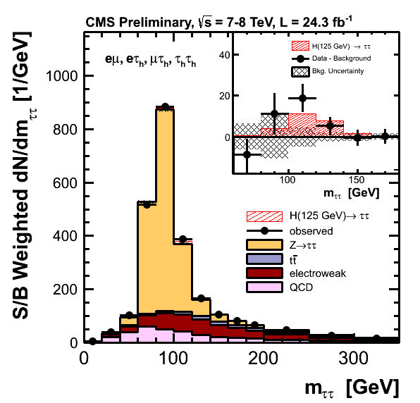
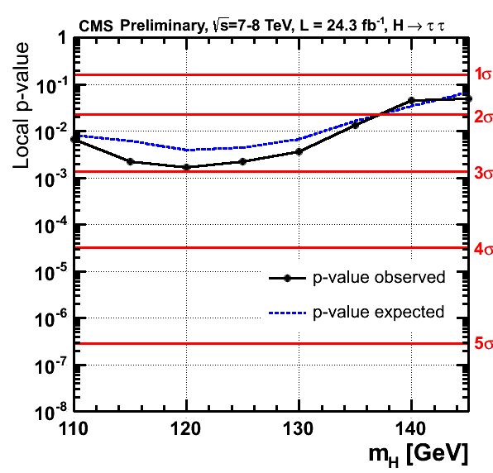
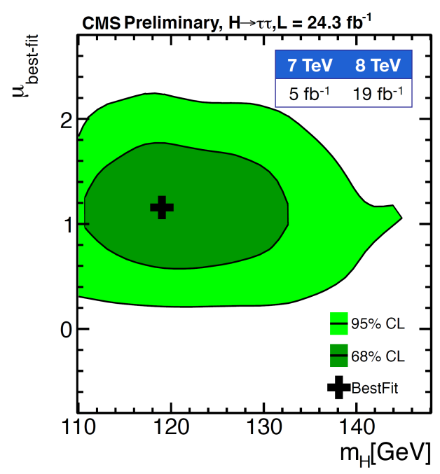

  H → τ⁺τ⁻ (CMS update)
Select two τ→e,μ,hadrons
  find best m_{ττ} given likelihood functions modelling τ decay
Significance @125 GeV: 2.9σ
(2.6σ expected SM)
m_{H} = ${120}_{−7}^{+9}$ GeV

Slide 21
Higgs Properties

Slide 22
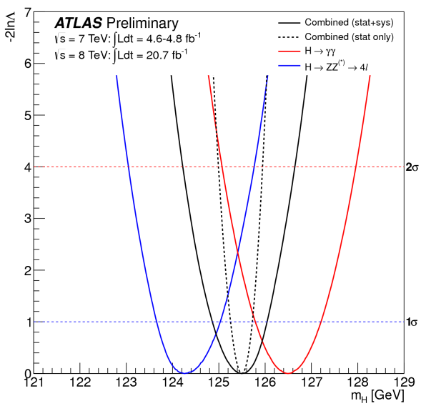
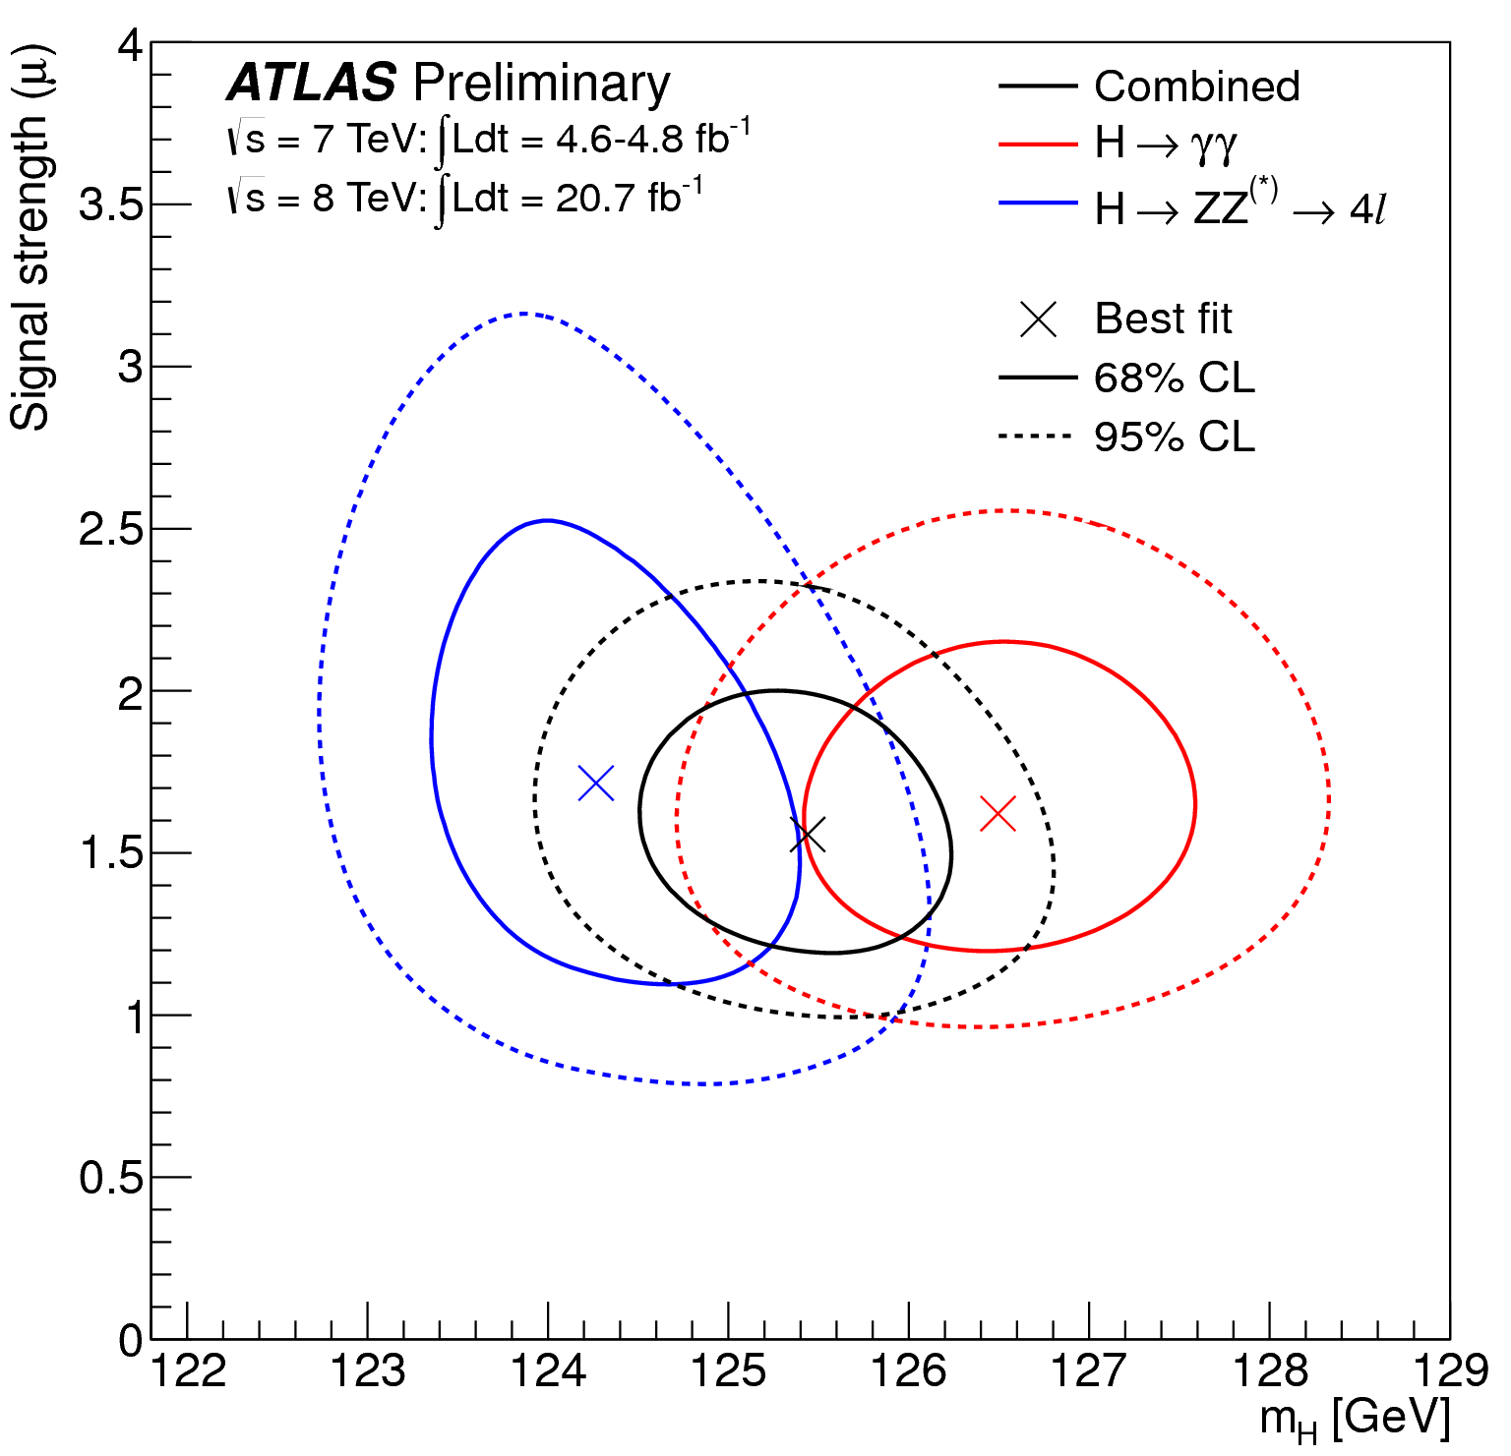
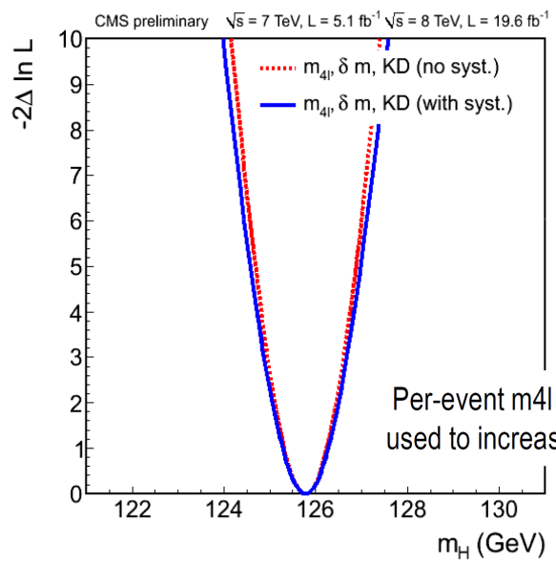
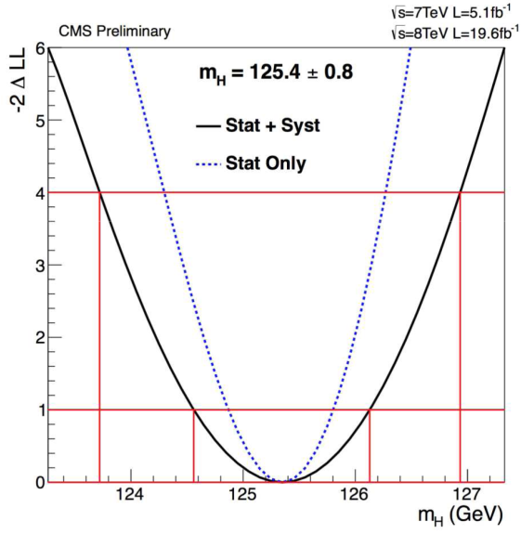
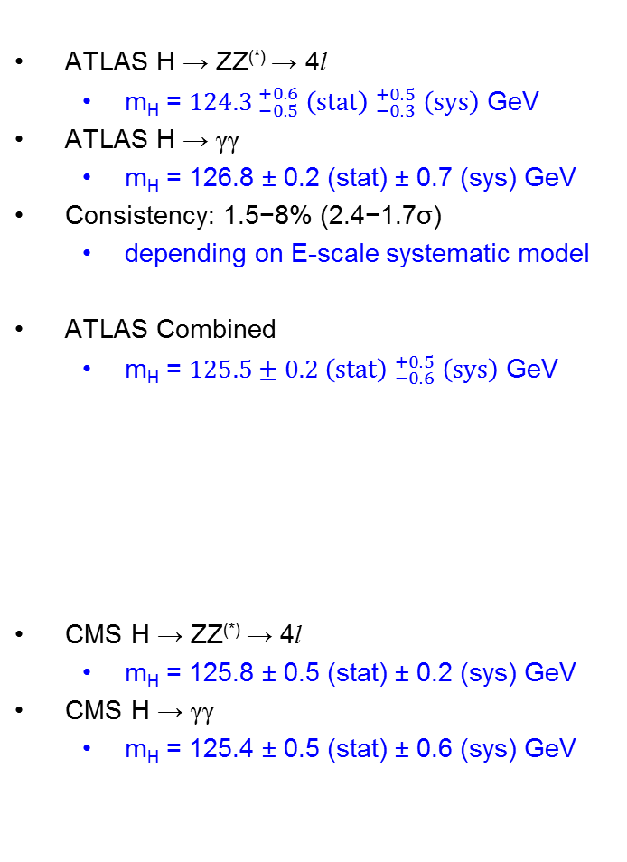
Higgs mass
ATLAS H → ZZ^{(*)} → 4l
  m_{H} = ${124.3 }_{−0.5}^{+0.6} {\left(stat\right) }_{−0.3}^{+0.5} \left(sys\right)$ GeV
ATLAS H → γγ
  m_{H} = 126.8 ± 0.2 (stat) ± 0.7 (sys) GeV
Consistency: 1.5−8% (2.4−1.7σ)
  depending on E-scale systematic model
ATLAS Combined
  m_{H} = $125.5±{0.2 \left(stat\right) }_{−0.6}^{+0.5} \left(sys\right)$ GeV
CMS H → ZZ^{(*)} → 4l
  m_{H} = 125.8 ± 0.5 (stat) ± 0.2 (sys) GeV
CMS H → γγ
  m_{H} = 125.4 ± 0.5 (stat) ± 0.6 (sys) GeV
ATLAS combined m_{H}
ATLAS μ vs m_{H}
CMS H → ZZ^{(*)} → 4l
CMS H → γγ

Slide 23
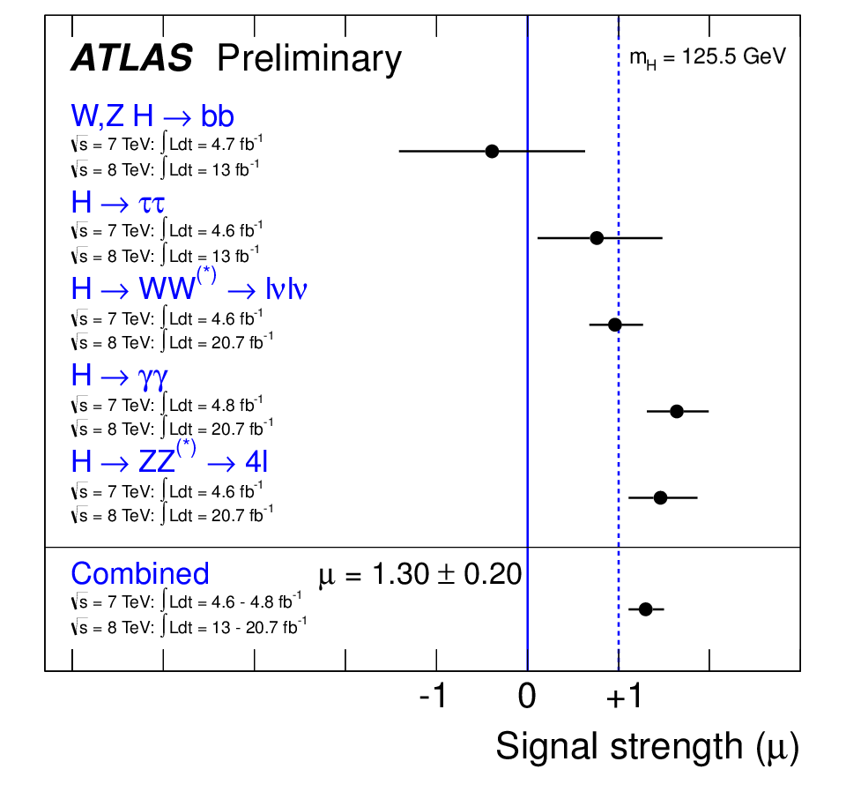
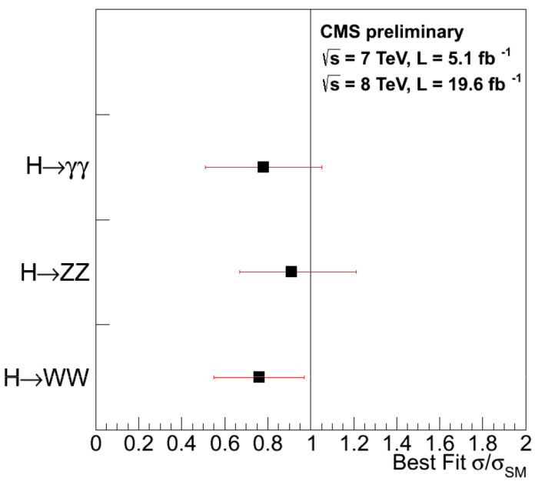
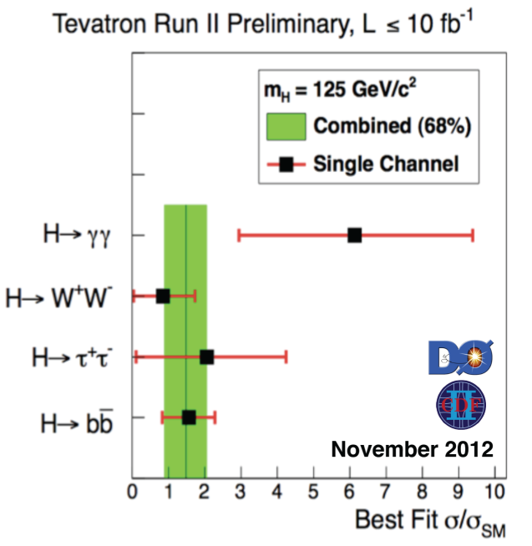
Signal strength
ATLAS combined signal strength
Signal strength μ = σ/σ_{SM} measured assuming m_{H}=125.5 GeV
  Only ±4% change to combined μ for ±1 GeV
Combined μ = 1.30 ± 0.13 (stat) ± 0.14 (sys)
Compatibility between measurements and SM (μ=1)
  Common μ vs SM: 9%
  with rectangular QCD scale/PDF constraints: 40%
  All μ_{bb}, μ_{ττ}, μ_{WW}, μ_{γγ}, μ_{ZZ} vs μ=1: 8% (5 d.o.f)
  All μ_{bb}, μ_{ττ}, μ_{WW}, μ_{γγ}, μ_{ZZ} vs μ=1.30: 13% (4 d.o.f)

Slide 24
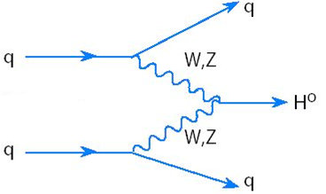
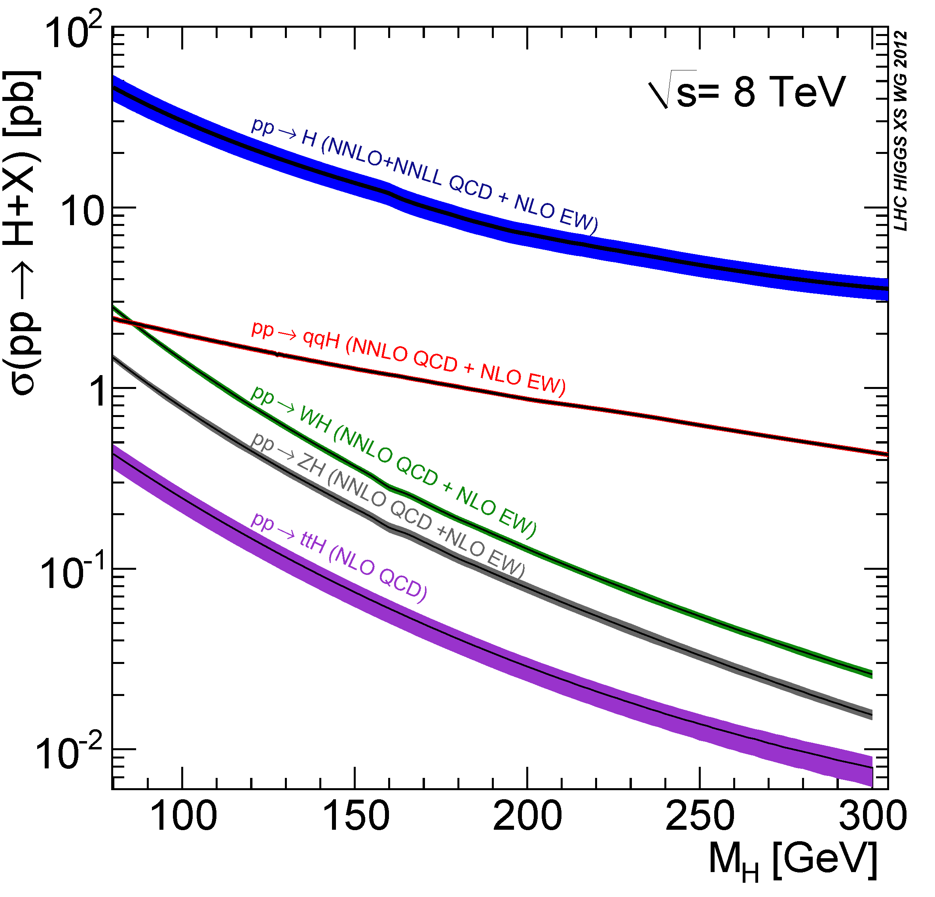
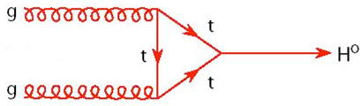
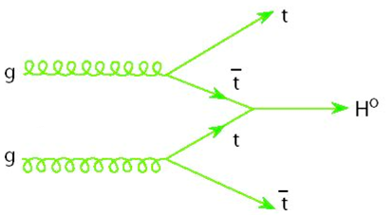
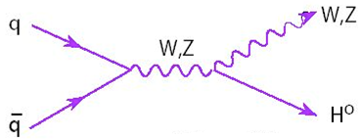
Higgs production modes
ggF
VBF
ggF
VBF
ttH
VH
VH
ttH
Dominant Higgs production modes expected from the SM at m_{H}=125 GeV:
  19.5 pb: gg fusion (ggF)
  1.6 pb: vector boson fusion (VBF) – tagged with 2 jets in γγ, ZZ, and WW analyses
  1.1 pb: W,Z + H (VH) – W,Z tagged in γγ, ZZ, and bb analyses
  0.1 pb: tt + H (ttH)
Group together production signal strengths:
  Fermion-mediated: μ_{ggF+ttH} ≡ μ_{ggF} = μ_{ttH}
  Boson-mediated: μ_{VBF+VH} ≡ μ_{VBF} = μ_{VH} ^{– ttH,VH rates subdominant}

Slide 25
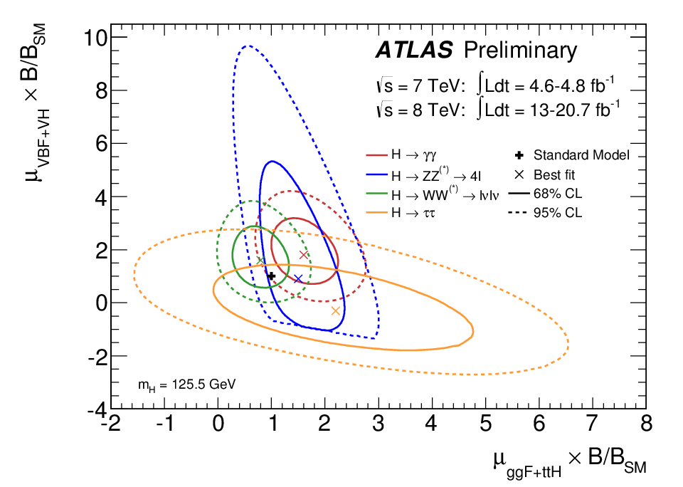
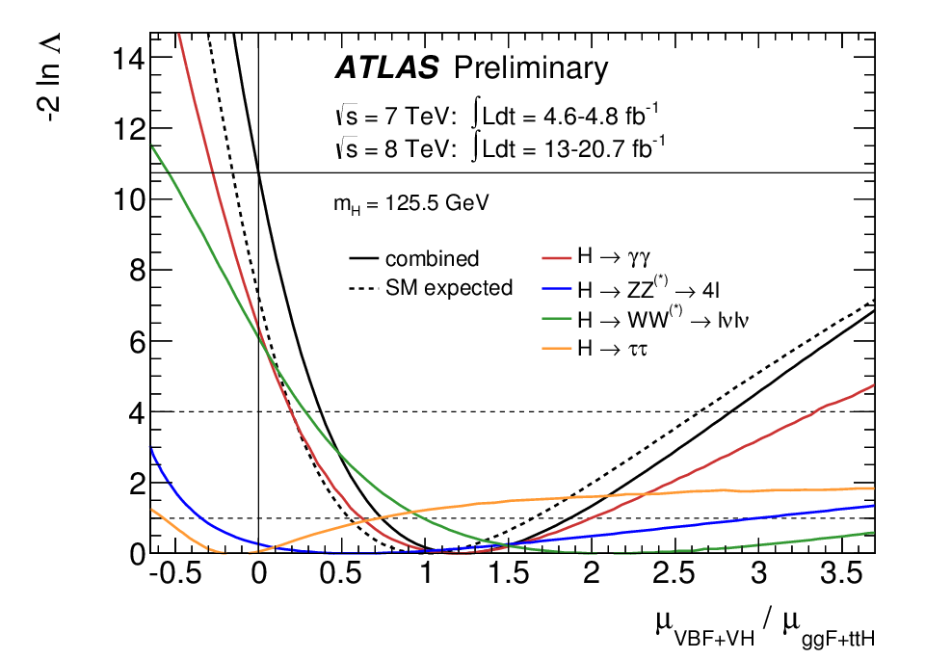
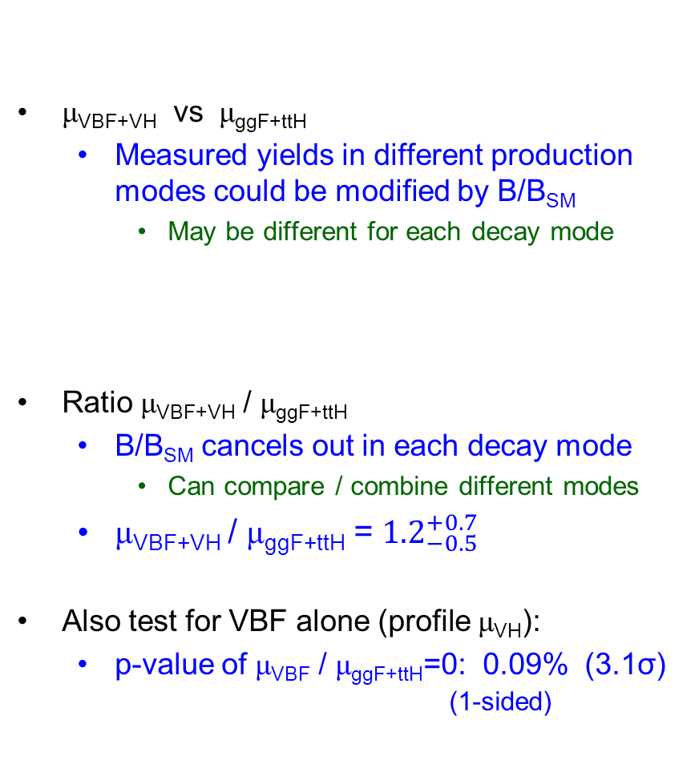
VBF and ggF production modes
μ_{VBF+VH} vs μ_{ggF+ttH}
  Measured yields in different production modes could be modified by B/B_{SM}
    May be different for each decay mode
Ratio μ_{VBF+VH} / μ_{ggF+ttH}
  B/B_{SM} cancels out in each decay mode
    Can compare / combine different modes
  μ_{VBF+VH} / μ_{ggF+ttH} = ${1.2}_{−0.5}^{+0.7}$
Also test for VBF alone (profile μ_{VH}):
  p-value of μ_{VBF} / μ_{ggF+ttH}=0: 0.09% (3.1σ)
  (1-sided)
Compatible with SM
Evidence for VBF

Slide 26
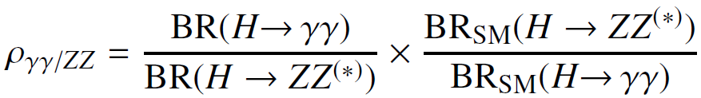
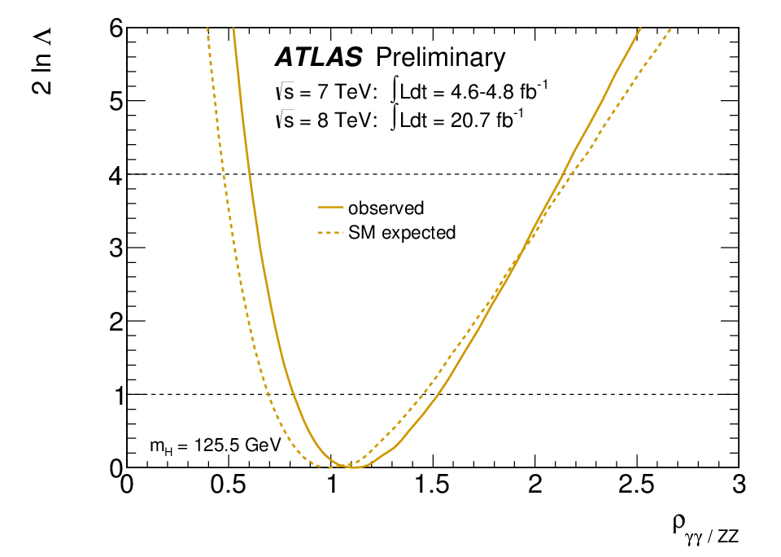




Higgs decays
Can also test decays in a fairly model-independent way
  Relative ratios of branching ratios, eg.
$ρ_{γγ/ZZ} ={1.1}_{−0.3}^{+0.4}$
$ρ_{γγ/WW}={1.7}_{−0.5}^{+0.7}$
$ρ_{ZZ/WW}={1.6}_{−0.5}^{+0.8}$
All compatible with SM
Note: only two ratios independent
_{γγ/ZZ}
_{γγ/WW}
_{ZZ/WW}

Slide 27





Higgs couplings
For each observed final state, production and decay involve several couplings
Test SM by applying scale factors κ_{i} to each coupling and fitting for κ_{i}s
  Assume a single resonance with a mass near 125 GeV
    Test at 125.5 GeV (varying mass hypothesis is a small effect)
  Assume narrow resonance (σ∙BR(ii→H→ff) ≈ σ_{ii}∙Γ_{ff} / Γ_{H})
  Only test modifications to the magnitude of the couplings (=> CP even scalar)
Not all couplings accessible with current data, so test specific scenarios
  Benchmark models defined by the LHC-XS-WG
Eg. H→γγ:
  where κ_{g} and κ_{γ} are effective scale factors on the loop couplings
    functions of κ_{t}, κ_{b}, κ_{W},...
Note: interference

Slide 28


Fermion vs Vector couplings
κ_{F} vs κ_{V}
Model:
  Vector and fermion couplings grouped together
  κ_{V} ≡ κ_{W} = κ_{Z} [SM: κ_{V}=κ_{F}=1]
  κ_{F} ≡ κ_{t} = κ_{b} = κ_{τ} = κ_{g}
  Assume only SM particles contribute to
  κ_{g} (gg→H, via fermion loop) and κ_{γ} (H→γγ)
    This assumption can be relaxed – see backup slides
Some sensitivity to relative sign due to H→γγ interference term
κ_{V} = [0.91, 0.97] and [1.05, 1.21] (68% CL)
κ_{F} = [-0.88, -0.75] and [0.73, 1.07]
2D Compatibility with SM: 8%
Contribution of
individual channels

Slide 29

Custodial symmetry: W vs Z couplings
Model:
  Ratio of W/Z couplings, fermion couplings grouped together, total width left free
  λ_{WZ} ≡ κ_{W} / κ_{Z} [SM: λ_{WZ}=λ_{FV}=κ_{ZZ}=1]
  λ_{FZ} ≡ κ_{F} / κ_{Z} (profiled in fit)
  κ_{ZZ} ≡ κ_{Z}κ_{Z} / κ_{H} (profiled in fit)
  Assume loops contain only SM particles
    Can relax assumption on H→γγ loop
    content – see backup slides
λ_{WZ} = [0.64, 0.87] (68% CL)
3D compatibility with SM: 5%
λ_{WZ} (λ_{FZ}, κ_{ZZ} profiled)
Fit prefers λ_{FZ}<0 minimum
compatible with λ_{FZ}>0 at 1.5σ

Slide 30


Non-SM particle content in gg→H and H→γγ loops
Model:
  Test for non-SM particle content in gg→H (κ_{g}) and H→γγ (κ_{γ}) loops
  Assume all tree-level couplings as in SM (κ_{W}=κ_{Z}=κ_{t}=...=1) and no extra SM contributions to the total width (κ_{H})
  Parameters: κ_{g} and κ_{γ} [SM: κ_{g}=κ_{γ}=1]
κ_{g} = 1.08 ± 0.14
κ_{γ} = ${1.23}_{−0.13}^{+0.16}$
2D compatibility with SM: 5%
κ_{g} vs κ_{γ}

Slide 31


Non-SM decay modes
Model:
  Assume all SM vertex couplings (κ_{i}=1) and test for invisible or undetectable non-SM decay modes
  BR_{inv,undet} = $1−\frac{κ_{H}^{2}}{Γ_{H}/Γ_{H}^{SM}}$ [SM: κ_{g}=κ_{γ}=1, BR_{inv,undet}=0]
  Profile κ_{g} and κ_{γ}
BR_{inv,undet} < 0.6 (95% CL)
3D compatibility with SM: 10%
ATLAS also has a dedicated search for
Z H → invisible (missing E_{T}):
  BR_{inv} < 0.65 (95% CL)
BR_{inv,undet} (κ_{g},κ_{γ} profiled)

Slide 32

Summary of coupling results
Overall compatibility with SM: 5-10%
  No significant deviation from SM
Note: each model is a different way of fitting the same data
  correlated, so don’t add them up!

Slide 33


Higgs spin: H → γγ
Compare spin 0⁺ (SM) to a 2⁺_{m} model (graviton-like with minimal couplings)
  Observation of H→γγ already excludes spin 1
Use polar angle, θ*, in Higgs rest frame to discriminate
Compared to 0⁺, can exclude 2⁺ at 99.3% (assuming 100% gg-production)

Slide 34



Higgs spin: H → WW^{(*)} → lνlν
Compare spin 0⁺ (SM) to a 2⁺_{m} model (graviton-like with minimal couplings)
Use m║, p^{T}║, Δφ║, and m_{T} to form BDT discriminants
Compared to 0⁺, can exclude 2⁺ at 95-99% (depending on qq production fraction)

Slide 35





Higgs spin and parity: H → ZZ^{(*)} → 4l
Compare spin 0⁺ (SM) to 0–, 1±, 2± models
Use 5 production and decay angles to form discriminants
ATLAS:
  Spin 0⁺ hypothesis favoured over 0–, 1⁺
CMS:
  Spin 0⁺ hypothesis favoured over 0–, 1±, 2⁺_{m}
Cannot yet distinguish well spin 0⁺ from, spin 2
ATLAS
CMS

Slide 36

Conclusion
Measurements of Higgs decays to γγ, ZZ^{(*)}, WW^{(*)}
New/updated limits for decays to Zγ, μ⁺μ⁻, τ⁺τ⁻
$mH=125.5±{0.2 \left(stat\right) }_{−0.6}^{+0.5} \left(sys\right) GeV$ (ATLAS; CMS similar)
Higgs production, decays, and couplings all consistent with SM
  Evidence for Higgs production via VBF
Spin and parity:
  compatible with 0⁺
  start to exclude 2⁺_{m} in γγ and WW (ATLAS), and 0–, 1±, 2⁺_{m} in ZZ
Conclusion from CERN DG, Moriond QCD discussion:
  It’s a Higgs! (no longer “Higgs-like”)
  Consistent with the SM Higgs, but do not rule out composite, doublets,...

Slide 37


From “hints” to “discovery” to “a Higgs”
H → γγ
H → ZZ^{(*)} → 4l
Evolution of the diphoton invariant mass spectrum
in 2011/2012 data, run by run
Evolution of the 4-leptons invariant mass spectrum
in 2011/2012 data, run by run

Slide 38
Backup

Slide 39
ATLAS References
Higgs couplings: ATLAS-CONF-2013-034
Higgs mass: ATLAS-CONF-2013-014
γγ: ATLAS-CONF-2013-012, spin: ATLAS-CONF-2013-029
ZZ: ATLAS-CONF-2013-013
WW: ATLAS-CONF-2013-030, spin: ATLAS-CONF-2013-031
ττ: ATLAS-CONF-2012-160 (Nov 2012)
bb: ATLAS-CONF-2012-161 (Nov 2012)
μμ: ATLAS-CONF-2013-010
Zγ: ATLAS-CONF-2013-009
ZH→invisible: ATLAS-CONF-2013-011
Previous combination: ATLAS-CONF-2012-170 (Dec 2012)
Previous coupling results: ATLAS-CONF-2012-127 (Sep 2012)
Observation: Phys. Lett. B 716 (2012) 1-29 (July 2012)
LHC XS WG coupling recommendations: arXiv:1209.0040

Slide 40

Combined p₀ vs m_{H} hypothesis
Update of combined p₀
  Mass scale systematics taken into account
  primarily of interest during discovery phase

Slide 41



Higgs mass
High resolution mass measurements from H→γγ and H→ZZ^{(*)}→4l spectra
Combine γγ and 4l mass measurements
  Signal strengths, μ_{γγ} and μ_{4l}, allowed to vary independently
    Don’t assume SM couplings
$mH=125.5±{0.2 \left(stat\right) }_{−0.6}^{+0.5} \left(sys\right)$ GeV
    (4.8 fb⁻¹ + 20.7 fb⁻¹)
Previous measurement, Dec 2012:
  m_{H} = 125.2 ± 0.3 (stat) ± 0.6 (sys) GeV
    (4.8 fb⁻¹ + 13 fb⁻¹)
Use profile likelihood ratio
$Λ\left(m_{H}\right)= \frac{L(m_{H},\hat{\hat{θ}}\left(m_{H}\right))}{L({\hat{m}}_{H},\hat{θ})}$ to quantify
m_{H} confidence intervals with
nuisance parameters, θ (μ_{γγ}, μ_{4l}, theory, experimental systematics)
Asymptotically, -2lnΛ distributed as a χ²

Slide 42



Comparison of H→γγ and H→ZZ^{(*)}→4l masses in ATLAS
The individual mass measurements, m_{γγ} and m_{4l}, are slightly correlated due to the common EM scale systematic (for photons in m_{γγ} and electrons in m_{4l})
  Pulls m_{γγ} down by 350 MeV in combined fit
Test assumption that both decays come from a common mass
  Δm_{H} = m_{γγ} – m_{4l}
  = ${2.3}_{−0.7}^{+0.6} \left(stat\right)±0.6 \left(sys\right)$ GeV
Consistency Δm_{H}=0:
  p-value = 1.5% (2.4σ)
  More conservative E scale model: allow systematics to vary without constraint ±1σ (rectangular PDF): p-value = 8% (1.7σ)
Previous measurement, Dec 2012:
  Δm_{H} = $3.0±0.8 {\left(stat\right)}_{−0.6}^{+0.7} \left(sys\right)$ GeV
m_{4l} vs m_{γγ}

Slide 43

H→ZZ^{(*)}→4l individual channel mass measurements
4μ
4e
2e2μ
2μ2e
Solid: with mass scale systematics
Dashed: without mass scale systematics

Slide 44


  ATLAS H → τ⁺τ⁻
8TeV τ_{l} τ_{had} VBF category
Significance @125 GeV: 1.1σ
(1.7σ expected SM)

Slide 45


Previous results – signal strength
Combined: μ = 0.88 ± 0.21

Slide 46

Tevatron κ_{F} vs κ_{V}

Slide 47

Fermion vs Vector couplings no assumption on total width
Model:
  Ratio of fermion/vector couplings with no assumption on the total width
  λ_{FV} ≡ κ_{F} / κ_{V} [SM: λ_{FV}=κ_{VV}=1]
  κ_{VV} ≡ κ_{V}κ_{V} / κ_{H} (profiled in fit)
λ_{FV} = [-0.94, -0.80] and [0.67, 0.93] (68% CL)
2D compatibility with SM: 7%
λ_{FV} (κ_{VV} profiled)

Slide 48


Fermion vs Vector couplings no assumption on total width or H→γγ loop content
Model:
  Ratio of fermion/vector couplings with no assumption on the total width or H→γγ loop content
  λ_{FV} ≡ κ_{F} / κ_{V} [SM: λ_{FV}=λ_{γV}=κ_{VV}=1]
  λ_{γV} ≡ κ_{γ} / κ_{V} (profiled in fit)
  κ_{VV} ≡ κ_{V}κ_{V} / κ_{H} (profiled in fit)
λ_{FV} = ${0.85}_{−0.13}^{+0.23}$
3D compatibility with SM: 9%
λ_{FV} (λ_{γV}, κ_{VV} profiled)

Slide 49

Custodial symmetry: W vs Z couplings no assumption on H→γγ loop content
Model:
  Ratio of W/Z couplings with no assumption on H→γγ loop content
  λ_{WZ} ≡ κ_{W} / κ_{Z} [SM: λ_{WZ}=λ_{FV}=λ_{γZ}=κ_{ZZ}=1]
  λ_{FZ} ≡ κ_{F} / κ_{Z} (profiled in fit)
  λ_{γZ} ≡ κ_{γ} / κ_{Z} (profiled in fit)
  κ_{ZZ} ≡ κ_{Z}κ_{Z} / κ_{H} (profiled in fit)
λ_{WZ} = 0.80 ± 0.15
4D compatibility with SM: 9%
λ_{WZ} (λ_{FZ}, λ_{γZ}, κ_{ZZ} profiled)

Slide 50

Summary of coupling results - detail
Overall compatibility with SM: 5-10%
  No significant deviation from SM
Note: each model is a different way of fitting the same data
  correlated, so don’t add them up!

