Slide 1
Antimatter in the Universe and the PAMELA/FERMI/AMS… anomaly
Gerry Skinner
gerald.k.skinner@gmail.com
Max-Planck Institut fur Extraterrestriche Physik , Garching
Max-Planck Institut fur Astrophysik , Garching
(Honorary) University of Birmingham, UK
(Department of Astrophysics and Space Research)
(Ex) University of Maryland
(attached to NASA Goddard Space Flight Center)
(Ex) Université Paul Sabatier, Toulouse
(attached to Centre d’Etudes Spatiales des Rayonnements)

Slide 2
There is direct evidence for
1) Anti-protons and positrons ~0.1-100 GeV in Cosmic Rays
2) The annihilation of 10⁴³ low energy (<~ keV) positrons per second in the Inter-Stellar Medium

Slide 3
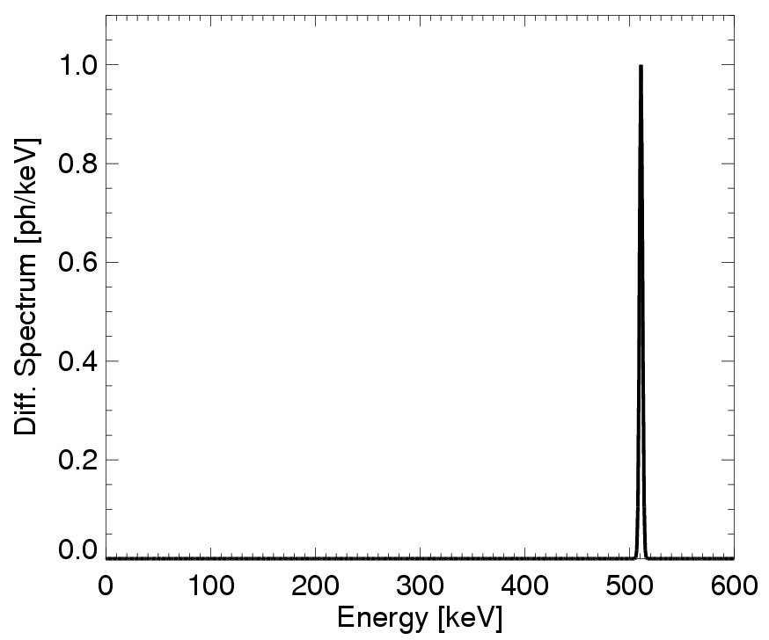
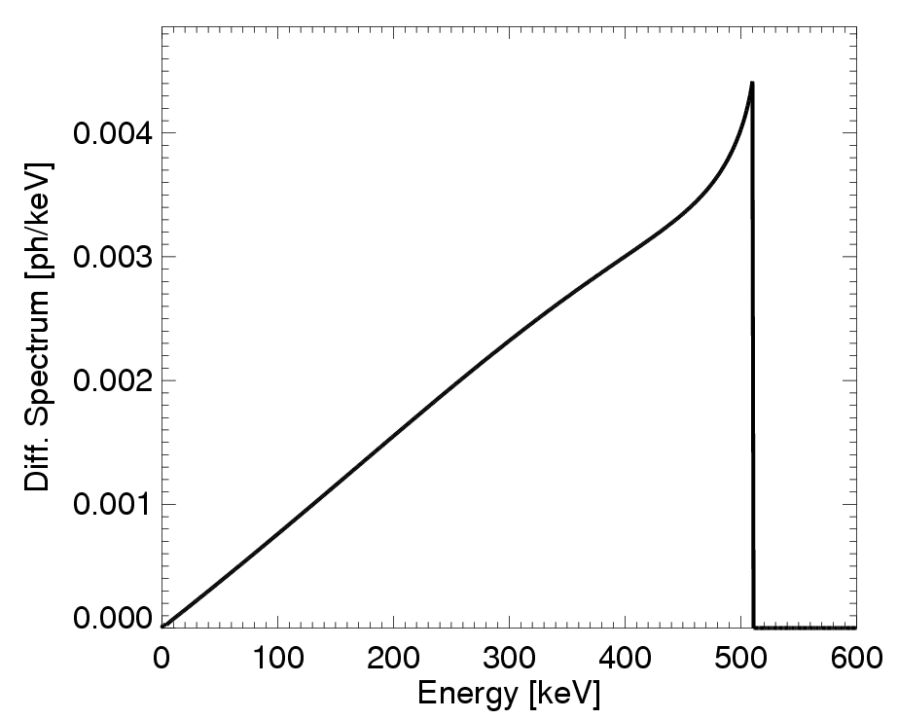
Electron Positron Annihilation
e⁺
γ
Direct annihilation
Annihilation line
E = 511 keV
γ
e⁻
Annihilation via positronium (Ps) formation
e⁻
γ
para-positronium
1/4
γ
τ = 1.2×10⁻¹⁰ s
e⁺
Positronium continuum
E < 511 keV
γ
e⁻
ortho-positronium
3/4
τ = 1.4×10⁻⁷ s
γ
γ
e⁺

Slide 4
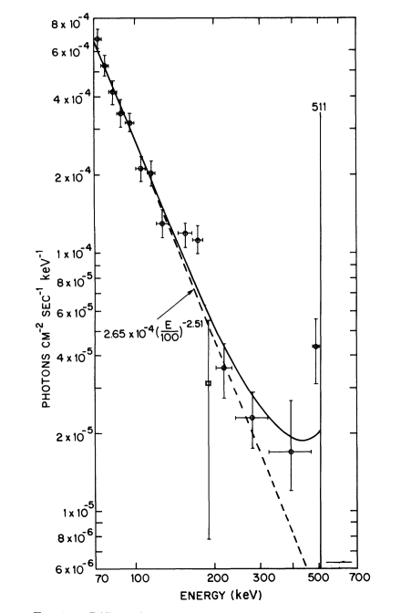
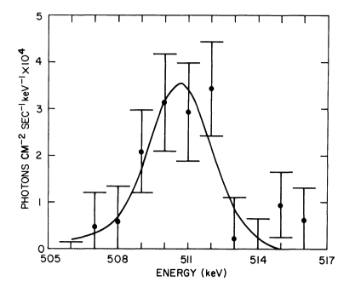
Line flux (12.2 ± 2.2) × 10⁻⁴ cm⁻² s⁻¹
in 15° FWHM field of view
Centroid (510.7 ± 0.5) keV
Leventhal, MacCallum & Stang
Ap J 225 L11 (1978)

Slide 5
Integral has confirmed earlier conclusions that the positronium fraction is close to unity.
  f_{p} = 94 ± 6% (Sazonov et al, 2005)
  f_{p} = 97 ± 2% (Jean et al., 2006)
  f_{p} = 100 ± 2% (Churazov et al., 2011)

Slide 6
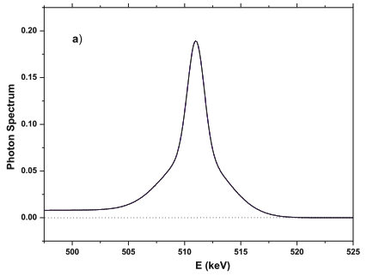
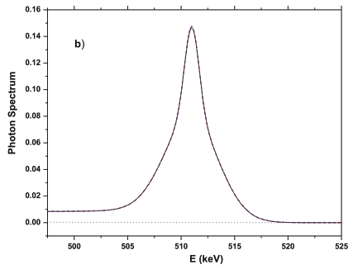
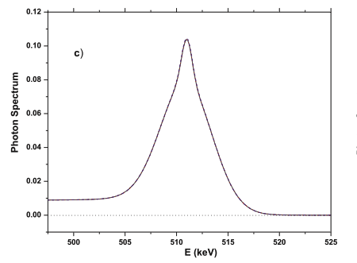
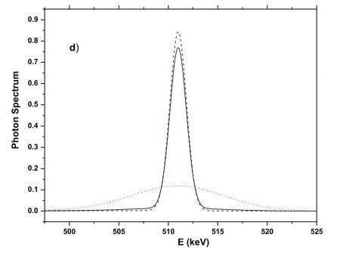
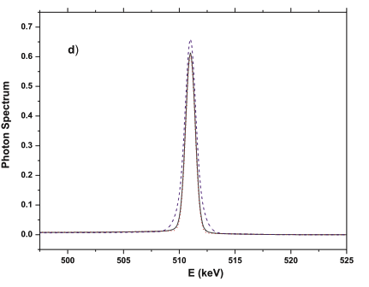
Cold H₂
Cold H
Warm
Neutral
Warm,
Ionized
Hot
Line shapes expected for annihilation in different media
Gessoum, Jean, Gillard (2005)

Slide 7
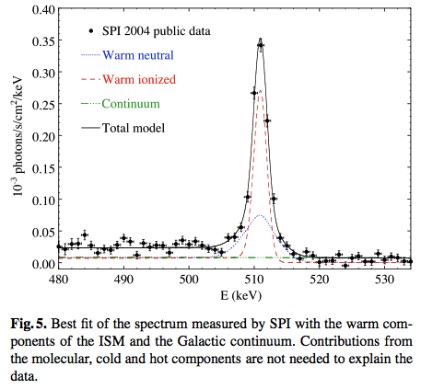
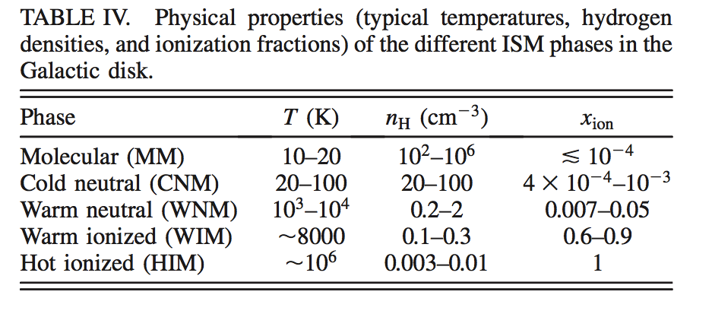
The detailed 511 keV line shape observed by INTEGRAL-SPI implies annihilation is in a mixture of warm neutral and warm ionized environments
Jean, et al. (2005)

Slide 8
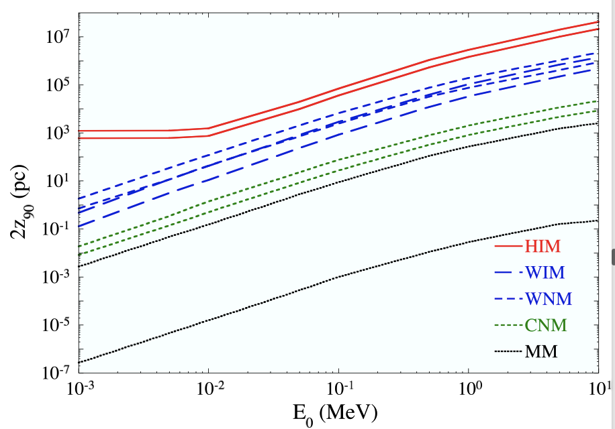
Centre of
the Galaxy
Higdon
et al.
Nearest
Star to
solar system
Boehm et al.
Earth
-Sun
Distance traveled before annihilation as a function of initial positron energy according to the analysis of Jean et al (2009) . Upper and lower extents of a band are shown for each medium. Data are for travel along field lines. The corresponding plot for transverse motion is similar with somewhat lower values.

Slide 9
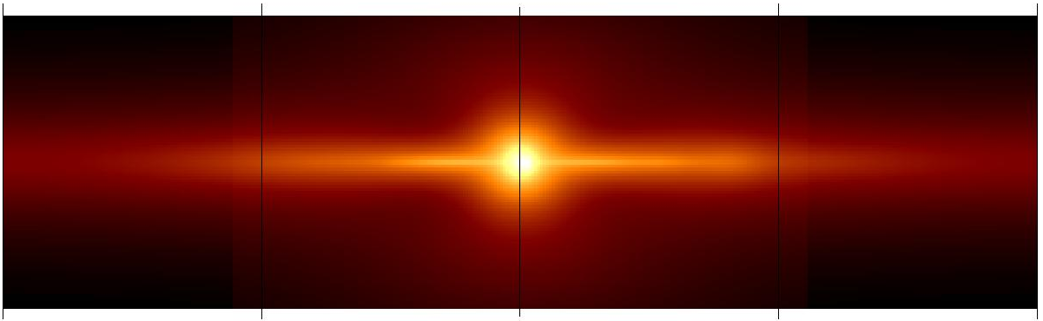
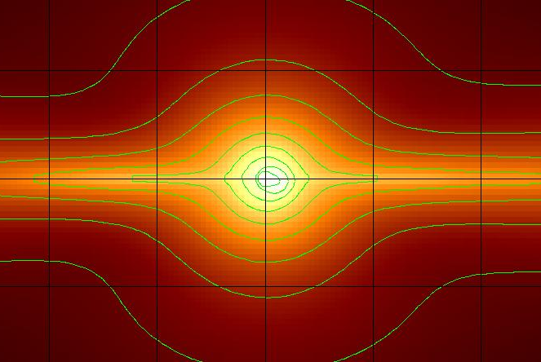
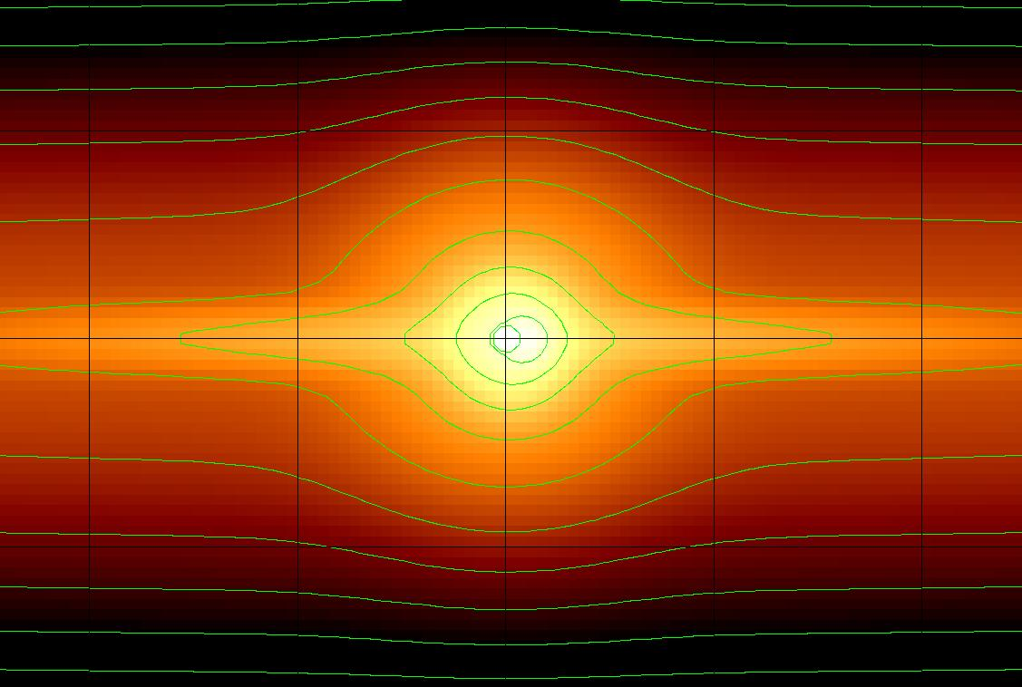
180°
90°
Galactic longitude
0°
-90°
-180°
Example of a model found by simulated annealing that fits the data
40°
0°
40°

Slide 10
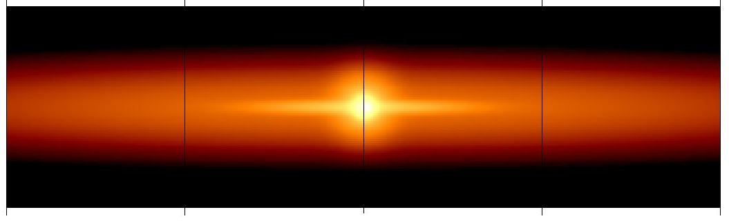
180°
90°
Galactic longitude
0°
-90°
-180°
Example of another model found by simulated annealing that fits the data equally well
40°
0°
40°

Slide 11
The problem is not that we don’t know how
the positrons could be produced …
… it is that there are too many possible explanations !
Hypernovae/GRB explosions in the galaxy (Lingenfelter &Heuter, 1984; Bertone et al., 2006)
Galactic Supernovae (Ramaty & Lingenfelter, 1979 )
Galactic Supernovae + escape from the disk (Higden et al., 2007)
Novae (Clayton & Hoyle, 1974; Jose, Coc & Hernanz, 2003)
LMXBs (Prantzos, 2004)
HMXBs / Micro-Quasars (Guessoum et al, 2006)
Wolf-Rayet stars (Dearbourne & Blake, 1985)
Red Giants (Norgaard, 1980)
Pulsars ( Sturrock, 1971)
Millisecond pulsars (Wang, 2005; 2006)
Cosmic Ray interactions with matter (Ramaty, 1970)
Light (MeV) dark matter (Boehm et al., 2004)
‘Heavy’ 500 GeV dark matter + de-excitation from an excited state (Finkbeiner & Weiner, 2007).
Sgr A* (Titarchuk & Chardonnet, 2006; Totani, 2007; Alexis et al, 2013)
Color superconducting dark matter droplets (strangelets) (Oaknin & Zhitnitsky, 2005)
Intergalactic space (Vecchio et al., 2013)
Small H atoms (Va’vra, 2013)
Dichromic dark matter (Bai et al., 2013)

Slide 12
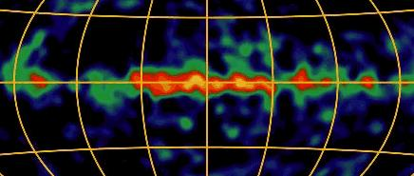
 | Rate century⁻¹ | Production M⊙ per event | Escape probability | Positrons × 10⁴³ s⁻¹
⁴⁴Ti | 0.4/2.1 SNIa/SNII | 2×10⁻⁵ /2×10⁻⁴ | 100% | 0.17-0.51
⁵⁶Co | 0.4/2.1 SNIa/SNII | 0.6/0.1 | 1.5-15% | 0.31-3.1
²⁶Al | Rate from 1809 keV line |  | non issue | 0.20-0.33
²²Na | ~1000 [ ONe novae) | 2×10⁻⁸ | 100% | 0.01
Total |  |  |  | 0.69-3.95
To explain |  |  |  | 2.6-3.4
Positrons from radioactive decay
Data from :
Martin et al. (2012)
Higdon et al. (2009)
Hernanz (2005)
Prantzos (2011)
1809 keV ²⁶Al

Slide 13
Another processes that certainly produces positrons:
Cosmic Ray interactions with the ISM
X = other products
(includes anti-protons)
(99%)
(1%)
(99.99%)
(100%)

Slide 14
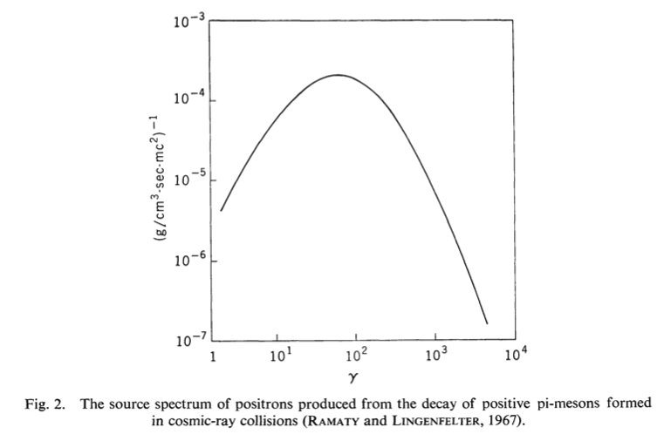
Masses
K± 493.7 MeV/c²
K⁰ 497.6
π± 139.6
π⁰ 135.0
105.7
Positrons produced have energies
^{10 MeV ➞ GeV}
Energy distribution of positrons from π⁺/μ⁺ decay
(Stecker, 1969)

Slide 15
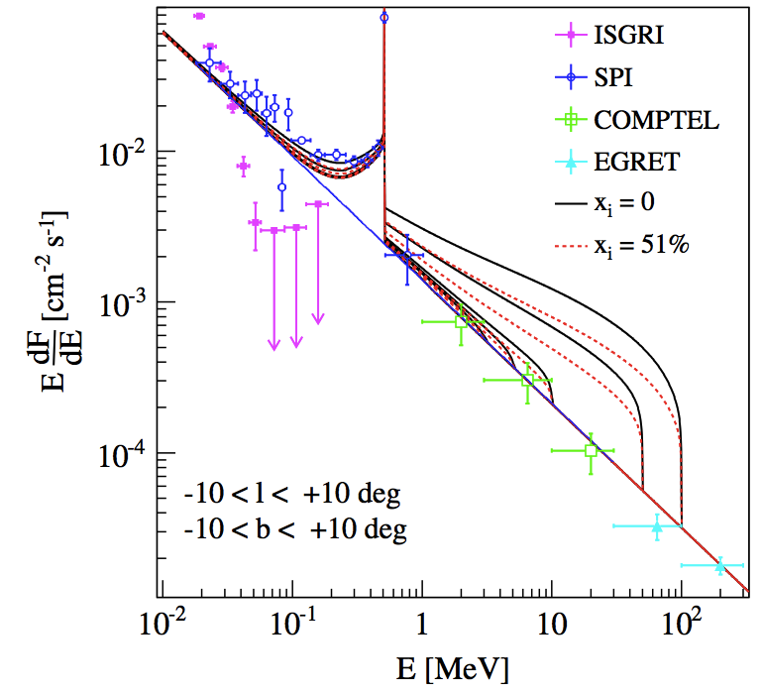
Gamma-ray excess due to annihilation in flight of high energy positrons
MeV excess from annihilation in flight
The curious fact :
- there isn’t any excess
Conclusion :
The positrons cannot have originated at energies greater than a few MeV
Cosmic ray positrons cannot explain the observed 511 flux
(anyway, there are not enough of them and they are produced mainly in the disk)
100 MeV
3 MeV
Sizun et al., (2006)

Slide 16
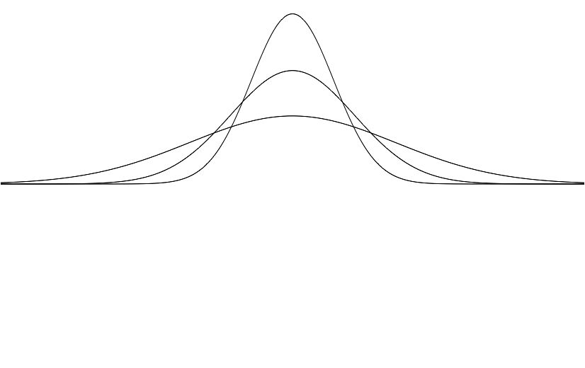
Need a separate component to explain the ‘bulge’ emission which is more concentrated than almost all of the proposed positron sources.
Transport should only allow the positrons to diffuse away from their origin, and so make the emission more diffuse, so must be very compact.
Some possibilities :-
Mini-Quasar-like outburst from the GC black hole 10⁵-10⁶ years ago
Burst of star formation ditto
Dark matter annihilation – arguably must be low mass (~MeV)
Decay of excited dark matter – must be a 2-body (ρ²) process

Slide 17
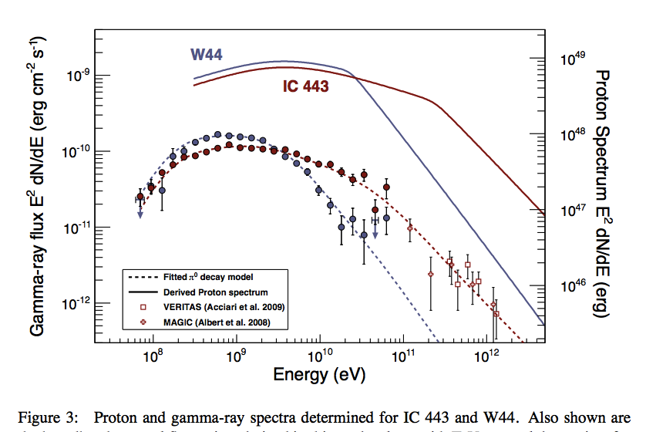
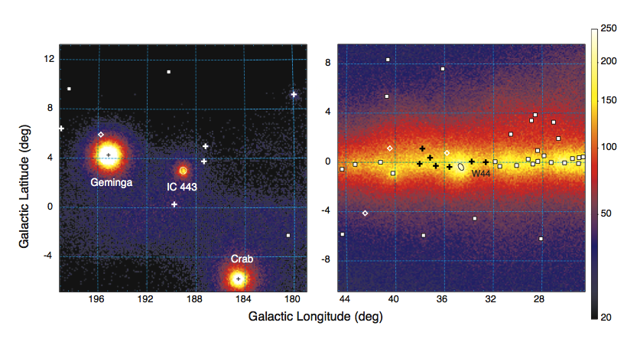
Gamma-rays from π⁰ decay
^{IC 443 Supernova} ^{remnant}
^{Age} ^{∼ 10, 000 years}
^{Distance 1.5 kpc}
Ackermann et al., (2013)
67.5
MeV
^{Also}
^{W44 Supernova} ^{remnant}
^{Age} ^{∼ 10, 000 years}
^{Distance 2.9} ^{kpc}

Slide 18
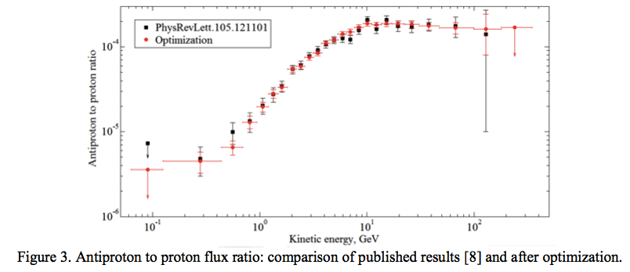
More direct evidence – Cosmic Rays measured inside the Solar System
Model and low energy observations (Mosalenko et al (2002)

Slide 19
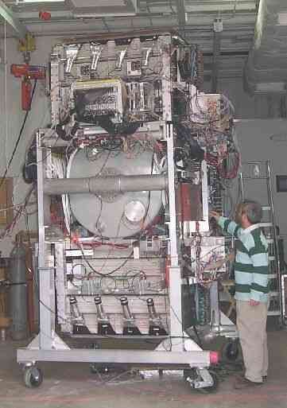
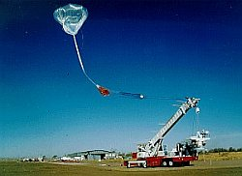
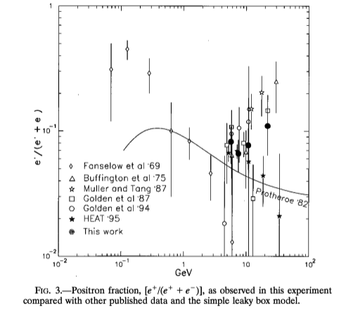
Anti-protons and positrons are seen in Cosmic Rays
Early balloon measurements of positron fraction hinted at an unexpected excess at high energies
Positron fraction →
Golden et al (1996)

Slide 20
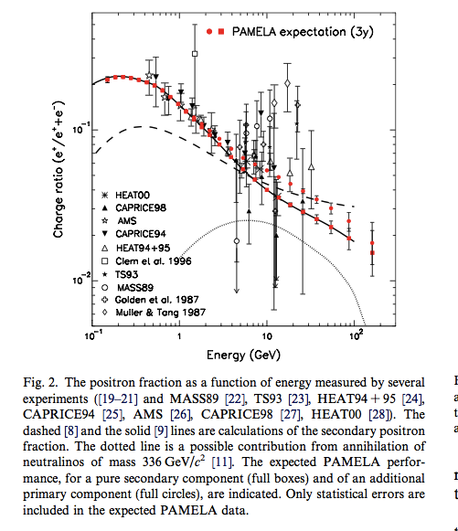
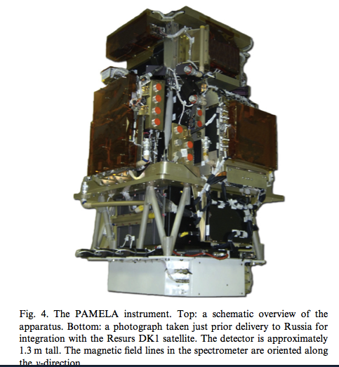
PAMELA – pre-launch prediction
PAMELA
Payload for Antimatter Matter Exploration and Light-nuclei Astrophysics
Launched June 2006
Positron fraction ➞

Slide 21
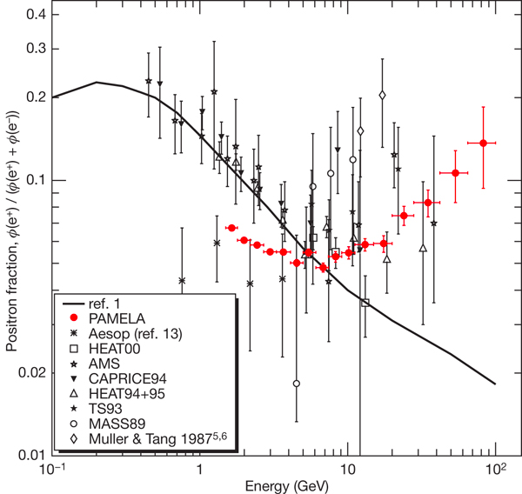
Positron excess seen with PAMELA
Positron fraction ➞
⁾
Adriani et al (2009)

Slide 22
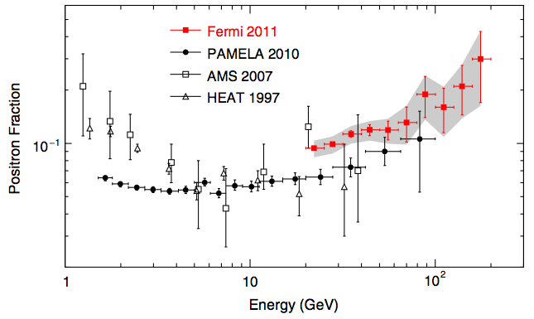
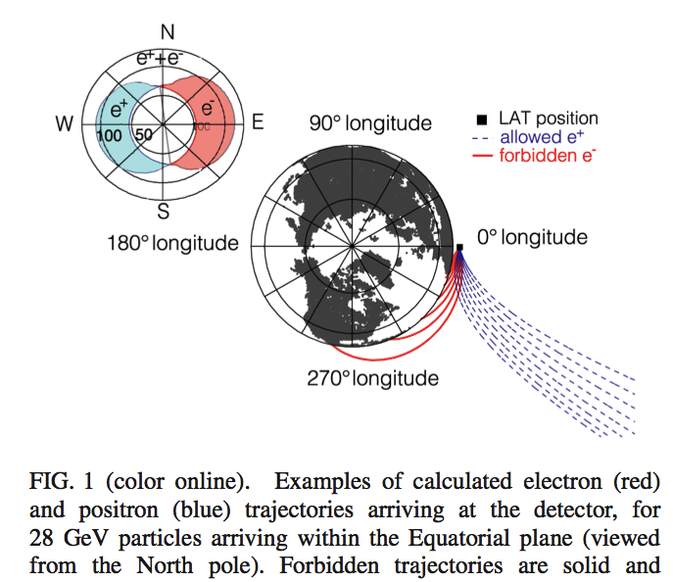
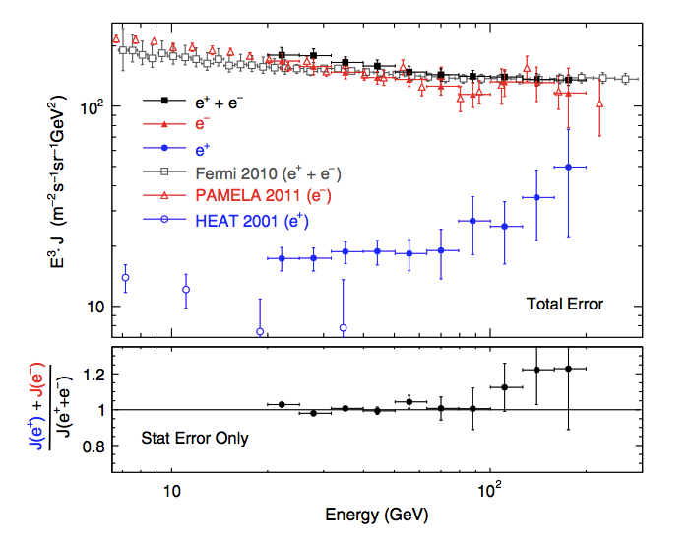
Further confirmation with Fermi using the Earth’s magnetic field
Ackermann et al.
(2012)

Slide 23
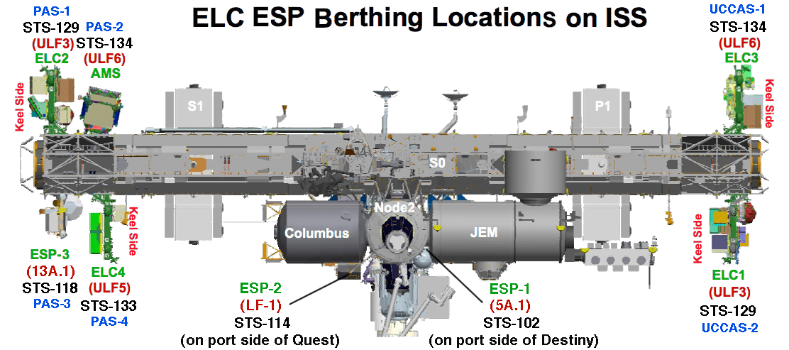
AMS-02 on Space Station
AMS-01 1998 prototype flown on Shuttle; Data link problems – little data
AMS-02 ~1999 Too much power for a satellite; moved to Space Station
2003 Columbia disaster – no room for launch in revised manifest
2008 Special bill passed by Congress and Senate and signed by Obama to add
an extra Shuttle mission to allow AMS-02 to be installed on ISS
2009 Problems with superconducting magnet
– replaced with permanent one from AMS-01
2011 Launch

Slide 24
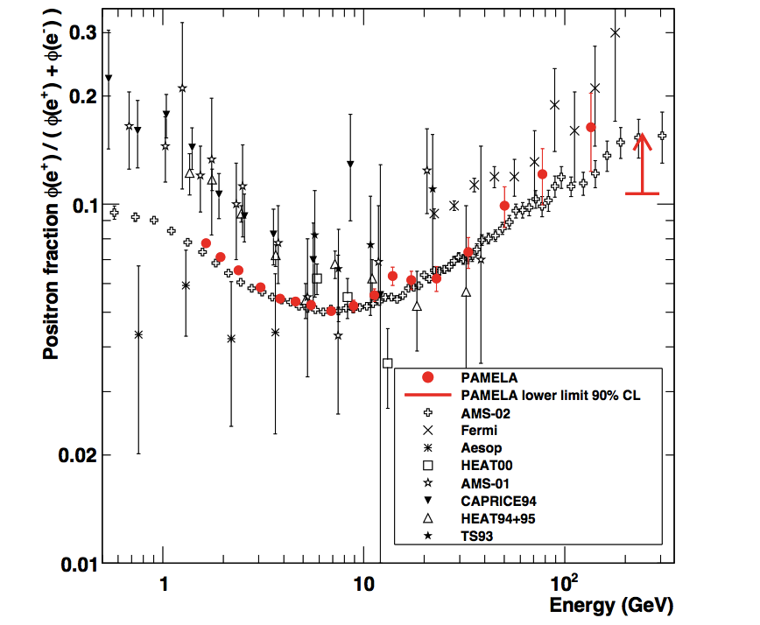
Positron excess confirmed with AMS-02
Pamela data
AMS-02 data
Adriani et al (2013)

Slide 25
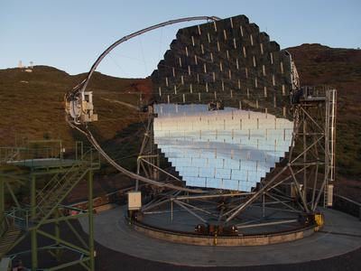
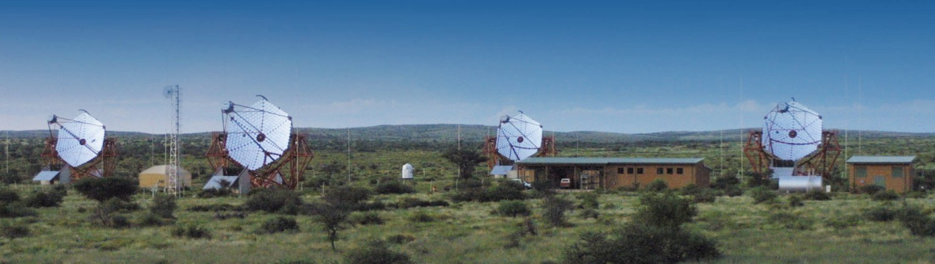
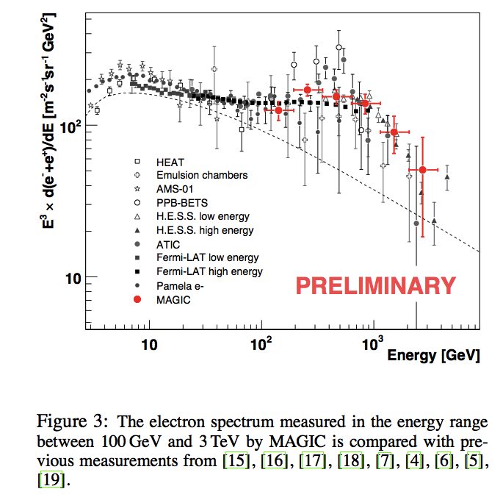
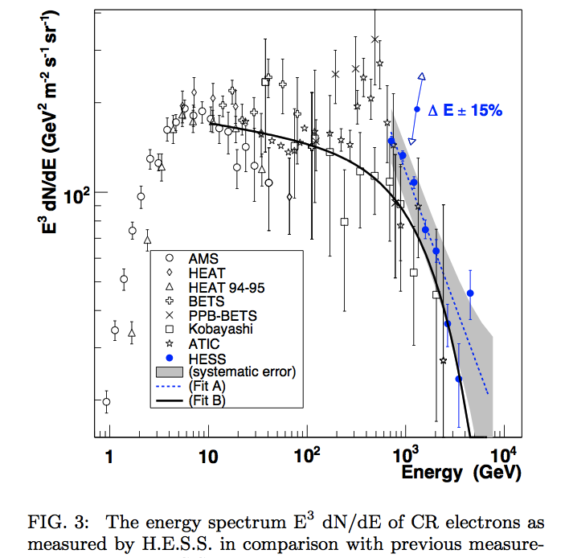
Ground-based experiments cannot distinguish positrons
from electrons but confirm an excess in the total
HESS
M.A.G.I.C
Aharonian et al. (2009)
Borla Tridon
et al (2011)

Slide 26
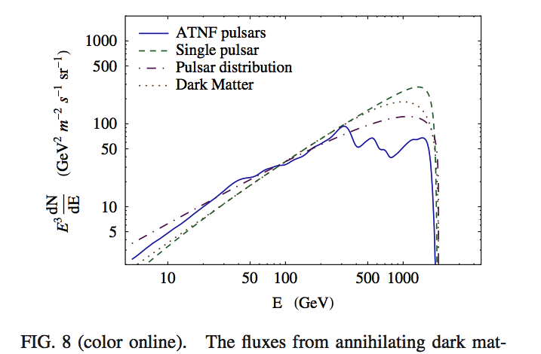
Proposed explanations of the ‘Pamela Excess’
Nearby Pulsars
Rotating Β field -> ➞ Ε field
ΔV~ 10¹⁶ V
Curvature Radn ➞ γ
γ + Β ➞ e⁺+e⁻
γ + γ ➞ e⁺
2) Dark Matter
annihilation or decay
Malyshev, Cholis & Gelfand (2009)
560 out of 1164 citations of the Adriani et al (2009) Nature paper on the Pamela excess contain ‘dark’ in the title; 761/1164 mention it in the abstract.

Slide 27
Anti Stars; Anti Galaxies; Anti Clusters ?
Dirac in his 1933 Nobel Lecture :
“….One might perhaps think that the same theory could be applied to protons. This would require the possibility of existence of negatively charged protons forming a mirror image of the usual positively charged ones. .
… we must regard it rather as an accident that the Earth (and presumably the whole solar system), contains a preponderance of negative electrons and positive protons.
It is quite possible that for some of the stars it is the other way about, these stars being built up mainly of positrons and negative protons. In fact, there may be half the stars of each kind. The two kinds of stars would both show exactly the same spectra, and there would be no way of distinguishing them by present astronomical methods”.

Slide 28
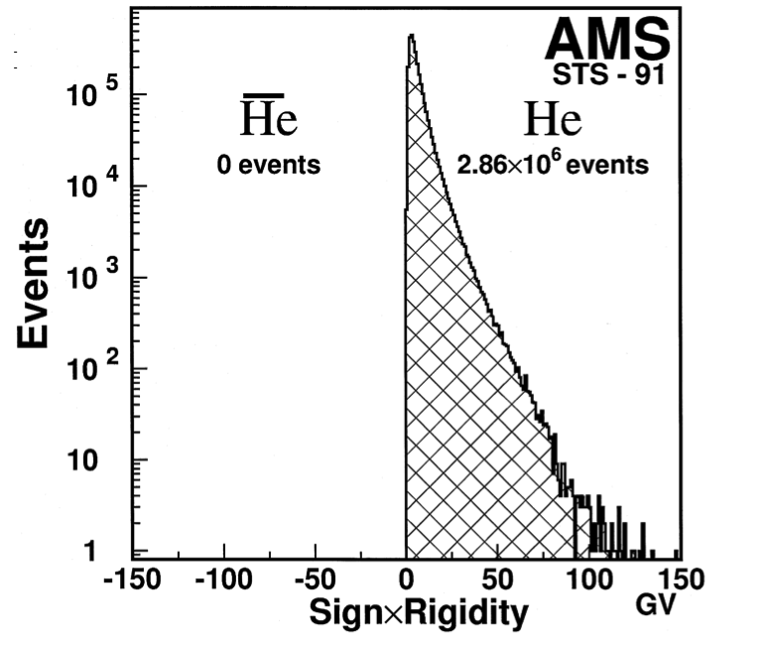
Anti-deuterons – a very small population of secondaries is expected from CR interactions
Consistent with upper limits
A certain detection of even one anti-Helium nucleus in CR would be decisive.
AMS-01 set tight limits N_{He}/N_{he} < 10⁻⁶
AMS-02 results that are awaited
They should be 1000x more sensitive.

Slide 29
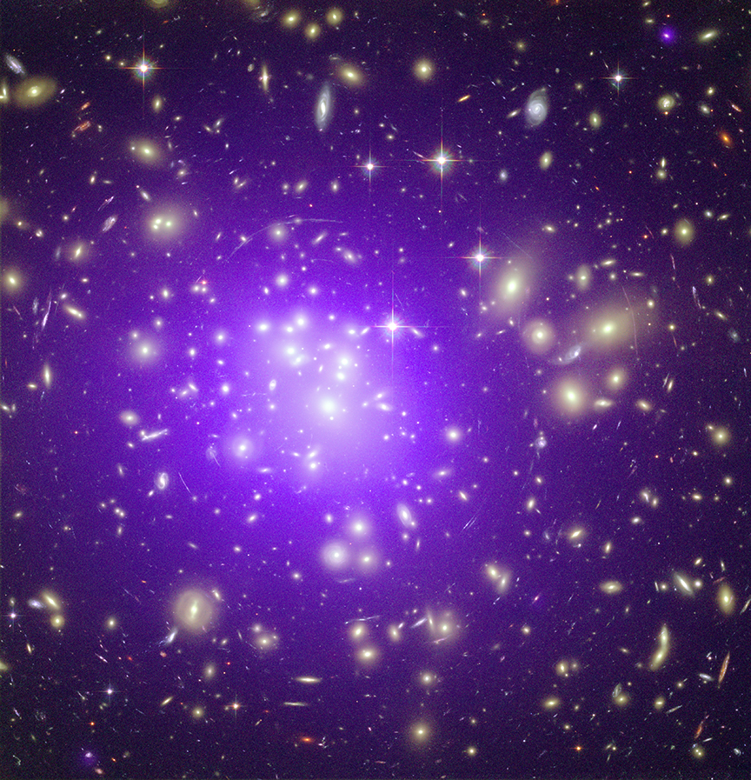
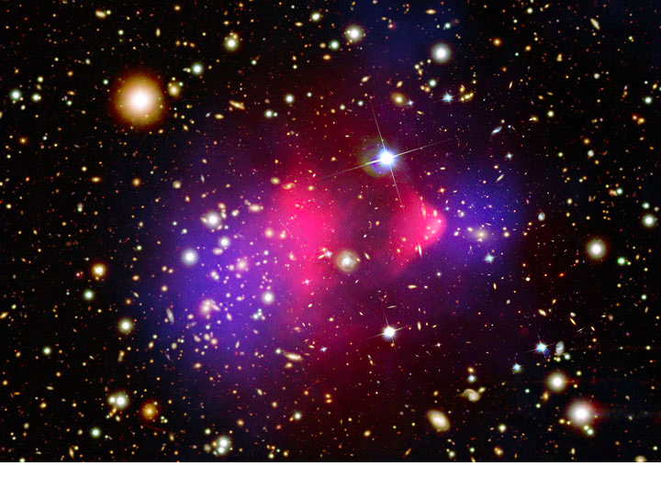
Anti Stars ?
No – at least not in equal numbers
Winds from stars
SuperNova explosions return (anti)matter to the InterStellar Medium
Limits < 1 in 104
Anti Galaxies ?
No – at least not in equal numbers
X-ray observations show that there is an InterGalactic medium in clusters that has been processed through stars
No gamma-rays seen
Anti Clusters ?
Difficult to exclude
In one case two colliding clusters
cannot have been one matter,
one antimatter

Slide 30


In principle, one CAN detect matter / anti-matter mixtures
with electromagnetic radiation
Polarized
source
Pulsar
Rotation measure
Dispersion measure
θ
λ²
τ
λ³

Slide 31
Gravitational redshift
The gravitational potential of the galaxy is well established from the velocity profile (which shows it to be dominated by dark matter)
For radiation coming from 1 kpc from the centre (an angular offset of 7°), there will be a redshift of 1 part in 10⁶.
Would negative gravitation mass for positrons mean that 511 keV positronium annihilation radiation would show no such redshift ?
But
1) The effect is small to measure at present
2) The redshift is a GR effect, but GR cannot hold

Slide 32
The END

Slide 33
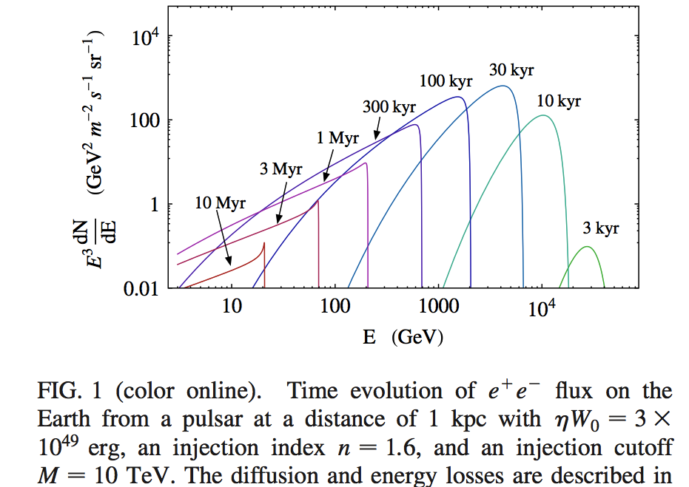
Predicted e⁺ + e⁻ flux from a pulsar at a distance of 1 kpc with ηW₀=10⁴⁹ erg, an injection index n=1.6, and an injection cutoff 10 TeV
Malyshev, Cholis & Gelfand (2009)

Slide 34
Malyshev, Cholis & Gelfand (2009)
e.g. Yin et al. (2013)
 | Pulsar | Age (y) | Distance (kpc)
Geminga | J0633+1746 | 3.7×10⁵ | 0.25
Monogem | B0656 +14 | 1.1×10⁵ | 0.28

Slide 35
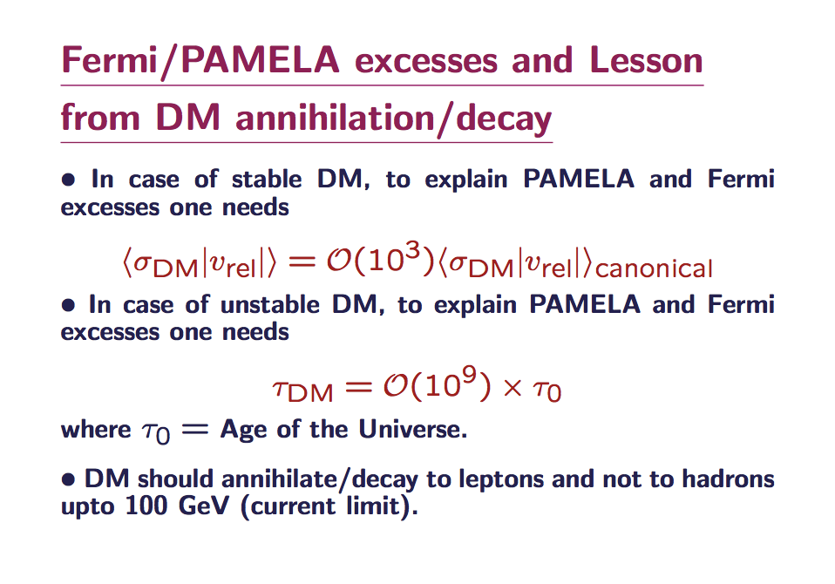
from Sahu (2012)

Slide 36
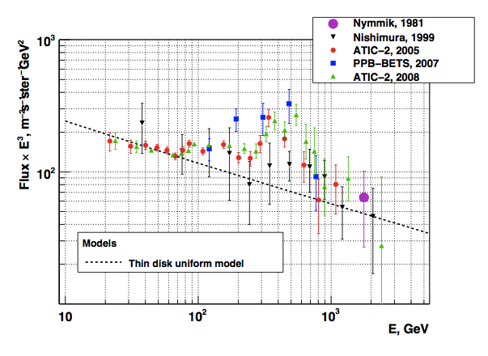
Malyshev, Cholis & Gelfand (2009)
Panov (2013)
By assuming a distribution of pulsars, or equally by considering dark matter with clumps (`sub-halos’) at different distances, one can even explain the features in the total lepton spectrum that may (or may not) have been seen with the ATIC balloon payloads.

Slide 37
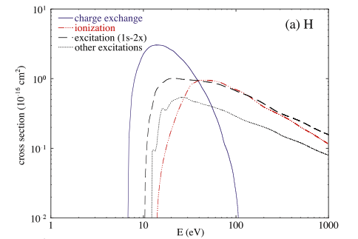
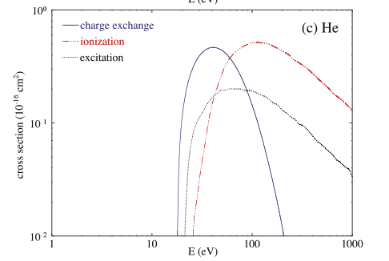
e⁺ + H → Ps + p
threshold 6.8 eV
e⁺ + He → Ps + He⁺
threshold 17.8 eV

Slide 38
MeV (plus)
e⁺
Based on
Guessoum, et al., (1991)
Murphy, Share & Skibo, (2005)
High f_{p} excludes many processes from being the dominant one
In flight
Thermalisation
×
Break -up
Charge
exchange
Radiative
re-combination
Collision with grains
Annihilationwith bound e⁻ in H, He..
Annihilation with free e⁻
3/4
³Ps
¹Ps
1/4
Pick
-off
×
×
×
×
3γ
2γ
2γ
2γ
2γ

Slide 39
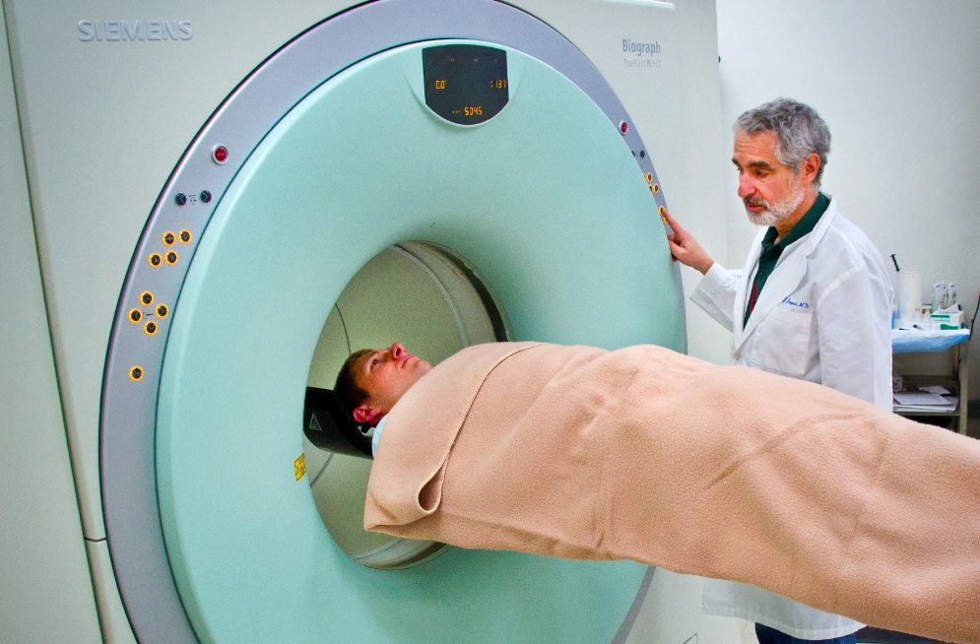
Positron Emission Tomography (‘PET scan’)
Detector 1
~ 1 m
~ 1 mm
-
+
~ 1 m
Detector 2
ν

Slide 40
Positron Emission Tomography
(‘PET scan’)
Positron Emission Astronomy
Detector 1
Gamma-ray Telescope
~ 1 m
~ 8 kpc
~ 1 mm
-
~ 100pc
-
+
+
~ 1 m
?
ν
Detector 2
ν
One knows, with limited precision, on what line the annihilation took place,
but not where along it.
Knowledge of where the positron was produced is limited by its stopping distance

Slide 41
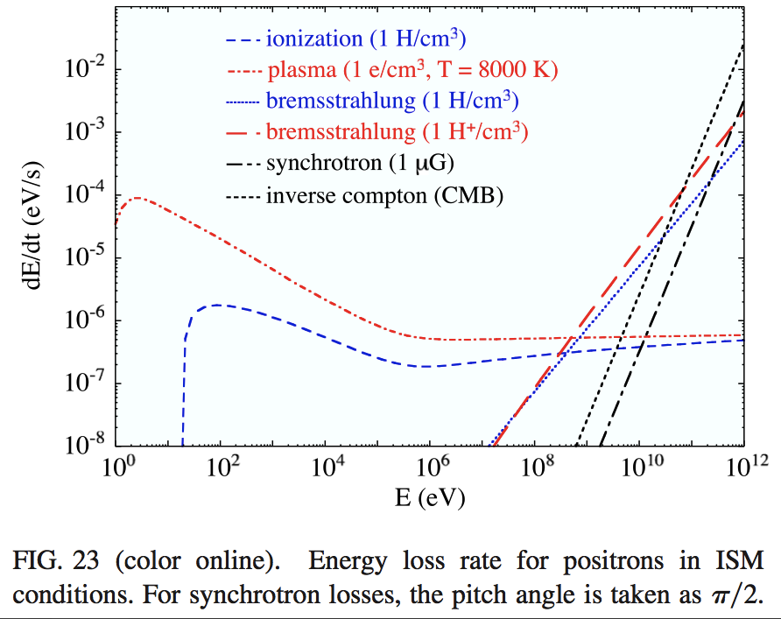
10³ yr
10⁶ yr
1 yr
τ = E/(dE/dt)
Prantzos, et al. (2011)

Slide 42
But these are distances along the path
Gyro radius is small
Pitch angle scattering
. . . . . . .
. . . . . . .
. . . . . . .
. . . . . . .
. . . . . . .
After scattering, particle spirals around a different, but nearby and nearly parallel, field line. But the pitch of the spiral, and hence speed along the line, may be different – even reversed
Diffusion-like process with a random walk along (in tight spiral around) field lines

Slide 43
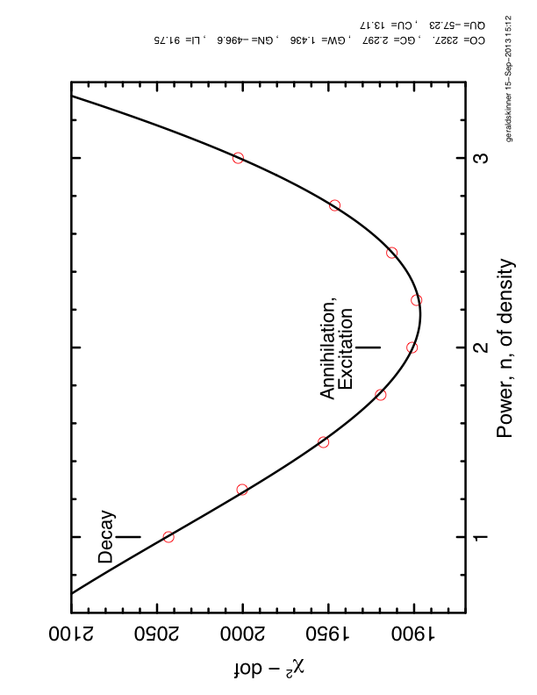
Fitting a model with a disk from radio-active decay plus a bulge component
with and based on an NFW dark matter profile
*
(* 1.2×10⁶ dof)

Slide 44

“We show that the position of the central dark matter (DM) density peak may be expected to differ from the dynamical center of the Galaxy by several hundred parsecs.”
Invoked to explain an offset in the centroid of the possible Fermi 130 GeV line by ~1.5° from the Galactic centre (to negative galactic longitudes).

