Slide 1
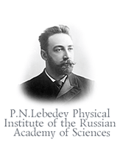



Gravitational Quantum States of Antihydrogen
WAG 2013, BERN
A. Voronin, V. Nesvizhevsky, P.Froelich
O.Dalkarov, E.Kupriyanova

Slide 2
Plan of the talk
Gravitational states of antihydrogen: Is it possible?
How can we get gravitational mass out of gravitational states?
Properties of gravitational states
Spectroscopy, interference and time-spatial resolution of gravitational states

Slide 3
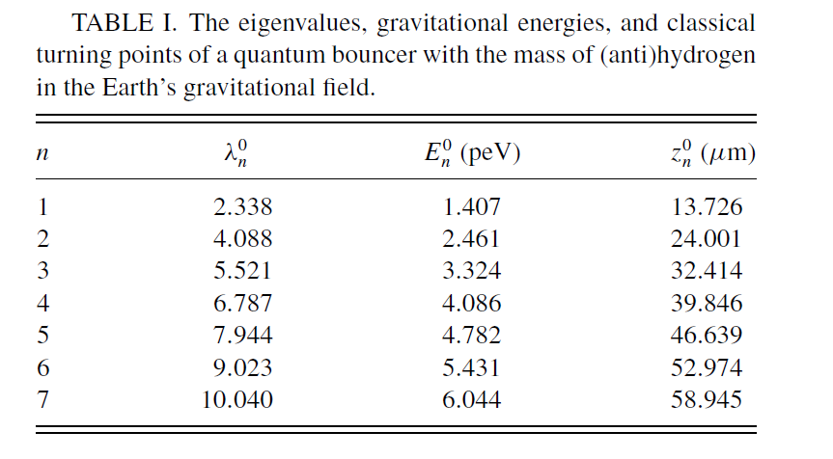
Gravitational quantum states?
State of motion of a quantum particle, which is localized near reflecting surface
in a gravitational field of the Earth.
E, peV
2.7
1.4
13.7
24.0
Z, μm

Slide 4
First Observation: Gravitational States of Neutrons
Nesvizhevsky et al. Nature 415, 297 (2002)
Slit Height Measurement
Inclinometers
Collimator
Absorber/Scatterer
Neutron
detector
Ultra Cold Neutrons
Bottom mirrors
~10-12 cm
Anti-Vibrational Feet
Count rates at ILL turbine: ~1/s to 1/h
Effective (vertical) temperature of neutrons is ~20 nK
Background suppression is a factor of ~10⁸-10⁹
Parallelism of the bottom mirror and the absorber/scatterer is ~10⁻⁶
GRANIT SPECTROMETER

Slide 5
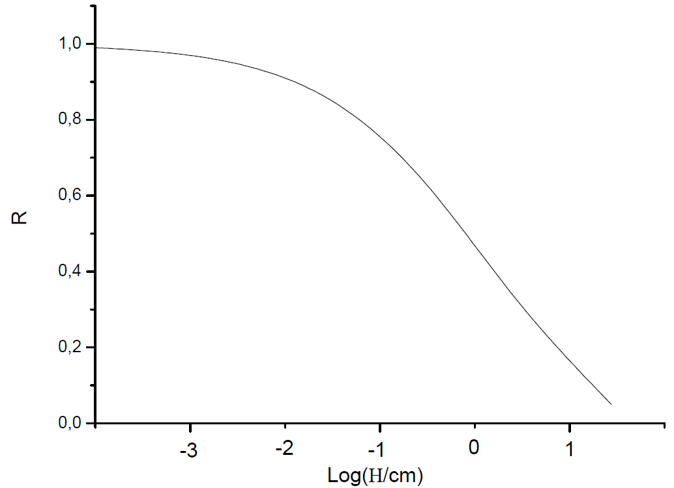
Gravitational states of Antihydrogen:
Seems Impossible? Quantum Reflection!
10 μm =98.5%
Red- silica, black- gold
10 μm = 97%
0.01cm = 96%
0.01cm = 92%
0.1cm = 89%
0.1cm = 78%
1cm = 73%
1cm = 47%
10cm = 32%
10cm = 14%
G. Dufour, A. Gérardin, R. Guérout, A. Lambrecht, V. V. Nesvizhevsky, S. Reynaud, A. Yu. Voronin Phys. Rev. A 87, 012901 (2013)

Slide 6
Gravitational states of antihydrogen
Quantum reflection is about 97% - it works like a reflecting wall
E, peV
2.7
1.4
13.7
24.0
Z, μm

Slide 7
Effects of surface
Hierarchy of scales : gravity and surface-atom interaction are factorized
Annihilation in the bulk of the wall: short –range atom-wall interactions are washed out
Small annihilation width of gravitational states: compromise between long life-time and observation

Slide 8
Correction by Casimir-Polder potential + annihilation
ε₂
Mgz
ε₁
V(z)
z

Slide 9
Gravitational states and Gravitational mass
Gravitational states are all about energy and spatial scales

Slide 10
Methods of observation
Spectroscopy: induced transition between gravitational states
Interference: temporal and spatial oscillations of annihilation signal of superposition of gravitational states
Time and spatial resolution of free-fall events: mapping of momentum distribution of gravitational state into time-of-fall or spatial distribution

Slide 11














Spectroscopy- to induce transitions between gravitational states with alternating magnetic field
Developed for neutrons by V. Nesvizhevsky, S. Baessler, G. Pignol, K. Protassov, A.Voronin
E
13.7
24.0
Z, μm

Slide 12



Antihydrogen in Magnetic Field
Effective Stark-effect
Center-of-mass fall
Coulomb
HF splitting
Field-magnetic moment interaction
E
d
F=1, M=1
c
F=1, M=0
b
F=1, M=-1
a
F=0, M=0
B

Slide 13
Possible scheme of flow-throw experiment
B
5
3
Hd
4
v
1
Ha
2
L
1-source of ultracold antihydrogen, 2-mirror, 3- absorber, 4- magnetic field, 5- detector

Slide 14
Transition probability
Transition probability as a function of frequency. Transition 1->5
Time of observation t=0.1 s

Slide 15
EP and gravitational mass
PRECISION

Slide 16
Interference of gravitational states

Slide 17
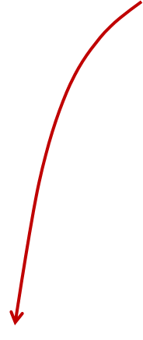
Time and Spatial Resolving of Gravitational States
Momentum distribution of gravitational state can be mapped into measurable
time or spatial distribution
Ha
H=10cm

Slide 18
Mapping of momentum distribution

Slide 19
1 state
velocity distribution
2 state
Time-of –fall distribution H= 10 cm
Spatial distribution time-of-flight T=0.1s

Slide 20
Phase monitoring

Slide 21

B
3
4
1
Ha
2

Slide 22
Conclusions
Gravitational states of Antihydrogen: simplest bound antimatter quantum system, determined by gravity. Effects of surface are canceled out.
Gravitational states of Antihydrogen- metastable and long-living, easy to study due to annihilation signal
Gravitational states- a way to precision measurement of the gravitational mass M

