Slide 1
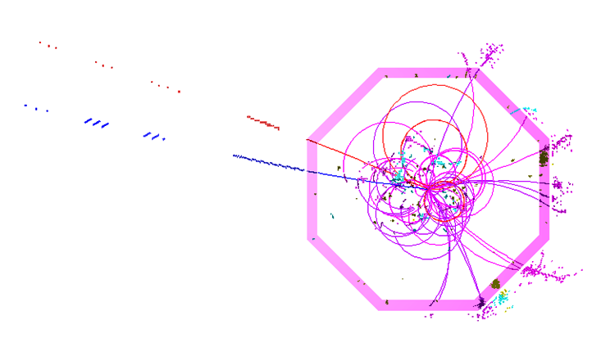
Pandora SDK for
Particle Flow Calorimetry
Friday 1st February 2013
J. S. Marshall
University of Cambridge

Slide 2
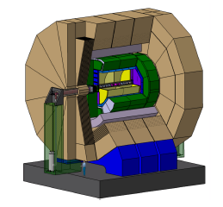
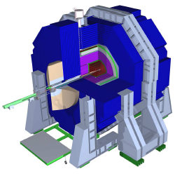
Pandora Client App
Can be detector or software specific
Custom Content Libraries
Runs registered content and performs book-keeping
Register, via APIs
Pandora
SDK
Pandora Client App
Isolates specific detector and software details, creating self-describing hits, tracks, etc.
Algorithm Manager
CaloHit Manager
ILD/Marlin
SiD/org.lcsim
Cluster Manager
Plugin Manager, etc.
Often re-usable, applicable to multiple detectors
Pandora Content Libraries
Pandora content:
algorithms, particle id functions, energy correction functions, shower profile calculators, etc...
FineGranularity Content
LAr Content, etc.

Slide 3
Pandora Algorithms
Pandora
SDK
Pandora
Algorithms
APIs
Algorithm Manager
Clustering Algs
CaloHit Manager
Cluster Merging Algs
Cluster Manager
Track-Cluster Assoc. Algs
Plugin Manager, etc.
Fragment Removal Algs, etc.
Owns named collections of Pandora objects: calo hits, tracks, clusters, PFOs.
Able to perform memory management, as content can only be provided or accessed via APIs.
Use APIs to access Pandora objects and carry out particle flow reconstruction.
Physics-driven code, with nested structure promoting re-use of code to perform specific tasks.
APIs
Currently available: 56 algorithms for fine-granularity detectors, including clustering, visualization, etc.
24 algorithms for reconstruction of neutrino-induced events in LAr TPCs.
6 algorithms for reconstruction in coarse granularity detectors.

Slide 4
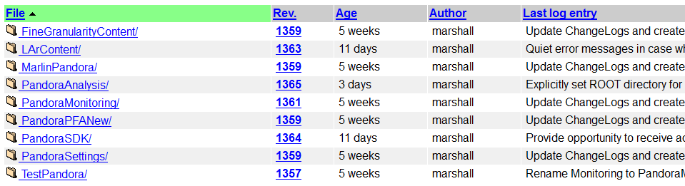
Pandora SVN Repository
Take this opportunity to discuss Pandora library structure, and the different SVN repositories in the main PandoraPFANew repository at DESY. Snapshot as of Tuesday 29th January:
Note: All libraries now contain change logs
https://svnsrv.desy.de/viewvc/PandoraPFANew/
Or use websvn if you prefer!

Slide 5
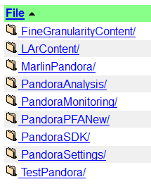
Pandora SDK
Pandora SDK contains source and include files for libPandoraSDK. No dependencies (except libstdc++, etc).
Contains Pandora object definitions, object and algorithm managers, APIs and some helper functions.
Dependency for Pandora client apps and algorithms.

Slide 6
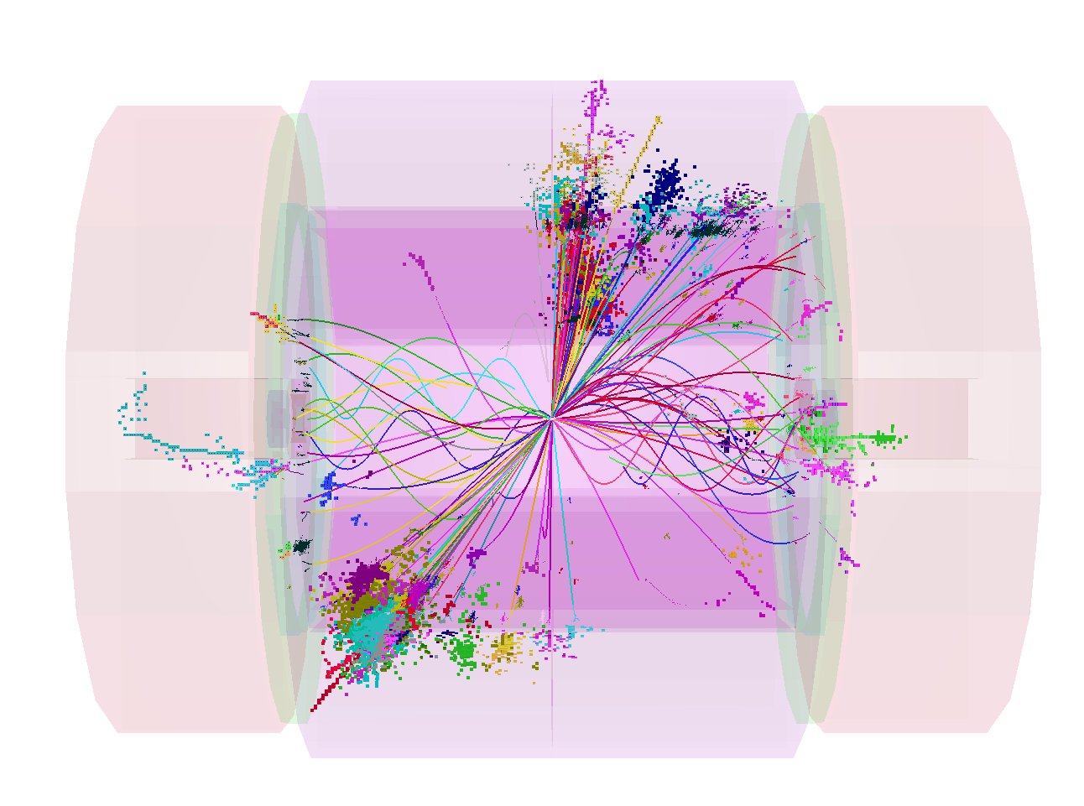
Pandora Monitoring
Pandora Monitoring library offers ROOT TEve-based event display, plus tree- and histogram-writing functionality.
Optional, depends upon ROOT and PandoraSDK.

Slide 7
Pandora Content Libraries
Pandora algorithms are registered by the client app and can exist in any external library.
Some algorithms are sufficiently generic that they can be re-used by multiple client apps. Algs for ILC/CLIC bundled together into FineGranularityContent library.
To use algs, client app must depend upon library.
Content library also contains particle id helper functions, shower-profile calculators, pseudolayer calculators, etc.
Content library depends upon PandoraSDK and, if monitoring functionality desired, can depend upon PandoraMonitoring.

Slide 8
Metadata Package
PandoraPFANew is now just a metadata package, containing build material.
For users of iLCsoft, CMakeLists file uses the ExternalProject_Add macro to check out and build:
PandoraSDK
PandoraMonitoring, if –DPANDORA_MONITORING=1
FineGranularityContent
Each library also contains a simple Makefile, so you can perform this process manually, too, if required.

Slide 9
Client Apps
Client app registers all Pandora content with PandoraSDK, plus provides “building blocks” and the PandoraSettings.
Registering content (algs, etc.) with PandoraSDK gives framework ability to instantiate and run content.
The content that is actually instantiated and run is then that referenced in PandoraSettings xml file.
MarlinPandora is the interface package for ILD-like detectors, described by GEAR, with input objects in lcio format.
TestPandora is the simplest possible client app. It is a command-line app that runs off Pandora .pndr binary files.

Slide 10
Remaining Repositories
PandoraAnalysis contains Marlin processors developed for examining PFA Z’ output in LCIO format.
PfoAnalysis processor writes out a ROOT TTree that can be queried using the simple executables in the PandoraAnalysis/test/ directory.
PandoraSettings repository contains Pandora configuration for fine granularity content algorithms.
Allows reproduction of optimal Pandora jet energy reconstruction. There are a few variant files, described in PandoraSettings_README.txt

Slide 11
Pandora code is in good shape and is cleanly divided into libraries for easy assembly and re-use.
Finish with a question for discussion: What are the priorities for future Pandora development?

