Slide 1
Common Generator Tools for LC
Akiya Miyamoto
KEK
LC Software meeting
1 February 2013
@ CERN

Slide 2
Common generator samples
DBD improvements w.r.t LOI
  Whizard 1.95 with new features such as
    full CKM matrix, complete τ polarization treatment,
    stores more information in generated files.
  Physsim for tth & 8 f background processes
As a common tools
  SVN repository for Whizard tool. Source, Lumi files, …
  Sample generations at SLAC, DESY, KEK and common files are placed on ILC VO GRID.
  Common format for generator meta info. ( process ID, names, cross sections, file names, …) and kept on webs.
    Uniq process ID, common filename convention, common metadata format. Maintained by Tim, Mikael, Stephan, Akiya

Slide 3
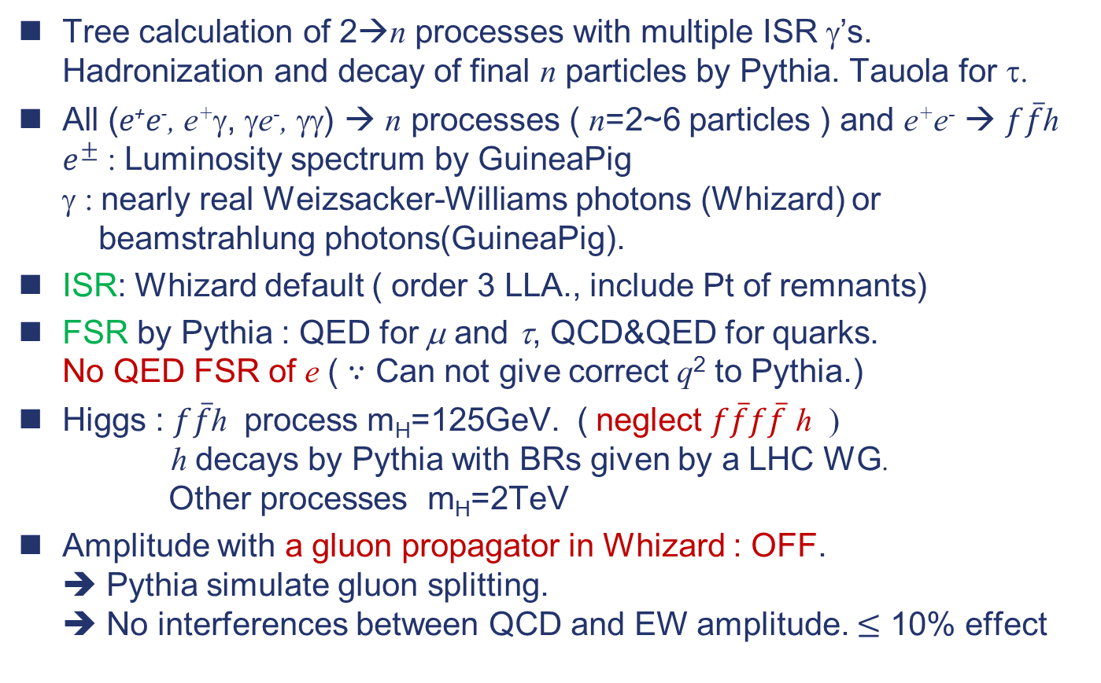
Whizard 1.95 generator
Tree calculation of 2→n processes with multiple ISR γ’s.
Hadronization and decay of final n particles by Pythia. Tauola for τ.
All (e⁺e⁻, e⁺γ, γe⁻, γγ) → n processes ( n=2~6 particles ) and e⁺e⁻ → $f\overline{f}$h
$e^{±}$ : Luminosity spectrum by GuineaPig
γ : nearly real Weizsacker-Williams photons (Whizard) or
beamstrahlung photons(GuineaPig).
ISR: Whizard default ( order 3 LLA., include Pt of remnants)
FSR by Pythia : QED for μ and τ, QCD&QED for quarks.
No QED FSR of e ( $∵$ Can not give correct q² to Pythia.)
Higgs : $f\overline{f}$h process m_{H}=125GeV. ( neglect $f\overline{f}f\overline{f}$ h )
h decays by Pythia with BRs given by a LHC WG.
Other processes m_{H}=2TeV
Amplitude with a gluon propagator in Whizard : OFF.
➔ Pythia simulate gluon splitting.
➔ No interferences between QCD and EW amplitude. $≤$ 10% effect

Slide 4
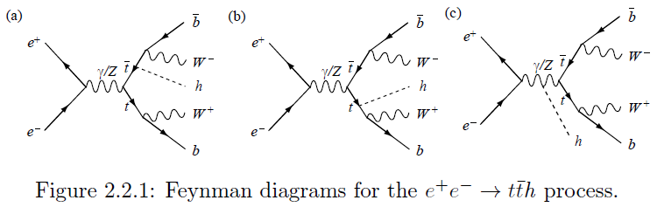
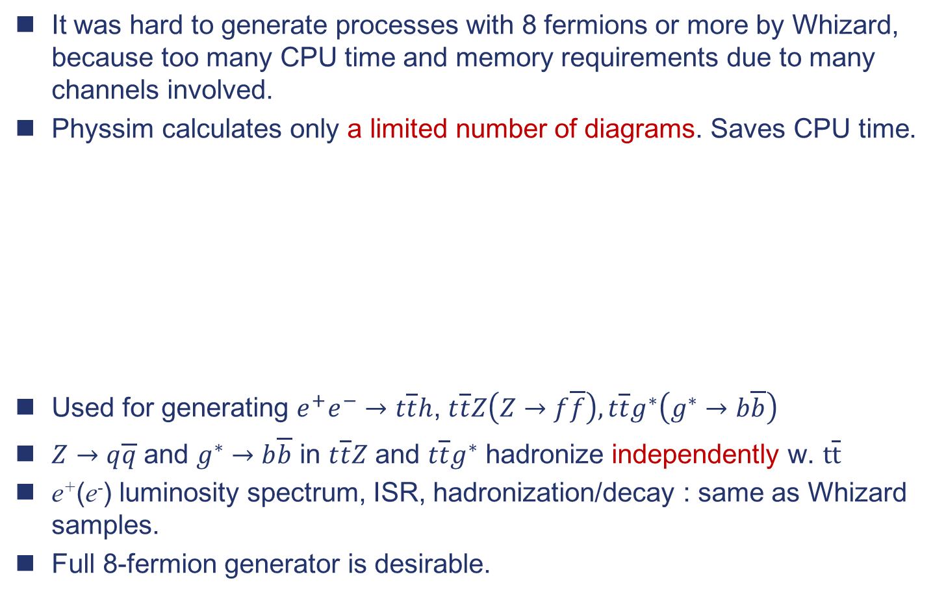

Physsim generator for $t\overline{t}h$
It was hard to generate processes with 8 fermions or more by Whizard,
because too many CPU time and memory requirements due to many channels involved.
Physsim calculates only a limited number of diagrams. Saves CPU time.
Used for generating $e^{+}e^{−}→$ $t\overline{t}h$, $t\overline{t}Z\left(Z→f\overline{f}\right),t\overline{t}g^{∗}\left(g^{∗}→b\overline{b}\right)$
$Z→q\overline{q}$ and $g^{∗}→b\overline{b}$ in $t\overline{t}Z$ and $t\overline{t}g^{∗}$ hadronize independently w. $t\overline{t}$
e⁺(e⁻) luminosity spectrum, ISR, hadronization/decay : same as Whizard samples.
Full 8-fermion generator is desirable.

Slide 5
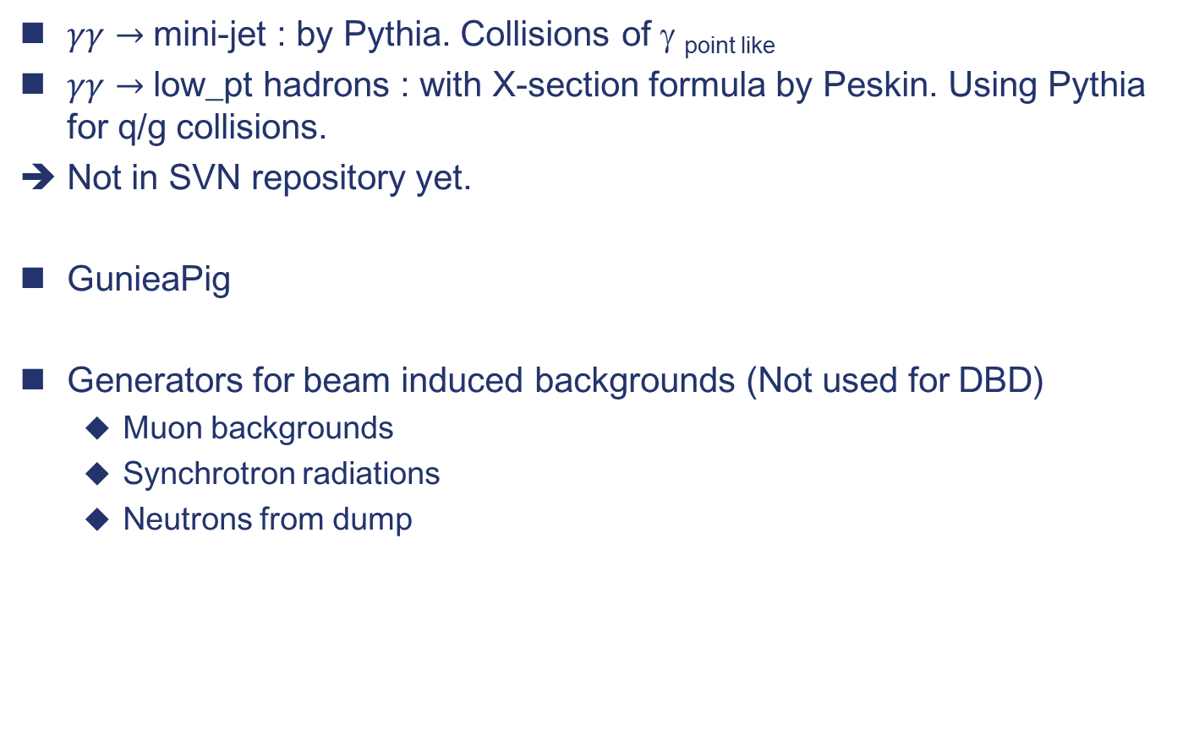
Other generators
$γγ→$ mini-jet : by Pythia. Collisions of γ _{point like}
$γγ→$ low_pt hadrons : with X-section formula by Peskin. Using Pythia for q/g collisions.
Not in SVN repository yet.
GunieaPig
Generators for beam induced backgrounds (Not used for DBD)
  Muon backgrounds
  Synchrotron radiations
  Neutrons from dump

Slide 6
Issues after DBD
New common samples
Generator updates
  Physics improvements : Detector benchmarking → For physics
    Matching of QCD radiation in ME and parton shower
    Bhabha/QED generators : There was a plan, but …
  Whizard 1.95 to Whizard2.x
  Repository for Physsim
  IO: STDHEP ➔ ?
    Whizard: Fortran 95. Is Fortran interface in LCIO useful ?

