Slide 1



The silicon strip vertex detector of the Belle II experiment
Yoshiyuki Onuki
On behalf of BelleII/SVD collaboration
University of Tokyo/Kavli IPMU

Slide 2
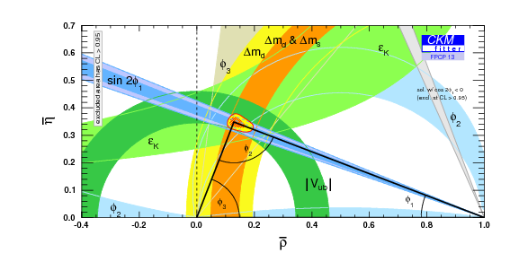
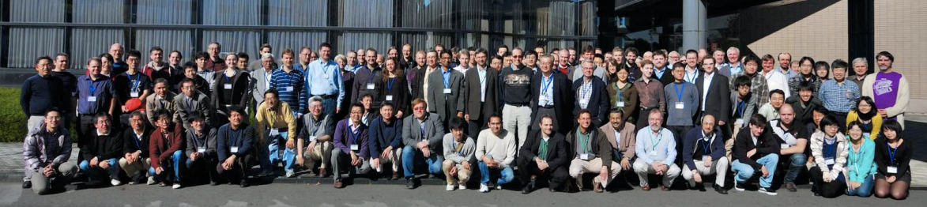
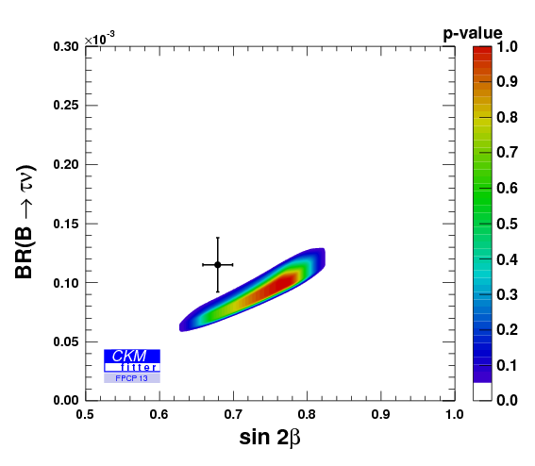
BelleII experiment
BelleII experiment is super B-factory with asymmetric energy of e+e- collider
BelleII
Measurements of CKM matrix elements and angles of the unitary triangle
CP & T & CPT test
Observation of direct CP violation in B decays
Measurements of rare decays (e.g., B→τν, Dτν) and the tension vs sin2φ₁
b→s transitions: probe for new sources of CPV and constraints from the b→sγ branching fraction
Forward-backward asymmetry (A_{FB}) in b→sll
Observation of D mixing and charm-meson physics
Searches for rare τ decays
Observation of new hadrons and resonances
Precise tests of the phenomena which expected to be contributed from beyond SM with enormous B-meson and τ lepton data

Slide 3
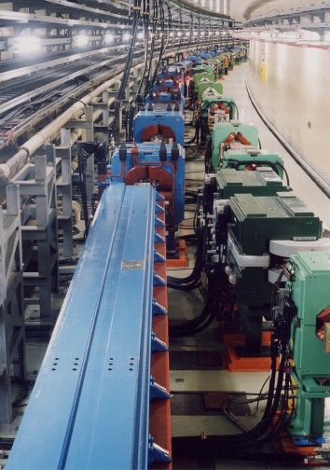
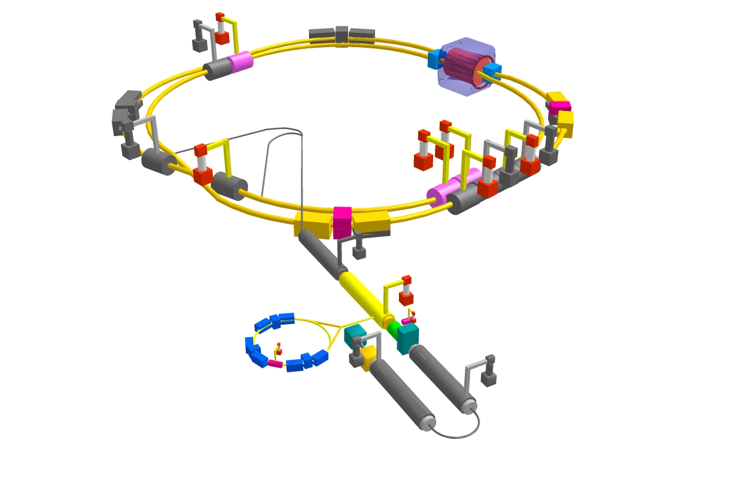
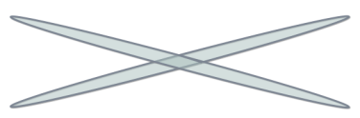
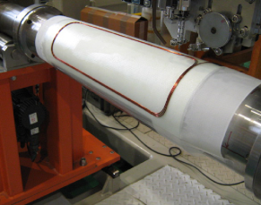
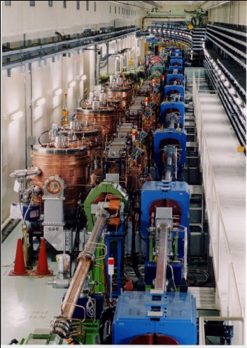

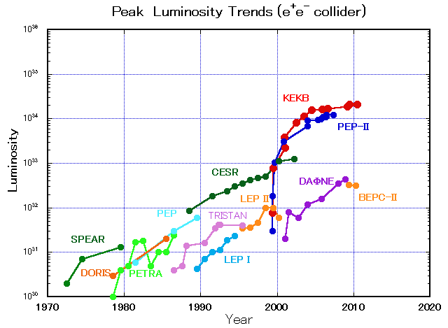

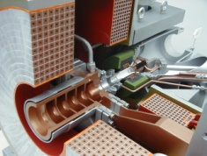
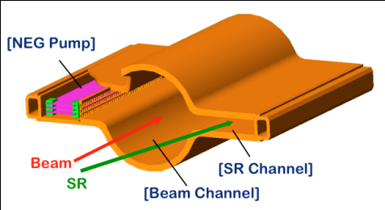
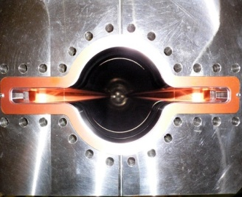

SuperKEKB collider
e⁺ 4GeV 3.6 A
Colliding bunches
Belle II
New IR
e⁻ 7GeV 2.6 A
New superconducting /permanent final focusing quads near the IP
New beam pipe
& bellows
SuperKEKB
Replace short dipoles with longer ones (LER)
ｘ４０
Add / modify RF systems for higher beam current
10³⁶
Low emittance positrons to inject
E.Kikutani / M. Masuzawa
Positron source
Redesign the lattices of HER & LER to squeeze the emittance
Damping ring
New positron target / capture section
KEKB
TiN-coated beam pipe with antechambers
Low emittance gun
Low emittance electrons to inject
Target: L = 8x10³⁵/cm²/s

Slide 4
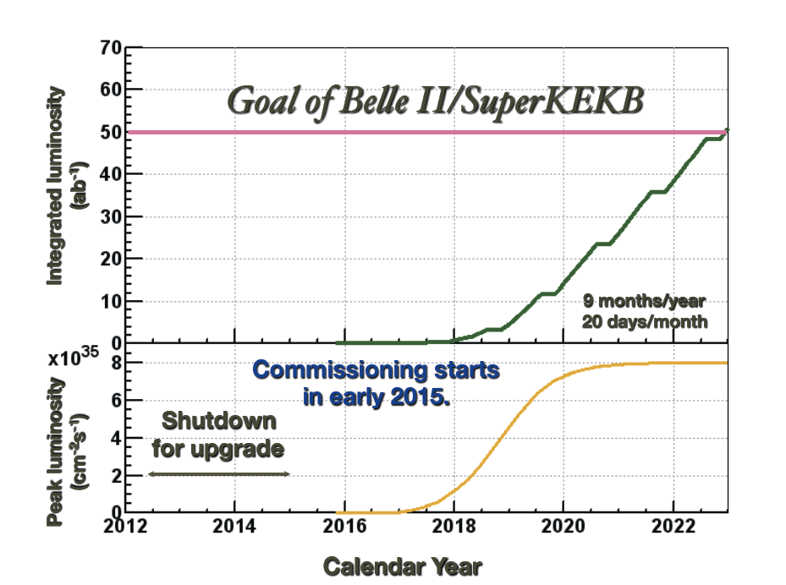
Luminosity projection

Slide 5
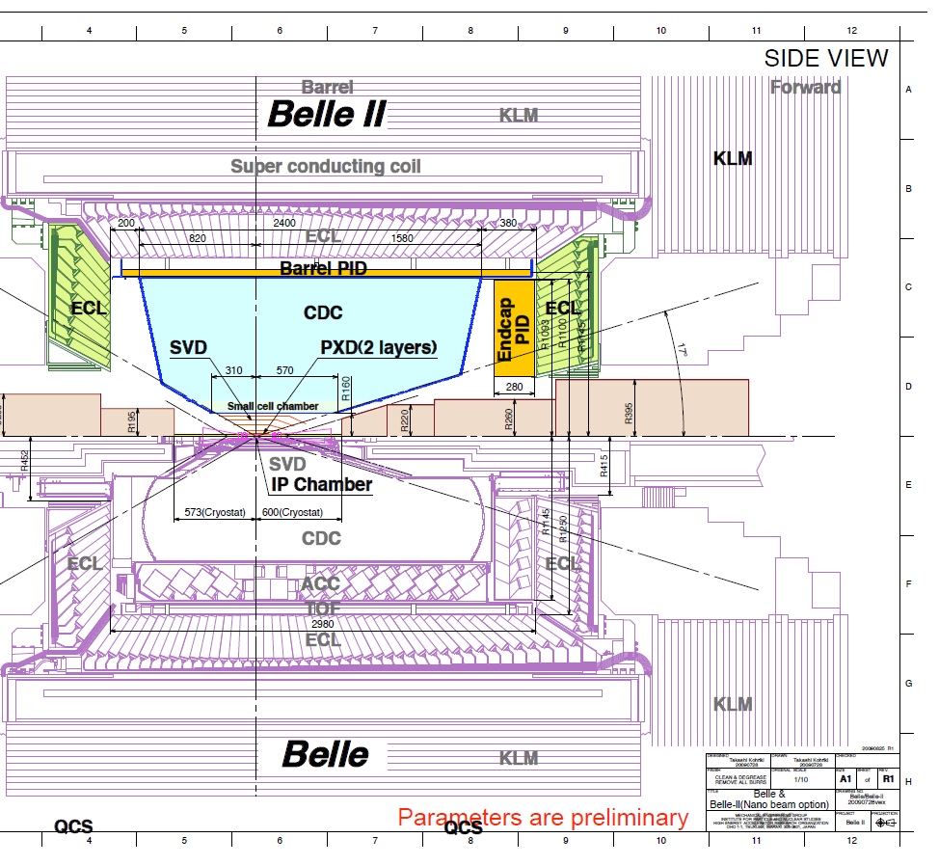
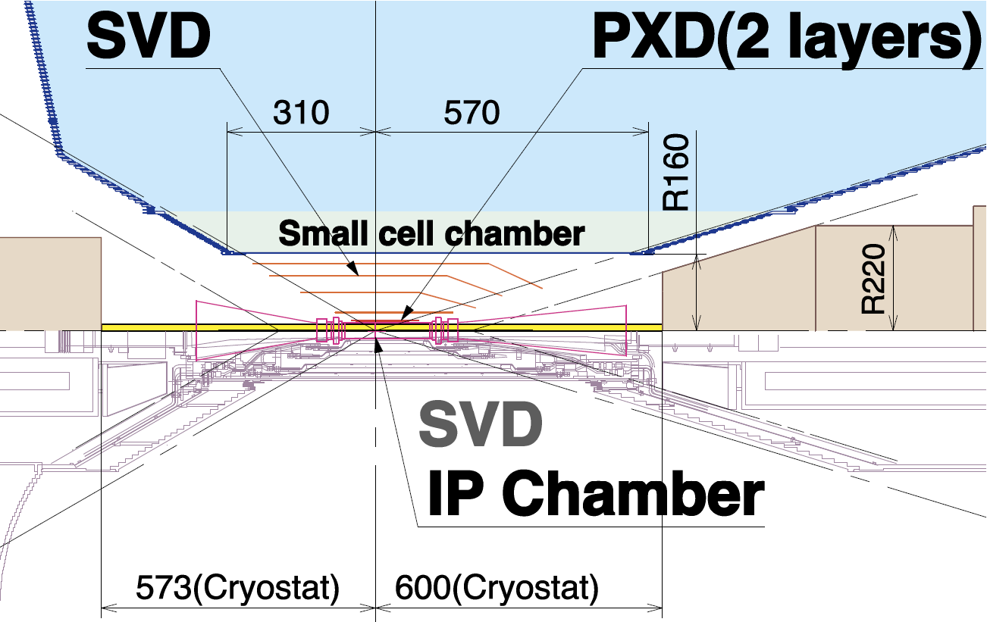
Detector upgrade
SVD: 4 DSSD layers g 2 DEPFET layers + 4 DSSD layers

Slide 6
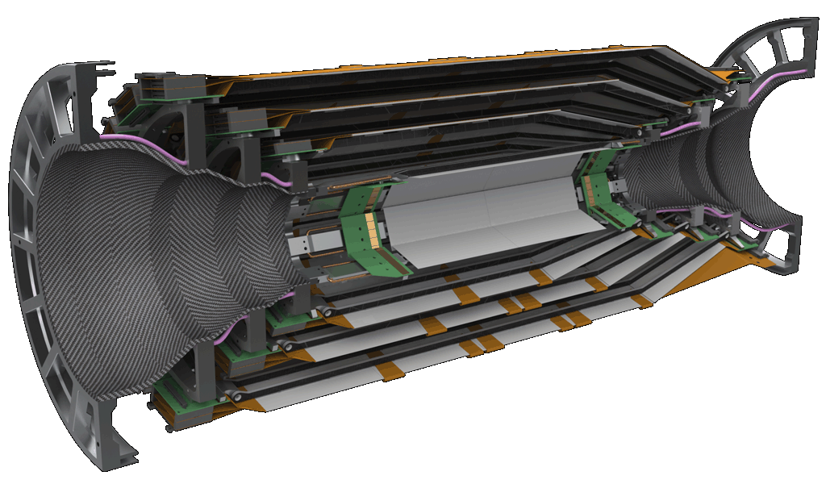
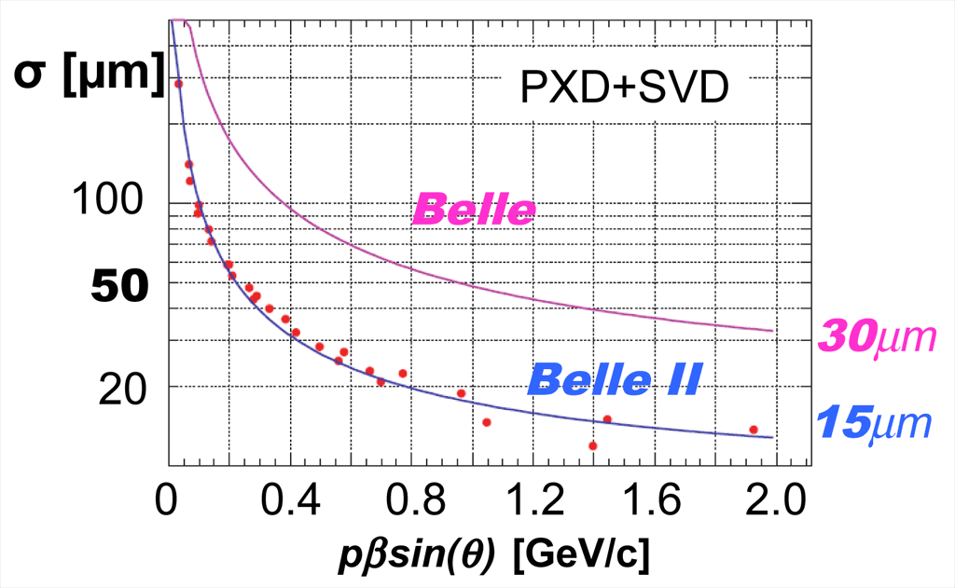
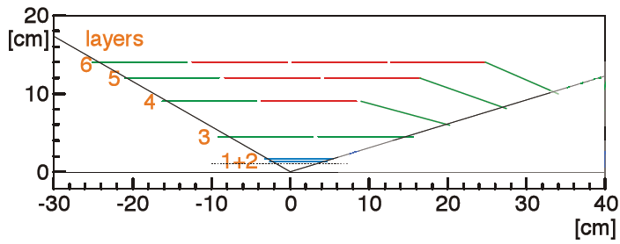
Strip Vertex Detector(SVD)
BelleII vertex detector(PXD+SVD)
@Low energy high luminosity machine
Good vertex resolution(incl. K_{S}→ππ)
Low pT tracking (D*→Dπ_{slow})
Low material budget
Fast readout(trig. max~30kHz)
CO₂ cooling pipe along with APV chips
Layer | Sensor/ladder | Origami | Ladder | Length | Radius | Slant angle | Occupancy
3 | 2 | 0 | 7 | 262 | 38 | 0 | 6.7%
4 | 3 | 1 | 10 | 390 | 80 | 11.9 | 2.7%
5 | 4 | 2 | 12 | 515 | 104 | 17.2 | 1.3%
6 | 5 | 3 | 16 | 645 | 135 | 21.1 | 0.9%

Slide 7
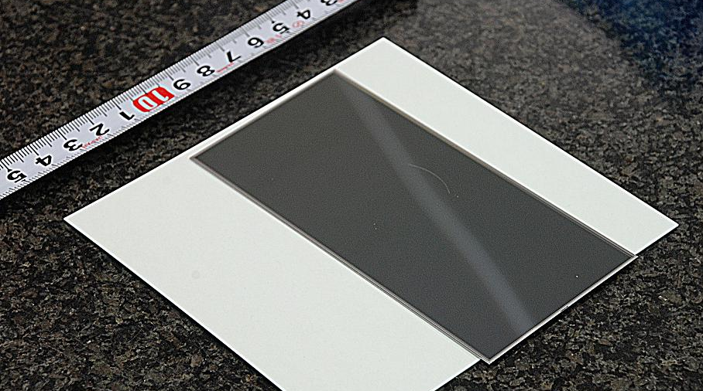
Double-sided Silicon Strip Detector(DSSD)
Layer3: Small DSSD
  Manufacturer: HPK
  Chip size: 124.88 mm ×40.43 mm
  Thickness: 320μm
  P-stop layout: Atoll p-stop
Layer4,5,6: Large DSSD
  Manufacturer: HPK
  Chip size: 124.88 mm ×59.60 mm
  Thickness: 320μm
  P-stop layout: Atoll p-stop
Layer4,5,6: Trapezoidal DSSD
  Manufacturer: Micron
  Chip size: 125.58 mm ×60.63(41.02) mm
  Thickness: 300μm
  P-stop layout: Atoll p-stop
 | Readout strip(p/Rφ) | Readout strip(n/z) | Readout pitch(p/Rφ) | Readout pitch(n/z) | Chip size (mm²) | Active area (mm²)
Large | 768 | 512 | 75 μm | 240 μm | 124.88x 59.60 =7442.85 | 122.90x57.72 =7029.88
Trapezoidal | 768 | 512 | 50-75 μm | 240 μm | 125.58x(60.63+41.02)/2=6382.60 | 122.76x(57.59+38.42)/2=5893.09
Small | 768 | 768 | 50 μm | 160 μm | 124.88x40.43 =5048.90 | 122.90x38.55 =4737.80

Slide 8
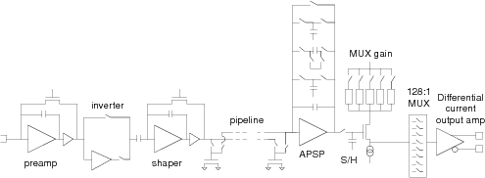
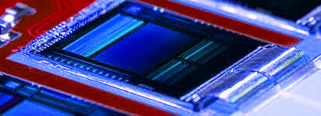
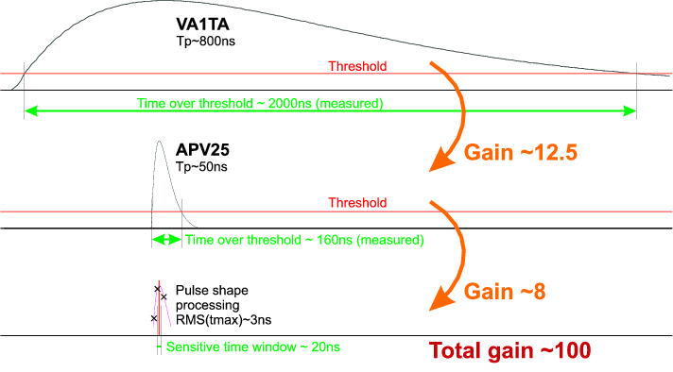
Readout Chip APV25
Schematics of one channel
APV25
Developed for CMS (LHC)
0.25 µm CMOS process
Shaping time 50ns
Input ch. 128ch
Power consumption 350mW
Thickness 100μm(thinned)
Radiation tolerance >30Mrad
ENC_{C} [e] 250e+36e×C[pF]
Multi-peak mode (read out several samples along shaping curve)
40x luminosity with harsh environment from beam background is expected.
We need fast shaping.

Slide 9
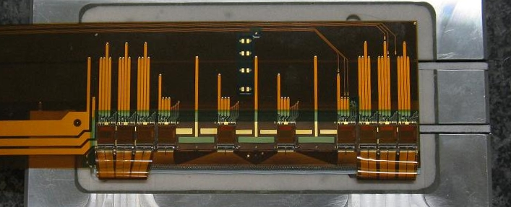
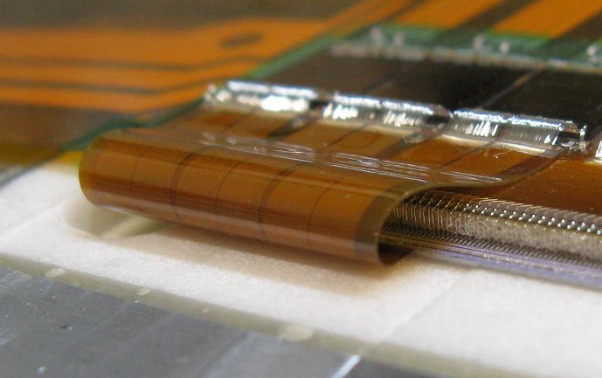
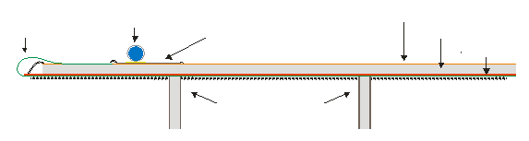
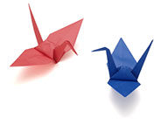
Chip-on-sensor method, Origami
Support ribs
APV25
Bonding wire
Wrapped FLEX
fanout for P-side
Airex
Kapton hybrid
APV25
Cooling pipe
Airex
(Polymer foam)
DSSD
DSSD
Support ribs
Chip-on-sensor for double-sided readout, named “Origami”
All chips aligned on one side → single cooling pipe (Ave. 0.59% X₀)

Slide 10
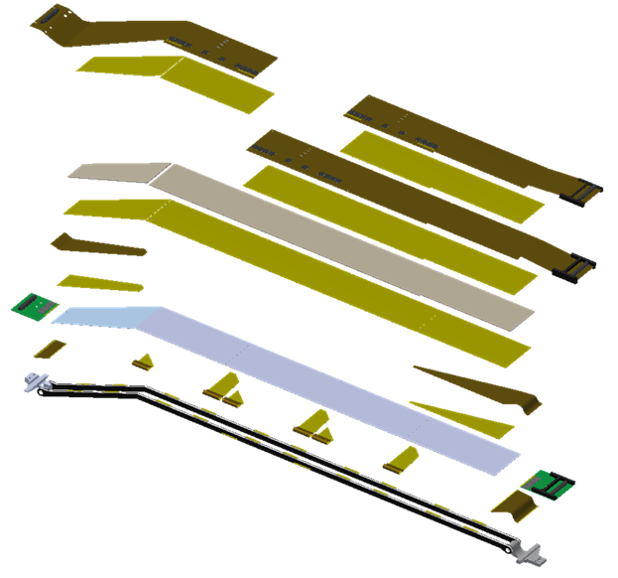
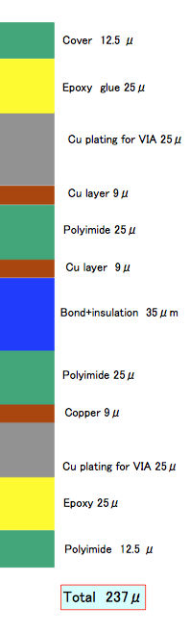
Breakdown of material budget
Origami +Z flex
Glue
Origami CE flex(length 450mm)
Airex
Origami −Z flex
…Three Cu layer FLEX(Taiyo Co.)
PF2
DSSD
PF1
PA1
Ribs…
Airex foam sandwiched by
Carbon fiber ribs
PA2
PB2
Ribs
L6 ladder explosion view
Glue…Araldite 2011
PB1
DSSD+ Origami | Rib | DSSD | Airex | Origami | CO2 Cooling | 100μm Glue | Total % X₀
HPK+1Origami | 0.035 | 0.340 | 0.055 | 0.133 | 0.037 | 0.033 | 0.593
HPK+2Origami | 0.035 | 0.340 | 0.055 | 0.266 | 0.037 | 0.033 | 0.733
Micron | 0.035 | 0.320 | 0.055 | 0 | 0 | 0.011 | 0.421
Micron+Origami | 0.035 | 0.320 | 0.000 | 0.133 | 0 | 0.033 | 0.576

Slide 11
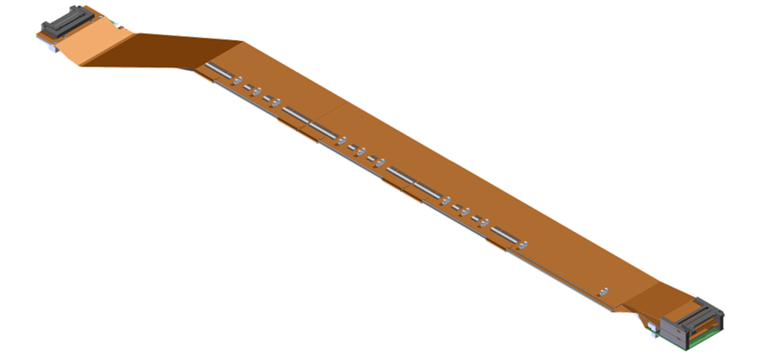
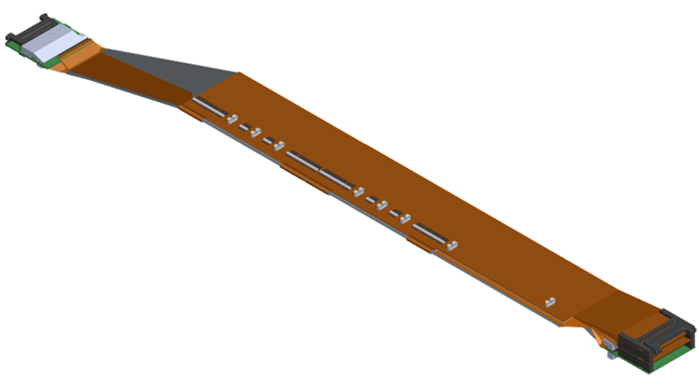
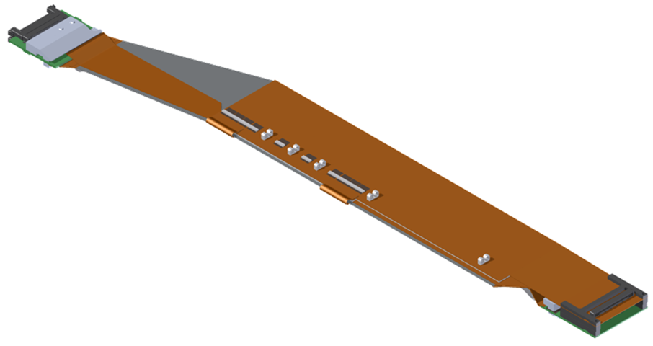
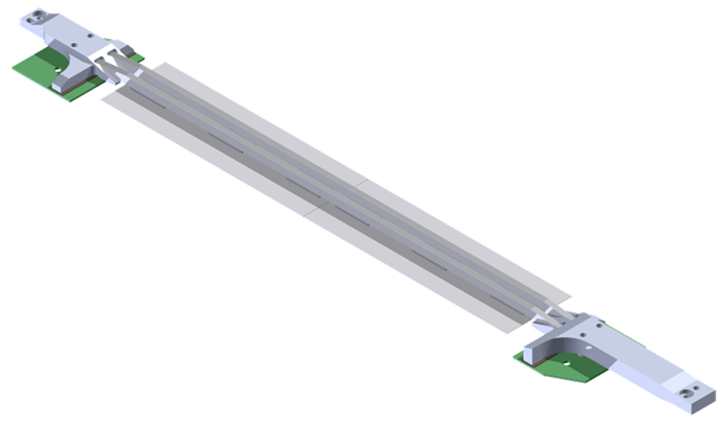
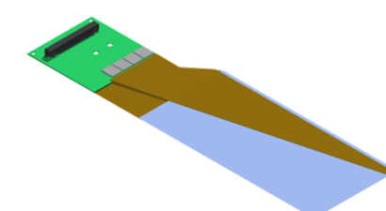
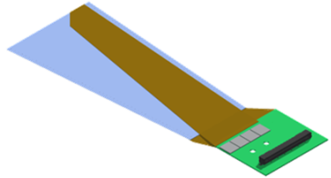
SVD Ladders
L6 Ladder
FW module
FW r/o
Origami module
BW r/o
L5 Ladder
Origami module
Origami module
Cooling pipe
L4 Ladder
FW r/o
BW module
L3 Ladder
BW r/o
Ladder production cites:
L3 Melbourne(Australia)
L4 TIFR(@Kavli IPMU)
L5 HEPHY(Vienna)
L6 Kavli IPMU(Japan)
Cooling pipe
Cooling pipe
Possible contribution for FW&BW module by INFN(Italia)
FW module
BW module
World wide collaborated ladder production

Slide 12
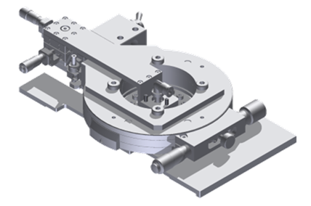
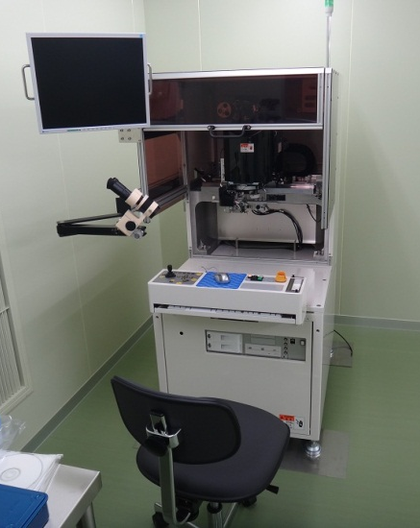
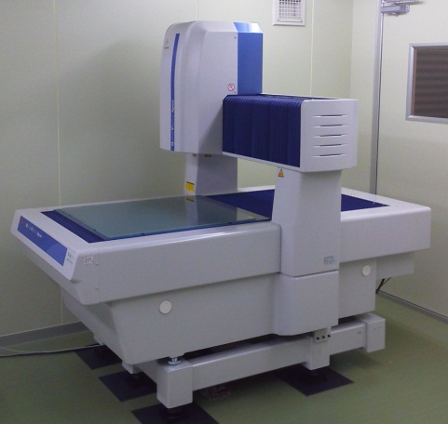
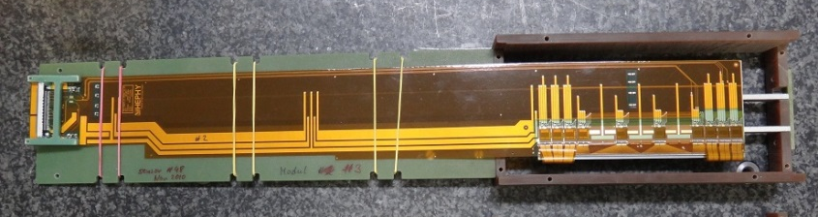
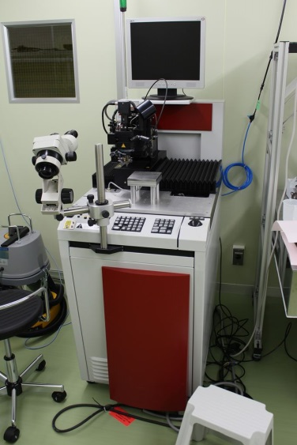
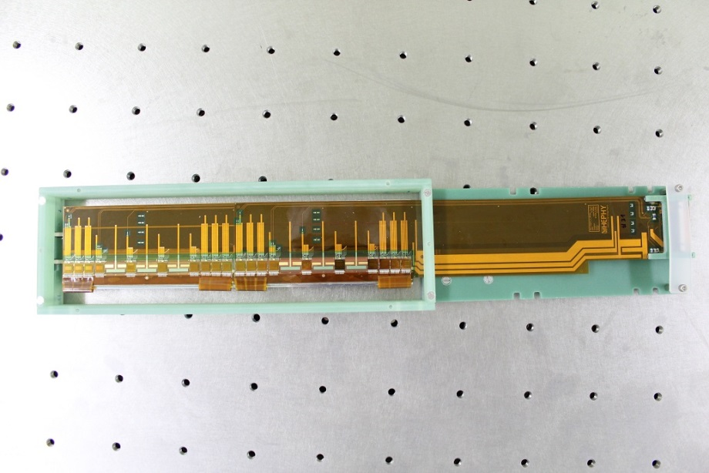
Ladder assembly
Strategy
  Active alignment of DSSDs at < O(10μm) with DSSD moving stage.
  Measurement of whole fiducial marks on DSSD by CMM after the assembly.
  Porting L6 production jigs to the other layer
Status
  A full set of L6 ladder production jigs in Kavli IPMU
  Working single and double Origami modules are produced so far.
  Verification of technical milestone w/ assembly of mockup ladder is in progress
  Collaborative research agreement was concluded btw TIFR and Kavli IPMU.
  Commissioning of wire-bonders in each institute is done. Training for production.
XYZθ-stage
Single Origami module
CMM
Mitsutoyo QV606
Kavli IPMU
Automatic wire bonder
Choonpa Co. REBO-7W
IPMU(borrowed KEK)
Automatic wire bonder
Delvotec 6400
HEPHY, TIFR(@Kavli IPMU)
Double Origami module

Slide 13
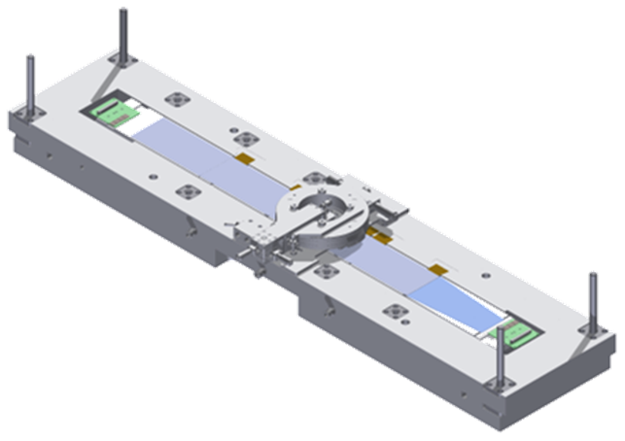
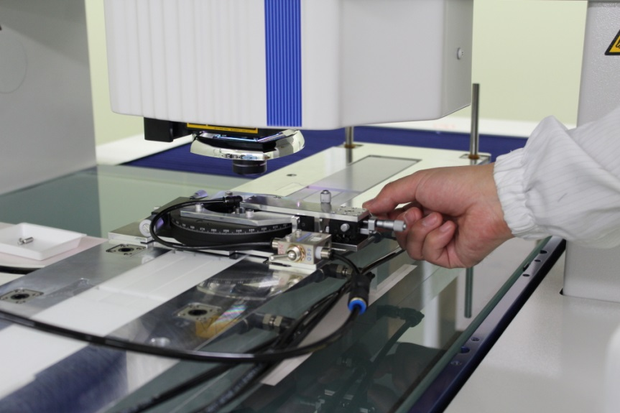
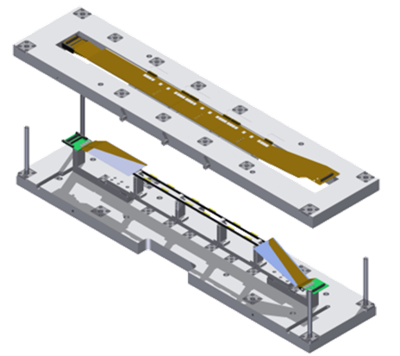
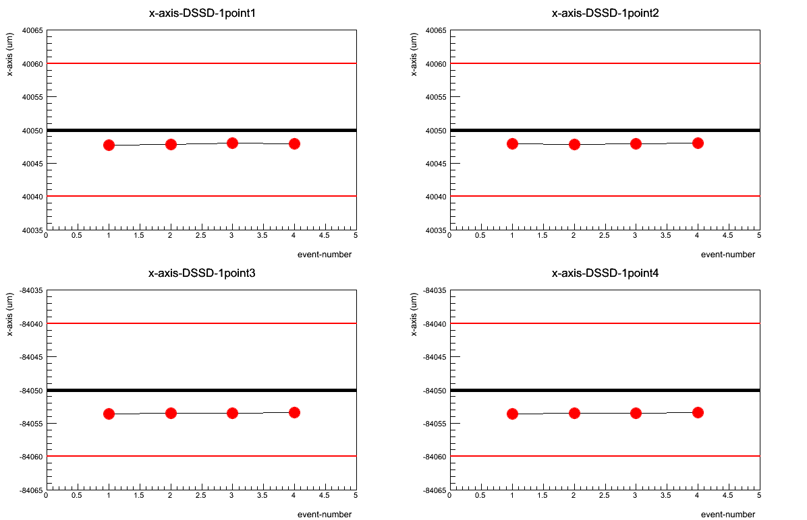
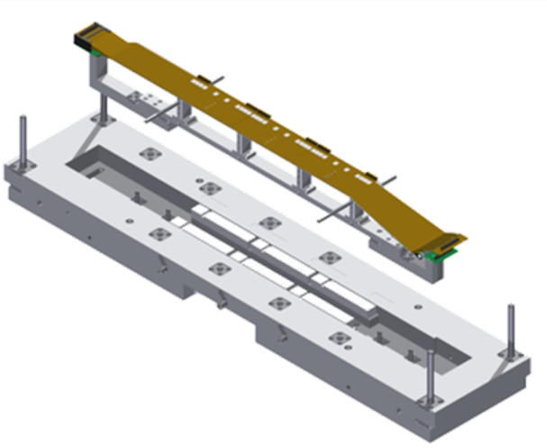
Ladder assembly procedure
Active alignment
w/ XYZθ-stage
Assembly-jig
DSSD
…
Gluing Origami module
and FW&BW module
Demonstration of alignment w/ 4DSSDs
Left Top Fiducial Mark
+10μm
Right Top FD
Design value
1st 2nd 3rd 4th
DSSD
−10μm
Left Down FD
Right Down FD
Finish
DSSDs are aligned and fixed at initial assembly procedure.
The alignment are kept till the end of the procedure.
χ2 fit will be performed for the data after the assembly.
The alignment correction parameters can be extracted at μm
precision. → will be used for initial alignment constant.

Slide 14
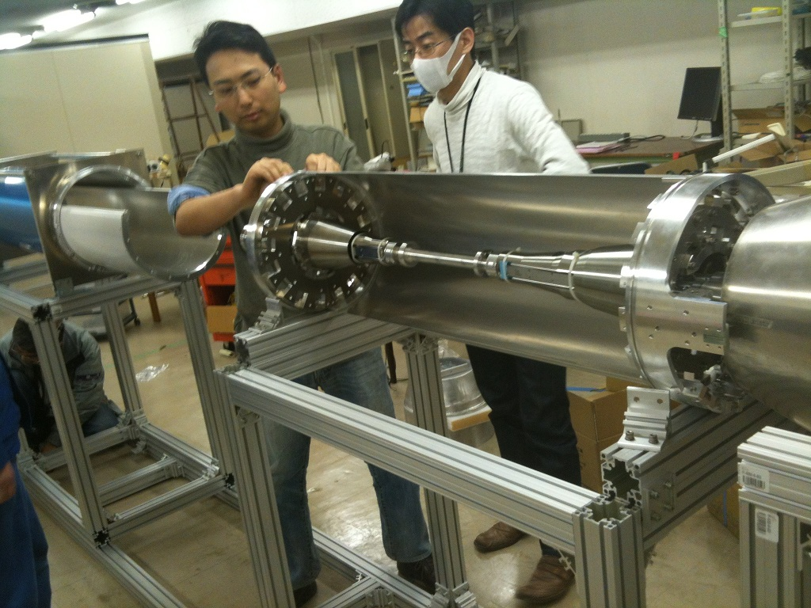
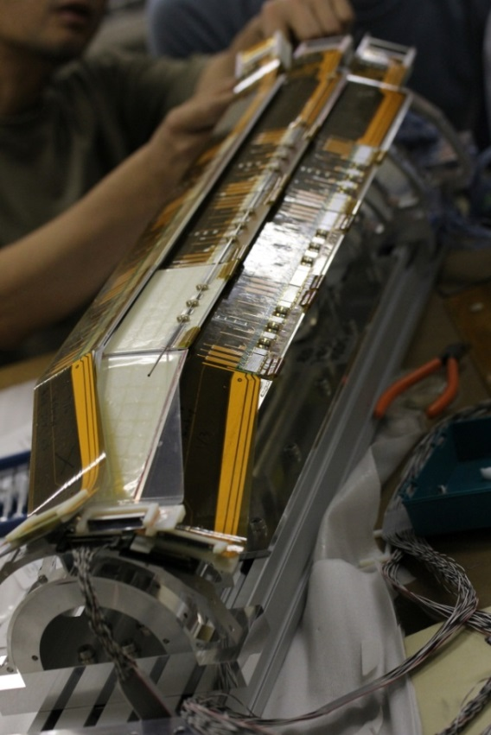
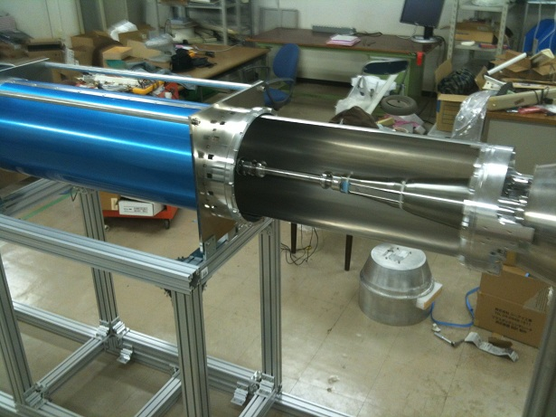
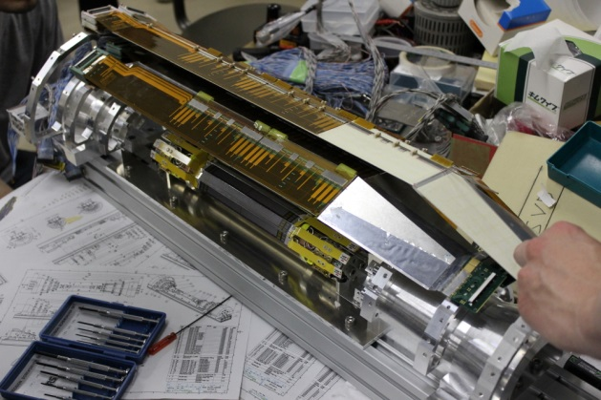
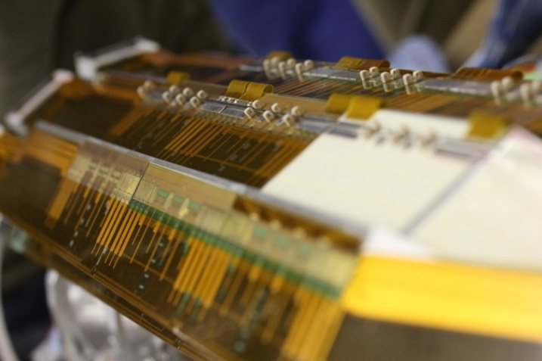
Mockup IR-PXD-SVD
IR+PXD+SVD precise mockup study @ KEK

Slide 15





SVD DAQ system
On top of BelleII
Electronics Hut
Inside of BelleII detector
BelleII DAQ system
Optical link (>20m)
FADC+PROC
~2m
cable
COPPER
1748 APV25 chips
DOCK
~10m
cable
FTB
Front-end hybrids
Rad-hard
DC/DC
converters
DatCon system
Analog level translation,
data sparsification and
hit time reconstruction
AMC board
PXD
Find RoI
DOCK
FADC+PROC
FTB
COPPER
AMC board
FADC-FTB-(COPPER+DatCon) chain test was succeeded on June 2013

Slide 16



CO₂ cooling
Closed CO₂ cooling plant under development
Collaboration with CERN
First step is to gain experience with open (blow) system
Control cabinet with touch screen
Accumulator
1.6 m
1.2 m
1.3 m
Liquid pumps
Common CO₂ plant with PXD

Slide 17
SVD construction schedule
Ladder production
  L6 ladder production
    14 workdays per ladder
    13months for 19 ladders
  L5 ladder production
    10months for 15 ladders
  L4 Ladder production
    9months for 13 ladders
  L3 Ladder production
    7months for 8 ladders
L6 Ladder production will start Nov. 2013.
Ladder mount on the SVD support structure will start Jan. 2015.
L6 Ladder production will end Feb. 2015
SVD ready Aug. 2015.
Physics run Oct.2016

Slide 18
Summary
SuperKEKB will be the highest luminosity machine
Belle detector upgrade
  Consists of 2 layers Pixel(PXD)+4 layers Strip(SVD) Vertex detector
SVD
  Layer3, 4, 5, 6 consist of 7, 10, 12, 16 ladders, respectively.
  Chip on sensor readout scheme, named Origami, for outermost three layers for low material budget.
  Active alignment will be applied in the ladder assembly.
  Production of ladder will start Nov. 2013.

Slide 19
Backup slide

Slide 20


FADC
Already partly equipped with components
Used for connectivity test as shown
Firmware development and testing of other parts has started

Slide 21

Material budget
PA/PE/PB/SMD/ are neglected.
Thickness of epoxy glue in ladder assembly is assumed to be 100 μm, or, 0.033 % X₀.
DSSD+ Origami | Rib | DSSD | Airex sheet | Origami | CO2 Cooling | 100 μm Glue | Total
HPK+1ORIGAMI | 0.035 | 0.340 | 0.055 | 0.133 | 0.037 | 0.033 | 0.593
HPK+2ORIGAMI | 0.035 | 0.340 | 0.055 | 0.266 | 0.037 | 0.033 | 0.733
Micron | 0.035 | 0.320 | 0.055 | 0 | 0 | 0.011 | 0.421
Micron+ORIGAMI | 0.035 | 0.320 | 0.000 | 0.133 | 0 | 0.033 | 0.576

Slide 22


Trapezoidal DSSD
Full wafer design by ourselves
Main sensor (trapezoidal)
Mini sensor (rect.)
Test structures
Baby sensors with various p-stop patterns
Atoll p-stop
Common p-stop
Combined p-stop

Slide 23
Comparison VA1TA – APV25
VA1TA (SVD)
Commercial product (IDEAS)
Tp = 800ns (300 ns – 1000 ns)
no pipeline
<10 MHz readout
20 Mrad radiation tolerance
noise: ENC = 180 e + 7.5 e/pF
time over threshold: ~2000 ns
single sample per trigger
APV25 (Belle-II SVD)
Developed for CMS by IC London and RAL
Tp = 50 ns (30 ns – 200 ns)
192 cells analog pipeline
40 MHz readout
>100 Mrad radiation tolerance
noise: ENC = 250 e + 36 e/pF
time over threshold: ~160 ns
multiple samples per trigger possible (Multi-Peak-Mode)

Slide 24




First 2 Origami module assembly@IPMU
Single Origami module assembly@HEPHY
2 Origami module assembly(Jun. 2012)@IPMU
Automatic wire-bonder
First 2 Origami module@new clean room at IPMU

Slide 25


L6 Mockup ladder

