Slide 1




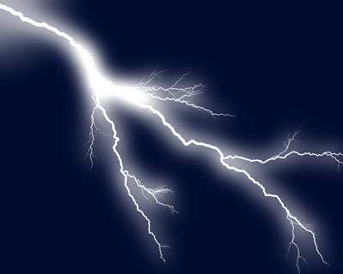
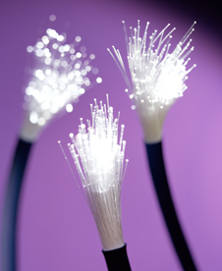
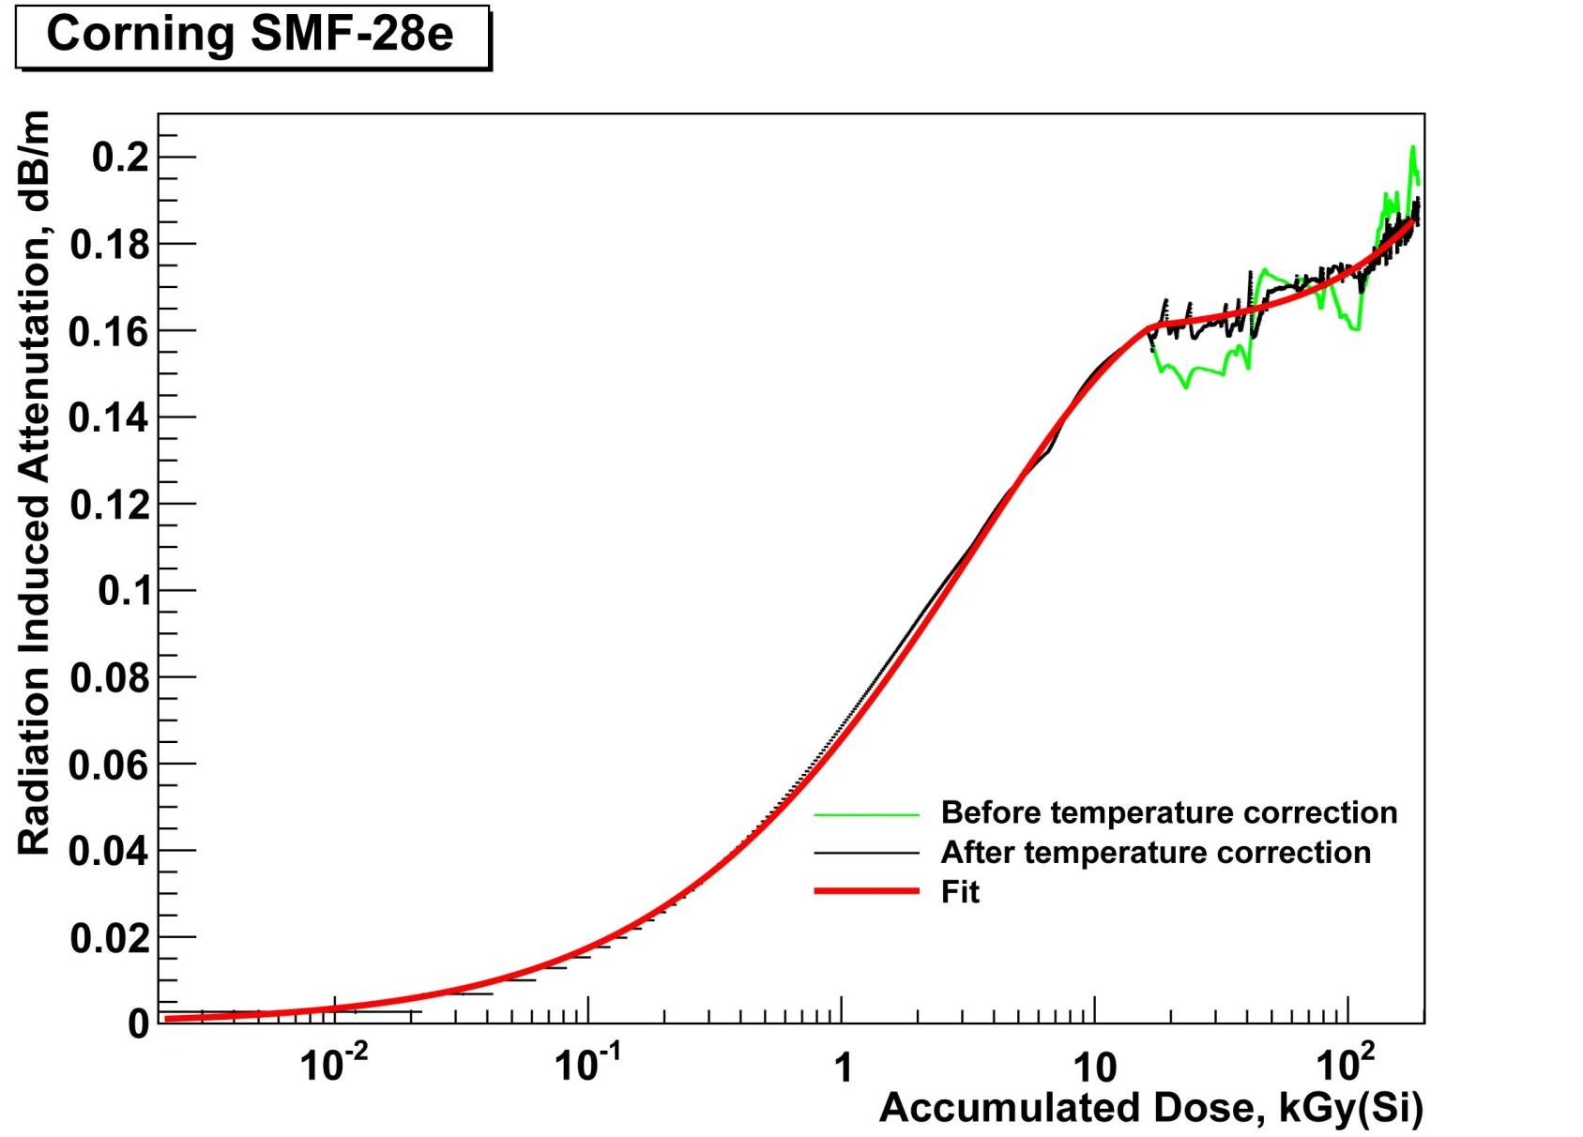
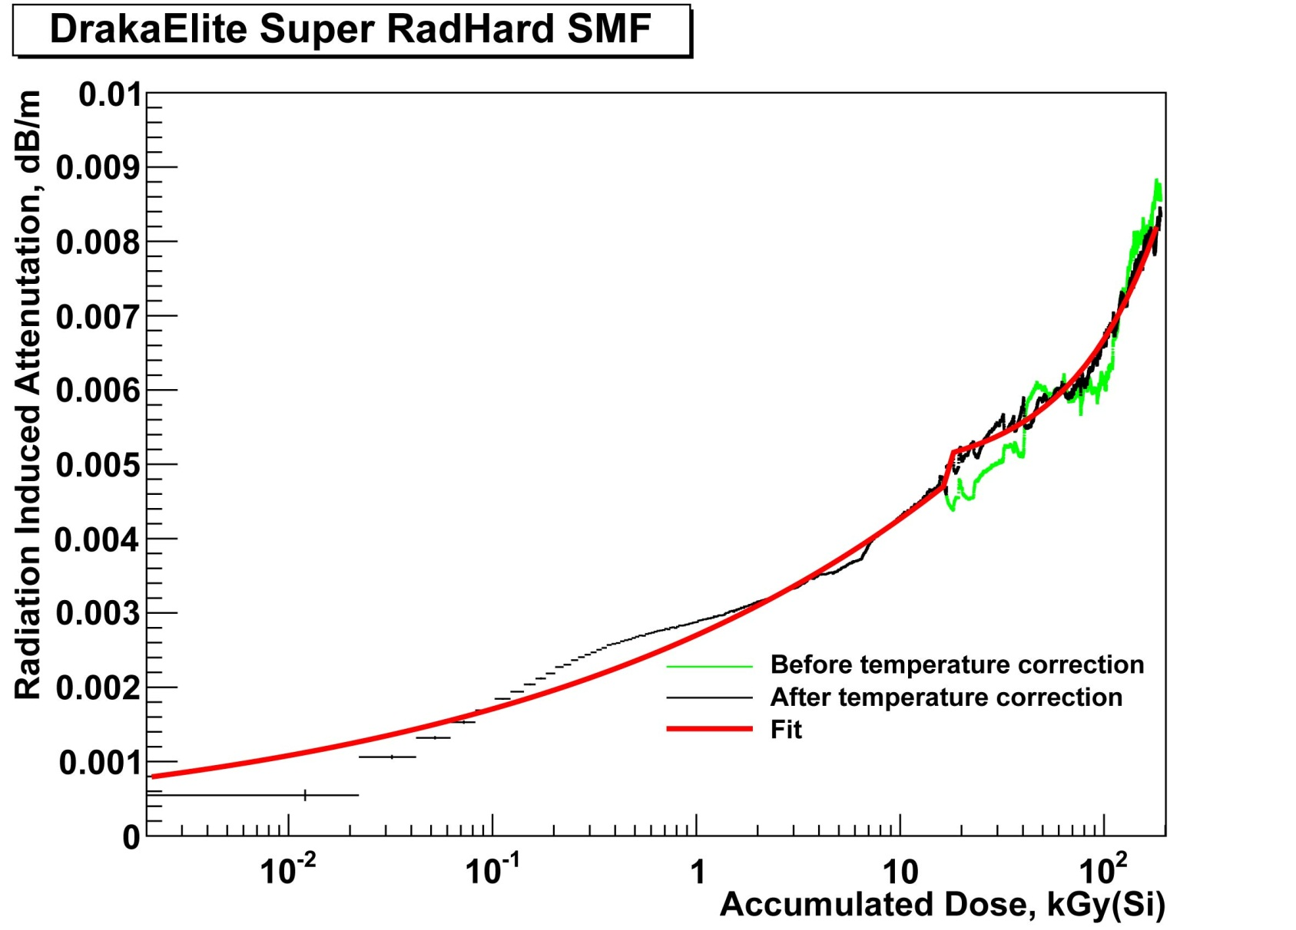
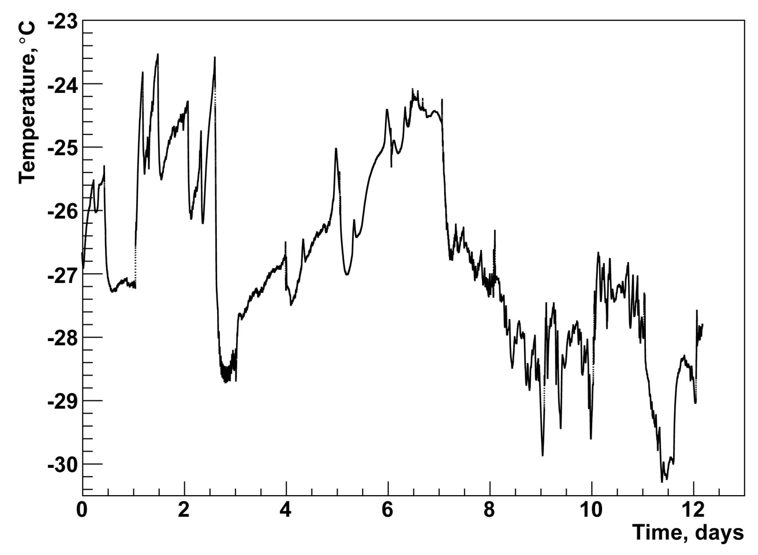
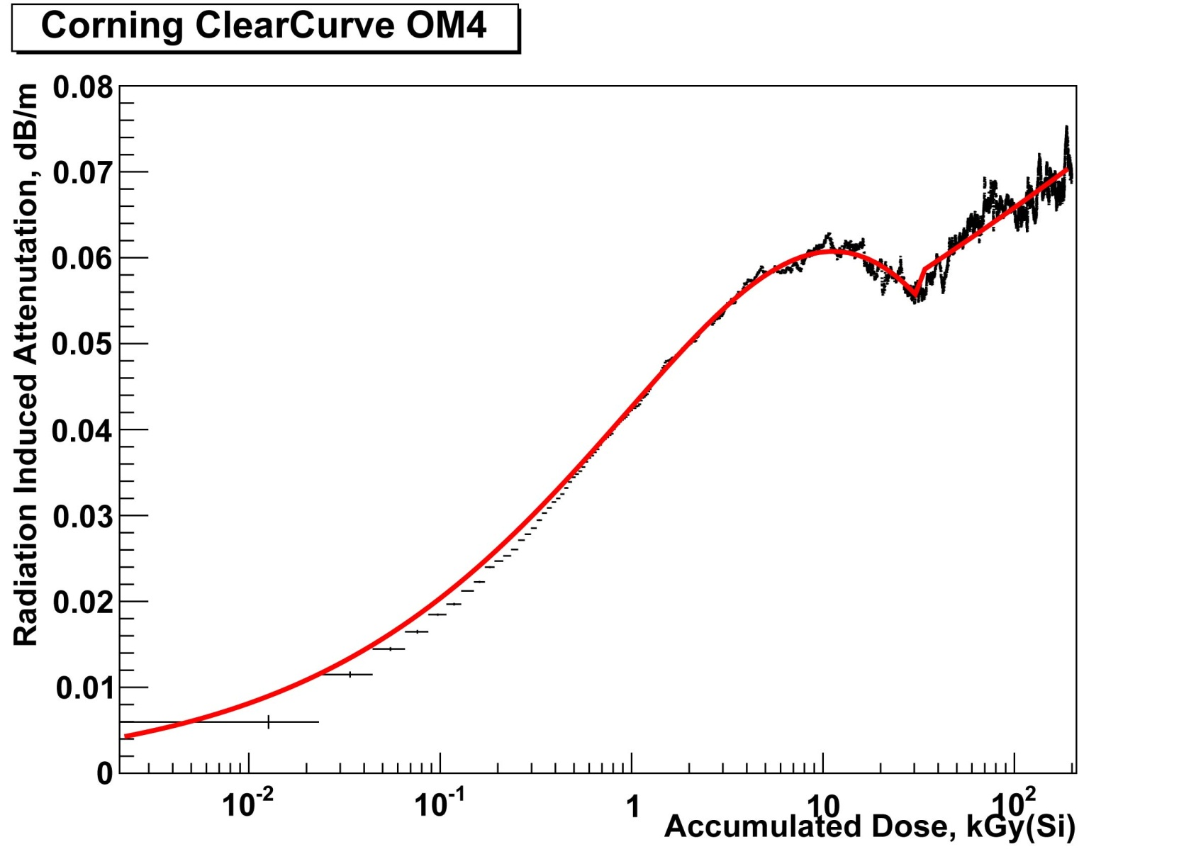
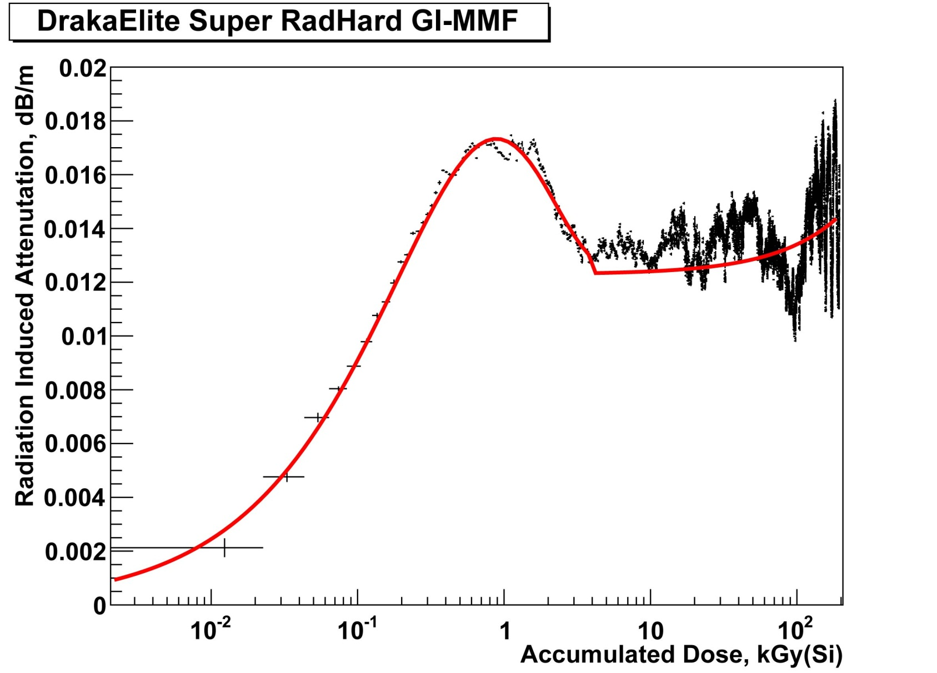

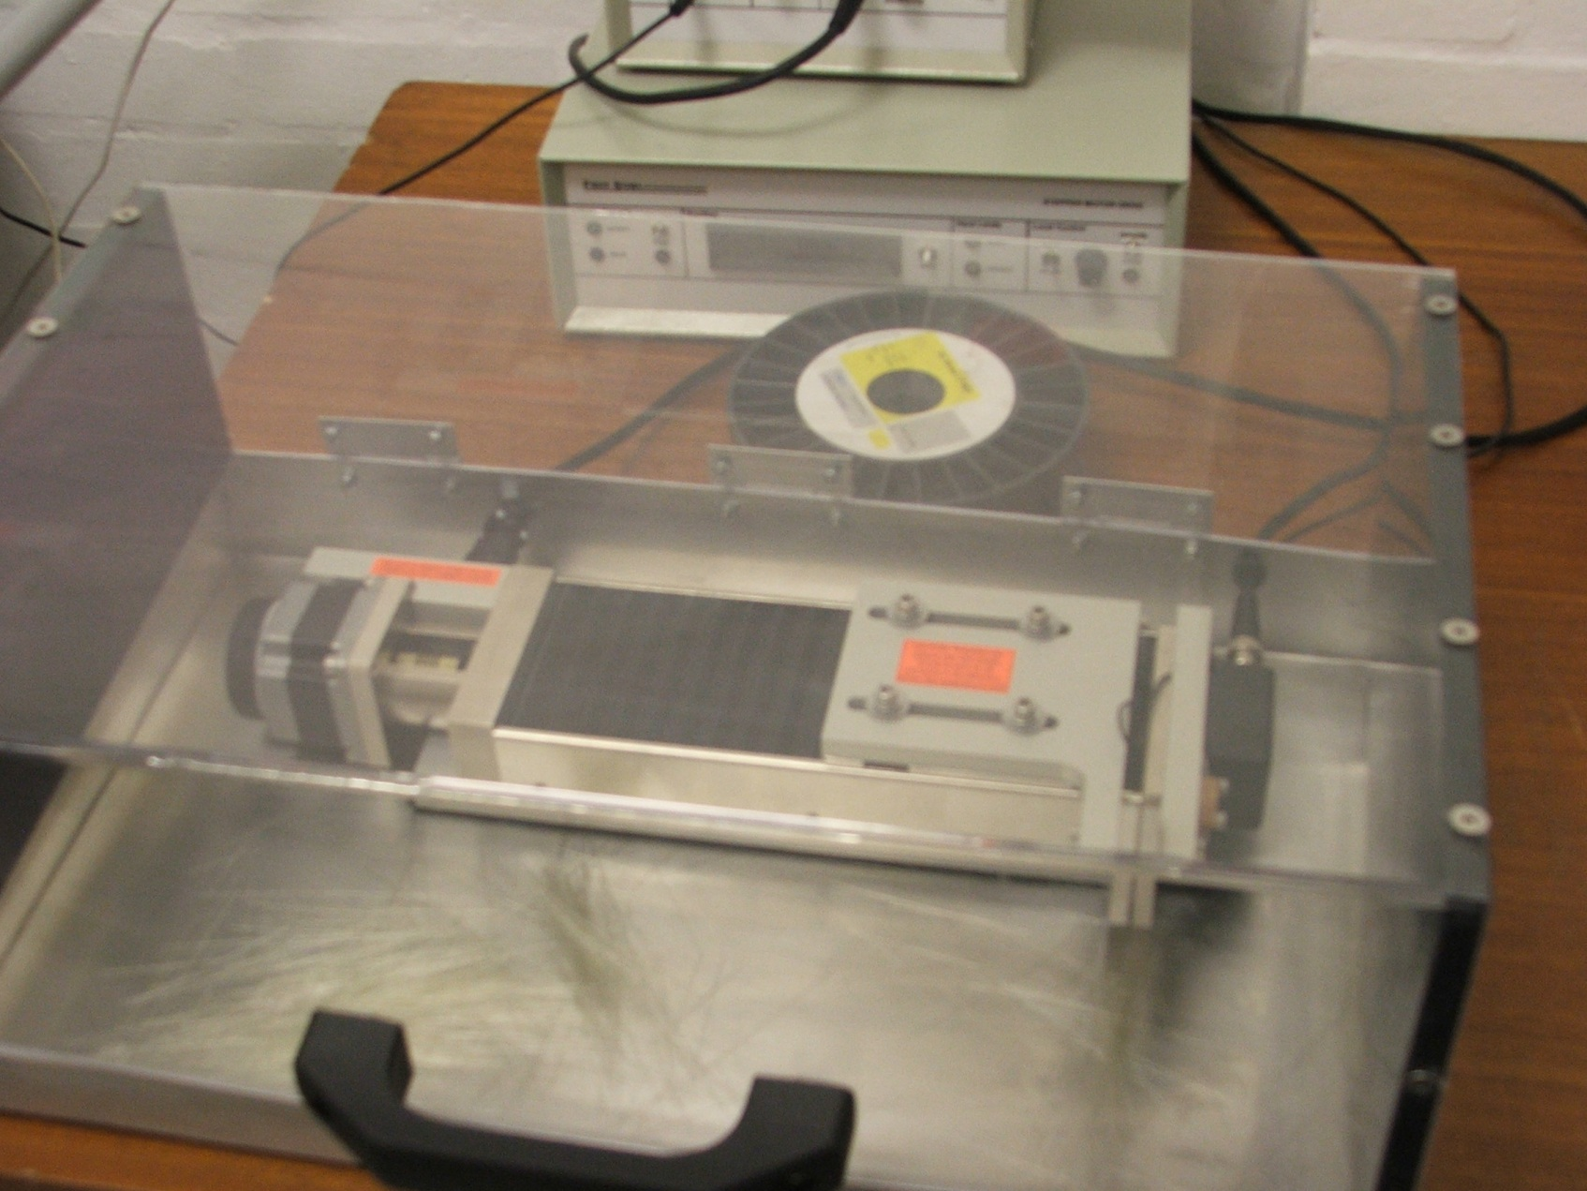
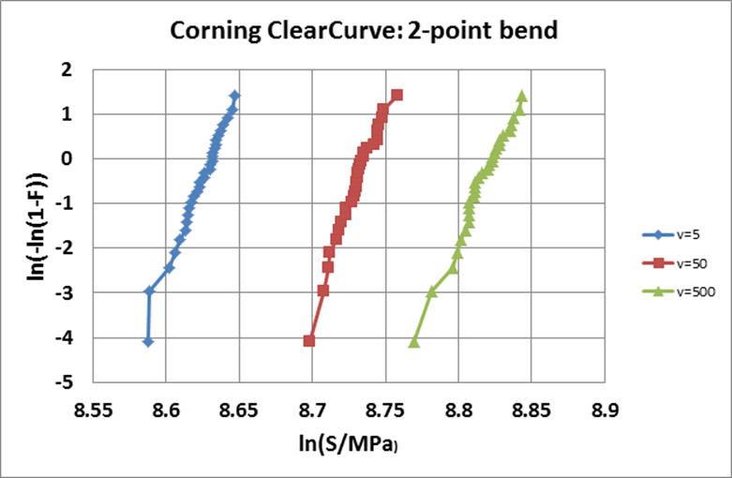

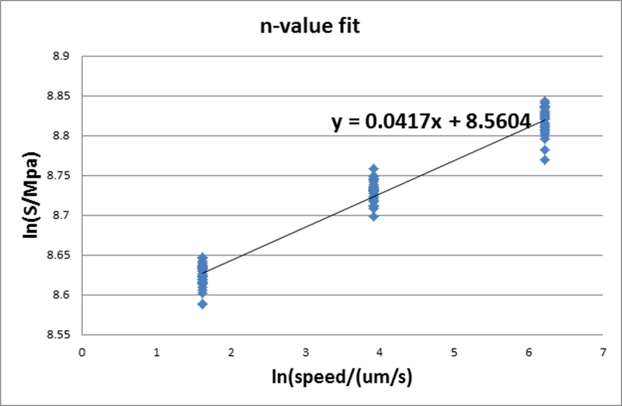

Poster ID: | P17 – 1st Day
Title: | Optical Fibre at HL-LHC
Author: | Dr. B. Todd Huffman (University of Oxford on behalf of the Versatile Link Group)
E-Mail | t.huffman1@physics.ox.ac.uk
Optical Fibre for HL-LHC
Qualifying optical fibres for high Radiation enviroments
Ionizing Radiation
+
Optical Fibres
=
→
Test Fibres in
Gamma Ray sources
Fibre optical test details
In-situ measurment of Radiation Induced Absorption (RIA)
Use ⁶⁰Co array at RITA (SCK·CEN, Belgium)
  Provides γ radiation at ~0.7 kGy(Si)/hr
  Large water heat bath
  A dose of 200 kGy(Si) was accumulated over 2 weeks
Liquid CO₂ evaporative cooling system kept fibres cold
Correct RIA for Temperature-related effects
D. Hall, et al. JINST 7 C01047
Ionizing Radiation
Optical Fibres
+
=
→
Test irradiated Fibres for
Tensile Strength
Fibre mechanical test details
“Before-and-After” test. Fibres sent away, irradiated, returned.
Use Mega Curie ⁶⁰Co array at Inst. Nuclear Energy Research, Taiwan
  Provides γ radiation at ~8.0 kGy(Si)/hr
  Highly uniform exposure of fibre spool.
  Control spool travels with spool under test
Irradiated and un-irradiated spools simultaneously tested
Tensile strength of fibres tested with 2pt Bend Tester
Compare tensile breaking stresses and try to fit an “n-value”
Linear precision
motion stage
Fibre crushing jaws
“weakest-link” hypothesis leads to a
Weibul distribution. The breaking stress
of the fibres follows a statistical distribution
The mean time to fibre failure is related to
the “n-value” above and this is fit in the graph
to the right. .
Fit this distribution to find “m” (a nuisance
parameter) and the median breaking
stress (σm).
Repeat this for three jaw closure speeds.
Outlook
SM & MM fibres have been qualified Rad. Hard
Standard COTS small-form factors LC connectors have also passed the test.
  [D. Hall, et al., JINST 7 P04014]
Bandwidth of MM fibres shows very little effect due to ionizing doses. [F.J. Achten, et al., 2012 JINST 7 P10021]
Full Cable prototype has been bend tested.
Ready for Pre-Production Testing!
B. Arvidsson, et al., 2013 JINST 8 P05011
Radiation Qualified Fibres
Type | Wavelength | Fibre name
SM | 1310 nm | Corning SMF-28e
SM | 1310 nm | DrakaElite Super RadHard SMF
MM | 850 nm | Corning ClearCurve OM4
MM | 850 nm | DrakaElite Super RadHard GI-MMF

