Slide 1
Monolithic Active Pixel Sensor Development for the
Upgrade of the ALICE Inner Tracker System
CERN/INFN/WUHAN ALICE ITS team
C. Cavicchioli, P. L. Chalmet, P. Giubilato, H. Hillemanns, A. Junique, T. Kugathasan, A. Lattuca, M. Mager, C. A. Marin Tobon, P. Martinengo, S. Mattiazzo, G. Mazza, H. Mugnier, L. Musa, D. Pantano, J. Rousset, F. Reidt, P. Riedler, W. Snoeys, J. W. van Hoorne, P. Yang

Slide 2
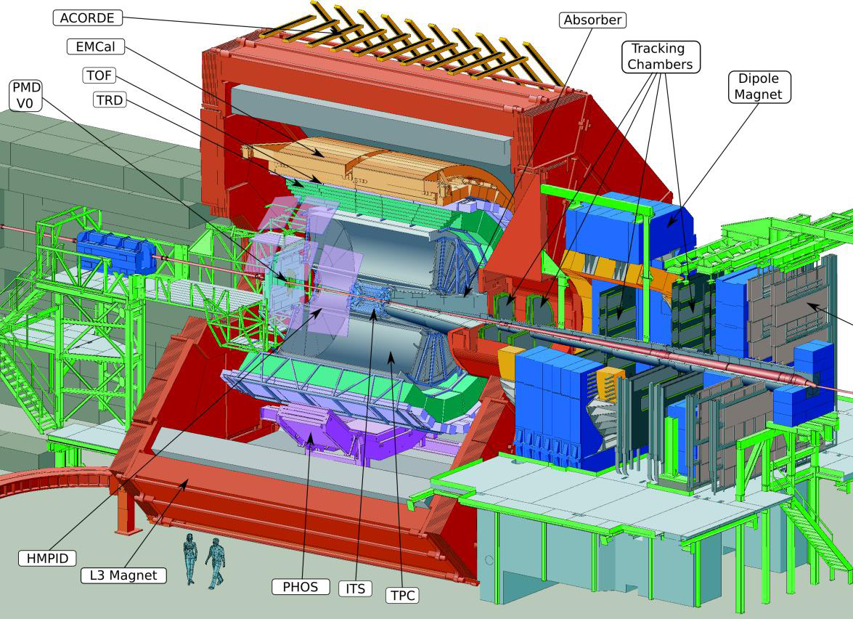
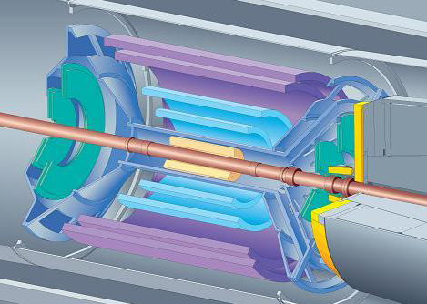
ALICE Inner Tracking System at present
2 layers of hybrid pixels (SPD)
2 layers of silicon drift detector (SDD)
2 layers of silicon strips (SSD)

Slide 3
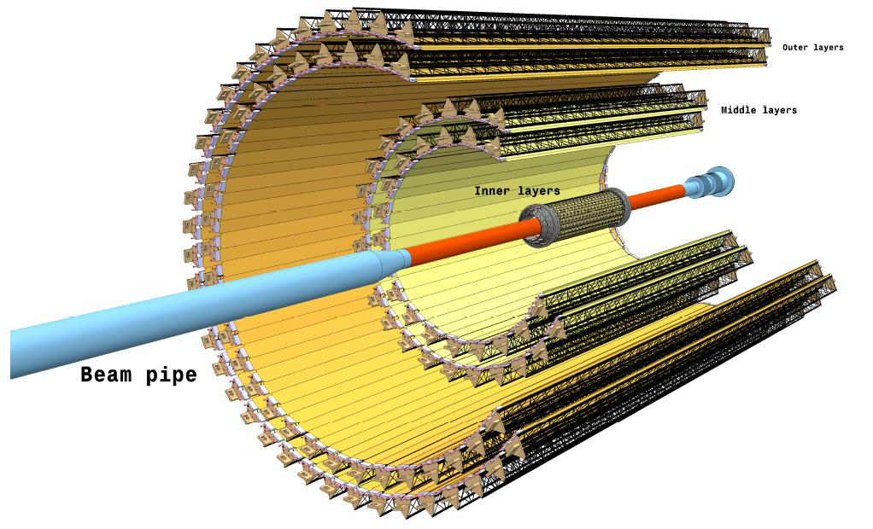
ITS upgrade
Objectives
record collisions:
  Pb-Pb at 50 kHz
  pp at 1MHz
improve impact parameter resolution by a factor 3
improve standalone tracking efficiency and pT resolution
fast insertion/removal for yearly maintenance
installation 2017-2018
New layout
7 layers (3 inner, 4 middle+outer)
reduce:
  X/X0 per layer from 1.14 to 0.3 %
  pixel size from 400x50 to O(30x30) μm²
  first layer radius from 39 to 22 mm
beam pipe outer radius: 19.8 mm
“Upgrade of the Inner Tracking System Conceptual Design Report” http://cds.cern.ch/record/1475244

Slide 4
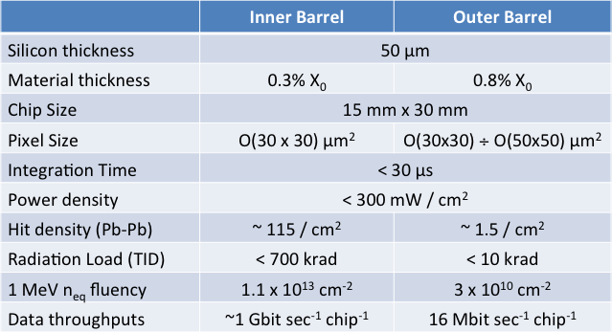
SPECIFICATIONS
UPPER LIMIT
lower much better !
Nr of bits to code a hit : 35
Fake hit : 10⁻⁵ /event
Lowering integration time would significantly reduce background
Lowering power would significantly reduce material budget

Slide 5
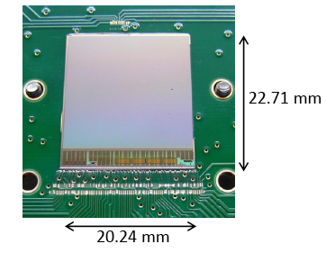
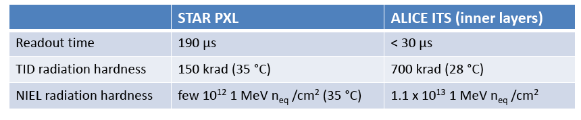
Starting point : ULTIMATE CHIP in STAR
Developed by IPHC Strasbourg
0.35 μm OPTO process
Rolling shutter and correlated double sampling
20.7x20.7 μm² pixel size
Power consumption 130 mW/cm²
Deeper submicron technology + development to meet ALICE specifications

Slide 6
Monolithic detector in TowerJazz 180 nm CMOS
Nwell
Collection Electrode
NMOS
PMOS
Pwell
Nwell
Pwell
Nwell
Deep Pwell
P-epitaxial layer
P-substrate
Gate oxide < 4 nm => better transistor radiation tolerance
6 metal layers
Epitaxial layer between 1 and 5 kΩcm, 15-18 μm
Deep Pwell shields Nwell with PMOS transistors from the epitaxial layer and allows full CMOS within the pixel without efficiency loss
  Difficult to deplete epitaxial layer under Pwell far from Nwell collection electrode, but radiation tolerance sufficient (see below)
  Stitching possible up to 200mm wafer scale

Slide 7
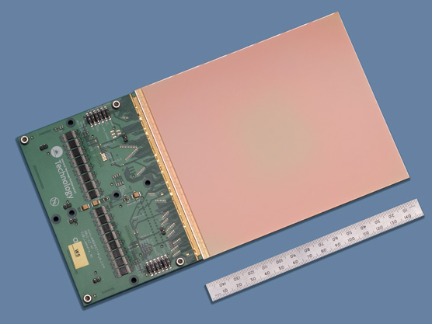
WAFER SCALE INTEGRATION by STITCHING
Courtesy: N. Guerrini, Rutherford Appleton Laboratory
Vth School on detectors and electronics for high energy physics, astrophysics, and space and medical physics applications, Legnaro, April 2013

Slide 8
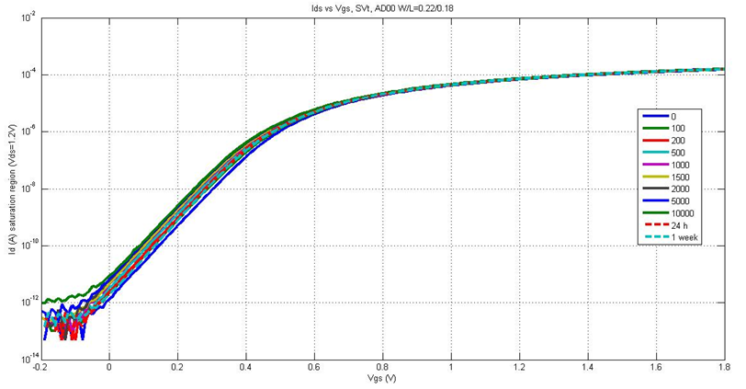
Radiation tolerance example: low voltage NMOS transistor
TID (Mrad)
I₀ = 100 nA . W/L
W/L = 0.22 um / 0.18 um -> I₀ = 122.2 nA
Curves do not change significantly with irradiation
Extensive testing campaign on transistors now complete and radiation tolerance in excess of ALICE needs

Slide 9
Developments and plan
3 Developments:
MISTRAL & ASTRAL by IPHC Strasbourg
  Rolling shutter with discriminator at the end of the column or in the pixel
  See presentation earlier this afternoon
CHERWELL by RAL
  Rolling shutter with strixel architecture: “end of column” circuitry
  integrated in pixels
ALPIDE by CERN, INFN, CCNU(China)
  Low power front-end (20.5nA/pixel) with data-driven readout, integration time of a few μs determined by shaping time of the front end
2013 : optimize pixel structure and study different options for the readout architecture to obtain medium/large scale demonstrator
2014 : decide & finalize full scale to be ready for volume production

Slide 10
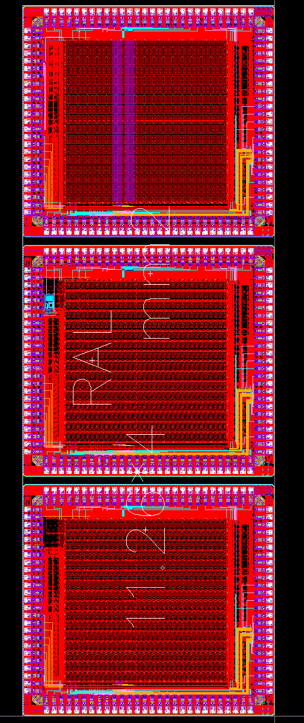
Last engineering run (April 2013) back from foundry
CERN/INFN/WUHAN: several matrices and test structures, LVDS driver
RAL: three matrices
IPHC: many matrices, also significant work on zero suppression circuitry.
23.5x31 mm² total
Several starting materials
Type | epi thickness [µm] | resistivity [Ω cm]
1 | 12 | 30
2 | 18 | > 1k
3 | 30 | > 1k
4 | 40 | > 1k
5 | 20 | 6.2 k
6 | 40 | 7.5 k
7 | CZ | > 700

Slide 11
EXPLORER :
PIXEL SENSOR OPTIMIZATION and MEASUREMENTS

Slide 12
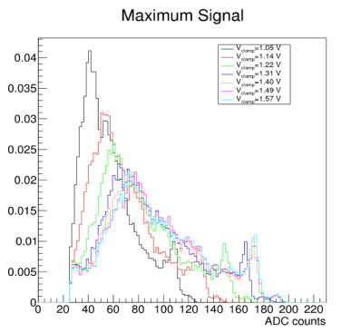

Starting point MIMOSA32 chips: Variation of V_{diode}
V_{diode} up to 1.3 V:
  Shift of the spectrum towards higher ADC values
V_{diode} larger than 1.4 V:
  No big differences observed
~1V
~1.6V
Example:
- Chip: 9B
- Structure: P00

Slide 13
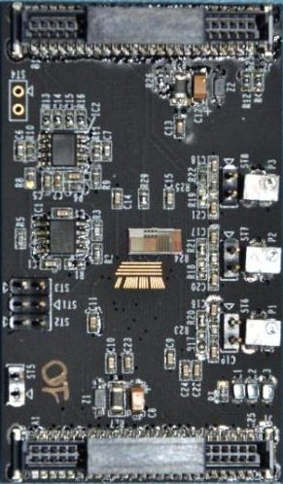
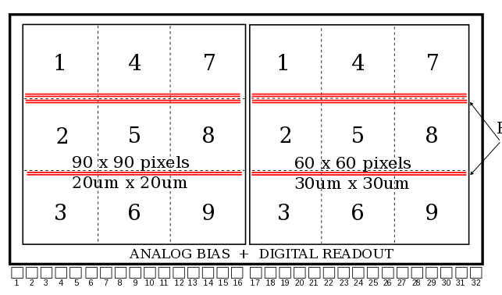
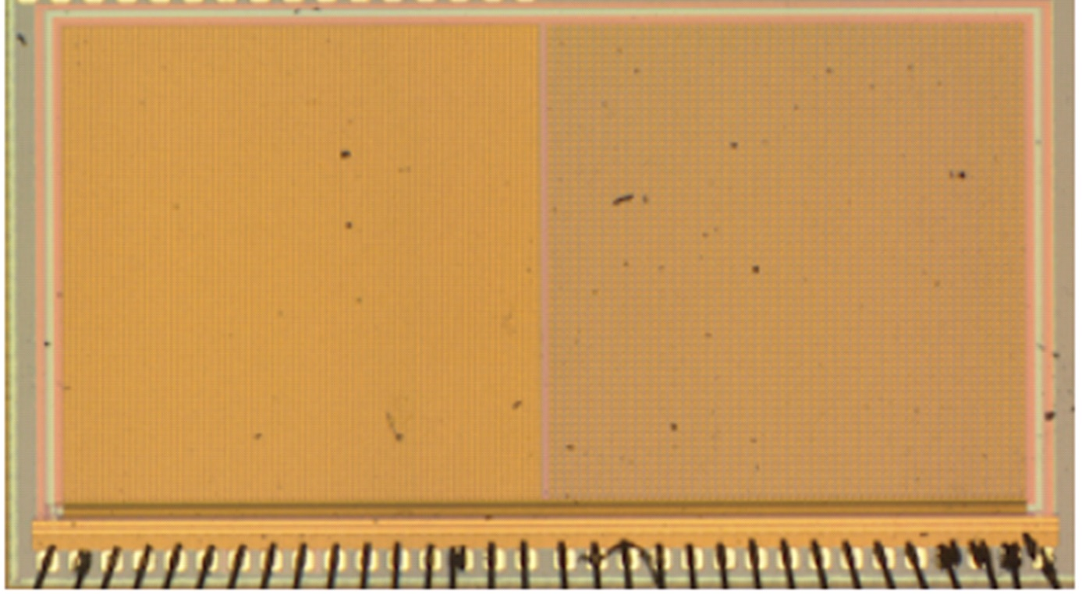
Prototype July 2012 submission: Explorer-0
Analog readout for pixel characterization
Readout time decoupled from integration time
Possibility to reverse bias the substrate
Sequential readout with correlated double sampling
Contains two 1.8x1.8mm² matrices of 20x20 and 30x30 micron pixels with different geometries
PULSED ROWS

Slide 14
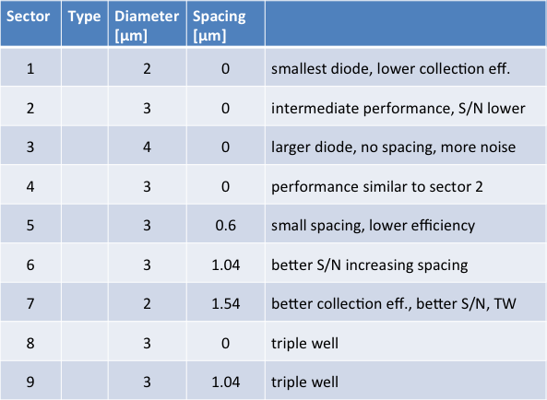
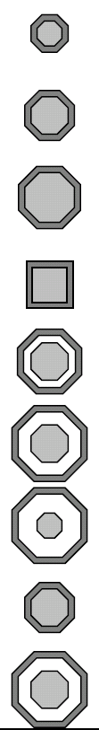
More detail on the collection electrodes

Slide 15
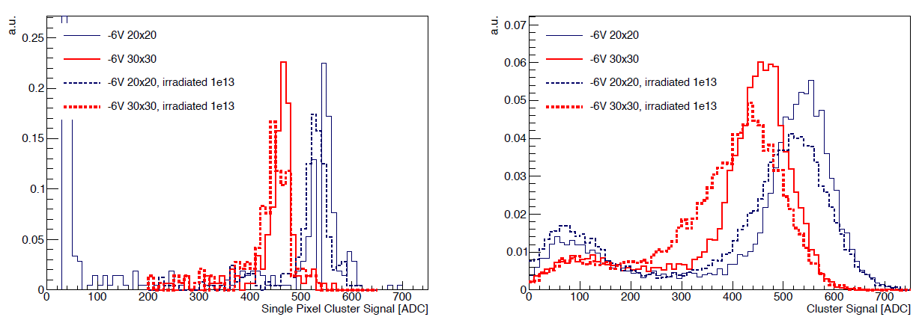
Charge collection efficiency in Explorer-0
response to ⁵⁵Fe X-rays for :
  seed (highest signal in 5x5 matrix)
  cluster (5x5 pixels around seed)
⁵⁵Fe calibration peak → charge calibration (1640 electrons in single pixel)
Seed
Cluster

Slide 16
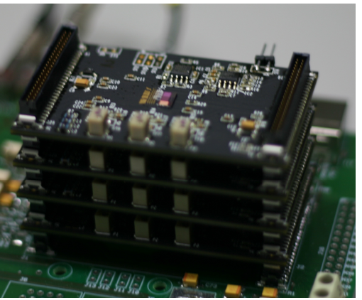
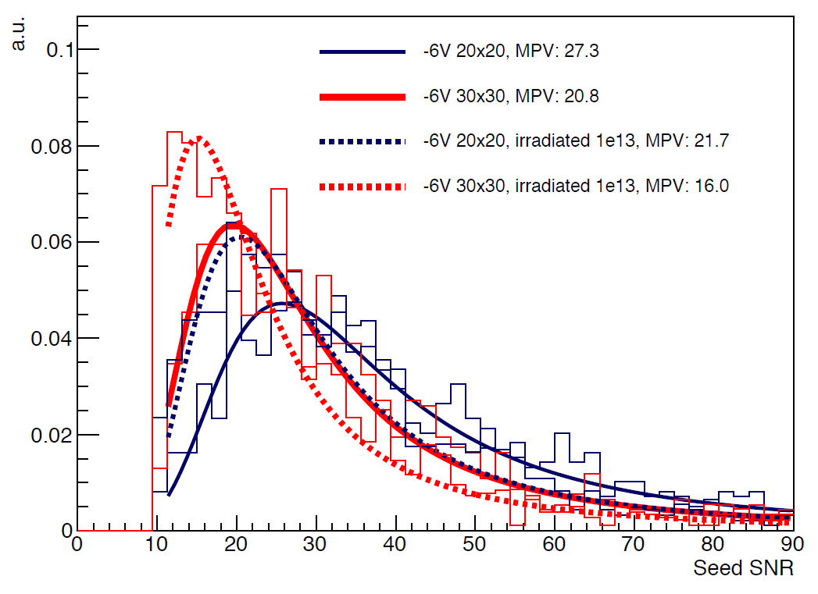
Test beam explorer-0
4 layers of explorer-0, modified setup of LePix
6 GeV/c pions
Reverse substrate bias gives extra margin
Penalized by too large input capacitance, corrected for Explorer-1.

Slide 17
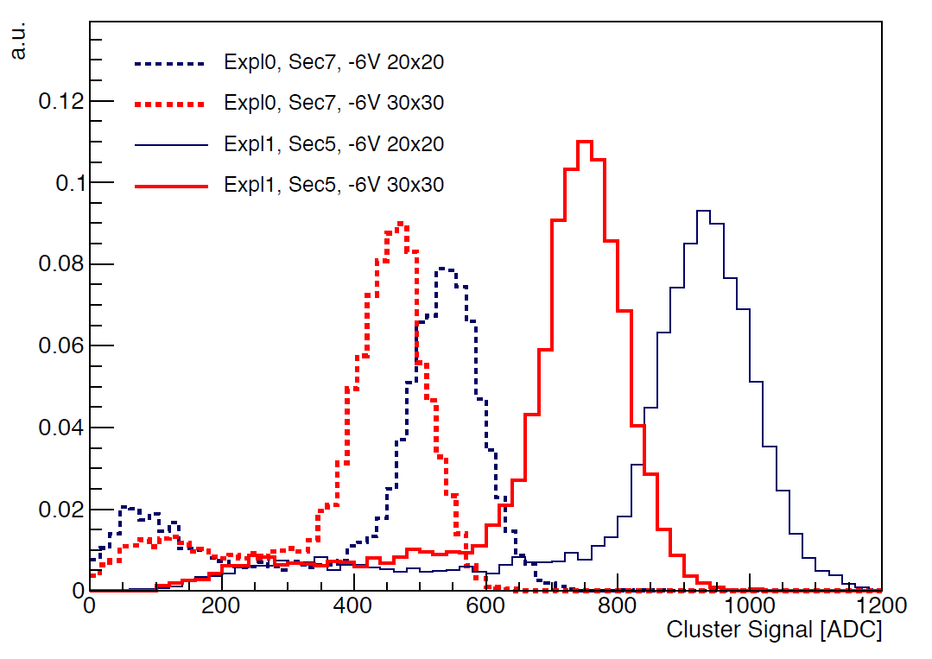
Explorer-1 vs Explorer-0
Comparison of ⁵⁵Fe cluster signal for Explorer-0 and Explorer-1
Explorer-1 shows ~ 2x signal increase, and similar noise level
Confirms correction on input capacitance, circuit contribution reduced from ~4.6 fF to ~2 fF

Slide 18
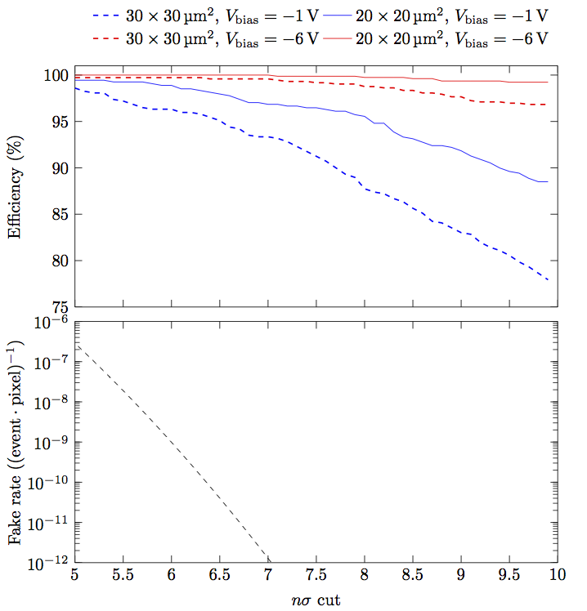
Efficiency & fake hit rate (Explorer-0)
High efficiency at low fake hit rates
Reverse substrate bias gives extra margin

Slide 19
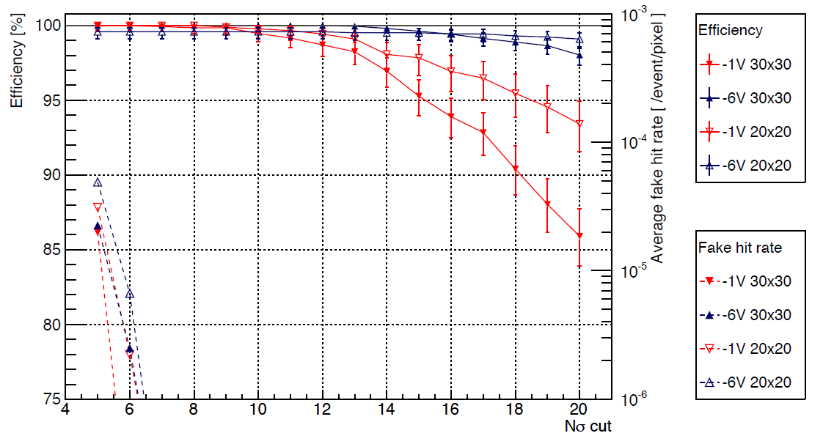
Efficiency & fake hit rate (Explorer-1)
Explorer-1 results after tests with electrons at DESY, averaged on all diode geometries
after irradiation drop of 10 - 20% in CCE, recovered with back bias
better performance of larger diodes with larger spacing to electronics
wider distance → wider depletion volume → lower input capacitance
better performance of 20 x 20 µm² at low back bias voltage
detection efficiency above 99% up to 10σ cut, also after irradiation

Slide 20
(p)ALPIDE
FRONT END AND READOUT

Slide 21
IN-PIXEL HIT DISCRIMINATION
VRESET
RESET
ENABLE
AMPL/COMP
Low power (20.5 nA) in-pixel hit discrimination allows other readout architectures
Large gain amplifier/comparator discharges ~ 80fF storage capacitor when the sensor receives a particle hit
Storage capacitor instead of full flip-flop to save space

Slide 22
Priority Encoder readout
hierarchical readout
4 inputs basic block repeated to create a larger encoder
1 pixel read per clock cycle
forward path (address encoder) in gray
feed-back path (pixel reset) in red
asynchronous (combinatorial) logic
clock only to periphery, synchronous select only to hit pixels
PIXEL
COLUMN
v[0]
v[1]
v[2]
v[3]
sel[0]
sel[1]
sel[2]
sel[3]
valid
select
a[0]
a[1]
v[0]
v[1]
v[2]
v[3]
sel[0]
sel[1]
sel[2]
sel[3]
valid
select
a[0]
a[1]
VALID
v[0]
v[1]
v[2]
v[3]
sel[0]
sel[1]
sel[2]
sel[3]
valid
select
a[0]
a[1]
Periphery
logic
SELECT
v[0]
v[1]
v[2]
v[3]
sel[0]
sel[1]
sel[2]
sel[3]
valid
select
a[0]
a[1]
CLOCK
TRIGGER
v[0]
v[1]
v[2]
v[3]
sel[0]
sel[1]
sel[2]
sel[3]
valid
select
a[0]
a[1]
ADDR[0:1]
ADDR[2:3]

Slide 23
ALPIDE: ALice PIxel DEtector
0
1023
STATE
STATE
STATE
STATE
512
512
512
512
RESET
RESET
…
RESET
RESET
in-matrix address encoder
tree structure to decrease capacitive load of lines
outputs pixel address and resets pixel storage element
Pixel front-end
Pixel front-end
Pixel front-end
Pixel front-end
512
512
512
512
Priority encoder
Priority encoder
low power in-pixel discriminator
current comparator (bias of ~20 nA)
storage element for hit information
10
10
VALID
ADDR
VALID
ADDR
SELECT
SELECT
Periphery
Bias
Clock
Control
+ trigger
Pulser
Data
loss-less data compression de-randomizing circuit
compresses cluster information in the column
multi-event memory

Slide 24
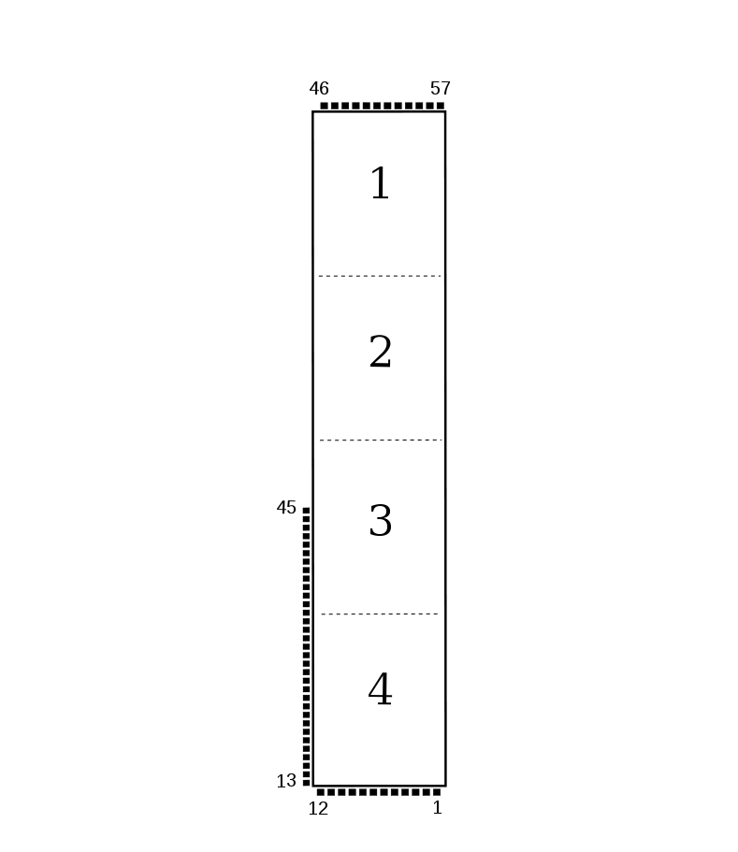
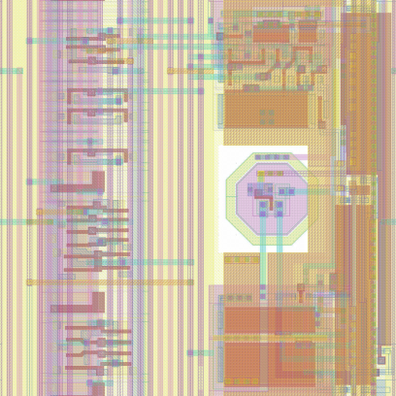
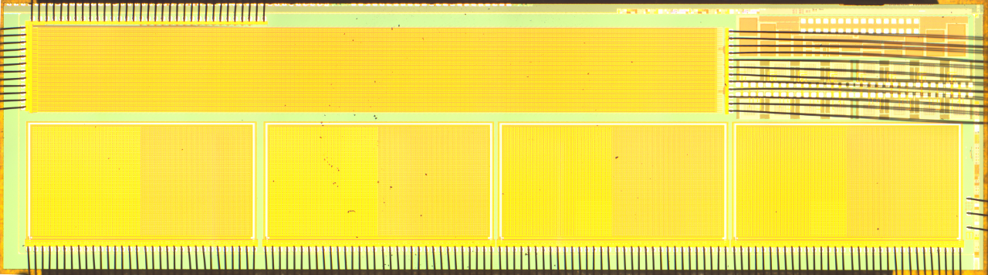
Prototype ALPIDE or pALPIDE (512x64 pixels)
12 µm + 10 µm
~ 12 mm
22 µm
pALPIDE
Part of Priority Encoder
Collection electrode
Analog
Front End
Memory
cell
~ 1.6 mm

Slide 25
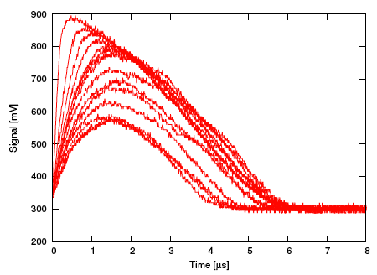
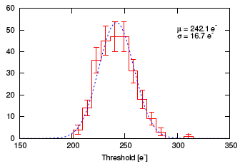
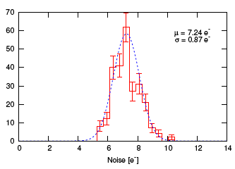
pALPIDE first results
Threshold
Noise
Analog output of one pixel under ⁵⁵Fe
Minimum detectable charge <130 e-
At nominal bias (20.5 nA/pixel) and threshold setting:
  Threshold spread 17 e-
  Noise ~ 7 e-

Slide 26
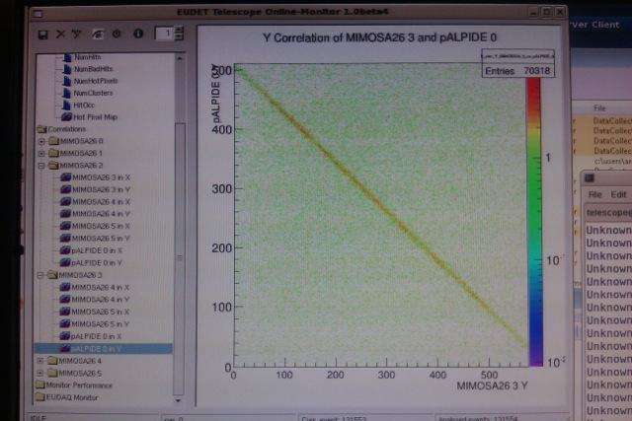
Beam test at DESY … now

Slide 27
CONCLUSIONS
Pixel sensor
  100mV distributed over a few pixels
  Could we get to digital signal by further optimization?
Analog front end design: 40nW*250 000 pixels = 10 mW/cm²
  Promising results, but more work and checking needed.
Digital: looking at solution around 10mW/cm²
Off-chip data transmission ~ 30-50mW/chip or <10mW/cm²
Trying to approach strip level power consumption per unit area and stay below 50mW/cm²
Radiation tolerance sufficient for Alice
Significant work in progress in design and in test

Slide 28
THANK YOU !

