Slide 1
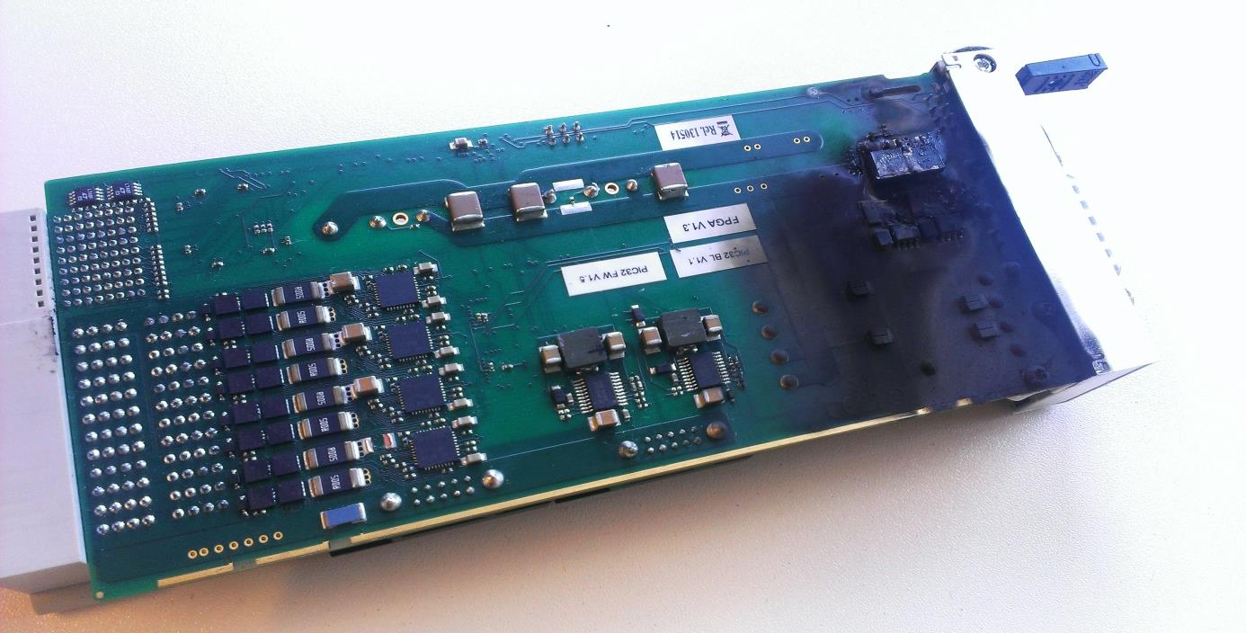

Summary of evaluation results
of xTCA equipment
xTCA Interest Group meeting
Topical Workshop on Electronics for Particle Physics - Perugia
26/9/2013
Collaboration (CERN PH-ESE-BE)
Matteo Di Cosmo, Vincent Bobillier, Stefan Haas, Markus Joos,
Sylvain Mico, Paschalis Vichoudis and Francois Vasey
PH-ESE-BE

Slide 2
> Outline
Outline
xTCA Evaluation Project update
MicroTCA evaluation
  Power modules
  Cooling units
  IPMI test
ATCA evaluation
  Cooling performance
Conclusions
  Observation
  Future work
M. Di Cosmo – Summary of evaluation results of xTCA equipment xTCA Interest Group - Perugia 26/9/2013

Slide 3
> Outline
Outline
xTCA Evaluation Project update
MicroTCA evaluation
  Power modules
  Cooling units
  IPMI test
ATCA evaluation
  Cooling performance
Conclusions
  Observation
  Future work
M. Di Cosmo – Summary of evaluation results of xTCA equipment xTCA Interest Group - Perugia 26/9/2013

Slide 4
> xTCA Evaluation Project update
During the last meeting .. (9/4/2013)
First evaluation results were shown (NAT DC780 and Vadatech UTC010)
Non-conformities with technical specification and interoperability problems were the main concerned topics
Since then
New MicroTCA components have been evaluated
Manufacturer | Reference | Description
Power Modules
NAT | DC780 (HW v1.2, HW v1.3) | DC/DC, 792W
Vadatech | UTC010 (FW v3.0, FW v4.0) | DC/DC, 792W
Wiener | AC800 (Prototype) | AC/DC, 800W
TreNew | CM100 | AC/DC, 300W
Crates
ELMA | 043-012 | MTCA.4, 12 AMCs, 4 PMs, 2 MCHs
Vadatech | VT892 | MTCA.0, 12 AMCs, 4 PMs, 2 MCHs
Schroff | 11850-019 | MTCA.4, 6 AMCs, 1 PM, 1 MCH
Schroff | 11890-035 | MTCA.4, 12 AMCs, 4 PMs, 2 MCHs
MCHs
NAT | NAT MCH | MTCA.4
Kontron | AM4904 | MTCA.4
Vadatech | UTC001 | MTCA.4
M. Di Cosmo – Summary of evaluation results of xTCA equipment xTCA Interest Group - Perugia 26/9/2013

Slide 5
> xTCA Evaluation Project update
During the last meeting .. (9/4/2013)
First evaluation results were shown (NAT DC780 and Vadatech UTC010)
Non-conformities with technical specification and Interoperability problems were the main concerned topics
Since then
New MicroTCA components have been evaluated
ATCA evaluation has started
Manufacturer | Reference | Description
Crates
Schroff | 11596-150 | 14 slots, dual star 40G Backplane, bused IPMB
ASIS | 144D422-000 | 14 slots, dual star 40G Backplane, bused IPMB
Shelf managers
Schroff | 21596-291 | Based on Pigeon Point ShMM
ASIS |  | Based on Pigeon Point ShMM
M. Di Cosmo – Summary of evaluation results of xTCA equipment xTCA Interest Group - Perugia 26/9/2013

Slide 6
> Outline
Outline
xTCA Evaluation Project update
MicroTCA evaluation
  Power modules
  Cooling units
  IPMI test
ATCA evaluation
  Cooling performance
Conclusions
  Observation
  Future work
M. Di Cosmo – Summary of evaluation results of xTCA equipment xTCA Interest Group - Perugia 26/9/2013

Slide 7
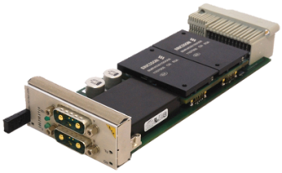
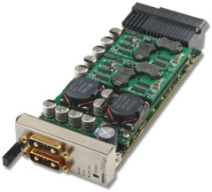
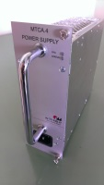
> MicroTCA evaluation\Power Modules
Power Modules test – First results obtained (Beginning of 2013)
 | Test Conditions | Measured | DC780 Specs
Maximum Power | Vi=-48V | 730W | 780W
Input Voltage |  | -48V to -53V | -40V to -60V
Load Regulation | Full power | 8.6% | 10%
Line Regulation | Full load, Vin: -40V to -53V | 2mV (max) before failure | Not reported
Efficiency | Vi = -48V, 1-100% of full power | 94% (max) | 95.5% (min)
Ripple | Full power | 20mV | Not reported
Voltage transient deviation | Load step from 25% to 75% of full load | ±0.5V | Not reported
NAT DC780
HW v1.2
 | Test Conditions | Measured | UTC010 Specs
Maximum Power | Vi=-48V | 600W | 780W
Input Voltage |  | -38V to -75V | -36V to -75V
Load Regulation | Full power | 1.2% | Not reported
Line Regulation | Full load, Vin: -38V to -53V | 1.93V | Not reported
 | Minimum load, Vin: -38V to -53V | 1.22V | Not reported
Efficiency | Vi = -48V, 1-100% of full power | 93% (max at 300W) | 95% (full load)
Ripple | Full power | 73mV | Not reported
 | Minimum Power | 700mV | Not reported
Voltage transient deviation | Load step from 25% to 75% of full load | ±0.4V | Not reported
Vadatech UTC010
FW v3.0
 | Test Conditions | Measured | Wiener Specs
Maximum Power |  | 800W | 800W
Load Regulation | 1-100% of full power | 3.5% | Not reported
Efficiency | 1-100% of full power | Not possible to measure | 93% (min)
Power Factor |  | Not possible to measure | 0.99
Ripple | Full power | 10mV | <10mV Pk-to-Pk
Voltage transient deviation | Load step from 25% to 75% of full load | To be done | Not reported
Wiener AC PM
Prototype
M. Di Cosmo – Summary of evaluation results of xTCA equipment xTCA Interest Group - Perugia 26/9/2013

Slide 8
> MicroTCA evaluation\Power Modules
Power Modules test – New results obtained (July 2013)
- Improvements: Efficiency, output power
 | Test Conditions | Measured | DC780 Specs
Maximum Power | Vi=-48V | 780W | 780W
Input Voltage |  | -40V to -60V | -40V to -60V
Load Regulation | Full power | 8.6% | 10%
Line Regulation | Full load, Vin: -40V to -53V | 2mV (max) | Not reported
Efficiency | Vi = -48V, 1-100% of full power | 94% (max) | 95.5% (min)
Ripple | Full power | 20mV | Not reported
Voltage transient deviation | Load step from 25% to 75% of full load | ±0.5V | Not reported
NAT DC780
HW v1.3
 | Test Conditions | Measured | UTC010 Specs
Maximum Power | Vi=-48V | 780W | 780W
Input Voltage |  | -38V to -75V | -36V to -75V
Load Regulation | Full power | 1.2% | Not reported
Line Regulation | Full load, Vin: -38V to -53V | 1.93V | Not reported
 | Minimum load, Vin: -38V to -53V | 1.22V | Not reported
Efficiency | Vi = -48V, 1-100% of full power | 93% (full load) | 95% (full load)
Ripple | Full power | 73mV | Not reported
 | Minimum Power | 700mV | Not reported
Voltage transient deviation | Load step from 25% to 75% of full load | ±0.4V | Not reported
Vadatech UTC010
FW v.4.0
 | Test Conditions | Measured | Wiener Specs
Maximum Power |  | 800W | 800W
Load Regulation | 1-100% of full power | 3.5% | Not reported
Efficiency | 1-100% of full power | Not possible to measure | 93% (min)
Power Factor |  | Not possible to measure | 0.99
Ripple | Full power | 10mV | <10mV Pk-to-Pk
Voltage transient deviation | Load step from 25% to 75% of full load | To be done | Not reported
new version
test pending
Wiener AC PM
Prototype
M. Di Cosmo – Summary of evaluation results of xTCA equipment xTCA Interest Group - Perugia 26/9/2013

Slide 9
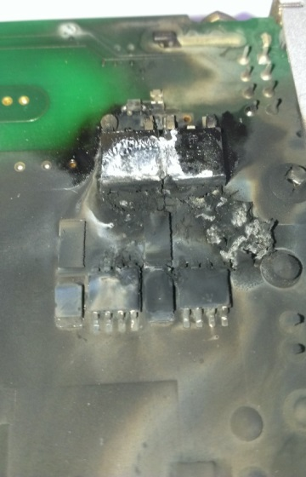
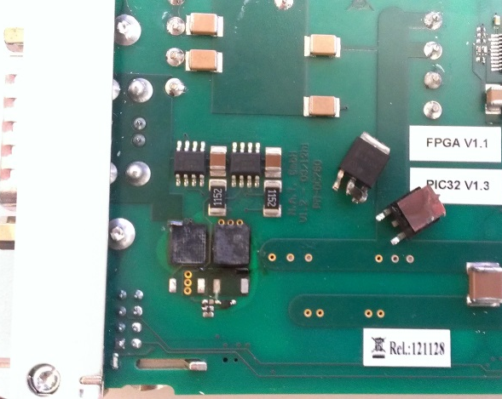
> MicroTCA evaluation\Power Modules
Power Modules test: NAT DC780
Several hardware problems have been found (HW v1.2 and HW v1.3)
  Input voltage range did not match the specification (Inrush current limiter stage)
  Drop of efficiency (Inrush current limiter overheating)
NAT released several patches in order to match the specification (Last version is HW v1.4)
DC780 has been discontinued
PM bottom PCB after line regulation tests
(Vin 40V, Pout 90%)
Unexpected input stage damage under normal conditions (Vin 48V, Pout 70%)
Input stage overheating effect: Efficiency drop
Replaced with DC840 (being released)
M. Di Cosmo – Summary of evaluation results of xTCA equipment xTCA Interest Group - Perugia 26/9/2013

Slide 10
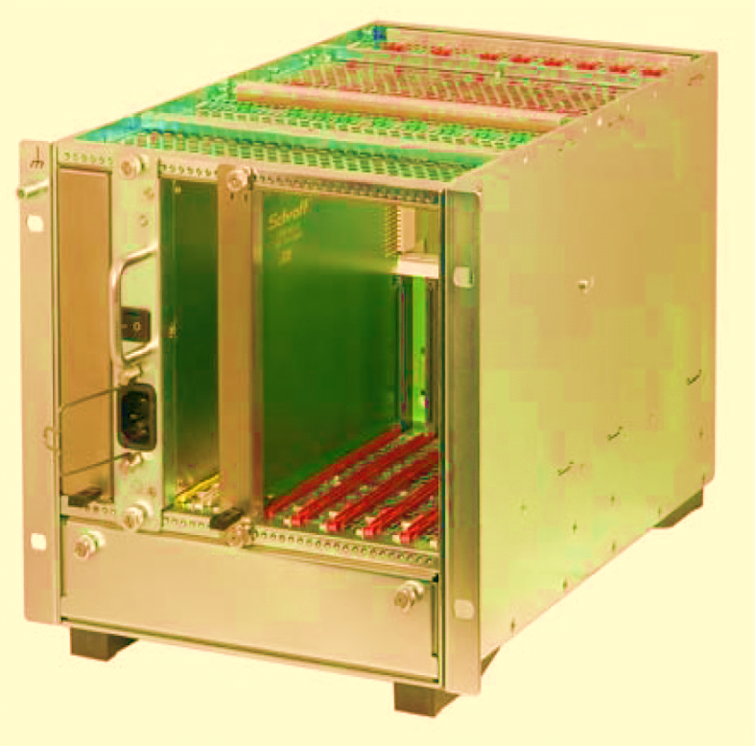
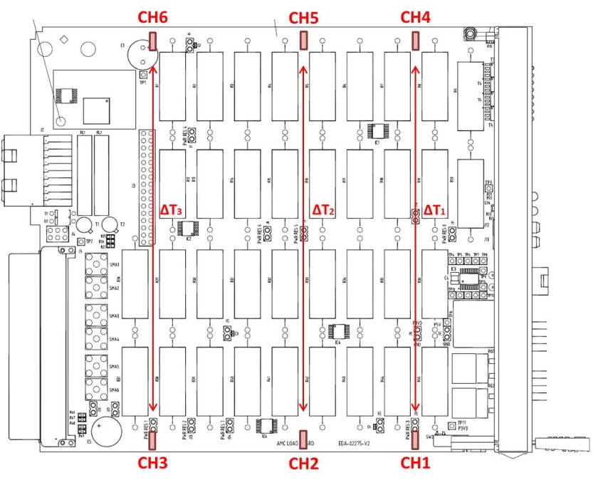
> MicroTCA evaluation\Cooling units
Cooling performance
  The aim is to evaluate the maximum temperature difference and the cooling homogeneity between slots
  Temperature measured on six different points on load boards
ALB temp sensors position
ALB heat distribution
M. Di Cosmo – Summary of evaluation results of xTCA equipment xTCA Interest Group - Perugia 26/9/2013

Slide 11
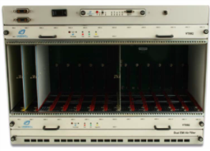
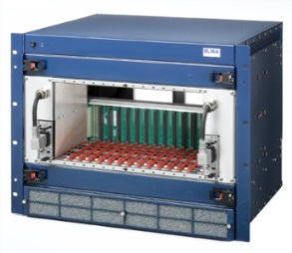
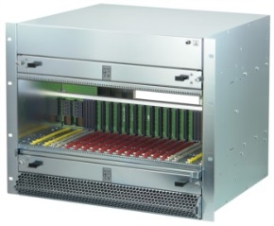
> MicroTCA evaluation\Shelves
Cooling unit test results
CFM Cubic Feet per Minute
AMC and RTM load modules dissipating max power (90W AMC, 40W RTM)
  - Fans model and mechanical layout have significant impact on the cooling capability
Crate | AMC delta plot (Average) | Max delta (°C)
Vadatech VT892 (2PM, 2MCH, 12 AMC)
 |  | AMC 25 °C
ELMA 043-012 (4PM, 2MCH, 12 AMC,RTM)
 |  | AMC: 47 °C RTM: 23 °C
Schroff 11890-035 (4PM,2MCH,12 AMC,RTM)
 |  | AMC: 19 °C RTM: 14 °C
FAN spec.: CFM 60 x 10
FAN spec.: CFM 100 x 3
FAN spec.: CFM 171 x 3
M. Di Cosmo – Summary of evaluation results of xTCA equipment xTCA Interest Group - Perugia 26/9/2013

Slide 12

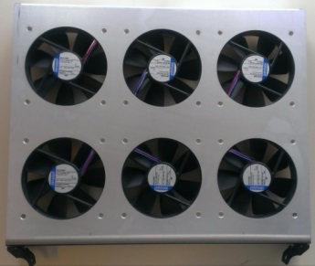
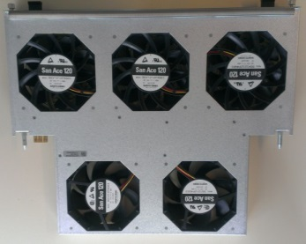
> MicroTCA evaluation\Shelves
Cooling unit test results
CFM Cubic Feet per Minute
AMC and RTM load modules dissipating max power (90W AMC, 40W RTM)
  - Fans model and mechanical layout have significant impact on the cooling capability
Crate | AMC delta plot (Average) | Max delta (°C) | FANS CFM (Spec.)
Vadatech VT892 (2PM, 2MCH, 12 AMC)
 |  | AMC 25 °C | 60 (10 front fans)
ELMA 043-012 (4PM, 2MCH, 12 AMC,RTM)
 |  | AMC: 47 °C RTM: 23 °C | 100 (3 front fans and 3 rear fans)
Schroff 11890-035 (4PM,2MCH,12 AMC,RTM)
 |  | AMC: 19 °C RTM: 14 °C | 171 (three front fans) 130 (two rear fans)
M. Di Cosmo – Summary of evaluation results of xTCA equipment xTCA Interest Group - Perugia 26/9/2013

Slide 13
> MicroTCA evaluation\IPMI test
IPMI Test
IPMI is the major cause of interoperability problems between different manufacturer components
Polaris tester is a useful tool to find potential interoperability problems
Polaris tester includes MCMC, MMC,EMMC and Backplane FRU test
Example of success: ELMA Backplane FRU information
M. Di Cosmo – Summary of evaluation results of xTCA equipment xTCA Interest Group - Perugia 26/9/2013

Slide 14
> Outline
Outline
xTCA Evaluation Project update
MicroTCA evaluation
  Power modules
  Cooling units
  IPMI test
ATCA evaluation
  Cooling performance
Conclusions
  Observation
  Future work
M. Di Cosmo – Summary of evaluation results of xTCA equipment xTCA Interest Group - Perugia 26/9/2013

Slide 15
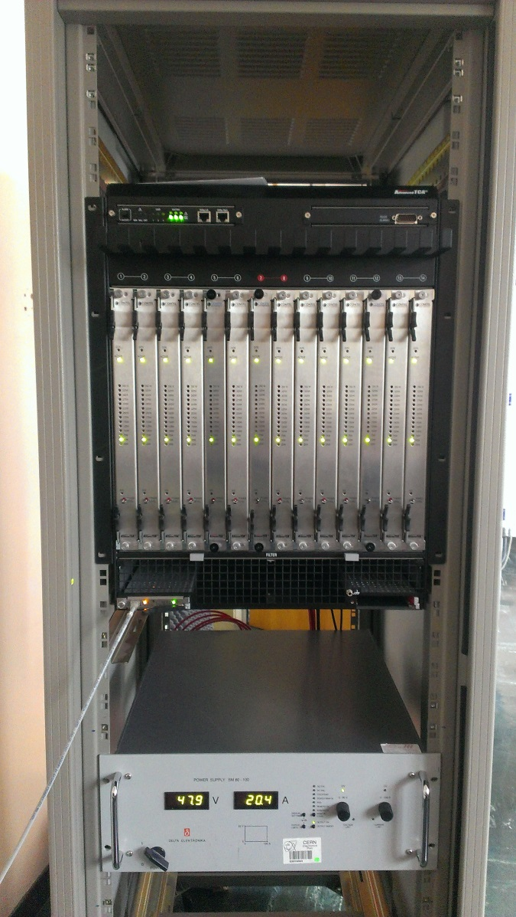
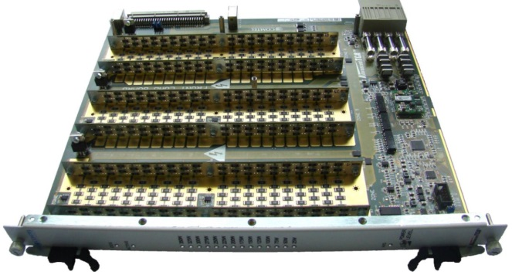
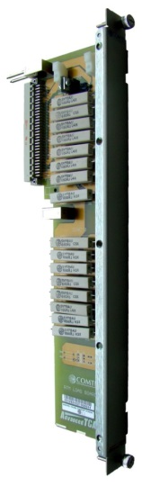
> ATCA evaluation
Commercial load boards for thermal tests
Front and rear boards
IPMI controlled
On board temperature monitoring
ATCA evaluation delayed by load boards
technical problems (airflow measurement not reliable)
IPMITOOL based Labview interface to communicate with load boards
Cooling performance
COMTEL Front and rear boards
Test setup
M. Di Cosmo – Summary of evaluation results of xTCA equipment xTCA Interest Group - Perugia 26/9/2013

Slide 16
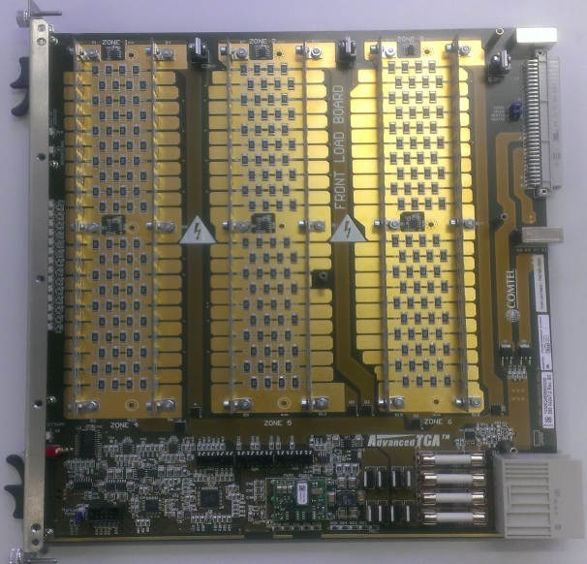
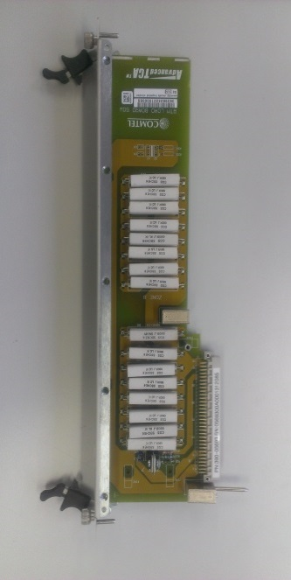
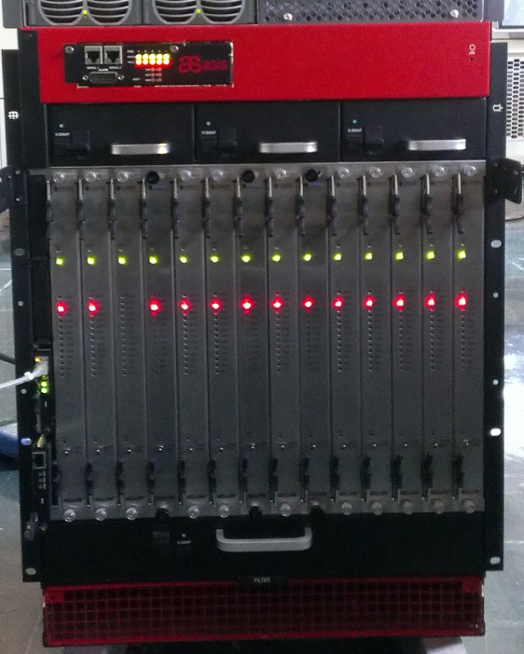
> ATCA evaluation\Test results
ATCA Evaluation: Schroff and ASIS crate
Test is performed with fans at maximum speed and:
  250W for front modules
  50W for rear modules
ΔT1
ΔT2
ΔT3
ΔR
Load boards
Schroff crate
ASIS crate
M. Di Cosmo – Summary of evaluation results of xTCA equipment xTCA Interest Group - Perugia 26/9/2013

Slide 17
> ATCA evaluation\Test results
ATCA Evaluation: Schroff and ASIS crate
Test is performed with fans at maximum speed and:
  250W for front modules
  50W for rear modules
ΔT1
ΔT2
ΔT3
ΔR
Load boards
Schroff crate
MAX front ∆T = 35 °C
ASIS crate
MAX front ∆T = 23°C
M. Di Cosmo – Summary of evaluation results of xTCA equipment xTCA Interest Group - Perugia 26/9/2013

Slide 18
> Outline
Outline
xTCA Evaluation Project update
MicroTCA evaluation
  Power modules
  Cooling units
  IPMI test
ATCA evaluation
  Cooling performance
Conclusions
  Observation
  Future work
M. Di Cosmo – Summary of evaluation results of xTCA equipment xTCA Interest Group - Perugia 26/9/2013

Slide 19
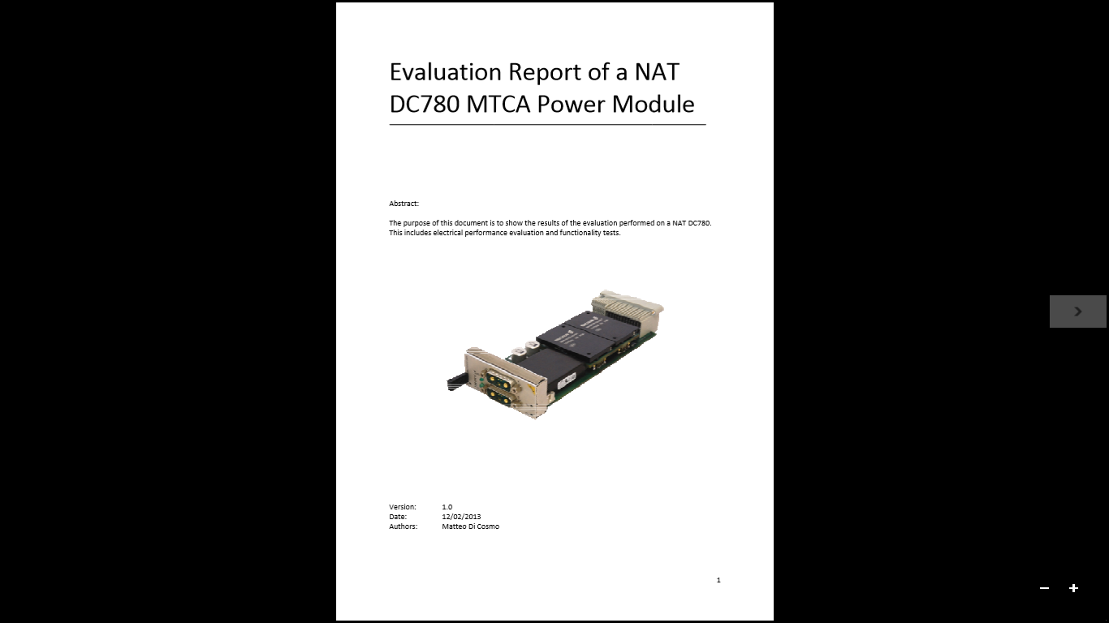
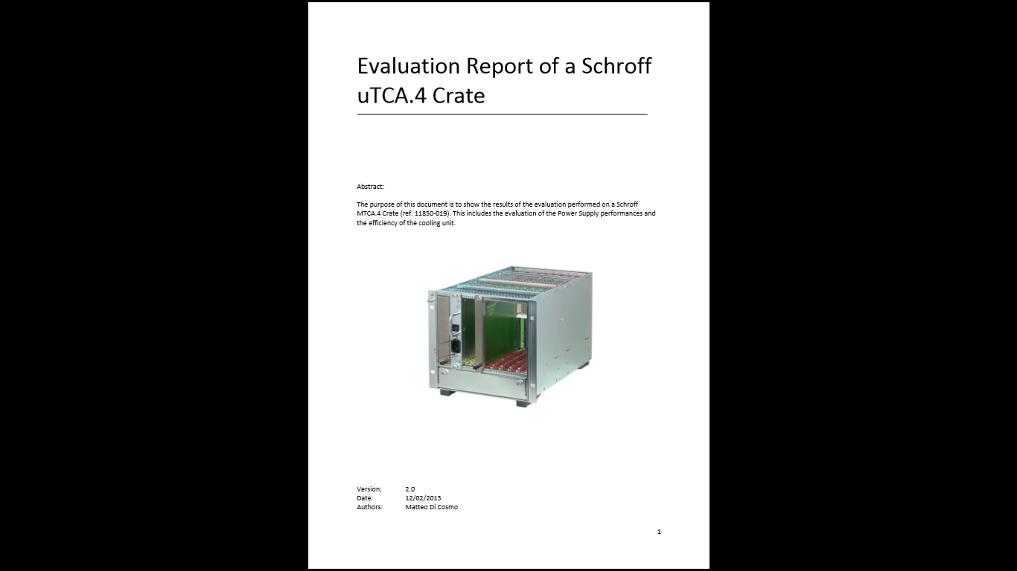
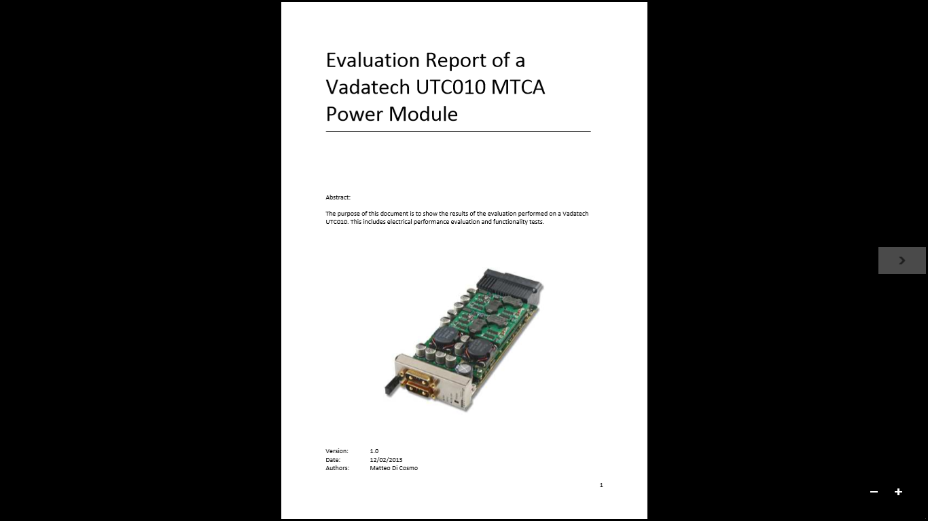
  > Conclusions\Observation
  Results obtained
  Detailed test procedures defined
Test systems developed (Modules, systems and software)
xTCA standards, systems and equipment know-how
Comprehensive set of tests performed for MicroTCA crates,
PMs and MCH. ATCA ongoing.
Interaction with manufacturers
(HW and SW modifications introduced)
Detailed evaluation reports published
Available on the uTCA/ATCA Repository
But also
  More than 25 xTCA components sent back for repair (100% repaired under warranty)
More than 200 emails sent in the last year for component malfunctioning and support
Several interoperability problems faced during test
  Must be solved in collaboration with the manufactures
Interoperability not always assured (standards lacks…)
Complete technical specification not always verified or provided by manufacturers
Good technical support from equipment manufacturers is essential
M. Di Cosmo – Summary of evaluation results of xTCA equipment xTCA Interest Group - Perugia 26/9/2013

Slide 20
  > Conclusions\Future Work
MicroTCA evaluation being finalized
  Pending tests: New NAT DC840 and revised Wiener AC/DC PM
  Polaris tester
  MCH evaluation
  New MCH coming in the next weeks
AdvancedTCA Evaluation
  Alternative ATCA shelf (to be selected)
  Kontron ATCA Carrier
  Shelf manager: IPMI tests
M. Di Cosmo – Summary of evaluation results of xTCA equipment xTCA Interest Group - Perugia 26/9/2013

Slide 21
  >
THANK YOU
M. Di Cosmo – Summary of evaluation results of xTCA equipment xTCA Interest Group - Perugia 26/9/2013

Slide 22
  >
Backup slides
M. Di Cosmo – Summary of evaluation results of xTCA equipment xTCA Interest Group - Perugia 26/9/2013

Slide 23
  > References
Useful links
MicroTCA Evaluation Repository https://espace.cern.ch/ph-dep-ESE-BE-uTCAEvaluationProject/default.aspx
ATCA Evaluation Repository https://espace.cern.ch/ph-dep-ESE-BE-ATCAEvaluationProject/SitePages/Home.aspx
PICMG Website http://www.picmg.org/
MicroTCA Short Form Specification http://www.picmg.org/pdf/MicroTCA_Short_Form_Sept_2006.pdf
AMC Short Form Specification http://www.picmg.org/pdf/AMC.0_R2.0_Short_Form.pdf
ATCA Short Form Specification http://www.picmg.org/pdf/PICMG_3_0_Shortform.pdf
IPMI, IPMB Specification http://www.intel.com/content/www/us/en/servers/ipmi/ipmi-specifications.html
Polaris Tester http://www.polarisnetworks.net/atca-test-tool.html
NAT Website http://www.nateurope.com/
Vadatech Website http://www.vadatech.com/
Schroff Website http://www.schroff.de/
ASIS Website http://www.asis-pro.com/
Wiener http://www.wiener-d.com/
ELMA http://www.elma.com/
COMTEL http://www.comtel-online.com/
M. Di Cosmo – Summary of evaluation results of xTCA equipment xTCA Interest Group - Perugia 26/9/2013

Slide 24
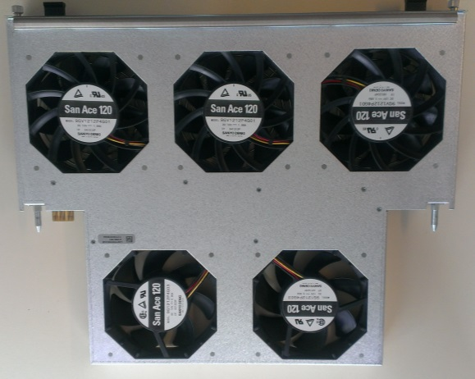

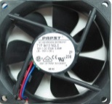
> Crates comparison: Cooling unit structure
SCHROFF (MTCA.4)
ELMA (MTCA.4)
VADATECH
Position | Number of fans | Fan model | CFM, max speed | Noise (dB, max speed) | MTBF
Schroff | Front (3) | SANYO 9GV1212P4G01 | 171 | 58 | 40000hrs (L10: Survival rate: 90% at 60º C, rated voltage, and continuously run in a free air state)
 | Rear (2) | SANYON 9G1212P4G03 | 129.94 | 51
ELMA | 6 | Papst 4412 F/2GP | 100 | 43 | 60000 hrs
Vadatech | 6 | Cooltron FD8025B12W11-3R21 | 59.2 | 44 | 75,000 hrs MTTF (Mean Time To Failure), Confidence Level 90%, 40C
M. Di Cosmo – Summary of evaluation results of xTCA equipment xTCA Interest Group - Perugia 26/9/2013

Slide 25
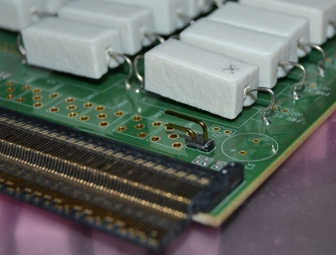
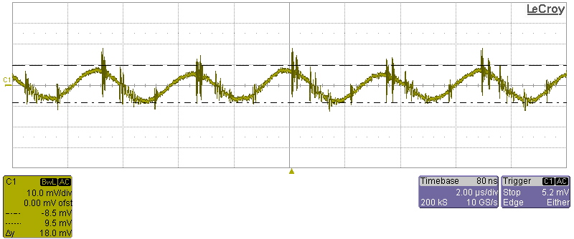
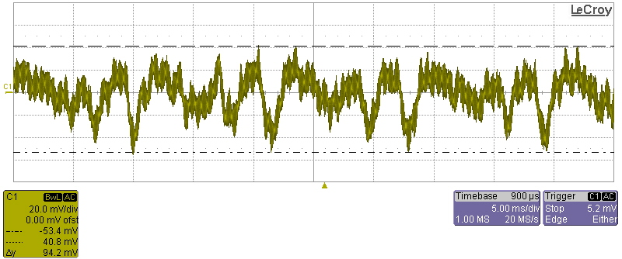
> Ripple Measurements
Power Modules test – Ripple measurements example
Test condition: Shared power topology, PM output power 90%.
∆V=20mV
Test condition: Redundant power topology, fans maximum speed, PM output power 90%.
∆V=95mV
M. Di Cosmo – Summary of evaluation results of xTCA equipment xTCA Interest Group - Perugia 26/9/2013

