Slide 1

TWEPP-2013 Close-out
Perugia, 23 – 27 September 2012

Slide 2
JINST Proceedings
JINST paper submissions
Before November 1st.
Proceedings for both Oral & Poster contributions
All papers will be reviewed
  Please assure good quality to minimize load on reviewers
    All co-Authors MUST have read paper and made corrections BEFORE submitting paper for review
  You may be requested to help with paper reviews
  Thanks for you help
Max. 8 pages
  Excluding Title and Table of Content
Detailed instructions:
  TWEPP-13 site: http://www.pg.infn.it/twepp2013/index.php/papers
  Indico: https://indico.cern.ch/internalPage.py?pageId=2&confId=228972
In case of problems contact Jorgen.Christiansen@cern.ch

Slide 3
Evaluation form
Please fill in evaluation form on Indico workshop home page: https://indico.cern.ch/conferenceDisplay.py?confId=228972 (menu on left side) to help us to improve and shape this yearly workshop to the needs of the HEP electronics community (you).
Anonymous process
  Good things
  Bad things
  New things and proposals
  Program
  Best presentations and posters
  Organization
  Practical aspects
  Proposals for future invited speakers and subjects
  ,,,,,,,

Slide 4

Thanks to our sponsors

Slide 5
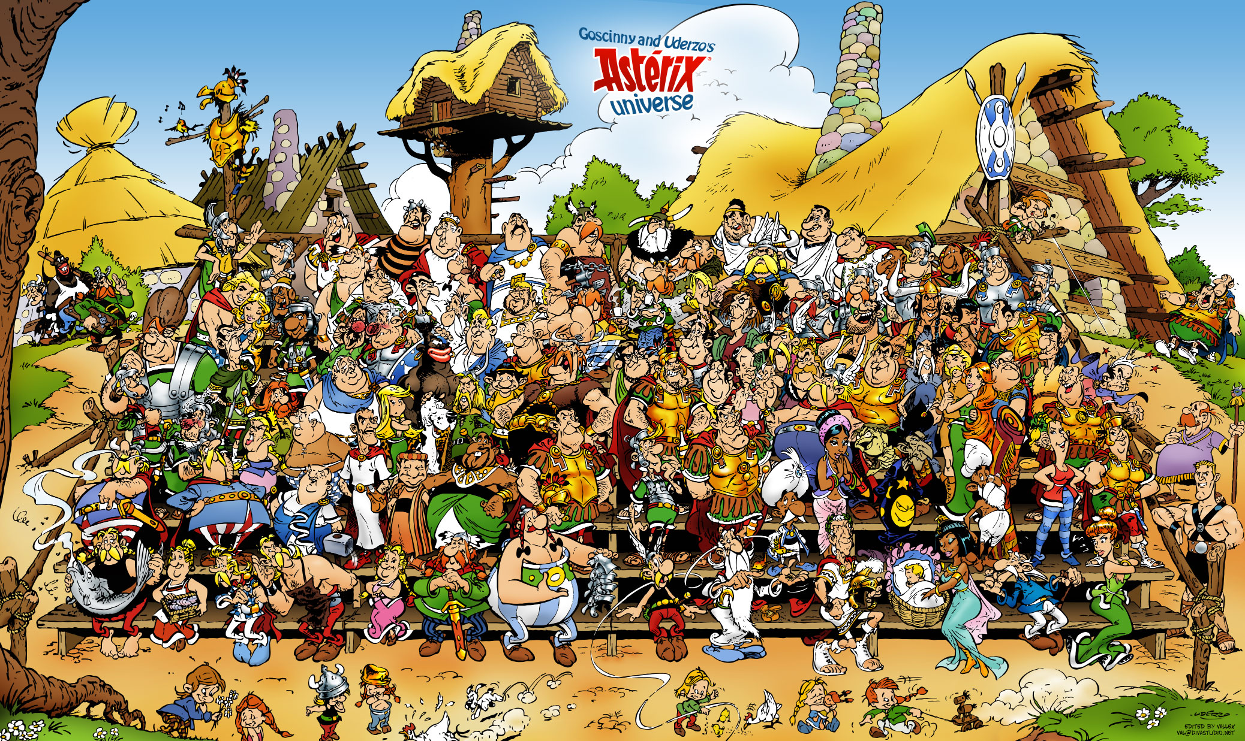
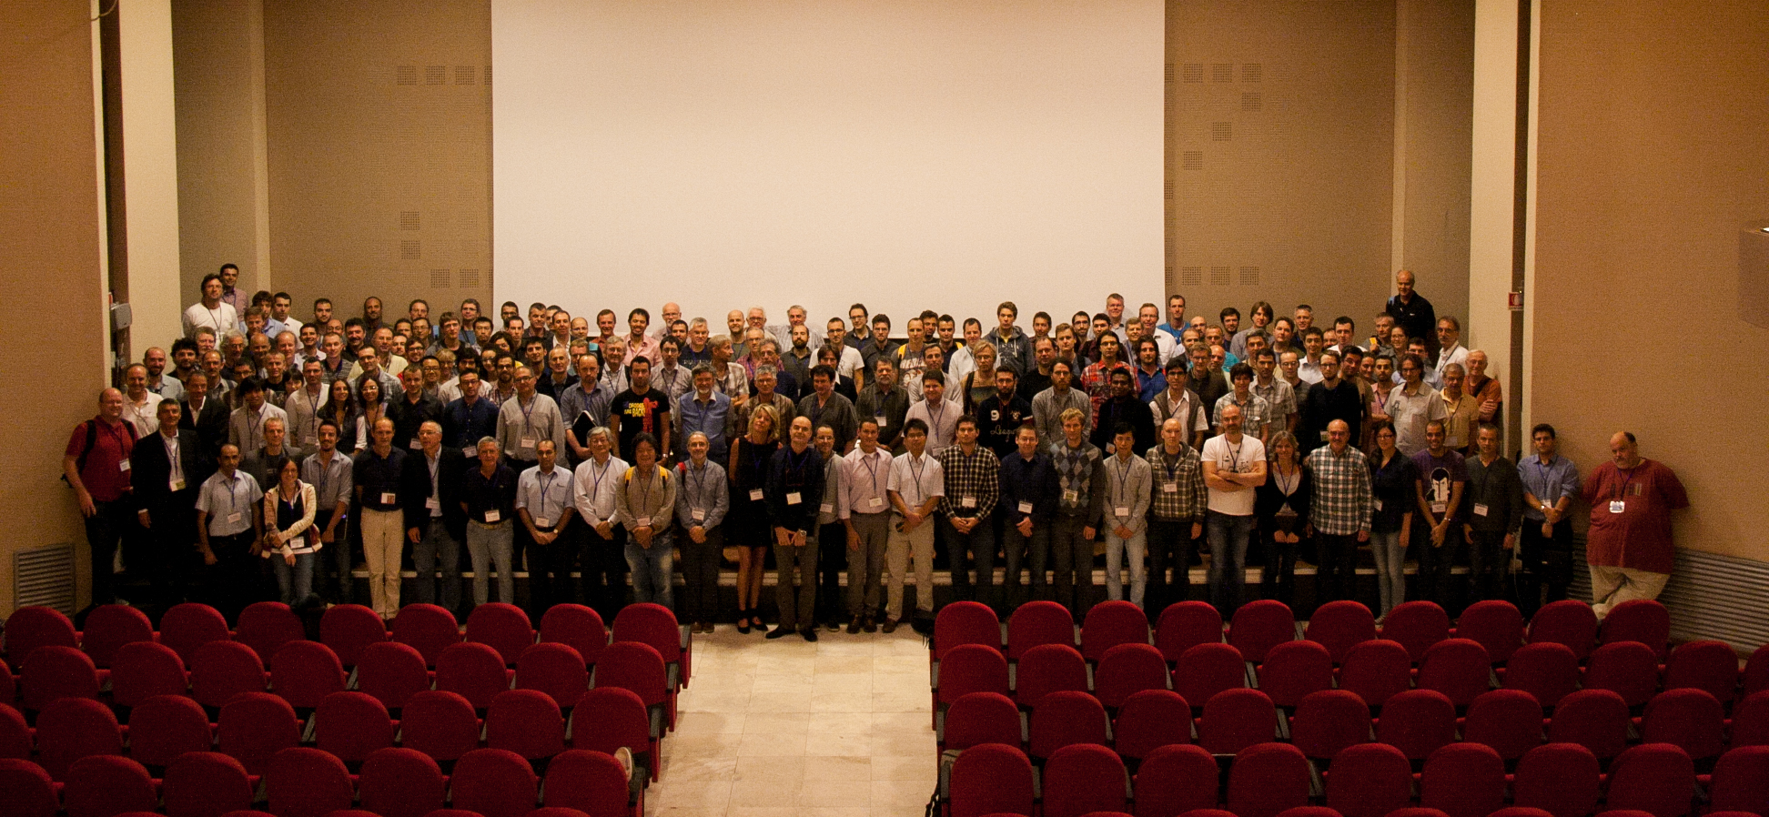
Thanks for your contributions
Excellent presentations
Excellent posters
Active working groups
Good and friendly coffee discussions
,,,,

Slide 6
Thanks to local organization
Gian Mario and his Perugia team
Superb city
Charming welcome
Effective organization
Excellent conference dinner
,,,,,,,

Slide 7
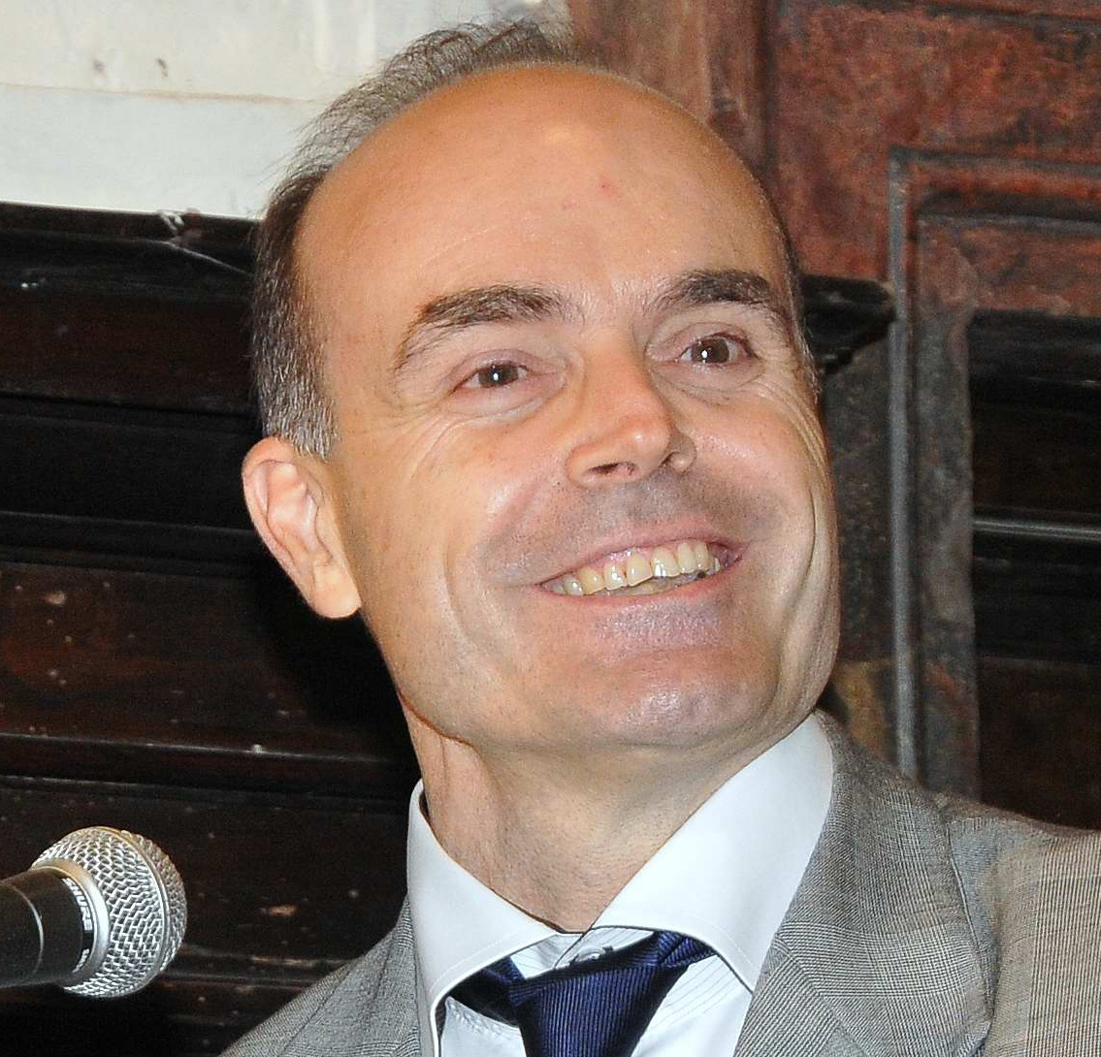
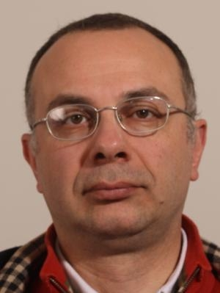

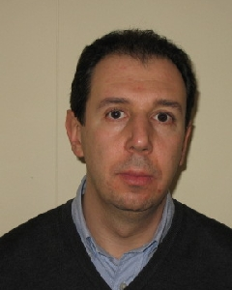
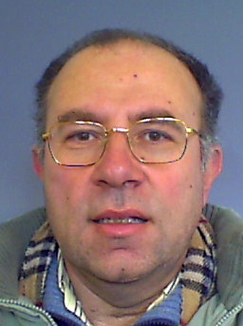
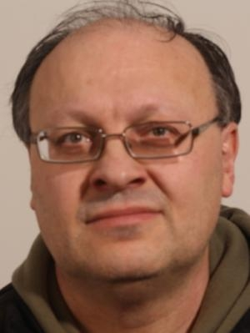
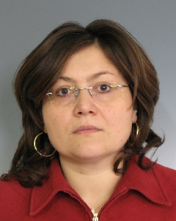
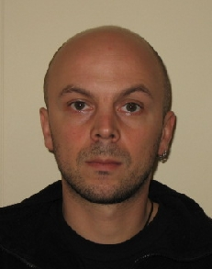
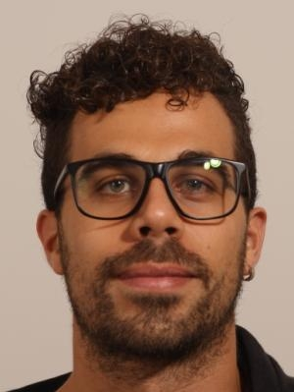
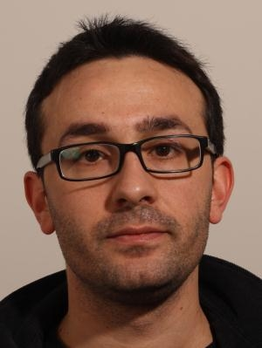
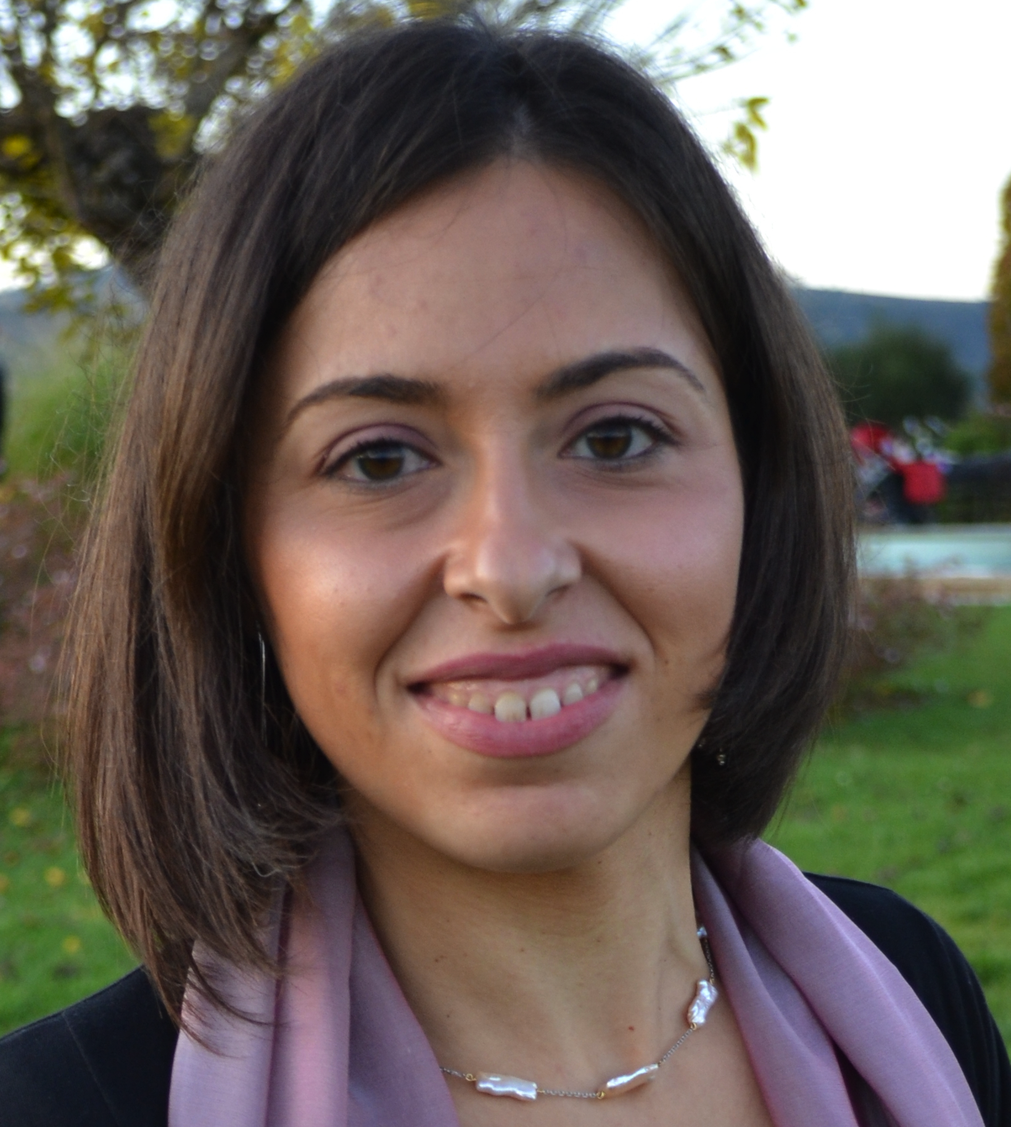
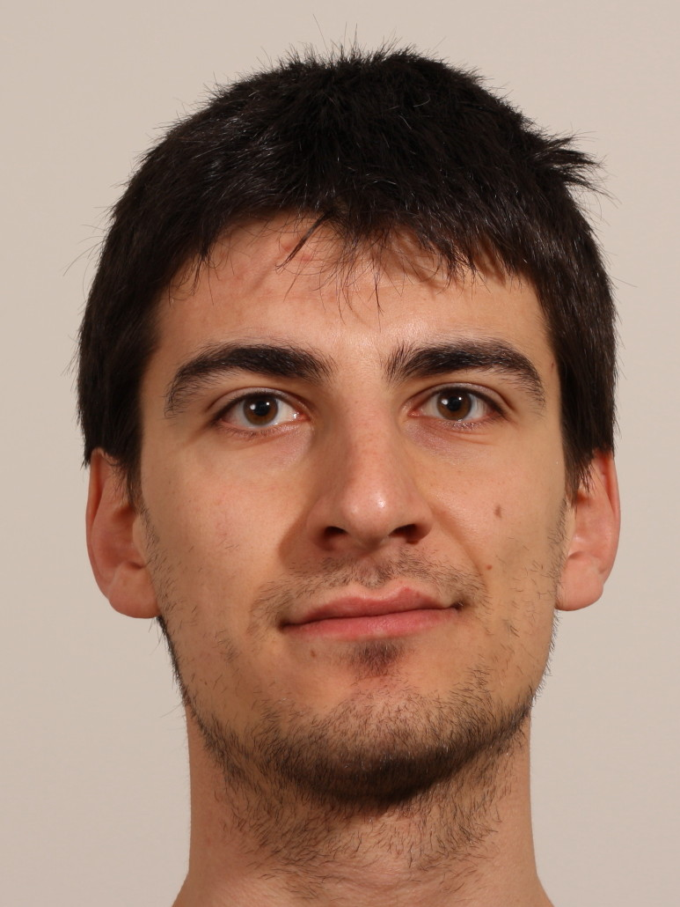
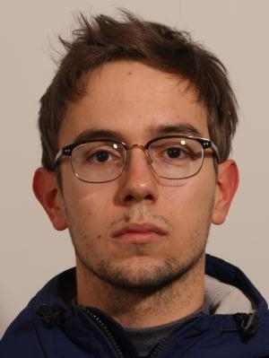
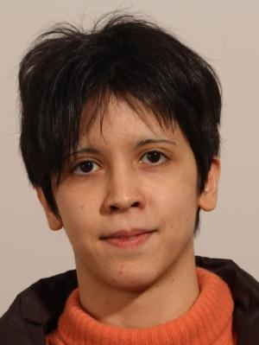
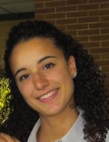
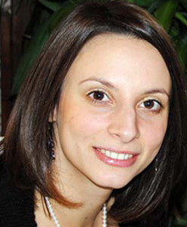
The Perugia team
Gian Mario Bilei
Attilio Santocchia
Giovanni Ambrosi
Daniele Passeri
Mauro Menichelli
Leonello Servoli
Pisana Placidi
Livio Fanò
Elia Conti
Michele Salvatore
Lucia Bissi
Aniello Spiezia
Diego Ciangottini
Luisa Alunni
Sara Marconi
Arianna Morozzi

Slide 8
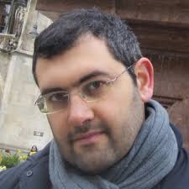
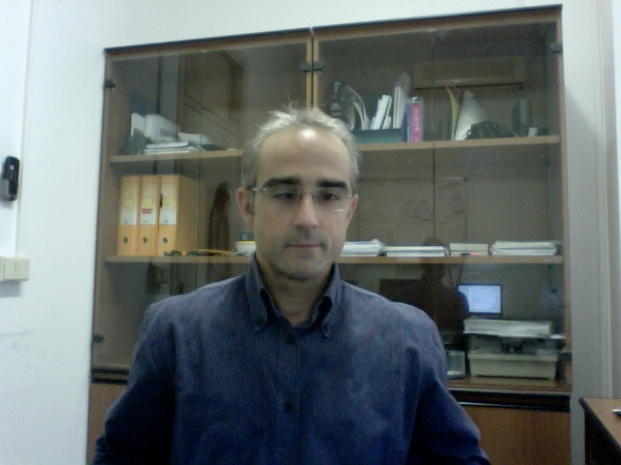
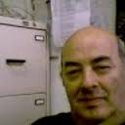
The IT support team
Mirko Mariotti
Enrico Becchetti
Francesco Babucci

Slide 9
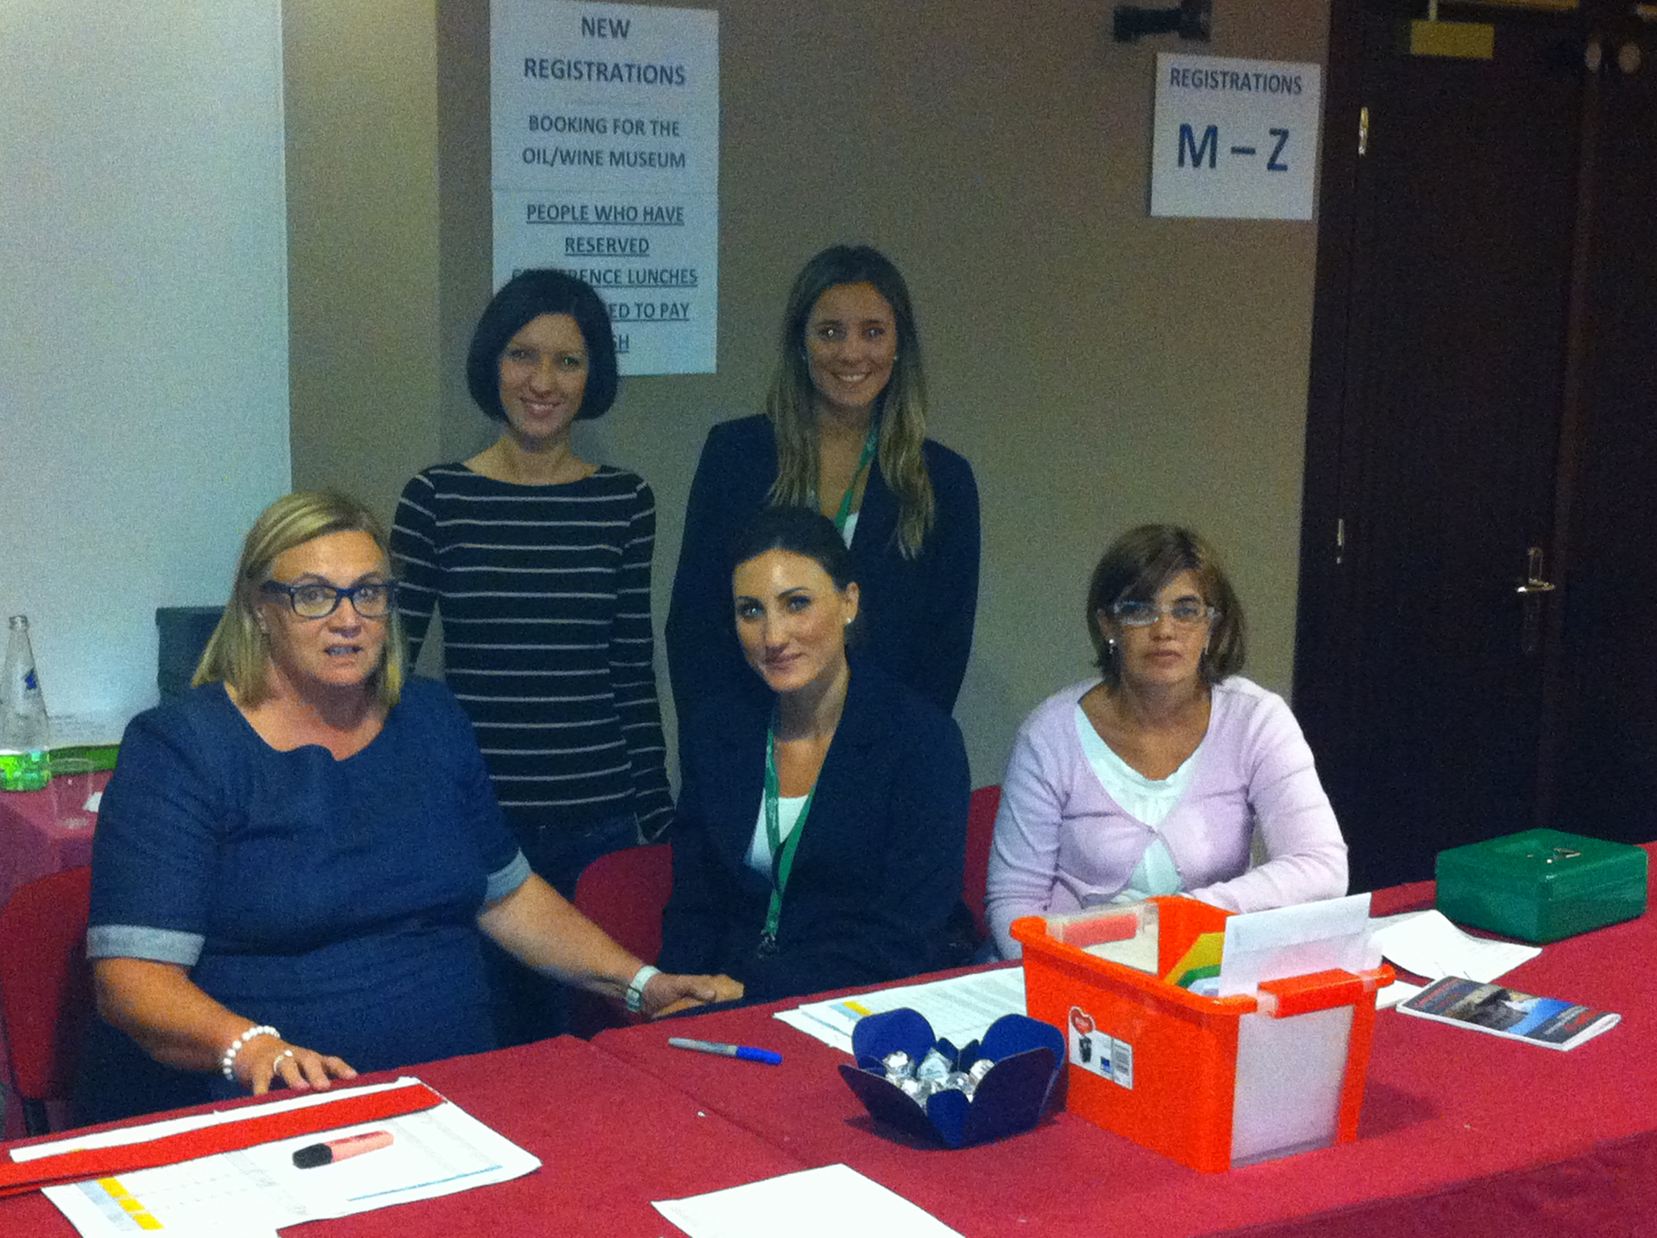
Consulta Congress Agency
Simona, Laura, Giada, Silvia and Giuseppina

Slide 10
The scientific committee
Scientific committee members:
Philippe Farthouat (CERN, co-Chair) G.M. Bilei (INFN Perugia) L. Feld (Aachen University) M. French (RAL) G. Hall (Imperial College) M. Hansen (CERN) L. Mapelli (CERN) A. Marchioro (CERN) L. Musa (CERN) M. Newcomer (U. of Pennsylvania) E. Petrolo (INFN Rome) J. Serrano (CERN) W. Smith (U. of Wisconsin) C. de la Taille (IN2P3) F. Vasey (CERN) K. Wyllie (CERN)
Jorgen Christiansen (CERN, co-Chair)
Evelyne Dho for Indico, poster, programme, Emails, ,

Slide 11
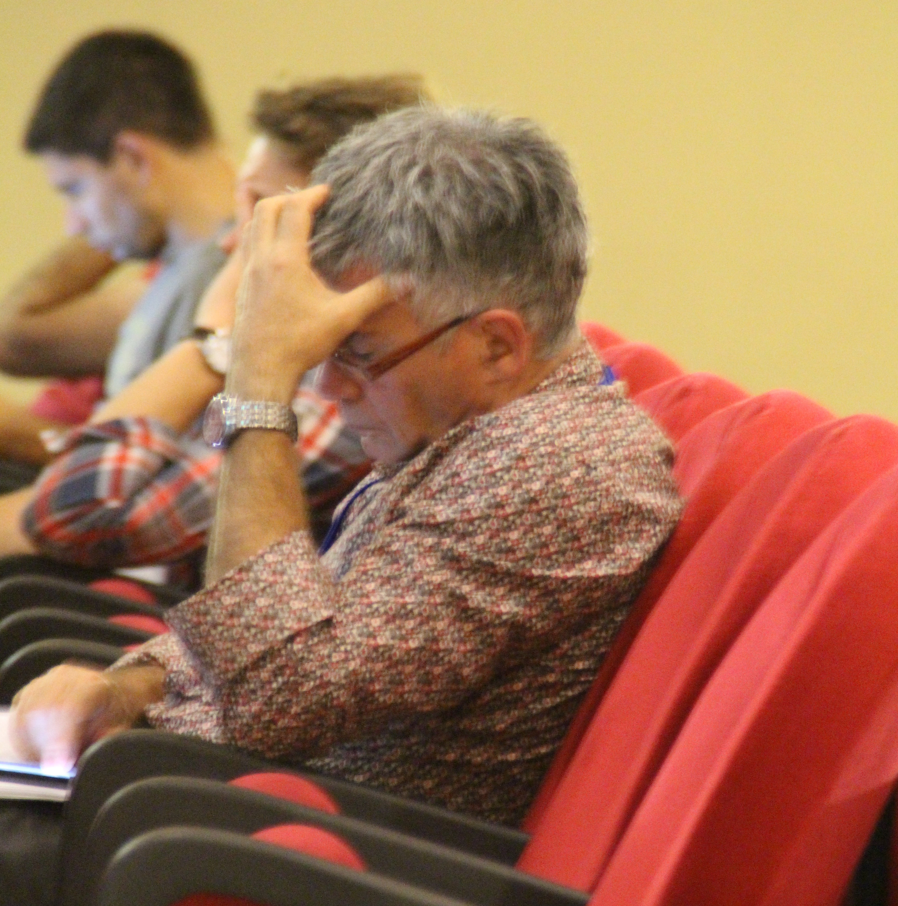
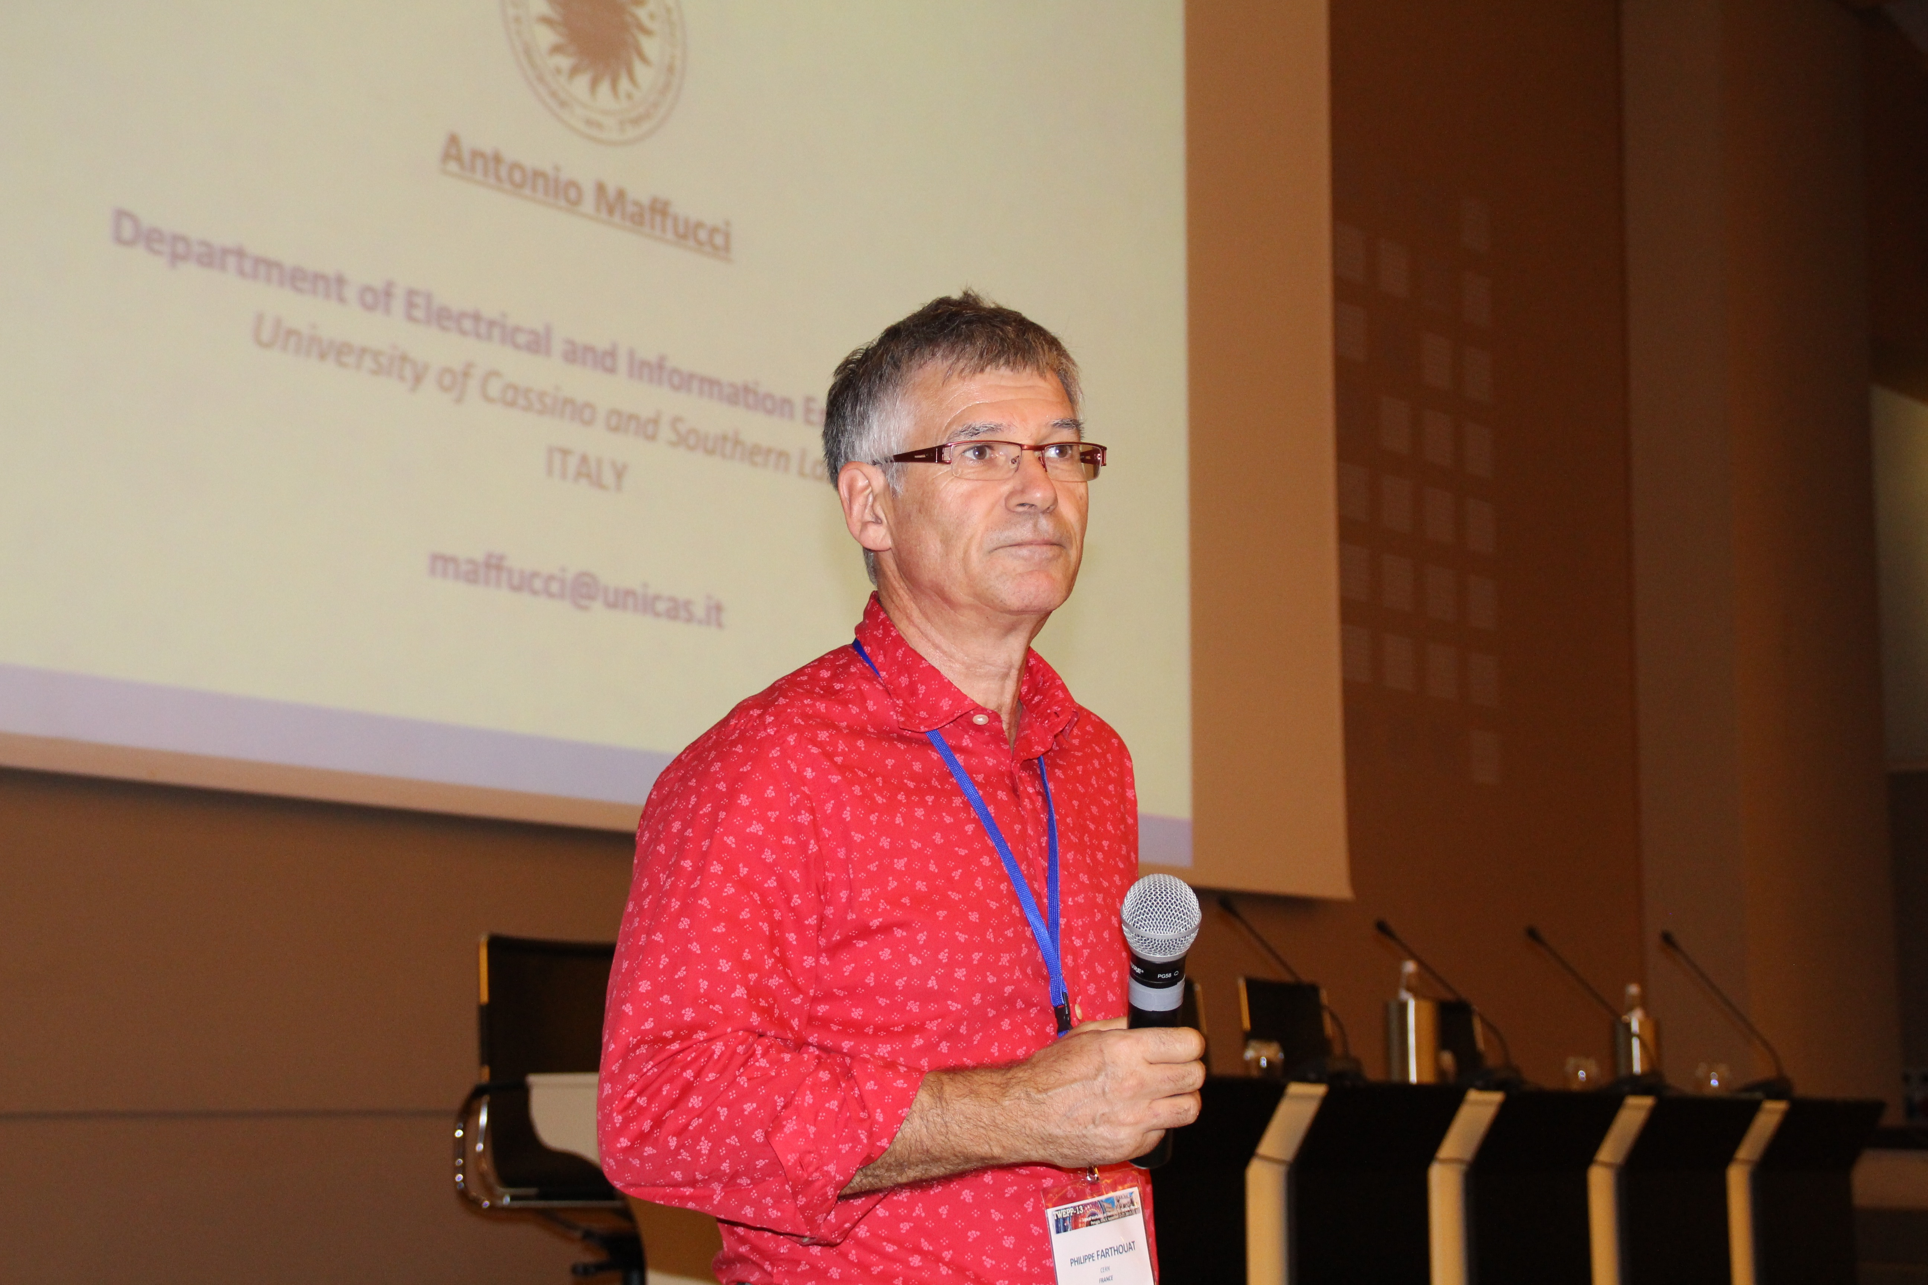
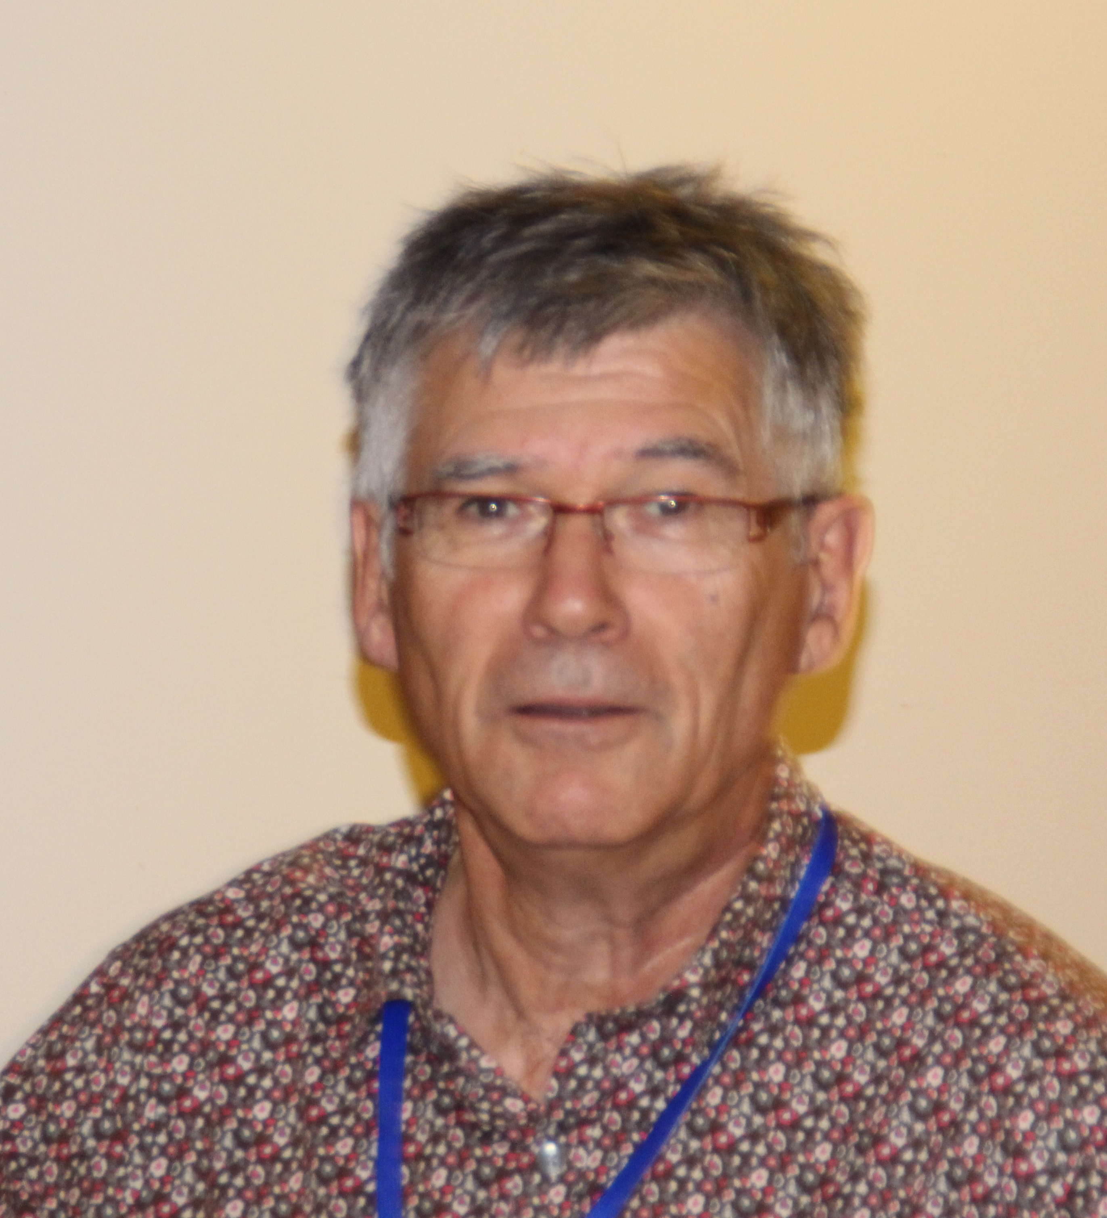
Thanks for 3 years of organizing TWEPP

Slide 12

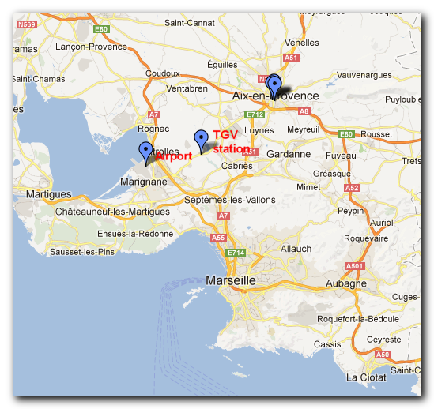
TWEPP-14
Aix en Provence,
France
Sep. 22 – 26 2014
Hosted by CPPM

Slide 13

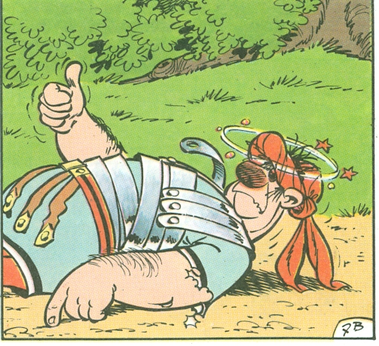
Time to go home

