Slide 1
LS1 activities Leak test-Consolidation-Maintenance EIV section
Activities
EIV Planning
Working tool
Documentation
Conclusion

Slide 2
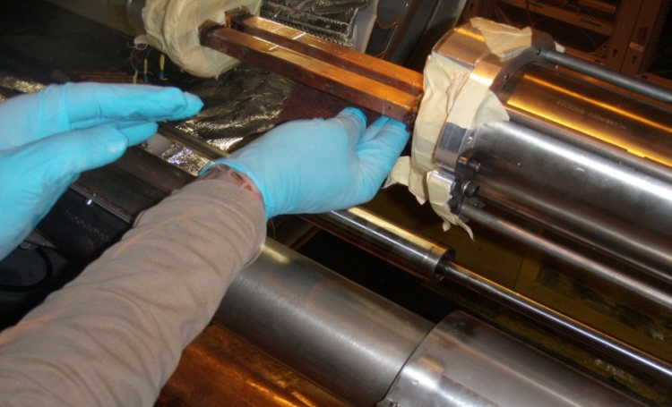
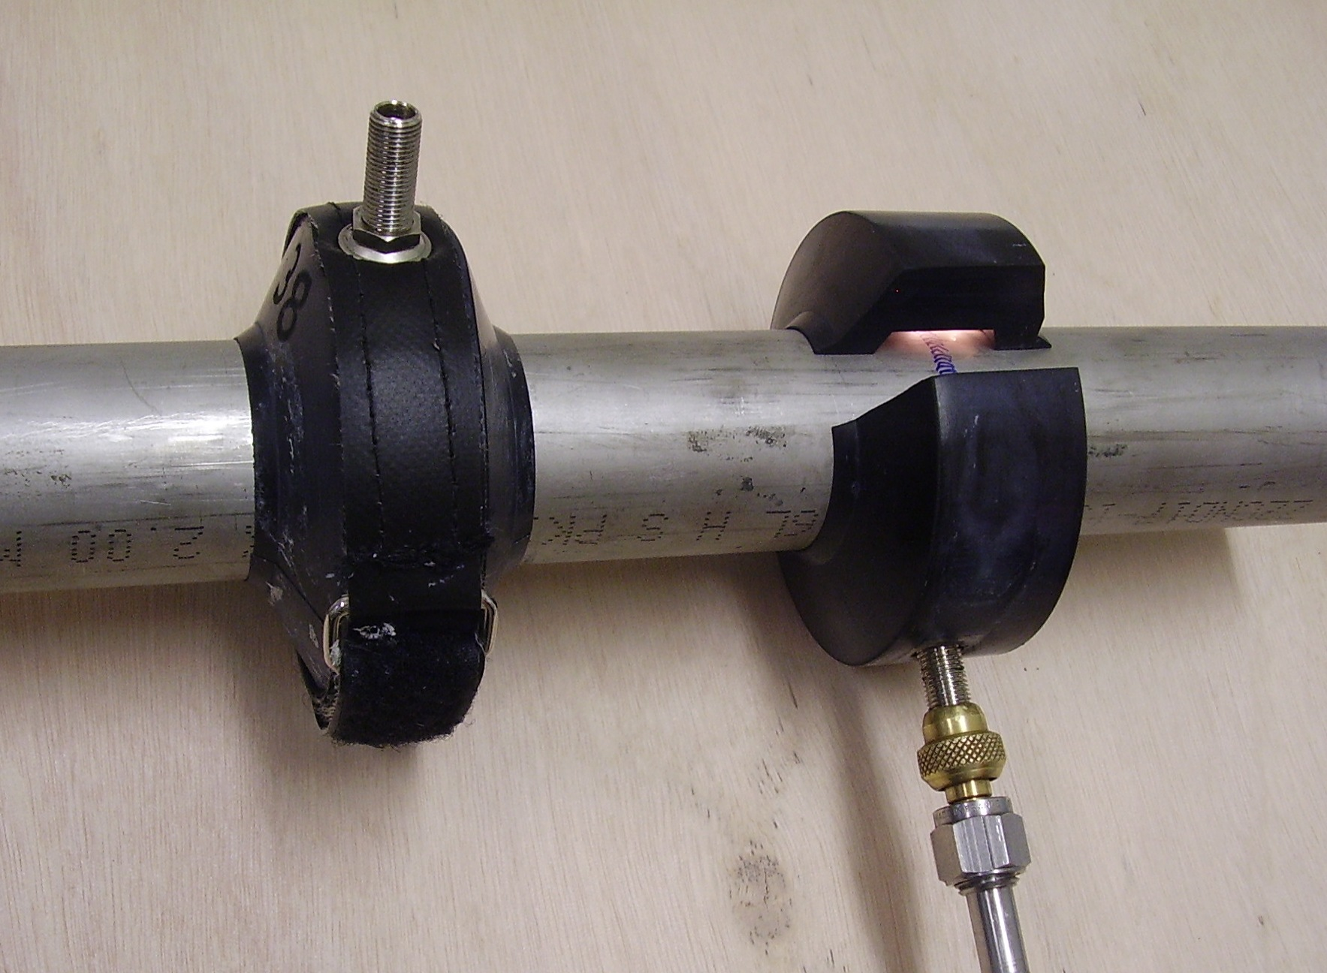
LS1 activities Leak test-Consolidation-Maintenance EIV section
Activities
Envelope leak testing above 80K total of~112 volumes
(3 days/arc with 2 teams for ~14 volumes )
Monitoring the pressure during the warm-up for a first diagnostic (CERN)
Leak test 0-rings that will not be exchanged (magnet foot, BPM free-throw’, level gauge, DFBA envelope, viton)
Open NC in case of leaks
Vacuum degradation & venting total of ~234 volumes
(1 day/arc with 1 team for ~30 volumes )
Degradation of the vacuum to accelerate the warm up (with dry air or N2)
Break vacuum at room temperature (with tunnel air)
Clamshell on M line and diode vessel total of ~11000 welds (20 days/arc with 2 teams for ~ 1400 welds )
Standard leak test after welding executed by dedicated team
(pumping down, inject He & leak test the weld on a vacuum subsector of 214m)
In case of leak or impossibility to perform the standard test call an expert
Expert will confirm the leak or will find an issue in case of problem.
Activities status and result daily reported (WISH tool only or other system is required?)
All welds will be re-validated by pressure test (whole sector)

Slide 3
LS1 activities Leak test-Consolidation-Maintenance EIV section
Tools for clamshells activities
Standard clamshells already exist for M & diode tests
New ‘long clamshell’ design is on going (Paul, Alain, Rafal, Hervé, Christophe)
Special clamshell to test two welds in the same time
20 extra clamshells “M” will be manufactured (25 in total)
Quotation is on going
10 extra clamshells “pot de diode” will be manufactured
166.5mm (12 in total) ⇒ Modification of the dimensions
94 mm (12 in total) ⇒ Modification of the dimensions
Quotation is on going
10 extra chart recorders ordered
delivery end of January
0-10V cable will be produced
Other
Bridging tool to pump and backfill the 214m volume with helium
Pump to evacuate cold mass volume to 1 mbar (RV12? IPX?)
Detector (10 planned+ 5 news)
Helium in 50 ltr (to be ordered)
Patrick’s trolley or adapted leak detector trolley?

Slide 4
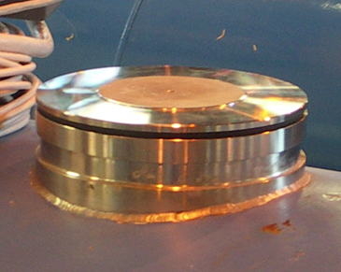
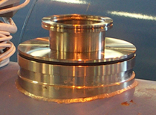
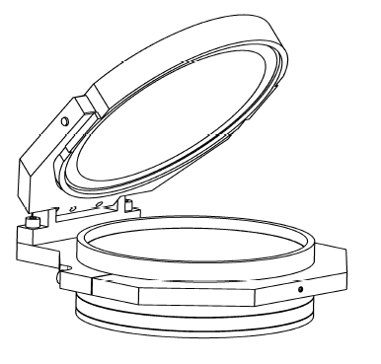
LS1 activities Leak test-Consolidation-Maintenance EIV section
Consolidation
DN200 (6 days/arc with 1 team)
Installation of DN200 & DN200 modified (actually manufactured in main workshop) with spring, Flap valve (on 3,5 sectors ) - LSS Rafal + Wim
Install DN200 modified & Flap valve on the consolidated subsector (on 4,5 sectors)
To improve redundancy on magnet & QRL (5 days/arc with 1 team)
Installation of 16 new pumping groups on the QRL (all sectors)
Installation of 21 by-pass valves on the magnet (3 sectors)
O-Ring exchange & reclamping (17 days/arc with 1 team)
Replace NBR O-ring (Black) with Viton (Green)
Reclamp DN100 & DN63 flanges (3,5 sectors)
After QRL consolidation (~16 days/arc with 1 team)
Pump QRL IV and leak test (New pumping groups, seals, gauges, safety valve)
DN200
DN200 modified
Flap valve

Slide 5
LS1 activities Leak test-Consolidation-Maintenance EIV section
After magnet consolidation & W magnet bellow closure
(~27 days/arc with 1 team)
Pump magnet Ins.V after W closure and leak testing the cryostat (New by-pass, BPM, W bellow, DN200 & DN100 flanges, etc) 21 days
Validation of internal lines “1 bar” (measure He residual on each subsector) 3 days
Validation of internal lines at 50% of ‘design pressure’ after pressure test 3 days
Maintenance (~5 days/arc with 1 team)
50 LSS turbo pump (60l/s) bearings (100%)
30 Q8 turbo pump (300l/s) bearings (100%)
Primary pump maintenance
Sogevac 100%
RV12 20% (maintenance anticipated in 2012)

Slide 6
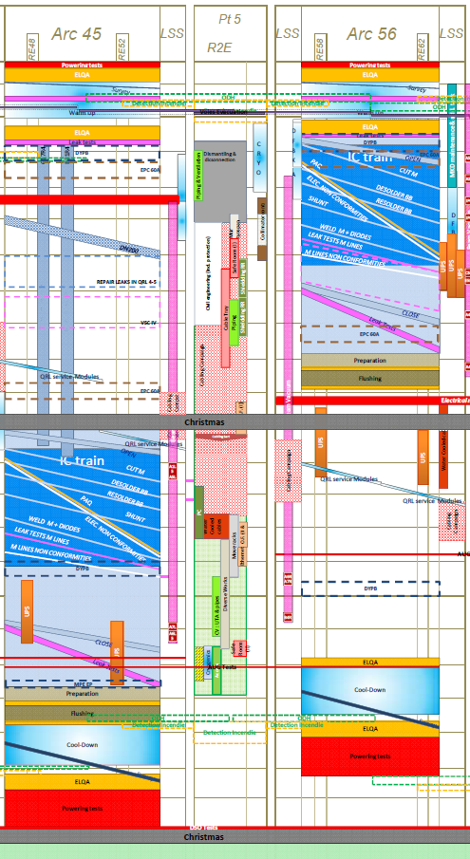
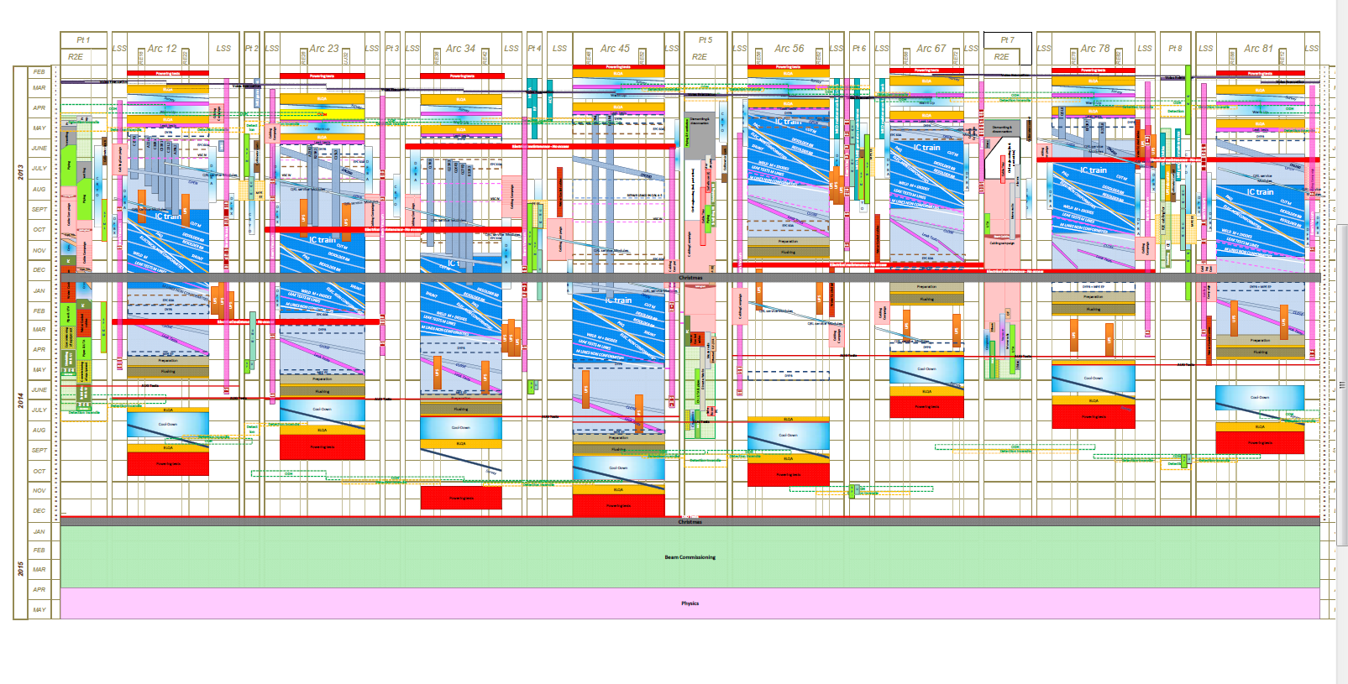
LS1 activities Leak test-Consolidation-Maintenance EIV section
EIV Planning
Envelope leak testing at 80K
Vacuum degradation & venting
Clamshell M line and diode vessel
Pump magnet IV after W closure and leak testing
Validation of internal lines “1 bars”
Validation of internal lines at 50% of ‘design pressure’
70% of the work load
Consolidation
DN200
News pumping groups
By-pass valves
O-Ring exchange & reclamping
Pump QRL IV and leak testing
Maintenance
30% of the work load
can move into the planning

Slide 7
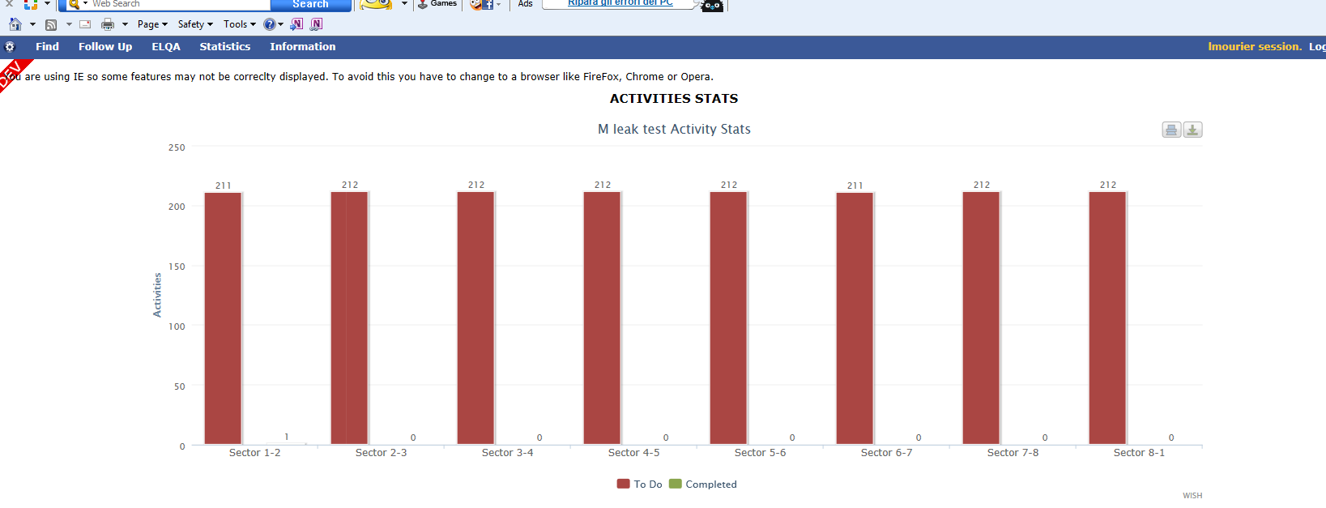
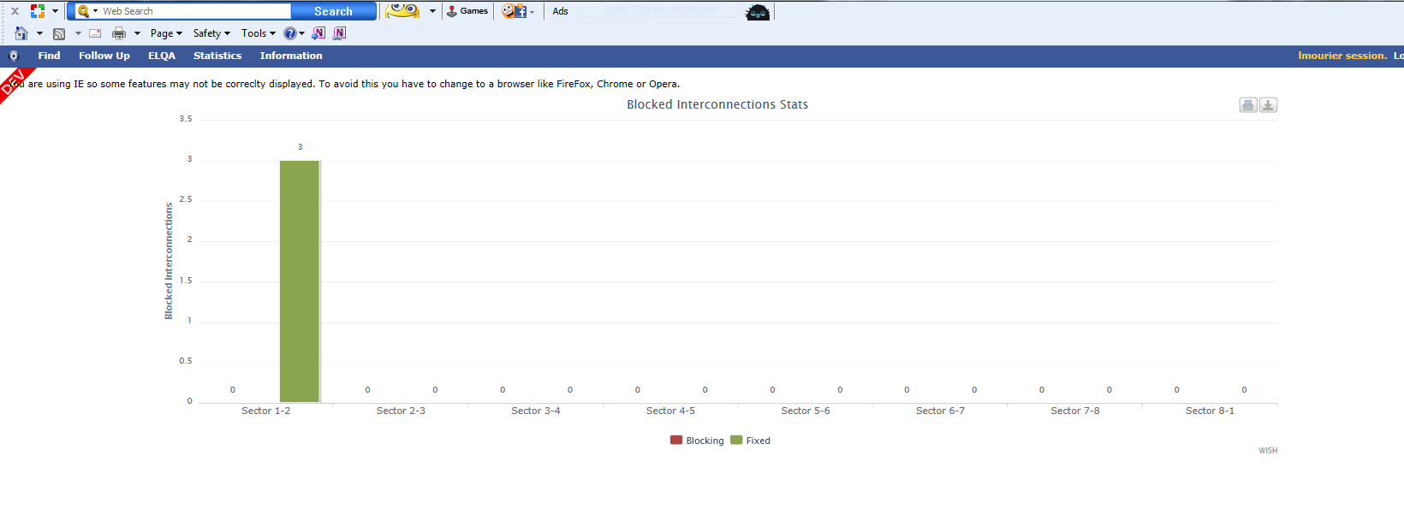
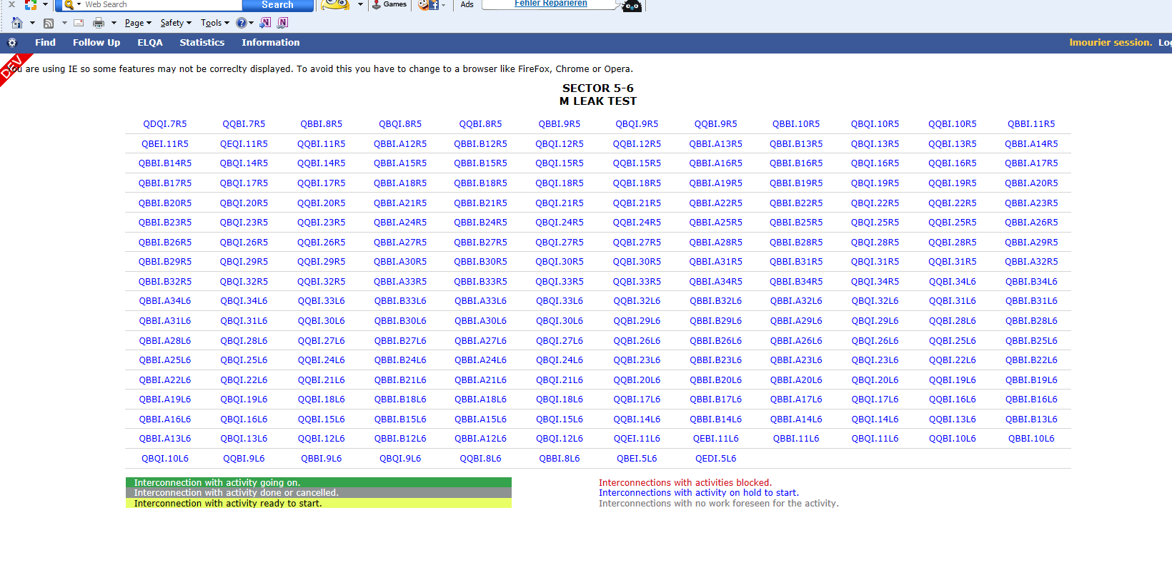
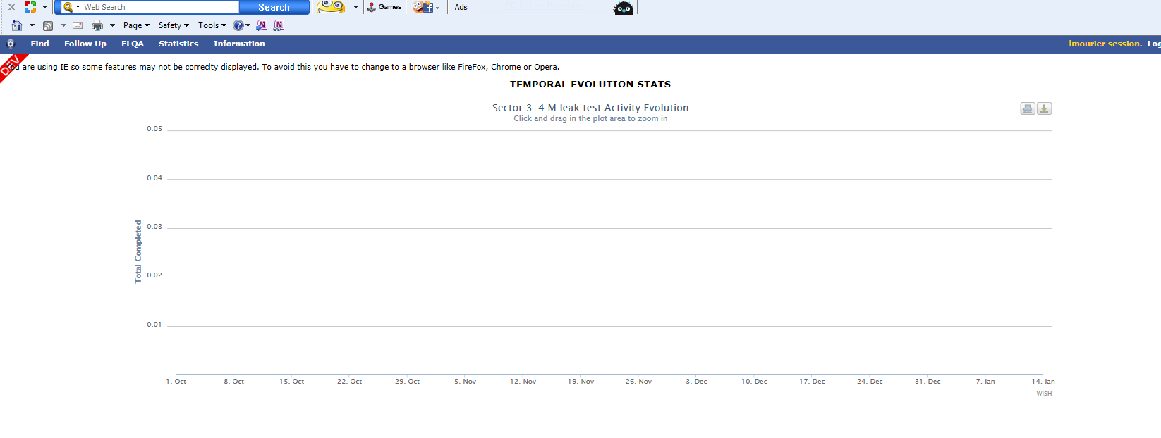

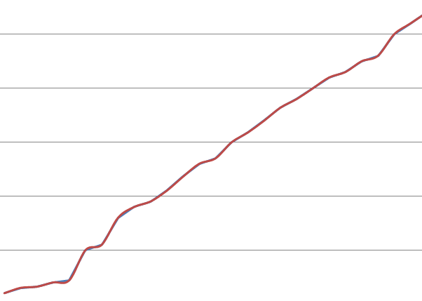
LS1 activities Leak test-Consolidation-Maintenance EIV section
Working tool
WISH

Slide 8
LS1 activities Leak test-Consolidation-Maintenance EIV section
Documentation
ECR
Done
DN200 & flap valves
By-pass valves (magnet)
To be Done
New groups on the QRL
Procedure (description, tooling, reporting, etc...)
Done
Clamshell leak test “Procédure de test d’étanchéité des lignes M1, M2, M3’’
Vacuum degradation EDMS 996513 “ Interventions sur le vide d’isolation des cryo-aimants du LHC’’
Maintenance EDMS 1160364 “ Maintenance des groupes de pompage fixes et mobiles du LHC “
To be updated
Validation of external envelope & internal helium line EDMS 353384
Other
On going
DN200 installation description (In excel file, describe which and where DN200 or flap valve should be installed)
Reclamping (use existing excel file)

Slide 9
Conclusion
To be confirmed…
Is WISH tool enough to follow status & result activities?
Step validation, NC reporting (attached to WISH), detail of the test if not standard, add comment etc..
Which type of pump for M circuit evacuation?
RV12, IPX, mobile pumping group
Type of trolley to use for detection?
Patrick’s trolley
Trolley delivered with new detector
On going…
New ‘long clamshell’ design is on going
Extra clamshell M and diode quotation on going
Extra recorder delivered and of January
ECR for new pumping groups
Update procedure leak test
DN200 modified is produced in main workshop (followed by TE-MSC-MNC)

Slide 10
LS1 activities Leak test-Consolidation-Maintenance EIV section
Thank you!

