Slide 1


LS1 Activities – CERN/AL4030
- Cold vacuum system recall
- Overview: Activities/Planning/Mandates/Resources, Infrastructure
- Localisation of known helium leaks
Paul Cruikshank TE-VSC

Slide 2
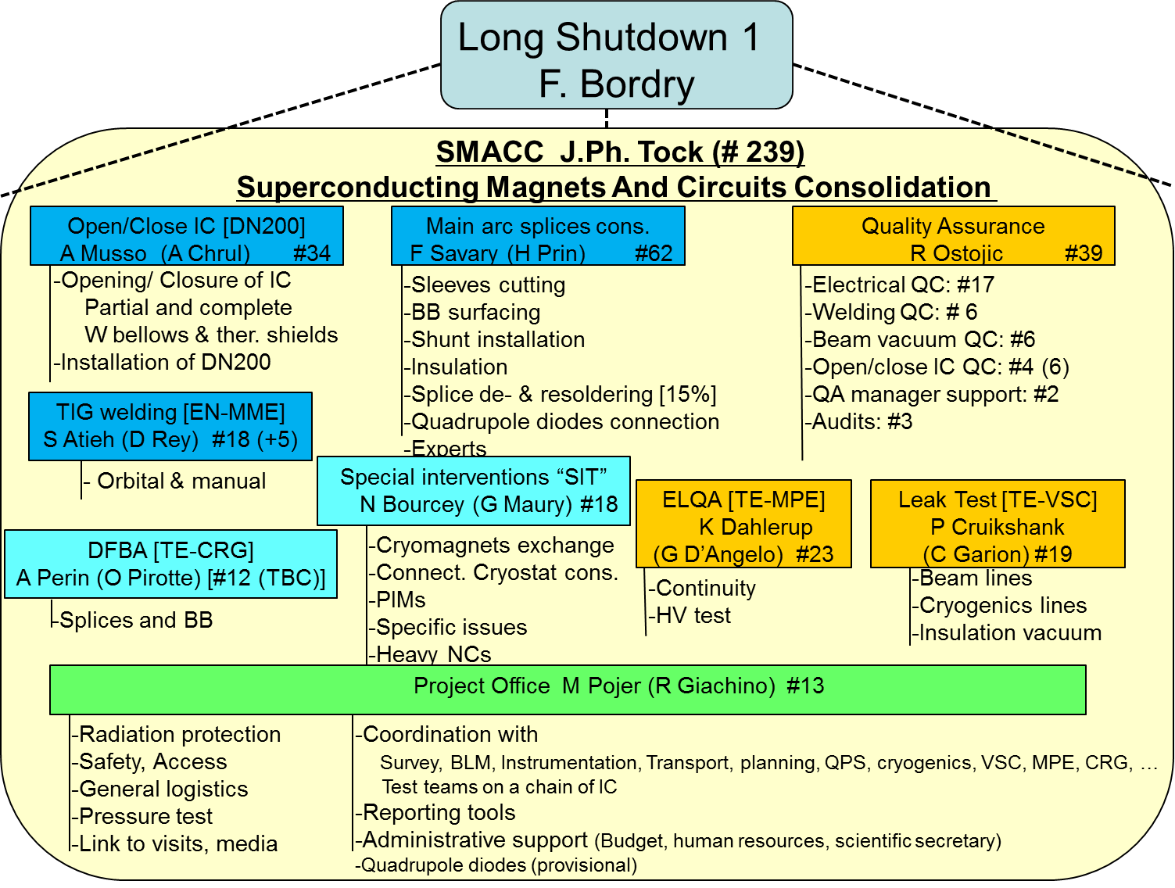

Slide 3
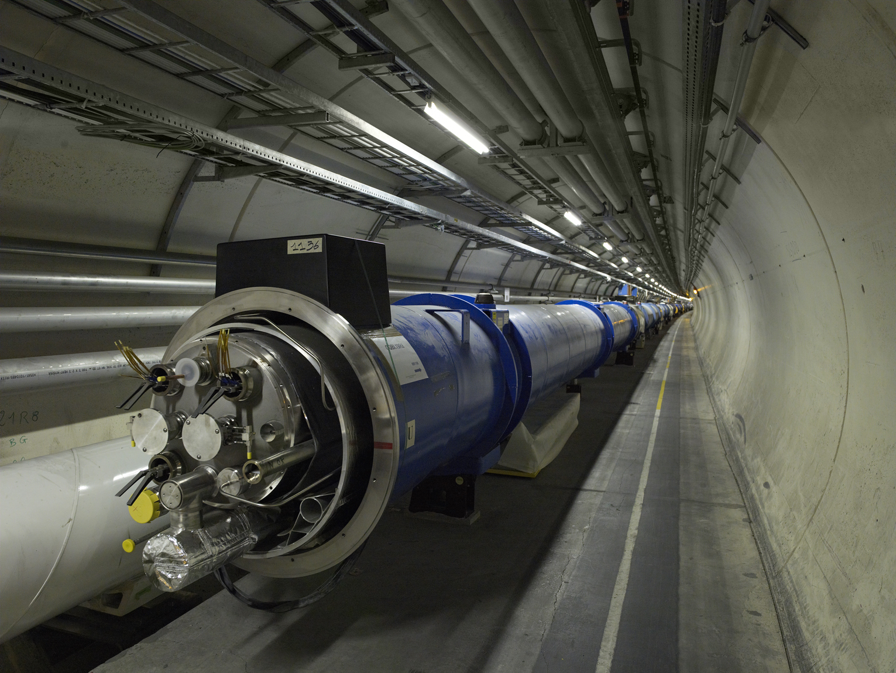
LHC arc cold vacuum systems - recall

Slide 4
LHC arc cold vacuum systems - recall

Slide 5
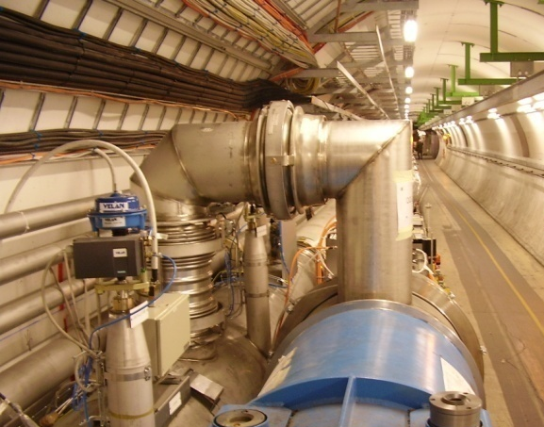
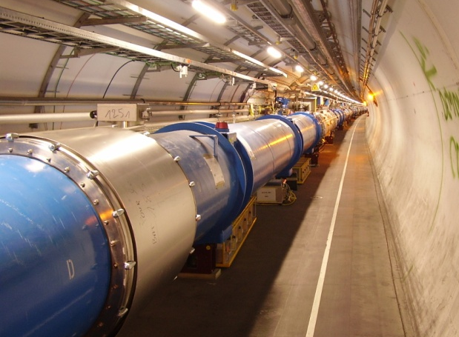
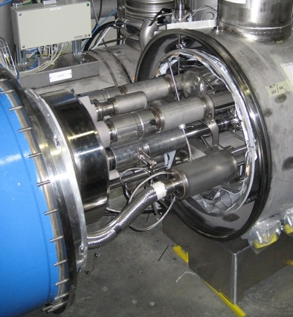
LHC arc cold vacuum systems - recall
QRL
cryostat
Jumpers
Vacuum
barriers
LHC
magnet
cryostat

Slide 6
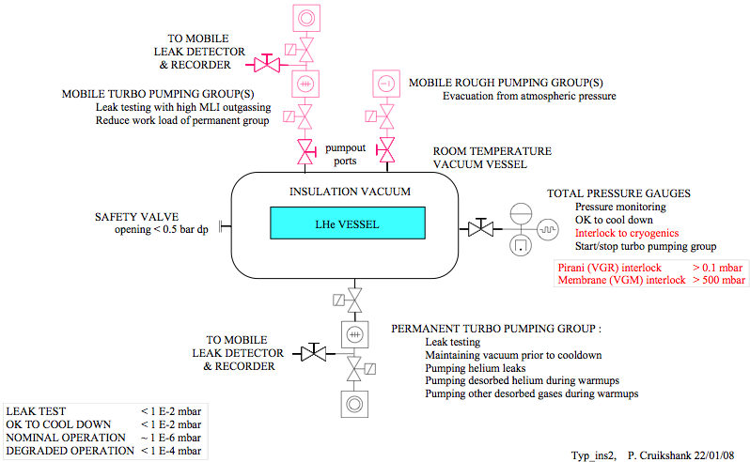
LHC arc cold vacuum systems - recall

Slide 7
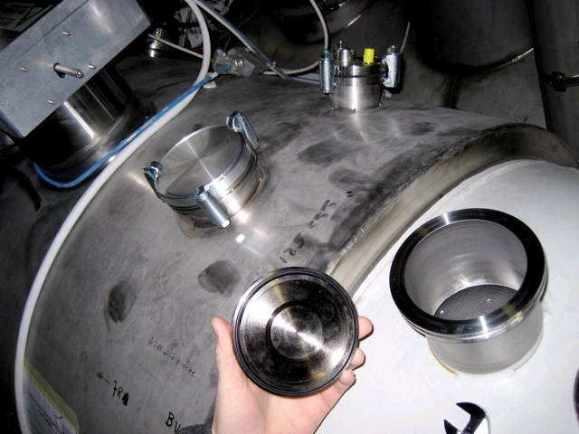
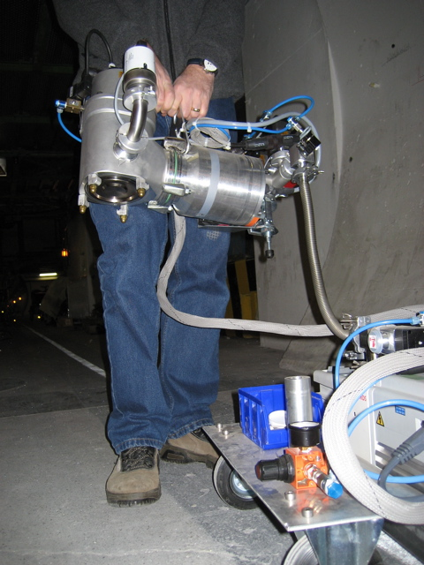
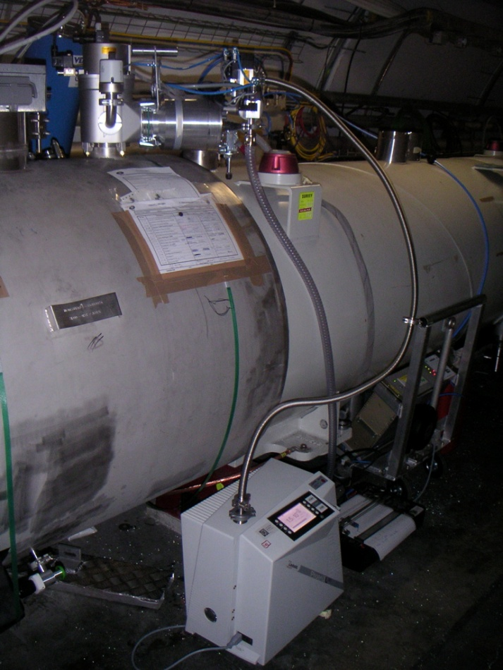
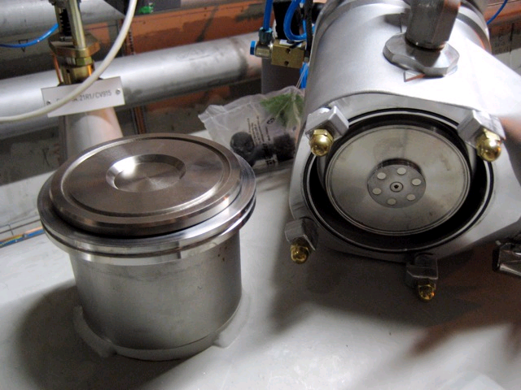
LHC arc cold vacuum systems - recall
LHC cryostats were designed with DN100 ISO-K ‘pumping’ ports at vacuum subsector extremities. 300l/s turbos can be installed (and removed) without breaking vacuum
Tunnel equipment: 63 m³/hr mobile primaries – 20 units
300 l/s mobile primaries – 40 units
MS Leak detectors – 20 units

Slide 8
LS1 leak test support & consolidation - cold vacuum
- typical activities in an arc
IC status | Arc splice train - LT support | LHC cons - LT support | DFBA - LT support | VSC IV consolidation | VSC cold BV cons
Closed (phase 1) | Degrade IV, Vent IV, |  |  | LT (80 K < T <300 K), Localise known He leaks, | He & RGA analysis Vent BV, RF ball,
Open (phase 2) | M clamshell, | Cryomagnets, CC, Y, Diodes | Splices & lyra, DFBAK, Flexibles, | Localise He leaks (5 bar), Vent QRL & SAM, Flap valves, DN200 springs & pumpouts, Reclamping of DN100 & 63, Additional by-passes & turbos, Turbo maintenance, Pump & LT QRL & SAM, | PIM temp protection, PIM exchange, Rupture discs, RF ball, Pump & LT BV, Protection shells,
Closed (phase 3) | Pump IV, LT envelope, LT internals, LT after PT, | LT envelope, LT internals, LT after PT, | LT envelope, LT internals, LT after PT,
time window
before train

Slide 9
LS1 leak test support & consolidation - cold vacuum
- typical activities in an arc
IC status | Arc splice train - LT support | LHC cons - LT support | DFBA - LT support | VSC IV consolidation | VSC cold BV cons
Closed (phase 1) | Degrade IV, Vent IV, |  |  | LT (80 K < T <300 K), Localise known He leaks, | He & RGA analysis Vent BV, RF ball,
Open (phase 2) | M clamshell, | Cryomagnets, CC, Y, Diodes | Splices & lyra, DFBAK, Flexibles, | Localise He leaks (5 bar), Vent QRL & SAM, Flap valves, DN200 springs & pumpouts, Reclamping of DN100 & 63, Additional by-passes & turbos, Turbo maintenance, Pump & LT QRL & SAM, | PIM temp protection, PIM exchange, Rupture discs, RF ball, Pump & LT BV, Protection shells,
Closed (phase 3) | Pump IV, LT envelope, LT internals, LT after PT, | LT envelope, LT internals, LT after PT, | LT envelope, LT internals, LT after PT,
time window
before train
IS Workload
50 %
10 %
10 %
20 %
10 %

Slide 10
LHC LS1 schedule
W-Up
W-Up
W-Up
W-Up
W-Up
W-Up
W-Up
W-Up
Splices
CSCM
Splices
W-Up
Splices
Splices
Splices
Splices
Splices
Splices
Cool-down
Cool-down
Cool-down
Cool-down
Cool-down
Cool-down
Cool-down
Cool-down
M
M
M
Beam Commissioning
13 TeV
Paul Cruikshank TE/VSC LSI Activities – CERN/AL4030 15th January 2013

Slide 11
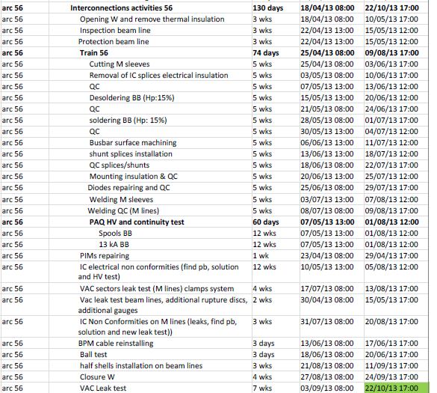
Detailed train arc 56
Powering tests
ELQA
Leak tests
Warm up
ELQA
PAQ
Open W
Open M
Desolder BB (15%)
Shunt
Solder BB (15%)
Diodes
Weld M
Elec. non conformities
Leak Tests M
Non Conformities M
Close W
Leak tests W
Preparation
Flushing
Paul Cruikshank TE/VSC LSI Activities – CERN/AL4030 15th January 2013

Slide 12
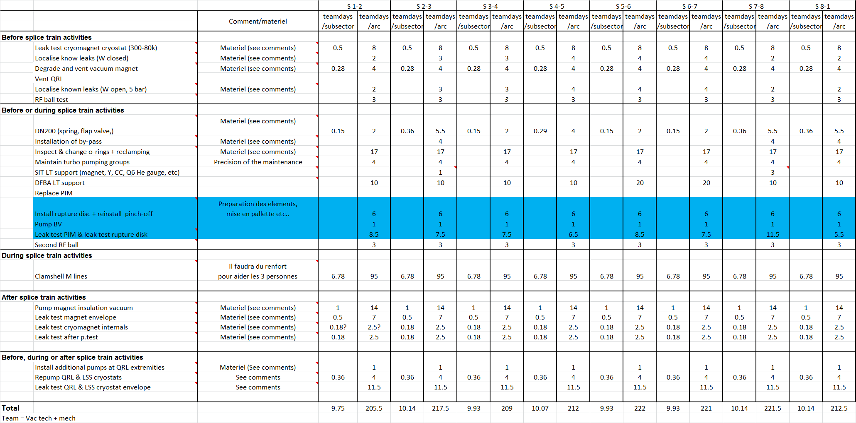
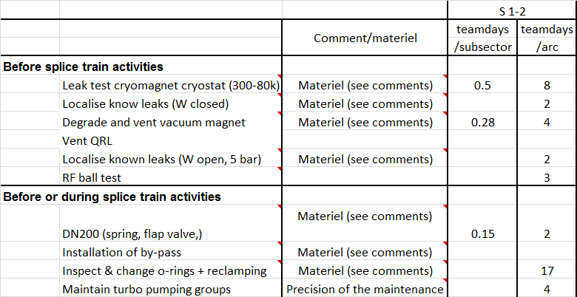
Cold vacuum - Task list & duration estimates
Inputs from Ludo, Wim, Paul, Julien, Alain, Nico, etc…

Slide 13
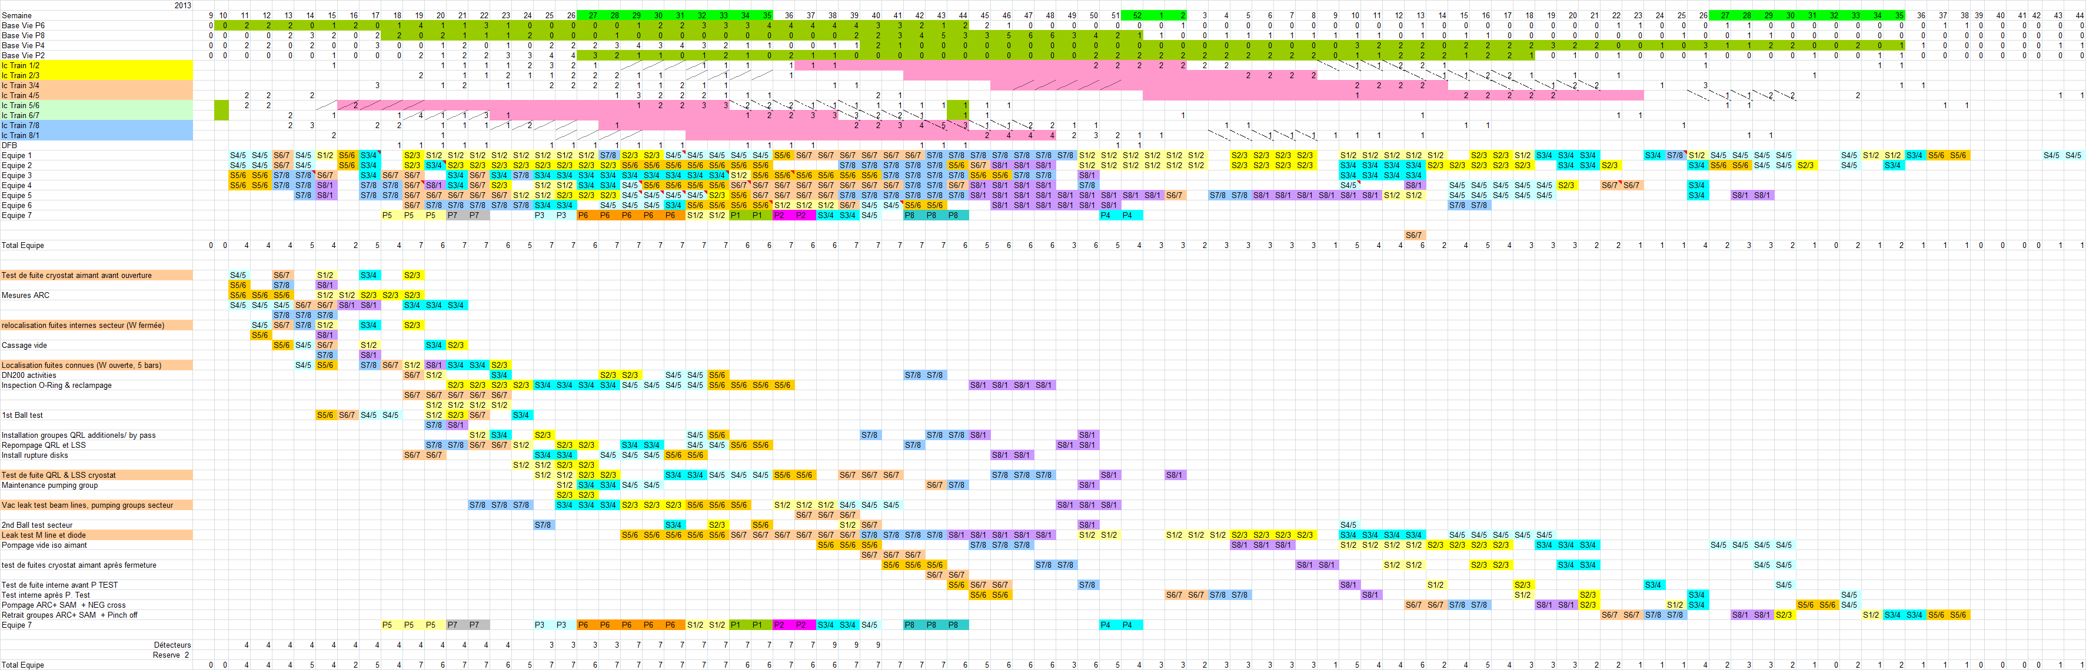
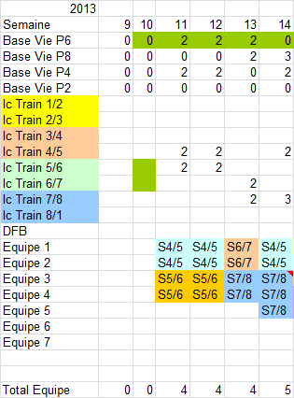
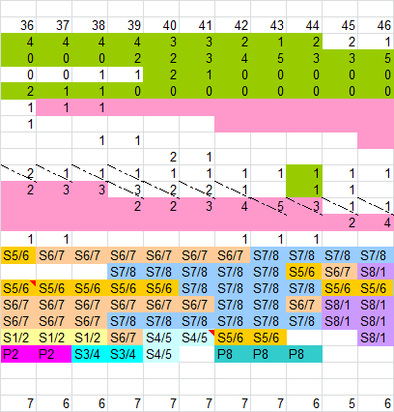
Cold vacuum – Task & team planning proposal
Created by Alain & Wim wrt respect to LHC schedule

Slide 14
Mandates for cold vacuum activities
Mandates:
  Activity responsible: Paul
    Prior to start – LS1 & SMACC coordination meetings, budget, resources, reviews,
    During execution – status reporting, LS1 & SMACC coordination meeting, VSC coordination meeting, NC overview,
  Sub-activity link person: Ludo, Wim, Rafal, Paul, Cedric, Julien,.
    Prior to start – ECR, procedures, tooling, materials, vacuum equipment, planning inputs, VIC,
    During execution – knowledge transfer, defining weekly actions, interface with other tech groups, trouble shooting, prioritizing, peak assistance, reunion de chantier, coordination of NC field actions,
  S133 support:
    Technical training, transport,
    PPSPS, safety training & equipment,
    Prior to start by sub-activity - mode operatoires, VIC,
    During execution:
      Teams – test execution, daily reporting, material logistics, consumables,
      Team support - test result validation, result recording (WISh), result archiving, NC creation & documentation, team deployment, field expertise, mode operatoire updates, equipment maintenance, VSC coordination meeting, PV creation, invoicing,

Slide 15
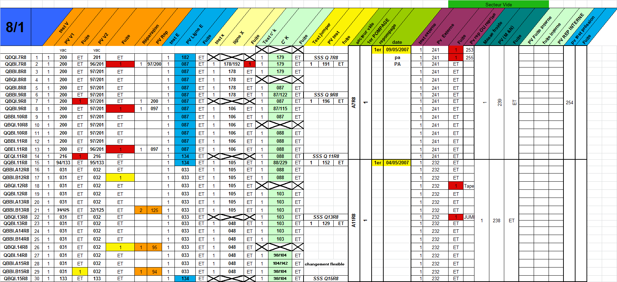
Data storage
Data storage:
  Use of WISH tool to define status of series leak test.
  Create NCR in edms in case of leak and attach to WISH step
  Maintain test/activity details in VSC Excel files – who, what, when,
    Team leaders in the tunnel send daily reports
  Maintain overview table of subsector status,
  List of known He leaks – NCR in edms
Test recording used during LHC installation (A.Grimaud)

Slide 16
Resources summary
VSC Staff
  2 Engineers, 1 Fellow, 5 technicians
Vacuum support contract S133
  14 industrial support staff required for ins vacuum system (& B.Vac) arc activities in 2013, then reduction will depend on agreed planning.
FSU support (FSU-TE-09,S145)
  0.5 additional workshop mechanic for PIM activity (+0.5 for expts)
Polish collaboration
  6 eng/technical staff for cold beam vacuum interconnect QA
    inspection at opening/closing, beam vac temporary protection,
    endoscopy at PIM cutting positions
    install protection shells
⇨ All will require safety training, access training, safety equipment..........

Slide 17
Infrastructure needs
Bungalows/office space:
  Office space at even points only (shared with VSC-LBV)
    CERN wireless intranet & telephone
    QA, doc, tech meeting, storage of sensitive equipment
Polish Collaboration – all equipment provided by VSC
  cars, bikes, trailers, safety equip, PC, cameras
PEFRA;
  3 dedicated VSC Pefra at each even point from tunnel access date.
    for mobile pumping groups, detectors, tooling – shared with LBV.
Dedicated VSC/EIV logistics zone on surface:
  At each even point, 5m2 storage, space for bicycles & trailers.

Slide 18
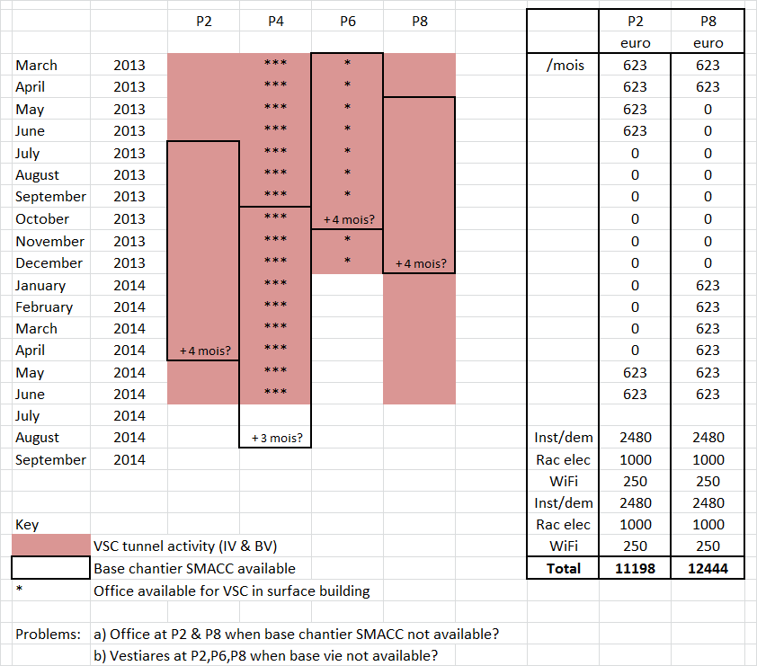
Office/vestiaires at Points

Slide 19
Phase 1 activities – known leaks
22 internal He leaks to solve 2 leaks > 10⁻⁴ mbarl/s , 12 leaks > 10⁻⁶ mbarl/s @ RT
Highest priorities are: 3-4, A27L4, coldmass circuit – very large leak should be localised quickly
4-5 QRL SubS B, line C – will need dedicated intervention scenario with CRG
Note: - the LHC operates with these leaks;
- the 2 biggest leaks weren’t present at RT after welding and PTest;
- for many of known leaks, search in 2006 & 2007 was not successful☹, but they have not evolved☺.
- previously eliminated leaks a) at welds - incomplete, inclusions, porosity, LME, etc
b) others - shocks, inclusions, false arcs, ultrasonic vibrations, etc

Slide 20
Longitudinal leak localisation - which IC to open?
An under vacuum leak test in molecular flow conditions, using turbomolecular pump, mass spectrometer leak detector and helium as tracer gas.
Assume linear conductance of cryostat, so C ∝ 1/L (with & without MLI)
For S >> C1 or C2: q1/q2 ∝ C1/C2 ∝ L2/L1
For LHC cryostats, S ~ C so apply correction for effective pumping speed
Experience shows method is not perfect to one interconnect! Additional adjacent interconnects were often opened to localise the leak.

Slide 21
Phase 1 activities - Leak testing
Known internal leaks:
Re-measure the known internal helium leaks before venting:
  Cryostat under vac, temp > 80 K, He pressure constant,
  Two 8 hour days per known leak with above conditions.
  Need CRG support to pump and pressurise circuits.
  Leaks in the same arc can be treated in parallel
  After venting @ RT, MSC to open 5 priority interconnects/leak (1 day).
  VSC will need pressure ~ 6 bar in cold mass & c’k circuit for 2 days.
  Co-activity with ‘special intervention team’ needs to be co-ordinated.
  The localisation method was successfully applied during LHC installation.
  Requires expert assistance in the tunnel
  Detailed procedure in preparation.

Slide 22
      Thanks for your attention.

