Slide 1
GIT Service in the Agile Infrastructure Project
Vítor Gouveia,
vitor.gouveia@cern.ch
IT-PES-PS

Slide 2
A brief note about current meetings…
During the next few months a series of meetings, presentations and tutorials will take place to prepare the upcoming migration from Quattor enviroment to the “Agile Infrastructure (AI)” project.
  Initial scope was to provide information to our colleagues from the experiments (aka VOCs)
We are expanding the current scope and everyone in the IT who is “light” Quattor user and have a particular interest in preparing early the migration is welcome to join
Notes:
Provide information to our colleagues from the experiments (aka VOCs) running machines within the IT infrastructure (aka VOBoxes) about the “Agile Infrastructure” (AI) projectPrepare them for the upcoming migration from the Quattor environment to the AI environment
IT Service Managers who are not yet involved in the AI project, but run Quattor- managed machines and wish to start preparing for the migration are welcome to attend as well

Slide 3
Agenda
What is GIT?
GIT Concepts
GIT and the Agile Infrastructure (AI)
GIT and the AI (demo)
Modules development cycle (current proposal)
Current support
Questions??

Slide 4
What is GIT?
Version Control System
  Software that allows to manage changes to a file or a set of files over time
  Revert files, projects to a previous state
  Compare changes over time, etc…
Some of the advantages include:
  Collaboration
  Change management
    Ownership, evolution, etc…
  branching
Notes:
What is version control, and why should you care? Version control is a system that records changes to a file or set of files over time so that you can recall specific versions later. Even though the examples in this book show software source code as the files under version control, in reality any type of file on a computer can be placed under version control.
If you are a graphic or web designer and want to keep every version of an image or layout (which you certainly would), it is very wise to use a Version Control System (VCS). A VCS allows you to: revert files back to a previous state, revert the entire project back to a previous state, compare changes over time, see who last modified something that might be causing a problem, who introduced an issue and when, and more. Using a VCS also means that if you screw things up or lose files, you can generally recover easily. In addition, you get all this for very little overhead.
Version Control Systems became an essential part of software development due to the following benefits:
collaboration - a team of developers (which could be distributed geographically) may be working on the same set of files at once without interrupting each other's work;
change management - changes can be inspected, reviewed or rolled back as needed; if you need that App.config file the way it was on May 17, 2008 - no problem;
tracking ownership - every change is associated with the name of the person, so we know whom to give kudos to or ask questions;
tracking evolution - every change is associated with a short description, so you just need to pull a change log of some class to see how it evolved and who did what;
branching - it is possible to create a copy (branch) of the entire project for some specific purpose (i.e.: prototyping or developing a fix for the important customer) without disrupting development workflow;
continuous integration - ability to split evolution of a software project into incremental changes allows to run all sorts of checks and tests against each incremental change in a continuous manner.
Distributed -> Multiple repositories can create different histories and changes
Shared -> Multiple developers can use and update a common repository
Private
Each developer has a local copy of the entire development history

Slide 5
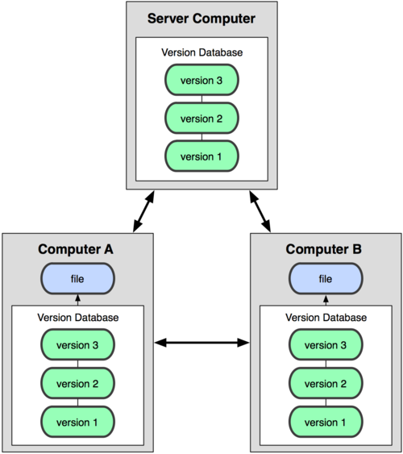
What is GIT?
Distributed Version Control System(DVCS)
    Full copy of the repository in your local computer
Some of the advantages of a distributed version control system:
Every checkout is really a full backup of all data. If a server dies, client repositories can be used to restore it.
We can have several remote repositories
No central repository
Fast and cheap branching

Slide 6
GIT Concepts
Branching Model in DVCS
  Cheap, easy and fast
Why Branching???
  Test an idea without destabilizing the production environment
    Fixes for bugs
    New features
    Version integration
  parallel development,
  etc…
Currently used in the development of the AI project!

Slide 7
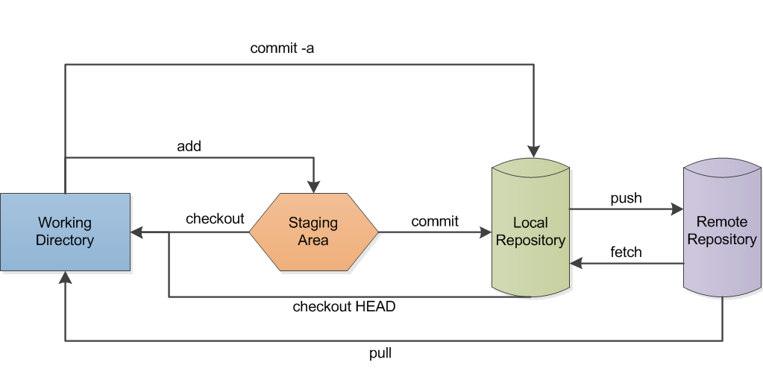
GIT Concepts
GIT Data Workflow
  Upstream flow
    Send your changes back to the remote repository
  Downstream flow
    Copy/Clone/checkout from a remote repository

Slide 8
GIT and the Agile Infrastructure
Web interface of the AI Git Service
https://gitgw.cern.ch/gitweb
  browse directory trees at arbitrary revisions, view contents of files
  see logs or shortlogs of a given branch
  examine commits, commit messages and changes made by a given commit
  Several repositories already there
  Repository of the puppet modules of the AI project
  punch-modules.git

Slide 9
GIT and the Agile Infrastructure
Organization of the AI repository punch-modules
  Several branches there, but the principal branches are:
    Master, devel and testing - Puppet production, development and testing environments
    vocs_devel – temporary branch for VOCs tests
    Each branch maps to a foreman environment
      Each environment contains the version of the code of the corresponding branch
Current documentation is being written at:
  http://cern.ch/go/RQ8j

Slide 10
GIT and the Agile Infrastructure
The new organization of the AI branches
  Manifests folder is now called Hostgroups
    Describe which resources should be applied to set of machines in a hostgroup
    Conceptually similar to cdb cluster/customization templates
Why the new organization?
  One to one correspondence between each hostgroup in foreman and each class name in the GIT repo.
  One place to configure the hostgroups

Slide 11
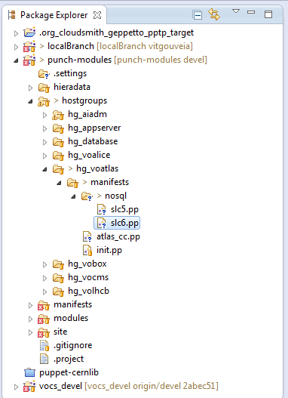
GIT and Agile Infrastructure
For example:
  The voatlas hostgroup will load automatically the puppet class hg_voatlas
  The voatlas/atlas_cc hostgroup will load automatically the puppet class hg_voatlas::atlas_cc
  The voatlas/nosql/slc5 hostgroup will load automatically the puppet class hg_voatlas::nosql::slc5
Notes:
Ai community exchange

Slide 12
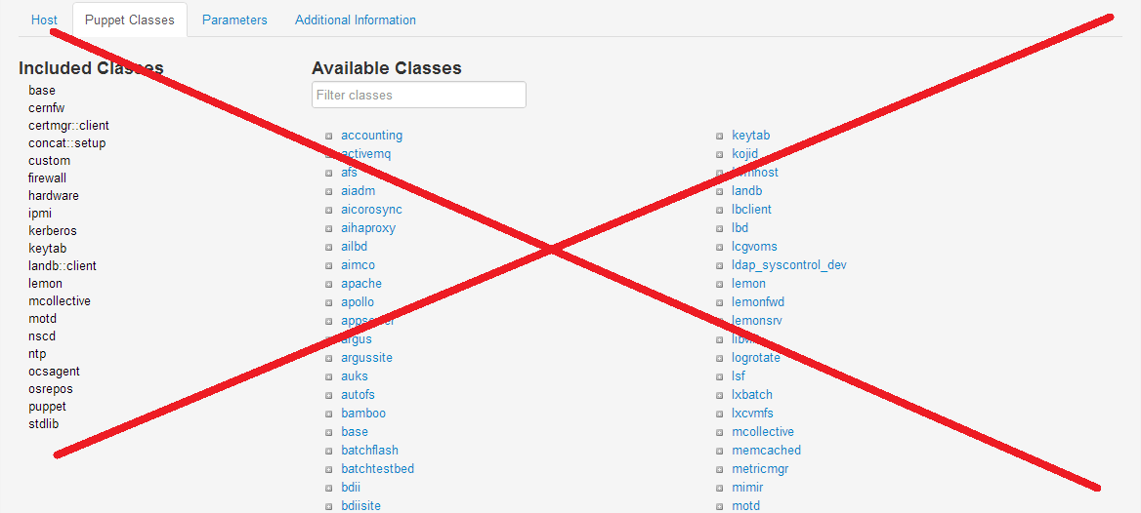
GIT and Agile Infrastructure
Forget about the GUI interface to setup your nodes/hostgroups
  This feature will be disable very soon

Slide 13
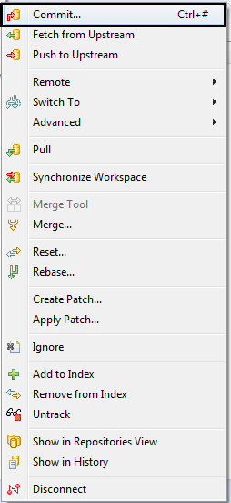
GIT and Agile Infrastructure
EGIT
  http://www.eclipse.org/egit/
  Allows to perform Git commands from the Eclipse IDE.
  Combined with Geppeto(Puppet IDE) provides a complete puppet+git development environment.
    Syntax highlighting
    Autocomplete
    Organization
    Quick navigation
    Easy to manage
    Etc..

Slide 14
GIT and Agile Infrastructure
Good practices
  Small, logical commits
  Each commit should affect only one module
  Write precise and meaningful commit messages
  Don’t push development branches to the central repository if you don’t really need them
    Every branch maps to an automatically generated environment
Let’s see GIT live

Slide 15
Modules/Manifests life cycle development proposal
Core roles
  Service manager (SM)
  Module maintainer (MM)
  Core modules team (CMT)
  Release managers team (RMT)
Golden branches
  Devel, Testing and Master
  Custom branches can be used but not for production.
Permissions
  Only RMT has write access to master
  CMT has write access to core modules
  MMs have write access to the modules of their responsability
Notes:
People using a given module for different use cases must work as a team and maintain one and only one CERN IT official module per software piece (exceptions will be considered if several modules are needed for different major versions of the software being configured)

Slide 16
Modules/Manifests life cycle development proposal
Modules life cycle
  Development (MM)
    New code written by module maintainers must be pushed to the development branch
  Testing (MM)
    all changes should be moved from devel to testing before going into production
  Going into production (RMT)
  Send signed email
  A RMT member replies setting an estimated date for the upgrade, giving always a reasonable time window to allow module users (SMs) to evaluate the impact of the change
  After the deadline and if there are no drawbacks the desire commits are pushed to the remote master
http://cern.ch/go/rmQ9

Slide 17
Current support - Go AI
The AI project isn’t ready to be a production service. At the moment we are defining the support lines.
To mitigate the problem a website was created. The website has two principals components.
Forum – a place where you can ask your questions and make suggestion or comments. We encourage all you to participate. ☺
Tutorials – a zone where you will find recipes, guidelines and procedures for the migration
https://community.web.cern.ch/home/quattor-ai

Slide 18

???????????????????????

Slide 19
Extra slides

Slide 20
GIT most used commands
  git clone [-b branch] <repository> [<directory>]
    Get a copy of a GIT repository
  git branch
    List, create or delete a branch
  git checkout [-b branch]
    Checkout a branch
  git add [filepattern]
    Add file contents to the index
  git commit
    Record changes to the repository
  git push
    pushes the current state of your local repository
git pull
  Pull the changes from the remote repo and updates the local repo

