Slide 1
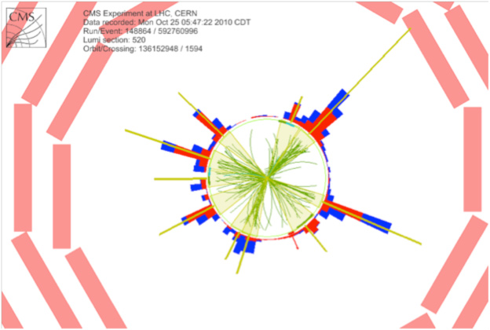


Beyond Feynman Diagrams
Lecture 3
Lance Dixon
Academic Training Lectures
CERN
April 24-26, 2013

Slide 2
Modern methods for loops
Generalized unitarity
A sample quadruple cut
Hierarchy of cuts
Triangle and bubble coefficients
The rational part

Slide 3


Branch cut information →
Generalized Unitarity (One-loop fluidity)
Ordinary unitarity:
put 2 particles on shell
Generalized unitarity:
put 3 or 4 particles on shell
Can’t put 5 particles
on shell because
only 4 components
of loop momentum
Trees recycled into loops!

Slide 4
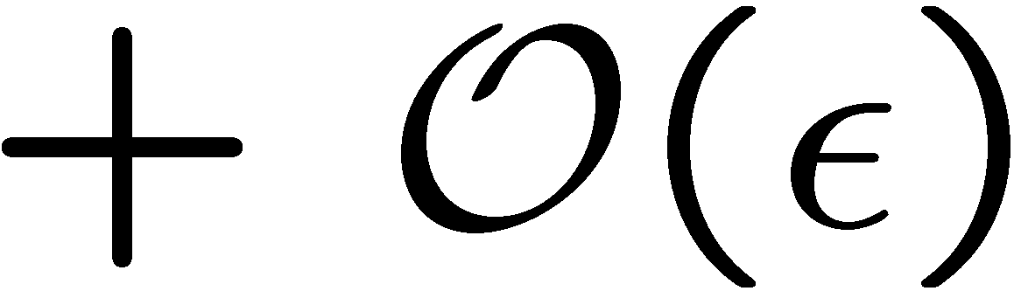
One-loop amplitudes reduced to trees
When all external momenta are in D = 4, loop momenta in D = 4-2ε
(dimensional regularization), one can write:
Bern, LD, Dunbar, Kosower (1994)
coefficients are all rational functions – determine algebraically
from products of trees using (generalized) unitarity
known scalar one-loop integrals,
same for all amplitudes
rational part

Slide 5
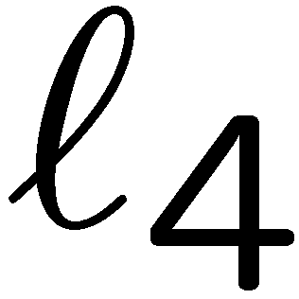
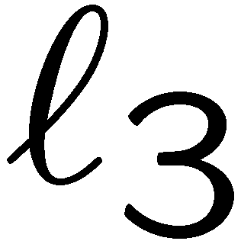
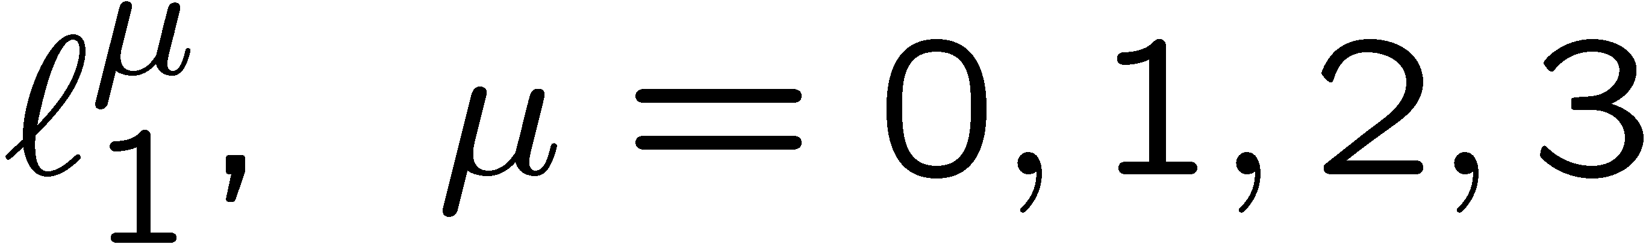
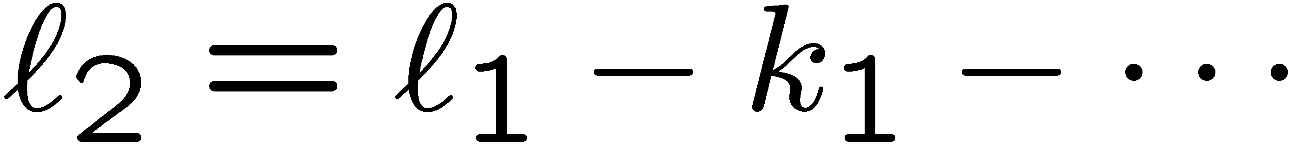
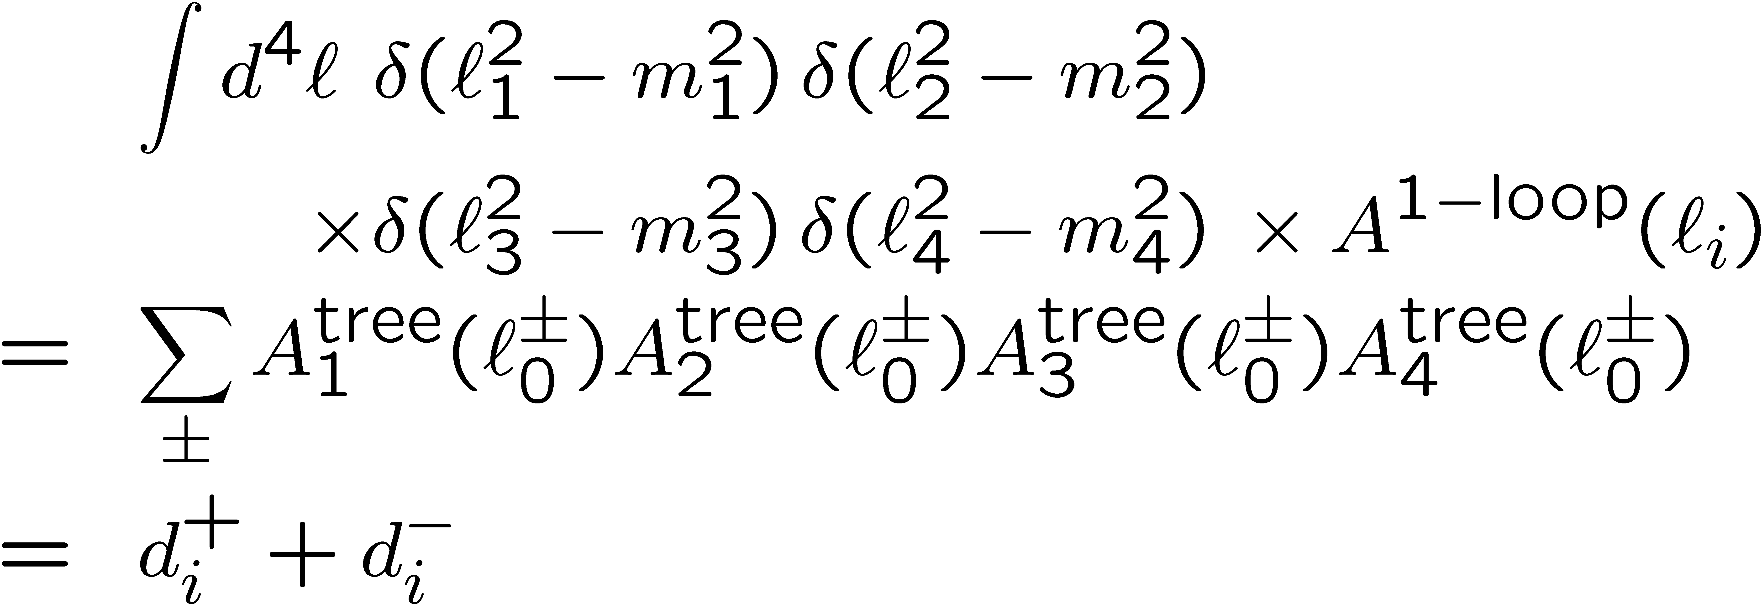
Generalized Unitarity for Box Coefficients d_{i}
Britto, Cachazo, Feng, hep-th/0412308
No. of dimensions = 4 = no. of constraints → 2 discrete solutions (2, labeled by ±)
Easy to code, numerically very stable

Slide 6
Box coefficients d_{i} (cont.)
General solution involves a
quadratic formula
Solutions simplify (and are more
stable numerically) when all internal
lines are massless, and at least one
external line (k₁) is massless:
k₁
Exercise: Show
l₂-l₃ = K₂, l₃-l₄ = K₃, l₄-l₁ = K₄
BH, 0803.4180;
Risager 0804.3310

Slide 7
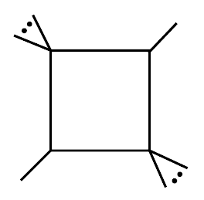
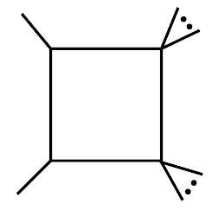
Example of MHV amplitude
-
+
+
-
All 3-mass boxes (and 4-mass boxes)
vanish trivially – not enough (-) helicities
-
-
+
Have 2 + 4 = 6 (-) helicities,
but need 2 + 2 + 2 + 1 = 7
+
-
-
+
k₁
+
+
2-mass boxes come in two types:
0
2me
2mh
0

Slide 8
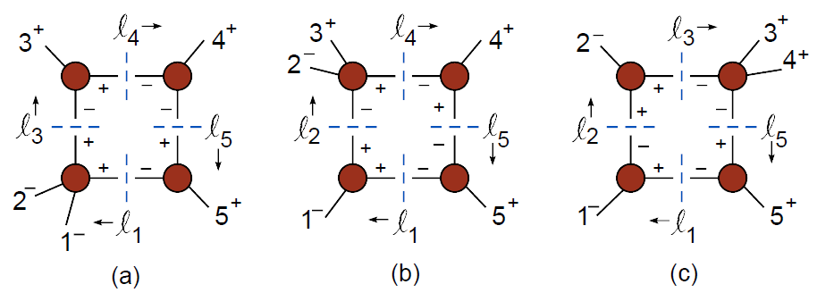

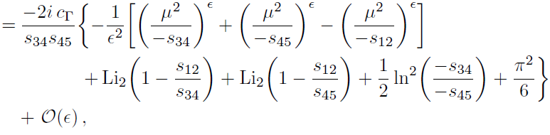
5-point MHV Box example
For (--+++), 3 inequivalent boxes to consider
Look at this one. Corresponding integral in dim. reg.:

Slide 9
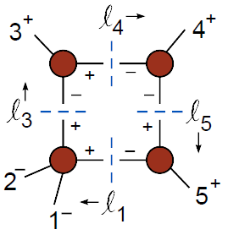
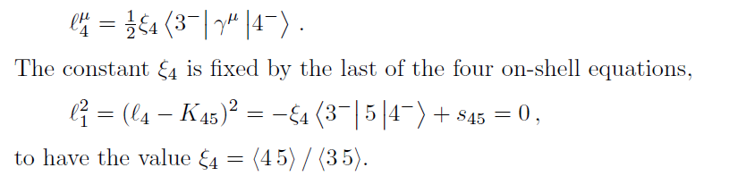
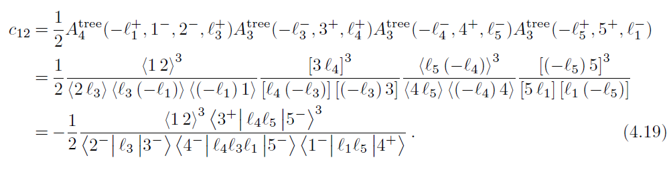
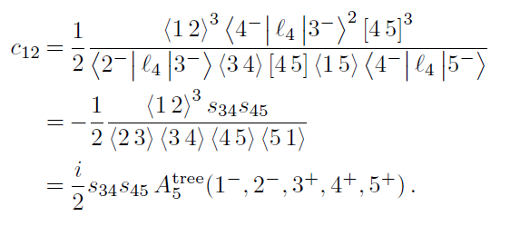
5-point MHV Box example

Slide 10
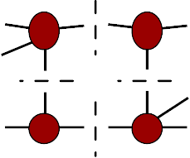
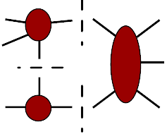
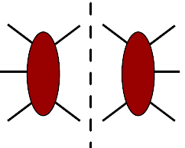
Full amplitude determined hierarchically
Each box coefficient comes uniquely from 1 “quadruple cut”
Britto, Cachazo, Feng, hep-th/0412103
Ossola, Papadopolous, Pittau, hep-ph/0609007;
Mastrolia, hep-th/0611091; Forde, 0704.1835;
Ellis, Giele, Kunszt, 0708.2398; Berger et al., 0803.4180;…
Each triangle coefficient from 1 triple cut,
but “contaminated” by boxes
Each bubble coefficient from 1 double cut, removing contamination by boxes and triangles
Rational part depends on all of above

Slide 11

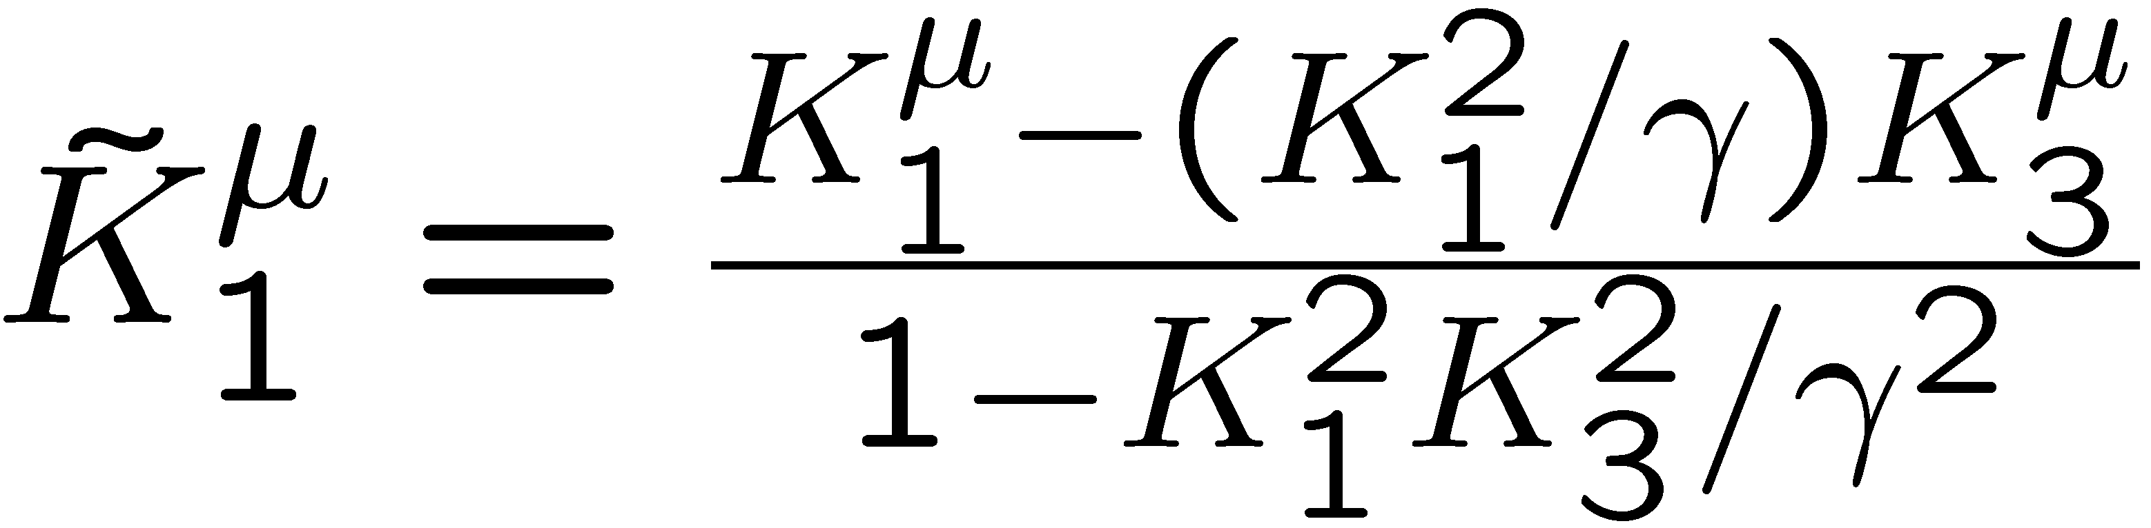
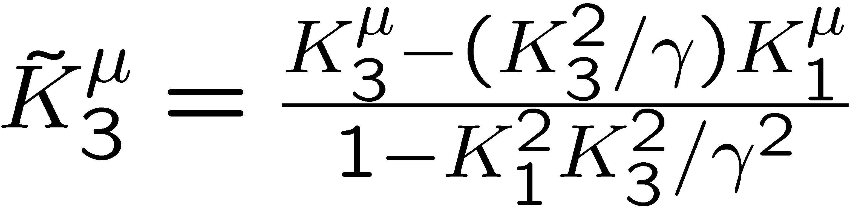
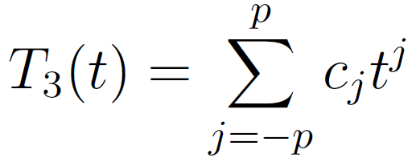
Triangle coefficients
Forde, 0704.1835; BH, 0803.4180
Triple cut solution depends on one complex parameter, t
Solves
for suitable definitions of (massless)
Box-subtracted
triple cut has poles
only at t = 0, ∞
Triangle coefficient c₀
plus all other coefficients c_{j}
obtained by discrete Fourier
projection, sampling at
(2p+1)^{th} roots of unity
Bubble coeff’s similar

Slide 12
Rational parts
These cannot be detected from unitarity cuts with loop momenta in D=4. They come from extra-dimensional components of the loop momentum (in dim. reg.)
Three ways have been found to compute them:
1. One-loop on-shell recursion (BBDFK, BH)
2. D-dimensional unitarity (EGKMZ, BH, NGluon, …) involving also quintuple cuts
3. Specialized effective vertices (OPP R₂ terms)

Slide 13
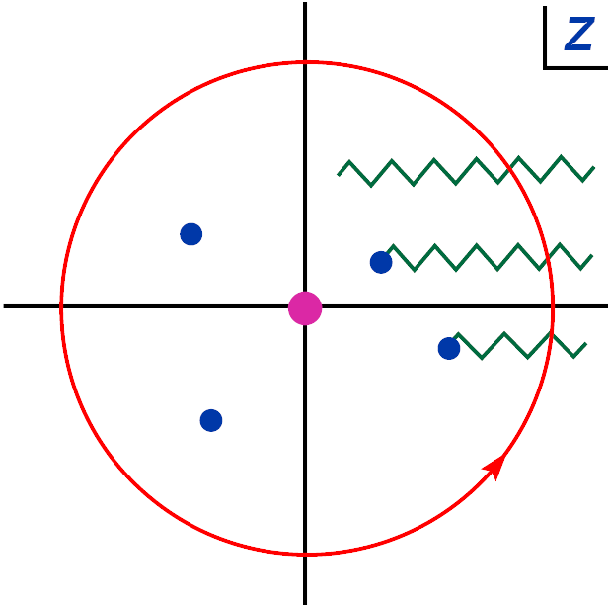
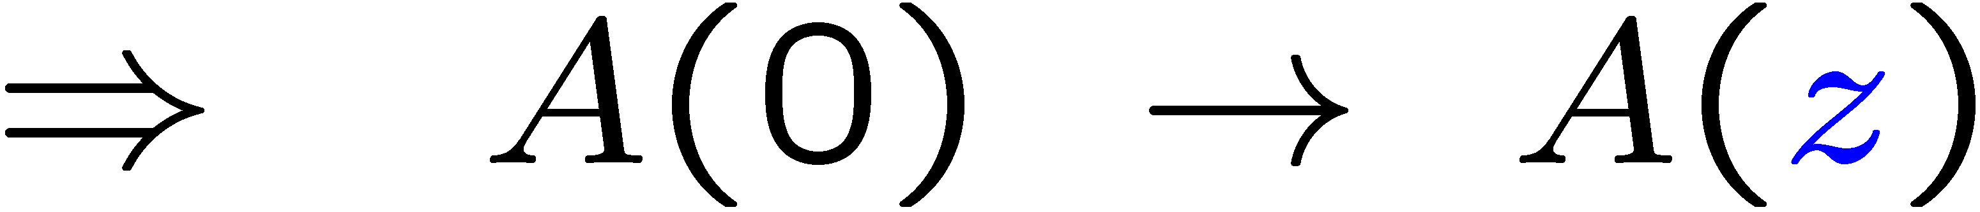
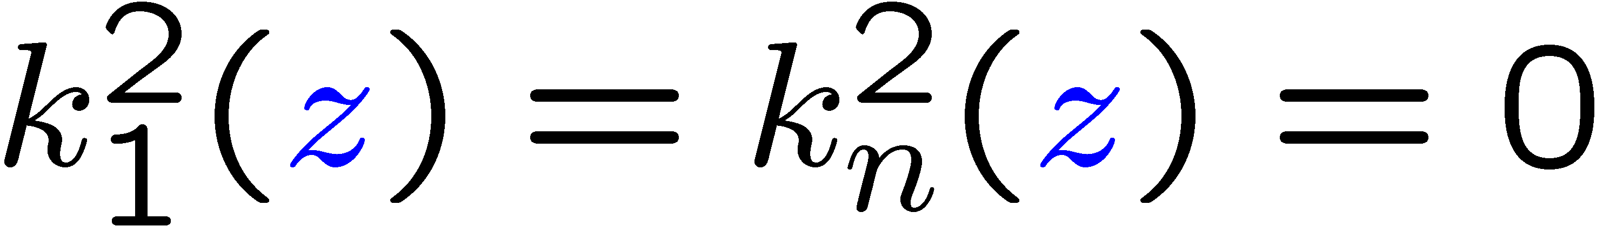
1. One-loop on-shell recursion
Bern, LD, Kosower, hep-th/0501240, hep-ph/0505055, hep-ph/0507005;
Berger, et al., hep-ph/0604195, hep-ph/0607014, 0803.4180
Same BCFW approach works for rational parts
of one-loop QCD amplitudes:
Inject complex momentum at (say) leg 1, remove it at leg n.
Full amplitude has branch cuts, from
e.g.
However, cut terms already determined using generalized unitarity

Slide 14
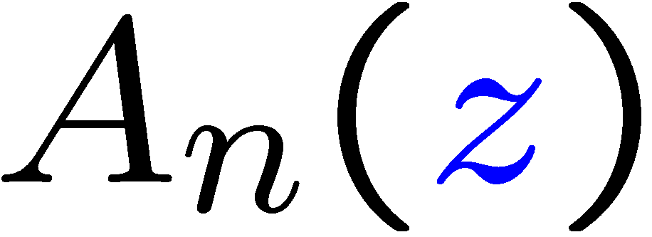
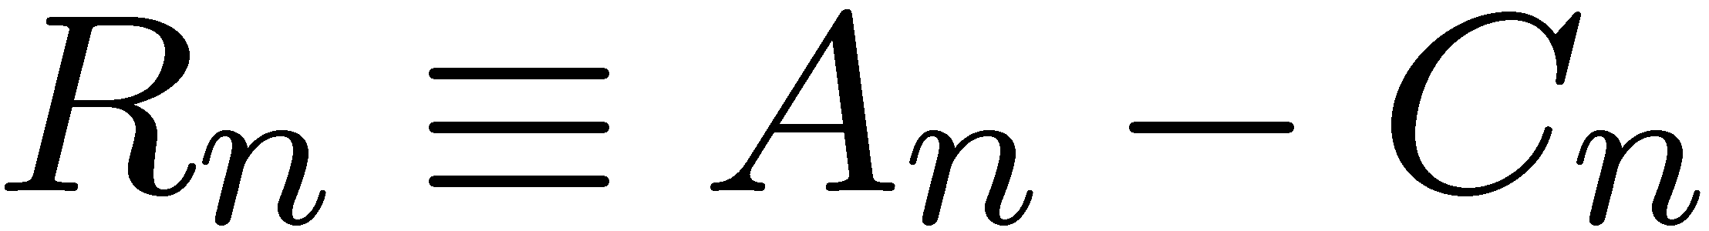
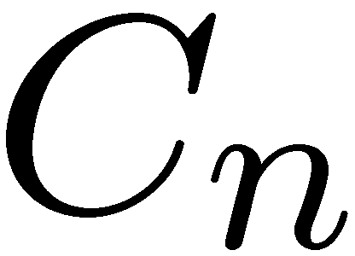
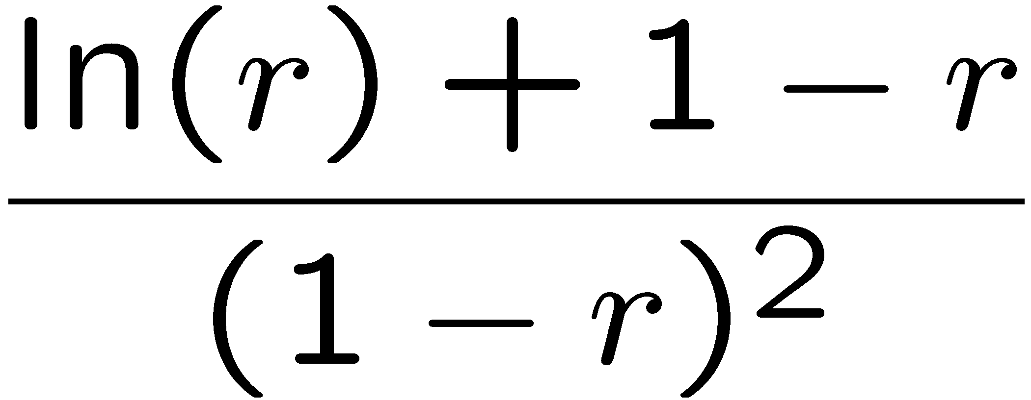
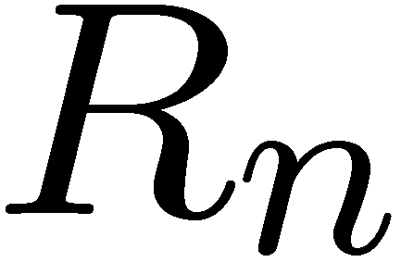
Subtract cut parts
Generic analytic properties of shifted 1-loop amplitude,
Cuts and poles in z-plane:
But if we know the cuts (via unitarity in D=4),
we can subtract them:
rational part
full amplitude
cut-containing part
Shifted rational function
has no cuts, but has spurious poles in z
because of C_{n}:

Slide 15
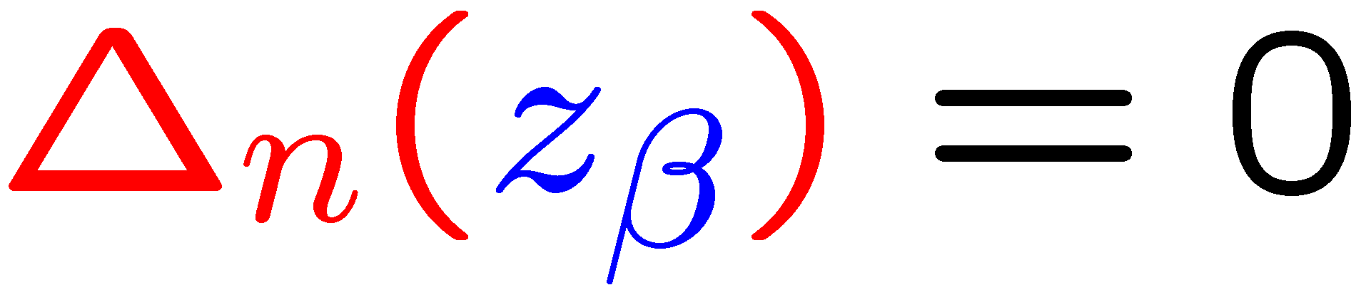


Computation of spurious pole terms
More generally, spurious poles originate from vanishing of
integral Gram determinants:
Locations z_{β} all are known.
And, spurious pole residues cancel between and
→ Compute them from known
Extract these residues numerically

Slide 16
Physical poles, as in BCFW
→ recursive diagrams (simple)
For rational part of
recursive:
Summary of on-shell recursion:
Loops recycled into loops with more legs (very fast)
No ghosts, no extra-dimensional loop momenta
Have to choose shift carefully, depending on the helicity, because of issues with z → ∞ behavior, and a few bad factorization channels (double poles in z plane).
Numerical evaluation of spurious poles is a bit tricky.

Slide 17
2. D-dimensional unitarity
In D=4-2ε, loop amplitudes have fractional dimension ~ (-s)^{2ε}, due to loop integration measure d^{4-2ε}l.
So a rational function in D=4 is really:
R(s_{ij}) (-s)^{2ε} = R(s_{ij}) [1 + 2ε ln(-s) + …]
It has a branch cut at O(ε)
Rational parts can be determined if unitarity cuts are computed including [-2ε] components of the cut loop momenta.
Bern, Morgan, hep-ph/9511336; BDDK, hep-th/9611127;
Anastasiou et al., hep-ph/0609191; …

Slide 18
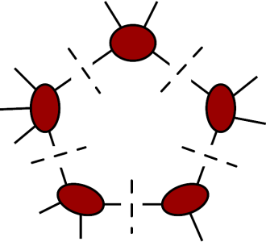
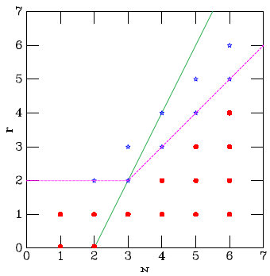
Numerical D-dimensional unitarity
Giele, Kunszt, Melnikov, 0801.2237; Ellis, GKM, 0806.3467; EGKMZ, 0810.2762;
Badger, 0806.4600; BlackHat; …
Extra-dimensional component μ of
loop momentum effectively lives in a 5th dimension.
To determine μ² and (μ²)² terms
in integrand, need quintuple cuts as
well as quadruple, triple, …
Because volume of d^{-2ε}l is O(ε),
only need particular “UV div” parts:
(μ²)² boxes, μ² triangles and bubbles
Red dots are “cut constructible”:
μ terms in that range → O(ε) only
EKMZ
1105.4319

Slide 19
D-dimensional unitarity summary
Systematic method for arbitrary helicity, arbitrary masses
Only requires tree amplitude input (manifestly gauge invariant, no need for ghosts)
Trees contain 2 particles with momenta in extra dimensions (massless particles become similar to massive particles)
Need to evaluate quintuple cuts as well as quad, triple, …

Slide 20
3. OPP method
Ossola, Papadopoulos, Pittau, hep-ph/0609007
Four-dimensional integrand decomposition of OPP corresponds to quad, triple, double cut hierarchy for “cut part”.
OPP also give a prescription for obtaining part of the rational part, R₁ from the same 4-d data, by taking into account μ² dependence in integral denominators. OPP, 0802.1876
The rest, R₂ , comes from μ² terms in the numerator. Because there are a limited set of “UV divergent” terms, R₂ can be computed for all processes using a set of effective 2-, 3-, and 4-point vertices

Slide 21
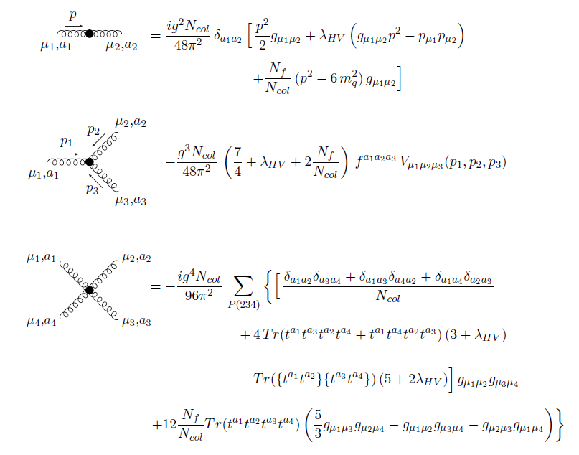
Some OPP R₂ vertices
For ‘t Hooft-Feynman gauge, ξ = 1
Draggiotis, Garzelli,
Papadopoulos, Pittau,
0903.0356
Evaluation of R₂
very fast (tree like)
Split into R₁ and R₂
gauge dependent
Cannot use products
of tree amplitudes to
compute R₁ .

Slide 22
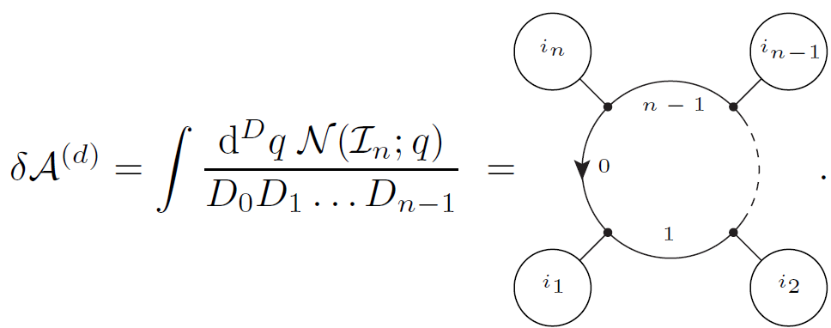
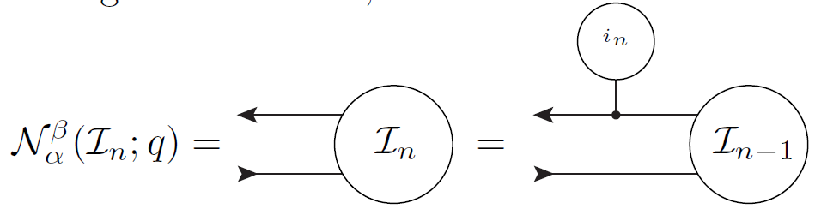
Open Loops and Unitarity
Cascioli, Maierhöfer, Pozzorini, 1111.5206; Fabio C.’s talk
OPP method requires one-loop Feynman diagrams in a particular gauge to generate numerators. This can be slow.
However, it is possible to use a recursive organization of the Feynman diagrams to speed up their evaluation → Open Loops

Slide 23
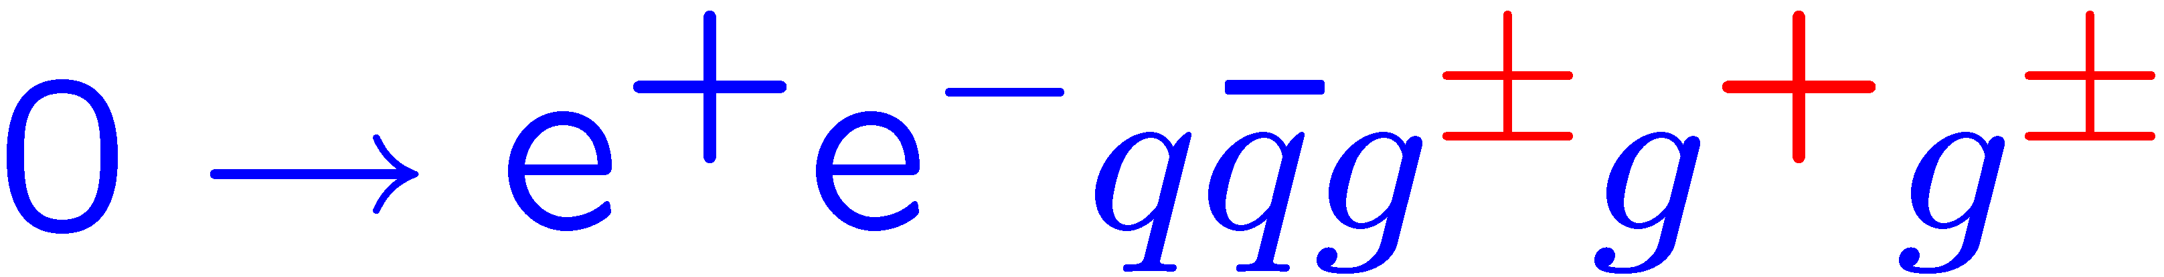
One example of numerical stability
Some one-loop helicity amplitudes contributing to NLO QCD
corrections to the processes pp → (W,Z) + 3 jets, computed using
unitarity-based method. Scan over 100,000 phase space points,
plot distribution in log(fractional error):
BlackHat, 0808.0941

