Slide 1


Future Applications of GEM Detectors at BNL
C.Woody
Physics Department
Brookhaven National Lab
RD51 Collaboration Meeting
January 31, 2013

Slide 2
New Applications for GEM Tracking detectors at BNL
Minidrift GEM detector
  Application for sPHENIX
  Future use in an EIC detector
  Positron imaging for PET
Fast, compact TPC with Cherenkov PID
  Use for tracking and particle id at EIC

Slide 3
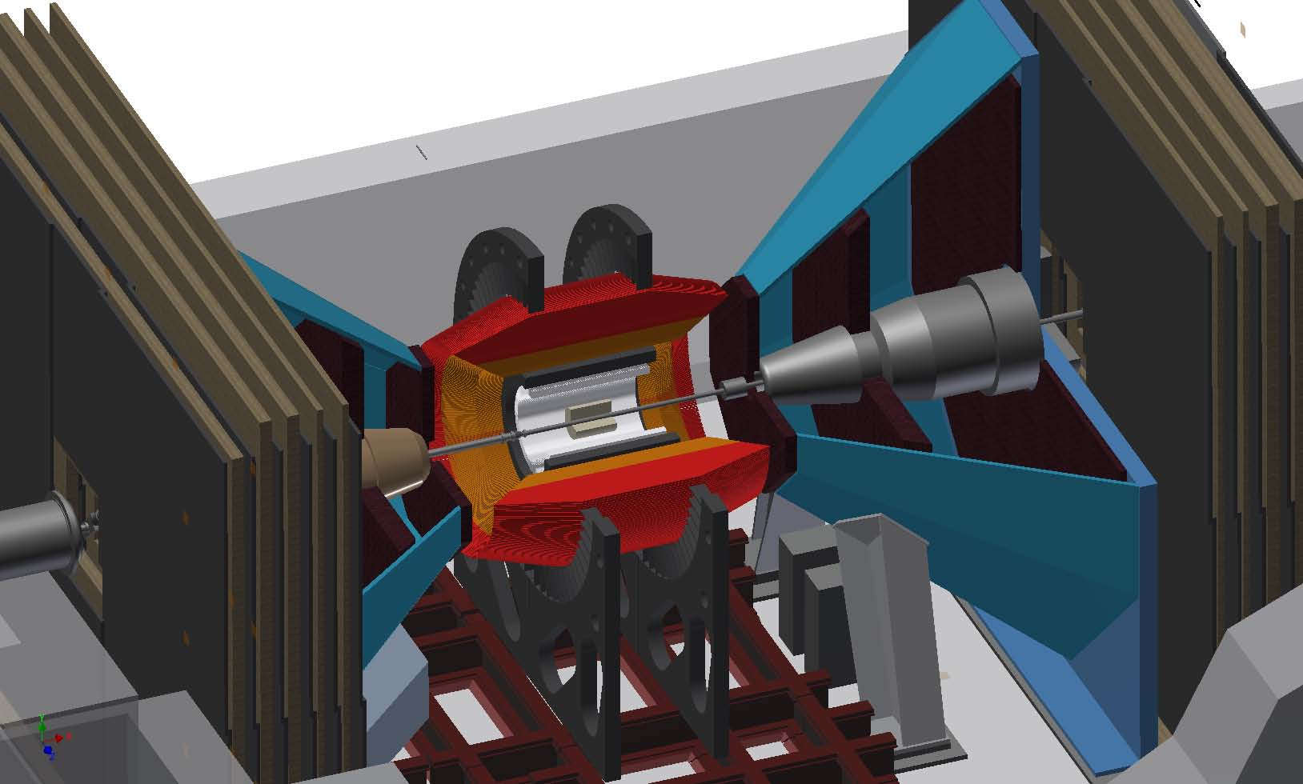
HCAL Outer
HCAL Inner
EMCAL
Solenoid
VTX

Slide 4
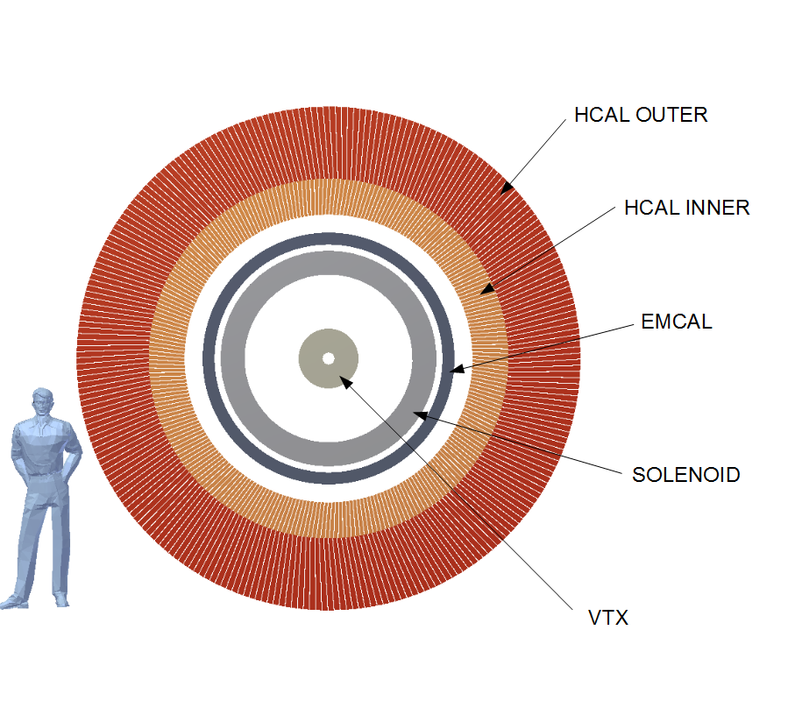
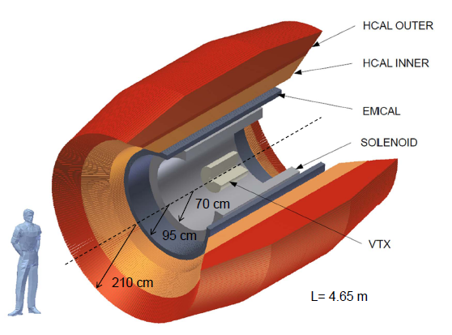
Δη=±1.1
Δφ=2π
4.65 m

Slide 5
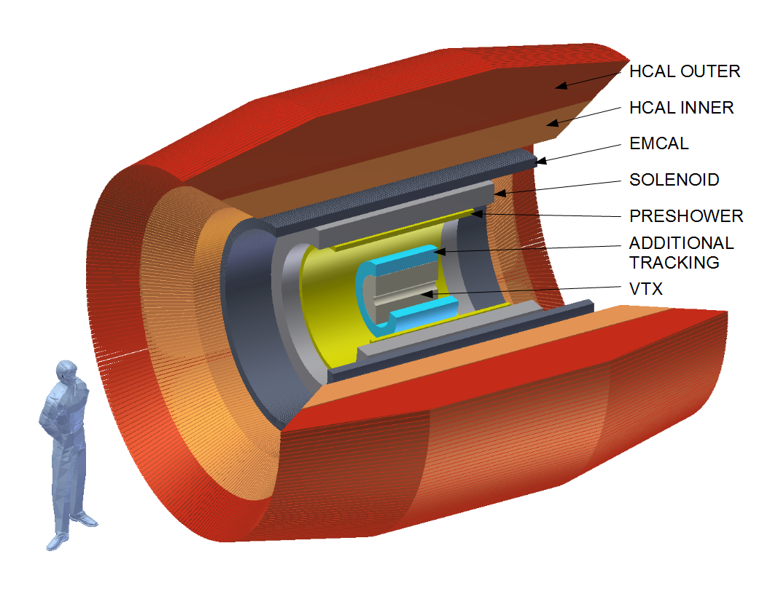
Δη=±1.1
Δφ=2π
4.65 m
Future additional tracking system
- Two additional layers of silicon tracking
- Cylindrical GEM tracker (possible radial minidrift)

Slide 6
Forward sPHENIX
Current VTX and FVTX detectors
Forward GEM trackers

Slide 7
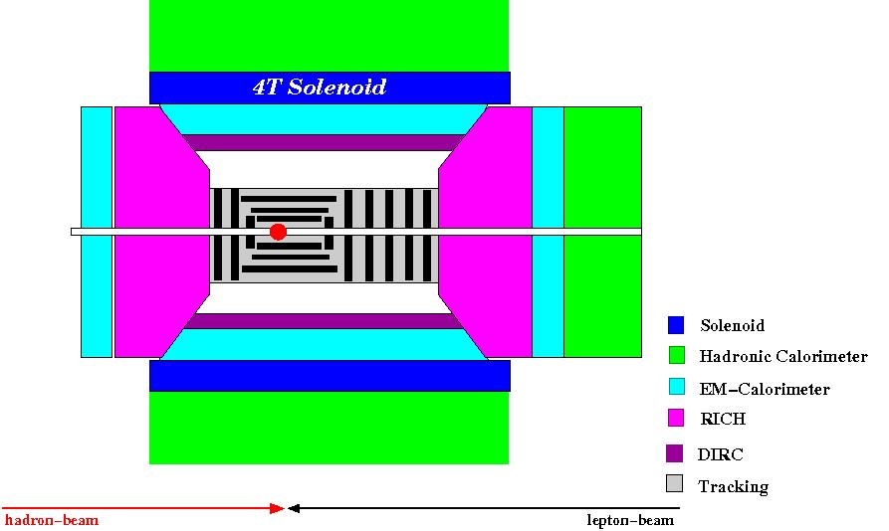
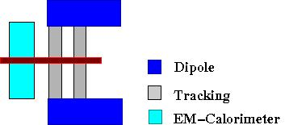
EIC Detector – Conceptual Design
Central Detector
Forward/Backward Detectors
GEM TPC w/PID
Si
GEM Tracker
Planar GEM Trackers
PID devices
Central TPC + Forward minidrift GEM Trackers
Large acceptance: -5 < η < 5
Asymmetric
Nearly 4π tracking and EMCAL coverage
HCAL coverage in central region and hadron direction
Good PID
Vertex resolution (< 5 μm)
Electron is scatted over large range of angles (up to 165˚)
Low Q² → low momentum (few GeV)
Requires low mass, high precision tracking

Slide 8
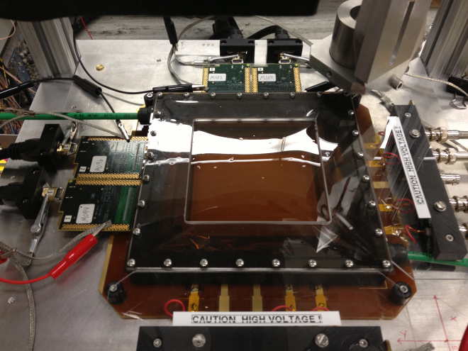
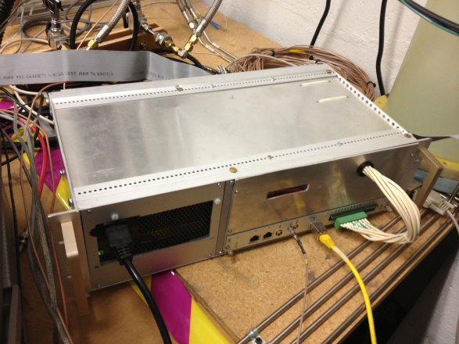
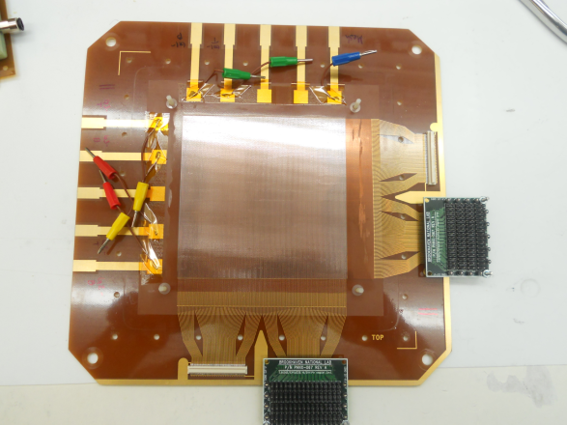
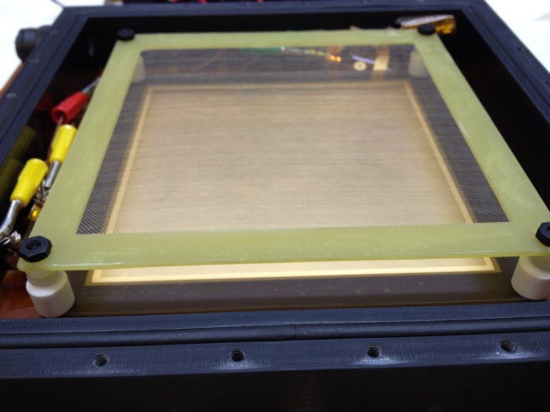
Minidrift GEM Detector with XY Readout
Y
X
Std. 10x10cm CERN 3-GEM Det.
ArCO2 (70/30)
Gain ~ 6500
~17mm Drift Gap
Drift Time ~600ns
SRS /512 channels APV 25
30 x 25ns Time Samples
Martin Purschke’s newly
developed RCDAQ
affords high flexibility
COMPASS style Readout:
256 x 256 X-Y Strips
~10cm x 400um pitch
Mesh
Primary Charge
Fluctuation
Drift Gap
17mm
GEM 1
Transfer 1
1.5mm
GEM 2
Transfer 2
1.5mm
GEM 3
X-Y Strips
Induction
2mm
Pitch: 400um
Preamp/Shaper

Slide 9
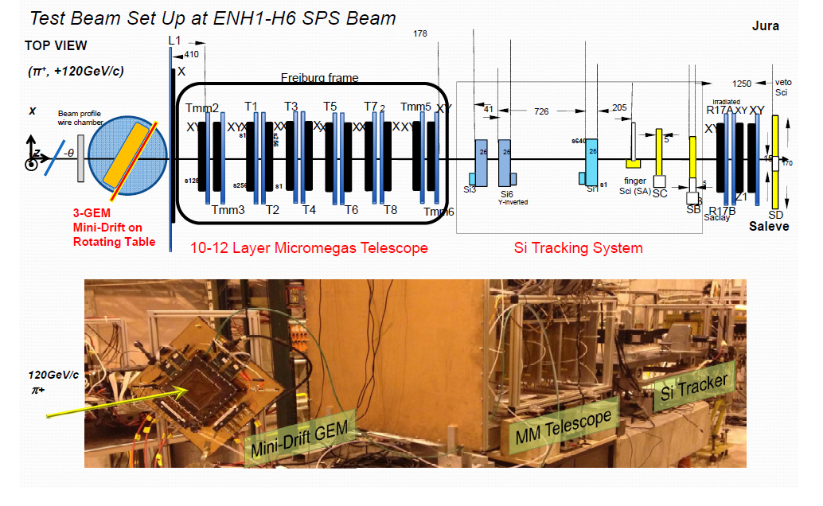
Beam Test in October 2012
Thank You RD51, ATLAS and everyone who made this possible !
Vinnie Polychronakos
Joerg Wotschack
Theo Alexopoulos
Konstas Ntekas
And many others…
And of course Bob Azmoun from our group !

Slide 10
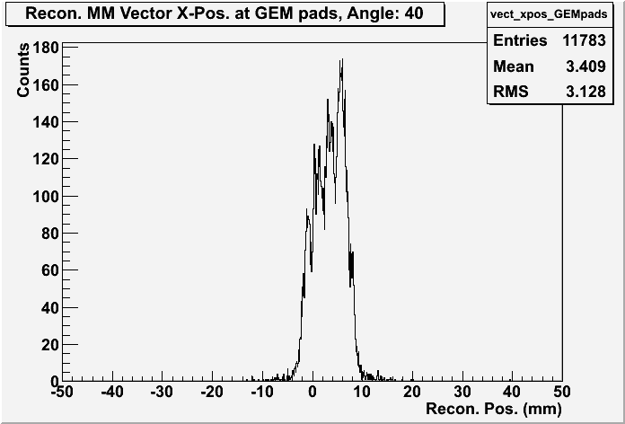
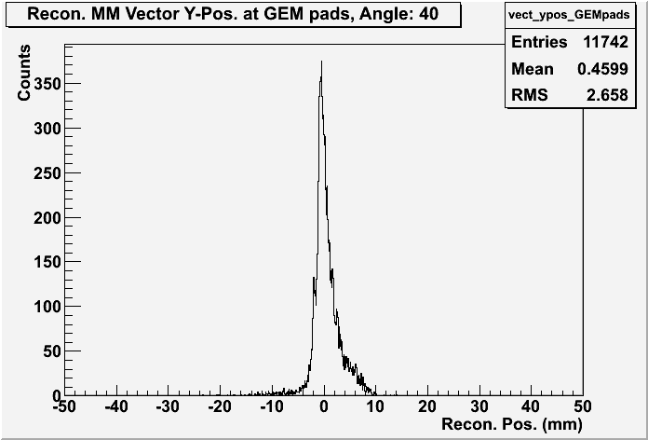
Test Beam Data – Micromega Detectors
Projection plane
Beam particle
Beam Profile – Extrapolated Tracks from Micromegas
X
Y

Slide 11
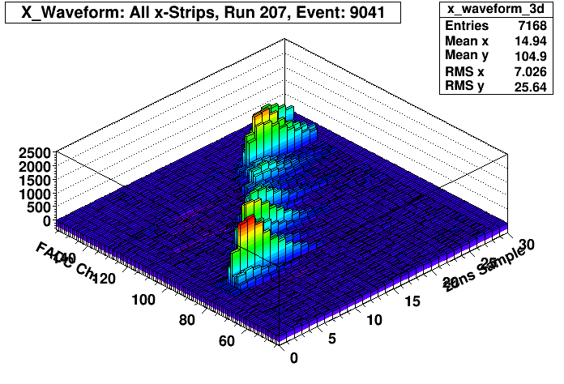
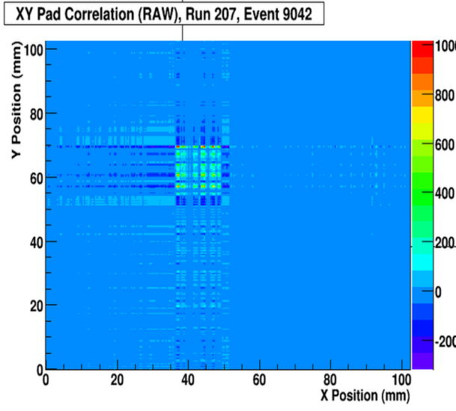
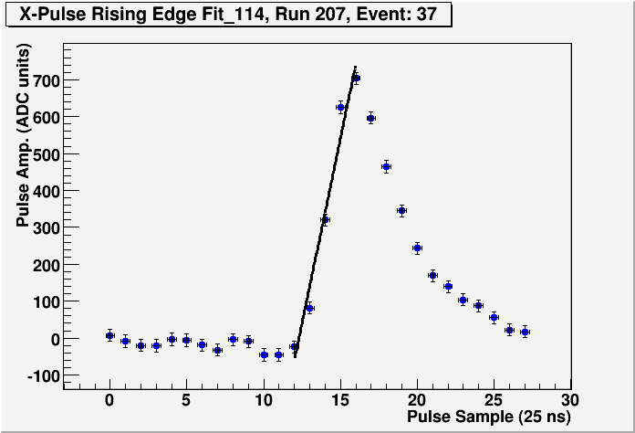
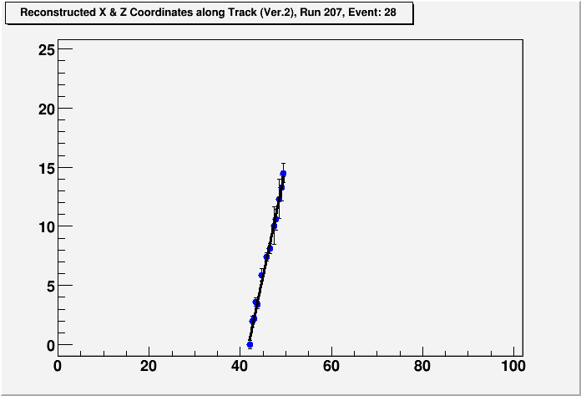
Vector Reconstruction in GEM Detector
B. Azmoun
Raw Data: Waveforms in Time
Vector Signature: “Charge square”
Error on reconstructed vector
Error on arrival time: ~ ± -1.8ns
⇒ error on z-coordinate ~ 60 μm
⇒ error on reconstructed vector
due to time resolution alone
~ 1 mrad (@ 40 degrees)
Main error on reconstructed vector is due to charge fluctuations
Linear Fit to determine arrival time = x-int.
30 samples x 25ns = 750ns window
Vector Recon:
X -coord. = middle of pad
Y-coord. = drift time * Drift Vel.
Fit (x,z) points to line

Slide 12
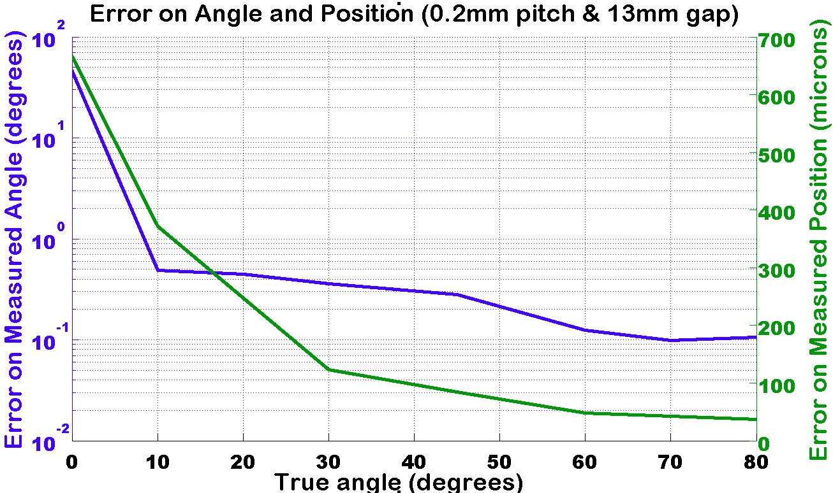
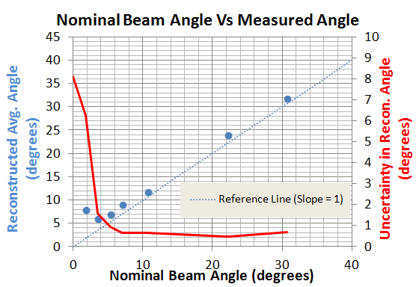
Angular Resolution
MC Simulation of Angle and Position Resolution
At small angles, it is not possible to measure a vector and the best position information is obtained from the centroid of the charge distribution
At angles > ~ 5 degrees, it is possible to determine a vector with an accuracy ~ 0.3 degrees (~ 5 mrad)
Track Recon. Fails
(Rely on Charge Centroid)
Uncertain Boundary
Track Recon. Successful
T. Cao, Stony Brook
Reconstructed angle in GEM detector assuming beam track is at zero degrees with no divergence
(not using MM data)

Slide 13
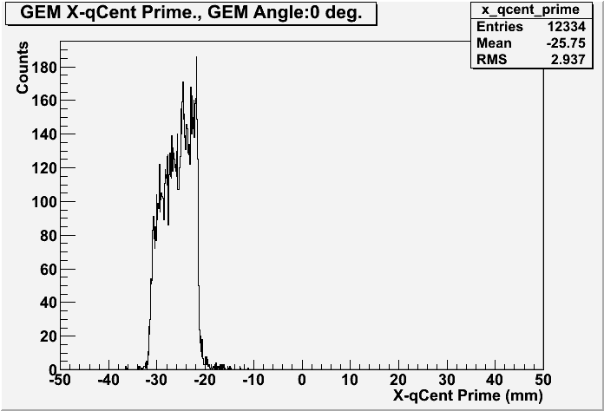
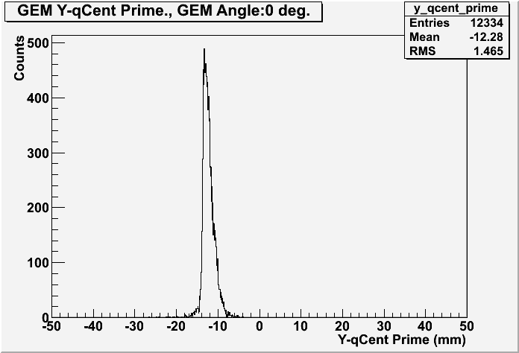
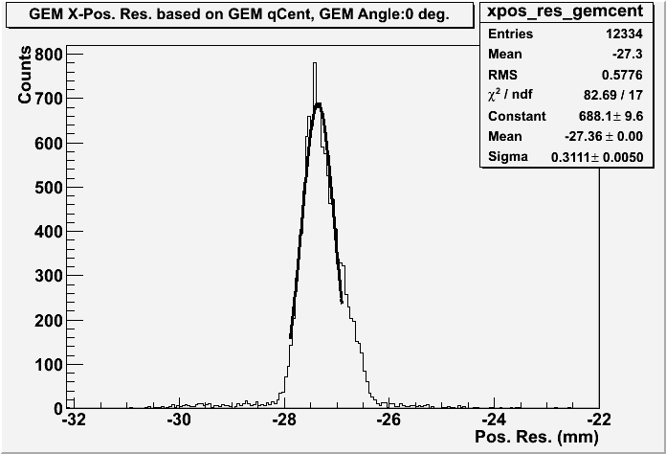
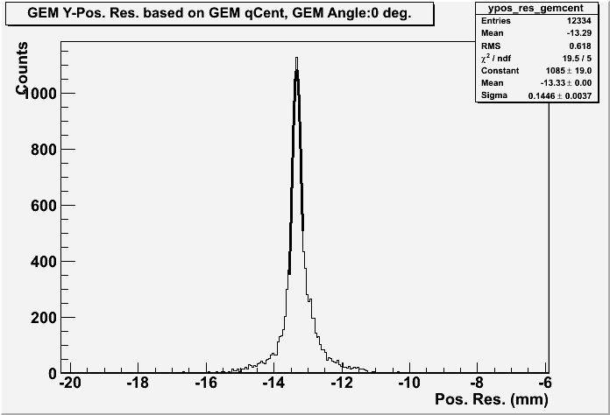
Test Beam Data – GEM Detector
Beam Profile from GEM detector – Charge Centroid (0 degrees)
X
Y
Difference in coordinate position (GEM Detector – Micromega Track Projection)
X
Y
σ ~ 300 μm
σ ~ 145 μm

Slide 14
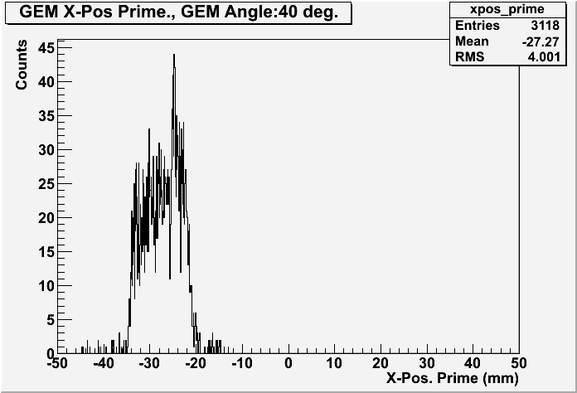
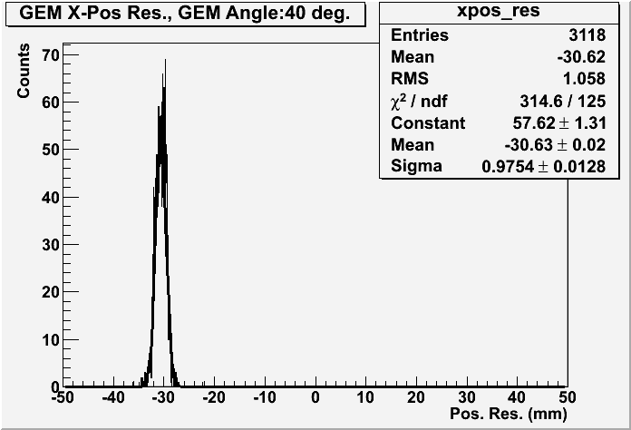
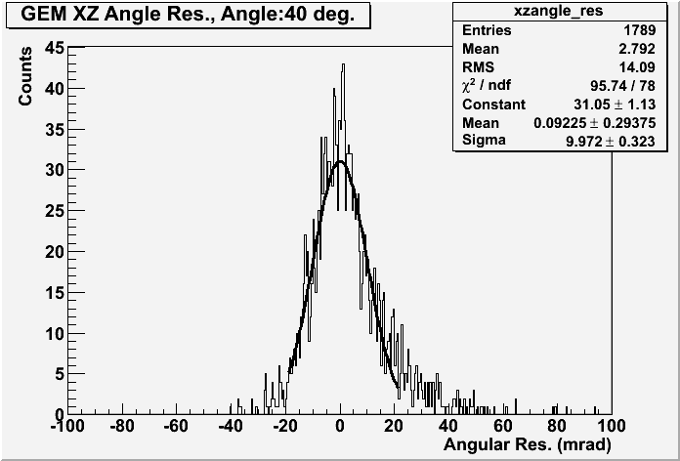
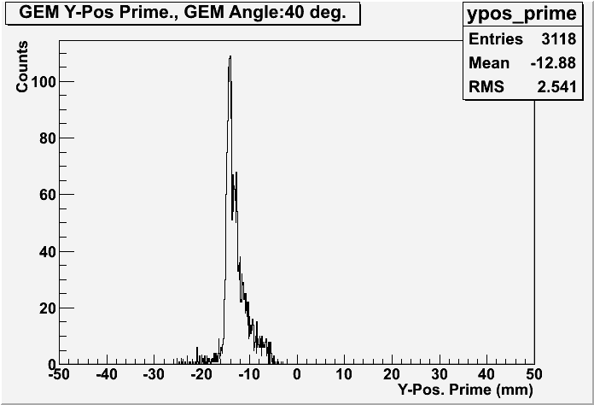
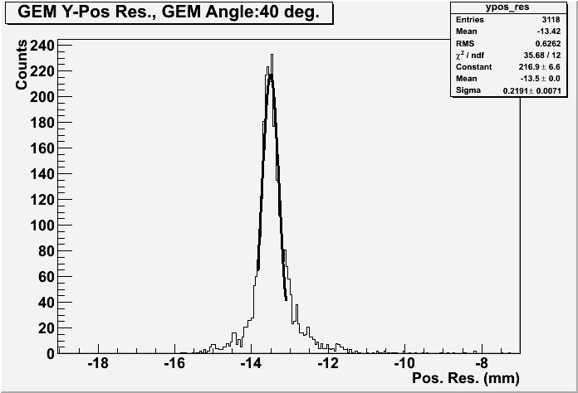
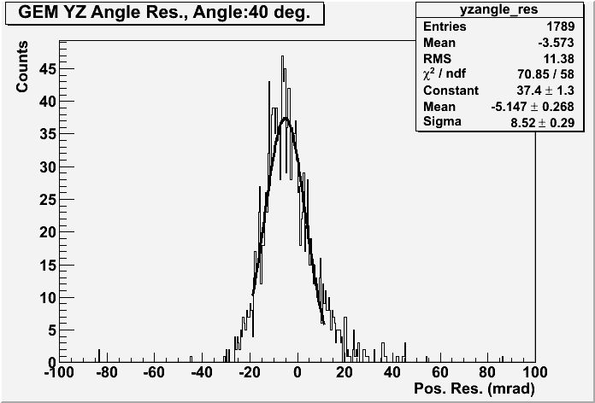
Test Beam Data – GEM Detector
GEM detector – Vector Reconstruction (40 degrees)
GEM position at projection plane
X
(GEM – MM) coordinate
(GEM – MM) angle
σ ~ 975 μm
σ ~ 10 mrad
Y
σ ~ 220 μm
σ ~ 8.5 mrad

Slide 15
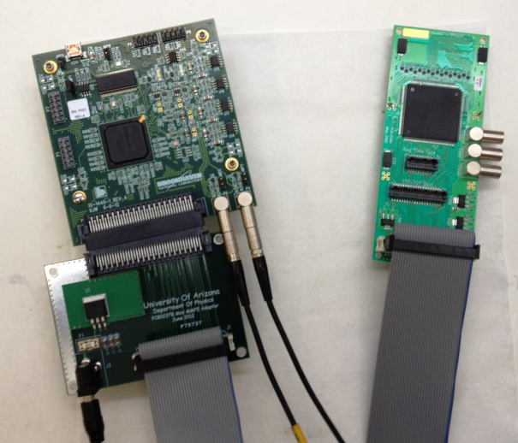
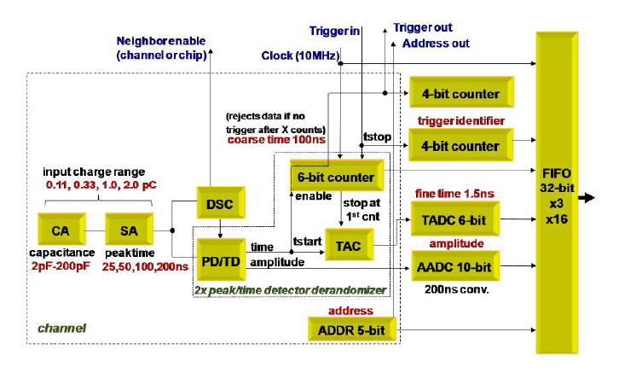
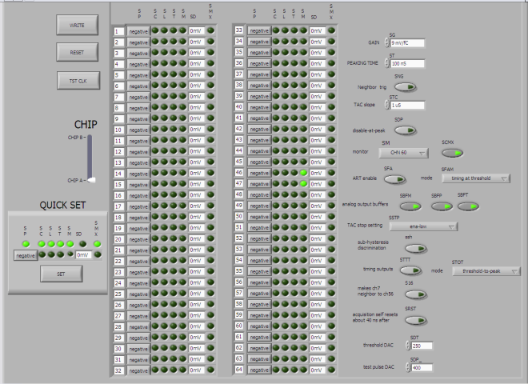
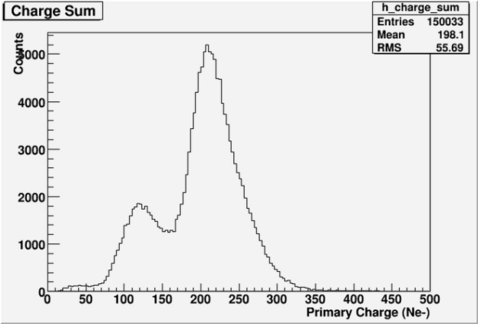
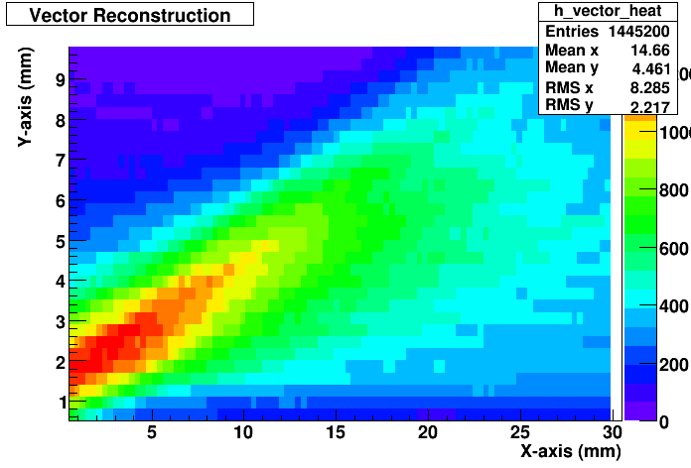
Minidrift GEM Detector with VMM1 Readout
VMM1 Labview Control panel
VMM1 →FEC →USB→PC
Preliminary Results (64 ch.):
Measured Fe55 spectrum
Measured Sr90 vectors at ~35º
Brief test (~ 1 day) of minidrift GEM with VMM1 readout at BNL
Despite the very short time available, got the detector and readout up and running very quickly in the lab
Unfortunately, no time to test in the test beam at CERN

Slide 16
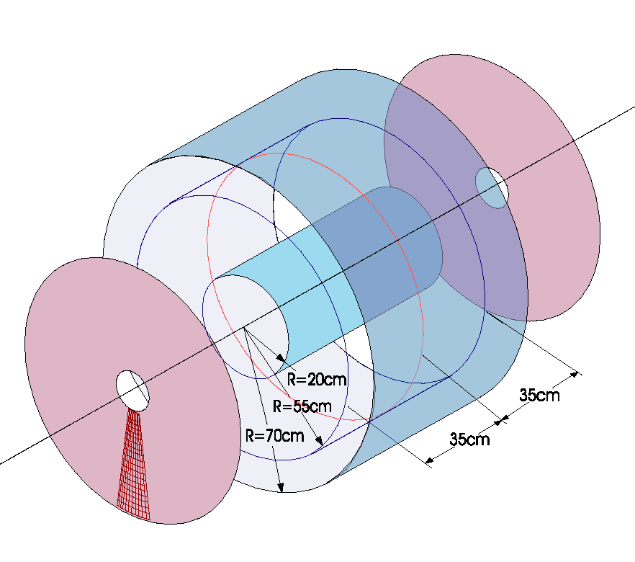
TPC with Particle ID (HBD)
Fast, compact TPC
Common CF₄ gas (windowless)
10 cm/μsec
Excellent UV transparency
CsI GEM Readout Plane for RICH
Cherenkov “blob”
e±
Ionization drift
TPC GEM Readout Plane
Readout Pads
DR ~ 1 cm
f ~ 2 mm
Drift regions
HV plane (~ -30kV)
Idea originally proposed for PHENIX (~ 2000)
In the end decided to build just the HBD portion
Idea now resurrected for EIC

Slide 17
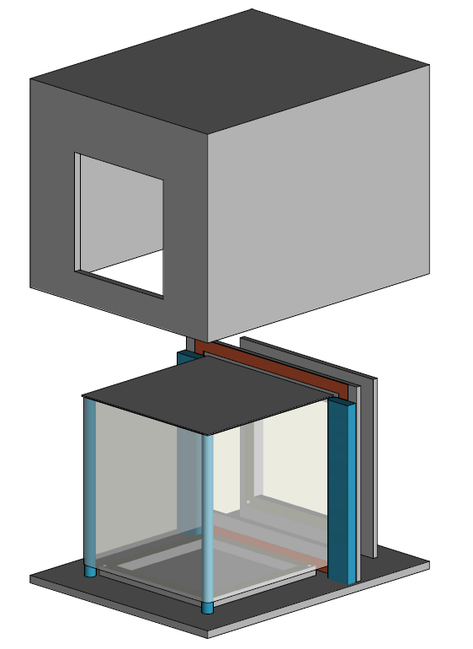
Prototype TPC/Cherenkov Detector
CsI coated triple GEM detector
(10x10 cm²)
3 sided kapton foil field cage
e±
Č
TPC readout triple GEM detector
(10x10 cm²)
E drift
Open wire field cage

Slide 18
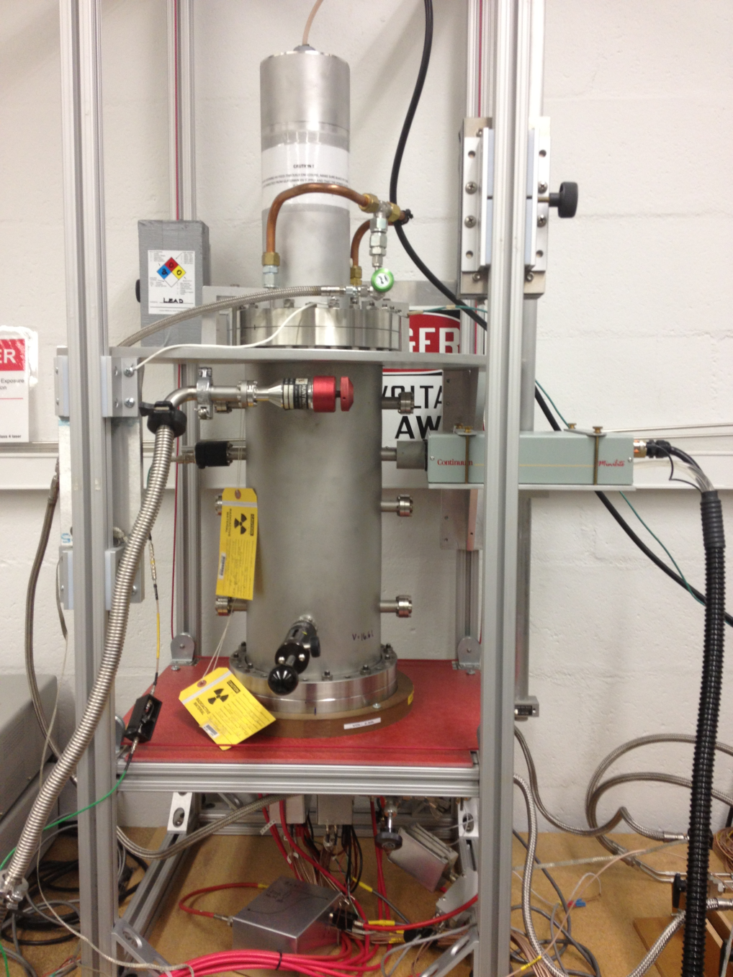
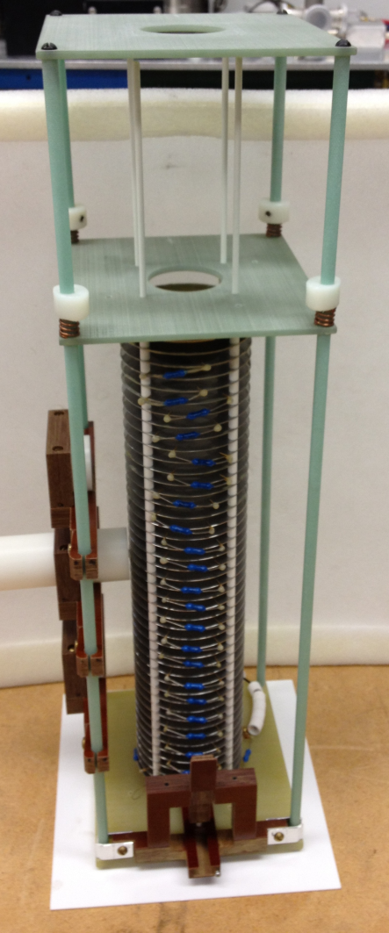
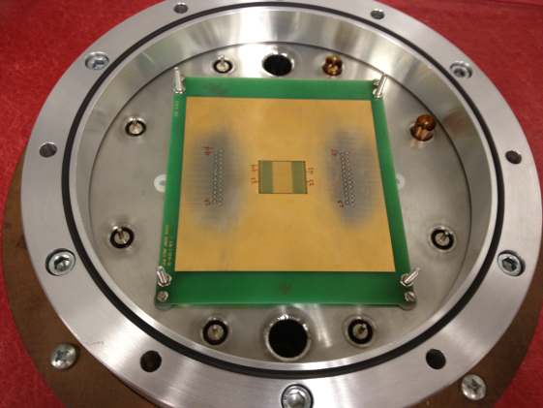
TPC Test Set Up
32cm Drift Cell
HV Feed-thru (60kV)
Top Fe55 Source
Class IV YAG Laser
Photodiode
-Trigger
SS Vacuum Vessel
Bottom Fe55 Source
24 ch. Readout Electronics
10x0.3mm pad
Readout (24ch.)

Slide 19
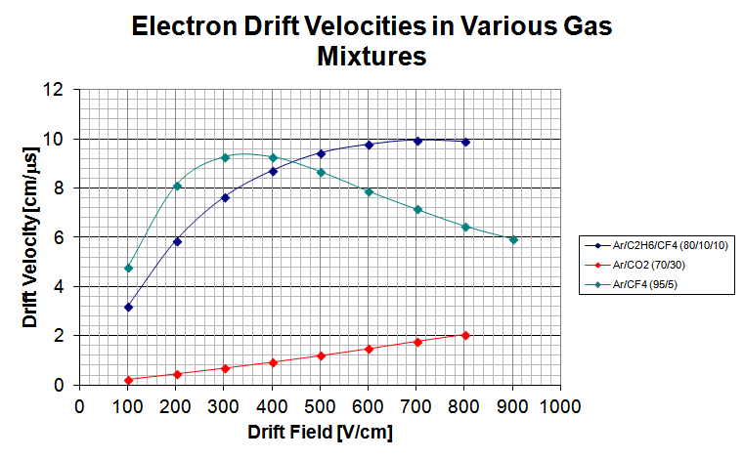
Drift Velocity Measurements
Ionization “spot” produced by YAG laser
Photodiode provides trigger
Drift time is measured as the arrival
time of the charge cluster at the readout
plane
HV (~32kV)
Lens to Focus
laser to a point
Photo-ionized gas
→Electron cluster
Laser
PD -Trigger
Drfit Electrons toward Readout
(Triple GEM + preamp/shaper)
B. Azmoun

Slide 20
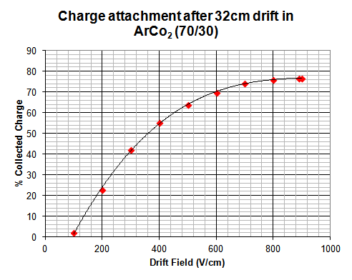
Charge Attachment Measurements
Fe55 source deposits known charge at the
top of the drift cell
Charge is measured at the readout plane
after 32 cm drift
Ratio determines fraction of charge collected
HV (~32kV)
Top Fe55 x-ray Source
Bottom Fe55
x-ray Source
Drfit Electrons toward Readout
(Triple GEM + preamp/shaper)

Slide 21
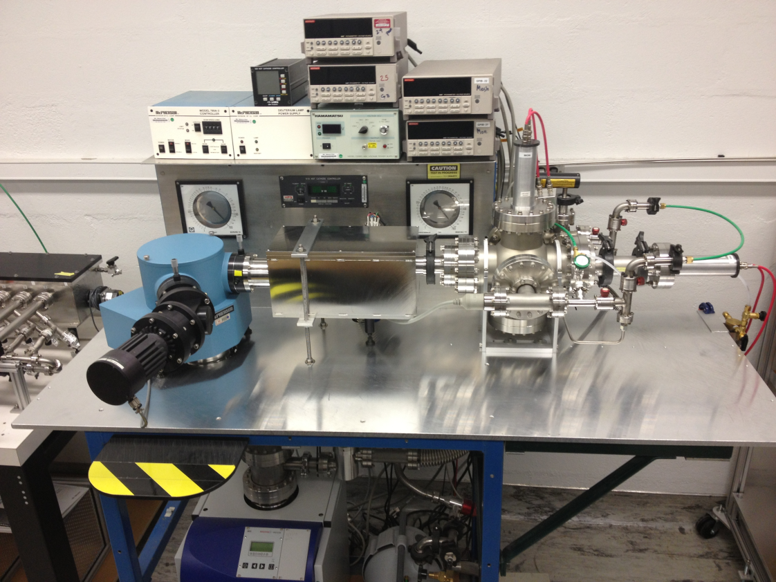
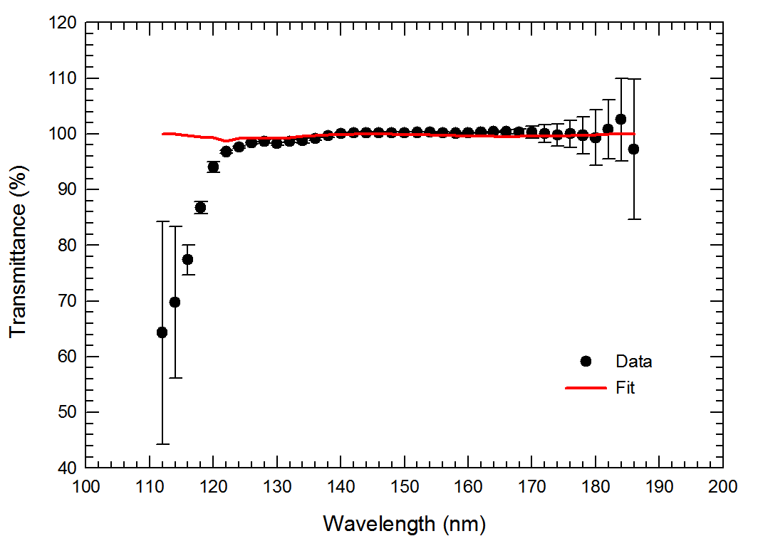
Gas Transmittance Measurements
VUV sensitive PMT‘s
Transmittance of pure CF₄
Collimated VUV light
Gas Sample
VUV Spectrometer for measuring transmission of gases down to ~ 120 nm

Slide 22
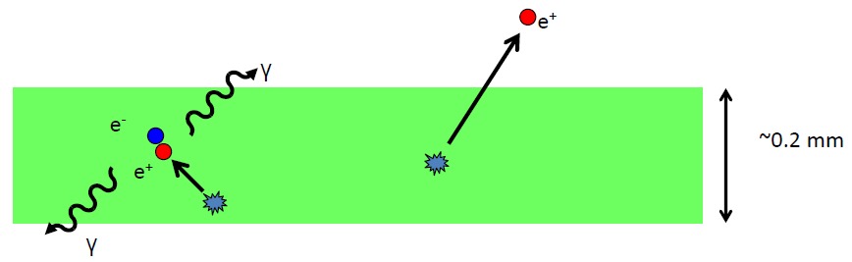
GEM Trackers for Positron Imaging
Efficiency for conventional Positron Emission Tomography is very low for imaging thin objects such as skin, plant leaves, etc.
  Large fraction of positrons escape without converting
Range of positrons for PET isotopes is many cm in gas
It is therefore possible to track the escaped positrons, generating a line of response similar to the one produced by back-to-back gammas in conventional PET, and use this for image reconstruction
Main problem is in multiple scattering of the positrons, primarily in the window of the detector

Slide 23
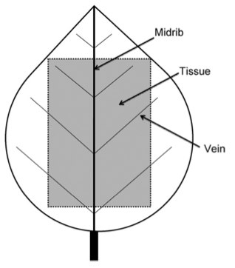
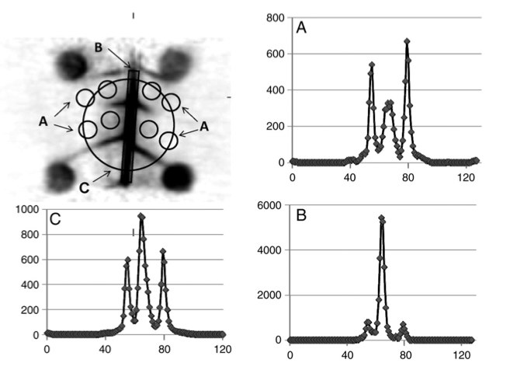
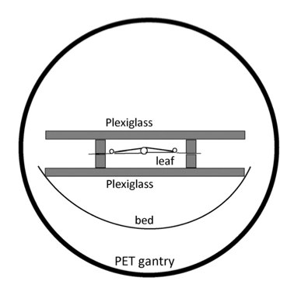
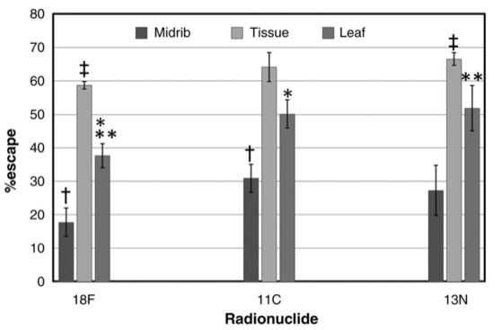
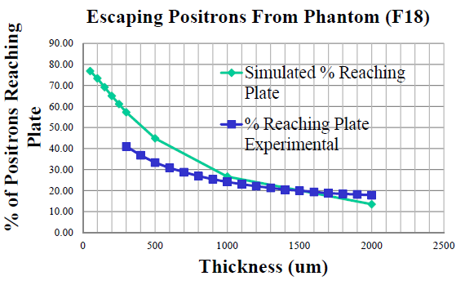
Positron Escape Probability
Leaf Experiment
Plexiglass plates stop escaping positrons which are then imaged by PET

Slide 24
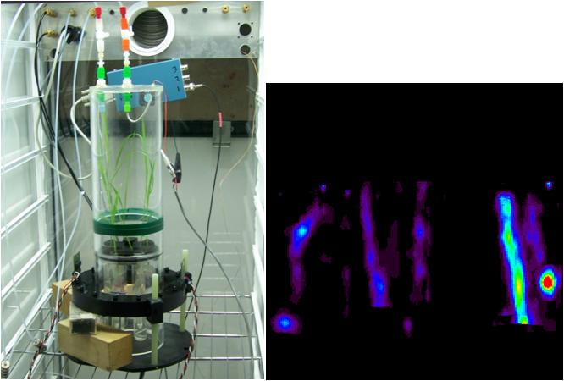

Positron Imaging Could be Complimentary to PET Imaging of Plants
PET image of the stems of a corn plant
Two Ring Ratcap PET imager

Slide 25

Position and Angular Resolution for Measuring Escaped Positrons
Detector Resolution
(stand alone Monte Carlo)
Spatial resolution due to multiple scattering in a 50 μm thick mylar window (Geant4)
T.Cao, Stony Brook
Position resolution is limited by scattering in detector window

Slide 26



Test with Collimated Beta Source
Brass Source Holder
⁹⁰Sr source (e⁻, E_{max} = 2.3 MeV)
Tungsten collimator with 1 mm hole
Need to reject background from γ conversions due to bremsstrahlung
Trigger on bottom GEM
Requires good single electron detection efficiency (⇒ high gain)
Sr-90
~50mm
1.00mm hole
Tungsten Collimator
Trigger timing determines displacement of vector relative to track, although no influence on angular resolution.
Preamp/Shaper
Capacitively couped to bottom GEM electrode
Trigger on bottom GEM
σ = 7.6°
4.5° due to multiple scattering

Slide 27



Planar Image vs Vector Reconstruction
Monte Carlo simulation of image reconstruction of a 1 cm disc of FDG
Planar image using only position information
Same image using vector information
Planar image from actual data of a 1 cm disc of FDG

Slide 28



Imaging a Source Phantom
2 mm diameter hole partially filled with ¹¹C/¹⁸F solution
Lucite cylinder
25 μm mylar window
e⁺
FWHM=5 mm
Using only vertical tracks: collimator mode

Slide 29
Summary
BNL is working on several new projects involving GEM detectors
  Minidrift
    Tracking for sPHENIX and EIC
    Positron tracking for medical imaging
  TPC/HBD
    Tracking and particle id for EIC
EIC tracking collaboration is also interested in large area GEM detectors for tracking (FIT, UVa), 3D readout (Yale) and RICH particle id (Stony Brook)

