Slide 1
CERN workshop upgrade
Rui De Oliveira

Slide 2
CERN workshop upgrade for MPGD
First step: buy and install 9 machines.
    These 9 machines are at CERN
    3 are still not installed
      Large photoresist developer
      Large photoresist stripper
      Large copper etching
Second step:
    -Redefine all the process parameter related to the new equipment
    -The last one to be define is the Polyimide etching
    -We have already parameters done with a small spraying
    machine.
    -Build some prototypes of the # detectors
    -Many have been already produced

Slide 3
TE/MPE/EM Workshop upgrade
An agreement was reached with CERN management in 2010 to purchase the subset of machines necessary to carry out R&D on large size GEM
(2m x 0.5 m) & Micromegas (2m x 1m) and the associated large size
read-out boards in the current CERN TE/MPE/ME facility.
GEM market call for order received ready
survey tender
  1 continuous polyimide etcher x x x x 02/2013
  1 Cu electroetch line x x x x 06/2012
Micromegas
  1 large laminator x x x x 06/2011
  1 large Cu etcher x x x x postponed
  1 large UV exposure unit x x x x 06/2011
  1 large resist developer x x x x postponed
  1 large resist stripper x x x x postponed
  1 large oven x x x x 06/2011
  1 large dryer x x x x 06/2011
3

Slide 4
Why postponing installation of 3 machines?
Status of Polyimide etching
These 3 machines : Copper etching, resist development and resist stripping
  are now constantly used in the std PCB production.
The time needed exchange machines is evaluated at
  1 to 1.5 week per machine.
We can not afford stopping our production for the time being.
We can still follow all the R&D program with our present equipment.
The new machines will be installed directly in building 107 and will
  greatly simplify the transfer from 102 to 107.
The commissioning of the polyimide etching machine have been delayed
because of extra addings for security .
It is now not yet stopping any R&D program but this year we have to make
2m x 0.5m GEMs and probably large read-outs.
The machine will be ready in theory in one month.

Slide 5
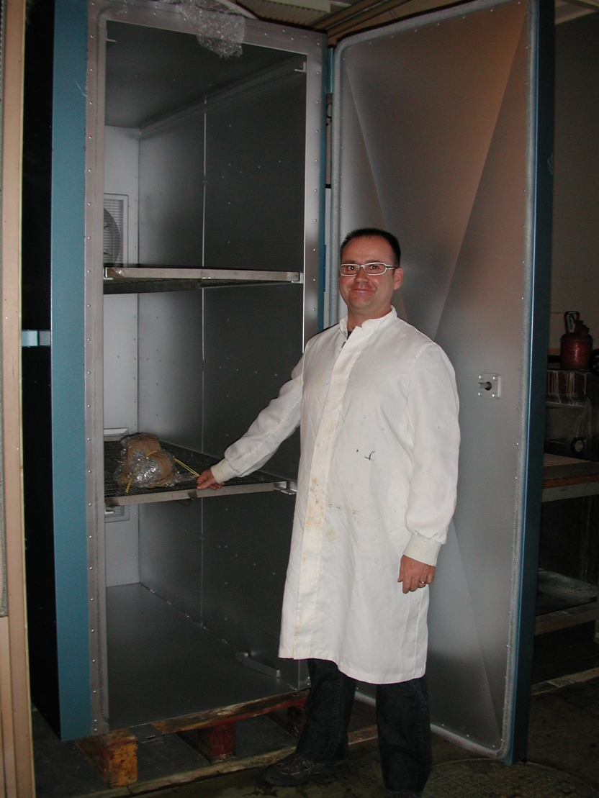
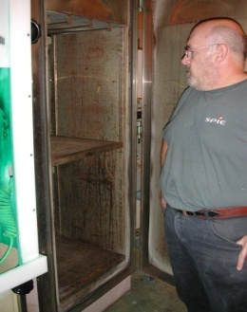
Ovens limited to 1.5m x 0.6m → 2.2m x 1.4m
In building 102 .

Slide 6
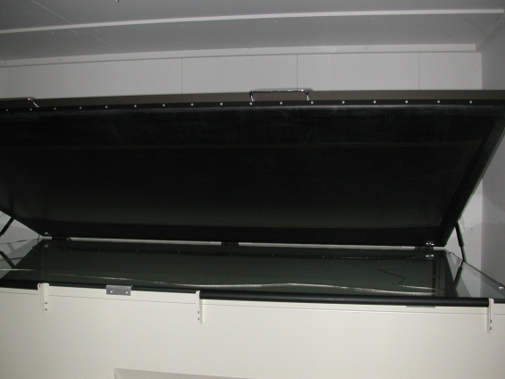
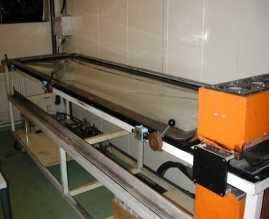
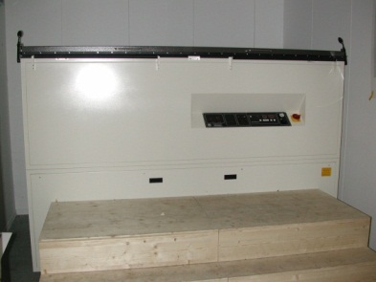
single side , direct exposure
2.2m x 1.4m
Short exposure
Cold exposure (3.5kW)
Double side , scanner type
2m x 0.6m
Long exposure times
Hot exposures (10 kW)
UV exposure unit limited to 2m x 0.6x → 2.2m x 1.4m
Single side exposure
We keep the old lamp anyway
In building 254

Slide 7
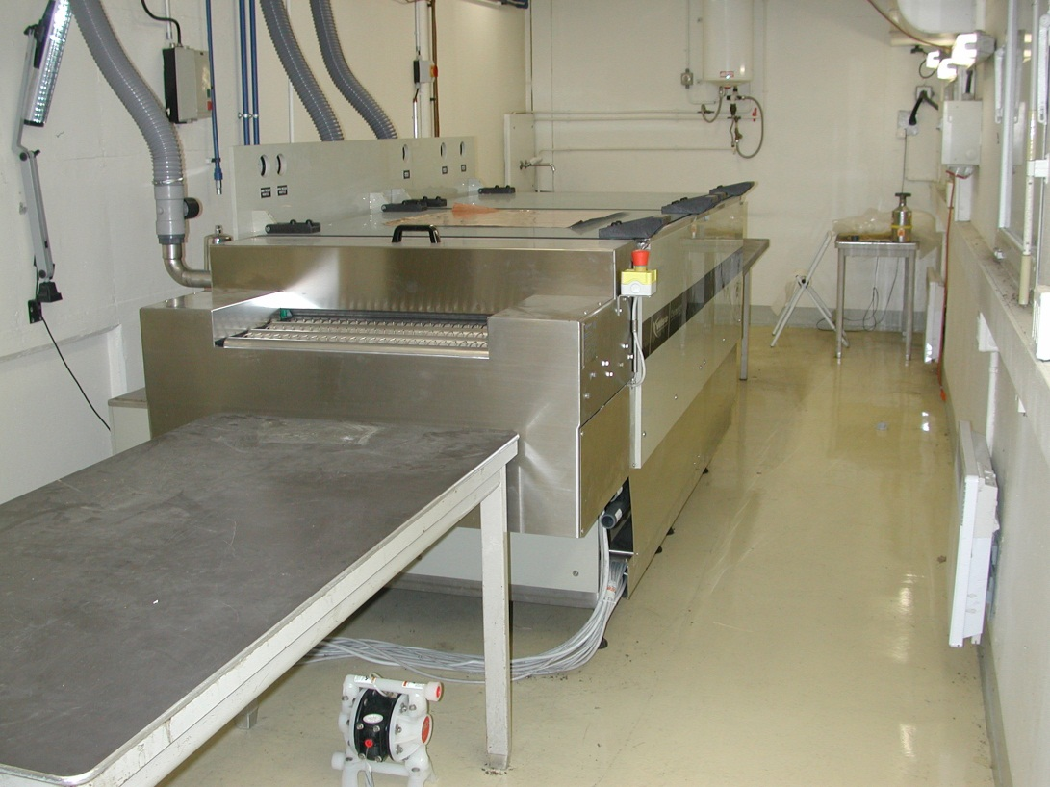
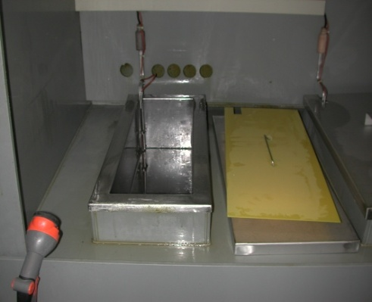
Spray continuous line etching
Dead bath etching
GEM polyimide etch limited to 1m x 0.5m → 2m x 0.5m
The filling and emptying pumps are still not connected
1 foil/hour → 12 foil / hour
No tooling needed
In building 254

Slide 8
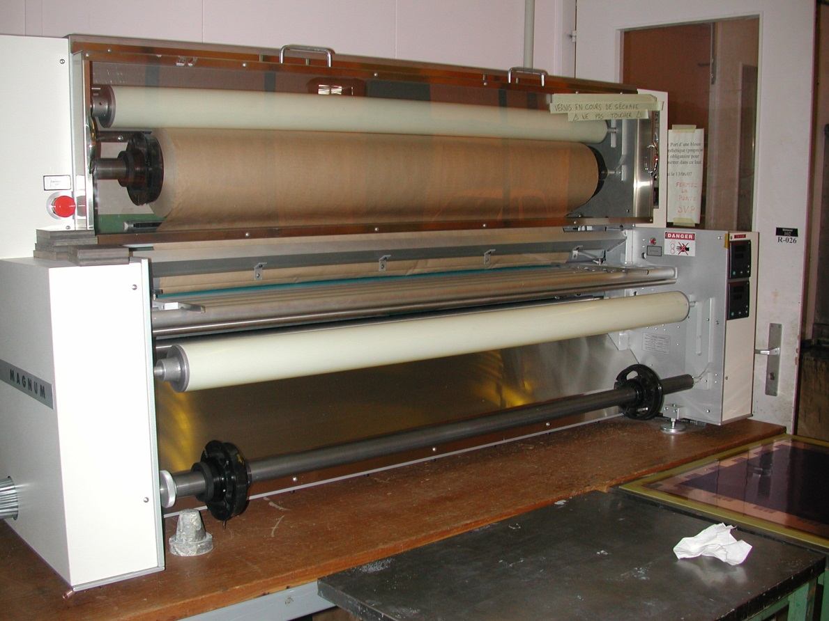
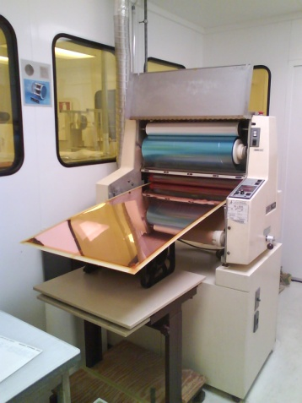
Laminator limited to 0.6m width → 1.4m width
Photoresist , Photoimageable coverlay
In building 102 .

Slide 9
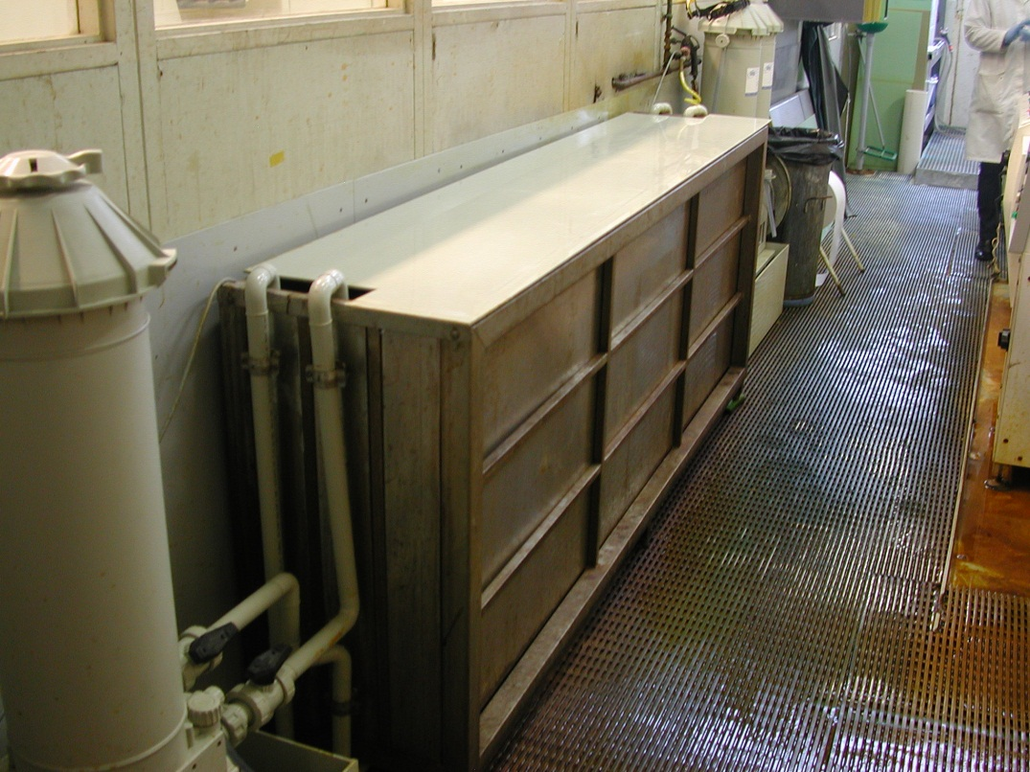
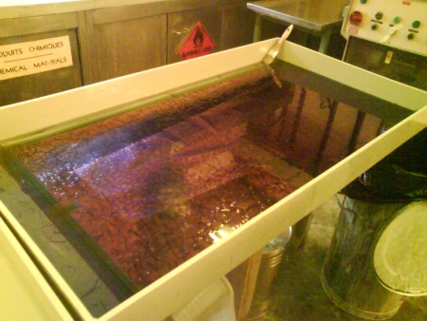
Vertical filtered dead bath
Horizontal dead bath
Ethanol GEM Resist stripping limited to 1m x 0.5 → 2m x 1m
Reduces the consumption of ethanol
Avoid Ethanol daily handling
In building 102 .

Slide 10
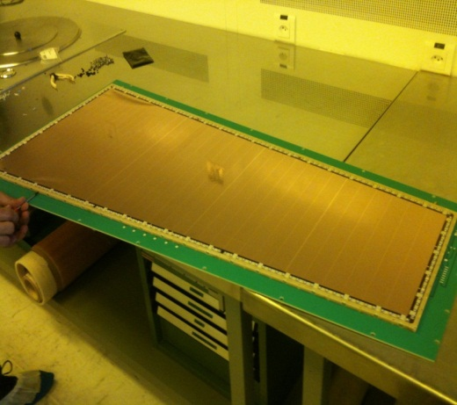
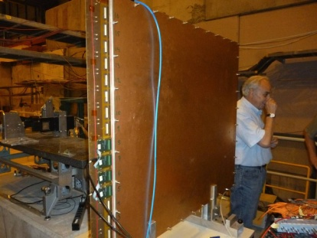
Examples of detectors produced with these equipment
CMS GE1/1 GEM detector
1m x 50cm
5 detector produced
6 more in production
ATLAS Muons Micromegas detector
1m x 1m active area (1 detector produced)
2m x1m 1 detector produced
  See Givi’s talk
second one in production

Slide 11
2013 program for significant size detectors
J Lab
  40 GEMs and associated read-out (50cm x 40 cm)
CMS
  4 To 6 detectors NS2 (1.1m x 0.45m)
ATLAS
  One detector 2m x 1m
  One real prototype ( 4 layers stack , 3.5m x 2.5m)
ALICE
  To be define
Geo Azur
  4 to 6 resistive BULK (1m x 50cm )
Solid
  To be define
LHCb
  To be define

Slide 12
Man Power affected to MPGDs
2012 MPGD team situation:
  GEM : 2 technicians (2 FSUs)
  Micromegas: 1.5 staffs
2013 MPGD team situation:
  GEM : 5 technicians (2 staffs + 3 FSUs)
  Micromegas: 2 staffs
The std detectors are now produced by the other members of the std PCB team.
Our production planning for GEMs is full till end of February
Our production planning for Micromegas is full till end of March

Slide 13
Conclusions
This year we will make GEMs of 2m x 0.5m
We will produce also Micromegas detectors 3.5m x 2.5m
Man power situation better than 2012
No large quantity project expected in 2013

