Slide 1
LAGUNA
Primary Beam: Extraction and Transfer
B.Goddard TE/ABT
23/01/2013
Reporting on behalf of many colleagues
400 GeV
  Extraction from SPS
  Upgrade of TT20
  Switch from TT20
  Transfer to neutrino target
Beam transfer for 30-50 GeV HPPS
  Injection / extraction straight
  Transfer line considerations

Slide 2
Extraction from SPS LSS2
Concept of non-local extraction already studied
  LSS2 bumpers, septa (electrostatic ZS retracted)
  Kickers MKP LSS1 or MKE LSS6 (100 or 400 GeV)
Principle proved in MD
  440 GeV beam extracted from LSS2, using LSS6 MKE kicker
Extraction/SPS systems needing upgrade:
  MKE6 (presently only single batch extraction, with 11 us flat-top. Needs major kicker upgrade for double batch – essentially exchange with LSS4)
  LSS2 TPSG (protection device to upgrade – being looked at for SBLNF but only 100 GeV and larger ohysical emittance).
  Interlocks (new LSS1 ‘master’ Beam Interlock Controller (BIC), cables, fiber LSS2->LSS1, new LSS2 BIC, new interlocks for extraction septa and bumpers and TL beam positions, probably also new TT20 BIC). Could be in place for SBLNF.
  LSS2 beam instrumentation (minimum 2 new BTV screens, additional beam loss monitors, new large aperture 206 mm BPCE coupler at QFA.218, cables, controls). Could be in place forSBLNF.

Slide 3
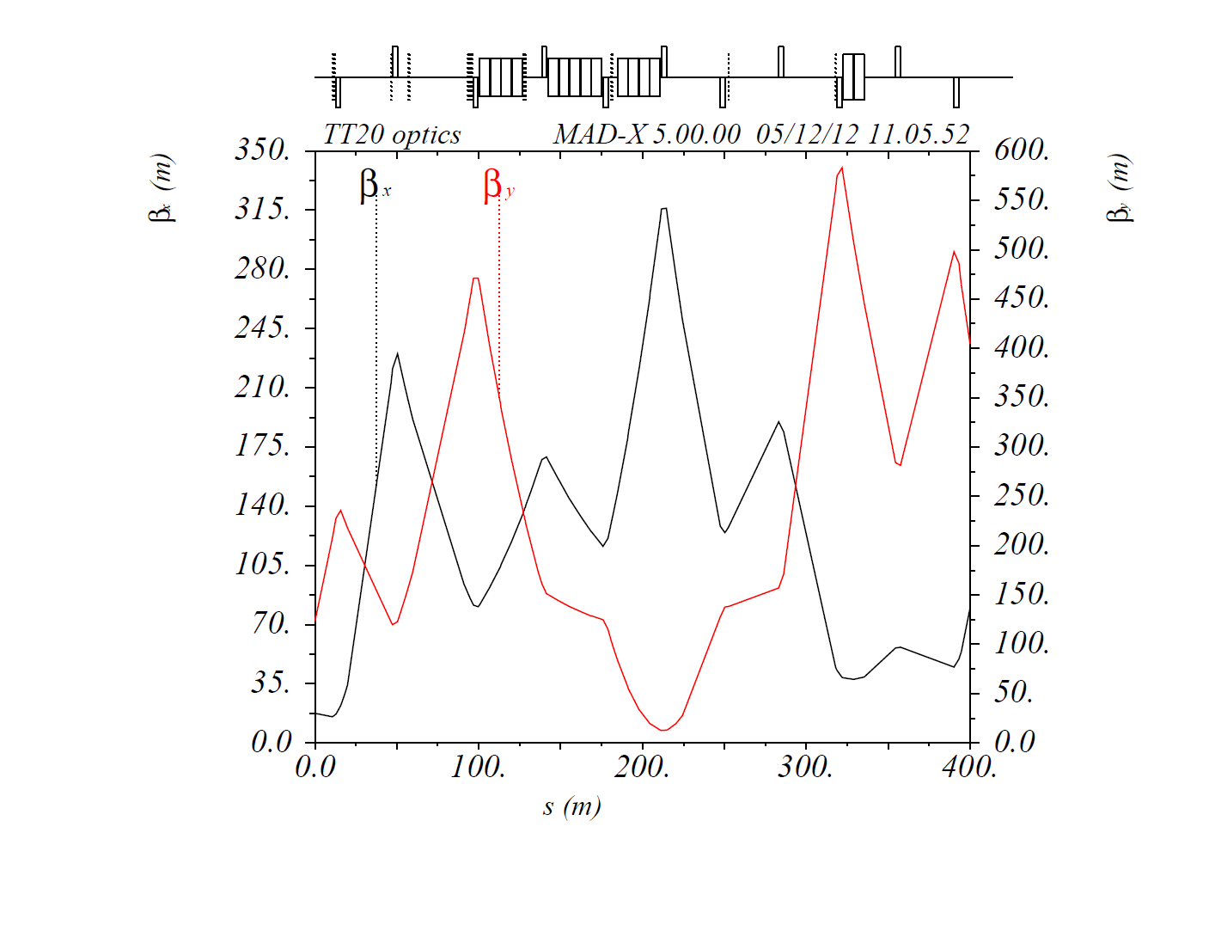
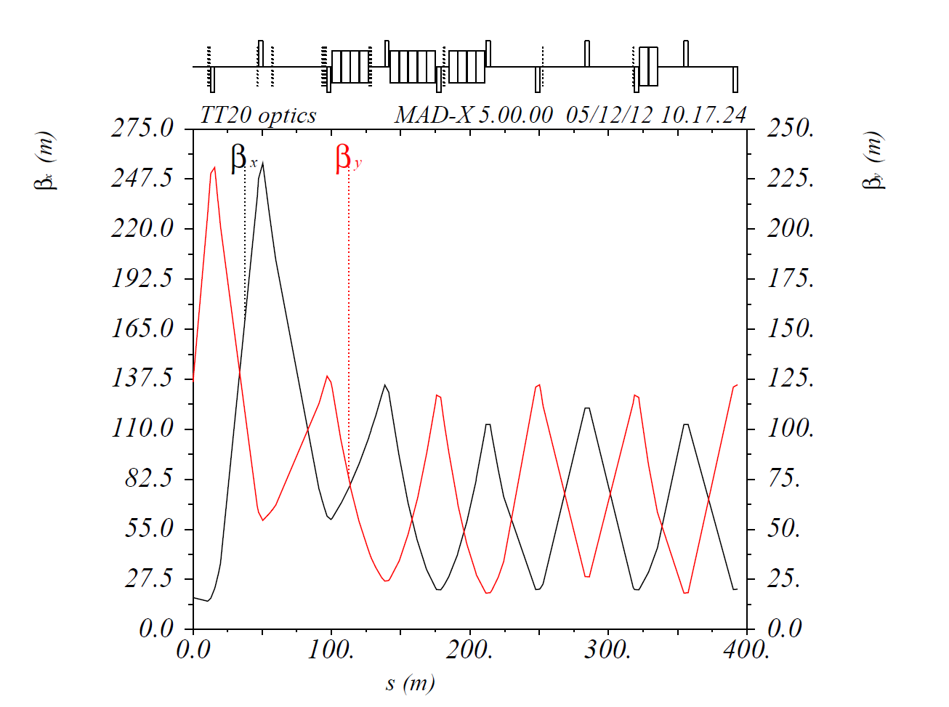
Transfer along existing TT20
Optics being rematched for SBLNF (100 GeV)
Aperture more relaxed at 400 GeV (max K to check)
Aperture probably too small at 30-50 GeV
Optics for fast extraction after matching
Optics from TT20 before matching
for given input

Slide 4
Transfer along existing TT20
New instrumentation needed for fast extracted beam
  Upgrade BTV.21026 and BTV.210352
  1 new BTV (for emittance measurements)
  12-16 BPMs with aperture of ~120 mm (as for QTL)
  12-16 BLMs (ionisation chamber SPS standard)
  1 Fast Beam Current Transformer
Interlocking needed of main bends, beam positions, BTVs, …
Magnets and power convertors need to be checked for new RMS (3.6 s cycle length)
  Could also be an issue for 400 GeV.

Slide 5
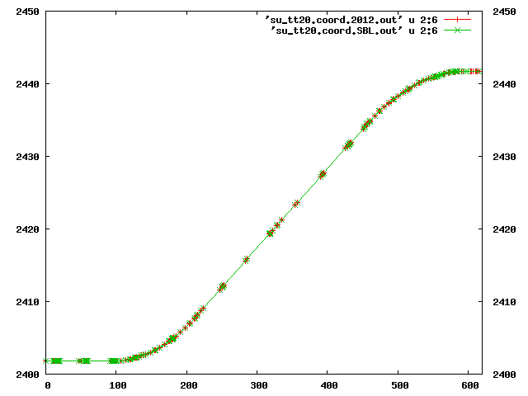
Switch from TT20
4 switch locations investigated for SBLNF
Before vertical bend α₂
At horizontal bend ϕ₂
In vertical bend α₂
After splitter 1
4
3
4
2
3
2
1
1

Slide 6
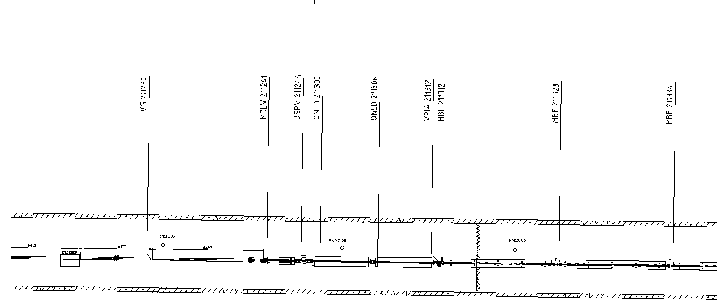
Option 1: Switch before vertical bend α₂
5x MBS-like switch magnets
Could work at 400 GeV for LAGUNA
Minimal changes on existing TT20 systems
Junction cavern exactly under decheterie – not feasible in short-term (abandoned for SBLNF)

Slide 7
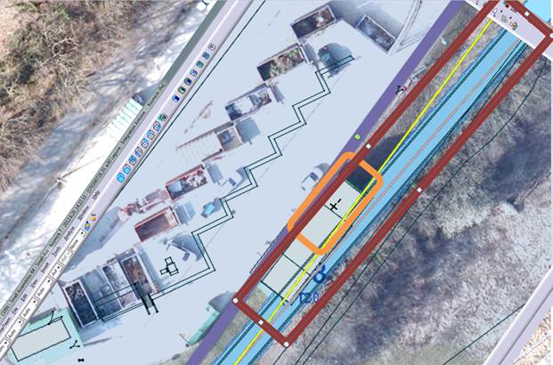
Option 1: Before vertical bend α₂

Slide 8
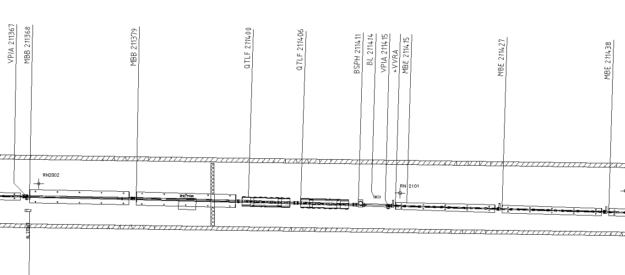
Option 2: at horizontal bend ϕ₂
Replace 1 existing MBB by 2x MBS magnets (from CNGS)
Replace 1 of 2 QTLF.2114 (600 mm wide) by DC QTS (320 mm)
Displace Quadrupoles 0.58 m downstream
2 additional MBB in TT20 tunnel
Not compatible with 400 GeV
Retained for SBLNF

Slide 9
Option 2: at horizontal bend ϕ₂
  Need to run switch dipole at 1.75 T for 400 GeV NA beam – present MBS maximum 1.7 T. Not expected to be an issue
  Switching MBB needs 1 T for 100 GeV – not OK for 400 GeV

Slide 10
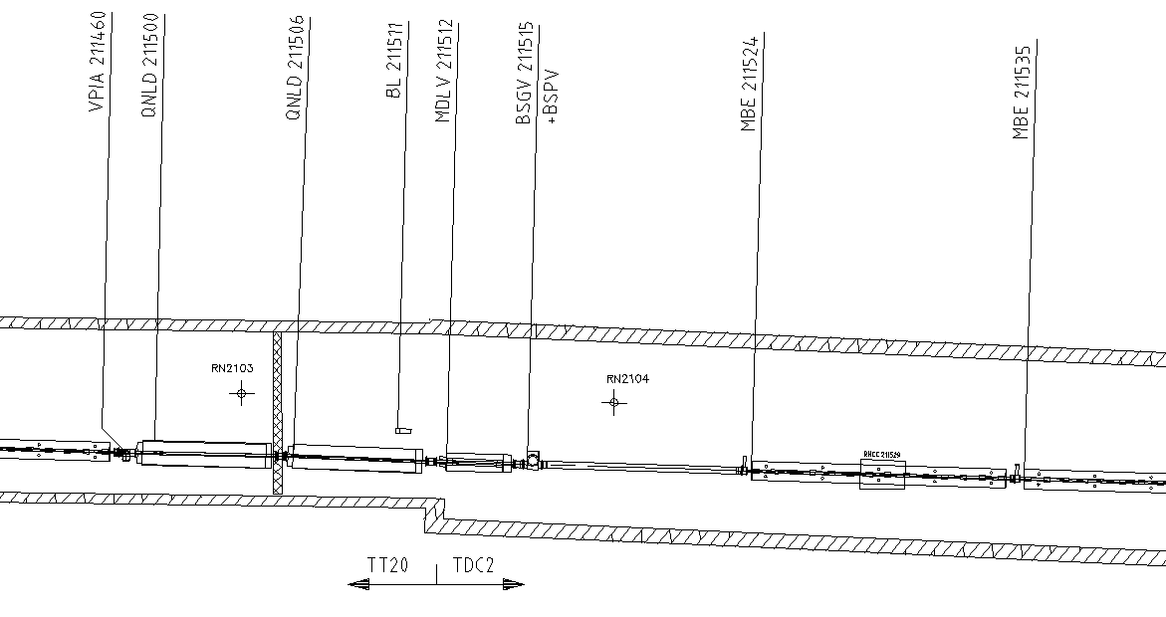
Option 3: In vertical bend α₂
Needs 3 MBS-like magnets
Requires major remodelling of TT20
  New main dipole families and convertors, water cooled cables, 80 mm vertical realignment over 120 m, …
Not compatible with 400 GeV

Slide 11
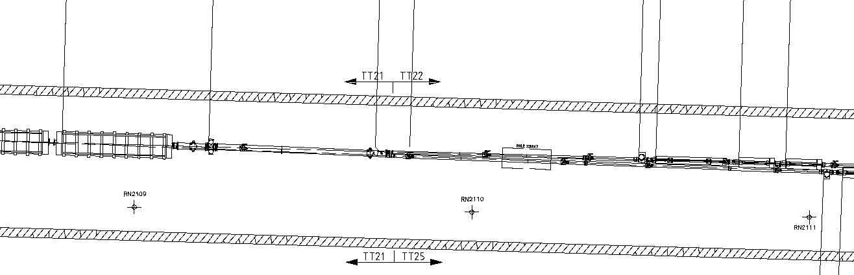
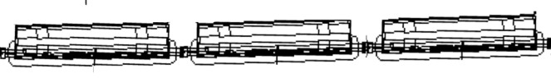
Option 4: After splitter 1
Needs ~5 HUGE vertical aperture dipoles – not really feasible.
Alternative to use last splitter in inverted polarity mode, but only works for 100 GeV
Civil engineering then in the splitter zone….abandoned for SBLNF, and does not look very attractive for LAGUNA
Could be made to work with 400 GeV

Slide 12
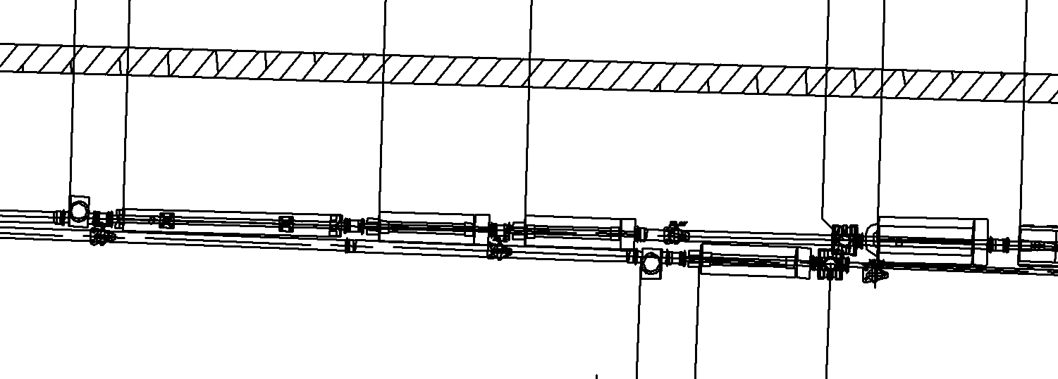
Option 4 after switch magnets
Around 14 m drift
Interesting challenge for access to central elements!!
Maybe space for 1 short (1.5 m) quad or corrector

Slide 13
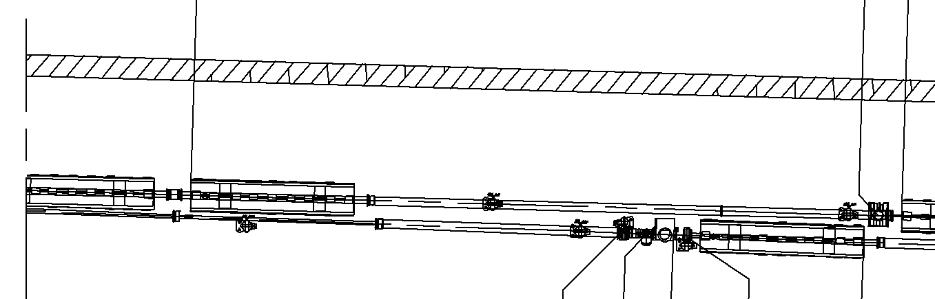
Option 4 bending away from TT21
More MCW where possible to fit them (just after QTAF220300)
Another 23 mrad angle per 5 magnets, so 10 additional MCs gives for total of 69 mrad into the beamline

Slide 14
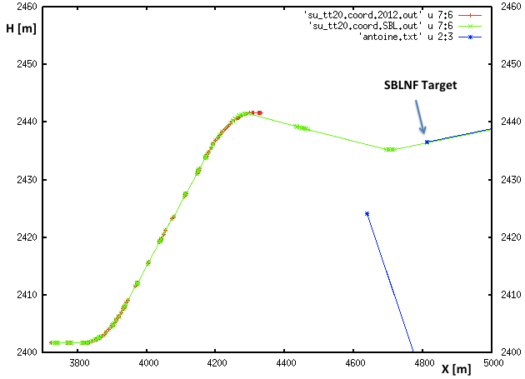
SBLNF geometry and LAGUNA - V

Slide 15
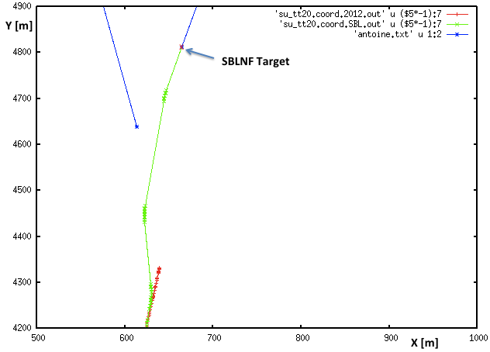
SBLNF geometry and LAGUNA - H

Slide 16
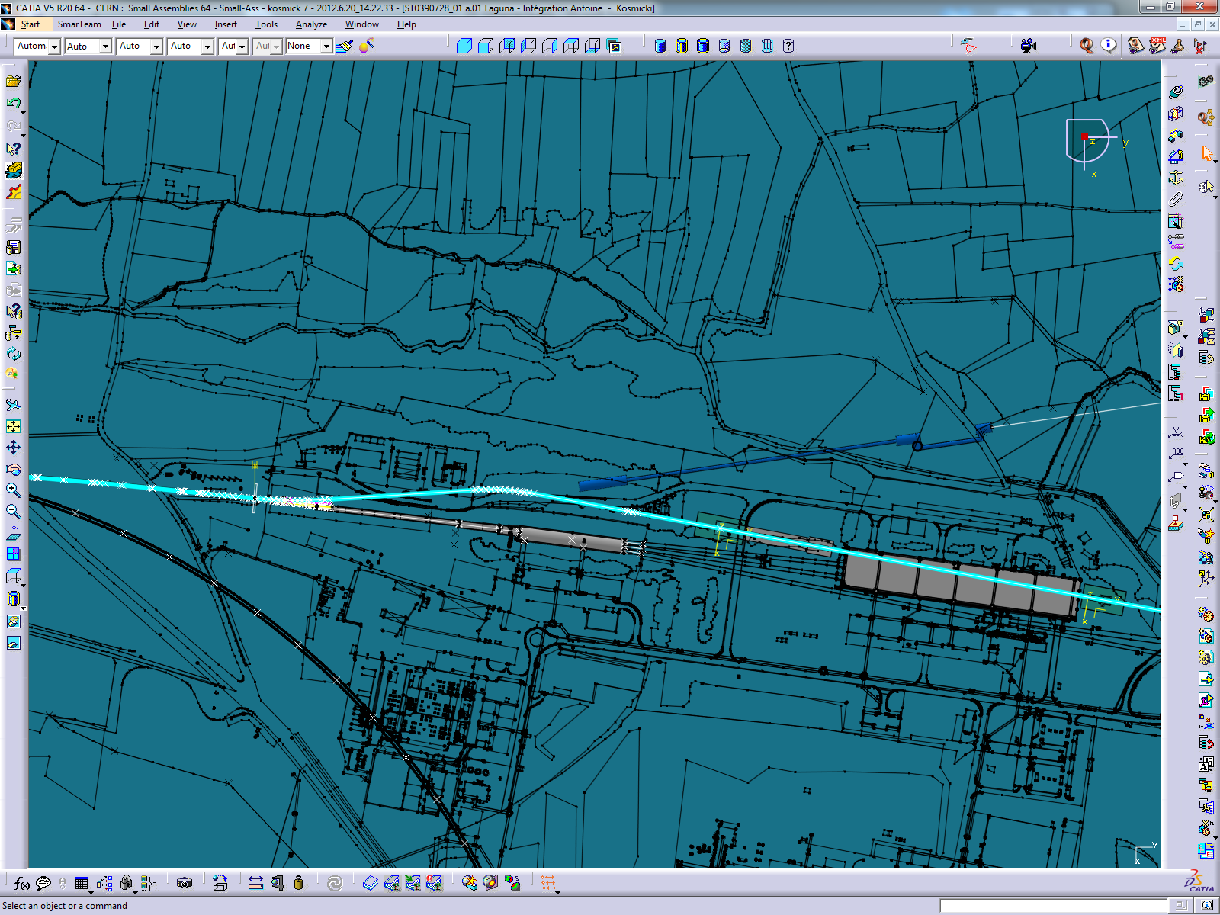
Surface structures (old SBLNF version)

Slide 17
Conclusions from discussion on HPPS injection/extraction
Should be easier than PS2 injection/extraction LSS
  Fewer beam transfer requirements
  Extract only at 50 GeV
The well-worked out H- injection system designed for PS2 at 4 GeV can basically be plugged into HP-PS
  24 m central drift
  1 m space for laser stripping elements
Fast extraction in the same LSS possible
  Minimum 12 m for the outer drifts
  Imposes large aperture doublet quadrupoles
Can we already start working with basic parameter set
  4 GeV injection, 1 ms injection; 50 GeV extraction, rise time?
  Target emittances??

Slide 18
HPPS injection/extraction: next steps
24 m central drift in the injection straight and matching of overall lattice with this new LSS (YP et al.). DONE
Generate an LSS sequence with the various injection and extraction elements (BG/AP). DONE
Definition of envelopes, apertures, kicker and septum strengths etc. (BG/AP). TO DO.

Slide 19
Some brainstorming input for layout
Is Finland still the only LBNO direction?
  Makes beamline design difficult if this changes
Should decouple LAGNUA completely from SBLNF
  Minor synergy, for LSS2 and TT20
  Needs dedicated LSS6, switch, transfer line
  Vertical switch from TT20 with open C core MBB?
  Keep target at SPS level?? Depth???
30-50 GeV beamline totally different proposition to 400 GeV
  Maybe consider reuse of tunnel (although this constrains 50 GeV ρ)
50 GeV HPPS after HP-SPL also seems to point to keeping target at SPS level
  Deep shafts and long cables to surface – any other problem??

Slide 20
Conclusion
Extraction from SPS to TT20 at 400 GeV is possible – most upgrades could come with SBLNF (although not MKE6 nor TPSG2).
TT20 should be OK for LAGUNA 400 GeV beam, if SBLNF upgrades take place.
New SBLNF switch (and TT26) essentially useless for LAGUNA 400 GeV beam. Geometry has had to be laid out with tight bending radius of 100 GeV (336 Tm).
Switching 400 GeV beam from TT20 looks tricky anywhere – might be best to stay at SPS level with LAGUNA target…
HPPS injection extraction straight being looked at – doublet layout with 24 m drifts should not pose problems. Will look at required kicker, septa and H- element parameters, and lattice magnet apertures.
Might be good to investigate more radical layout departure, keeping target at SPS level?

