Slide 1
Non-Invasive Beam Profile: Methods in Evaluation
Residual Gas Luminescence
  Estimated photon count in ESS cryogenic section (without additional gas): ~1/s
Residual Gas Ionization
  Estimated ion rate ~2000/(s*cm)
  Using MCPs limits operational lifetime
  Other detectors (wire, silicon strip)
Crossed Particle Beam Interaction
  Ageing of electron gun may not be a problem

Slide 2
Techniques for Main Injector
Various techniques for measuring deflection
  Fast scan through peak of bunch (see W. Blokland’s SNS talk)
    Requires fast deflector (< 1 ns sweep time)
  Slow scan, akin to flying wires (most likely solution in short time frame of Nova)
    Position the beam and record the maximum deflection as the beam passes by
      Leave the electron beam stationary
      Sweep the beam along the proton direction
        Obtain longitudinal distribution
Is one of these an option for the CERN PS?

Slide 3
Electron-beam scanner experience at ORNL
Electron Scanner progress:
  Verified with wirescanner and position measurements
  Improvements made:
    Scan range, cathode current, cameras, analysis, magnetic shielding
  Future plans:
    Better cameras, deflector electronics, HV transformer, move markers, scrapers, simulation for ebeam transport
  Important to verify e-beam density for faster scans, i.e. can the camera see something

Slide 4
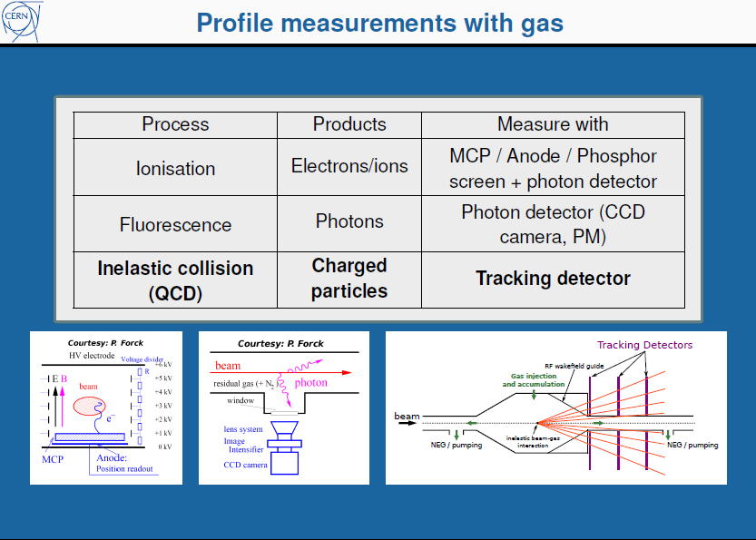

Slide 5
To do list for DR@LHC
DR light intensity is not a limitation even for large impact parameters (turn-by-turn, bunch-by-bunch measurement ?)
Compared to Sync. Light monitor, no limitation from diffraction nor from having an extended source
Imaging the slit might be enough to monitor the evolution of beam size through the cycle – Imaging in far infrared ?
Sensitivity to beam size using slit interference to be checked carefully – Choice of wavelength – might be very different at injection and top energy
Need a precise positioning of the target with respect to the beam (high precision BPM close to the Target)
Impedance is an issue in LHC – Lessons from the LHC sync. light telescope – Adequate design of the slit holder and choice of slit material – Temperature effects might be a killer for interference scheme
Do we need a SR mask in LHC ?
Will OTR from halo particles degrade the measurements (How much of beam halo to be expected at distances of 10σ or higher) – Measuring OTR at shorter wavelength and compensating for that

