Slide 1

Summary of experience with LHC and SPS IPM monitors in 2011 & 2012 (& 2013)
Mariusz Sapinski, CERN BE/BI

Slide 2
Outlook
High-brightness beams
Short description of SPS and LHC IPM
  HV
  Gas injection
  Magnets
  Imaging, signal distortion (along the path)
Hardware failures
Calibration methods

Slide 3
Beams
Beams with emittance as small as 0.7 μm∙rad (pPb run)
Typical emittance for high-intensity protons: 1.5 μm∙rad
(designed emittance 3.5 μm∙rad)
Up to 1.7∙10¹¹ protons/bunch
Beam size: at 7 TeV, β=100 m: 100 μm
2800 bunches

Slide 4
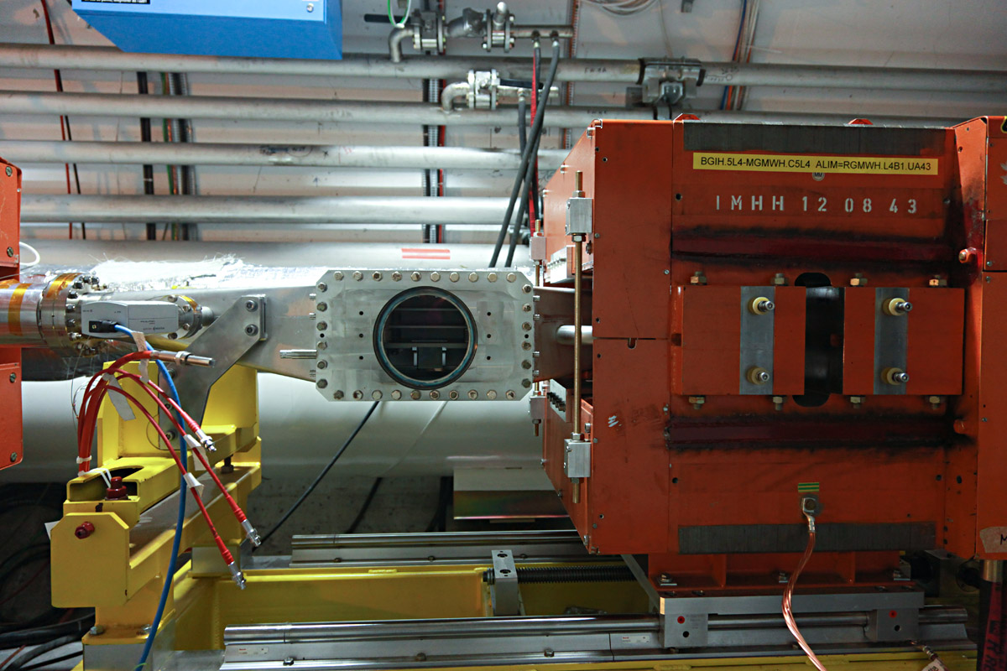
System: HV cage

Slide 5
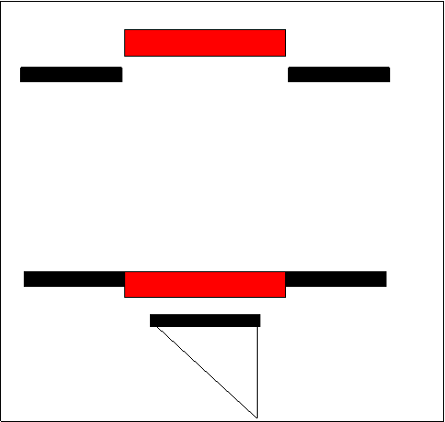


System: HV cage + PS + control
EGPin - 1800 V
EGPout - 1900 V
Cgrid - 2000 V
HVctrl
VME
anti-SEM wires
Field-shaping electrodes
beam
Accelerating potential
MCPin +2000V
MCPout +2600V
Phosphor +5000V
PS
~ 180 m

Slide 6
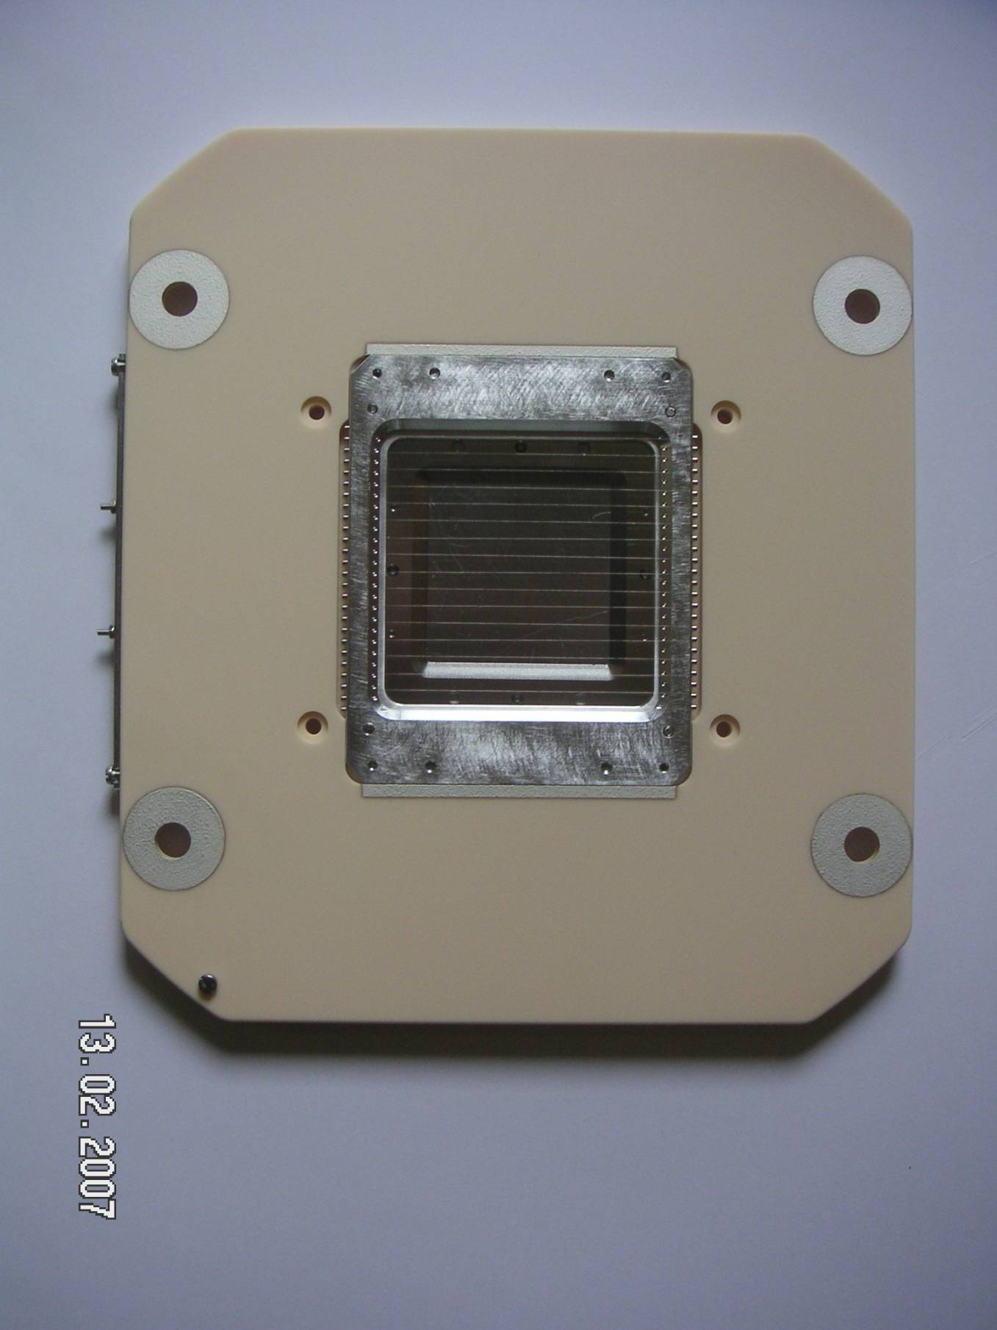
Negative electrode
VME

Slide 7
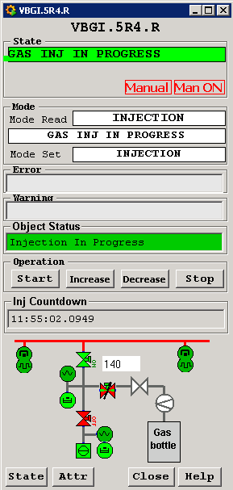
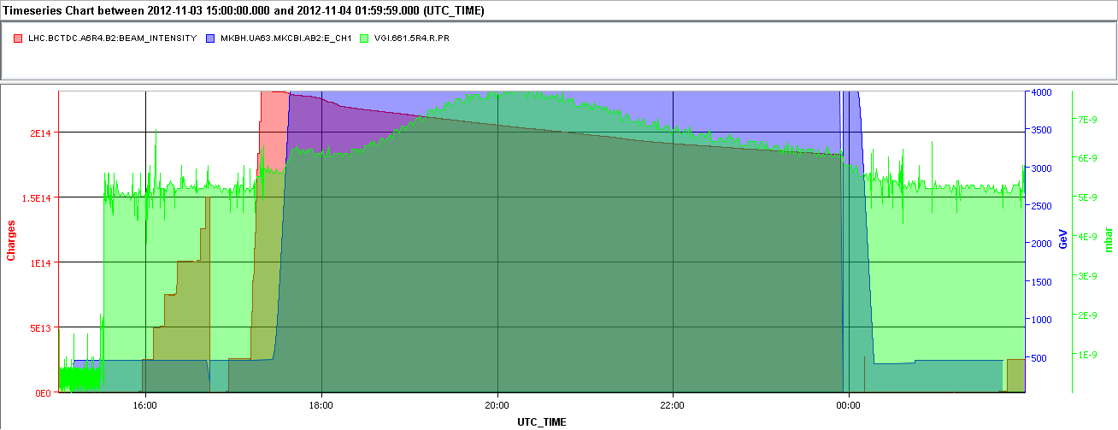
System: gas injection
needed in LHC (normal vacuum 10⁻¹¹ mbar)
gas injection up to 10⁻⁸ mbar
PVSS application
manual control (3-4 steps)
timeout after 12 h
VME
beam intensity
beam energy
pressure
max after ~2h on flat top
typical LHC fill

Slide 8
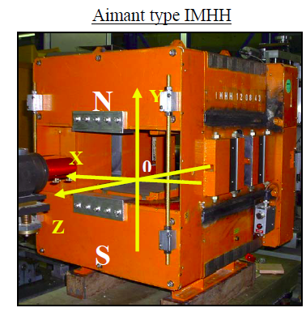
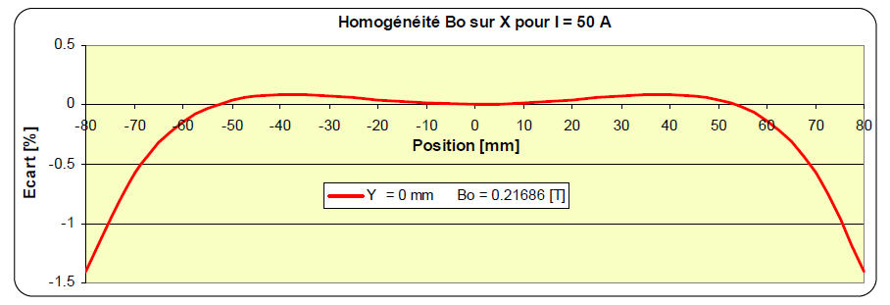
System: magnetic field
Magnetic field needed to keep minimize beam space charge effect
0.2 T magnets originally from ISR, yoke modified to extract light
Need to exchange power converters on SPS magnets to allow cycling.
magnets are compensated (ie. 2 magnets/detector/plane in the same circuit)
length 43 cm
20 cm space between poles
Field quality:
VME

Slide 9
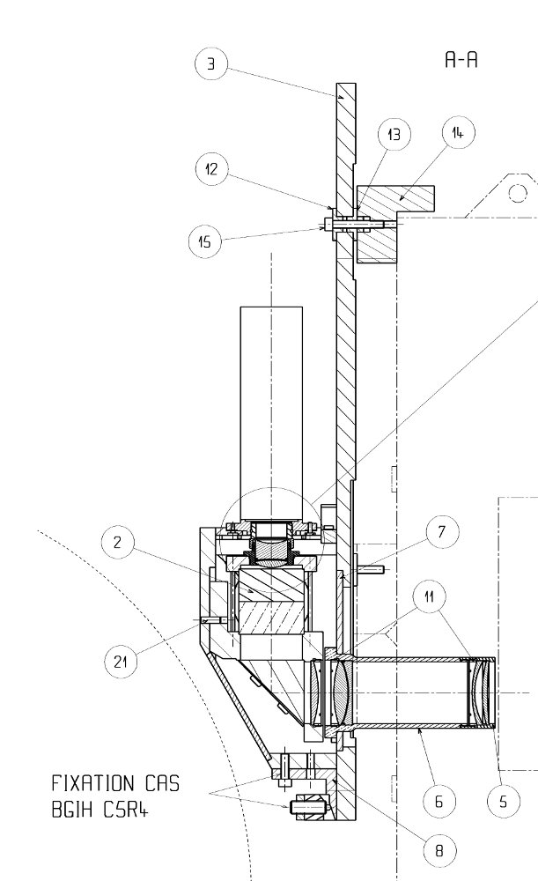
System: imaging
Frame grabber
EGP with anti-SEM wires
(calibration of MCP ageing)
~180 m
CID camera
(intensified)
Thermo Scientific
CID8712D1M-XD4
E
B
beam
MCP
Phosphor
Prism
Video amplifier
Optical system View port

Slide 10
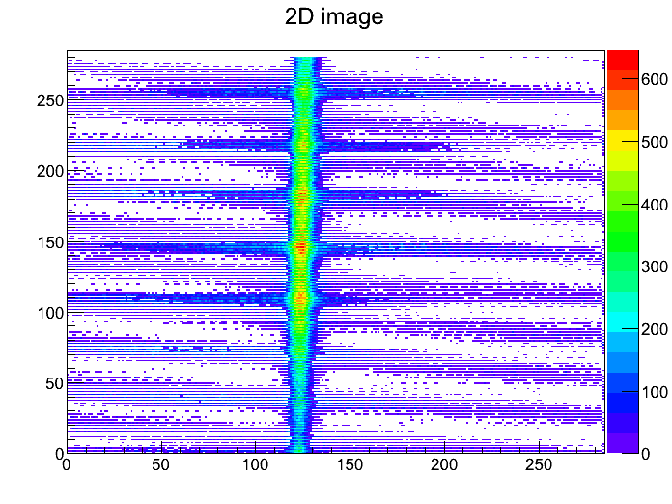
Signal distortion
Frame grabber
Anti-SEM wires glowing:
~180 m
CID camera
(intensified)
Thermo Scientific
CID8712D1M-XD4
E
B
beam
MCP
Phosphor
Prism
Video amplifier
Optical system View port

Slide 11
Signal distortion
Frame grabber
Solution: masking at level of image processing
~180 m
CID camera
(intensified)
Thermo Scientific
CID8712D1M-XD4
E
B
beam
MCP
Phosphor
Prism
Interestingly it is mainly observed in
vertical IPM
Video amplifier
Optical system View port

Slide 12
Signal distortion
Frame grabber
Beam space charge
And electron gyroradius
See Marcin’s presentation
~180 m
CID camera
(intensified)
Thermo Scientific
CID8712D1M-XD4
E
B
beam
MCP
Phosphor
Prism
Video amplifier
Optical system View port

Slide 13
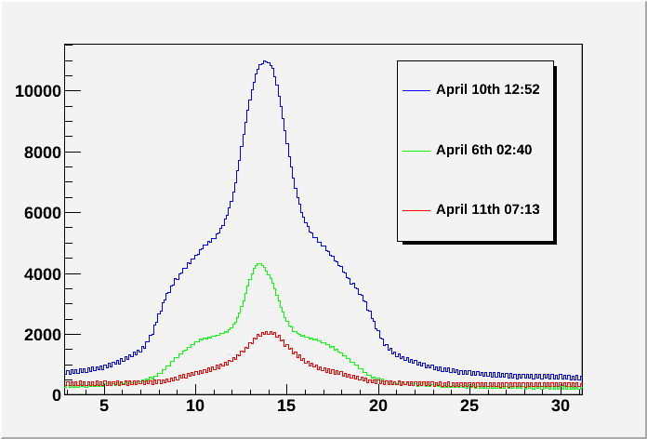
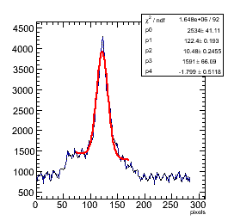
Signal distortion
Frame grabber
Electron cloud (suspected)
scrubbing
~180 m
CID camera
(intensified)
Thermo Scientific
CID8712D1M-XD4
E
B
beam
MCP
Phosphor
Prism
Video amplifier
Appears only in specific conditions (scrubbing).
electrodes and MCPs are NEG-coated to suppress e-cloud
Optical system View port

Slide 14
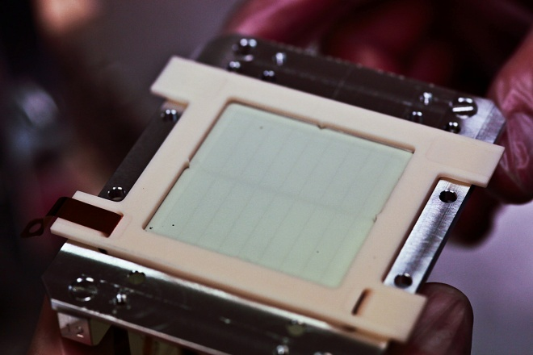
Signal distortion
Frame grabber
Nonuniform MCP ageing
Phosphor screen burn-in?
~180 m
CID camera
(intensified)
Thermo Scientific
CID8712D1M-XD4
E
B
beam
MCP
Phosphor
Prism
Video amplifier
During winter 2011/12 MCPs in 2 BGIs have been exchanged. Signals improved a lot, but both MCPs died soon because of HV/high signal problems.
Optical system View port

Slide 15
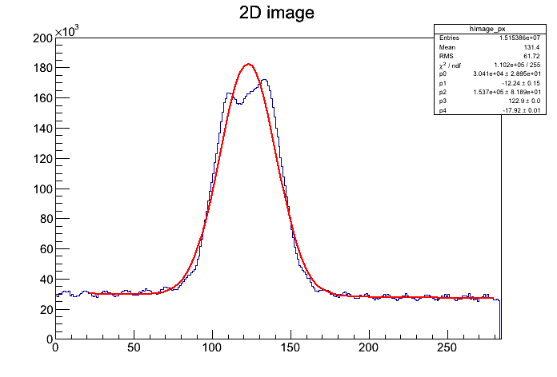
Signal distortion
Solution: use EGP to measure nonuniformity and correct for it.
Frame grabber
~180 m
CID camera
(intensified)
Thermo Scientific
CID8712D1M-XD4
E
B
beam
MCP
Phosphor
Prism
But EGPs did not work in a very reliable way.
They stopped working at the end of run (ageing?)
Orbital bump possible, but small at injection.
Video amplifier
Optical system View port

Slide 16
Signal distortion
MCP hole pitch: 32 μm
+
Signal broadening between MCP and Phosphor screen due to emission cone.
Frame grabber
~180 m
CID camera
(intensified)
Thermo Scientific
CID8712D1M-XD4
E
B
beam
MCP
Phosphor
Prism
Video amplifier
Optical system View port

Slide 17
Signal distortion
Frame grabber
Optical system PSF is
estimated to be 22 μm (ZMAX)
D. Kramer et al., CERN-AB-2005-072
~180 m
CID camera
(intensified)
Thermo Scientific
CID8712D1M-XD4
E
B
beam
MCP
Phosphor
Prism
Video amplifier
Optical system View port

Slide 18
Signal distortion
Frame grabber
Camera tilt, measured and corrected.
~180 m
CID camera
(intensified)
Thermo Scientific
CID8712D1M-XD4
E
B
beam
MCP
Phosphor
Prism
Video amplifier
Optical system View port

Slide 19
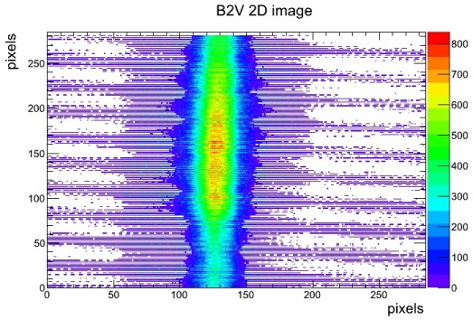
Signal distortion
Frame grabber
Transmission using analog video signal:
line-to-line noise and other artefacts
~180 m
CID camera
(intensified)
Thermo Scientific
CID8712D1M-XD4
E
B
beam
MCP
Phosphor
Prism
Video amplifier
Optical system View port

Slide 20
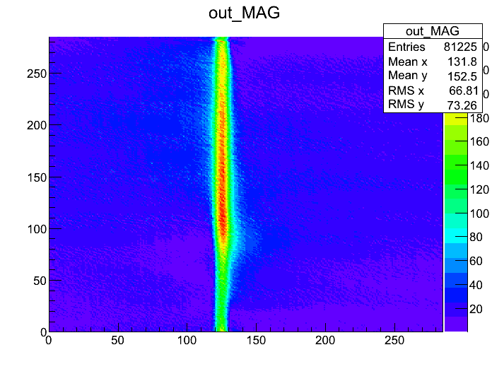
Signal distortion
Frame grabber
Transmission using analog video signal:
line-to-line noise and other artefacts
Solution: image filtering, eg. 2D FFT filters (still being tested)
~180 m
CID camera
(intensified)
Thermo Scientific
CID8712D1M-XD4
E
B
beam
MCP
Phosphor
Prism
Video amplifier
Optical system View port

Slide 21
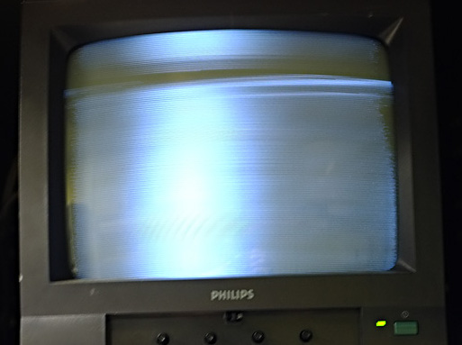
Signal distortion
Frame grabber
SPS: picking up a huge noise on video signal correlated with beam type/intensity
~180 m
CID camera
(intensified)
Thermo Scientific
CID8712D1M-XD4
E
B
beam
MCP
Phosphor
Prism
Video amplifier
Cable shielding and exchange of video signal amplifier were helpful.
Optical system View port

Slide 22
Hardware failures
(other than already mentioned)
HV ctrl card – problem with compatibility with VME (linux CPU)
5 CID cameras stopped working, in most cases we suspect that intensifier reached MTTF (tbc by ThermoFischer).
failures of MCPs
  “conditioning effect” for MCPs
  too high input electron current might kill MCP
  abrupt HV change might kill MCP (and dump the beam!)
Killed MCP: creation a conducting channel through the plate: cannot set HV anymore, cannot amplify the signal.

Slide 23
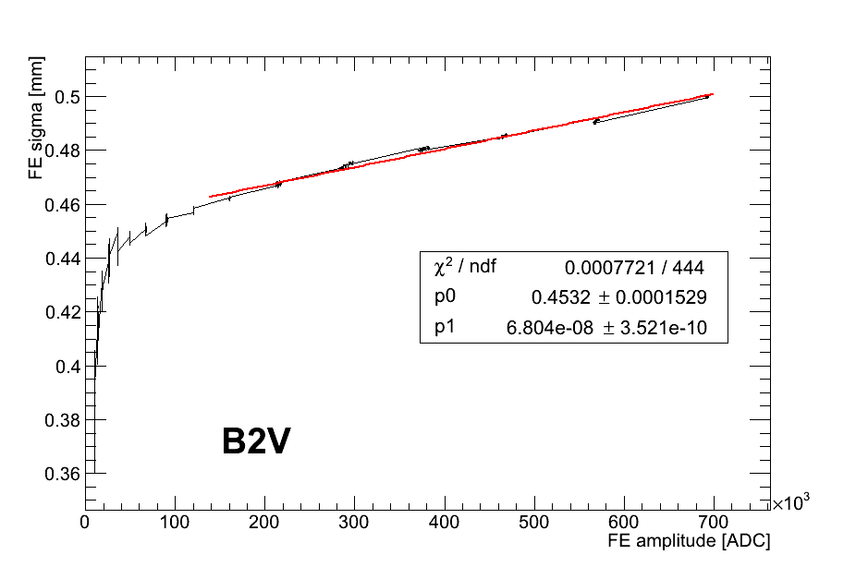
Fit and amplitude dependence
ROOT fitting library (the same as for BSRT)
there is a dependence of measured beam sigma on the signal amplitude
amplitude feedback is crucial (we do it through camera intensifier gain)
(changing HV on the MCP in the vacuum is risky)

Slide 24
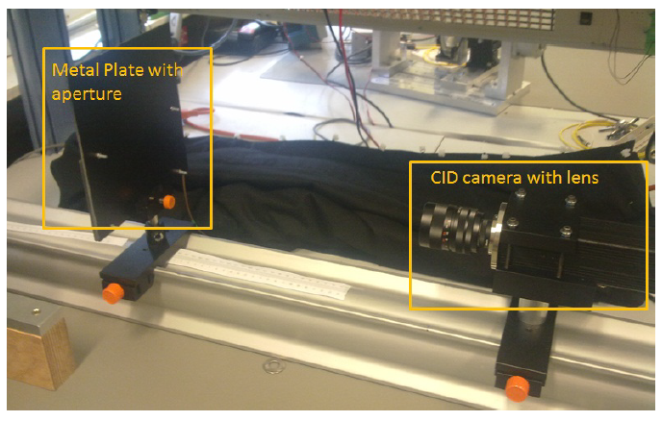
Calibration from specifications
Camera pixel size: 11.5 μm * 1.6 (taper)
Optical system magnification: 0.2
Calibration = 92 μm/pixel
Calibration in the lab
The value found:
115 ±3 μm/pixel
by Marcin

Slide 25
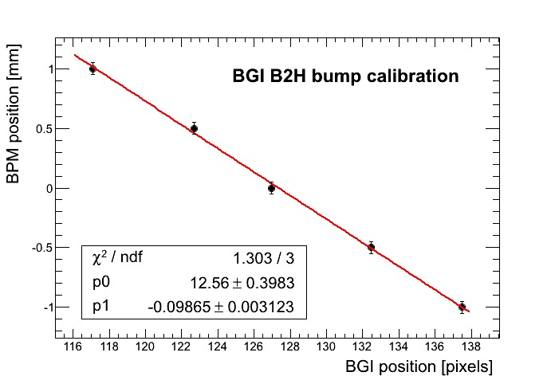
Beam-based calibration
Interpolate beam position from neighbor BPMs.
Make an orbital bump
Error on orbit position in BGI location: 100 μm (interpolation error)
BPM1 75m BGI 30m BPM2
Calibration = 95-99 μm/pixel
Installation of BPM close to
BGI is foreseen during LS1

Slide 26
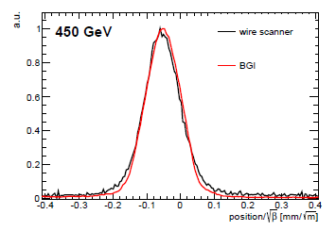
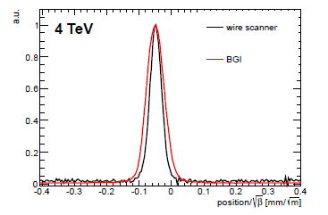

Cross-calibration (WS, BSRT)
Because of old MCPs BGI sensitivity starts where WS cannot measure
But for ions there was an overlap
BSRT uses cross-calibration with WS, so calibration with BSRT is of “second order”.
Pb82+
Pb82+
Additional broadening in BGI – point spread function?

Slide 27
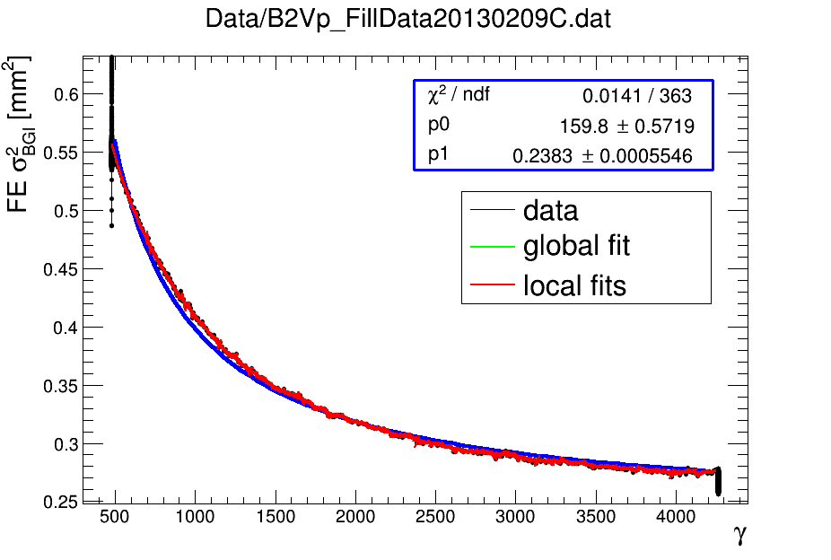
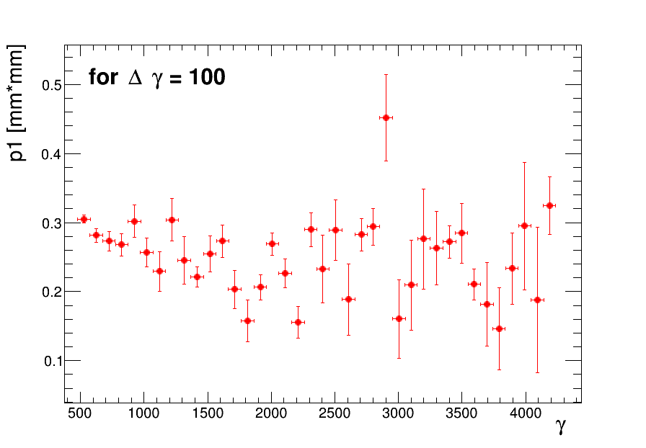
Ramp-based calibration
σ_{PSF}=√p1 = 0.5 mm
It is possible to optimize the fitting procedure, but is the quadratic correction enough to correct for all errors, especially the beam space charge?

Slide 28
Conclusions
LHC IPM deals with beams of unprecedented brightness.
System was in commissioning for the whole period. Almost not used for operation during Run 1 because of difficulties to calibrate it.
But a lot of studies were done, a lot of data collected, significant upgrades.
We suspect that there are strong physical reasons behind calibration issue.
We think that we need a stronger magnetic field.
SPS IPM was renovated but noise on video signal was too large for most beams to use it.
There are some hints on how to reduce it.
A series of upgrades during LS1 is planned but we are happy to hear your advices.

