Slide 1
Summary of experience with LHC synchrotron light monitors
9th DITANET Topical Workshop on Non-Invasive Beam Size Measurement for High Brightness Proton and Heavy Ion Accelerators
CERN – 16-Apr-2013
F.Roncarolo for the BI-BSRT team
W.Andreazza, A.Boccardi, E.Bravin, F.Caspers, A.Fisher, A.Goldblatt, J-J. Gras, A.Guerrero, M.Kuhn, L.Jensen, R.Jones, T.Lefevre, A.Nosych, G.Schneider, G.Trad, R.Veness, M.Wendt … and many others.

Slide 2
Scope and Contents
SCOPE
Give an overview of the LHC sync. Light systems (BSRT), outlining reached performances and issues.
More details and numbers in G.Trad’s presentation
CONTENTS
LHC sync. Light detector (BSRT) introduction
  Light source(s)
  Imaging system
  Image acquisition
Performances and issues
  Heating
  Calibration
  Accuracy and resolution

Slide 3
Introduction

Slide 4
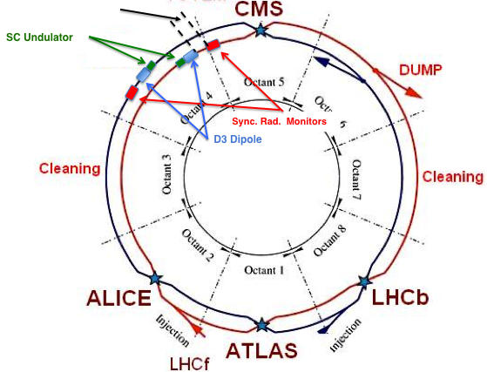
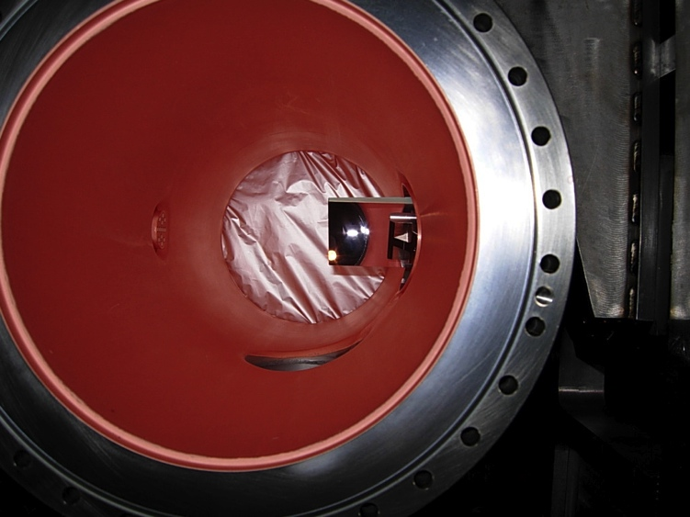
LHC BSRT
~ 30 m
Extraction mirror
Synchrotron radiation is generated by the SC undulator up to proton energies of ~ 1.5 TeV and by the D3 dipole for higher energies
View Port

Slide 5
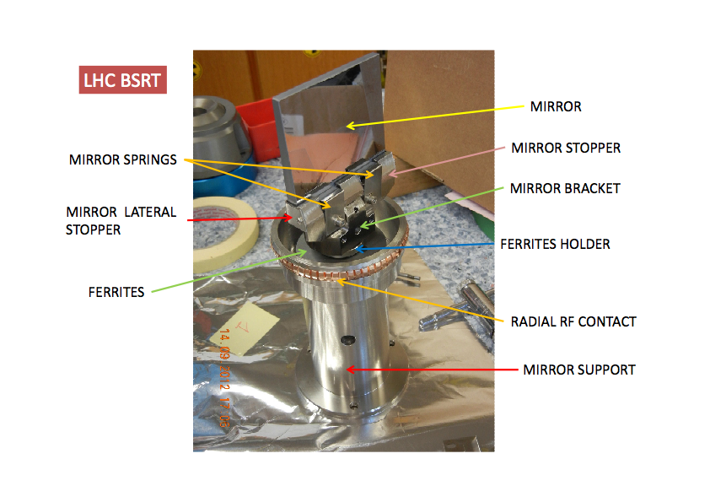
Extraction Mirror

Slide 6
Optical Telescope Layout
Light delivered (after extraction) among transverse and longitudinal diagnostics
Gated camera
(BSRTS)
Proton/Ion
beam
Optical delay line
DC Camera
60 %
Abort Gap Monitor
(AGM)
40 %
10 %
Neutral filters
90 %
Color filters
Long. Density Monitor
(LDM)
60 %
40 %

Slide 7
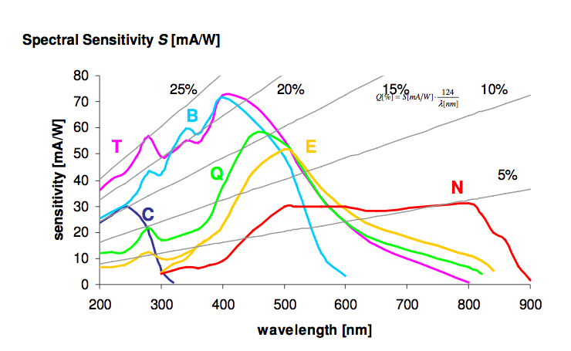
Image Acquisition
Proxitronics gated intensified (MCP) camera
  Intensifier max trigger rate : 200 Hz (~55 LHC turns)
  Intensifier min gating : 25ns (1 LHC bucket)
Present max acq. rate (including low level SW overheads)
  10 Hz → on paper 10 bunches per second, then slower to get statistics on bunches
Overall system sensitivity
  We have enough light to see
    single proton pilot bunch (5e9p) at injection (450GeV), single turn (not consecutive turns due to 200Hz trigger limit)
    ~20 Ion Pb bunches at injection, averaged over 4 turns
Photocathode response
(our cameras are equipped with N type for the moment)

Slide 8
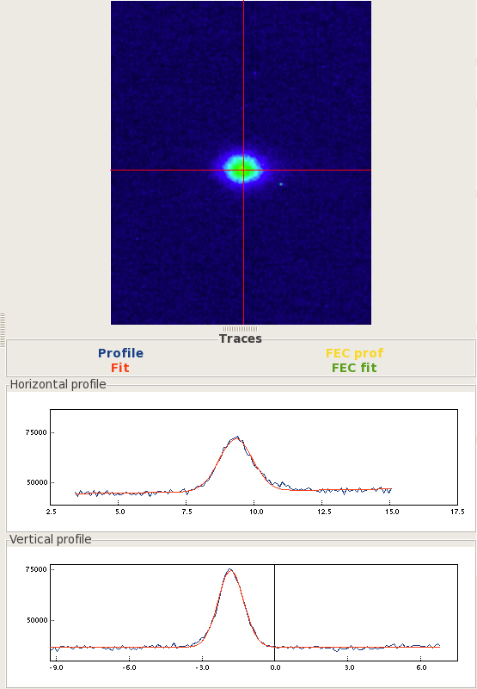
BSRTS - Proton Image Example
Single bunch ~1.1e11p @ 3.5 TeV
Accumulated over 4 turns separated of 55 turns (200 Hz trigger rate limit on image intensifier)

Slide 9
Telescope Optics
Imaging system needs to
  Propagate light in the wavelength accepted by the camera photocathode
  Adjust focusing according to the dominant source (undulator, dipole edge, dipole core)
Version 1 : 2 focusing mirrors and adjustable delay-line
  Mirrors minimize aberrations over a large wavelength range (need infrared for ions)
Version 2 (middle 2012): 2 focusing lenses and adjustable Lens1 position
  Lenses optimized in the visible
  Allow a much simpler telescope layout

Slide 10
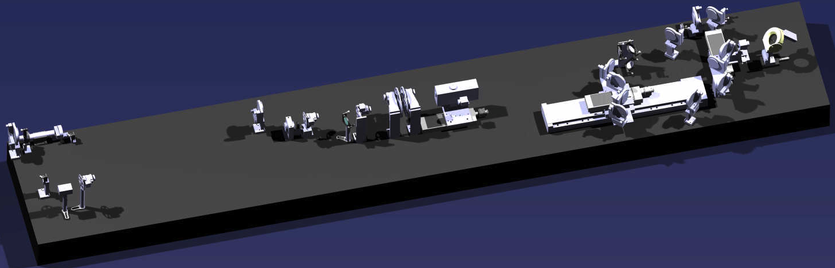
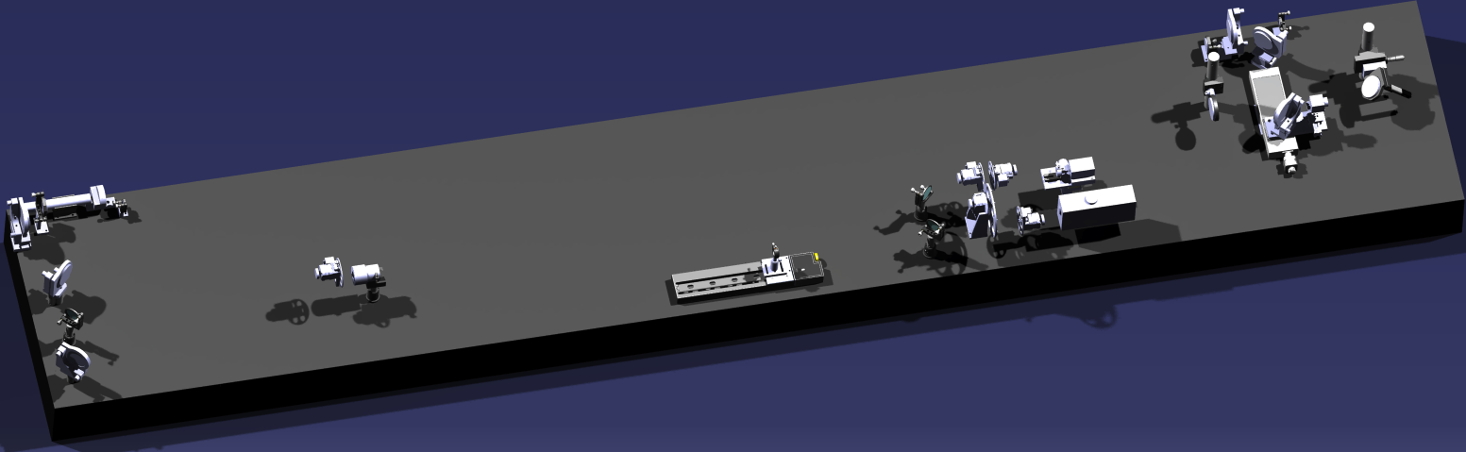
BSRT Optics
Old Optics
Mirror 1
Mirror 2
Delay Line
Entrance (steering) mirror
New Optics
Lens 1
Lens 2

Slide 11
Old Optics
Pictures showing only part of the optical path
LIGHT EXTRACTION WINDOW
FIRST MIRROR ON TELESCOPE BELOW THE BEAM PIPE
MIRRORS ON MOVABLE STAGE “Trombone”
→ VARIABLE OPTICAL PATH LENGTH

Slide 12
BSRTS -Effect of optical path length and color filter
[mm]

Slide 13
BSRT Heating

Slide 14
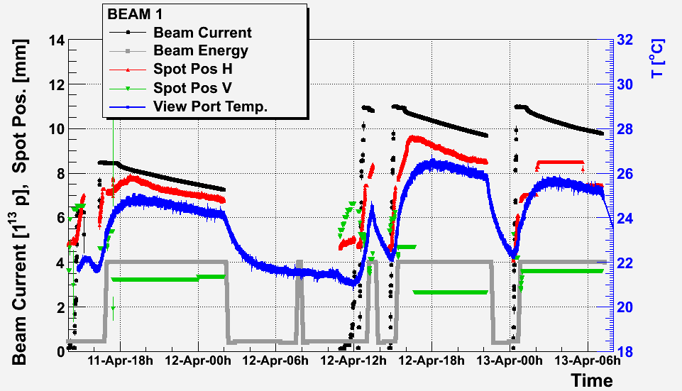
BSRT heating
From end 2011: observed hints of extraction system deformation
  beam spot @ camera displacing
  correlated to beam intensity
  not compatible with beam orbit changes
Beginning of 2012:
  spot displacement correlated to temperature outside the tank

Slide 15
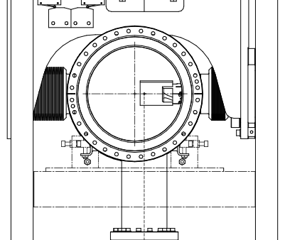
Temperature Probes (outside vacuum)
Flange 1
Flange 2
View Port 1
View Port 2
Bellow

Slide 16
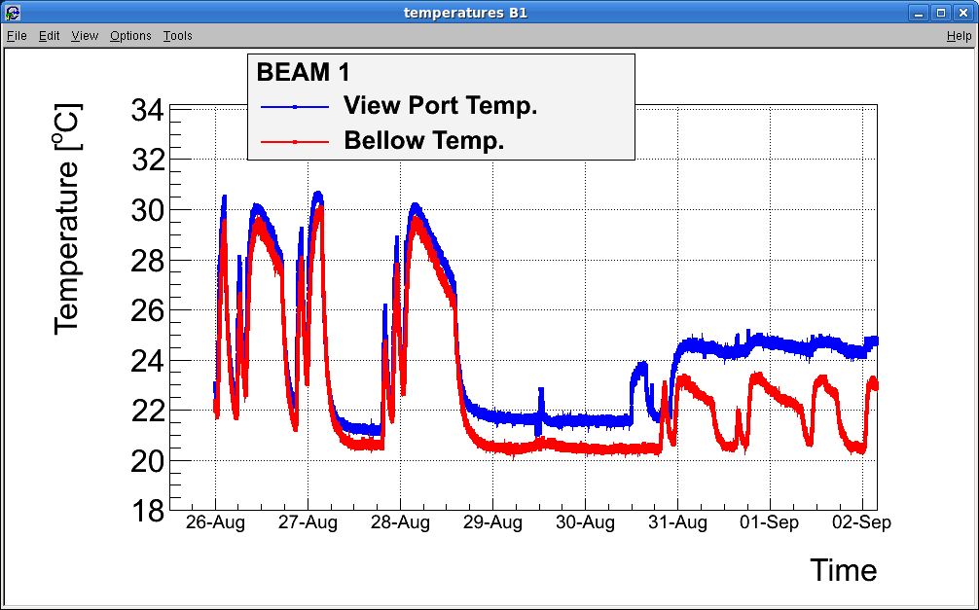
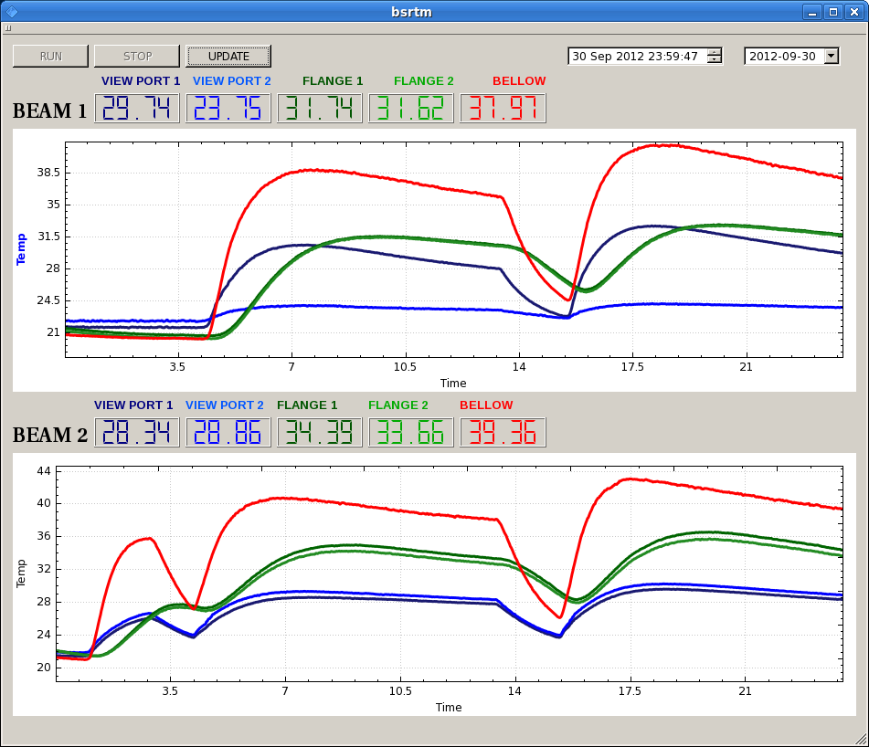
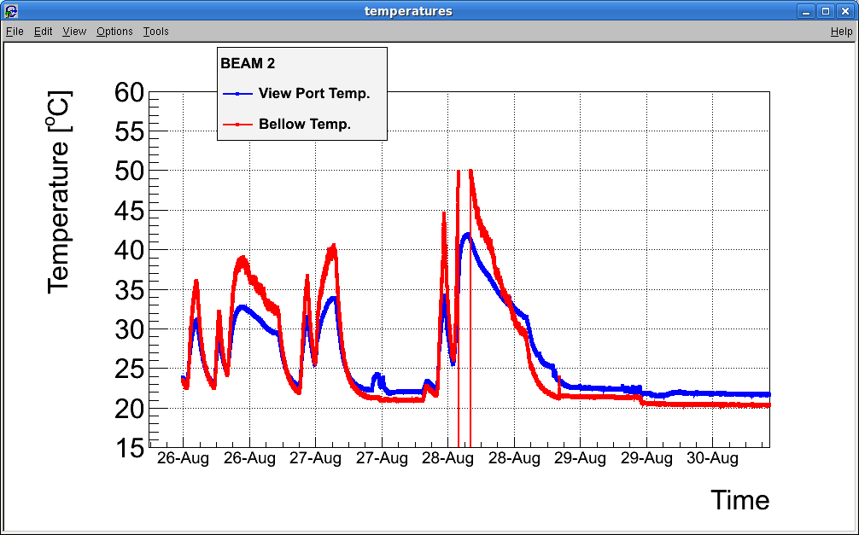
BSRT - Heating
Before TS#3 (‘bellow’ probe B1 not at same location as B2)
After TS#3
‘bellow’ probe B1 displaced to be = B2
Added 2 probes on flange
BEAM 1
1380 b
Mirror OUT
1380 b
LAMP ON
1380 b
Bellow
View Port
Flange
Mirror IN
BEAM 2
Mirror Falling
1380 b
1380 b
Bellow
1380 b
Flange
View Port
B1 heating ~= B2 heating
Bellow heats more and faster than flange (== is radiation higher than conduction?)
15

Slide 17
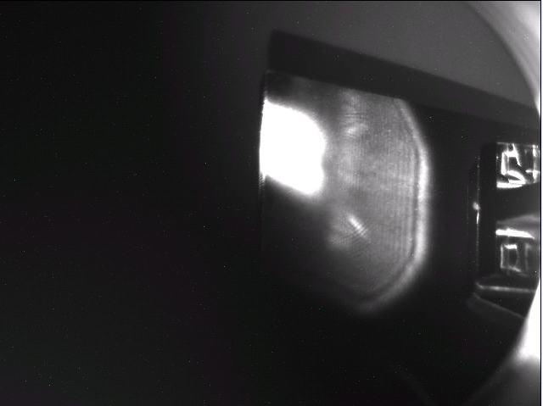
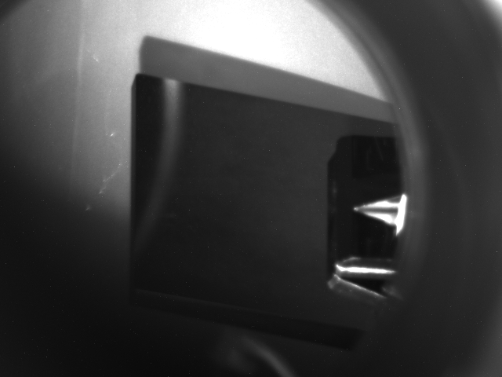
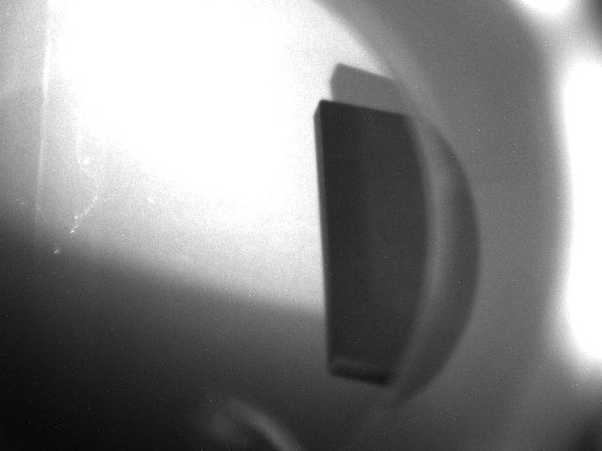
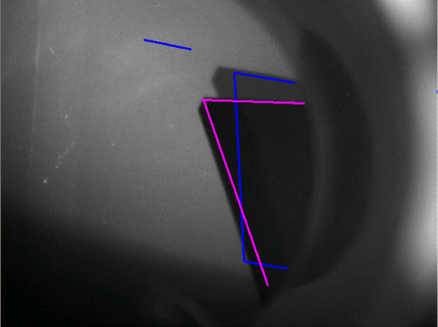
BSRT – Heating – B2 Mirror 28-Aug-2012
1- Beam (spot not in the ‘right’ place vertically)
Access to remove mirror
2- Beam dump
3- Close Vacuum sector and retract mirror to OUT
4-No beam, no motors movement, mirror moved

Slide 18
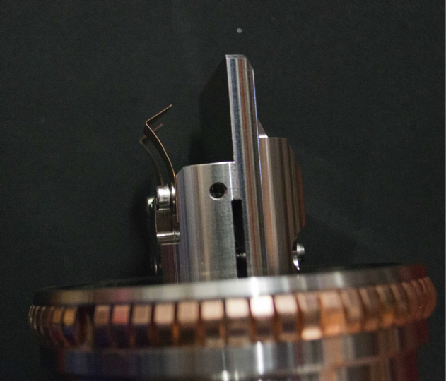
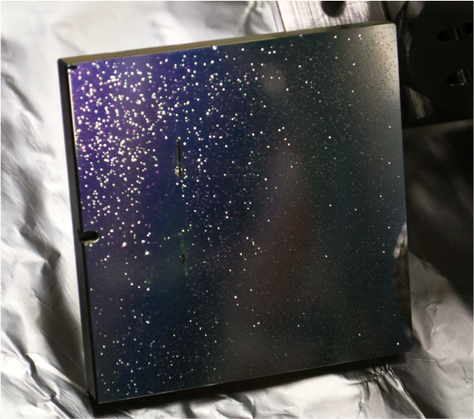
BSRT – Heating – Findings after B2 mirror removal
Mirror clamps deformed
Mirror coating blistered
Later Removal of B1 mirror evidenced similar effects
  Both mirrors were: silicon bulk + dielectric coating
TS#3: replaced both mirrors
  B1: glass bulk + metallic coating – OK only at low beam intensities
  B2: silicon bulk + polishing (no coating) – not usable for imaging

Slide 19
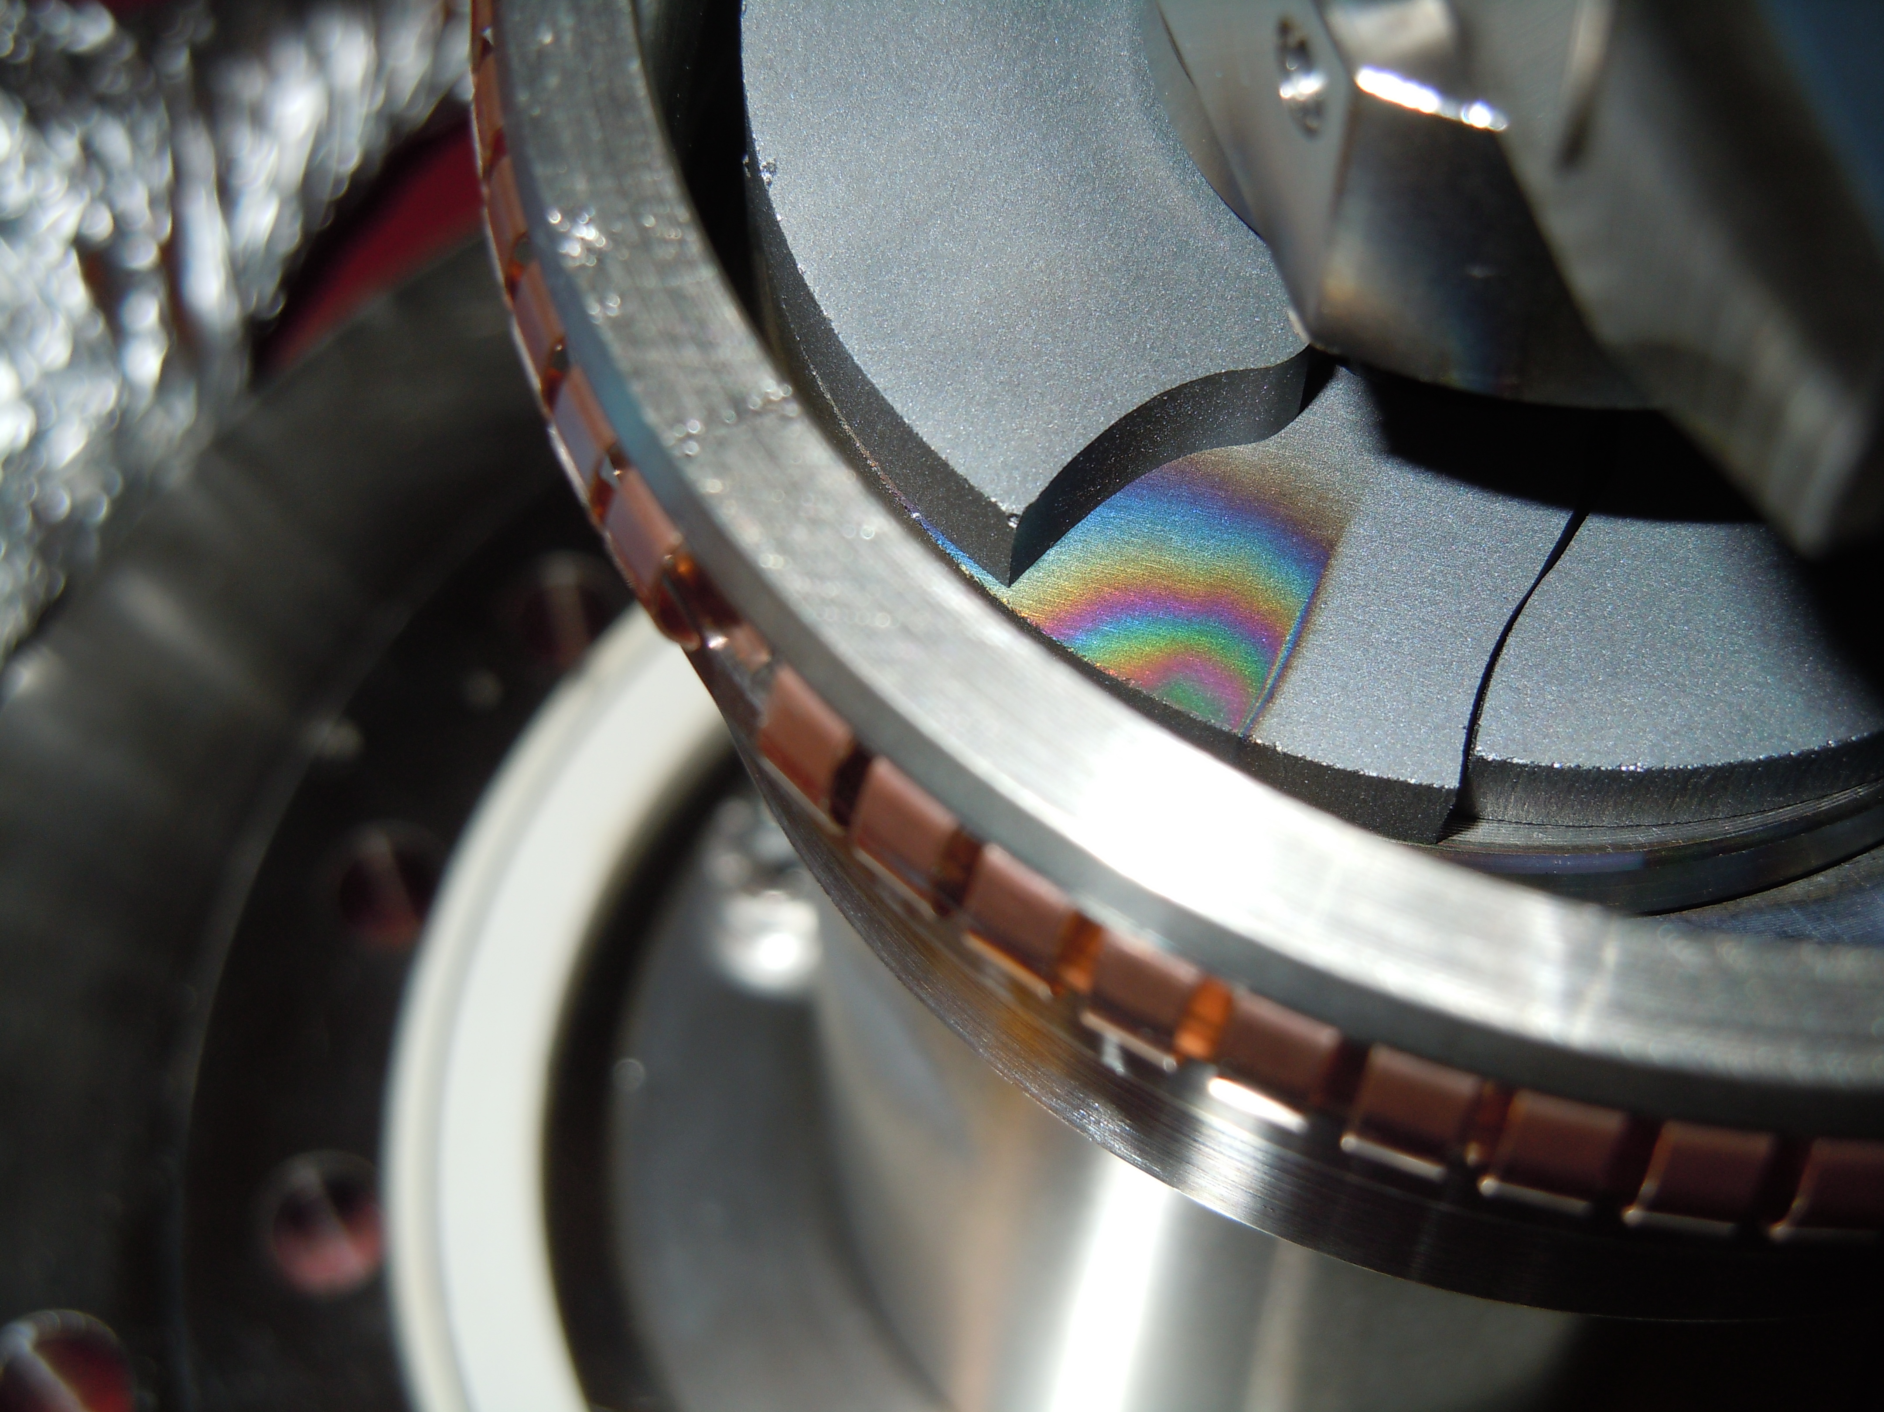
Broken Ferrite

Slide 20
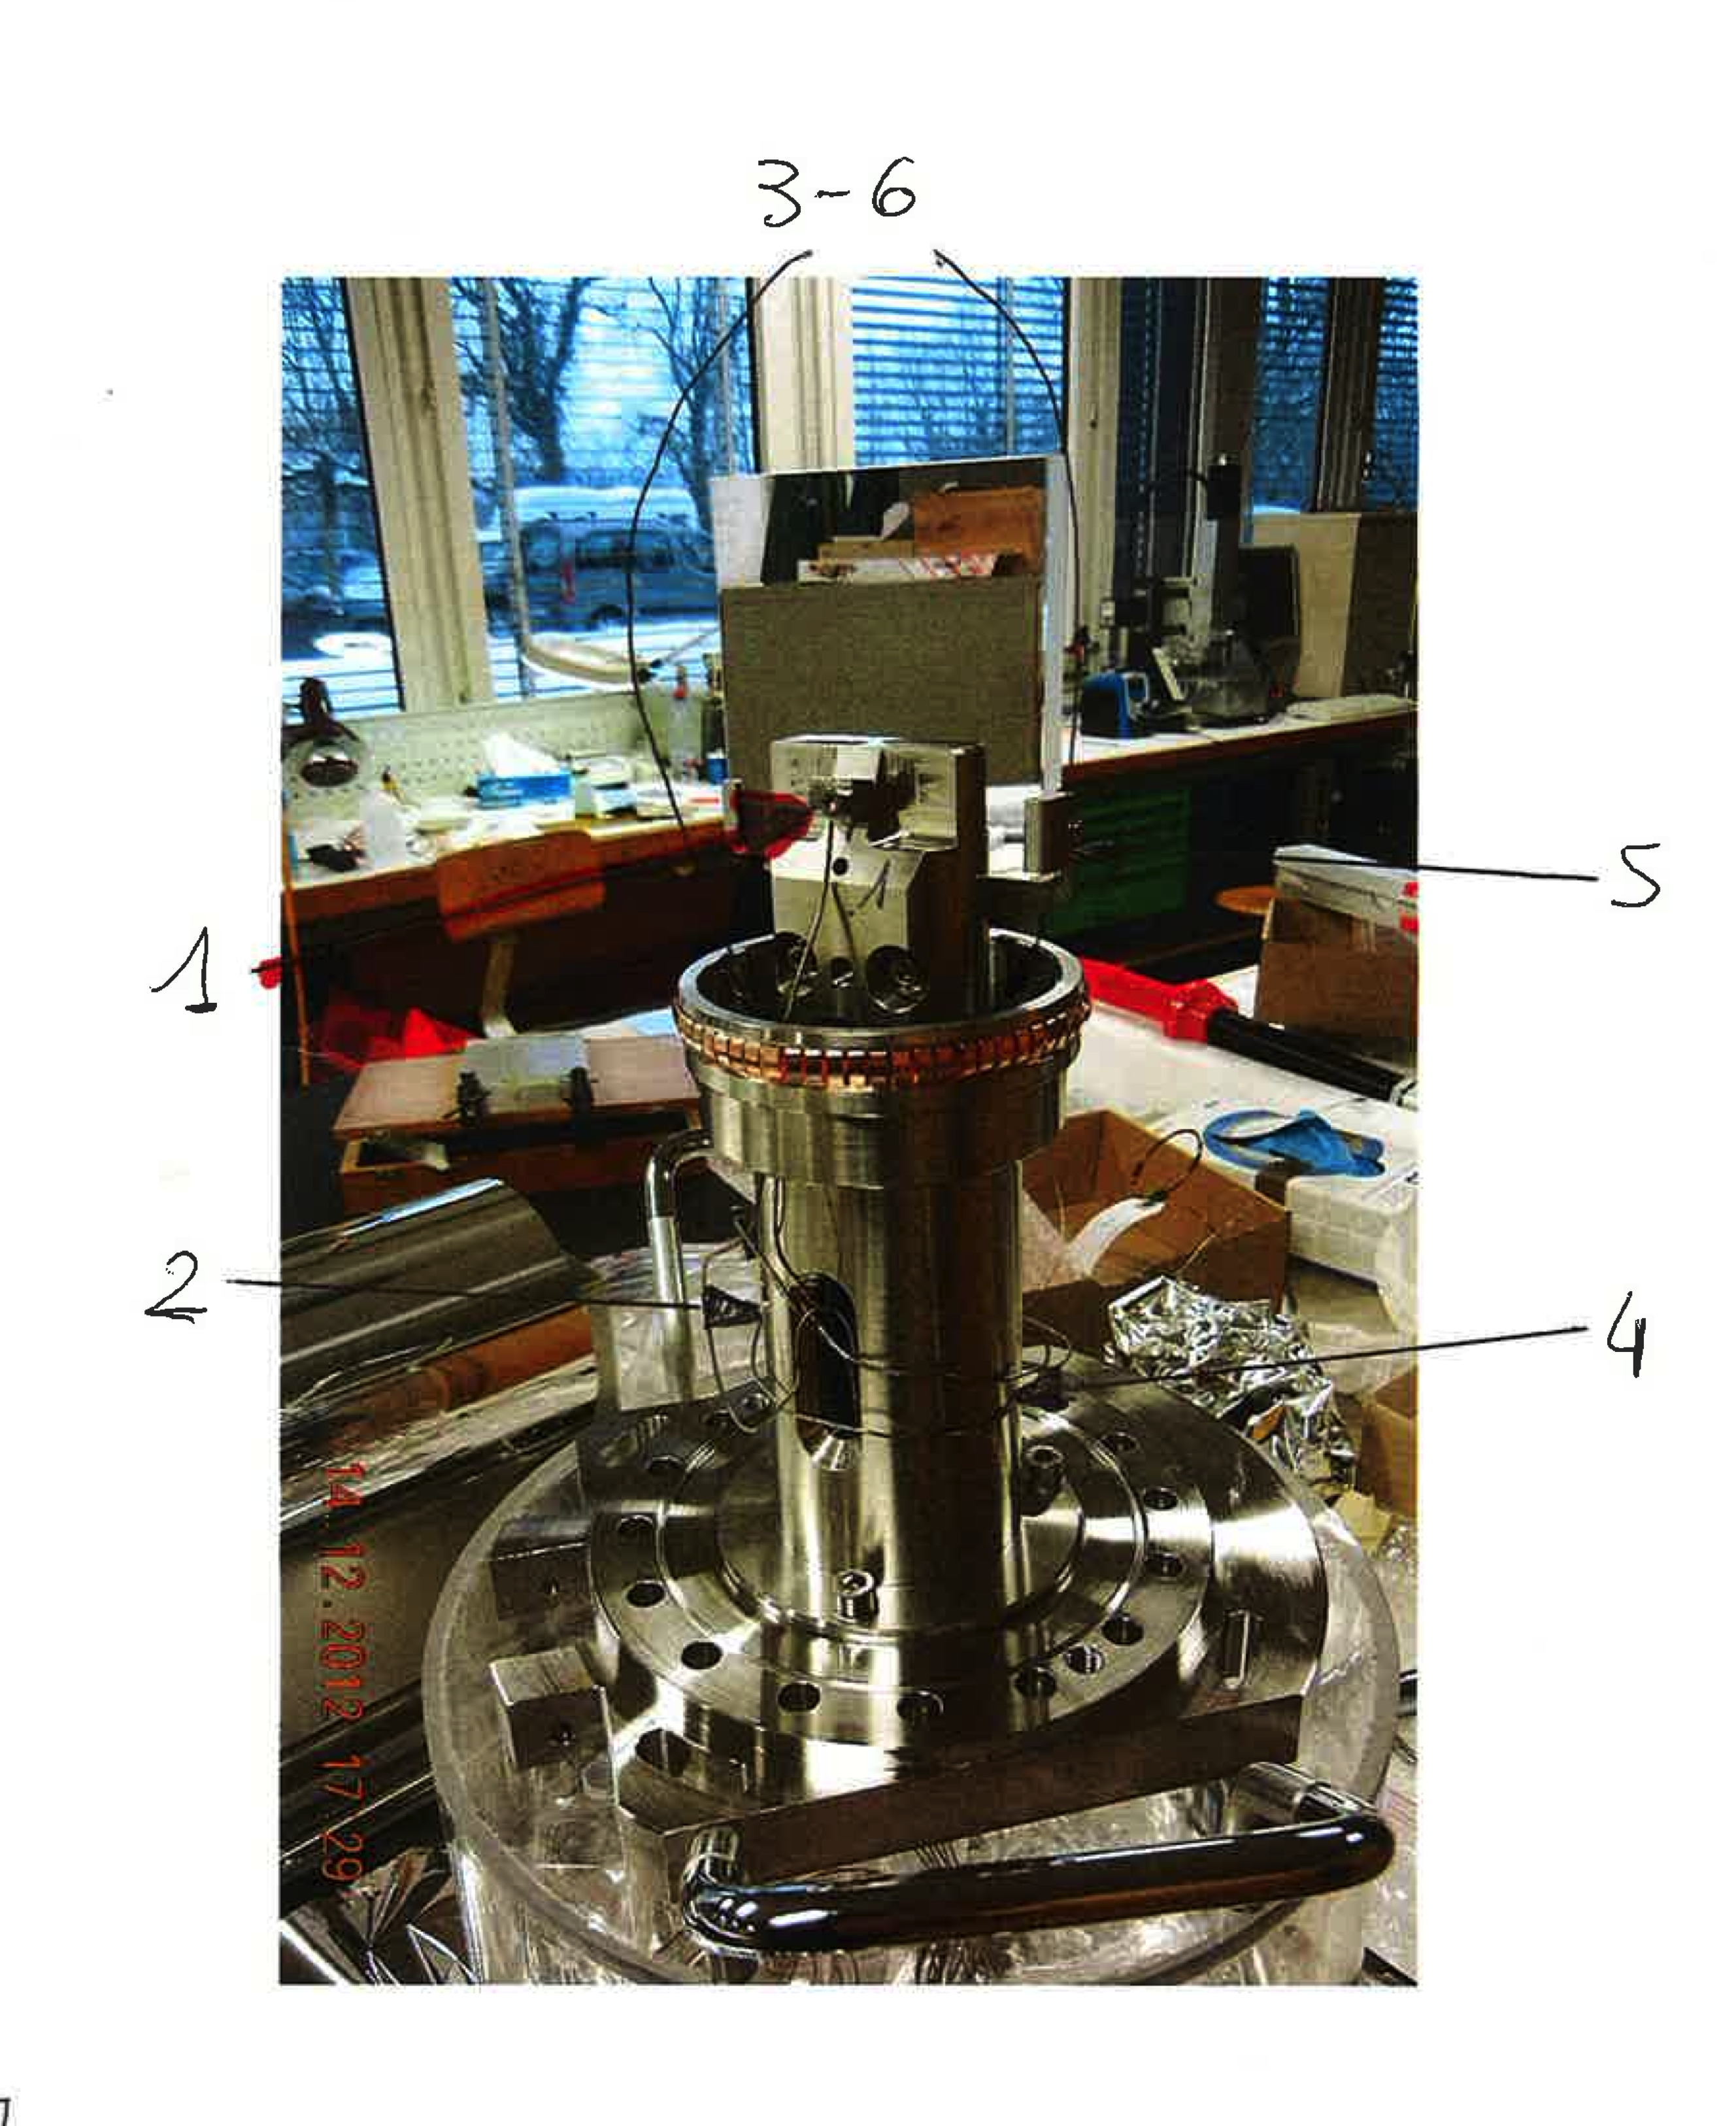
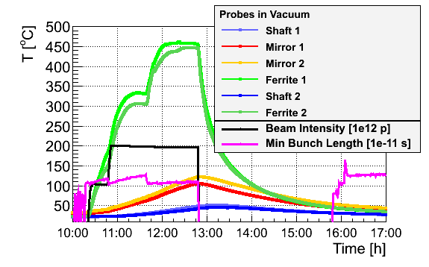
Temperatures in vacuum
Xmass 2012: installed probes in vacuum
Mirror 1
Mirror 2
Ferrite 1
Ferrite 2
Shaft 1
Shaft 2
Ferrite heating likely > Curie Temp
Clear correlation to beam intensity and bunch length
Many RF simulations and lab meas. ongoing → aim at new Tank design for after LS1

Slide 21
Mirrors
Silicon Bulk – Dielectric coated mirror: found damaged
After this, we tested different solutions (LAB + beam tests)
  A silicon bulk, uncoated mirror showed a reduced heating (as measured with temperature probes outside the BSRT tank), but resulted to be unusable for imaging, given the distorted recorded images.
  A glass bulk, metallic coated mirror resulted in a reduced heating effect at low beam intensities, but suffered coating deformation (evidenced by the beam spot image deformation) at high intensities.
  A glass bulk, dielectric coated mirror resulted in a reduced heating (w.r.t. the original silicon bulk, dielectric coated mirror) and did not show any coating deformation according to the recorded images, also at high intensity.

Slide 22
BSRT Calibration

Slide 23
BSRT - Calibration
Strategy is simple:
  Measure beam size with WS and BSRT simultaneously
  Machine development periods with large emittance difference among bunches
From WS
σ_{m} [pixels] = Measured Sigma
M [mm/pixels] = System magnification (optical line + pixel size)
  determined by optical line adjustment with energy (UND → D3)
  reference target vs closed orbit bumps give up to 10% differences
σ_{psf} [pixels] = measurement error due to
  aberration, diffraction
  extraction mirror aging/deformation
During 2012 heavily affected by extraction mirror heating (deformation + coating damages)
Difficult to find a stable calibration w.r.t. WS
Normally assuming
BSRT magnification
BEAM optics from WS to BSRT
as known
See G.Trad presentation

Slide 24
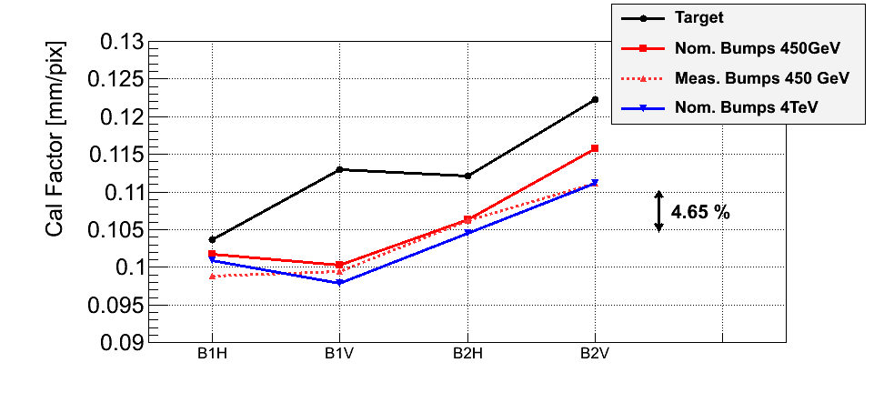
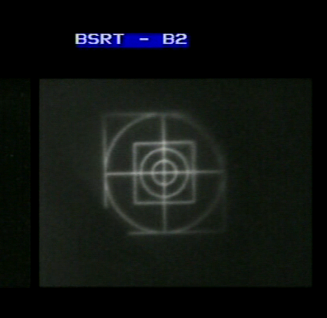
LHC Beams – BSRT magnification
Need to measure beams as small as 300um (150-200um at 7 TeV)
Optical magnification ~0.3 (Simulation, Zemax)
Old Optics : ~0.11 mm/pix
New Optics: ~0.05 mm/pix (2 pixels per sigma criterion respected)
Magnification measurements done with calibration target and beam orbit bumps
Calibration target @ same distance as undulator
Conclusion (if we believe target): we can’t say we know magnification better than 10%
(again: error on beam optics == error on target)

Slide 25
BSRT – WS calibration example (2011)
Bunches with different emittances from the SPS

Slide 26
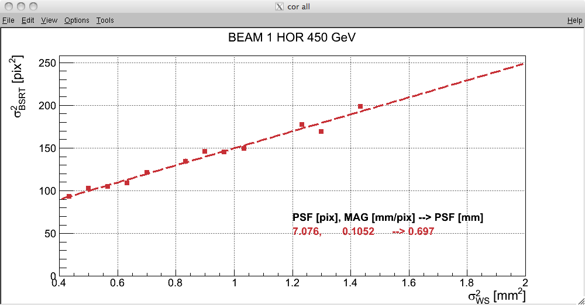
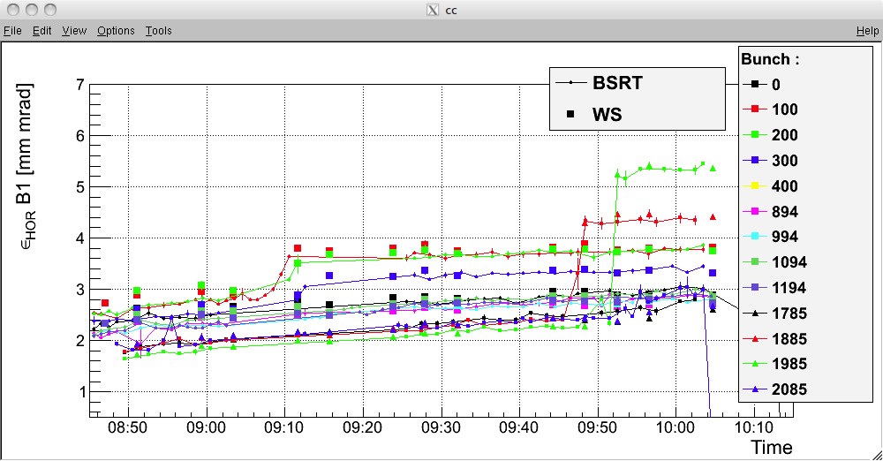
BSRT – WS calibration Example (2012)
MAY 2012 – 450GeV
Injected 12 bunches per beam with emittance as small as possible
Use ADT to blow-up single bunches
Different ADT strength, excitation time on different bunches
→ circulating bunches with emittance spread in the 1.5 – 5 um range
Measure with WS and BSRT
Calculate BSRT magnification and point spread function to match WS
Calibration BSRT - WS
Emittances after calibration

Slide 27
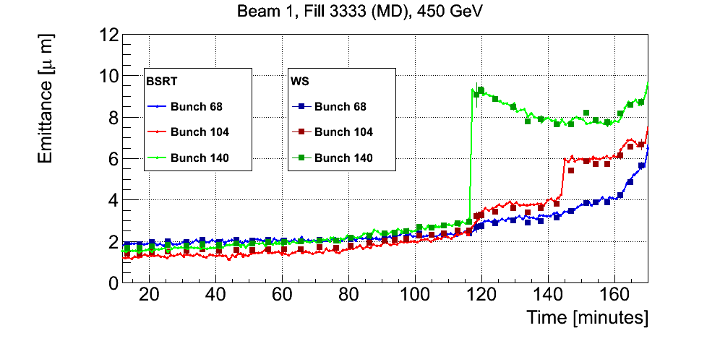
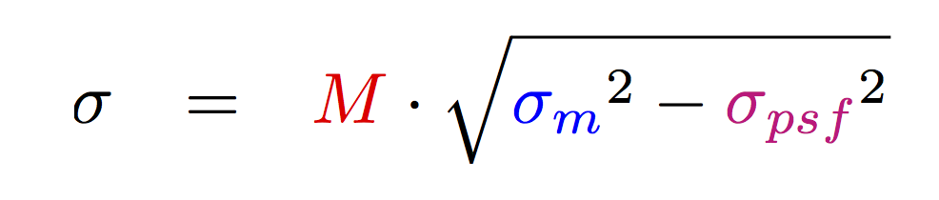
BSRT – Calibration Example (2012, new optics)
B1 with new optical line (focusing lenses instead of mirrors), 450 GeV during MD period
Excellent agreement BSRT – WS over a wide emittance range, after applying
  Magnification within 10% w.r.t. nominal
  PSF ~20% smaller than typical values with old optics
B1 Vertical
Scraping
Similar examples exist at 4 TeV
More numbers on corr. factors in G.Trad’s presentation
1 mm
1.3 mm
0.8 mm

Slide 28
BSRT calibration - Outlook
Combining
  magnification estimate from target and bumps
  Cross-calibration w.r.t. WS
  We managed to find calibration factors providing excellent agreement w.r.t. WS, over a wide emittance range
BUT:
  Calibration is not stable
    Surely depending on extraction mirror ageing
    Dependence on light traversing the optics off-axis?
      Hope to improve stability with new optics (less folding mirrors, didn’t have enough statistics with new optics yet)
  Correction in quadrature (psf form aberration, diffraction etc) higher than expected from theory

Slide 29
Issues Snapshot
Problems encountered
Improvements – Upgrades during 2012
Electro-magnetic coupling - heating
  Mirror support failures, coating blistering → needed to replace both mirrors after August
New mirrors
From Si to Fused Silica bulk – reduced EM coupling
Absolute calibration
  Drifting due to mirror coating damages
  Noisy due to numerous folding mirrors (?)
  → Image blurring
New optics
Simplified imaging system – lower PSF corrections
New FESA server
Improved reliability
Fast bunch per bunch scans (~10Hz)
Overall reliability
auto-steering, auto-gain

Slide 30
BSRT useful data examples for LHC operation

Slide 31
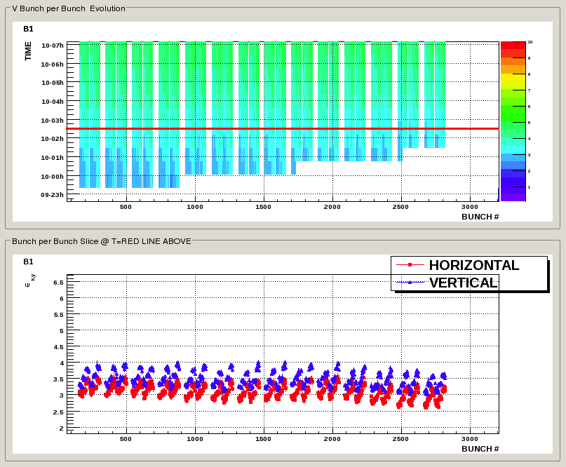
Bunch per bunch from BSRT
Bunch per bunch emittance vs time
Allowed diagnosing systematic emittance pattern from injectors (PSB rings)
Bunch per bunch emittance @ given time

Slide 32
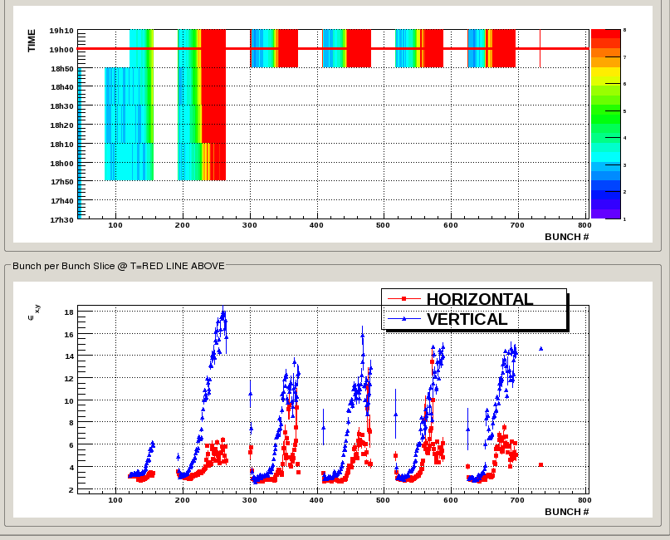
Bunch per bunch from BSRT
During 25ns bunch spacing scrubbing run:
E-cloud makes bunches in the second part of each train to blow-up

Slide 33
Outlook
Upgrades for LS1
  New light extraction system to cope with RF coupling
    Option 1: Ceramic holder + support
    Option 2: Longer mirror through a slit (metallic parts “hidden”)
  Optics compatible with higher energy / higher diffraction contribution
Further (not decided, not scheduled) upgrades
  We have a good optical calibration system: long (multi folding mirrors) line on the optical table) for alignment but not for imaging a target
    Should we envisage a target system in vacuum?
  New (digital) intensified cameras?
  Thank you for the attention and ….
  Ideas are very welcome !! ;-)

Slide 34
SPARES

Slide 35
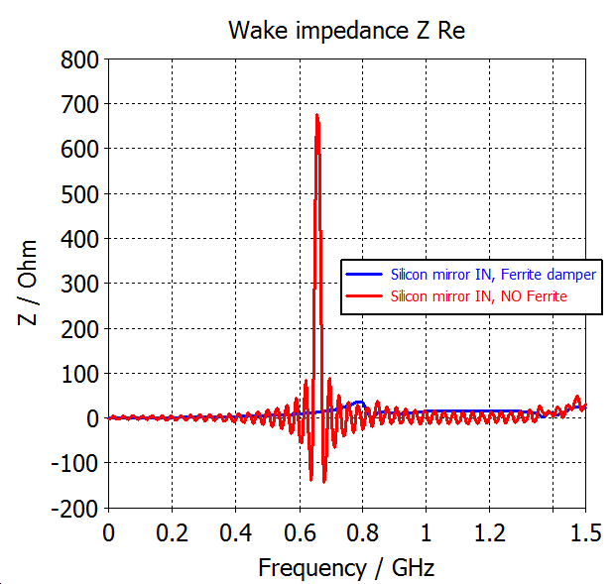
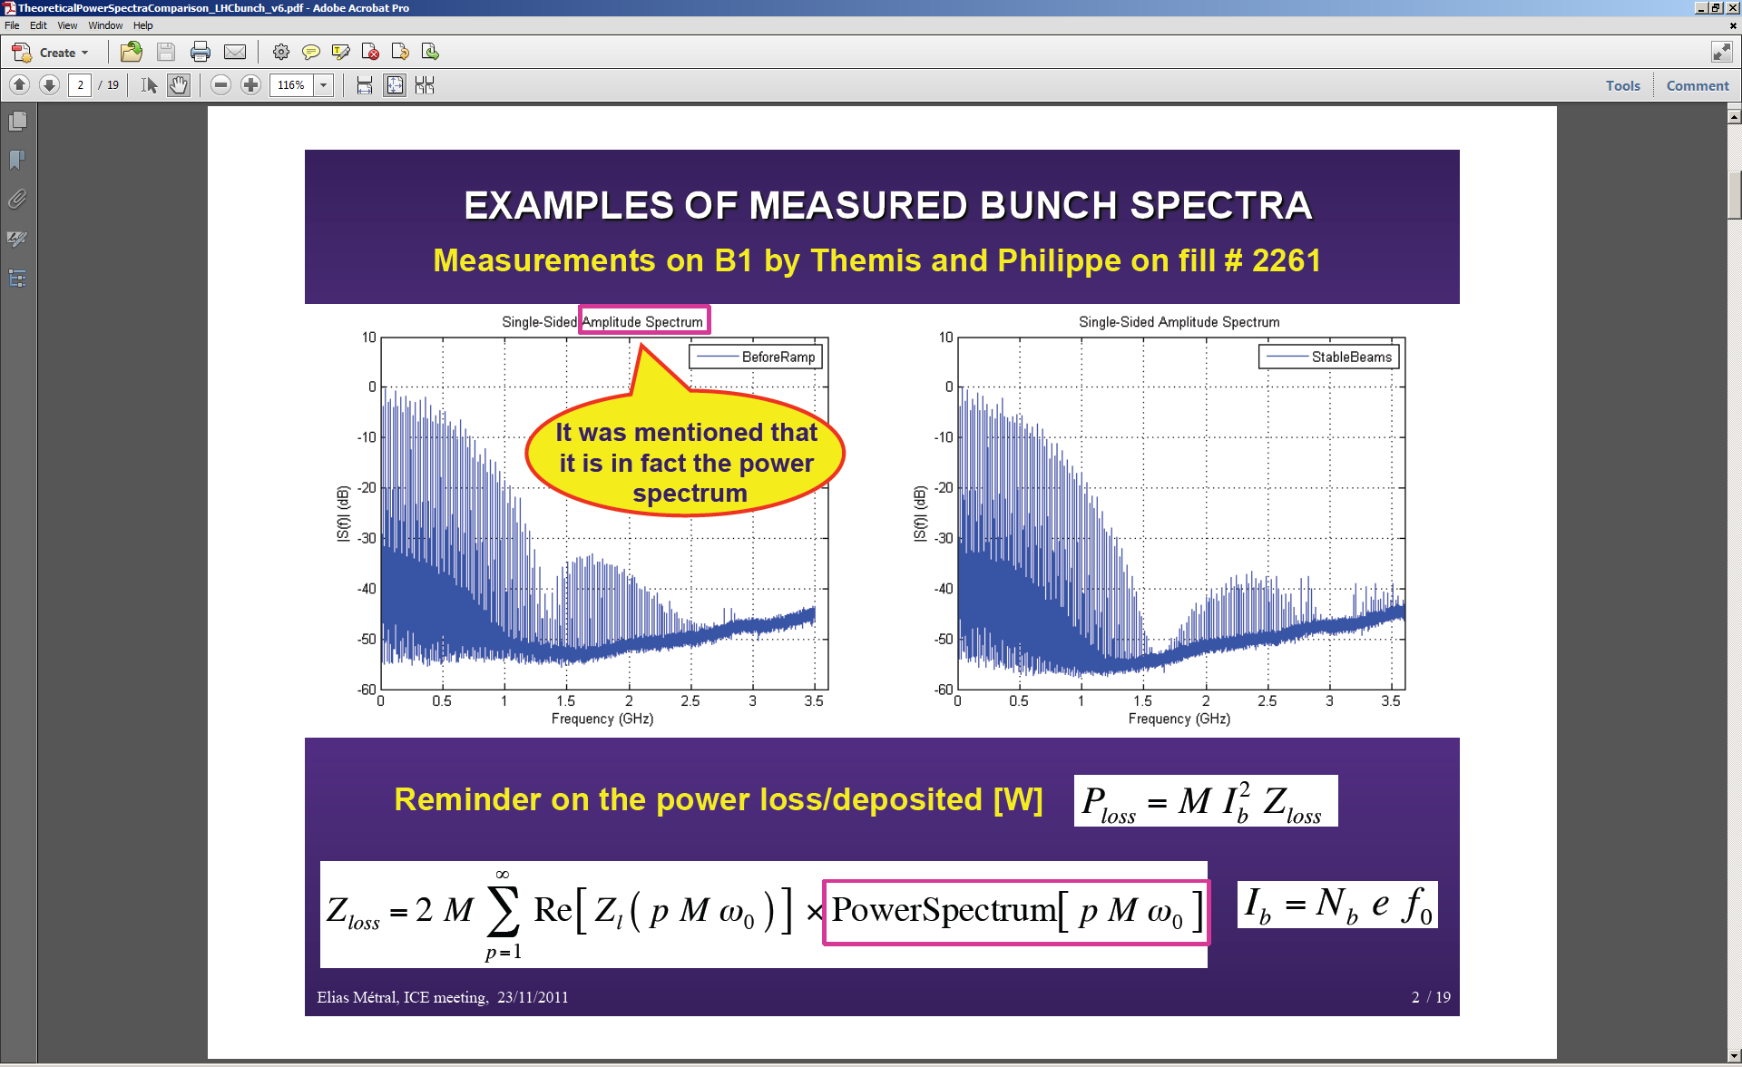
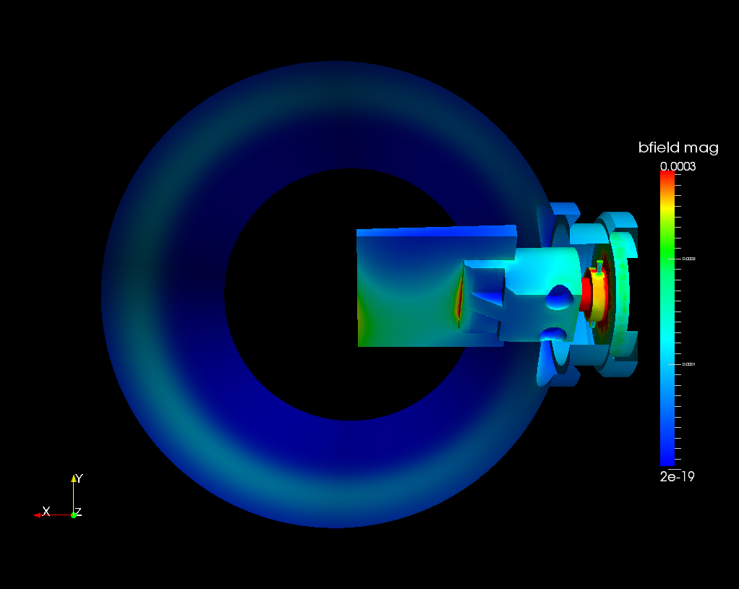
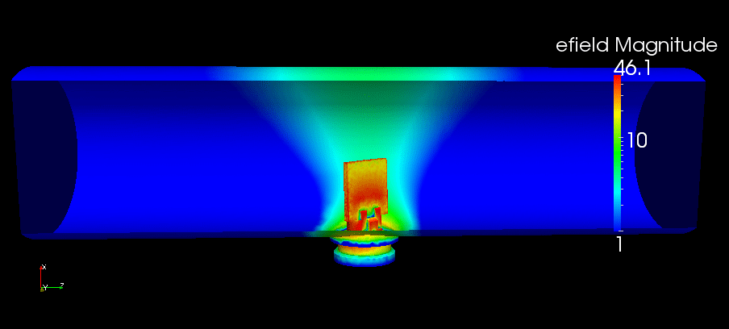
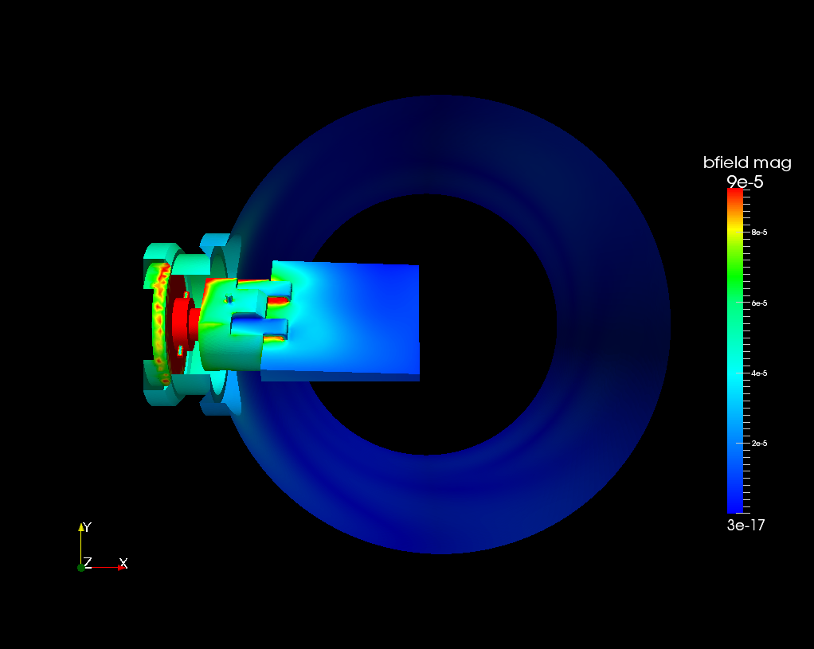
BSRT – RF simulations
LHC bunch power spectrum
F = 650 MHz
P_loss = 10-50W
From January:
RF laboratory measurements on spare tank
Credits: T.Mastoridis,
P.Baudrenghien/CERN
Longit. wake impedance of BSRT
with and without Ferrite damping
Measured LHC bunch power spectrum. A 650 MHz resonance is very dangerous.
Mirror front
Mirror Back
B-filed of the beam in Time Domain.
Red = Hot (bigger current density)
Blue = Cold
E-field of a dominant resonating mode at 650 MHz.
(Q = 1263 / Rsh = 25841 Ohm)

Slide 36
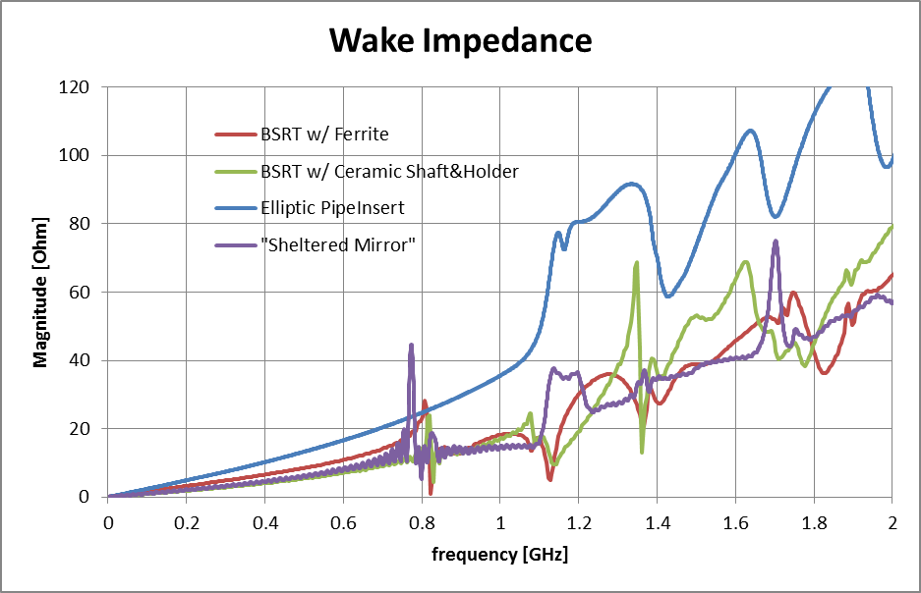
Long. Wake Impedance (magnitude)
BSRT w/o Ferrite not shown!
M.Wendt, A.Nosych

Slide 37
Calibration with target

Slide 38
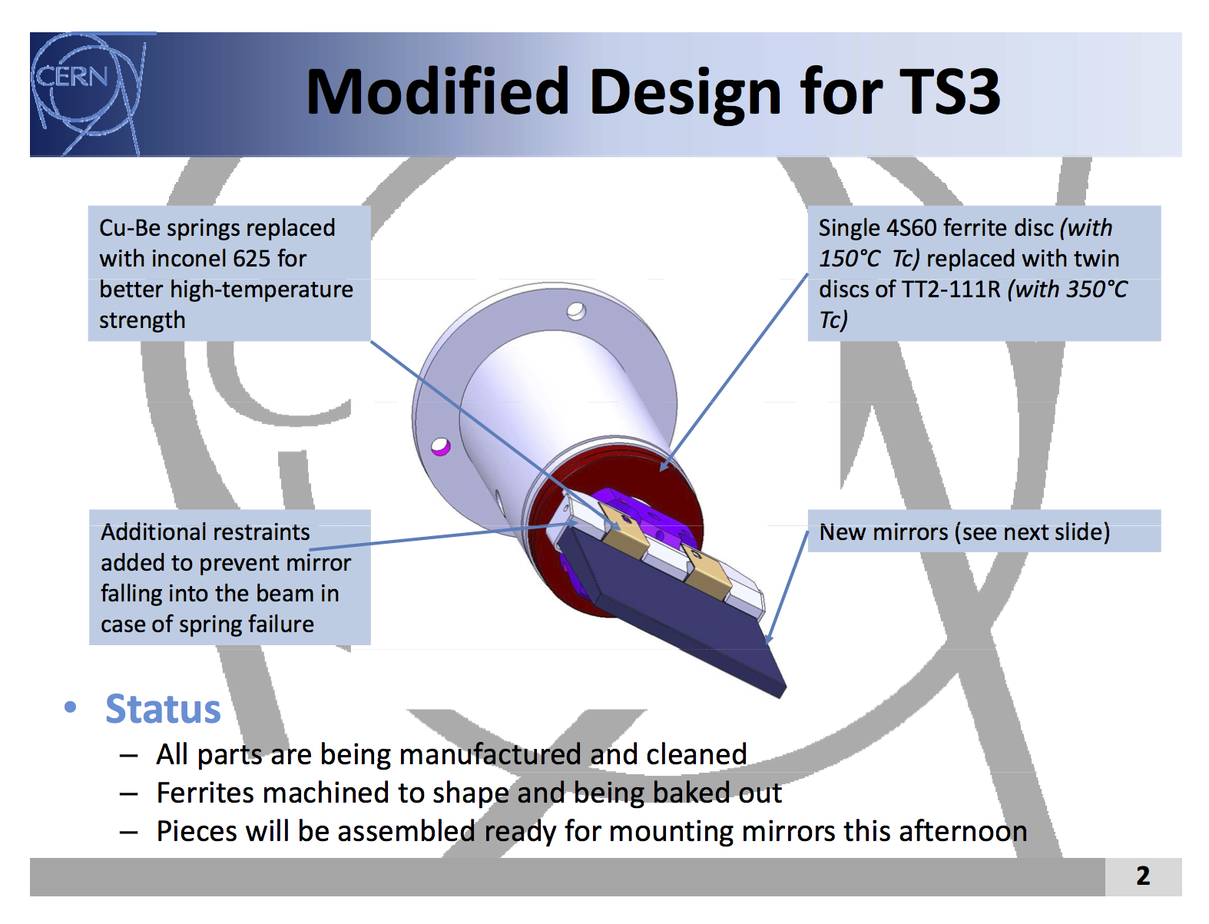

Slide 39
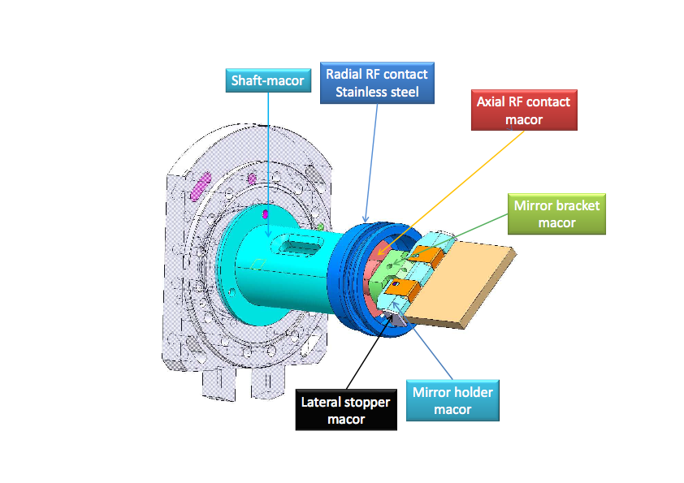
MACOR version

Slide 40
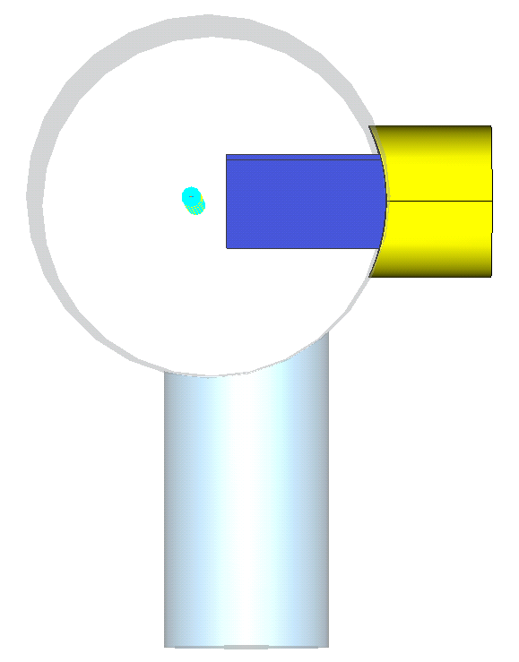
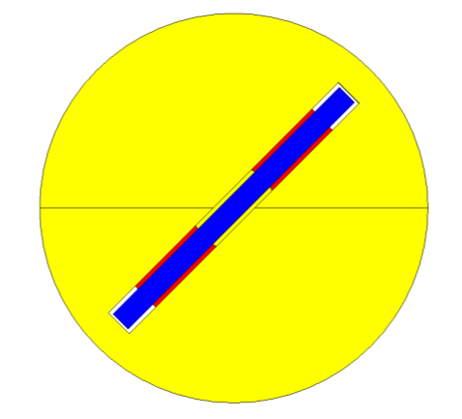

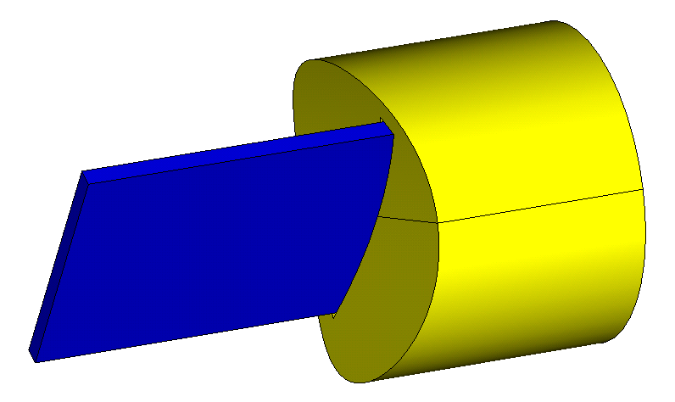
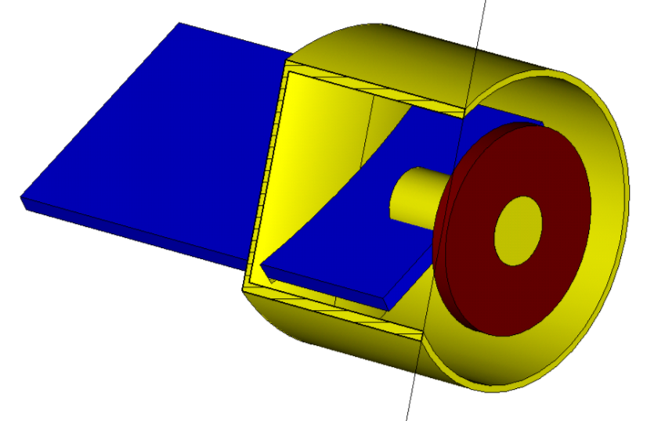
Introducing: elongated Fused Silica mirror in an obstacle-free copper holder with a slit.
Slit is 1 mm wider than the mirror in each direction (so the mirror can be adjusted)
Ferrite TT2 ring to damp any field entering through the slit. However no visible effect in simulations.

Slide 41
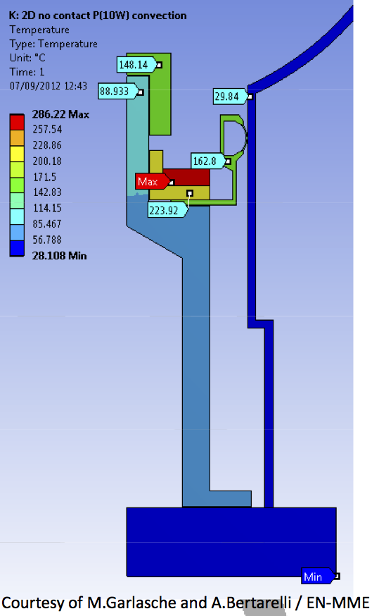

Slide 43
AGM and BSRT - Simulated vs Measured light intensity
⎯ BSRTS HOR.
- - Simulation p+
⎯ BSRTS VER.
⎯ Measured AGM p+
- - Simulation Pb Ions
Intensity per charge (equiv. AGM counts at 3200V
Intensity per charge (equiv. AGM counts at 3200V
- - AGM
LEAD IONS, Abort Gap Monitor (AGM) and BSRTS
Visible Photons per Charge
Visible Photons per Charge
- - Simulation Pb ions
⎯ Measured AGM Pb Ions
Abort Gap Monitor (AGM)
Beam Energy [GeV]
Beam Energy [GeV]
At least a factor 1e4 difference between protons and ions at injection energy
Nevertheless: we managed to see light at injection with ions

Slide 44
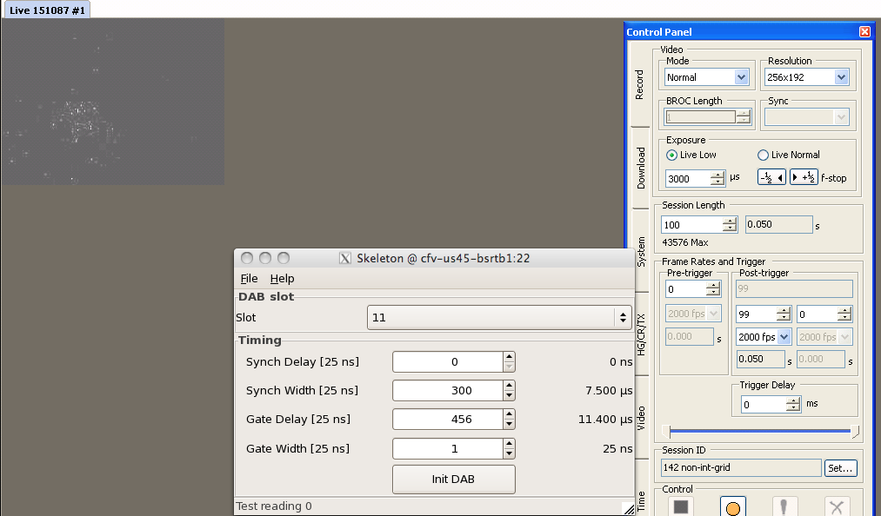
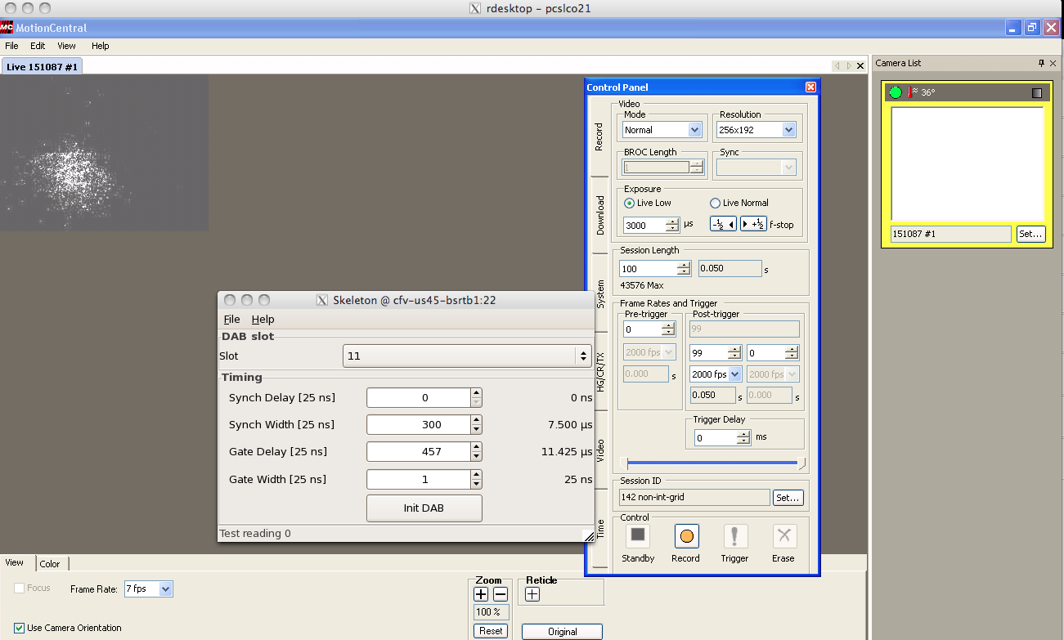

Fast Camera Tests
Single Nominal bunch 450 GeV
Mode Normal
Gain 4.99V
Exposure 3ms
Gate size 25ns
Scan of 3 consecutive 25ns slots
Prove that gating can be done

Slide 45
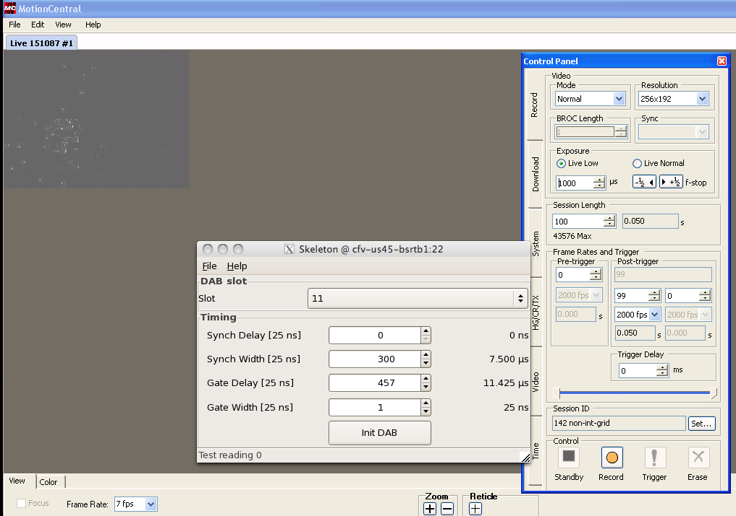
Fast Camera Tests
Exposure
Exposure 3ms
Single Nominal bunch 450 GeV
Mode Normal
Gain 4.99V
Gate size 25ns
Need to integrate > 10 turns to measure a single bunch
Camera and gating control via FESA not fully proved
Exposure 1ms

