Slide 1

Specification for CERN-PS IPM
Mariusz Sapinski, CERN BE/BI
(after discussion with Simone Gilardoni)
CERN, 2013.04.16

Slide 2
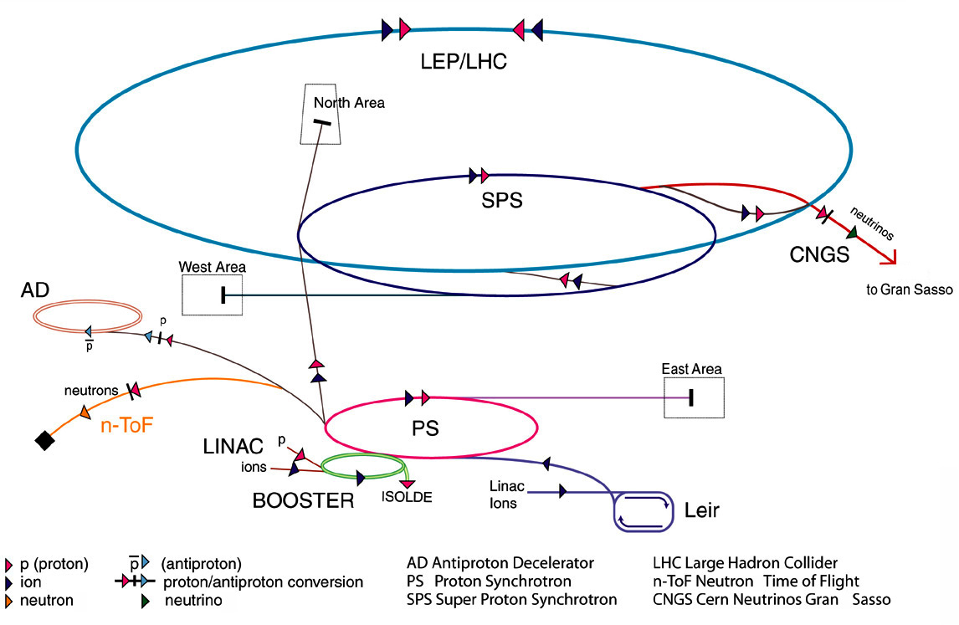
PS in CERN accelerator system

Slide 3
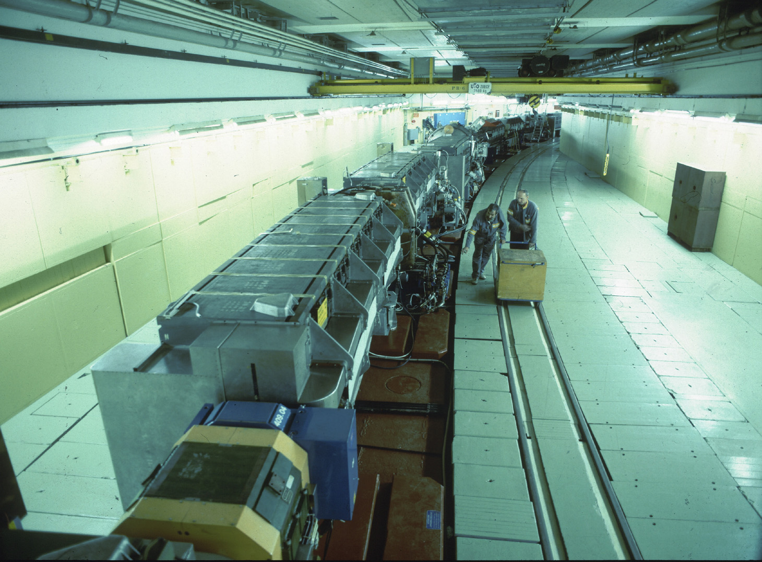
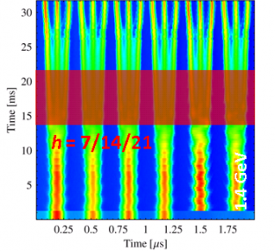
CERN PS
Constructed: 1959
Circumference: 628 m
Injection: 1.4 -2.0 GeV
Extraction: 14-26 GeV
Cycle length: 1.2-2.4 s
Revolution period: 2.1μs
bunch splitting:

Slide 4

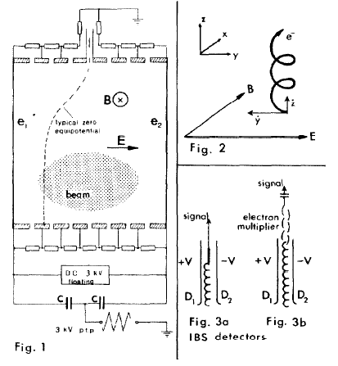
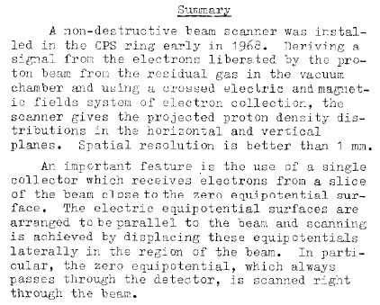

CPS IPM A.D. 1968
PAC 1969
Argonne, 1967

Slide 5
PS beams – examples from LIU
beam | SPS ftarget | TOF | EASTA | LHC 25 ns 72 bunches
Injection
Ek [GeV] | 2.0 | 2.0 | 2.0 | 2.0/1.4
Bunch nrb | 8 | 1 | 1 | 6
Charges/b | 3.1E12 | 8E12 | 4E11 | 1.5E12
Bunch len [ns] | 150 | 190 | 170 | 180
εH/V [μm rad] | 7.6/5.4 | 9.2/7.8 | 1.5/1.5 | 1.5
Extraction
Ek [GeV] | 14 | 20 | 24 | 26
Bunch nbr | 420 (deb) | 1 | 1 | 72
Charges/b | ~5E10 | 8E12 | 3.8E11 | 1.25E11
Bunch len [ns] | 5 | 50 | debunched | 4
εH/V [μm rad] | 11/8 | 12/10 | - | 1.5
EDMS 1157752, document in work

Slide 6
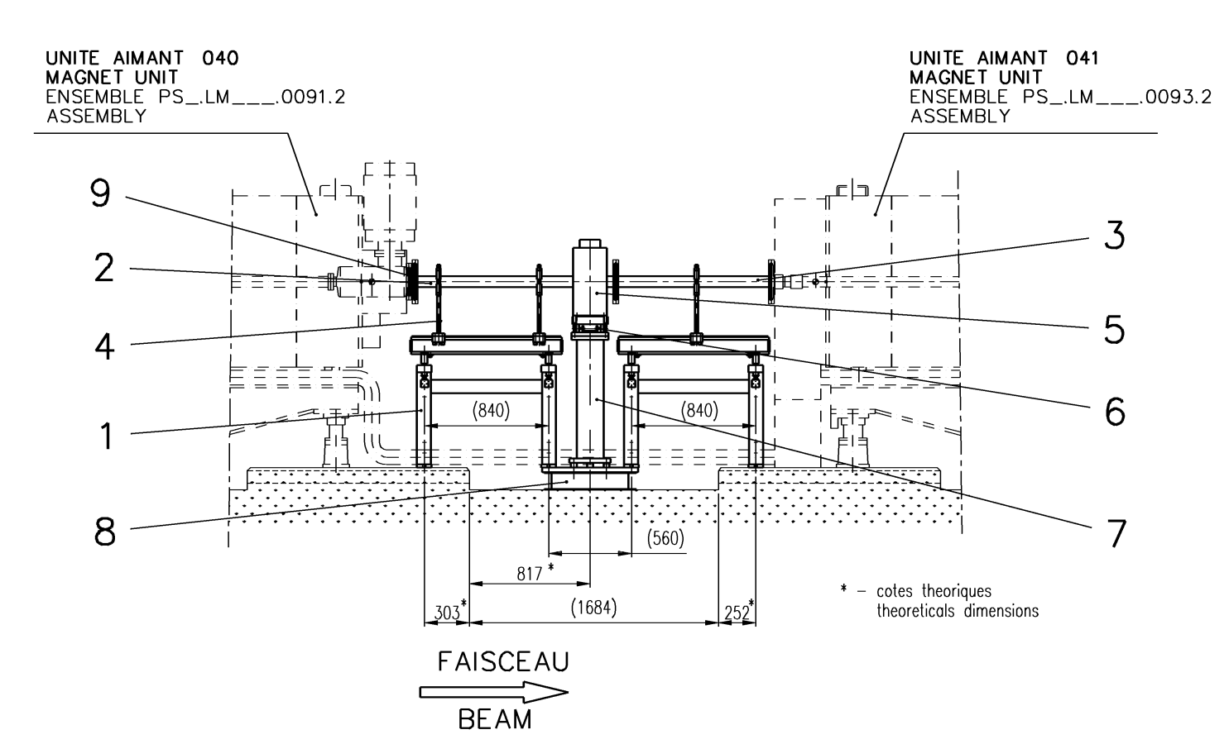
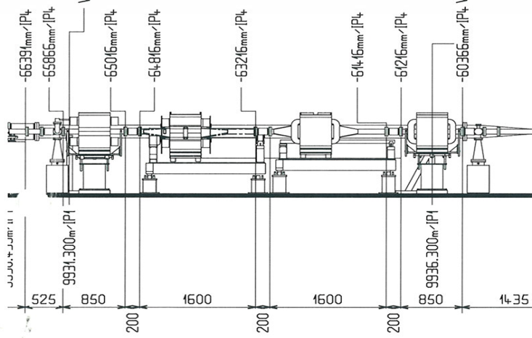
Location (1)
The largest available space:
SS41 near injection
region (radiation!)
β_{H}=22 m
β_{V}=12 m
Beam size =
0.8-8.5 mm
<2m
5.5m

Slide 7
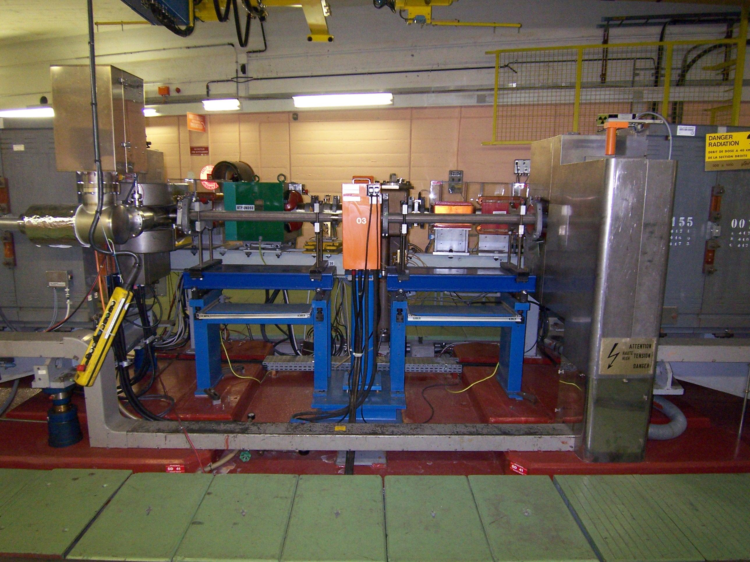
Location (2)

Slide 8
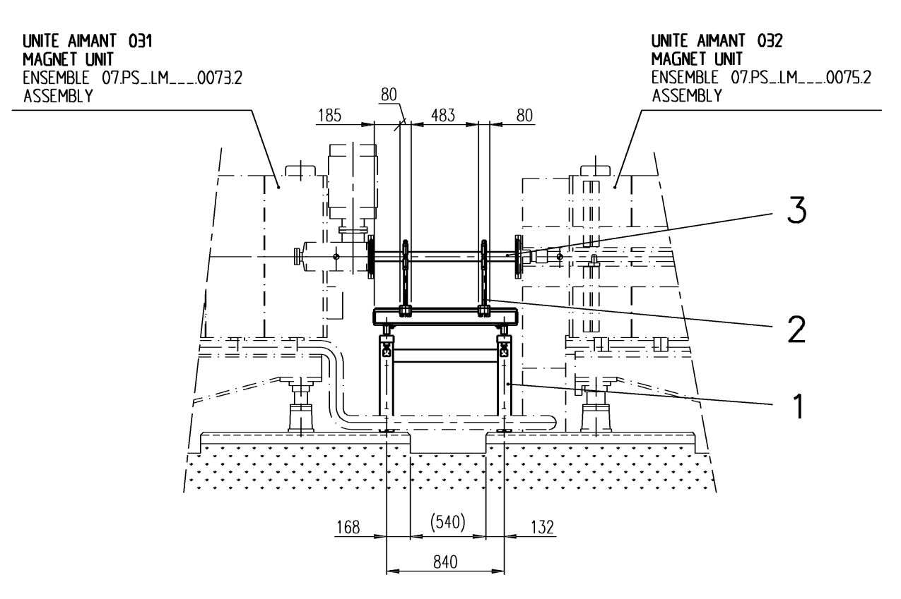
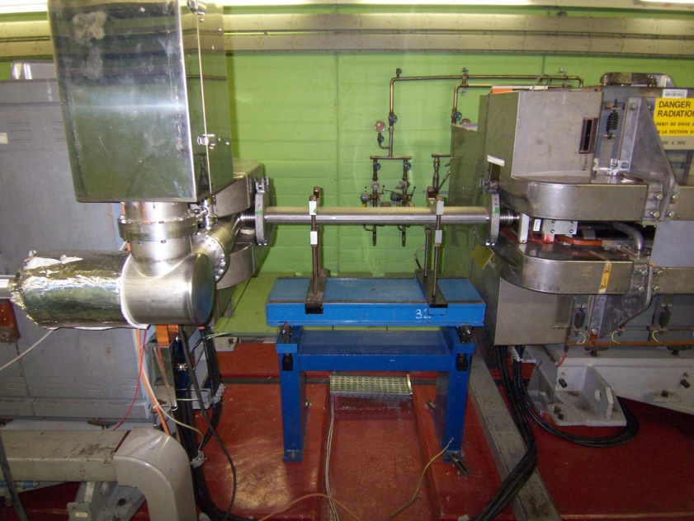
Location (3)
5 other locations: SS24, 32, 33, 62, 82
~84 cm

Slide 9
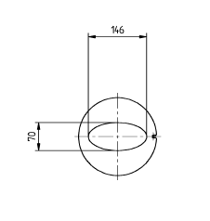
Typical vacuum chamber

Slide 10
First specification
Integration time: 1 ms or better
Acquisition frequency: 1 kHz or better
Bunch-by-bunch (72 bunches max, not 420)
Rest gas pressure: ~10⁻⁸ mbar
Beam sizes: σ = 0.5-10 mm (but small ones more important)
Emittance accuracy: 10% or better
Increasing number of bunches during the cycle might be a challenge.

Slide 11
What could it be…?
Small detector, but we have more space than IFMIF.
We could likely go for:
  Electron collection with compact magnets.
  Ion collection, compensating for space charge
  …
Multi-strip detector (silicon detector?) as the smallest beam is quite large
MCP probably needed - need to measure fast.
No gas injection system? Or yes? Fluorescence monitor possible with new cameras?
…………………………………………………………………….

