Slide 1
Specifications and Planning for future wirescanners at CERN
Bernd Dehning
CERN BE-BI-BL

Slide 2
Content
Specification
Limitation of existing scanners
Goals for new design
Planning
Personal

Slide 3

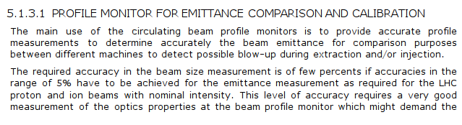

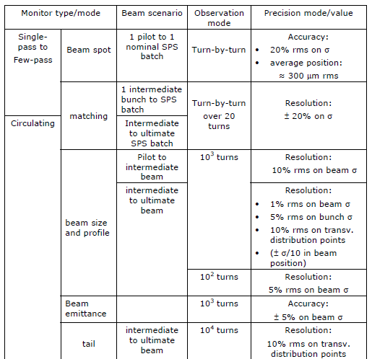

Specifications
(EDMS n. 772786)
Aim: Common basic layout of
design for all CERN rings

Slide 4
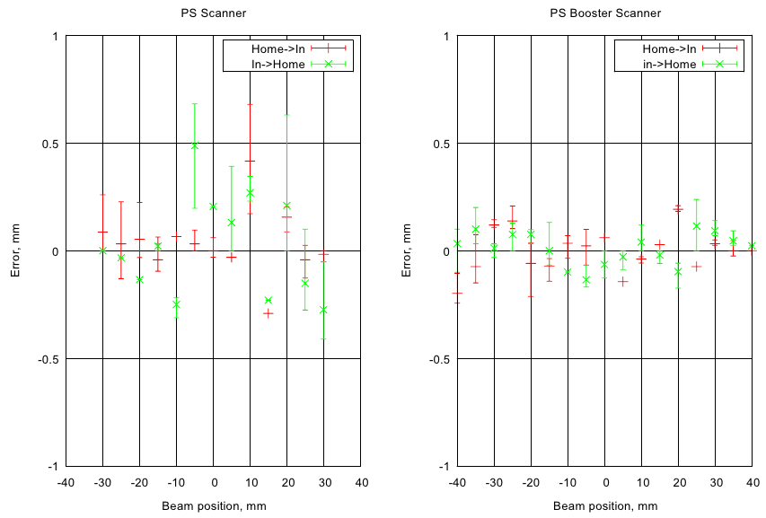
LASER beam reproducibility test measurements
Verification measurement accuracy after having introduced calibration data
Fluctuation up to several 100 um
Fluctuation due to principle of scanner hardware

Slide 5
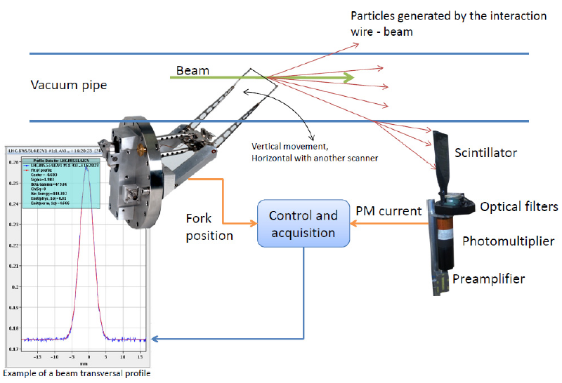
Limitations
Reproducibility much larger as required by specification
  Beam size min LHC 130, PSB 2000 um
  Flexible design of wire fork
    Deformation of fork are not measured
  Angular position measurement outside of vacuum system
    Lever arm play is not measured
Speed regulation circuit
  Analog feedback loop difficult to optimize
Secondary particle acquisition system
  Requires accurate adjustment of working range
    Saturation effect of PM
  Dynamic of working range small < 200
    Tail measurement limited by noise
  High intensity beams cause an increase of background signal
    Dynamic of working range reduced
Aging of bellows
Motor
&
Position
sensor

Slide 6
Goals
Scan at least as fast as the existing system (20 m/s needed to avoid wire damage)
=> Rotational system (power ~ inertia ~ m * r²)
Absolute accuracy of beam width determination of about 5 um
  Reduction of play in mechanical system
  => all elements mounted on same axis
  Position measurement
  => high accuracy angular position sensor
  Overcome bellow limitations:
    Low lifetime
    Friction
  => Locate all moveable parts in the vacuum
  Minimize fork and wire deformations
  => Study of dynamic behavior of fork/wire system
  => Vibration mode optimized acceleration profile
Large dynamic range for secondary particle detection
=> Usage of sensor with large dynamic (diamond)
=> Automatic electronic switching of gain ranges (range dynamic 1E4)
Increase MTBF compared with existing systems

Slide 7
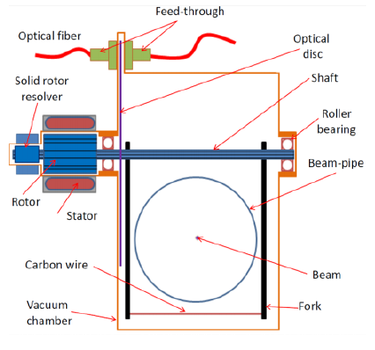
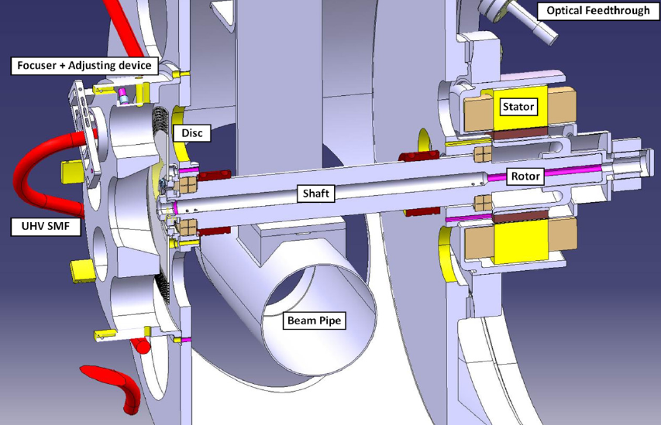
Schematic and First Design

Slide 8
Planning
Finished first mechanical design begin 2013
Produce first prototype Q3 2013
Produce second prototype Q1 2013
Installation of second prototype in SPS before startup 2014 (cell 517)
Commission system up to 2015/16
Production of system for installation in 2018

Slide 9
People involved
BE-BI-BL
  Jose Sirvent Blasco (Master: past: optical angular position sensor, future: PhD on diamond acquisition electronics)
  Bernd Dehning (scanner system)
  Jonathan Emery (electronic system)
  Juan Herranz Alvarez (PhD: accuracy of mechanical system)
  Carlos Pereira (electronic designed)
BE-BI-ML
  Raymond Veness (mechanical system)
  Sebastian Samuelsson (Master: mechanical design)
EN-MME
  Nicola Chritin (design office)

Slide 10
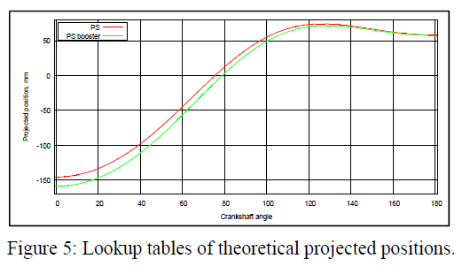
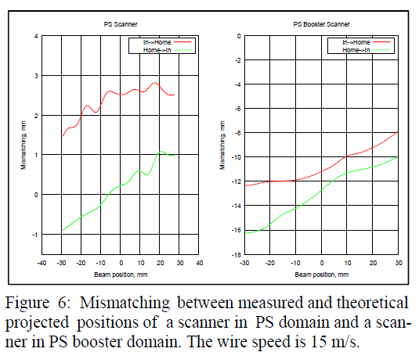
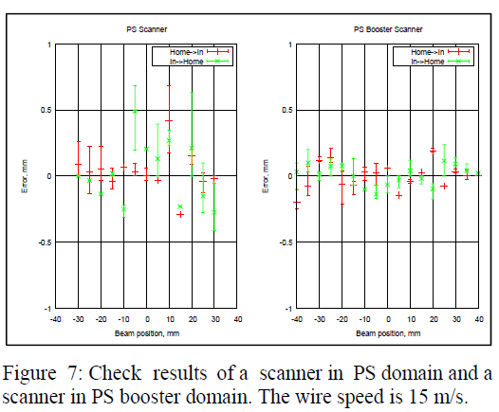
Calibration
Table used to calculate projected position from measured angular position
Calibration: Difference of LASER position and projected measured position by scanner results in correction table (error)
After correction: repeat previous step to check correction

Slide 11
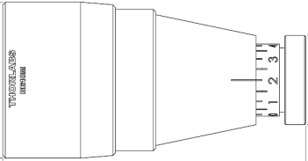
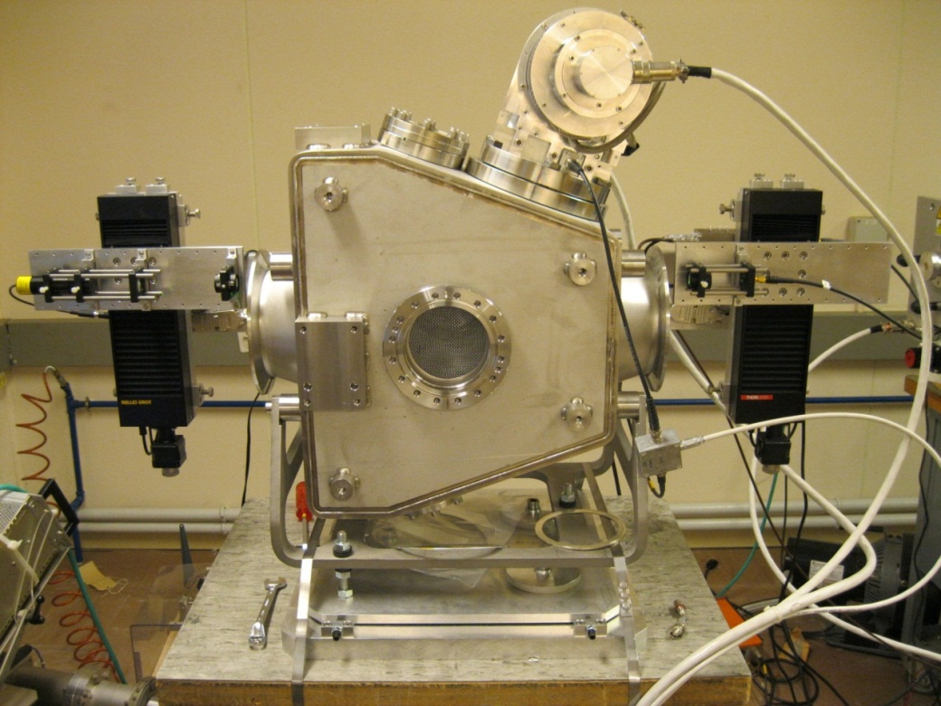
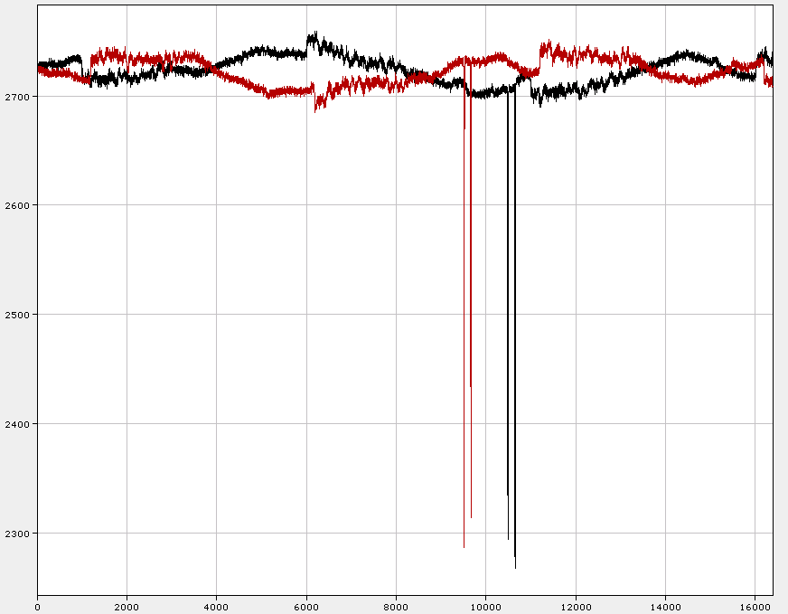
Minimization strategies - Calibration
Beam expender
Laser
Displacer
Scanner
Displacer
Photodiode
+/- 50 mm
Calibration table
diode signal
IN
OUT
Thanks to Jonathan Emery
time

