Slide 1
The Actuator and Control unit
CERN wire-scanner development review
18.04.2013
J.Emery for the BWS team

Slide 2
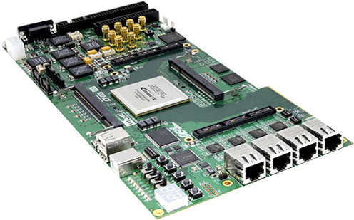
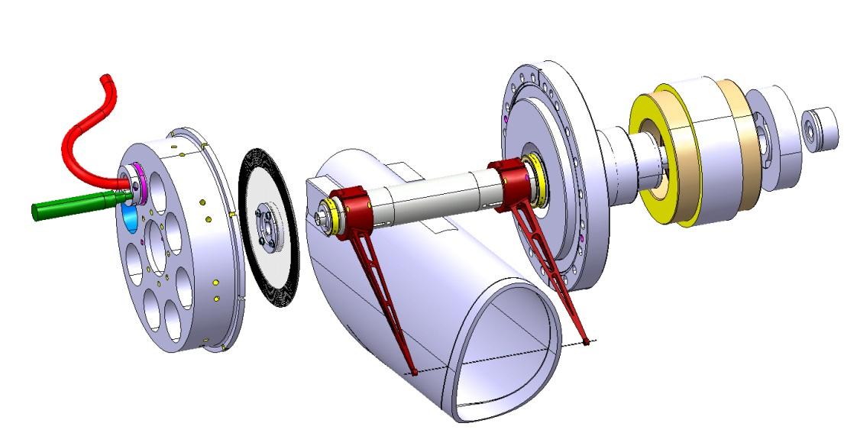
Future Actuator and Control unit
Scanner control, monitoring and supplies BWS_SCMS
Optical encoder interface
Condition monitoring of variables could act on the feedback like:
- Mechanical vibration
- Electrical connections
- Motor power consomption
Long range resolver interface
Digital control (FPGA)
3-phases PWM
Resolver
Optical encoder
Motor

Slide 3
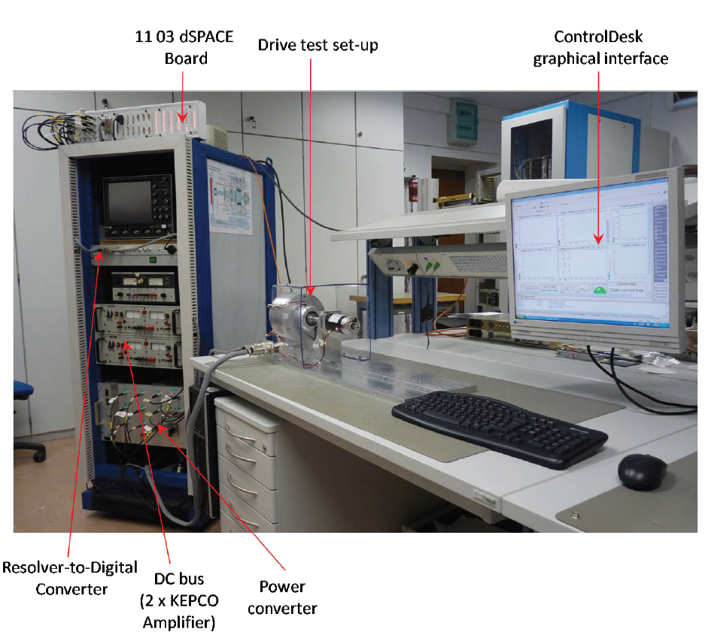
Plan
Actuator parts selection
Laboratory bench & limitations
Collaboration with the heig-vd on the motor supply
Preliminary results
Perspectives
2 first points are from ‘Design and construction of a new actuator for the LHC Wire Scanner’,
PhD. Thesis 2013, Mohammed Koujili

Slide 4
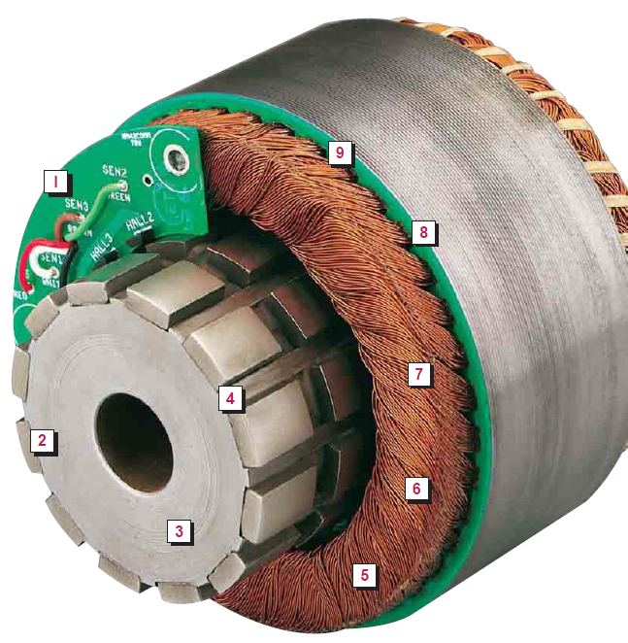
Motor description
Rotor must be compatible with high temperature and vacuum
Multiple types of motor studied
Induction Motor (IM), Switched Reluctance Motors (SRM), Permanent Magnet Assisted Reluctance Motor (PMASynRM), Permanent Magnet Synchronous Motor (PMSM)
High power density => lower mass and inertia at equivalent torque
Frameless => insertion of a vacuum barrel between the stator and rotor
Use of Samarium-Cobalt (SmCo) for the permanent magnets for its high temperature stability
Sizing based on expected inertia
Stator
Air gap
Permanent magnet
Rotor

Slide 5

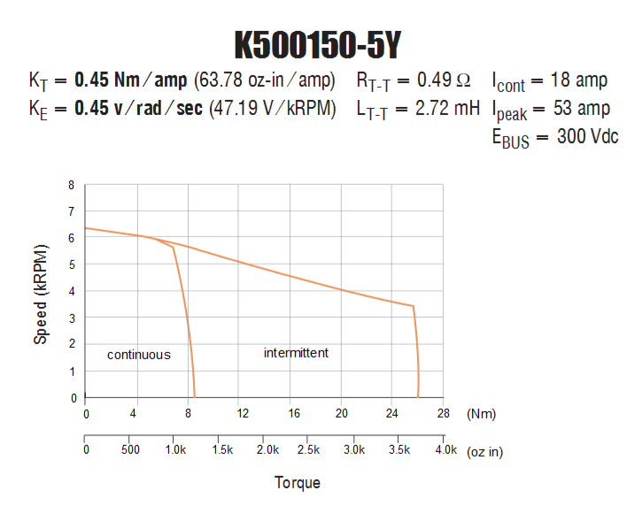
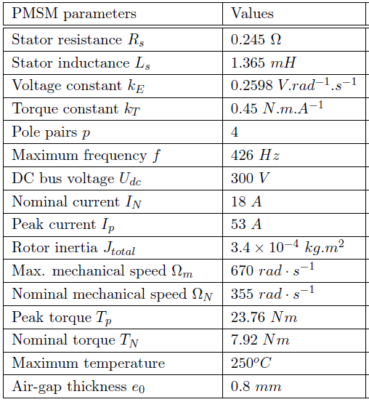
Motor caracteristiques

Slide 6
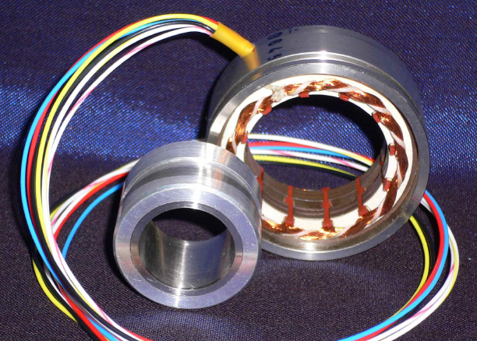
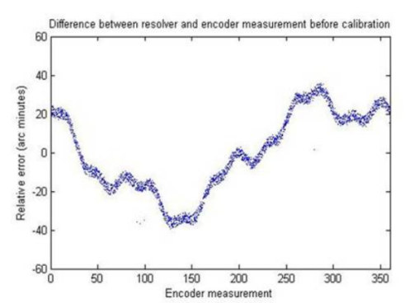
Resolver RO3620
Special resolver without windings on the rotor
Compatible with temperature and vacuum
Vacuum barrel in between rotor and stator, like the motor
Usable like any other resolver
See Jose’s talk for more details
Stator
Air gap
Rotor
Calibration improves absolut positionning
and is most likely usefull for our applicaiton

Slide 7
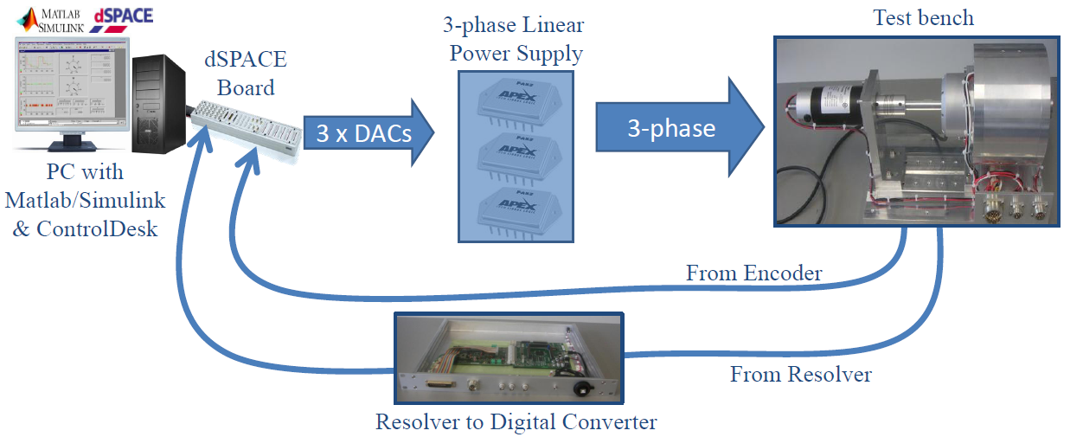
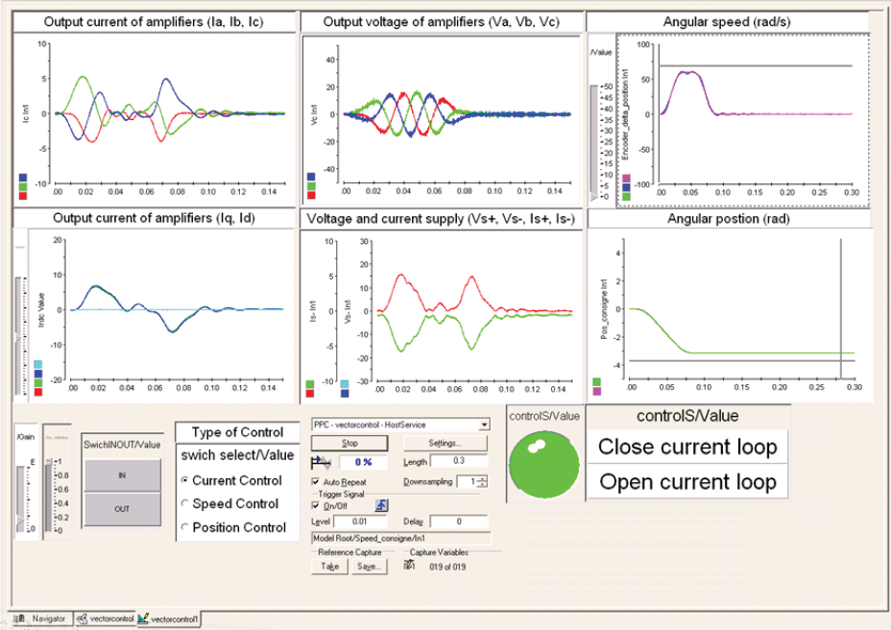
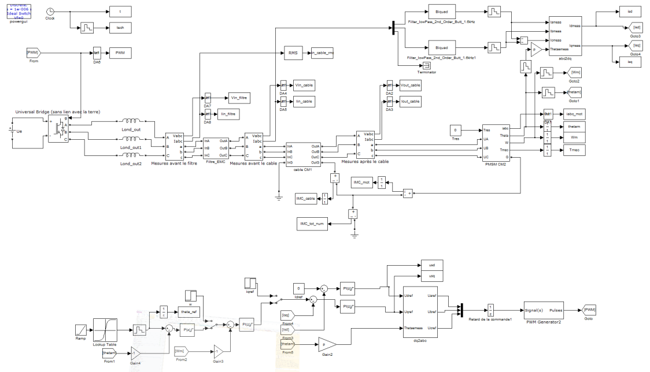
Laboratory test bench setup
Simulink position feedback loop

Slide 8
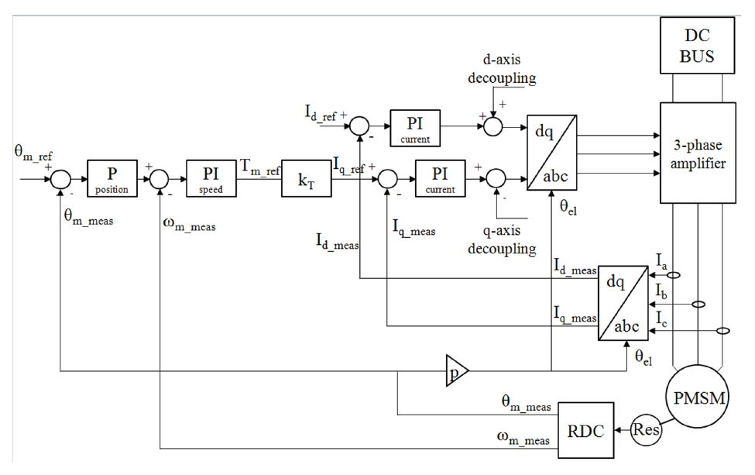
Position control feedback using vector control
Developped on the laboratory bench
Park
transform
Current
Position
Speed
Power supply
Motor
Under devloppment
(with heig-vd)
Resolver

Slide 9
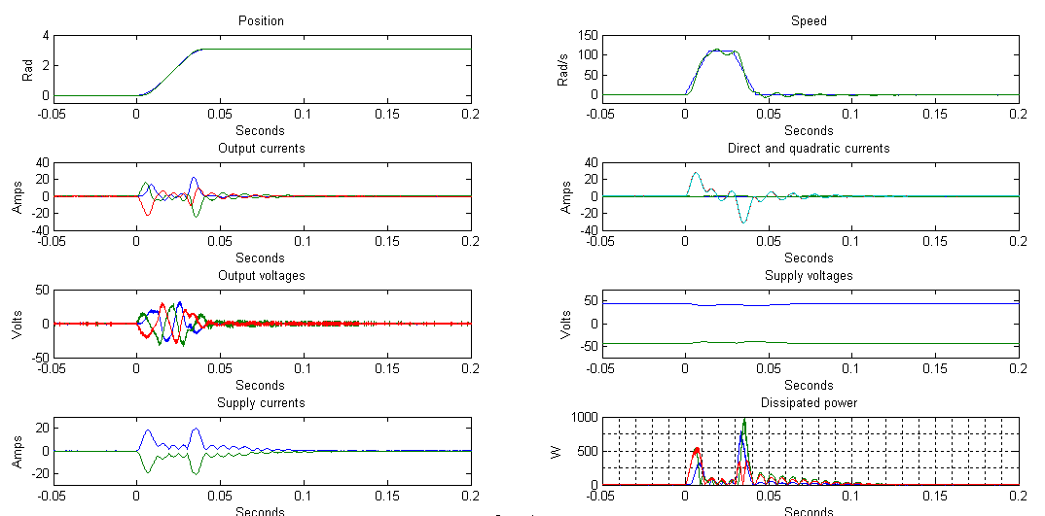
Performances of the bench
Speed: 110 rad/s
(Needs 128 for the SPS)
But with tests with low inertia
Linear driver used for power stage (as for last 2 WS designs)
But we are close to their maximum dissipation ability
Go for more efficient power control

Slide 10
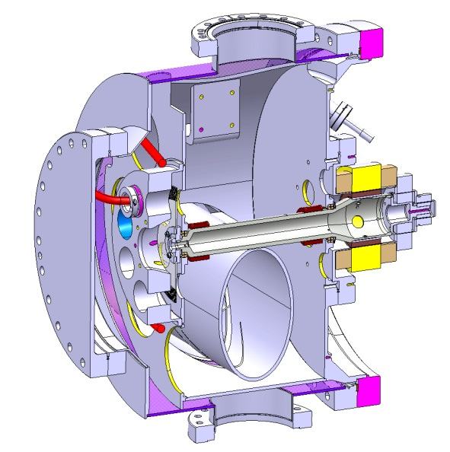
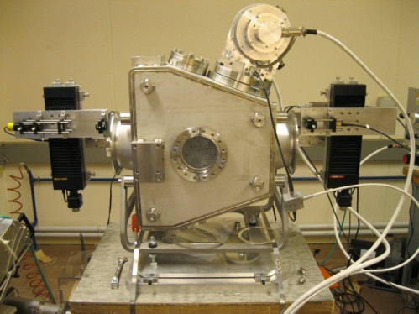
Prototype validation in the laboratory
Switch mode power supply and filters
Oscilloscope
Interface encodeur optique
Mesure des vibrations
Interface photodiode
Laser calibration bench similar that PSB and PS

Slide 11


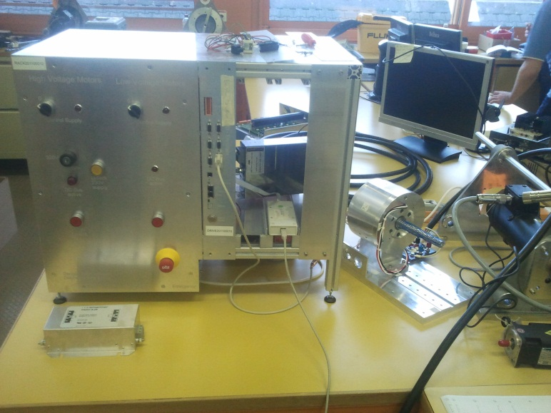
Study of Switch Mode Power Supply (SMPS) principle for the wire-scanner actuator
On-going mandate with the heig-vd, Industrial and Automation Institute (IAI)
Models development of
- Power supply
- Output filtering
- Long cable to be used
- Motor for high frequency
- Simulation of the EMI
Validation of the position feedback stability of such system
Implementation of this system with their electronics
EMI measurements and comparison with current implementaion using linear drivers
Our motor!

Slide 12
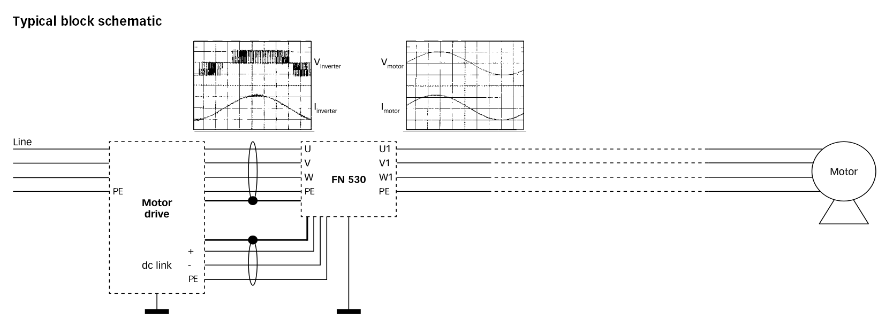
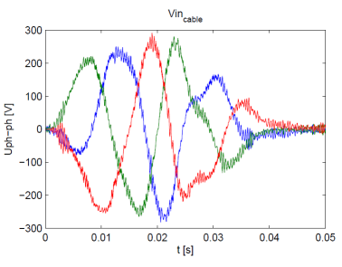
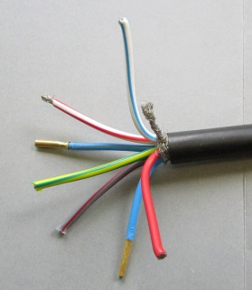
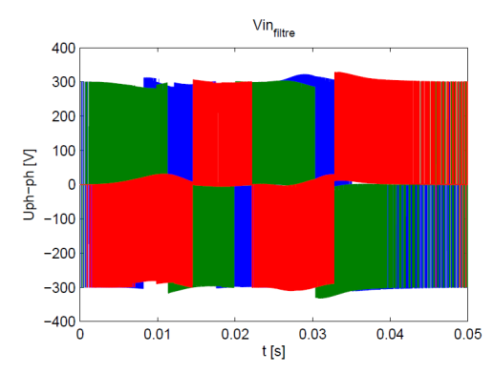
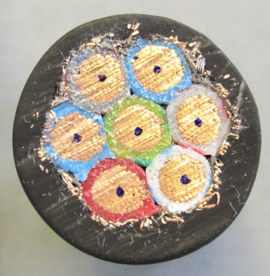
Switch mode output filter principle
Results:
Reduction of ElectroMagnetic Interferences (EMI)
Better compatibility with signal cables neaby this cable
Shielded power cable 6mm2

Slide 13
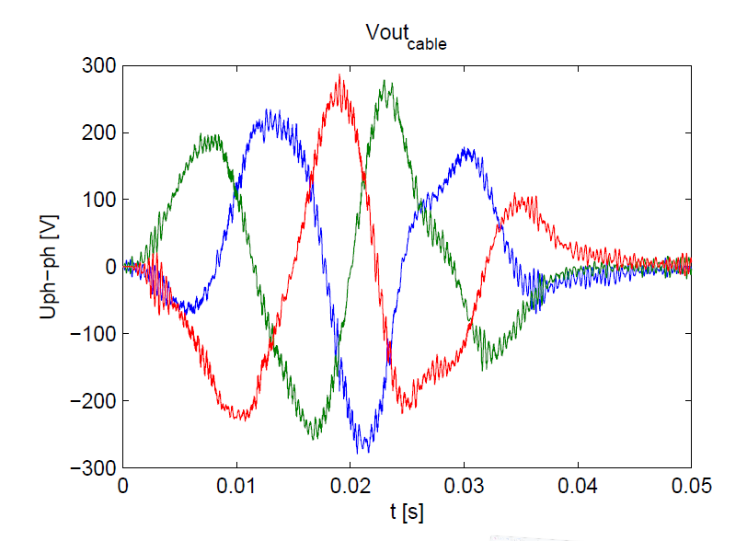
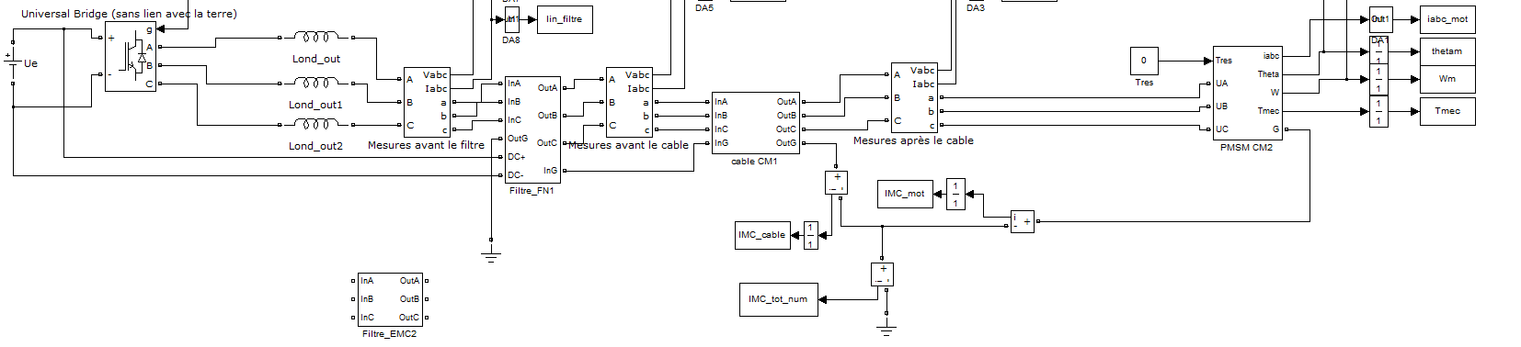
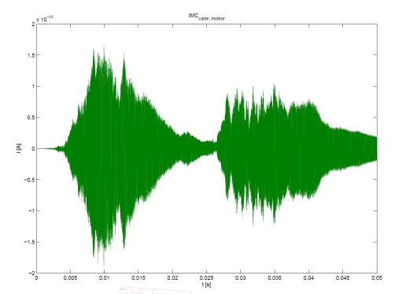
Models for the SMPS simulation
Switch mode
Filter
Motor
Cable

Slide 14
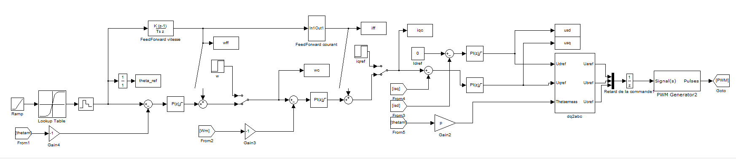
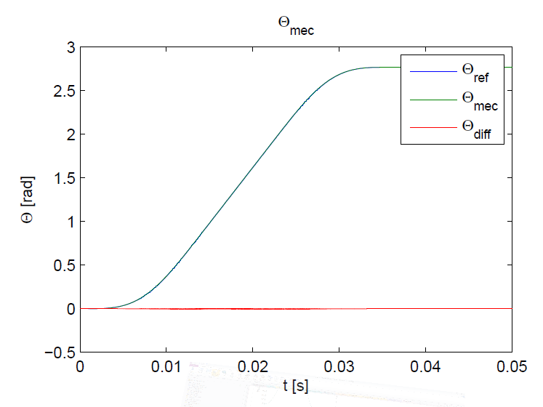
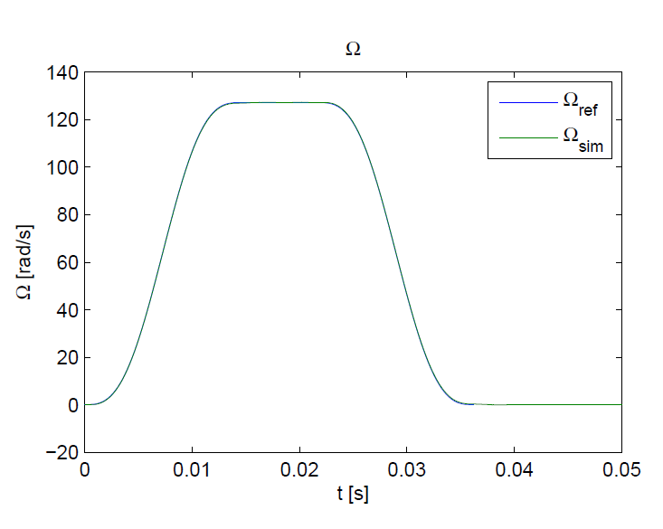
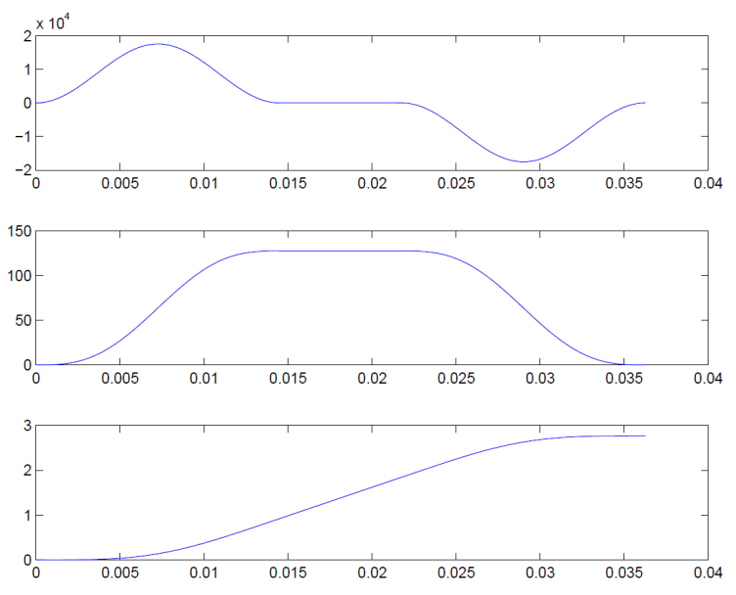
Position feedback stability study by simulation after integration of the SMPS
Position
Profile
Current correctors
Park
PWM
Pos
Speed
Result: Stable system following
the expected profile (includes latest inertia value 1.04E-3, See Sebastian’s talk)
Position

Slide 15
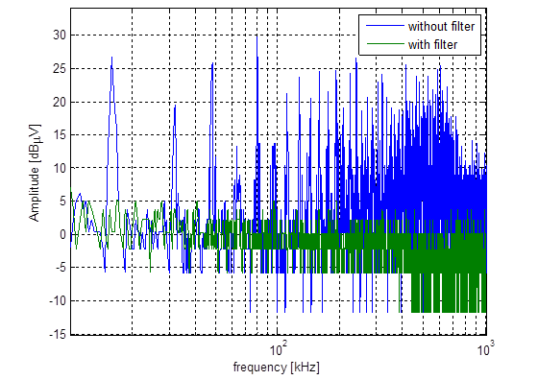
Preliminary study results
Principle validated with long cables by simulation and experience
Position feedback is stable and correct dynamic
Physical implementation on their bench with our motor finished
Filtering reduces considerably the emitted interferences
(see measure, using parallel cable as receiver)

Slide 16
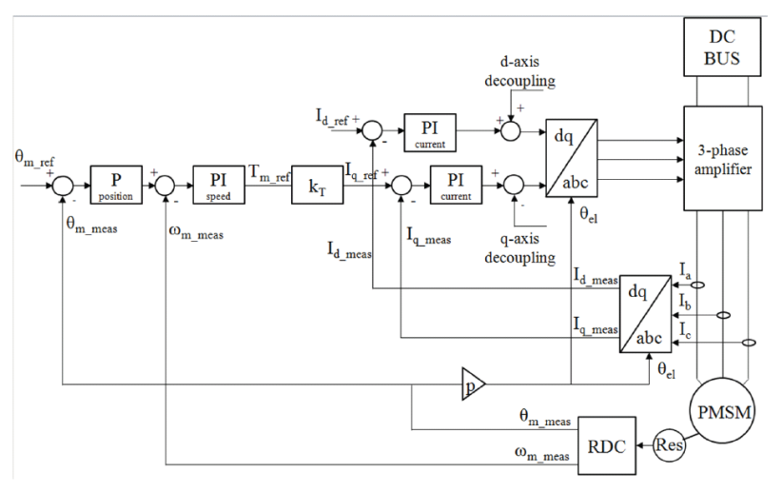
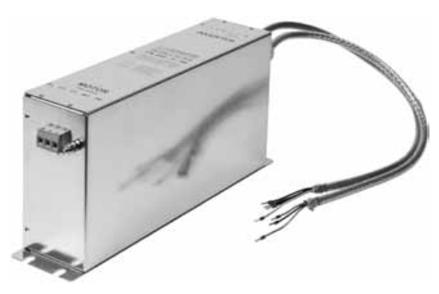
Location of the position feedback in the future system
Scanner control, monitoring and supplies BWS_SCMS
Optical encoder interface
Long range resolver interface
Feedback implementation
Digital control (FPGA)
3-phases PWM
Filtering
Filter

Slide 17
Perspectives
Actuator parts integrated on the mechanical prototype
Linear motor drivers where limiting performances
Successful collaboration with the heig-vd to study alternative
Validation of switch mode power supply with filtering
Stability of the position feedback verified
Next step
Integration of this technics on the laboratory bench
Then
Integrate this technics in the electronics for the prototype!
Questions?

