Slide 1
Overview of the control and acquisition systems
CERN wire-scanner development review
18.04.2013
J.Emery for the BWS team

Slide 2
Plan
Initial system layout consideration
Overview
Acquisition part
Control and monitoring part
Details on the wire measurement
Connection to external systems

Slide 3
System layout consideration
Minimisation of complexity
- As less as possible electrical connections
- Avoid multiplexing channel
- Settings and parameters (control and acquisition)
Separate critical and non-critical functions
- Instrument safety in the low level hardware
- High level software configure, analyse and record the measurements
Early failure detection
- Constant hardware Condition Monitoring (CM)
- Programmed maintenance
Continuous connection between mechanics and electronics
=> no multiplexing scanner control
Position measurement and motor driver on the same board
Self contained actuator control disconnected from the crate
=> usable without CPU
Monitoring at the same location as the actuator to act in case of failure
Acquisition (non-safety critical) don’t share the same firmware with the actuator (safety critical)

Slide 4

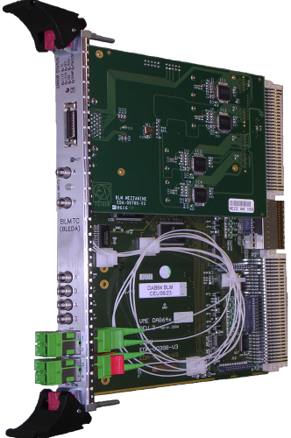
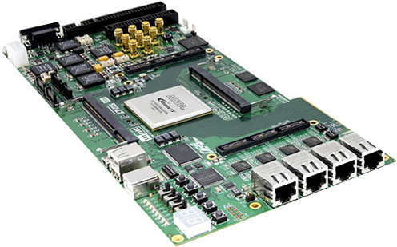
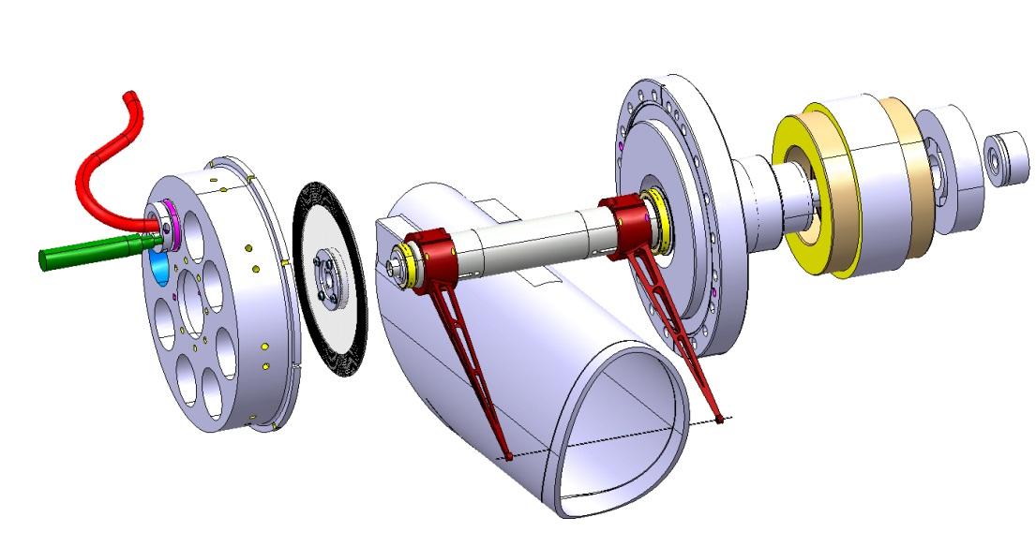
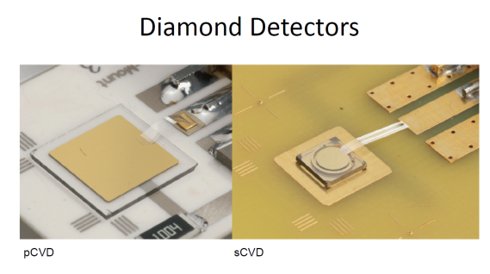
Future Scanner Control and Acquisition System
Scanner control, monitoring and supplies BWS_SCMS
High Precision Bunch by Bunch Profiling BWS_HPBBP
SFP Ethernet
SFP Optical link
BST receiver
SFP Optical link
CPU
T IMING
HV
CTRL
SFP Optical link
Wire resistivity & Strain gauge
SFP Optical link
External temperature and vibration
Optical encoder interface
Optical encoder interface
Long range resolver interface
Fast integration secondary shower
Magnetic stopper
3-phases PWM
Tunnel Electronics and GBT Link
Secondary particles shower acquisition
See Jose’s talk

Slide 5
Acquisition system overview
High Precision Bunch by Bunch Profiling (HPBBP)
Bunch synchro
CPU interface
Link to BWS_SCMS
Combines the diamond detection and optical encoder => See Jose’s talk
Digital platform (VME, SFP and FPGA)
Specific interfaces to detectors
Custom firmware
Programmable device (FPGA)
Analog frontend
laser
Pdiode
laser
Pdiode
Circulator
Circulator
Optical feedthrough
Optical feedthrough
Electrical feedthrough
Motor stator
Secondary particules detector
Fork
Wire
Break
stator
Vacuum Focuser
Optical disk
Motor
Break
Res stator
Resolver
Shaft
Bearings
Bearings
Vacuum Focuser
Vacuum barrel

Slide 6
Control and monitoring overview
Scanner Control Monitoring and Supplies (SCMS)
Ethernet monitoring
Link to HPBBP & CPU
GBT interface
Machine synchro
Main supply input
Programmable device (FPGA)
DC low voltages
DC bus 300V
Digitalisations (A/D, D/A)
Optical position sensor interface
Wire
resistivity
Strain gauge
Temperature
vibrations
Resolver
Driver
Stopper
Driver
3 phases Motor PWM
Filters OTS
Optical feedthrough
Optical feedthrough
Electrical
feedthrough
Motor stator
Fork
Wire
Break
stator
Vacuum Focuser
Optical disk
Motor
Break
Res stator
Resolver
Shaft
Bearings
Bearings
Vacuum Focuser
Vacuum barrel

Slide 7
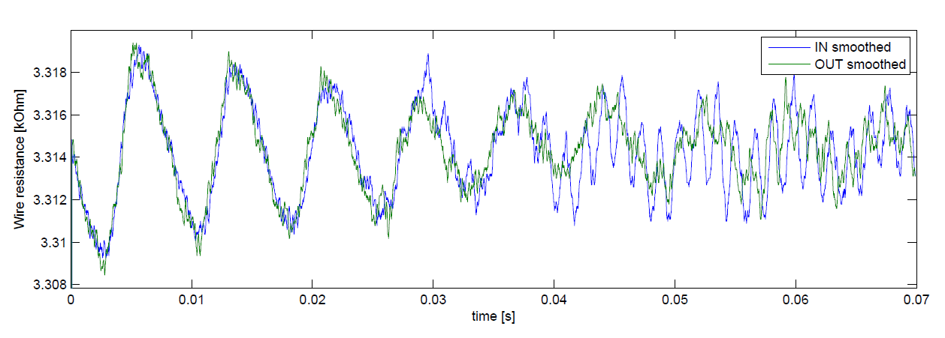
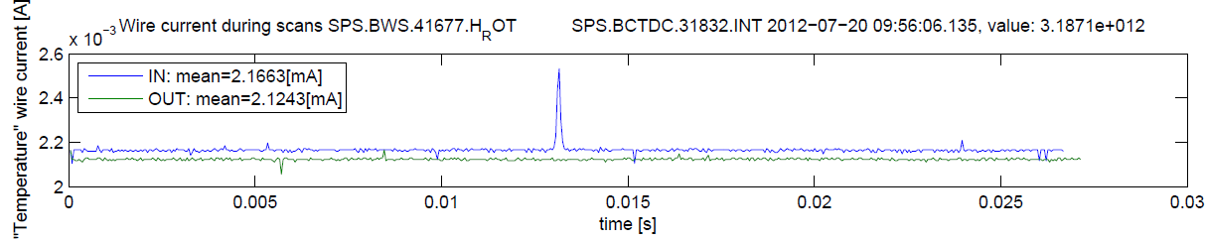
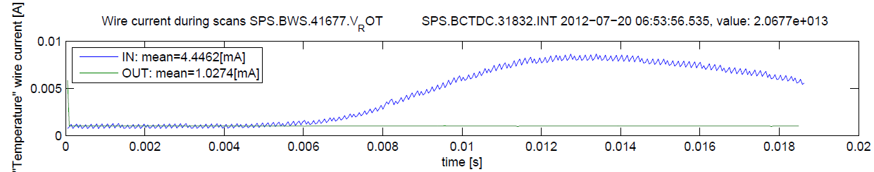
Interface to the wire resistivity, thermionic and RF induced current
PSB Ring 1 H at 15 m/s
Wire resistivity variation during a movement due to mechanical constraints (See Juan’s talk)
SPS 416 H at 6 m/s
Wire current variation when interacts with beam (thermionic effect)
SPS 416 H at 6 m/s
Wire current variation induced by the beam exitating RF modes inside a cavity (BWS tank)

Slide 8
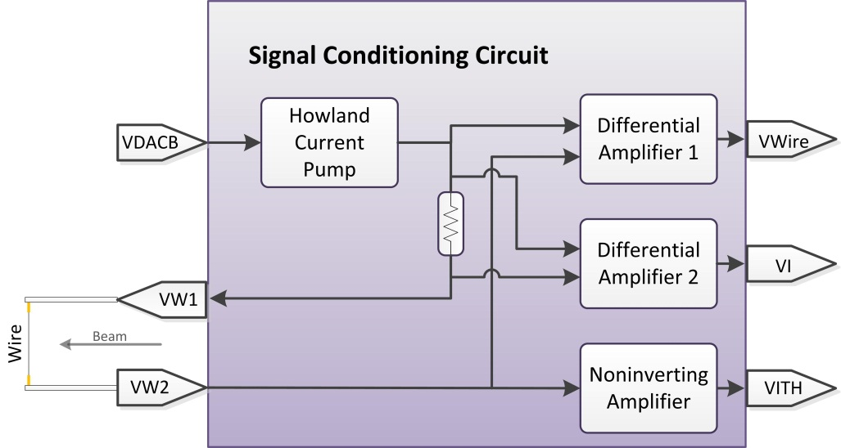
Wire interface: Functions and principle
Survey nominal wire resistivity
Record eventual resistivity variation over time
Visualise during movement:
- Resistivity variation (vibration)
- Thermionic current
- RF induced current
Speculate about the temperature during bakeout
(~0.5[Ohm/deg])
Slide from C. Morais Pereira

Slide 9
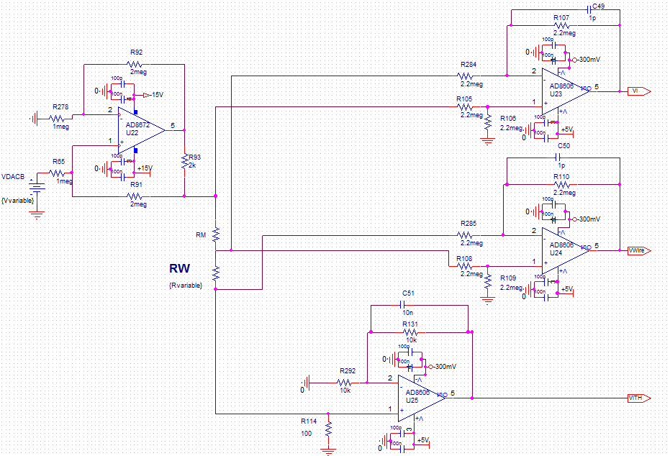



Wire interface: Implementation
$$I_{HCP}=\frac{\frac{2M+2k}{1M}}{2k}∗V_{DACB}≈1.000∗{10}^{−3}∗V_{DACB}$$
Injected current
measurement
Voltage across
the wire
$$R_{W}=\frac{V_{wire}}{I_{return}}$$
Returning current
measurement
$$I_{return}=I_{HCP}{+I}_{th}{+I}_{RF}$$
Slide from C. Morais Pereira

Slide 10
Wire interface: Operating point
P_{WNOM} = 5mW
considering
I_{THMAX} = 0.5mA
 | Wire resistivity on the operational system today (PSB, SPS and PS and LHC) |  |  |  |  |  | 7 um wire
R_{W} | 1kΩ | 2kΩ | 3kΩ | 4kΩ | 5kΩ | 6kΩ | 15kΩ
P_{WMax} | 10mW
P_{WNOM} | 5mW
I_{Wire} | 2.2mA | 1.5mA | 1.3mA | 1.1mA | 1mA | 0.9mA |  | 0.55mA
V_{WIRE} | 2.2V | 3V | 3.9V | 4.4V | 5V | 5.4V |  | 8.25V
R_{RESOLUTION} | 1Ω
V_{RESOLUTION} | 2.2mV | 1.6mV | 1.3mV | 1.1mV | 1mV | 0.9mV |  | 0.5mV
ADC Min Resolution | min. 14 bits
Slide from C. Morais Pereira

Slide 11
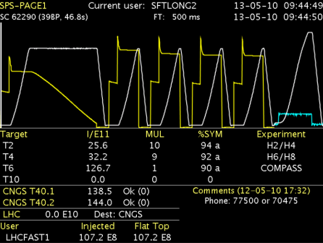
Interfaces to external systems for synchronisation, data visualisation and storage
General Machine Timing (GMT)
Low jitter < 1ns
Granularity: 1ms
Beam Synchronous timing (BST):
- Bunch synchronisation
=> 25 ns accurate clock
- Revolution frequency synchronisation
=> for LHC 89us pulse period
Triggers: Wire-scan trigger, post-mortem, acquisition
- Granularity: 89us, low jitter < 1ns
Expert
monitoring
SFP Ethernet
Control room
(CCC)
SFP Optical link
SFP Optical link
CPU
T IMING
Wire resistivity & Strain gauge
BST receiver
External temperature and vibration
SFP Optical link
Optical encoder interface
Trigger input
Long range resolver interface
Trigger output
Magnetic stopper
Databases (Logging)
Long term storage
offline analysis
3-phases PWM
Trigger input
Scanner control, monitoring and supplies
BWS_SCMS
High Precision Bunch by Bunch Profiling
BWS_HPBBP
- Scan trigger at μs scale use serial data link
- If we need ns scale, use of dedicated line

Slide 12
Summary
Somme consideration about the system layout
Acquisition part
=> More to come next talk
Control and monitoring part
=> More to come on talk on the actuator
Details on the wire measurements
Connection to external systems
Phase 1 (2013-2014)
Build the Scanner Control Monitoring and Supplies (SCMS)
Phase 2 (2015-)
Build the High Precision Bunch by Bunch Profiling (HPBBP)
Questions?

