Slide 1
Quality Control on Silicon Sensors
Betreut durch Sonia Fernández Pérez
CERN Internship 08.04. - 19.4.2013

Slide 2
Inhalt
Übersicht ATLAS
Grundlagen Halbleiter
  Dotierung
  p-n-junction
Halbleiter als Sensoren
Sensortypen
Unsere Aufgaben
Fazit

Slide 3
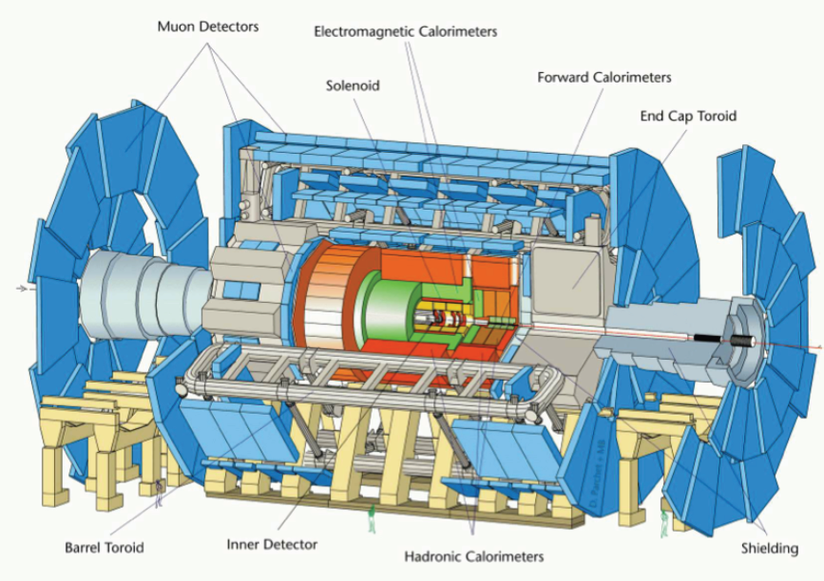
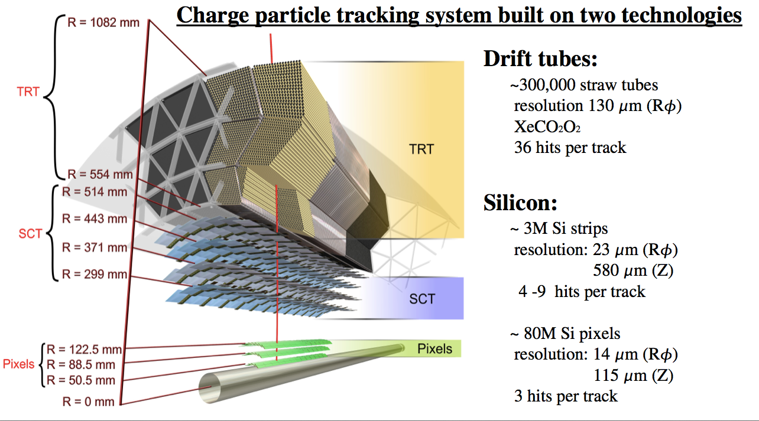
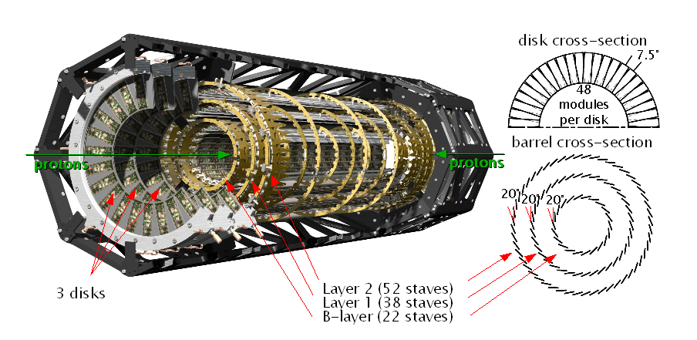
Der Pixeldetektor und IBL

Slide 4
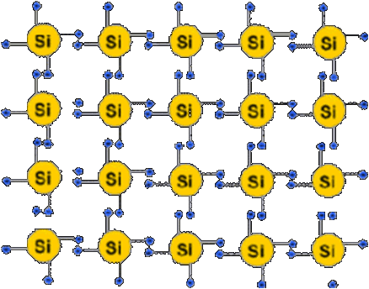
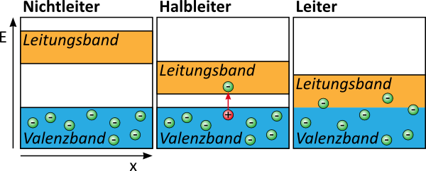
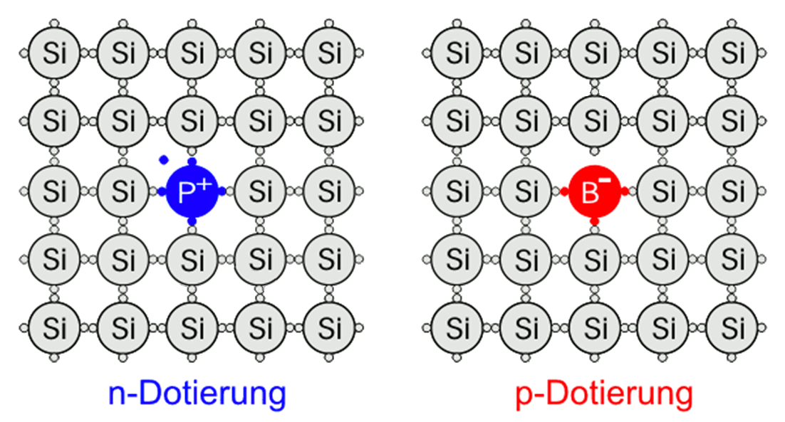
Dotierung

Slide 5
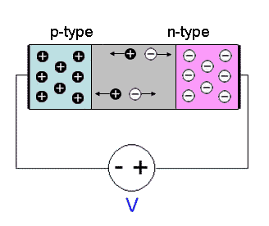
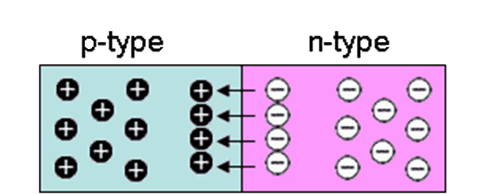
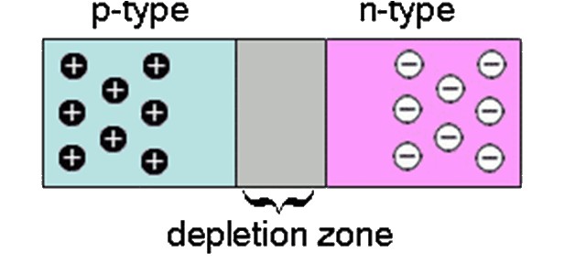
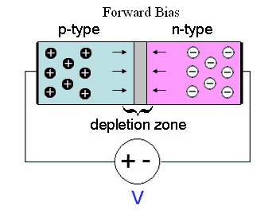
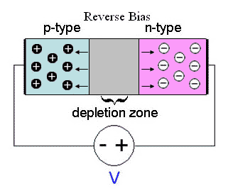
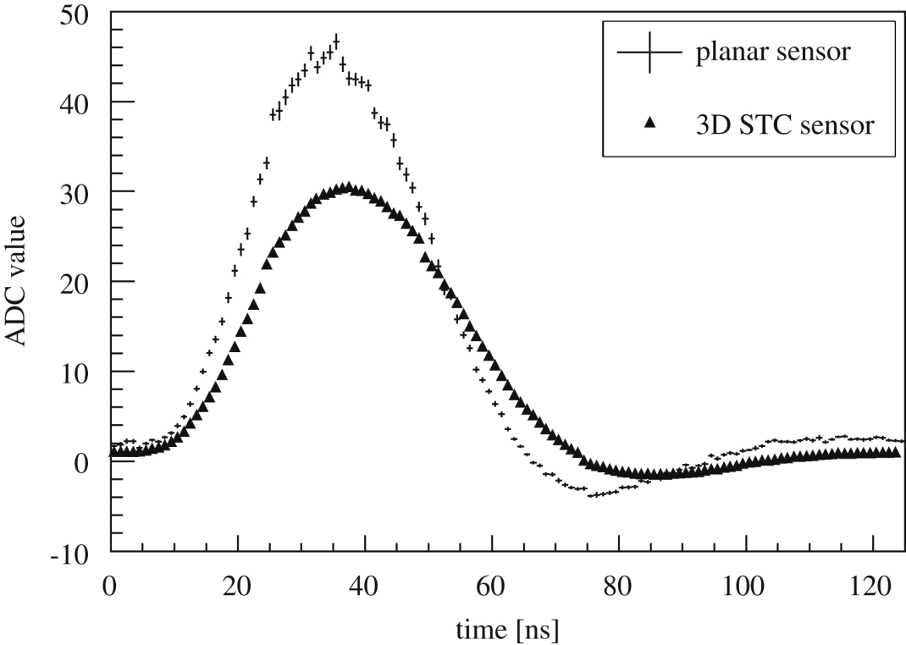
Halbleiter als Sensoren

Slide 6
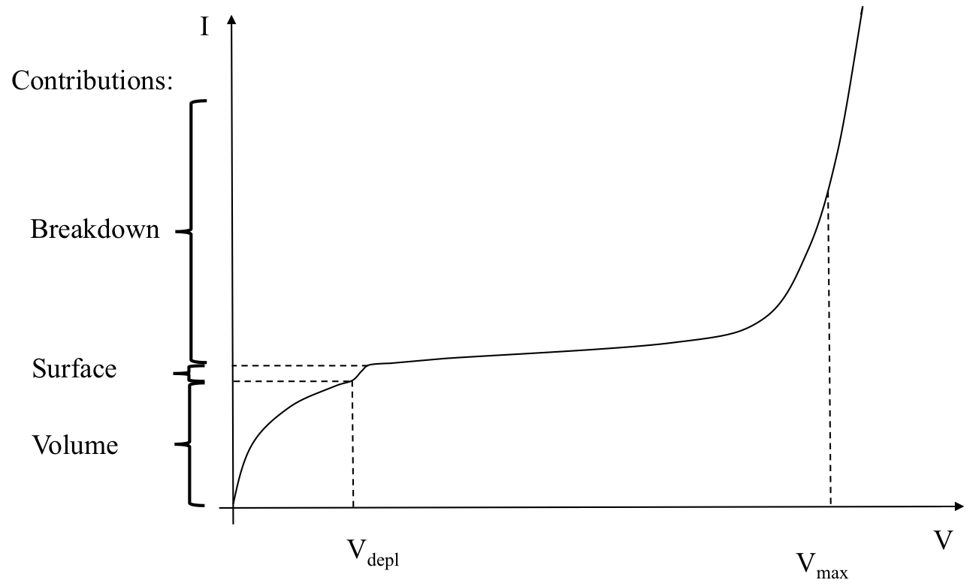
current and bias

Slide 7
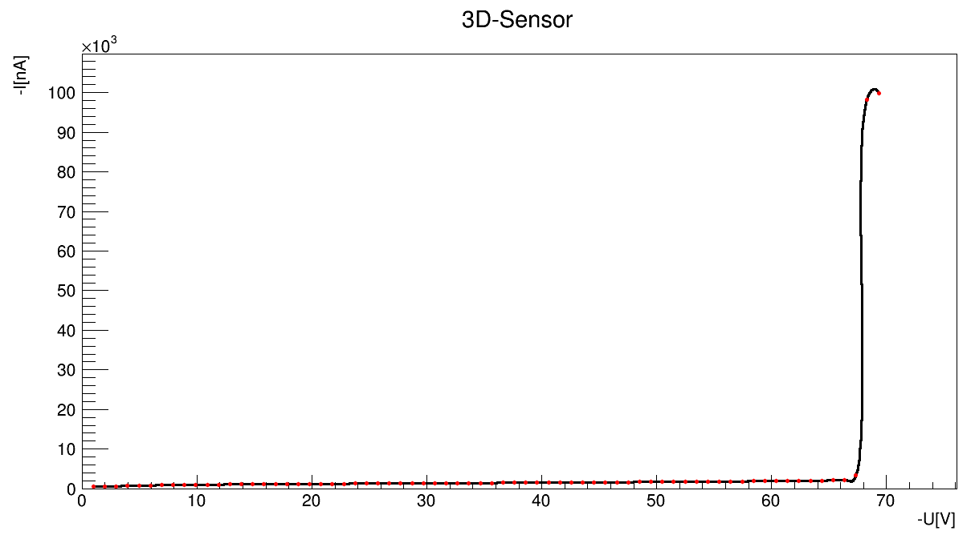
… in der Praxis

Slide 8
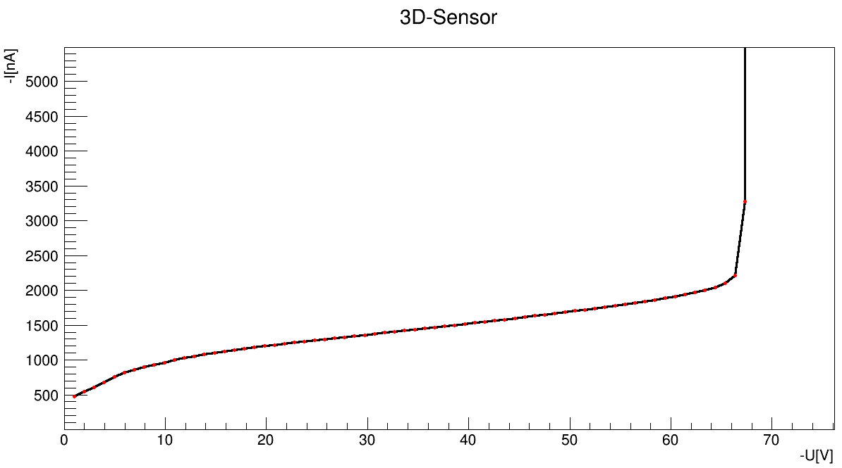
… in der Praxis

Slide 9
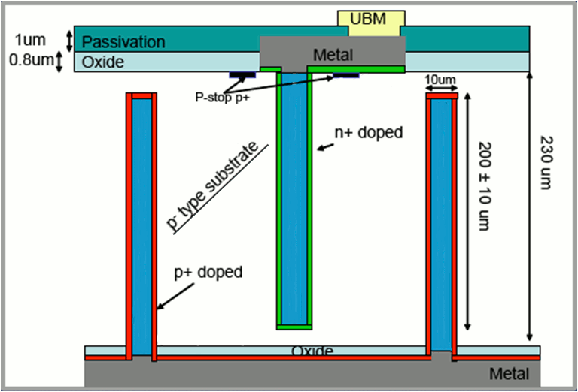
3D-Sensoren

Slide 10
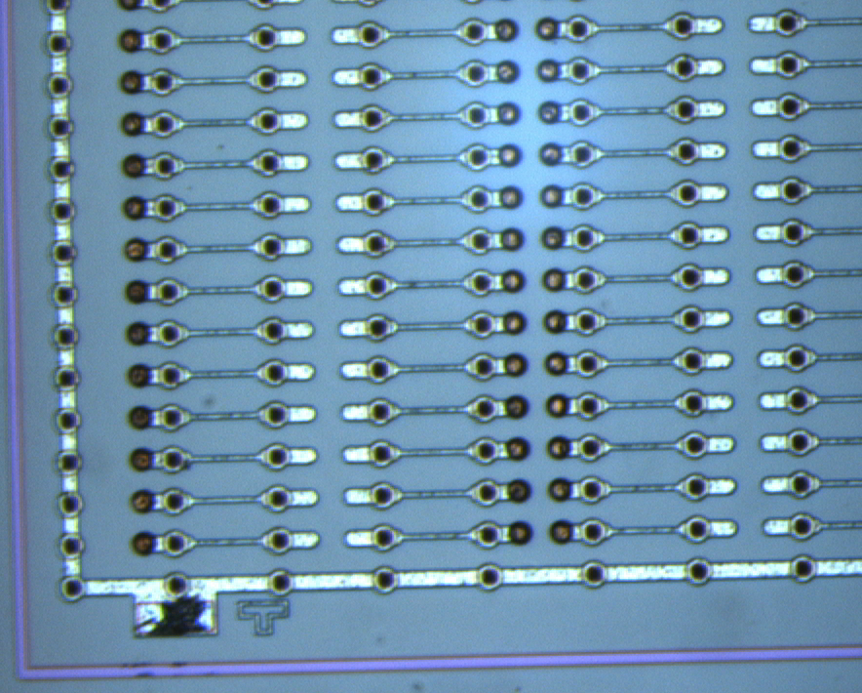
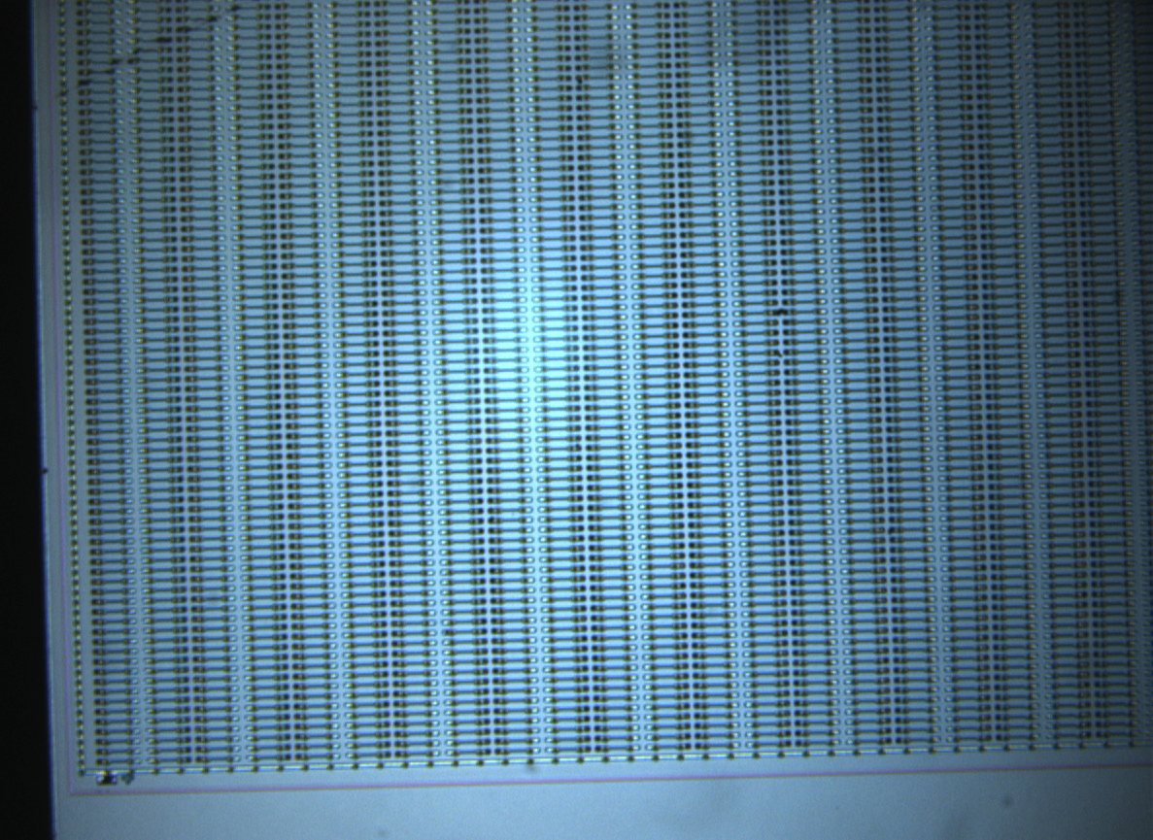
3D-Sensoren

Slide 11
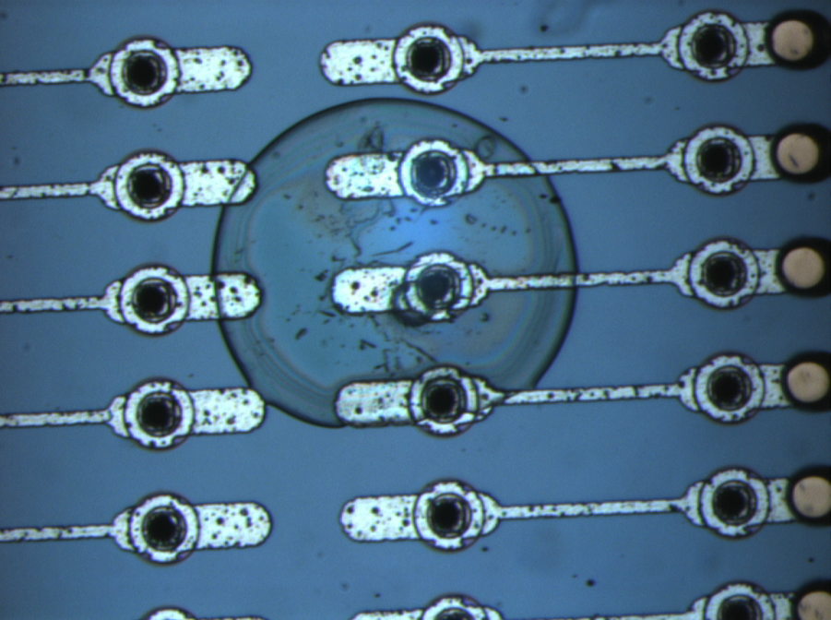
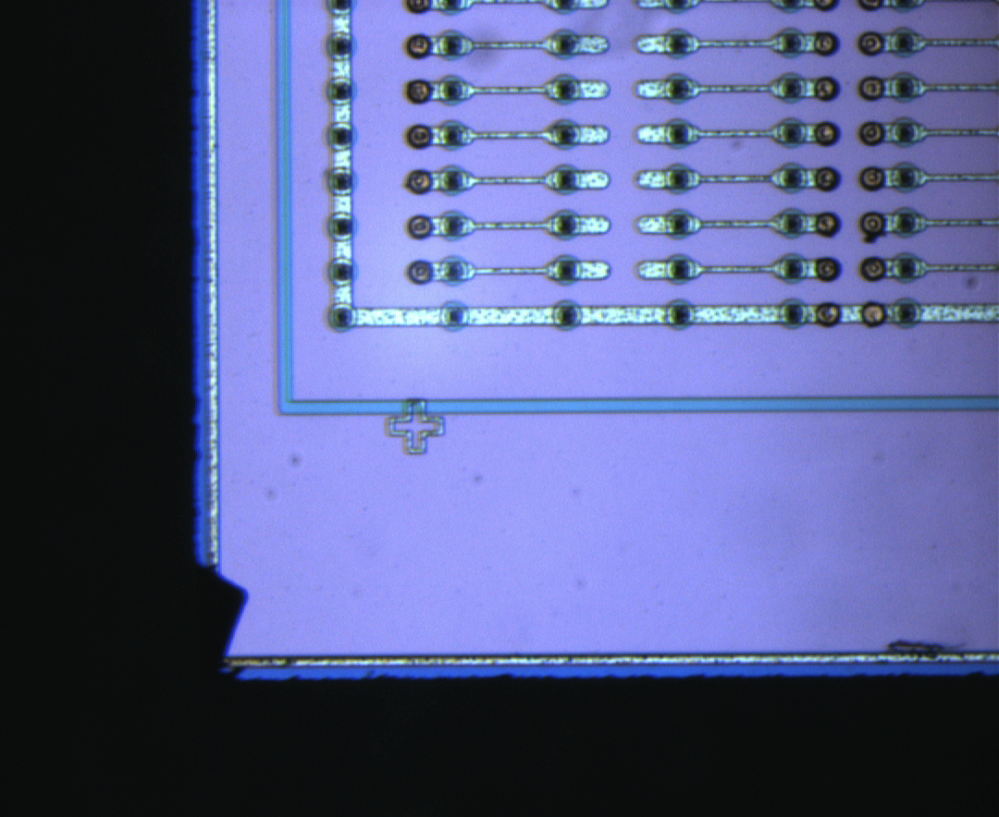
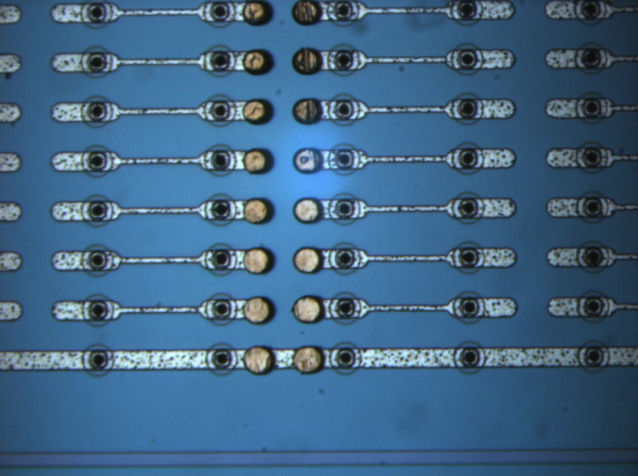
Optische Untersuchung

Slide 12
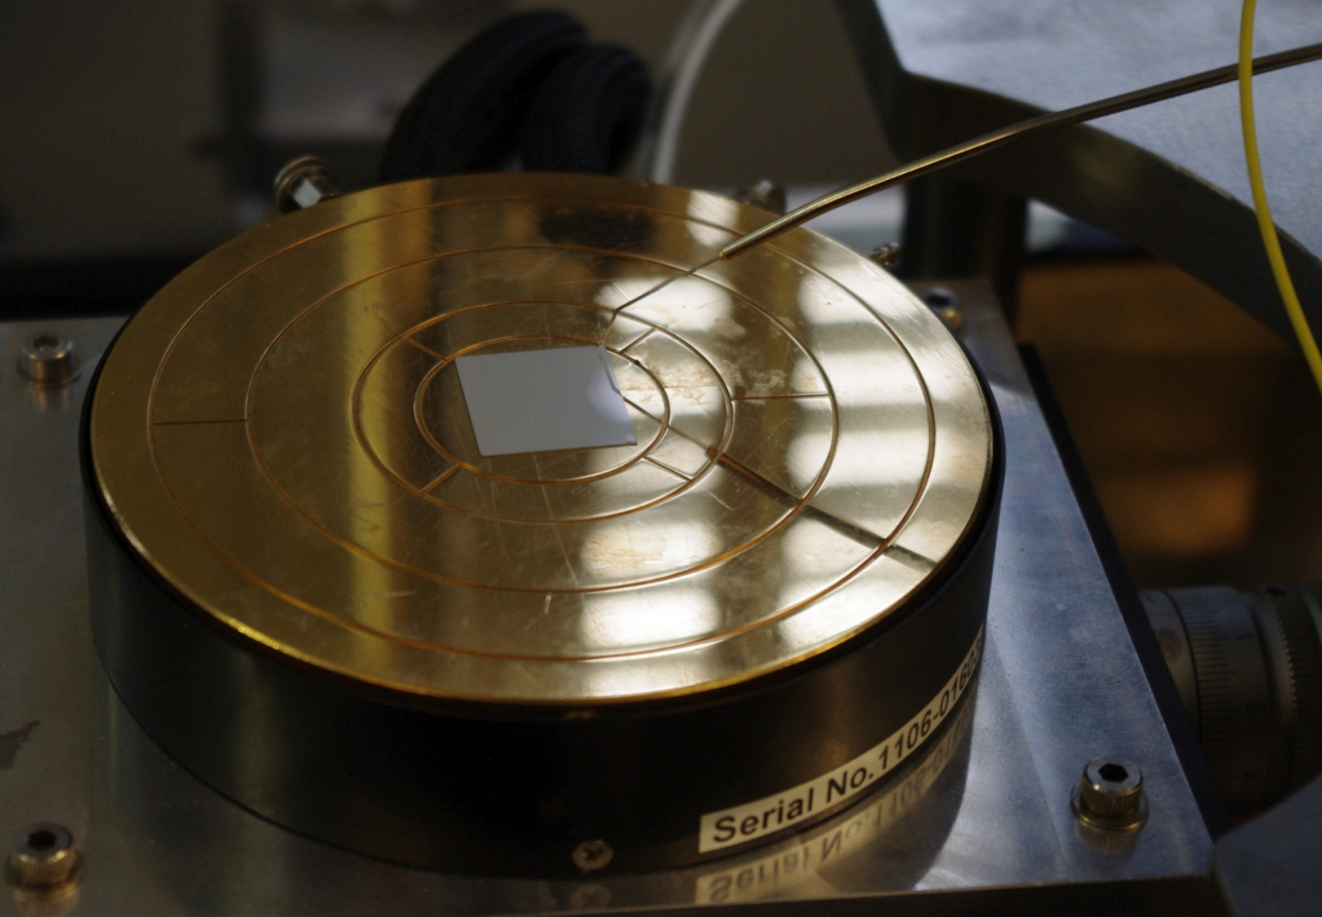
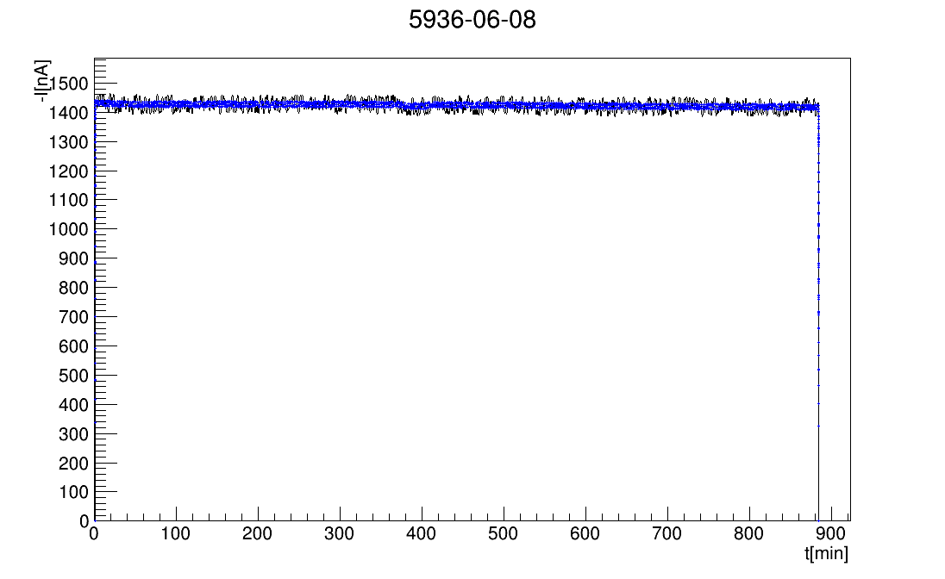
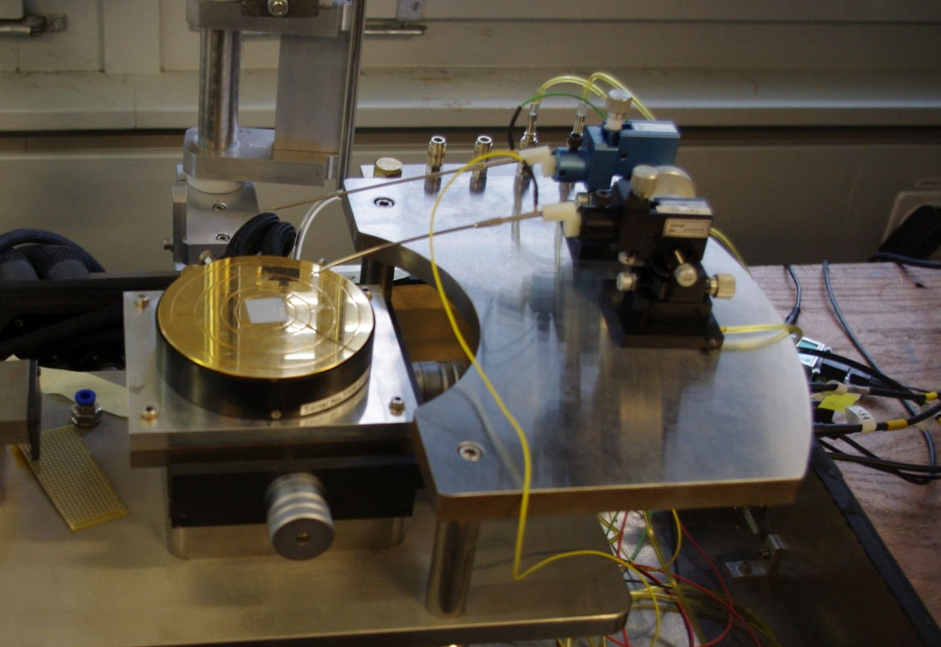
long-term-measurement

Slide 13
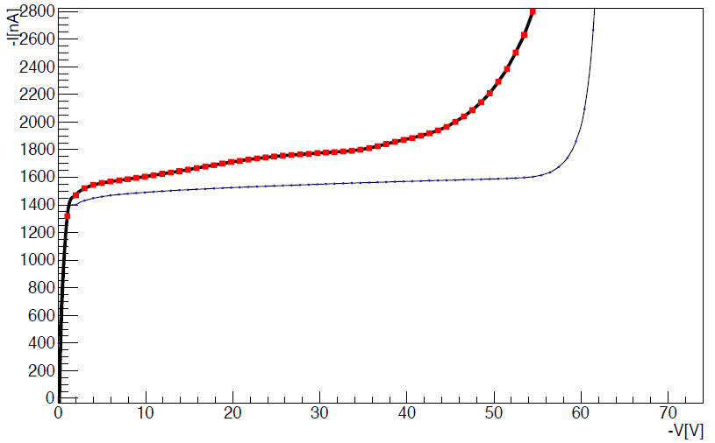
Weitere Messungen

Slide 14
„We have a lot to do …“ Sonia
all in all two challenging
and very enjoyable
weeks full of great experiences
Therefore: Thanks a lot to
Sonia for ten days of patience and teamwork!
Mr. Schmeling for the hitch-free organisation.

Slide 15
Quellen
http://indico.cern.ch/getFile.py/access?contribId=301&sessionId=22&resId=0&materialId=slides&confId=102998
http://www.fisica.uniud.it/~micelli/download/AMicelli_PhDThesis.pdf
http://www.filmscanner.info/Bilder/CCD_01.gif
http://hades.mech.northwestern.edu/index.php/Semiconductors
http://www.sciencedirect.com/science/article/pii/S0168900209001612
http://intel.pclabs.com.tr/wp-content/uploads/2010/10/45nm-wafer-photo-3.jpg
http://lp.uni-goettingen.de/get/bigimage/6798

Slide 16
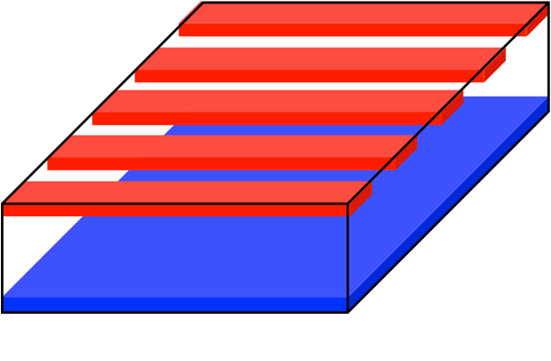
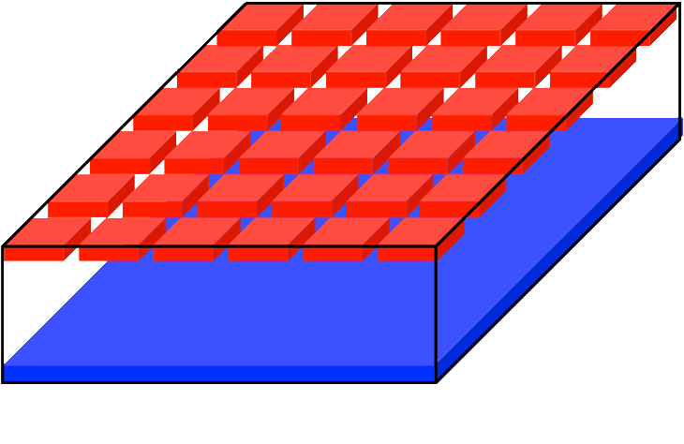
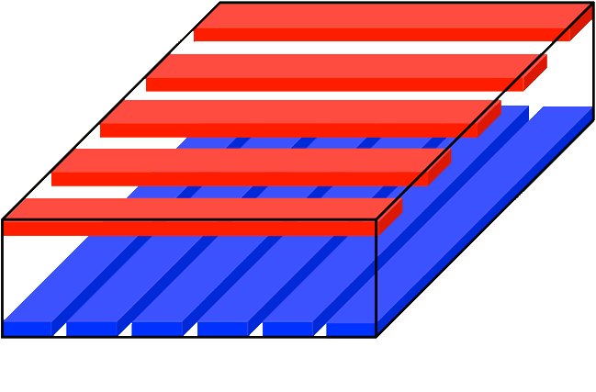
planare Sensoren

Slide 17
3D-Sensoren
3D advantages
Low depletion voltage and low power
Fast charge collection
Radiation hard
3D complications
Partially inactive columns: loss of efficiency
Production Yield/cost

