Slide 1
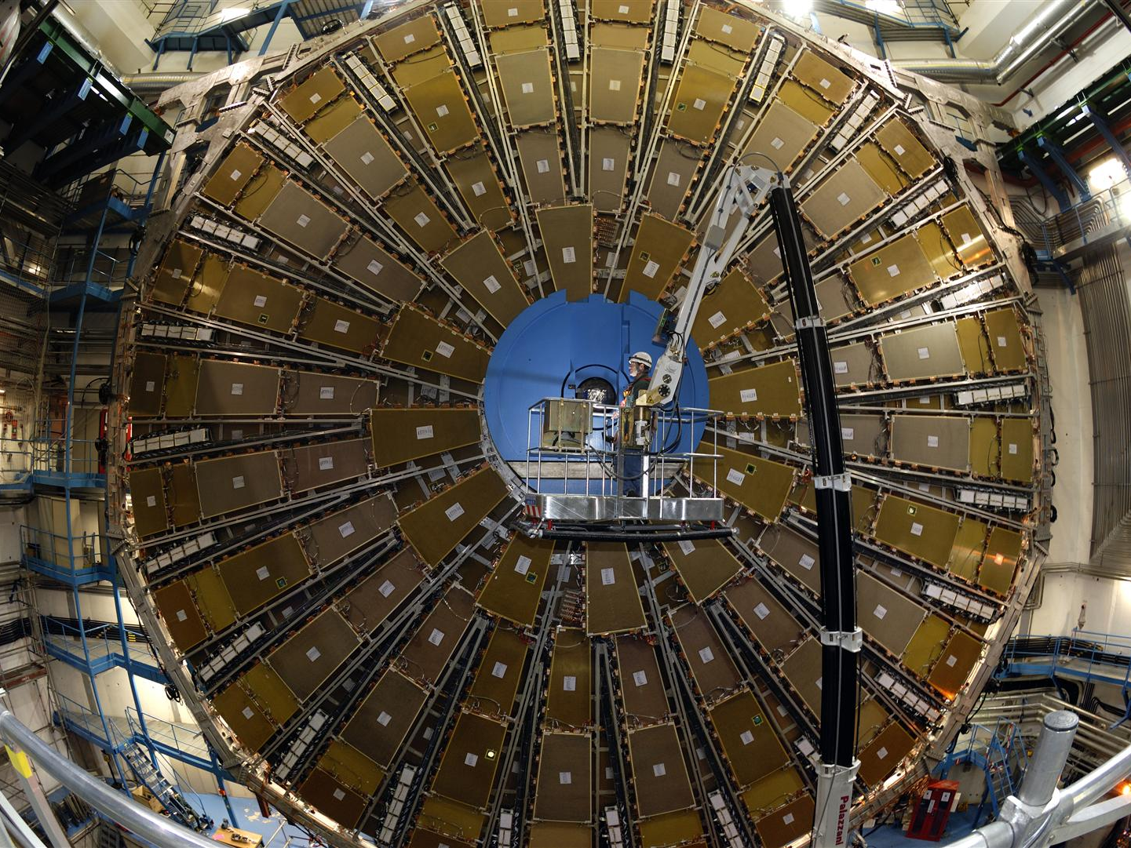
Measurements with Micromegas Detector Prototypes for the Atlas Myon System
Anna Ravensburg and Pascal Grobecker
CERN Internship 08.04. – 19.04.2013
http://www.atlas.ch/photos/muons-tgc.html

Slide 2
Micromegas

Slide 3
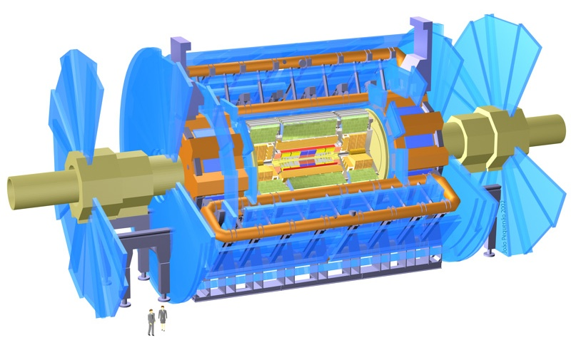
The ATLAS - Detector
Task: To build Myon-Detectors (blue) which work faster
Time: About 5 years
*http://core.physicsinfo.co.uk/filestore/104/atlas.jpg

Slide 4
Setup of a Particle Detector
-
+
-
+
-
+
Electric Field
Particle
Argon

Slide 5
Avalanche-Effect
-
+
-
-
+
+
-
+
Electric Field
Particle
Argon
Notes:
Many ionisation
→ Ar+ is too slow for high rates in ATLAS

Slide 6
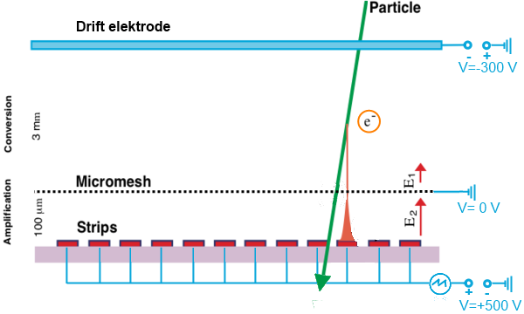
Micro-Mesh Gaseous Detector
Changed from http://en.wikipedia.org/wiki/File:MMPrincipe.png
Notes:
Higher rate because avalanche-effect is only in small part of the chamber
Each readout-strips can induce a signal → position of the particle is detected

Slide 7
Problems at ATLAS with Micromegas

Slide 8
Dust between Mesh and Strips
Changed from http://en.wikipedia.org/wiki/File:MMPrincipe.png
Notes:
Dust between Mesh and the strips cannot be avoided in large scale → cleanage was impossible

Slide 9
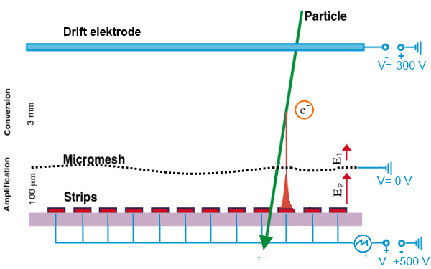
Irragularities of the Electric Field
Notes:
Difficulties is producing mesh and strips in large scale → there are no machines

Slide 10
Our tasks

Slide 11
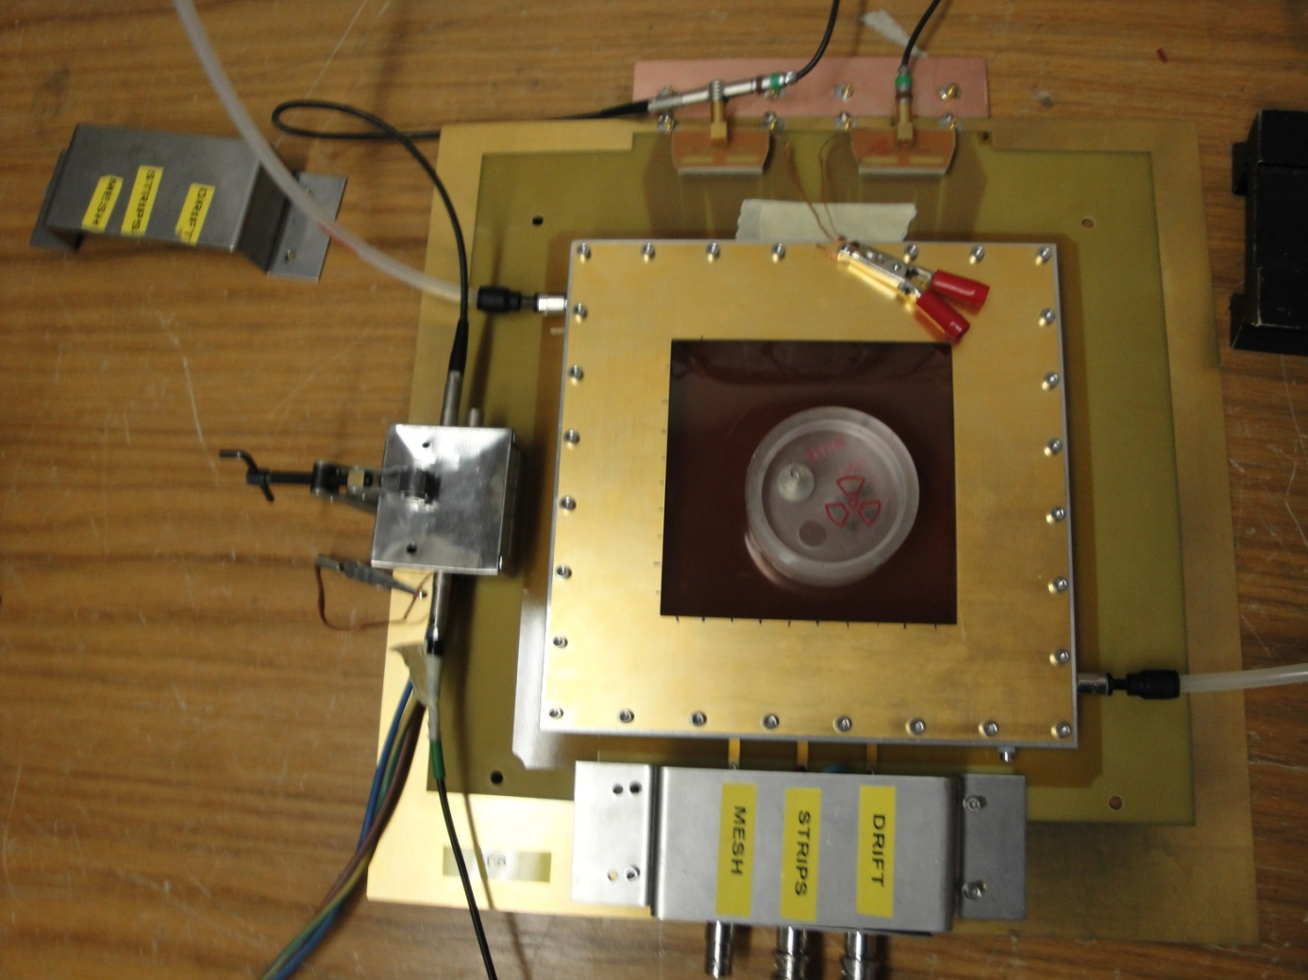
Building a Micromegas Detector
Gas in
Fe55
Preamplifier
Gas out

Slide 12
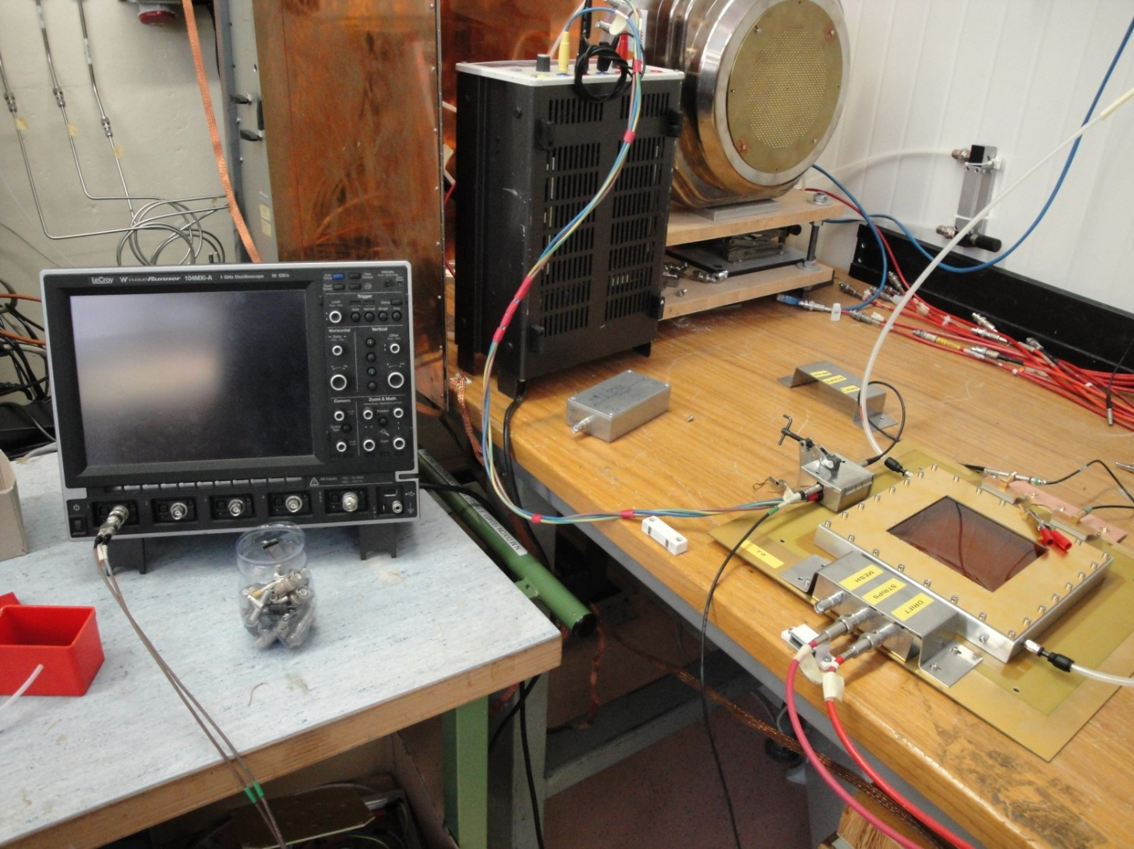
Building a Setup for Measurements
To Power Supply
Oscilloscope
To Amplifier

Slide 13
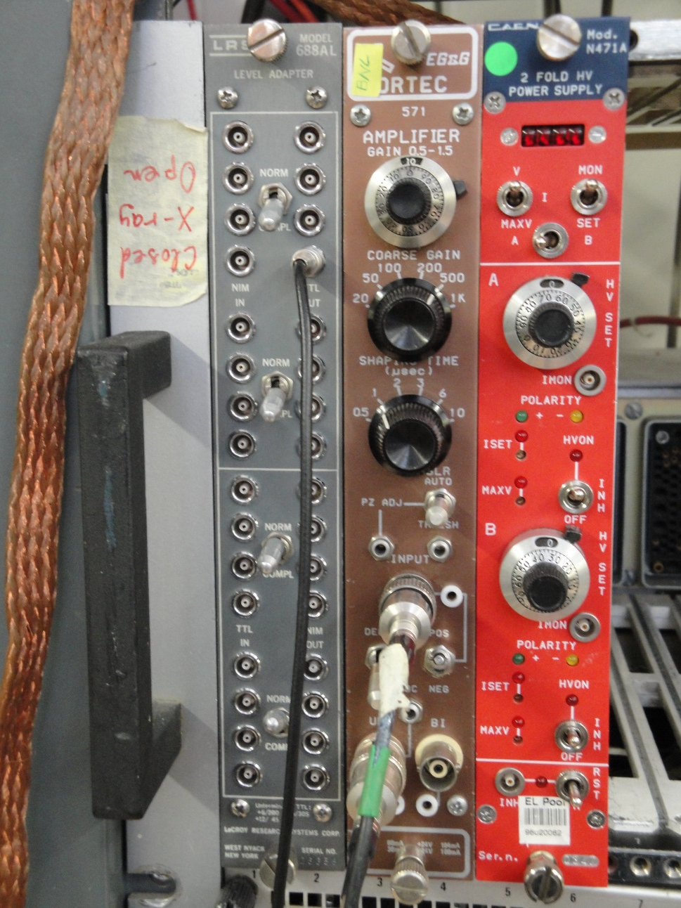
Building a Setup for Measurements
A Strips: +534V
B Drift: -300V

Slide 14
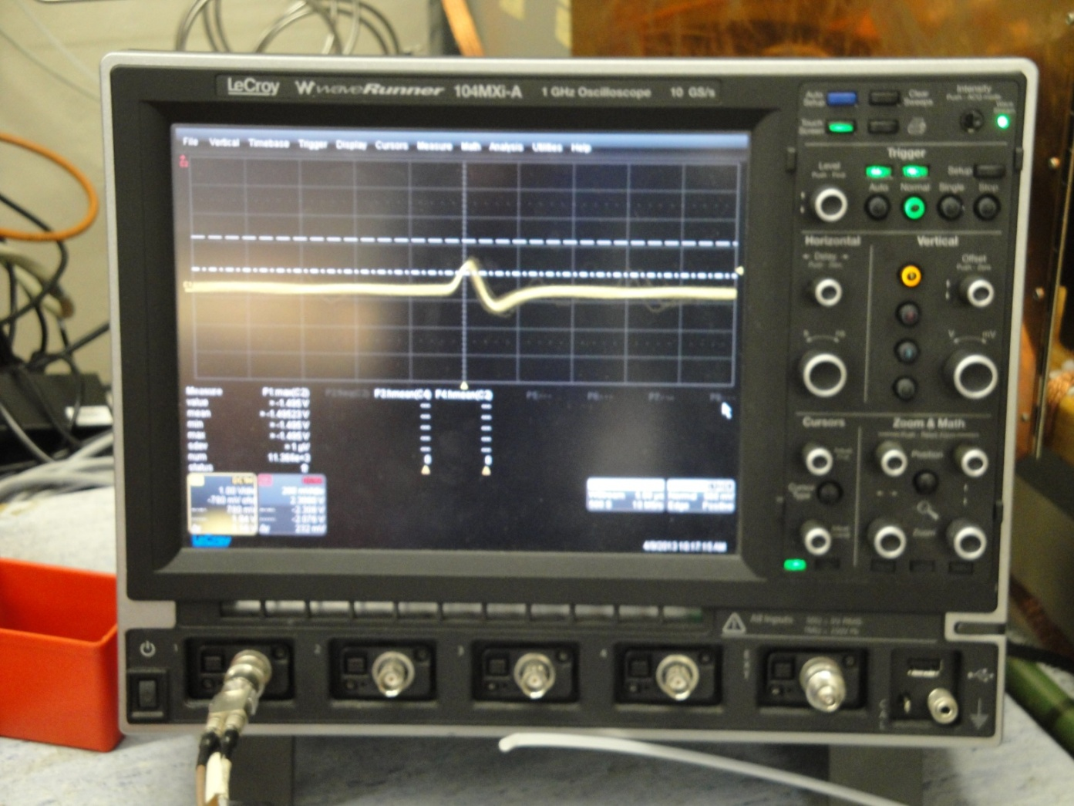
Our Measurements
Notes:
A signal from the micromegas detector

Slide 15
Our Measurements
Fe55: radioactive source
6 keV
Ar: Excitation
Notes:
First peak: excitation of Ar
Second peak: Fe55
→ Position depends on gain in the detector ➔ Gain=# of electrons in strip/# of ionisations ➔ Gain depends on electric field, gas, …

Slide 16
Peakposition
Deviation from average

Slide 17
Building a Micromegas Detector
Gas in
Fe55
Preamplifier
Gas out

Slide 18
Full Width at Half Maximum (FWHM)
Half Maximum
FWHM

Slide 19
Gain Curve
Notes:
Higher voltage → higher electric field → bigger gain → peakposition moves to higher channel

Slide 20
Measurement of cosmic radiation

Slide 21
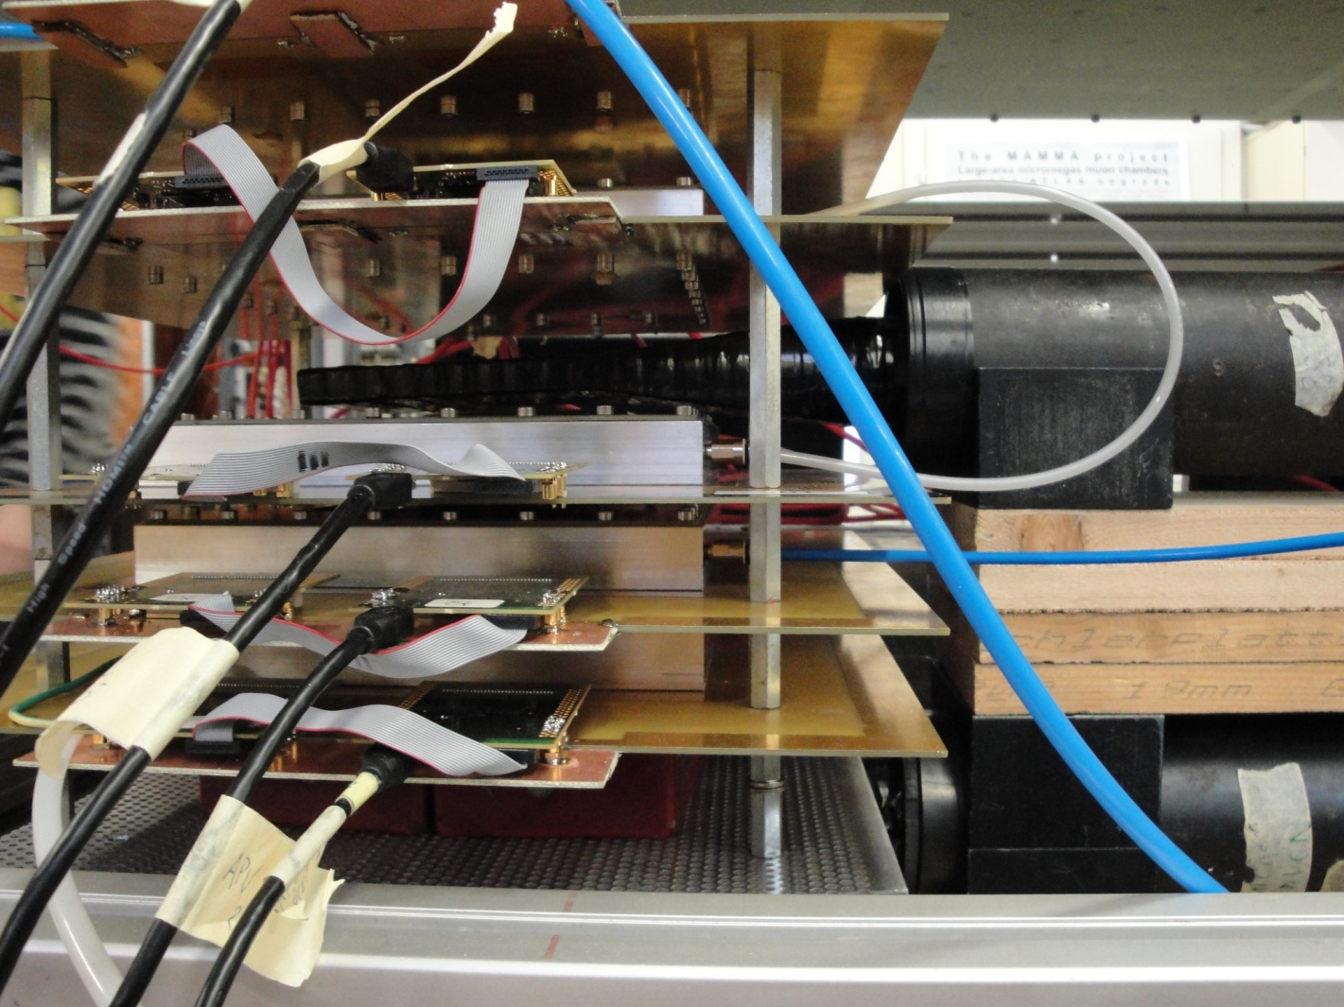
Setup
Micro-megas
Scintillators
Lead
Notes:
Scintillators: measurements are only saved, if both scintillators detect a particle → only high energy particles because of lead
Depending on which strips a signal is induced, the path of the particle can be detected

Slide 22
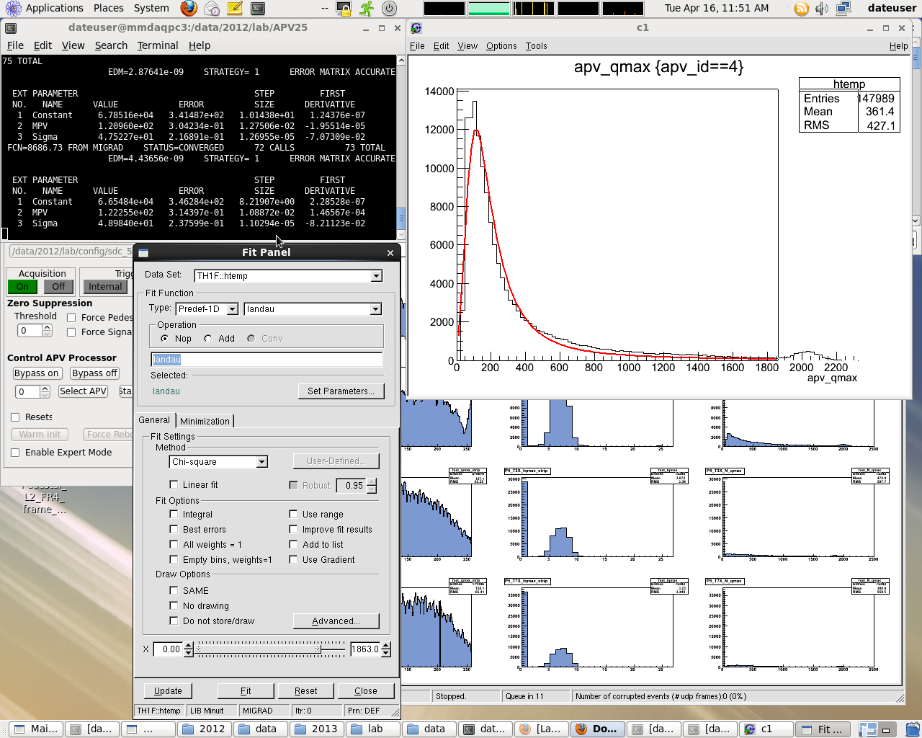
Our Measurements
Data of a Micro-megas detector with fitting line
Console
Fit Panel

Slide 23
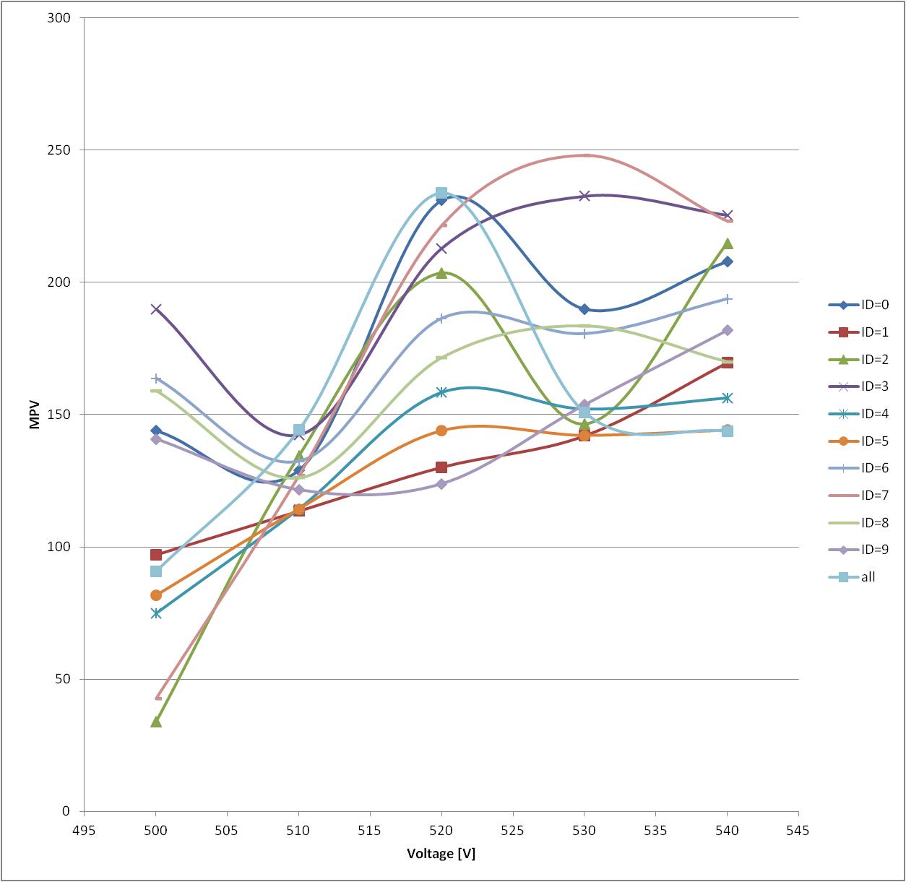
Comparision of different Detectors
Notes:
Very bad results → normally there should be gain curves
Reasons: fitting not always very well, noise

Slide 24
Conclusion

Slide 25
Thank you for giving us the chance to come to CERN and have 12 great days!
Notes:
Practical Experiences
Interesting insights into the work in a Lab
Super supervisors
Good explanations for difficult facts about ATLAS
- Not much work

