Slide 1
General holomorphic pure supergravity and its cosmology
Generalization of Supergravity
19th International Summer Institute on Phenomenology of Elementary Particles and Cosmology
Takahiro Terada
Univ. of Tokyo, Japan
Sergei V. Ketov and TT,
JHEP07(2013)127,
arXiv:1304.4319 [hep-th]
Supersymmetrization of Modified Gravity

Slide 2
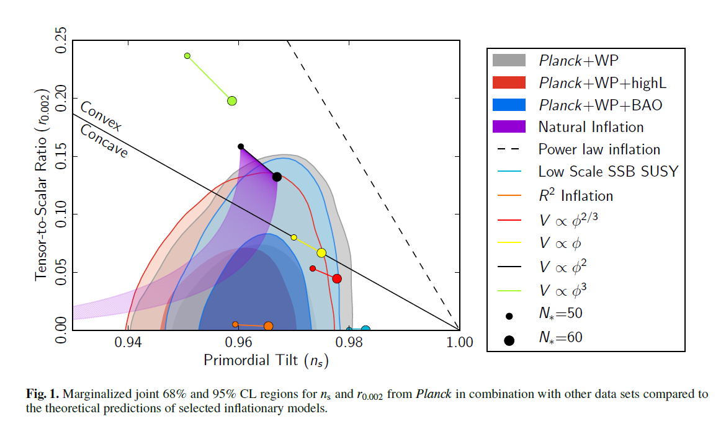
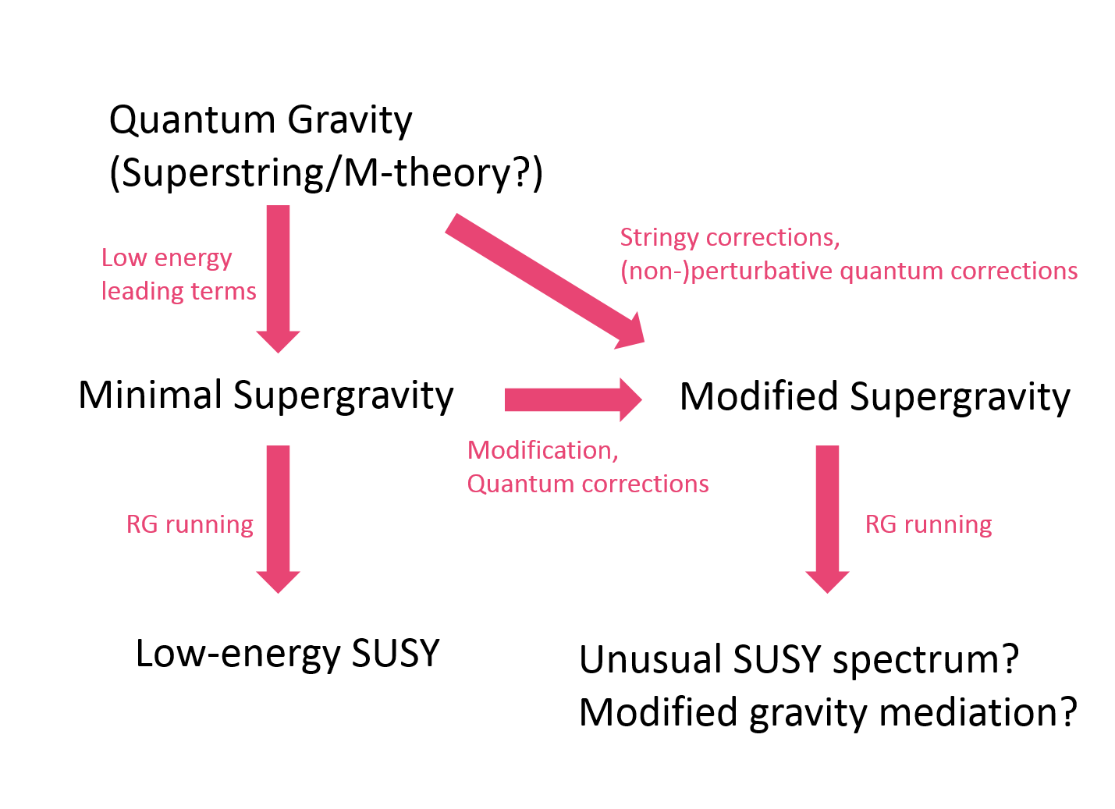

Planck collaboration, arXiv:1303.5082
Many reasons to do that!!
pure theoretical interests
stringy/quantum corrections
potential applications to pheno
application to inflation
to embed modified gravity into fundamental theory, etc.
$$G_{μν}=8πGT_{μν}$$

Slide 3
Positioning of the work
Supersymmetrization
Simple
$ℛ$
ℛ
$F(ℛ,𝒲)$ supergravity
𝐹(ℛ,𝒲) supergravity
$F(ℛ)$ supergravity
𝐹(ℛ) supergravity
S.J. Gates, Jr. and S.V. Ketov, Phys. Lett. B674 (2009) 59
Our work
D. Z. Freedman, P. van Nieuwenhuizen and S. Ferrara, Phys. Rev. D 13 (1976) 3214;
S. Deser and B. Zumino, Phys. Lett. B 62 (1976) 335.
$R$
𝑅
$f(R,C)$ gravity
𝑓(𝑅,𝐶) gravity
$f(R)$ gravity
𝑓(𝑅) gravity
Our work
A. De Felice and S. Tsujikawa, Living Rev. Rel. 13 (2010) 3 and references therein.
A. Einstein, 1915
NEW
NEW
General
Bosonic sector

Slide 4



New action for supergravity
$$ℒ=∫d^{2}Θ2ℰ F\left(ℛ,𝒲\right)+H.c.$$
where $F$ is a holomorphic function.
$$e^{−1}ℒ=−\frac{1}{4}\left(−\frac{1}{3}R−\frac{2}{3}ie_{a}^{m}𝒟_{m}b^{a}+\frac{4}{9}M^{∗}M+\frac{2}{9}b^{a}b_{a}\right)\left.\frac{∂F}{∂ℛ}\right|−M^{∗}\left.F\right|$$
$−\frac{1}{2304}ε^{ρλ}\left(R_{λ\dot{ρ}γαβ}^{\dot{ρ}}+iε_{λα}σ_{β\dot{ρ}}^{m}𝒟_{m}b_{γ}^{\dot{ρ}}\right)\left(R_{ρ\dot{σ}δεφ}^{\dot{σ}}+iε_{ρδ}σ_{ε\dot{σ}}^{n}𝒟_{n}b_{φ}^{\dot{σ}}\right)\left.\frac{∂^{2}F}{∂W_{δεφ}∂W_{αβγ}}\right|$
+H.c.

Slide 5




$f(R,C)$gravity and Inflation
$$S=−\frac{1}{2}∫d^{4}x \sqrt{−g} f(R,C)$$
Starobinsky model + correction term ($∝b$) as a simple non-trivial example:
$$f\left(R,C\right)=R−\frac{R^{2}}{6M^{2}}+bRC^{μνρσ}C_{μνρσ}$$
where $M$ is the inflaton mass and $b$ is a coupling constant.
f(R) gravity
equivalent
Scalar-tensor gravity
f(R,C) gravity
equivalent
scalar-tensor gravity with Weyl tensor
$$V=\frac{3}{4}M^{2}{\left(1−e^{−\sqrt{2/3}σ}+bC^{μνρσ}C_{μνρσ}e^{\sqrt{2/3}σ}\right)}^{2}$$

Slide 6
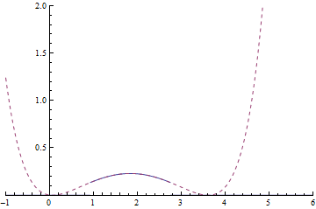
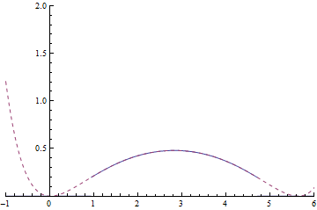
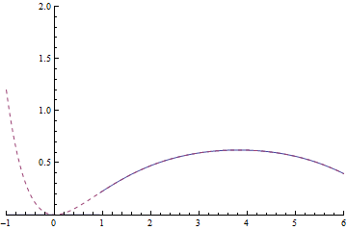
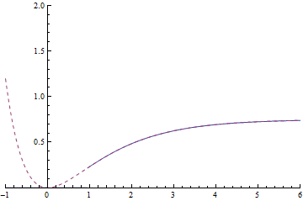
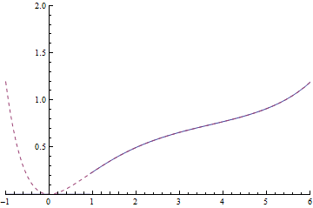
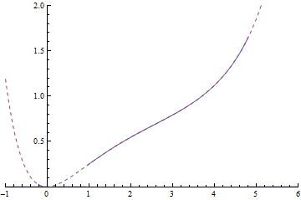
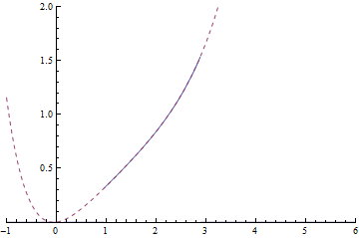





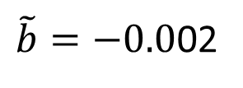



$$V=\frac{3}{4}M^{2}{\left(1−e^{−\sqrt{2/3}σ}+\tilde{b}e^{\sqrt{2/3}σ}\right)}^{2}$$
$$\tilde{b}≡bC^{μνρσ}C_{μνρσ}$$
$$\tilde{b}=−0.05$$
$$\tilde{b}=−0.01$$
$\tilde{b}=−0.0$02
$$\tilde{b}=0$$
$$\tilde{b}=0.002$$
$$\tilde{b}=0.01$$
$$\tilde{b}=0.05$$

Slide 7

General holomorphic pure supergravity and its cosmology
19th International Summer Institute on Phenomenology of Elementary Particles and Cosmology
Takahiro Terada
Univ. of Tokyo, Japan
Sergei V. Ketov and TT,
JHEP07(2013)127,
arXiv:1304.4319 [hep-th]
$$ℒ=∫d^{2}Θ2ℰ F\left(ℛ,𝒲\right)+H.c.$$
Summary
There are many reasons to study modified supergravity.
We proposed a new type of action for modified gravity and supergravity.
It’s interesting to compare the results with future CMB data.

