Slide 1
1-2 Mass Degeneration
in the Leptonic Sector
Hiroyuki ISHIDA
(Tohoku University)
18th. Aug 2013 @SI 2013
Collaboration with : Takeshi ARAKI (MISC)
Ref ; T. Araki and H.I. arXiv : 1211.4452 [hep-ph]

Slide 2

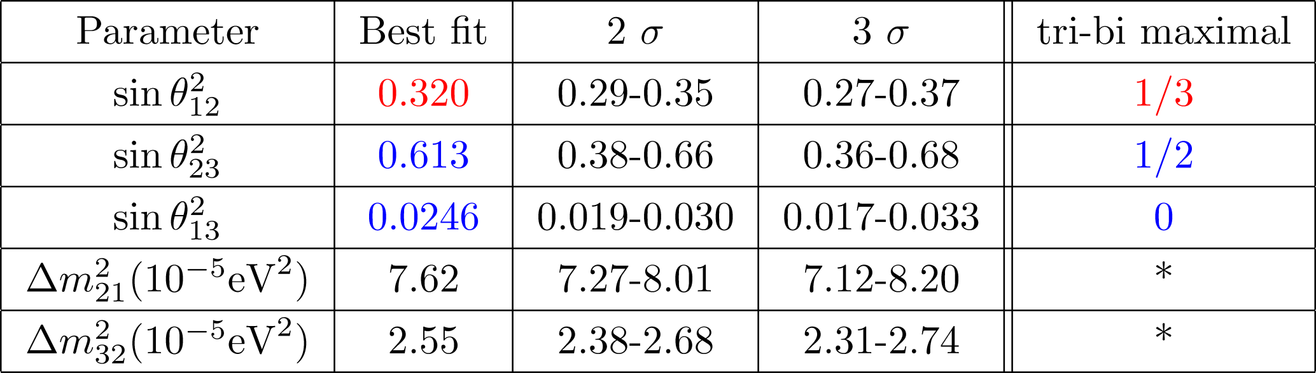


Introduction
On Mar. in 2012, non-zero was discovered @DAYA-BAY.
Phys. Rev. Lett. 108 (2012)
D. V. Forero et al. Phys. Rev. D 86 (2012)
and do not match the values predicted by tri-bi maximal anymore.
We need to reconsider about the origin of flavour structure!

Slide 3
Motivation
We would like to understand the origin of flavour structure
by introducing some symmetries,
BUT…
Even if such symmetries were ensured at very high energy,
it should be broken or hidden at low energy.
Furthermore, we don’t know how to break these symmetries.
Spontaneously? or Explicitly?
Slightly? or Grossly?
What is the guidepost?

Slide 4
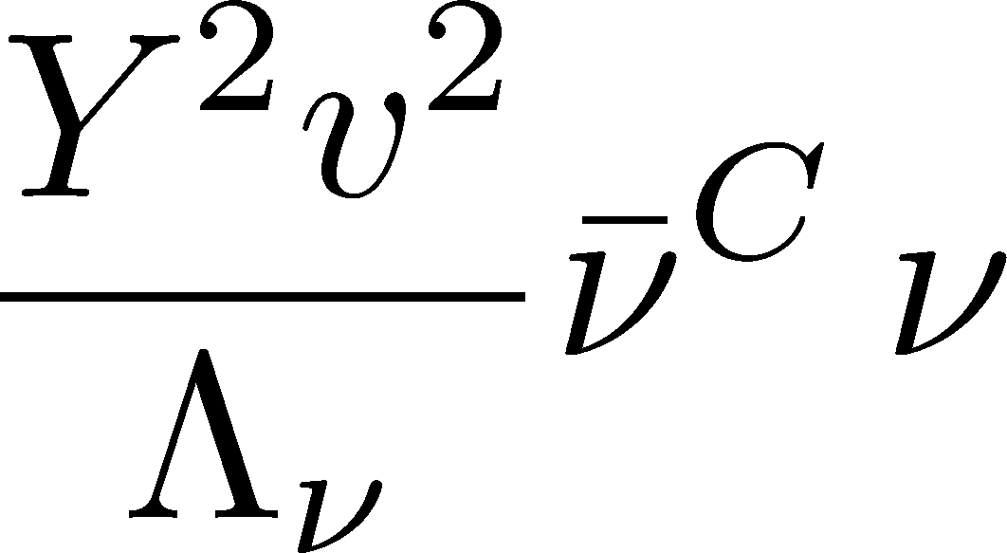
Motivation
One of the possible guide for searching such broken symmetries
’t Hooft’s criterion (1980)
If a new symmetry appears in the model when arbitrary parameters set to zero,
such parameters are naturally small.
For example ; Lepton number symmetry
In the limit of massless neutrinos in the effective theory,
the lepton number symmetry appears.
: this effective term violates lepton number 2 units.

Slide 5
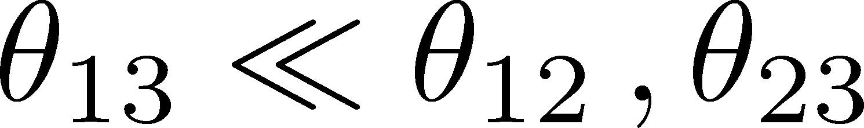
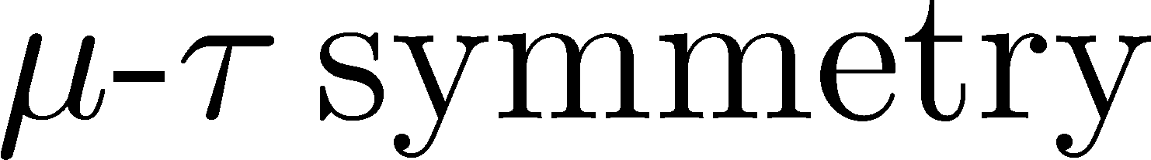

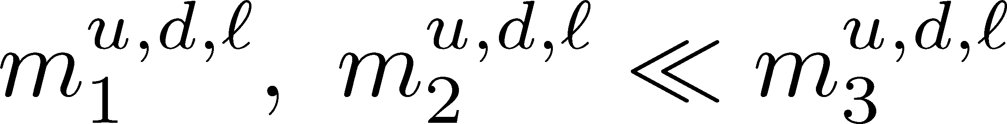
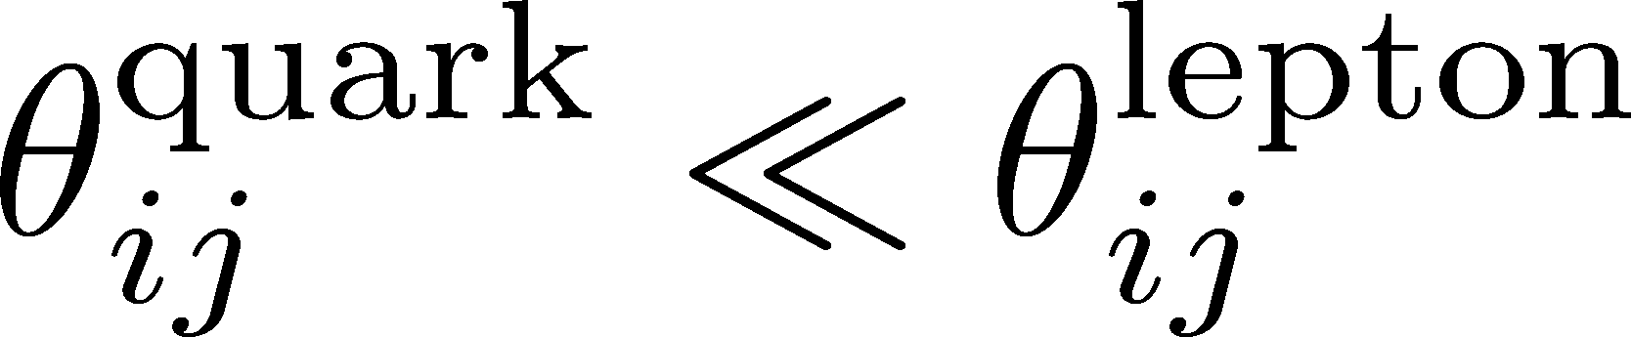
Motivation
Candidates of small parameters in lepton sector
1.
T. Fukuyama and H. Nishiura (1997)
G. Altarelli and F. Feruglio (1998) etc..
2.
3.
4.
This work
5.
What happens when we focus on these small parameters?

Slide 6
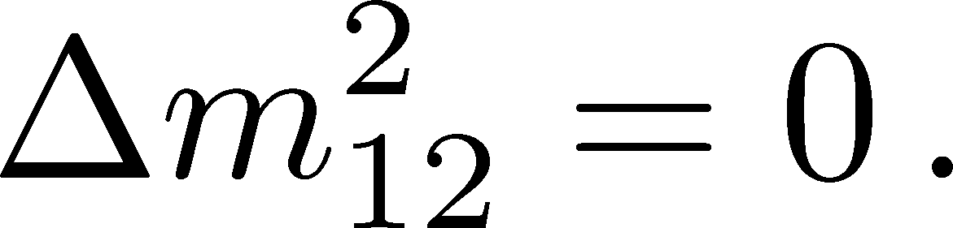

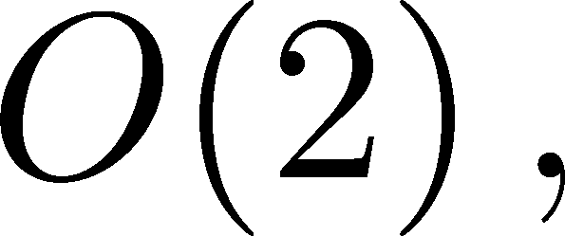
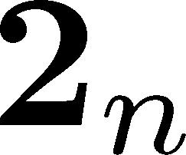
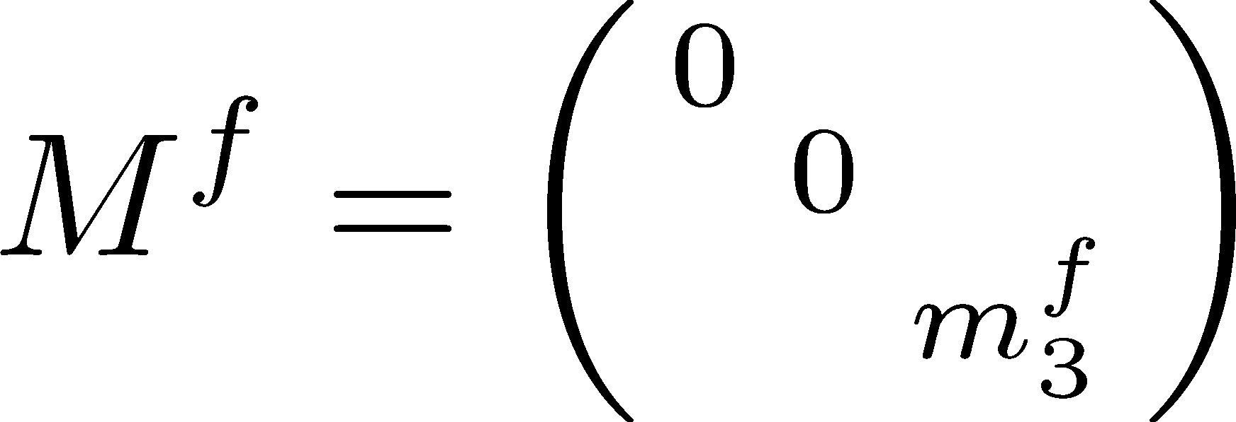
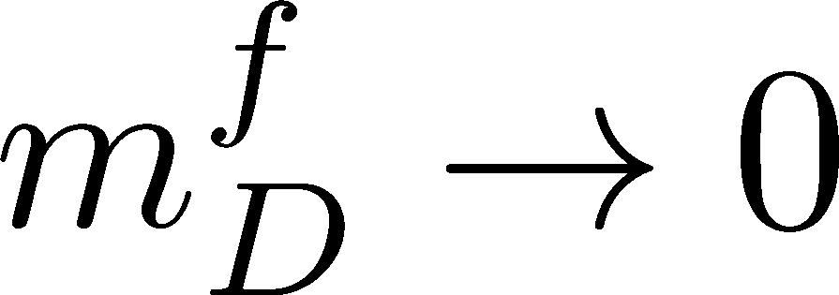

Motivation of Orthogonal Symmetries
Here, we take solar neutrino mass squared difference to be zero ;
In this limit, the
symmetry appears in the neutrino sector :
In other words, the 1st and 2nd generation of neutrinos
are embedded into a doublet representation of
e.g., .
This type of mass spectra cannot apply to charged fermion sector,
because they are strongly hierarchical between the 3rd generation and others.
For now, we assume

Slide 7
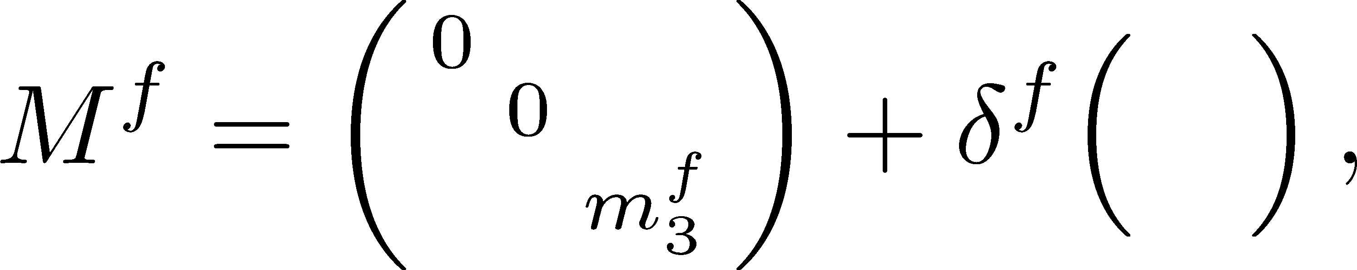
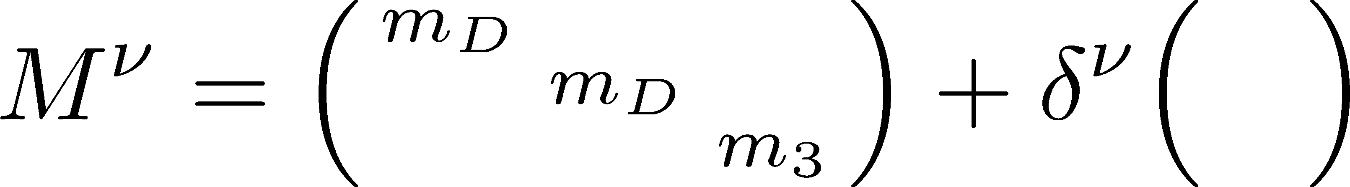
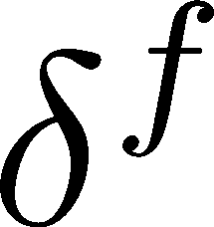

Motivation of Orthogonal Symmetries
To construct realistic mass matrices, we introduce small breaking terms as
Charged fermion sector
Small breaking parameters
In this situation, both of 2-3 and 1-3 mixings depend on .
Small
On the other hand, 1-2 one does not strongly depend on .
Need not so small
Compatible with mixing pattern of CKM matrix
Neutrino sector
Because neutrino mass spectrum might be milder than charged fermion sector,
the leading term is close to the identity matrix.
Weakly depend on
Large mixing in the PMNS matrix
Degeneracy of the 1st and 2nd generation seems to a good starting point.

Slide 8
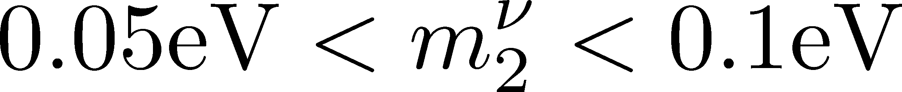
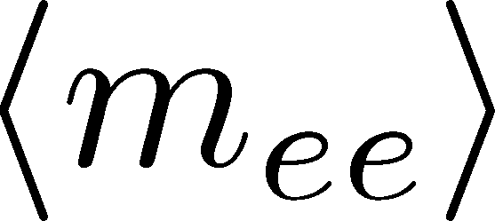
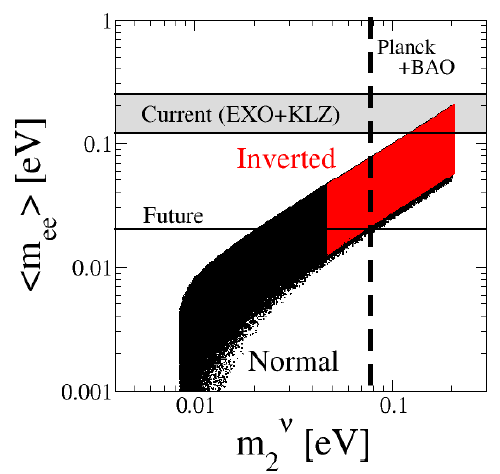
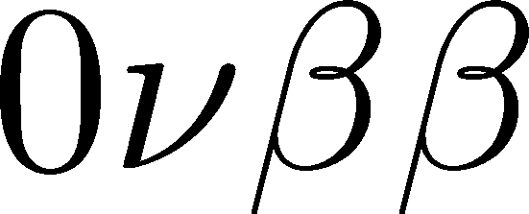
Motivation of Degenerated Masses
Neutrinoless double beta decay
If the neutrino masses are degenerated, e.g. ,
the effective mass, , can be estimated as
In both case, the effective mass is finite
decay can be observed in near future?
OR
Such degenerated region will be excluded?
Actually, such region is being excluded by Planck!
Degenerated region is very attractive!

Slide 9
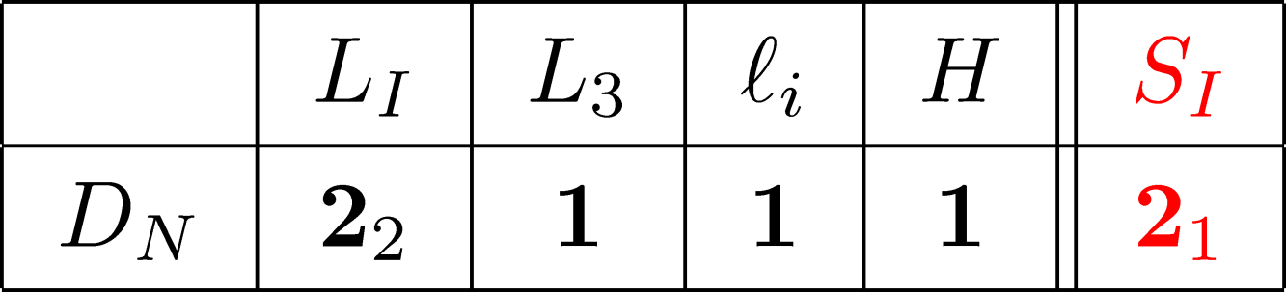
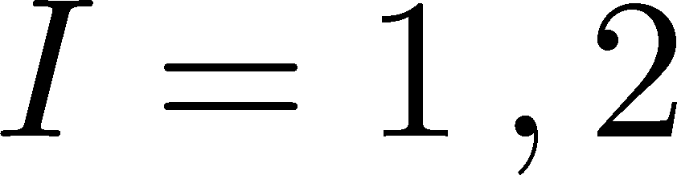




Model
Charge assignments (The simplest extension of the MSM)
where
and
denote the indices of generations.
and
represent the left- and right-handed leptons, respectively.
means SM Higgs field.
is SM gauge singlet scalar field.
The VEVs of singlet scalar fields can be considered into two patterns.

Slide 10
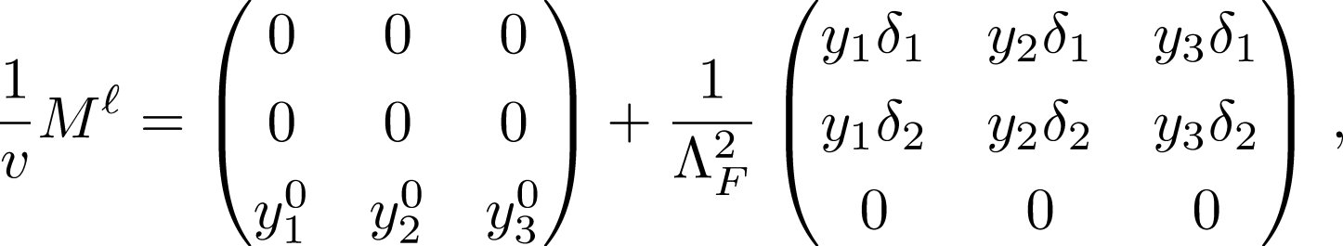
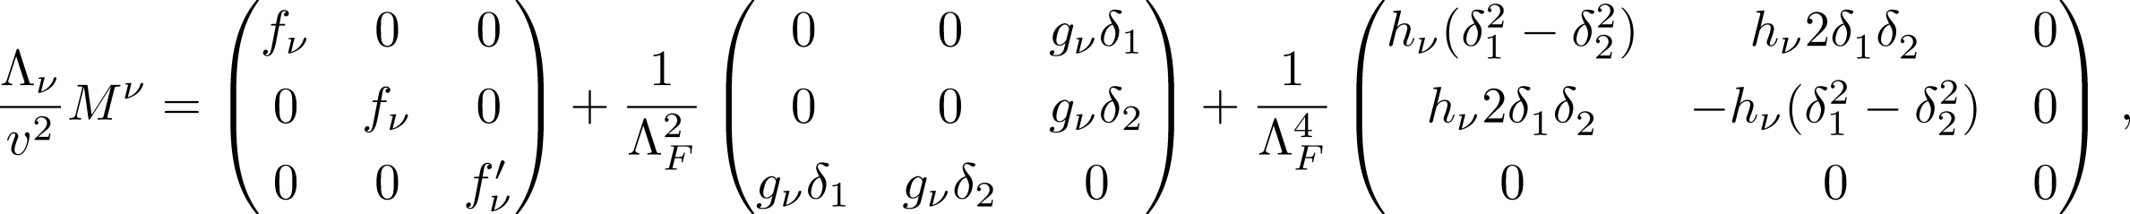

Property of our Model
・Real scalar case
where are functions of the VEVs of singlet scalar.

Slide 11
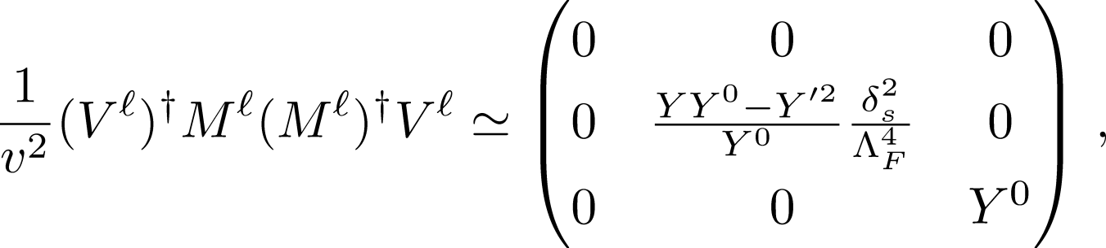
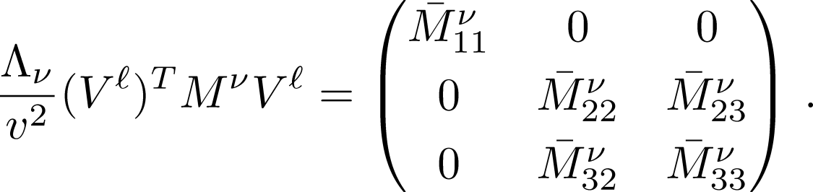




Properties of our Model
・In the basis of charged lepton mass matrix is diagonalized,
Electron is massless
and are zero
These features are by remaining symmetry
after breaking symmetry.
Smallness of electron mass and
is related with this symmetry.

Slide 12

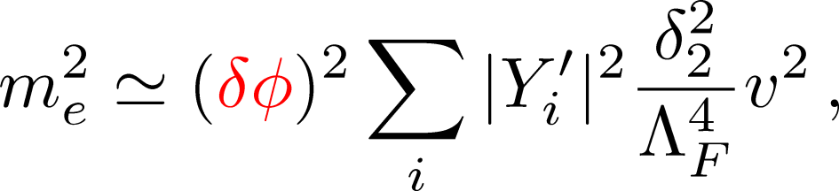
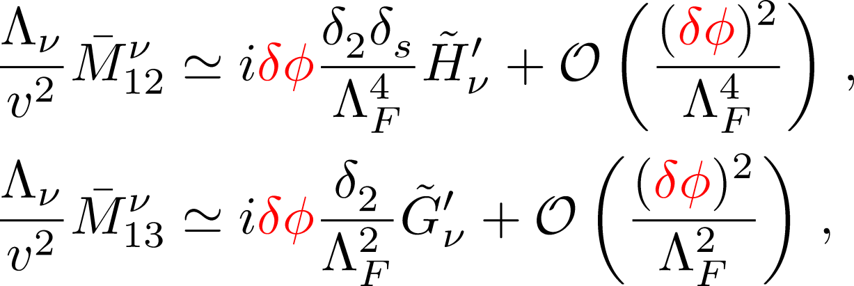


Property of our Model
・Complex scalar case
The remained symmetry is violated by complex VEVs of .
Electron mass is induced as
while 12 and 13 elements of the neutrino mass matrix are given as
where and are functions of couplings and phases.

Slide 13
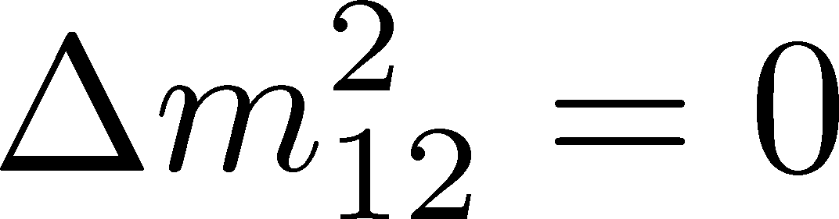

Conclusions
・We discuss a model in which 1st and 2nd generations are degenerated
motivated by .
・In this model, mixing patterns of quarks and leptons are realized naturally
due to dependence on small breaking parameter δ.
・To illustrate such a degenerate model,
we consider a D_{N} flavor symmetric model which is a discrete subgroup of .
・We introduce one new D_{N} doublet and SM gauge singlet scalar, .
・Due to residual symmetry, electron mass and tend to be small.
・Our model has a lot of parameters therefore, we cannot predict anything.
However, we need not to assume hierarchy among the coupling constants
in order to reconstruct experimental data.

Slide 14
Thank you for your attention!

Slide 15
Back up

Slide 16
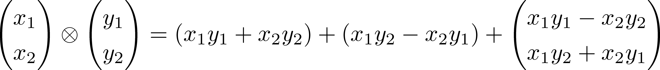




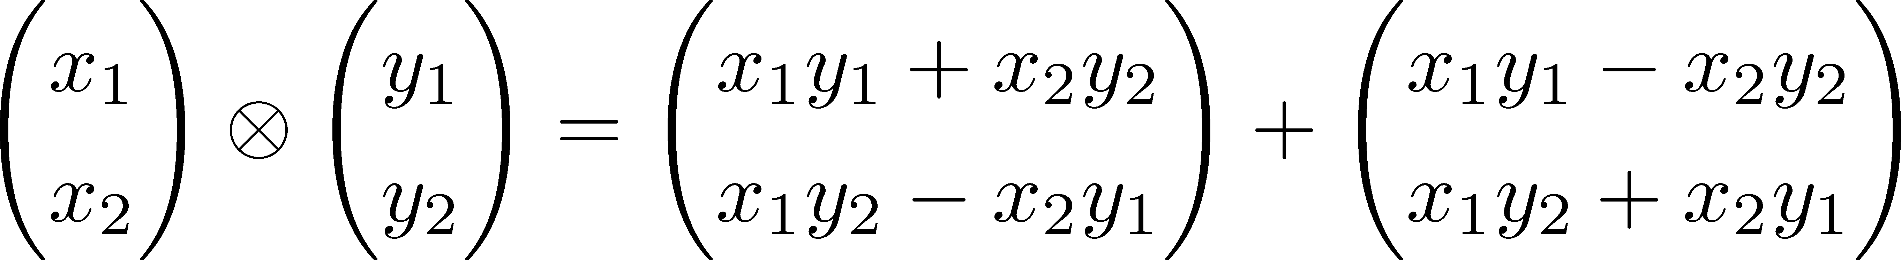

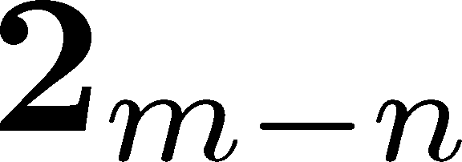
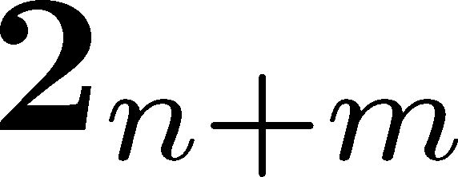
D_{N} flavour symmetry
D_{N} flavour symmetry is a dihedral group and discrete subgroup of .
This symmetry has two singlet and some doublet irreducible representations.
・Multiplication rules (same as )
These extra charges are a little bit important for the model.

Slide 17
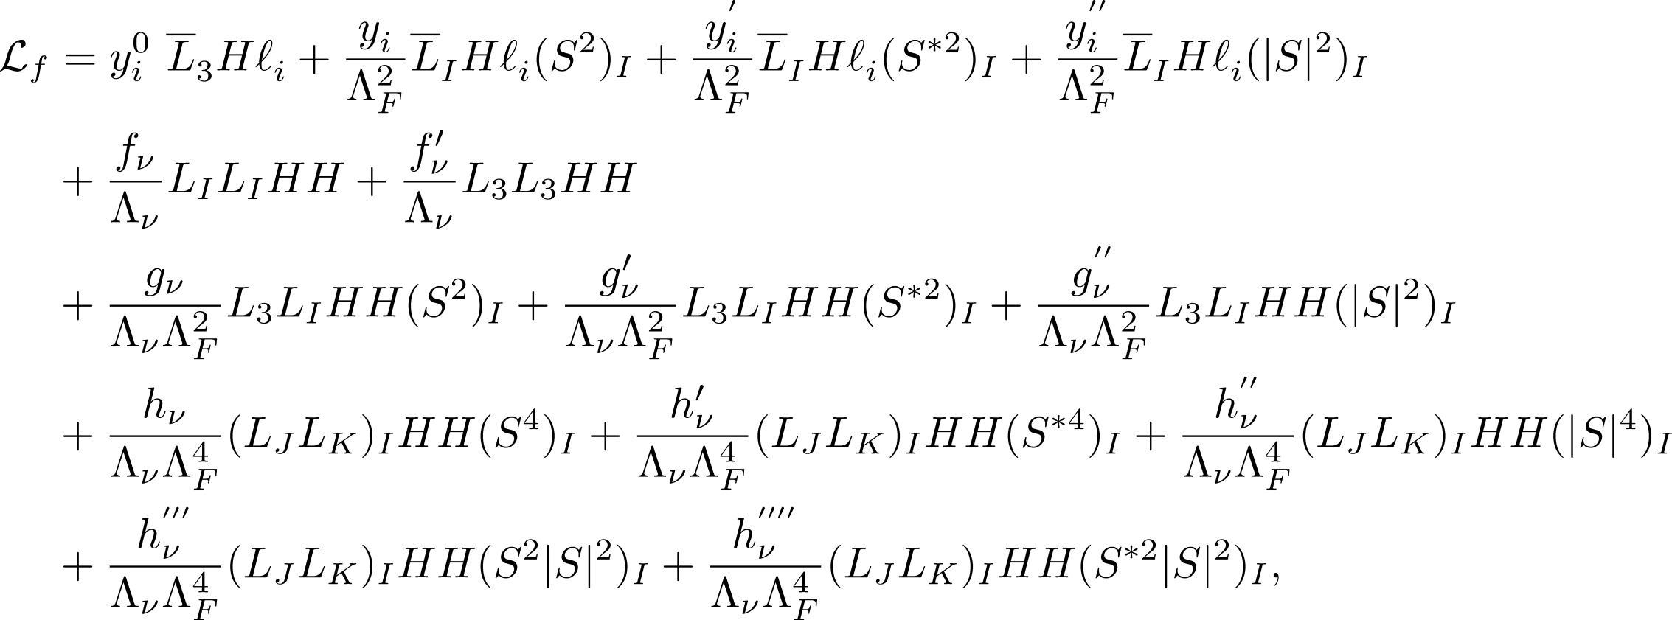

Model
Lagrangian invariant under D_{N} (up-to NNLO)
Froggatt-Nielsen like structure due to D_{N}
A typical energy scale of D_{N} symmetry
Dimension five Weinberg operator
with an energy scale .

Slide 18
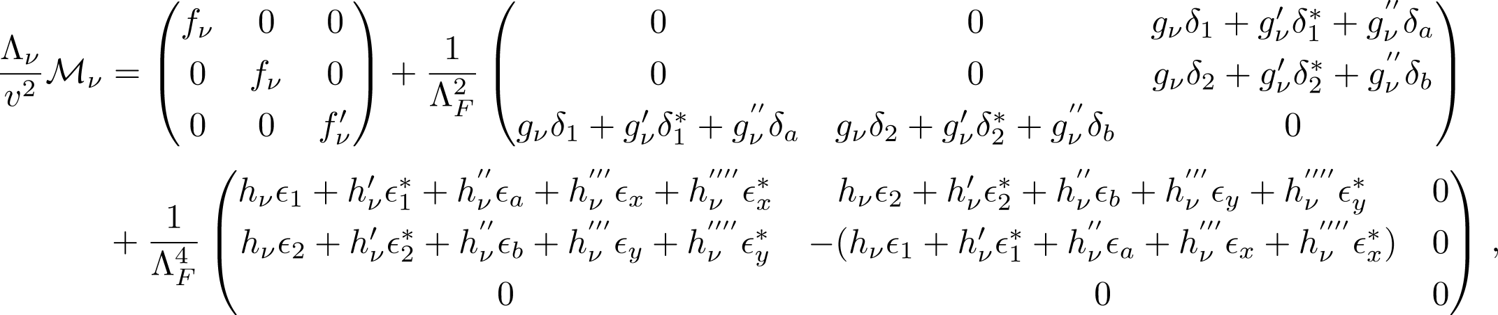


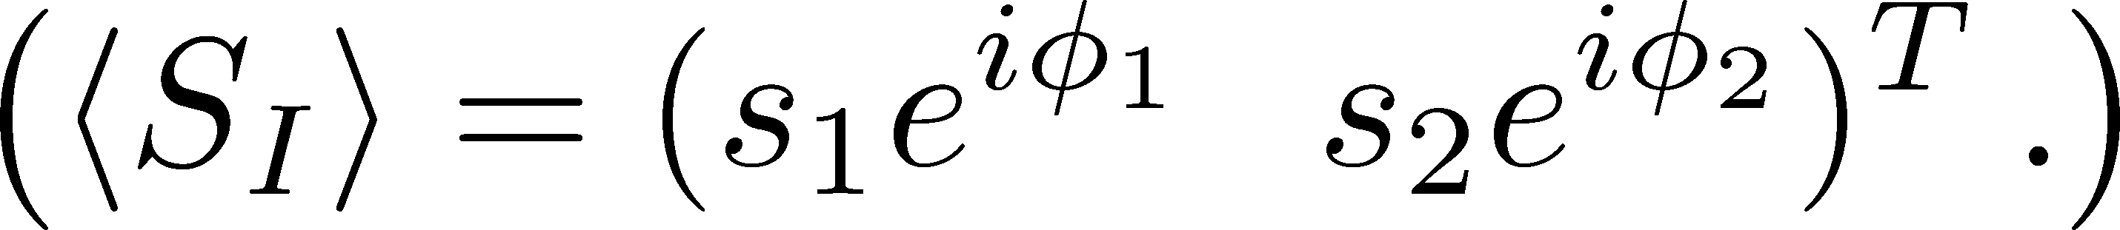
Model
After scalar fields have vacuum expectation values,
mass matrices are given as follows :
where,
s and
s are some functions of
and
There are so many parameters = No prediction.
But we note that there is no strong hierarchy among each couplings.

Slide 19
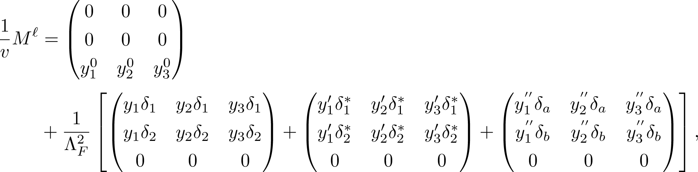

Feature of mass matrices
The mass matrix for charged lepton sector
rank=1
If VEV of is real, the second term is also rank=1 matrix,
therefore we can not obtain the electron mass.
Here, we suppose complex VEVs for the scalar field,
the second term is rank=2 matrix.

Slide 20
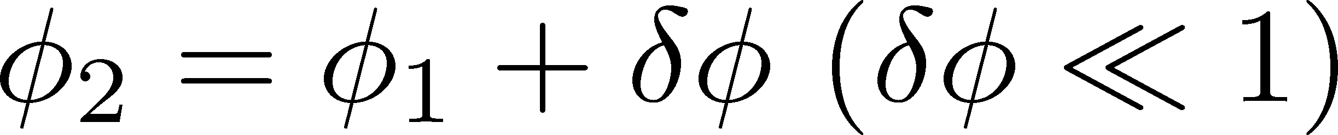
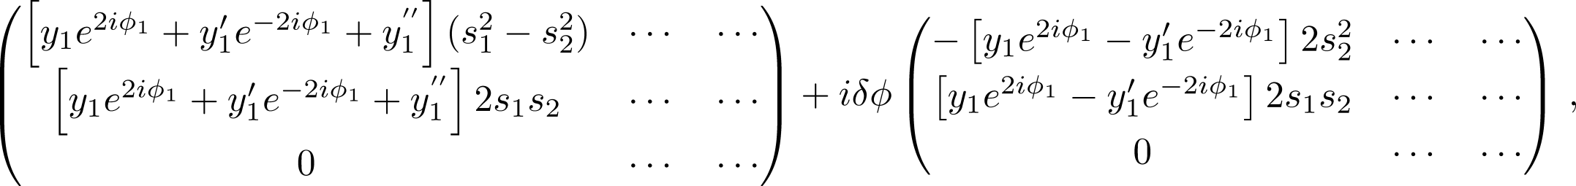

Feature of mass matrices
This model has a relationship between electron mass and .
When ,
the second term of charged lepton mass matrix can be divided into
Each term is rank = 1 matrix.
Correspond to muon mass
Correspond to electron mass
Small electron mass is induced by spontaneous CP violation,
that is, non-vanishing .

Slide 21
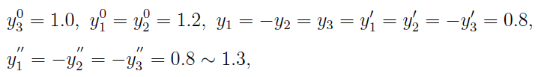
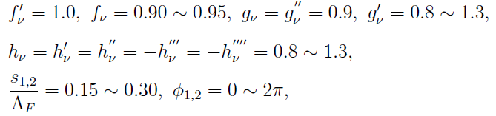
Parameter sets (Normal hierarchy case)

Slide 22
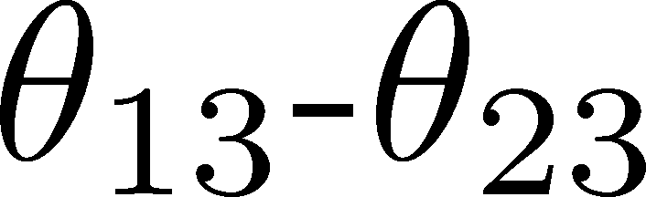
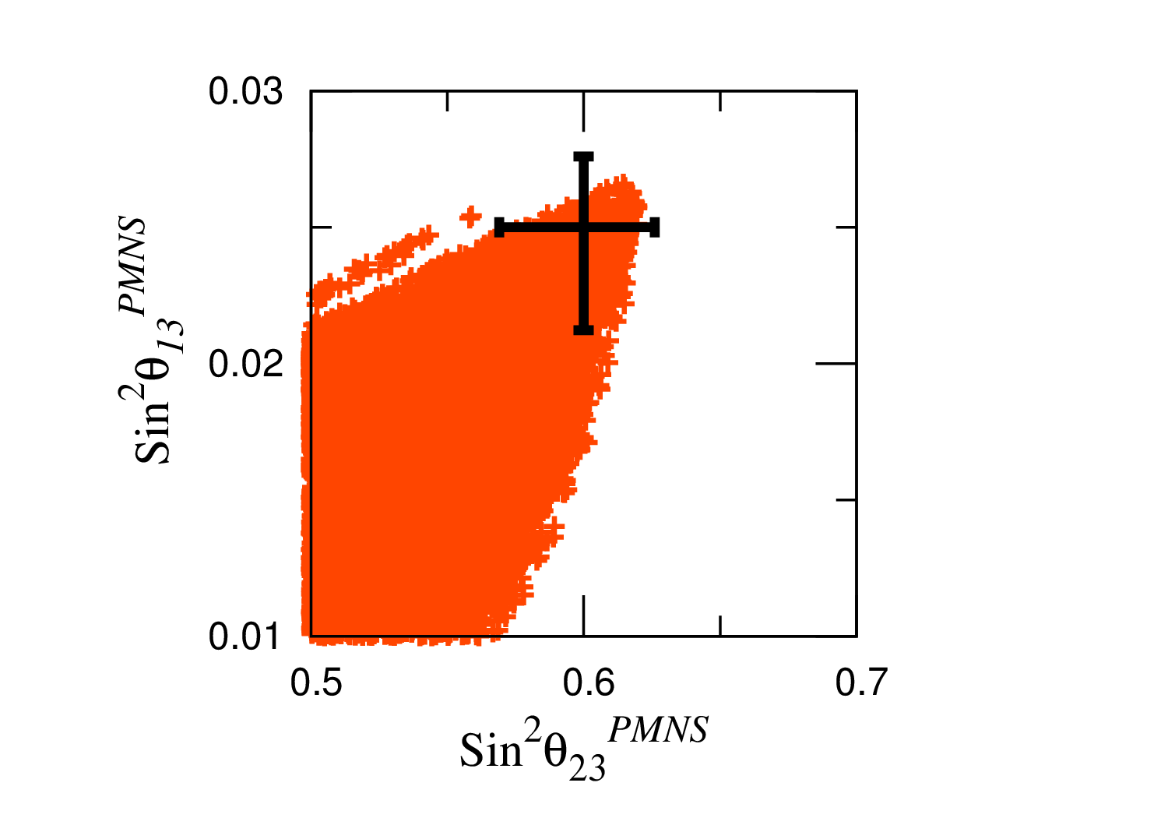
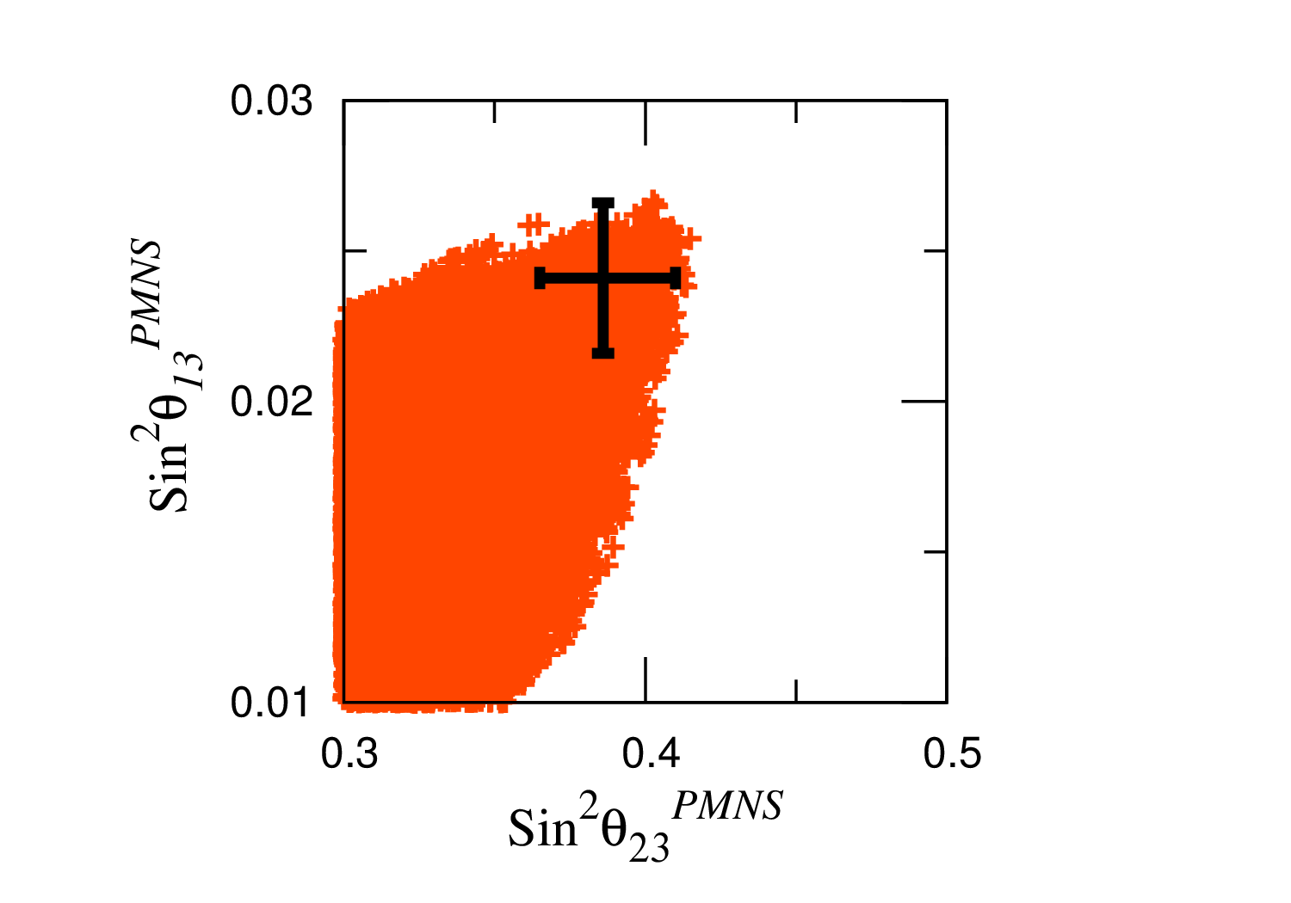
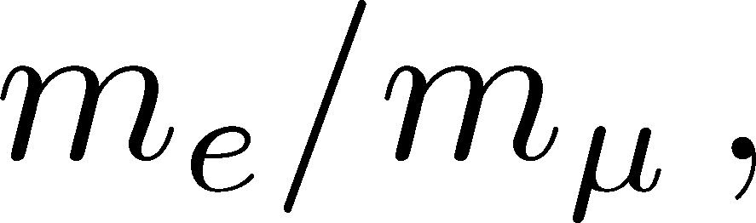
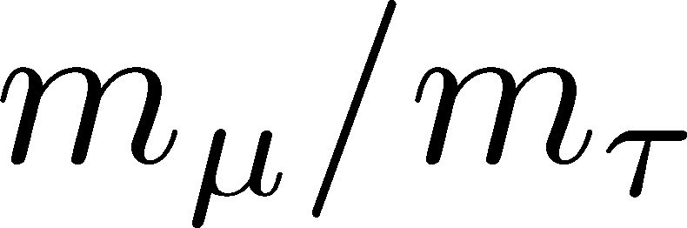




Numerical Analysis ( plane)
NH case
IH case
Constraints
・
and in 1σ range
・
Fogli et al. 1205.5254
Forero et al. PRD 86
Nearly maximal and relatively large are successfully obtained.

Slide 23
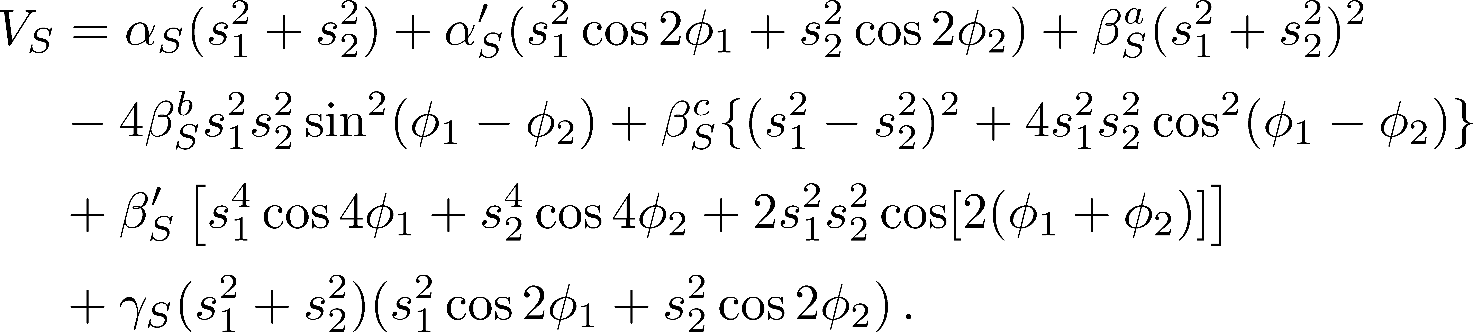
Possibility of Spontaneous CP Violation
We assume that the singlet scalar fields were completely decoupled
from the theory at high energy.
We investigate only the potential of the singlet scalar
Scalar potential

Slide 24
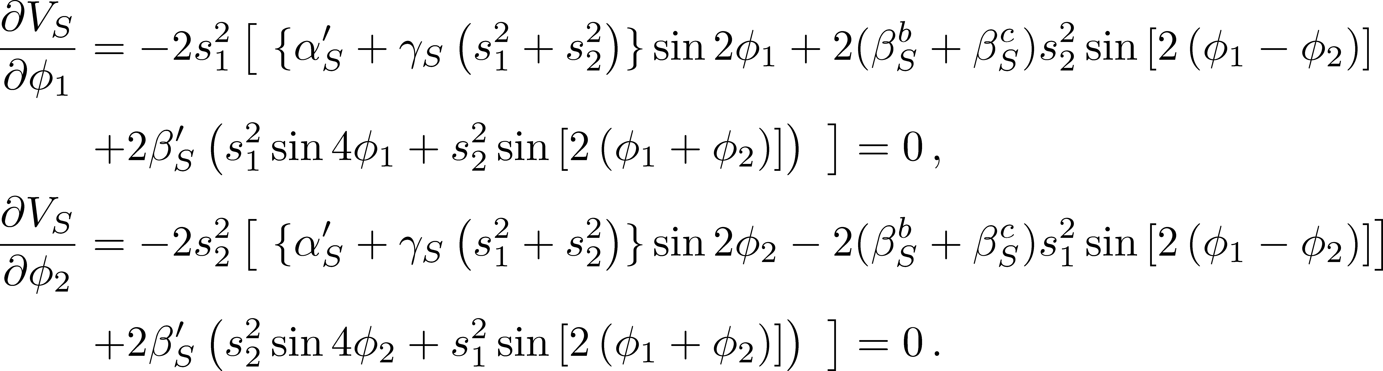
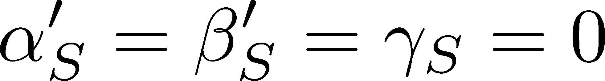
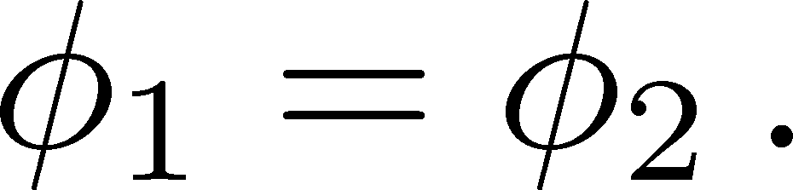
Possibility of Spontaneous CP Violation
The minimization conditions respect with the phases are given as
For simplicity, we set .
Then we get,
These condition suppose

Slide 25
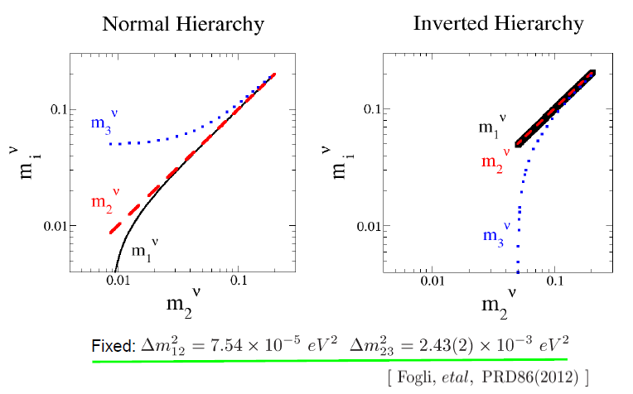
Hierarchy among neutrino masses
Completely degenerate
Focusing region : Partially degenerate
Completely hierarchical
T. Araki @26th neutrino conference

