Slide 1
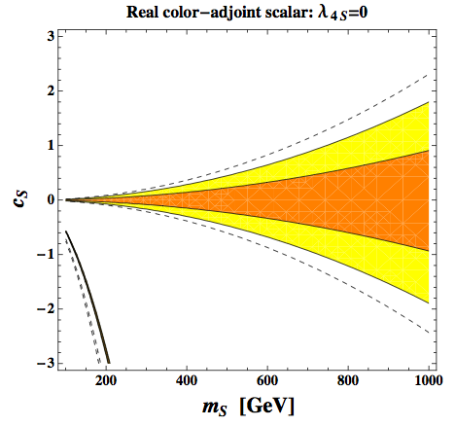
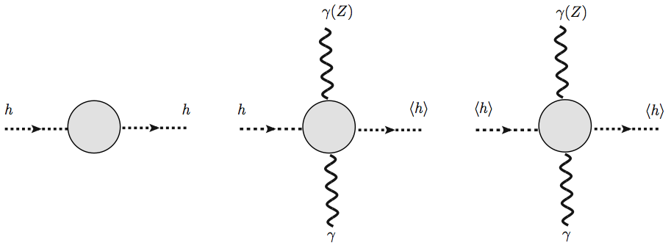
Higgs Physics (III): Precision Measurements
Ian Low
Argonne/ Northwestern
August, 2013 @ SI 2013 Korea

Slide 2
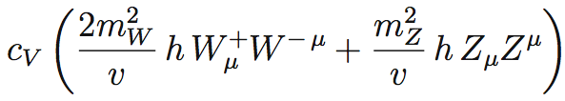
The goal of Precision Higgs measurements: discover new physics through precise determination of Higgs couplings.
“Higgs” boson couplings to SM matters at leading orders:

Slide 3
I will start with the loop-induced couplings and the lessons one could from measuring them precisely.
But in the end we’ll see that we need to know many other (tree) couplings
as well!

Slide 4
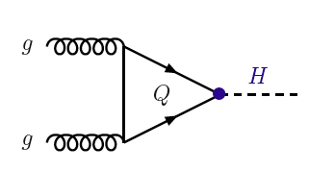
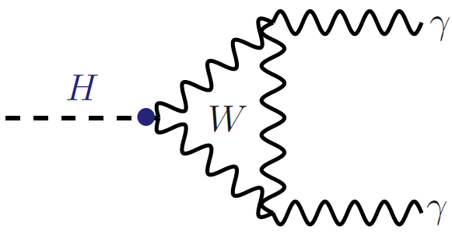
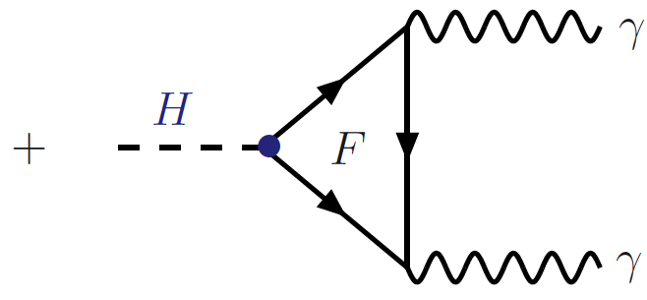
Why loop-induced couplings?
Experimentally
The dominant Higgs production mode at the LHC is through gluon fusion process, a loop-induced process mediated by the top loop in the standard model:
Higgs to diphoton decays are also mediated by the W loop and the top loop:

Slide 5
Why loop-induced couplings?
Theoretically
They are excellent indirect probe to new physics. This is where new physics is likely to show up first!
They are intimately connected to the major guiding principle for physics beyond the SM:
The naturalness principle.

Slide 6
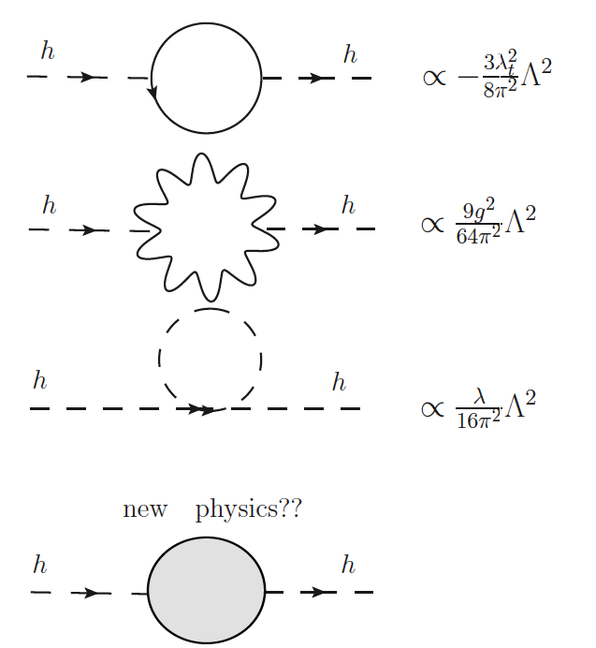
Naturalness:
one-loop quadratic divergences in the Higgs mass is cut off by some “blob” at the TeV scale:

Slide 7
Lock up 10 model-builders in one room and they’ll come up with 10^{N} (N>1) models for the “blob” in no time:
However, no matter what the blob is,
if it carries QCD color, Higgs-glue-glue coupling will be modified.
if it carries weak isopsin or hypercharge, Higgs-photon-photon and Higgs-Z-photon couplings will be modified.

Slide 8
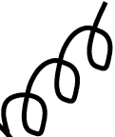

It is simple to see how these statements come about:

Slide 9
Loop-induced Higgs couplings in “natural” EWSB are modified naturally.
Any observed modification in loop-induced couplings is a smoking-gun signal for (un)naturalness.

Slide 10
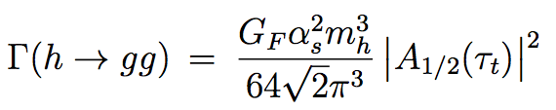
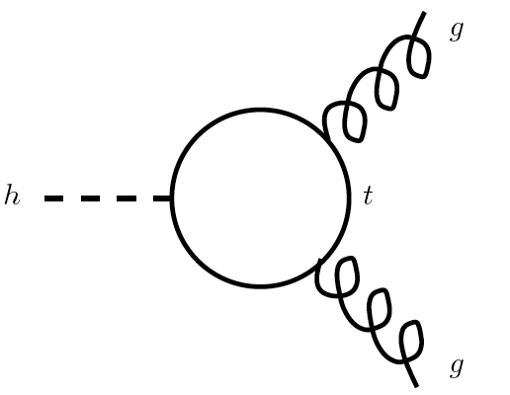



Let’s take a look at the hgg coupling first.
In the SM, it is given by the one-loop diagram
It turns out that, in the heavy top quark limit, the rate is very well-approximated by the (point-like) effective coupling:

Slide 11
If you stare at this picture, there is something wrong about this limit….

Slide 12
If you stare at this picture, there is something wrong about this limit….
Usually when one takes the mass of the loop particle to be infinite, the amplitude should become zero. This is the famous decoupling theorem.
In this case the amplitude goes to a non-zero constant when the top quark mass becomes infinite!

Slide 13
It is instructive to re-write the dim-5 effective coupling as follows:
It is simple to understand the parametric dependence here:
The top Yukawa controls the Higgs coupling to top quarks, hence the linear dependence in the numerator.
The top mass dependence in the denominator comes from the top propagator. There is only one power because it is a dimension-five operator.

Slide 14
It is instructive to re-write the dim-5 effective coupling as follows:
This formulation does suggest decoupling in the heavy top mass limit, except that the top mass is proportional to the top Yukawa coupling, y_{t} , because of the Higgs mechanism.
Then the large top mass limit is equivalent to the large top Yukawa limit. In the end we obtain a non-zero constant, 1/v.
This is the (only) famous counter-example to the decoupling theorem!

Slide 15
One learns two powerful statements from this reasoning:
If there exists a new colored fermion which also receives ALL of its mass from the Higgs mechanism, its contribution is identical to that of the top quark in the heavy mass limit:
  The gluon fusion production rate of Higgs will be increased by a factor of (1+1)² = 4 times.

Slide 16
Applying the statement to the case of fourth generation fermions, the hgg coupling is increased by a factor of (1+1+1)=3, and the gluon fusion cross section would increase by a factor of 3² = 9!
We certainly do not see a 10-fold increased production cross section at the LHC.
This is the most stringent and powerful constraints on fourth generation.
You can forget about fourth generations! (At least fourth generation quarks.)

Slide 17
One learns two powerful statements from this reasoning:
If the particle mediating the loop process does not receive all of its mass
from the Higgs, ie if it has a Dirac mass component:
  Then the large mass limit would not require increasing its coupling to the Higgs. In this case the decoupling WILL happen and the amplitude vanishes in the heavy mass limit.

Slide 18


The expression
needs a little explanation….
If a Dirac mass term is allowed, the new fermion must be vector-like, instead of being chiral like the SM fermions.
Then it couples to the Higgs through the dimension-five operator
So the correction to the production rate conforms to expectation:

Slide 19
Recall that I emphasized there’s intricate connections between naturalness and loop-induced couplings:

Slide 20
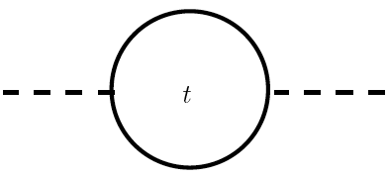


We have seen that a fourth generation fermion enhance the Higgs production rate by a factor of 9.
It turns out that it also increases the fine-tuning in the Higgs mass:

Slide 21
On the other hand, in the case of a vector-like fermion, whether the rate is enhanced or decreased depends on the sign of Y:
Y > 0 : constructive interference.
The fine-tuning is increased, just like the fourth generation fermion.
Y < 0 : destructive interference.
The fine-tuning is reduced!

Slide 22
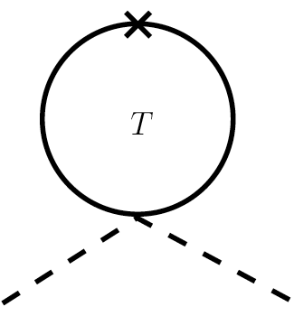


This can be seen easily:

Slide 23
Again two powerful statements can be made following this simple analysis:
One can never use fourth generation fermions to solve the naturalness problem.
  If using a fermionic top partner to cancel the top quadratic divergence in the Higgs mass, it must be a vector-like quark with a four-point coupling.
  If the two diagrams have a relative minus sign, fine-tuning is reduced.

Slide 24


Again two powerful statements can be made following this simple analysis:
2. There is a correlation between the naturalness in the Higgs mass and the
modification in the hgg production rate:
Natural theories tend to have a reduced ggh rate.
Unnatural theories tend to have an enhanced ggh rate.

Slide 25
The correlation can be made precise using the low-energy Higgs theorem, which relates c_{g} to the one-loop QCD beta functions.
That there is a relation is can be seen from the following pictorial representation:

Slide 26
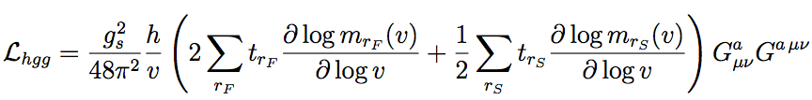
Quantitatively, let’s turn on the Higgs as a “background field” when computing the threshold effect in the QCD beta function:
Then the ggh coupling is readily obtained by making the substitution h -> h + v in the above and keep only terms linear in h:
(This is a more general formula in the presence of both fermions and scalars, as well as several multiplets.)

Slide 27

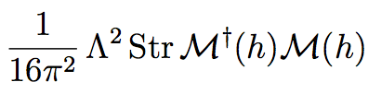
So the expression that controls the ggh coupling is
On the other hand, the quadratically divergent contribution in the Higgs potential is given by the Coleman-Weinberg result:
It is the interplay between the (super-)trace and (the derivative on) the determinant of the mass matrix that a correlation is possible.
Obviously this allows for generalization when there’s mixing between standard model top quarks and the new heavy fermions or among the scalar partners themselves.

Slide 28
Because it is the supertrace in the Coleman-Weinberg potential, which gives the scalar an extra minus sign relative to the fermions, the correlation pattern between naturalness and ggh rate is reversed:
If a scalar top partner reduces the fine-tuning, it interferes constructively with the SM top in ggh.
If the scalar partner worsens the fine-tuning, the interference is destructive in ggh amplitude.
Since the only symmetry that contains a scalar partner to a fermion is supersymmetry, and supersymmetry requires two top squarks (one for each chirality of the top), there is a caveat to the above statement:
If the mixing between the top squarks is large, a constructive interference is turned into a destructive interference, and vice versa. (It’s the determinant of the mass matrix!)

Slide 29
These general statements are of course borne out in specific models, both in supersymmetric models (the MSSM more specifically) and PNGB Higgs models.

Slide 30
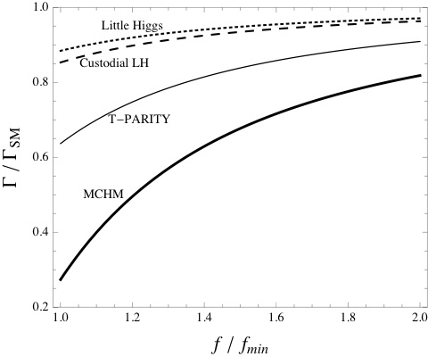
A “reduced” gluon coupling is a smoking-gun signal for “Naturalness,”
In composite Higgs models
this coupling is always suppressed!
Low, Rattazzi, Vichi:0907.5413
Low and Vichi:1010.2753
The deviations are generically larger than the 5% because they have top partners
Lighter than 1 TeV, but also there are accumulative effects I will discuss later.

Slide 31
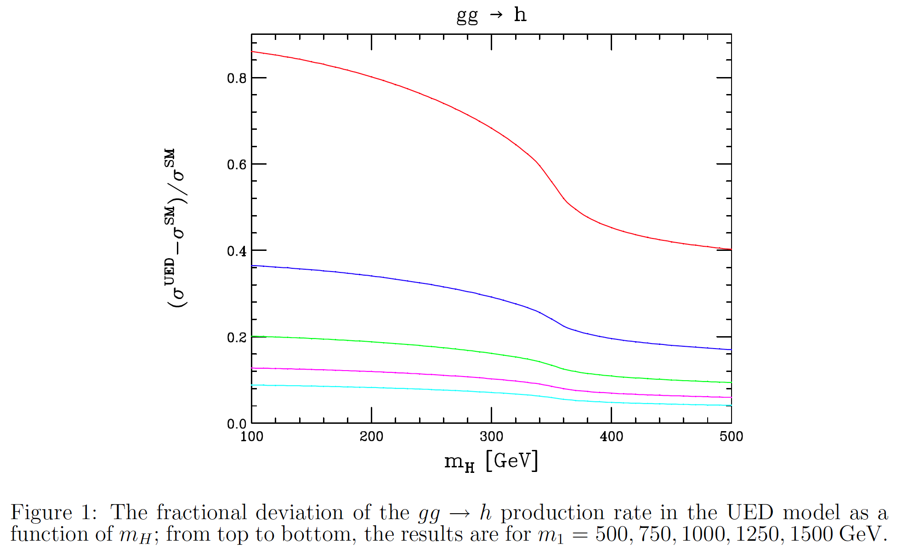
A “reduced” gluon coupling is a smoking-gun signal for “Naturalness,”
while an “enhanced” gluon coupling may suggest fine-tuned Higgs mass.
F. Petriello, hep-ph/0204067

Slide 32
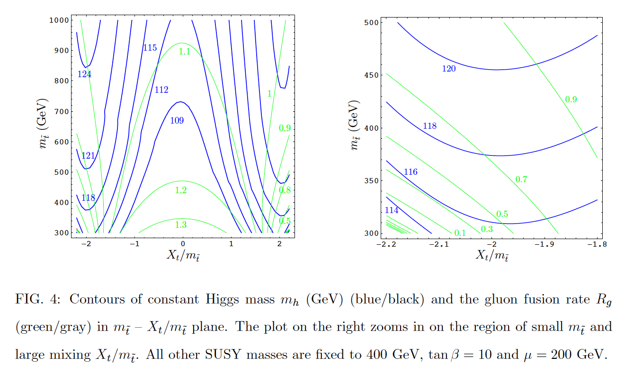
The ratio of the gluon fusion rate in the MSSM over the SM:
The right panel is the region where the Higgs mass in the MSSM is least fine-tuned, and the rate is reduced!

Slide 33
Well, all these plots seem nice, but I have swept some dirt under the rug….
There are a lot of subtleties in trying to relate c_{g} , upon which the naturalness argument base, and experimental observables such as the gluon fusion production rate.
The question is essentially:
if we measured a modified ggh production rate or a modified h->gg partial width, can we attribute the change to c_{g} ?

Slide 34
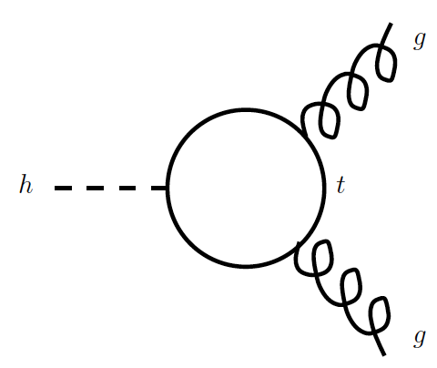
Let me use Γ(h --> gg) as an example and analyze how it can be modified by new physics effects. The same reasoning goes through for diphoton width.
The SM contribution is mainly from the top quark loop:

Slide 35



In this diagram alone, there are two ways new physics could enter:
1. The Higgs-fermion-fermion coupling could be modified by new physics through the dim-6 operator:
(roughly) scale of
new physics

Slide 36



2. The Higgs field may need a finite wave function renormalization through the dim-6 operator:

Slide 37
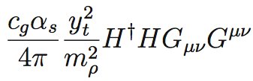

Finally, there could a new loop diagram due to new colored particles:
For non-supersymmetric theories, it could be a new top-like fermion, the top partner.
For supersymmetric theories, it could be a new top-like scalar, the top squark.

Slide 38
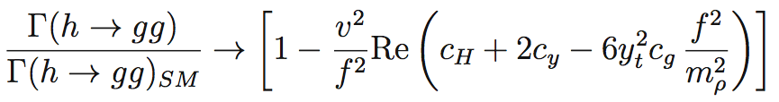
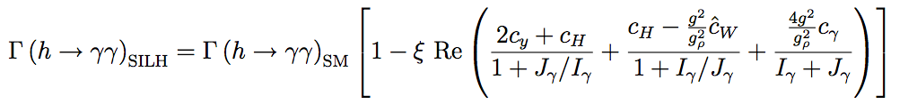
Summarizing all three effects, the Higgs partial width into gluons are given by
Similarly for the diphoton (and Z+photon) partial widts:
These two oddly looking combinations have very simple interpretations:
Giudice, Grojean, Pomarol, Rattazzi: hep-ph/0703164

Slide 39
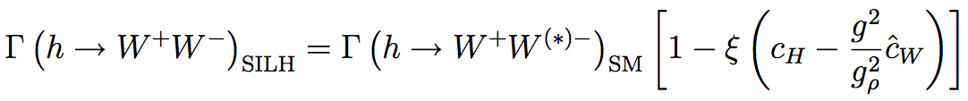
These two oddly looking combinations have very simple interpretations:
These two modify “on-shell” Higgs couplings to top quark and W bosons:
Giudice, Grojean, Pomarol, Rattazzi: hep-ph/0703164

Slide 40
This is just saying something very obvious from looking at the Feynman diagrams:
In order to extract hgg coupling precisely from data, we need to first measure htt coupling with equal or better precision.
In order to extract diphoton coupling, we need precise ly measured hWW and htt couplings.

Slide 41
In the end,
Precision measurements on loop-induced couplings must go hand-in-hand with precision measurements on tree-level couplings.

Slide 42
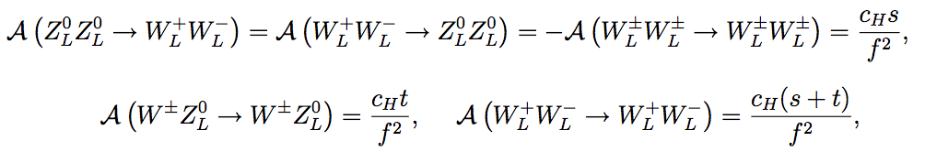
The operator
is quite interesting in its own right!
It enters directly into the WW scatterings
So a non-zero c_{H} implies the h(125) does not fully unitarize WW scattering!
Giudice, Grojean, Pomarol, Rattazzi: hep-ph/0703164

Slide 43
Additional interesting features:
Its size indicates the scale where Higgs self-interactions become strong
→ smoking gun signal of the compositeness of the Higgs boson.
2. There’s a positivity constraint from unitarity arguments that
unless there exists charge-2 scalars.
3. It modifies on-shell Higgs decay widths universally, producing a similar
effect to a modified total decay width of the Higgs, since we measure
Need to disentangle from the total width!
2+3 → tend to reduce all on-shell Higgs decays.
Low, Rattazzi, Vichi: 0907.5413

Slide 44

Everything discussed above apply to diphoton coupling as well, although there are some differences:
There are two SM contributions, W-loop and top-loop,
  Since W mass is smaller than Higgs mass, infinite W-mass limit is not a good approximation. Need to use the full one-loop result

Slide 45
That the W-loop dominates and has the opposite sign to the top-loop imply
if any new physics contribution trying to enhance the diphoton width should interfere constructively with the W-loop.
As a corollary, the new amplitude interfere destructively with the top-loop. So if the new particle also carry color, it would tend to reduce hgg coupling and enhance diphoton coupling.
It won’t be easy to overcome the large W-loop amplitude and have a significant impact in the diphoton channel, unless new particles are very light!

Slide 46
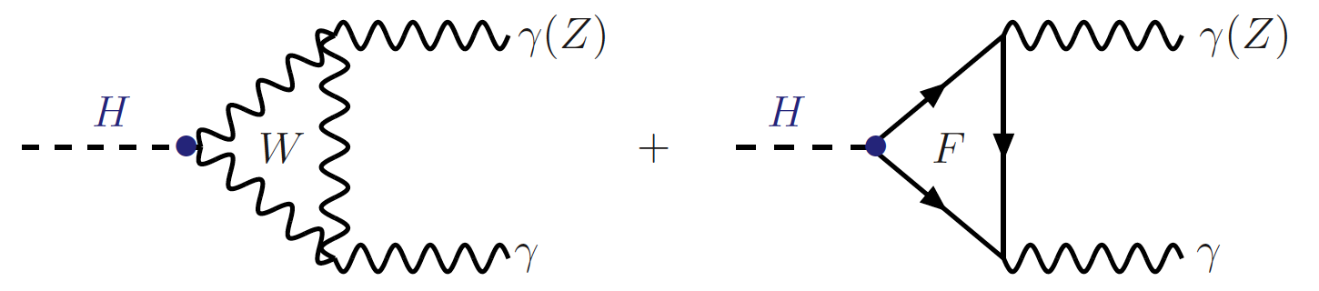
An important feature is the correlation between diphoton width and Z
+ photon channel:
  This is because whatever couples to the photon would also couple to the Z by electroweak gauge symmetry.
  So any deviations in diphoton width should be accompanied by a shift in the Z+photon channel.
  However, the modifications in Z+photon is generically less pronounced.

Slide 47
So if we see deviations in the loop-induced couplings, we can use the combination of gg, diphoton, and Z+photon to probe the color and electroweak quantum numbers of new particles running in the loop, respectively.
If we see no deviations in these couplings, we can use the measurements to constrain masses and couplings of new particles.
Since we are expecting small deviations, O(5%), higher order corrections in hgg coupling are important to be included.

Slide 48

Use hgg coupling to constrain new colored scalars:
The limit on the mass change by
O(100 GeV) without NLO effects.
Gori and IL: 1307.0496

Slide 49
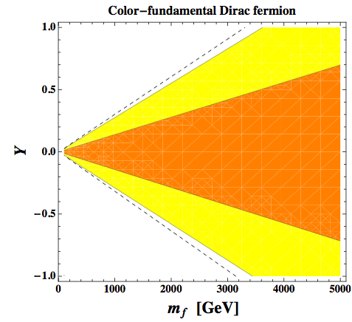
Use hgg coupling to constrain new colored fermions:
Gori and IL: 1307.0496

Slide 50
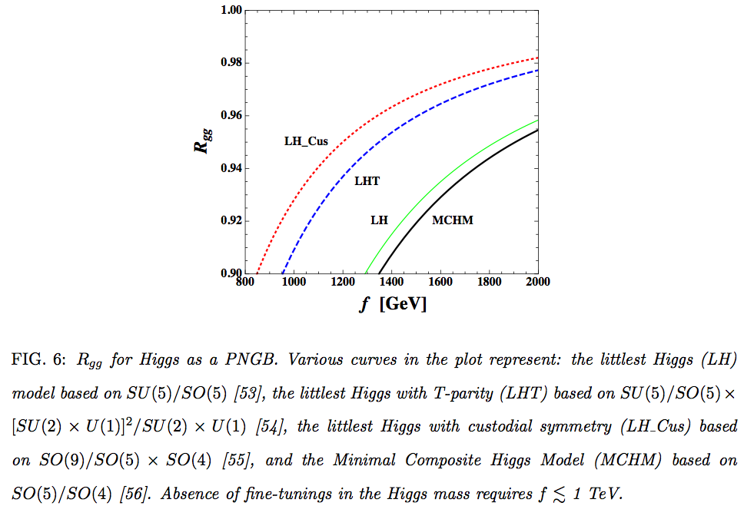
Constraints on the PNGB composite Higgs models:

Slide 51
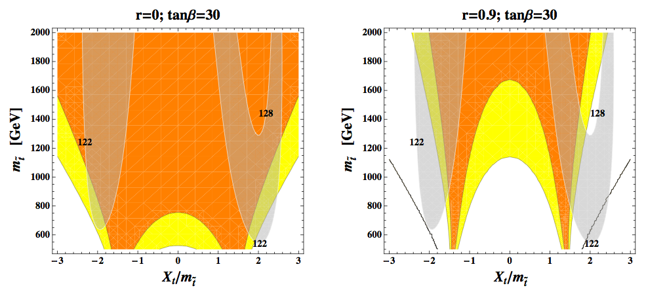
Constraints on the stop sector in SUSY:
This is independent of MSSM and applies to SUSY in general!

Slide 52
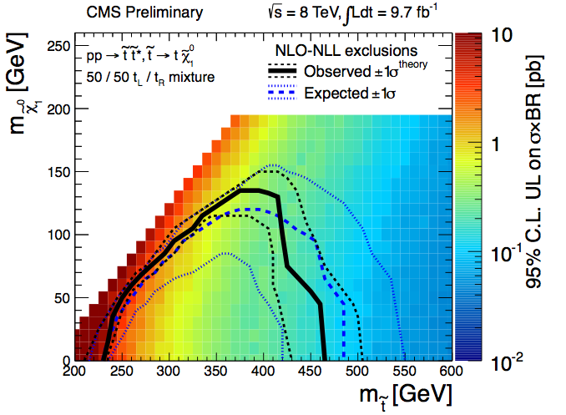
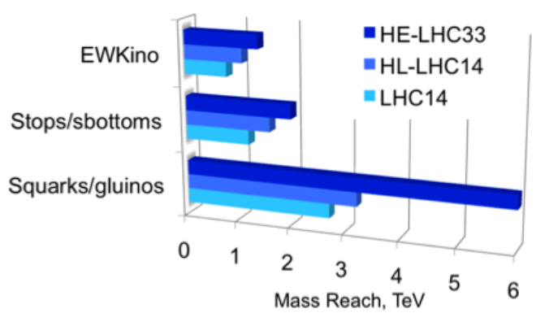
It’s interesting to compare the bound from precision Higgs measurements with those from direct searches at the LHC:
Current bound < 600-700 GeV
Projection for 14 TeV LHC is
about 1.2 TeV!
Physics Briefing Book for “European
Strategy for Particle Physics”

Slide 53
It is important to recall that direct searches always depend on the decay final states and the rest of the spectrum:
Direct searches have less/no acceptances in this region
due to kinematics, hence the degraded limits.

Slide 54
Constraints from precision Higgs measurements, on the other hand, involve a different set of assumptions from the direct searches.
So precision measurements and direct searches are very much complementary to each other!

Slide 55
Closing remarks:
The discovery of the Higgs is one-of-a-lifetime event. We are lucky to be living at this particular juncture in history!
The future ahead of us is exciting and challenging. However, I was reminded of the following quote at ISHP2013 in Beijing last week:

Slide 56

“…we chose these things not because they are easy, but because they are hard, because that goal will serve to measure and organize the best of our energies and skills, because that challenge is one that we are willing to accept, one we are unwilling to postpone, and one which we intend to win”: J.F. Kennedy, president of the US, 1962
Slide from Michael Koratzinos at ISHP13, Beijing

