Slide 1
History and motivation for a high harmonic RF system in LHC
E. Shaposhnikova
01.02.2013
With input from T. Argyropoulos, J.E. Muller and all participants of the LHC MD

Slide 2
High harmonic RF systems at CERN
Multi-harmonic RF systems exist in many CERN accelerators
  PSB: 4th harmonic, bucket increase, peak current (space charge) reduction (BL-mode), controlled emittance blow-up using phase modulation
  PS: 4 RF systems, RF manipulations (bunch splitting, rotation, emittance blow-up)
  SPS: 4th harmonic, beam stability (BS-mode)
Used in many accelerators in the world, usually in BL-mode (low energy accelerators and lepton rings)

Slide 3
High harmonic RF system in LHC was considered for
"LHC Luminosity and Energy Upgrade: A Feasibility Study", LHC Project Report 626, 2002, O. Bruning et al.
LHC Luminosity upgrade scenario with short bunches (F. Zimmermann et al., 2002), (S. Fartoukh, 2011)
LHC Luminosity upgrade scenario with flat long bunches (F. Zimmermann et al.)
Beam stability (T. Linnecar, E. Shaposhnikova, 2007)
Reduction of beam induced heating and e-cloud effect (C. Bhat et al., LMC, 2011)
Reduction of IBS effect and beam losses on FB (T. Mertens, J. Jowett, 2011)
Reduction of local luminosity/pile-up (LHC experiments wish)
See also
“On the possibility of utilizing flat longitudinal beam profiles to increase luminosity in collisions with large Piwinski angle” (D. Shatilov and M. Zobov, 2012)

Slide 4
High harmonic RF system in LHC
Main possible applications
  shorter bunches (?)
  change in synchrotron frequency distribution
    beam stability
  change in bunch shape
    heating
    beam-beam (?)
    luminosity

Slide 5
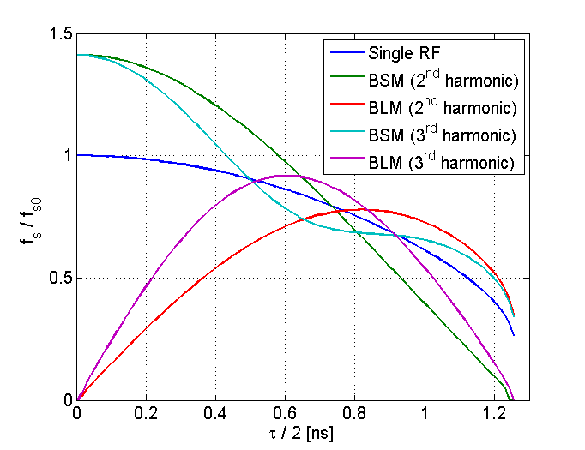
Different operational modes and beam stability in a double RF system
Voltage in a double RF system:
V = V₁sinφ +V₂ sin(nφ + Φ₂)
n=h₂/h₁
in non-accelerating bucket above transition:
Φ₂ = 0 - bunch-lengthening (BL) mode
Φ₂ = π - bunch-shortening (BS) mode
BL mode: region with ω_{s}'(J_{cr})=0 exists for any voltage ratio -> local loss of Landau damping for long bunches -> bunch length (4σ) limited to
~ 1.2 ns for n=3
~ 1.7 ns for n=2 – OK
BS-mode:
n=2: monotonic dependence ω_{s}(J)
n=3: limitation to bunch length or voltage
Synchrotron frequency distribution for V₂/V₁= 1/n

Slide 6
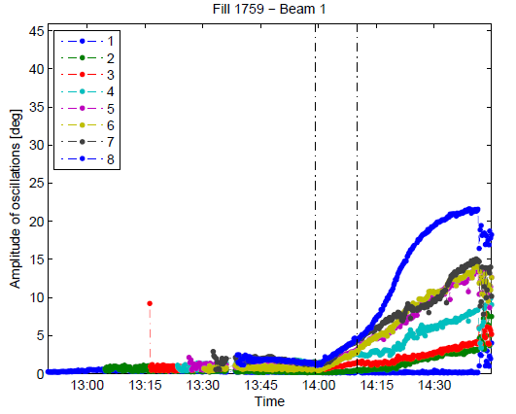
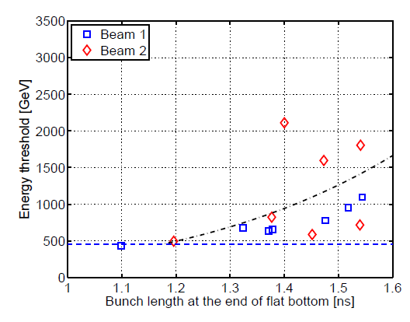
Longitudinal instability during LHC ramp
J. Esteban Muller et al.
Dipole mode: loss of Landau damping on the flat bottom for emittances below 0.5 eVs (intensity 1.2x10¹¹), instability during ramp, threshold decreasing with energy and longitudinal emittance
Cure: controlled longitudinal emittance blow-up during ramp to ~2eVs
(4σ bunch length of 1.2 ns) also required for IBS and heating problems

Slide 7
Longitudinal beam stability in LHC
In absence of longitudinal bunch-by-bunch feedback, we rely on beam stability provided by natural synchrotron frequency spread. It is significantly increased in a double RF system.
To have the same bunch length (1.2 ns) and stability as now at 4 TeV (with 1.5x10¹¹/bunch), at 7 TeV we need emittance of 2.7 eVs (2.05 eVs now) in 12 MV at 400 MHz.
(Design value of voltage is 16 MV. To have the same bunch length as now (1.2 ns) we would need 3.25 eVs. Design value of emittance was 2.5 eVs.)
For single bunch stability (loss of Landau damping) at 7 TeV we would need in 12 MV only 1.2 eVs for 1.5x10¹¹ and 1.8 for 3.6.
The present limitation to bunch length (emittance) comes from beam induced heating. However too long bunches are also leading to geometrical reduction of luminosity (~7% due to 1.2 ns bunches instead of 1.0 ns) and reduction of (single) beam life time.

Slide 8
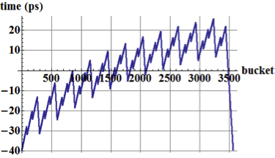
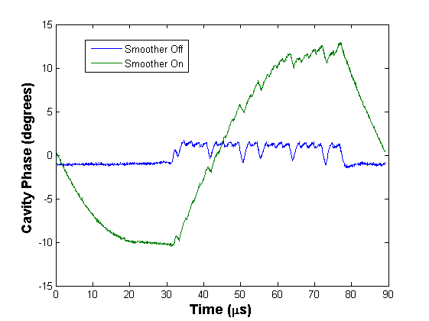
High intensity operation with scheme of “full cavity detuning”
Not possible to operate above nominal intensity with constant cavity voltage and phase over turn (actual half-detuning scheme) => use proposal of D. Boussard (1991): keep klystron current constant and let beam gaps modulate the cavity phase => full cavity detuning (P. Baudrenghien et al., IPAC11); tested in MD in 2012 with nominal 50 ns beam, cavity phase modulation with 732 bunches => reduction in klystron forward power
in this scheme transient beam loading
changes bunch positions;
effect ~ average beam current
+/- 35 ps bunch displacement =>
+/- 10 deg at 800 MHz
similar effect in the SPS (+4th harmonic)
doesn’t allow to operate in BL-mode
=> BS-mode is used

Slide 9
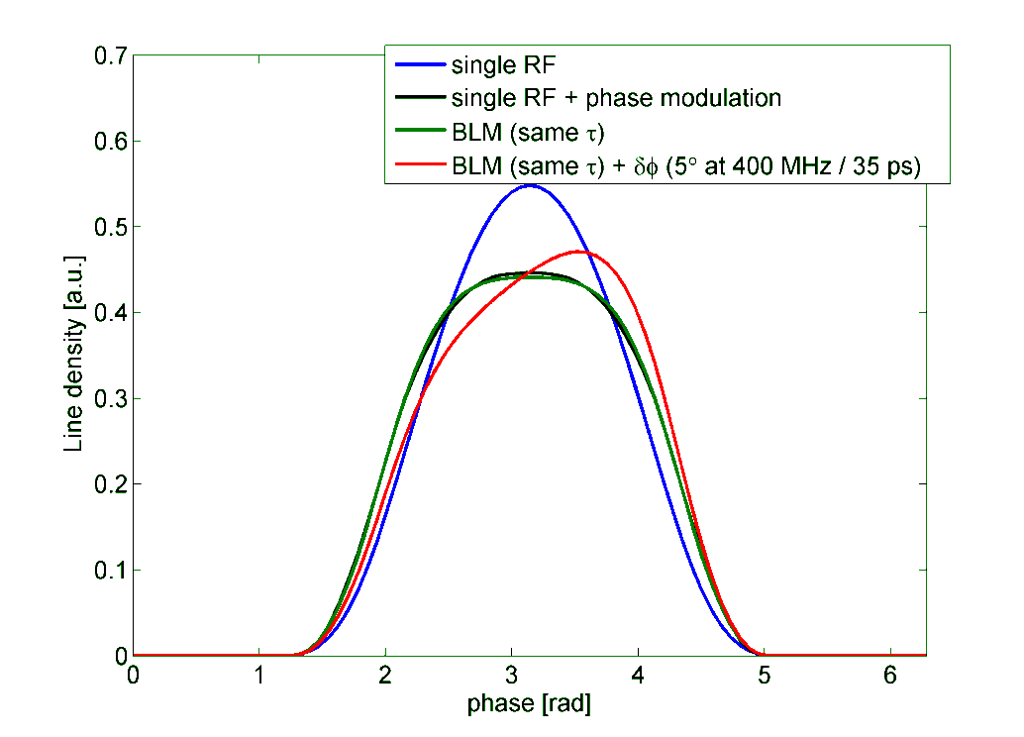
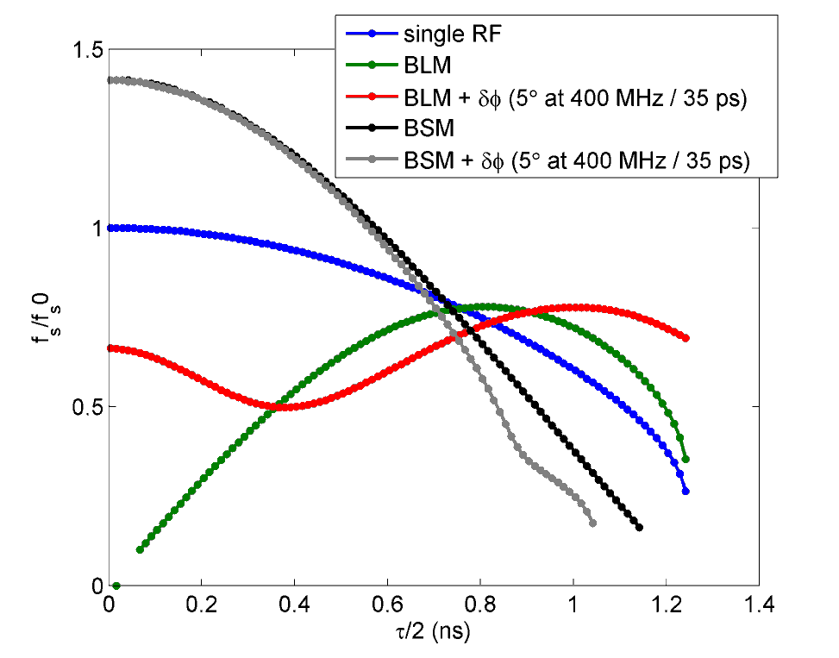
Longitudinal beam stability for tilted bunches in BS- and BL-modes
Bunch profiles
Synchrotron frequency distribution
for n=2, V1/V2=2
T. Argyropoulos
2 RF: particle distribution function as measured on the LHC flat top after controlled emittance blow-up (1RF).
Optimum phase modulation in 1RF.
=> Reduced beam stability for tilted bunches in BL-mode

Slide 10
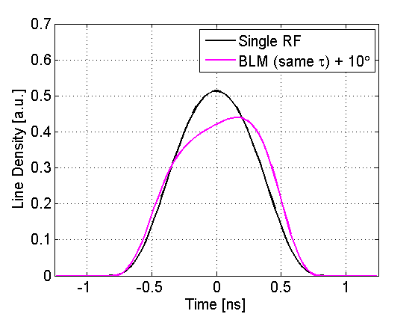
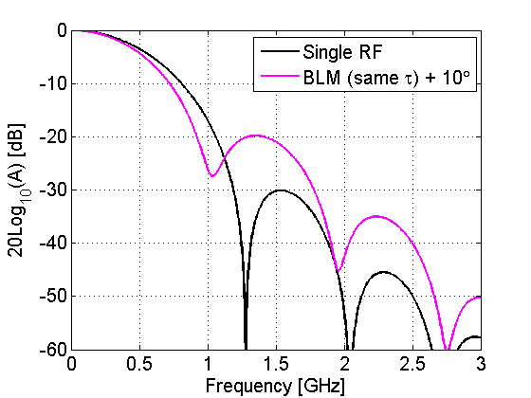
Tilted bunches in a double RF system: effect on heating
Bunch profile
Spectrum
Single RF: τ =1.5 ns => ε = 4 eVs
Double RF: τ =1.5 ns => ε = 3.2 eVs
(T. Argyropoulos)
No improvement in heating for tilted bunches even for the same τ

Slide 11
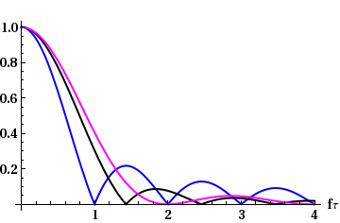
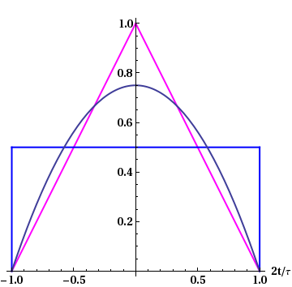
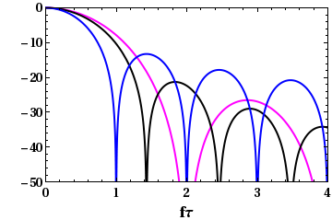
Bunch profile and power spectrum
1/(f τ)²
1/(f τ)
less heating
more heating
Less heating only at f < 1.2/τ for flat bunch with same max length
=> below 1 GHz for τ = 1.2 ns
No advantage for 20% shorter bunches
Broad-band impedance losses with
ReZ ~ ω^{1/2} scale ~ a/τ^{3/2}, where a_{bl}= 1.77, a_{bs}=2.22 and a_{1RF}=1.89

Slide 12
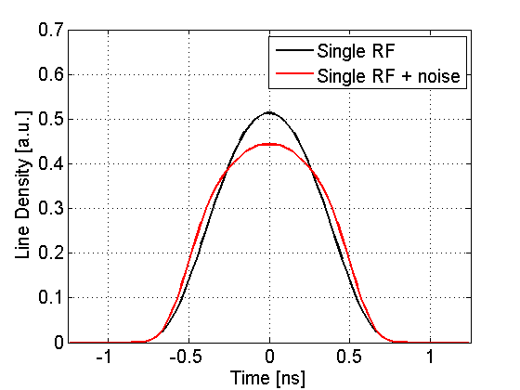
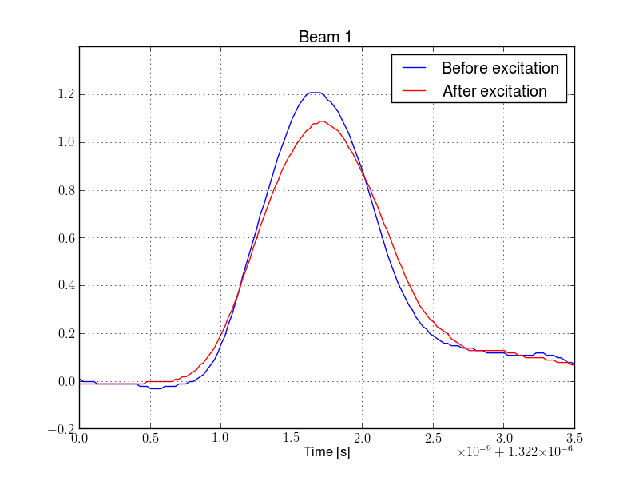
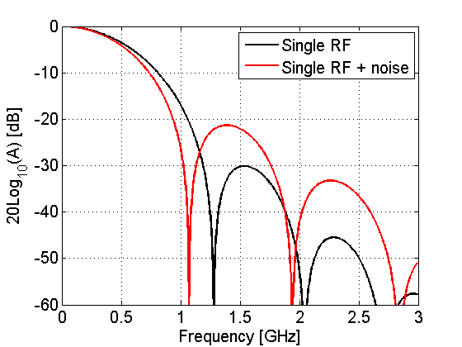
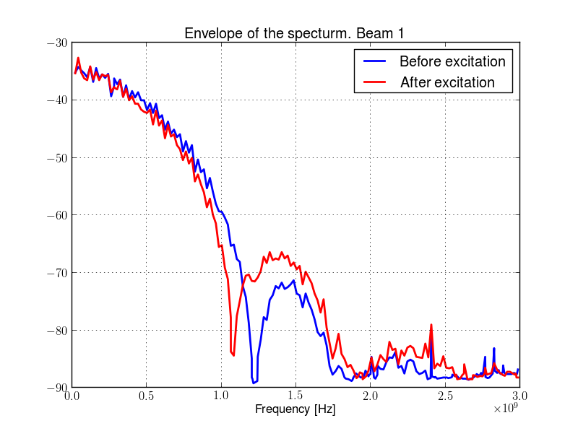
“Flat bunches” in a single RF: effect of RF phase modulation
simulations
measurements - LHC MD 29.11.12
T. Argyropoulos. Parameters as in Tevatron – (A. Burov et al.) - not optimum for flattness
J. Esteban Muller et al.

Slide 13
Summary of heating for 50 ns beam (B. Salvant et al.)
 | Single RF | Single RF + noise | BLM same tau | BLM same emit
TCP at half gap 9 mm | 53 W | 47 W (-11%) | 46 W (-13%) | 40 W (-25%)
TCP at half gap 1.25 mm | 250 W | 222 W (-11%) | 213 W (-15%) | 186 W (-26%)
BSRT | 29 W | 23 W (-21%) | 21 W (-28%) | 17 W (-41%)
ALFA | 23 W | 13 W (-43%) | 11 W (-52%) | 6 W (-74%)
MKI (15 cond) | 54 W | 47 W (-13%) | 46 W (-15%) | 39 W (-28%)
MKI (19 cond) | 23 W | 21 W (-9%) | 21 W (-9%) | 19 W (-17%)
TDI at half gap 8 mm | 450 W | 775 W (+72%) | 943 W (+110%) | 919 W (+104 %)
Depending on the impedance, the effect can be small (10 %) or significant (>50 %)
Gain for devices with significant broadband impedance below 1 GHz, but much worse for devices with large resonant modes above 1.2 GHz.

Slide 14
Preliminary summary for HH RF in LHC
Main applications are related to flat bunch shape or beam stability, in both cases the 2nd harmonic is the best choice, 8 MV maximum
Useful for longitudinal beam stability. With present ImZ_{L}/n impedance budget, Landau damping is still preserved in a single RF for highest HL-LHC bunch intensity for emittances > 2.0 eVs. Less obvious for coupled-bunch instabilities. Need studies for transverse instabilities.
For high intensity beams, achievable bunch flatness and beam stability in BL-mode is affected by beam loading in 400 MHz RF system (full detuning scheme) => Possible solutions to be studied.
Bunches with reduced peak line density can be produced in a single RF by phase modulation (successful LHC MD Nov 2012) for possible beneficial effects on:
  beam induced heating below 1.2 GHz (to check above 1.2 GHz)
  peak luminosity
  beam-beam or transverse instabilities (not tested)
  => However with time the shape will evolve to Gaussian (to be studied)

