Slide 1
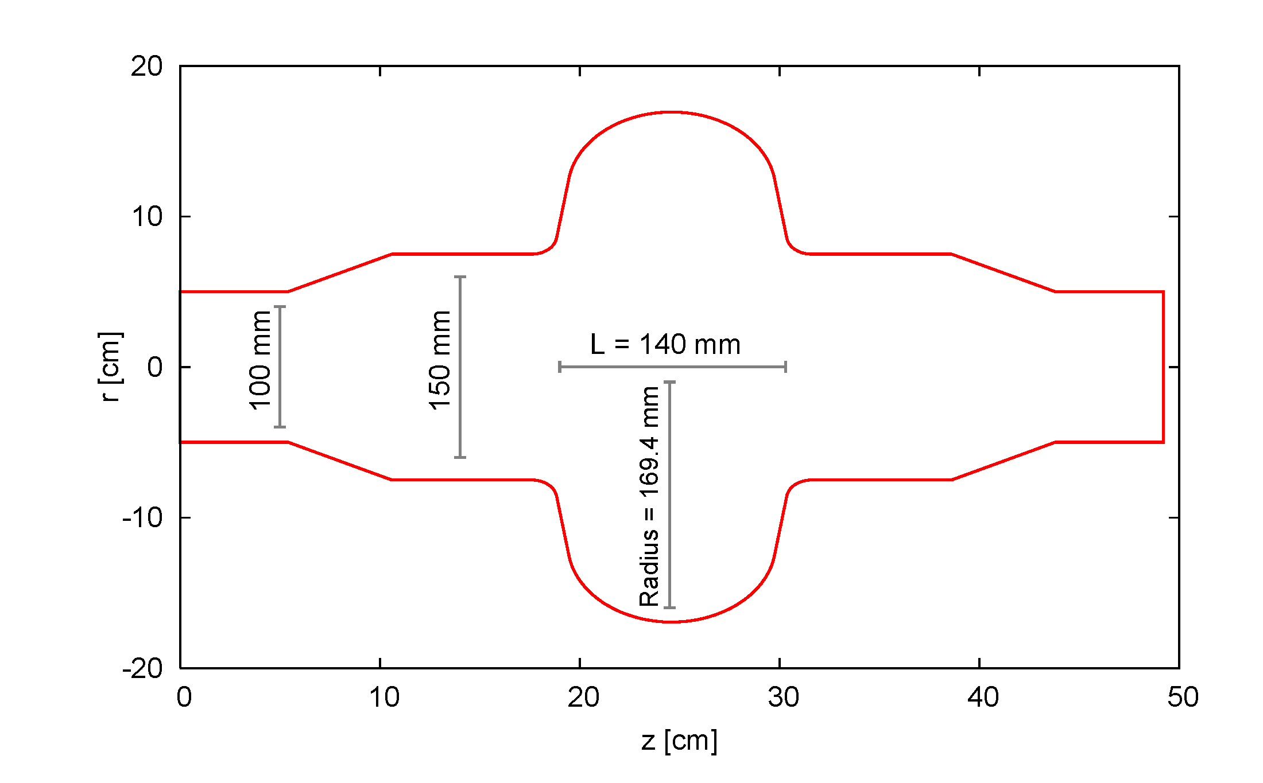
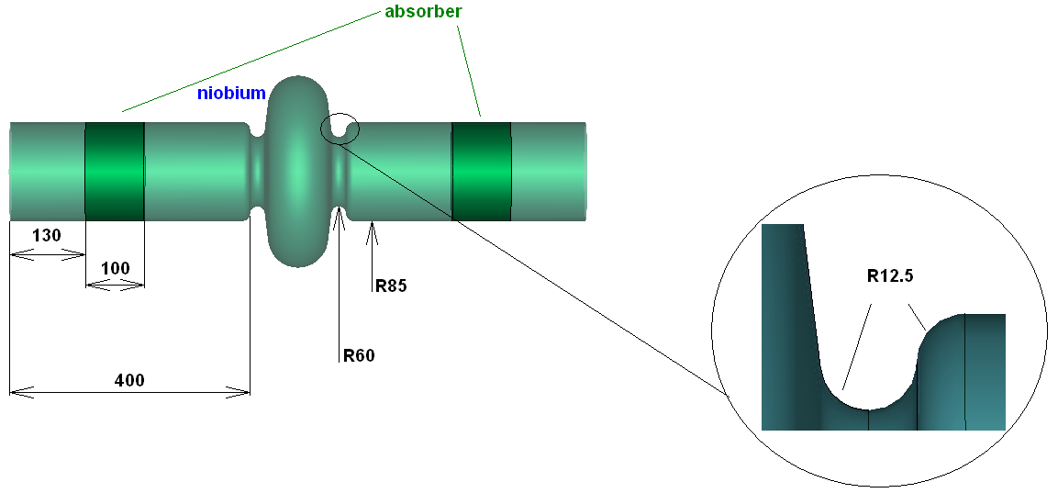
800 MHz impact on HL-LHC impedance model
Impedance model in work (deliverable of WP 2.4 for November 2013)
Until the HL-LHC impedance model is available, we use the current impedance model as benchmark
The higher order modes should be efficiently damped by couplers or dampers
The low frequency impedance should remain low compared to the rest of the machine
Work on new design of 800 MHz RF cavities by:
  R. Calaga, L. Ficcadenti, J. Tϋckmantel (CERN BE-RF) → see talk by L. Ficcadenti at HL-LHC LARP meeting (Nov 2012)
  M. Zobov (LNF INF Frascati), R.Bolgov, Ya.Shashkov, N.Sobenin (MEPHI, Moscow)
CERN design (draft)
LNF design (draft)

Slide 2
800 MHz impact on HL-LHC impedance model
 | 5 CERN cavities (ABCI simulations R. Calaga) | 5 Frascati/Moscow cavity (ABCI simulations M. Zobov + CST) | LHC Total impedance (at injection)
Low frequency Longitudinal effective impedance | ~4.2 mΩ | ~5.6 mΩ | 90 mΩ
Low frequency Transverse effective impedance (*) | ~5 kΩ/m | ~5 kΩ/m | 2 to 4 MΩ/m
(*) assuming average beta function at location of cavities
First remarks:
→ both designs are similar from the low frequency impedance point of view.
The transverse part is negligible if the beta function is not too high (~ 0.2% of total effective impedance).
The longitudinal part is not negligible (~5% of total effective impedance). Do we have margin?

