Slide 1
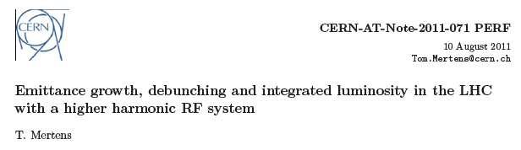
IBS and luminosity evolution with higher harmonic RF
Tom Mertens
(former Technical Student now doing PhD in Quantum Field Theory in Brussels)
Some changes to his 2011 slides, mostly in blue, by JMJ 1/2/2013

Slide 2
Outline
Introduction
Simulation Program: Collider Time Evolution (CTE)
Evolution of a Gaussian distribution in the double RF system
Protons : 450 GeV , 3.5 TeV and 7 TeV in collision
Ions : 450 Z GeV , 3.5 Z TeV and 7 Z TeV in collision
Side note : Luminosity and debunching vs initial longitudinal emittance
Conclusions
Remarks

Slide 3
Introduction
Problems with heating in beam screens of the LHC -> add secondary RF system to modify longitudinal bunch profile (C.M. Bhat. Bunch shaping in the lhc a quick look, June 2010 LMC Meeting 97 on 22/06/2011)
How does such a double RF system affect emittance growth, debunching and integrated luminosity for protons and Pb ions?
Double RF system:
  800 MHz
  ½ RF Voltage of Primary RF (6 MV)

Slide 4
Simulation program
Particle Tracking code written in FORTRAN developed by
M. Blaskiewicz and R. Bruce (work continued now by Michaela Schaumann)
Physics processes taken into account:
  Injection :
    Betatron motion
    Synchrotron motion
    Radiation Damping
    IBS
  3.5 (Z) TeV and 7 (Z) TeV
    Same as injection
    Collisions
Several different IBS models implemented -> used Nagaitsev (successfully applied for ions 2010) with the Coulomb log put to 20.
Allows for effect of non-gaussian longitudinal distributions

Slide 5
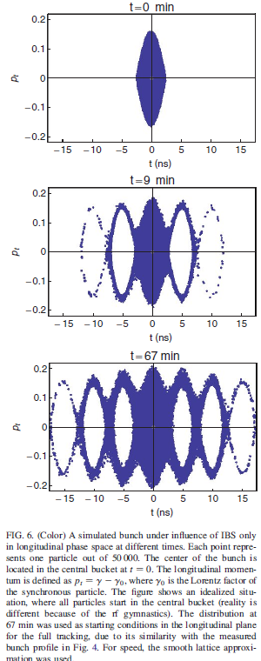
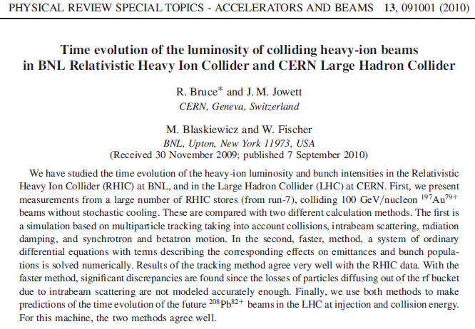
Simulation was tested at RHIC and has worked well for LHC. See various reports and presentations by Tom Mertens, Michaela Schaumann (also for p-p at HL-LHC).

Slide 6
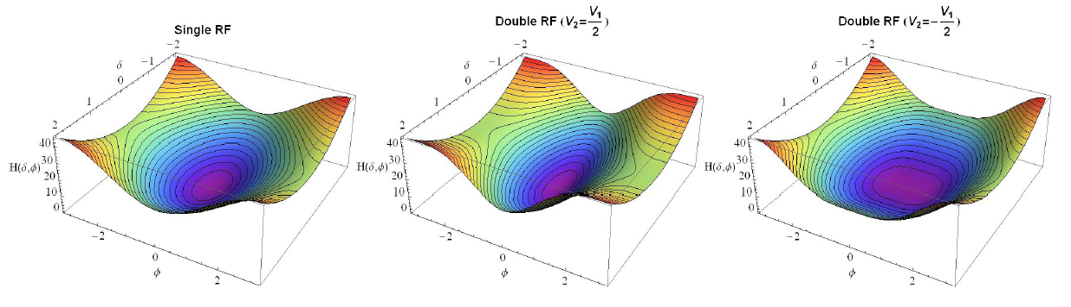
Evolution of a Gaussian distribution in the double RF system
Relative Hamiltonians

Slide 7
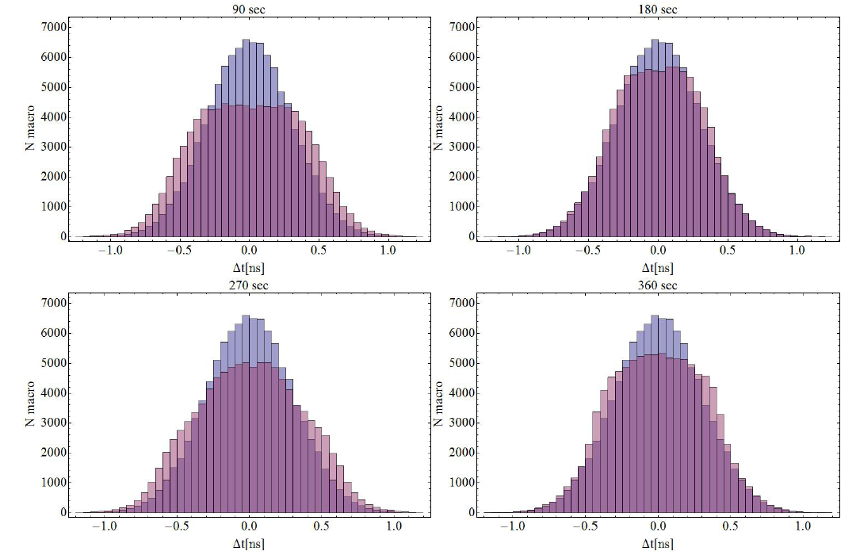
Evolution of a Gaussian distribution in the double RF system
Starting with a Gaussian bunch matched to the single RF system we turn on the secondary RF. Plots below show the evolution of the longitudinal profile. Blue histogram is original Gaussian bunch, pink histogram is the profile with the secondary RF system turned on.

Slide 8
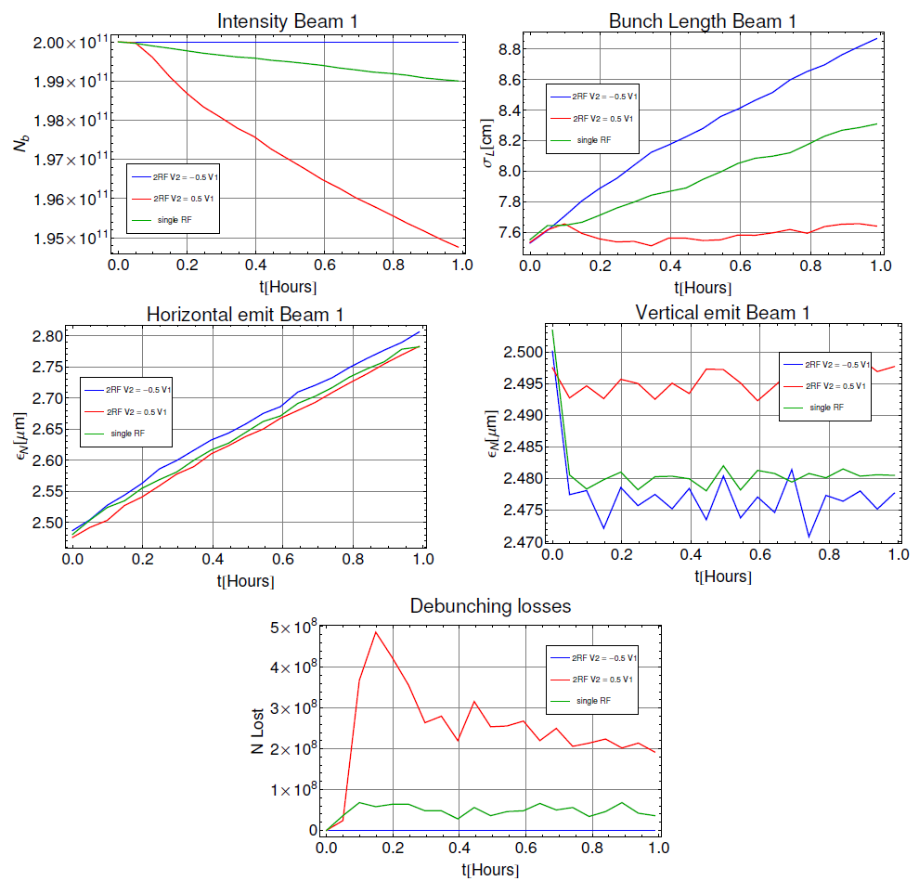
Protons at 450 GeV

Slide 9
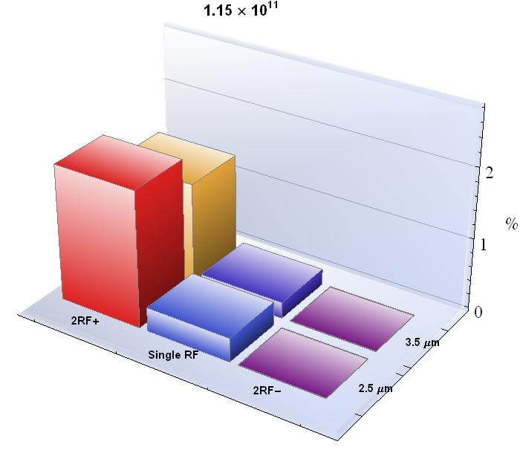
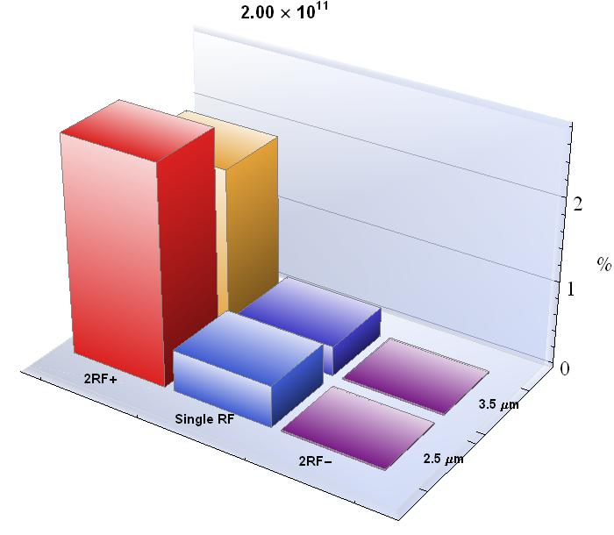
Protons 450 GeV
Debunching Losses (in % of initial beam) after 1 hour
Roughly 1-2 percent improvement of debunching losses.

Slide 10
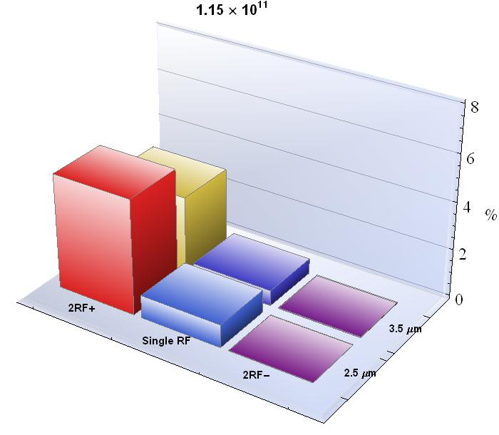
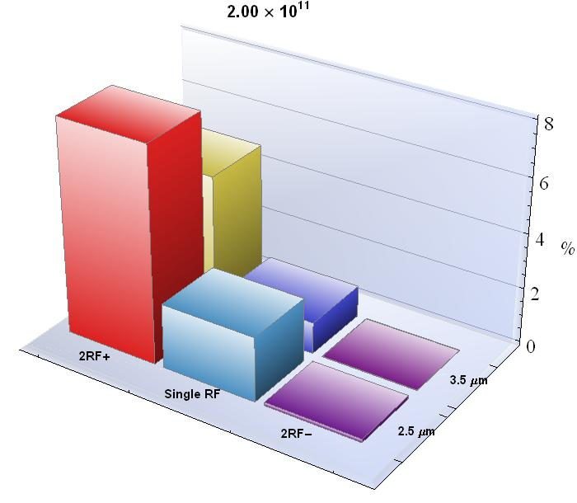
Protons 3.5 TeV
Debunching Losses (in % of initial beam) after 10 hour
Rougly 1-2 percent improvement of debunching losses.

Slide 11
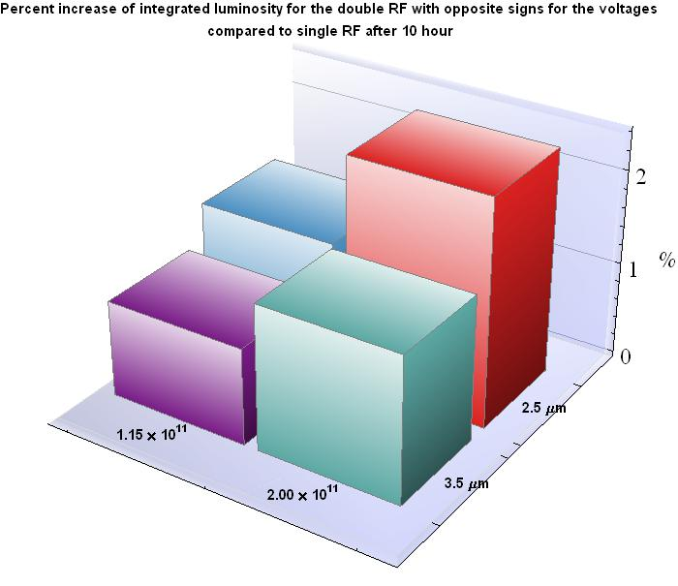
Protons 3.5 TeV
Expect the trend to continue at smaller emittances

Slide 12
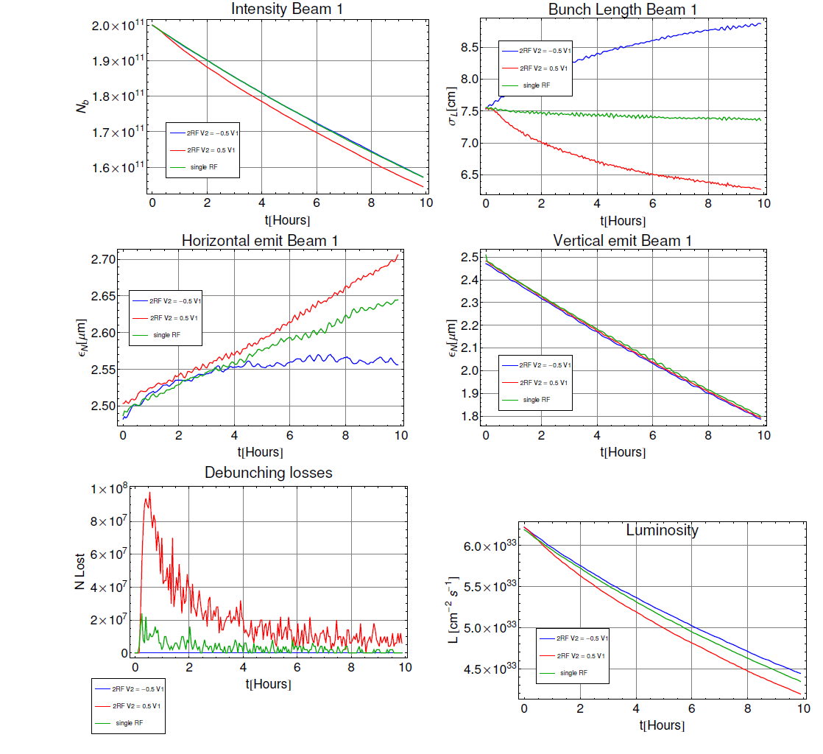
Protons at 7 TeV

Slide 13
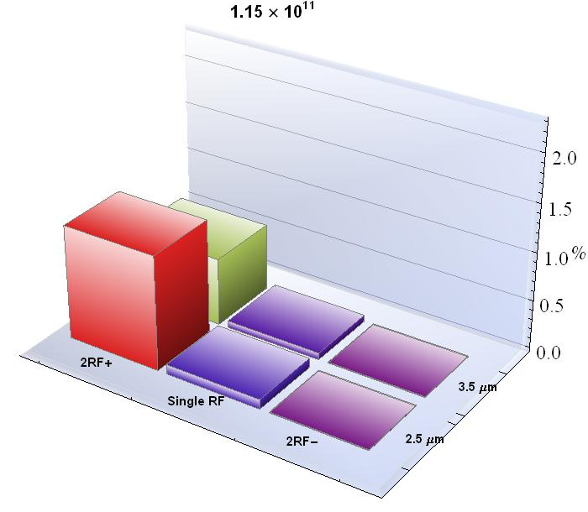
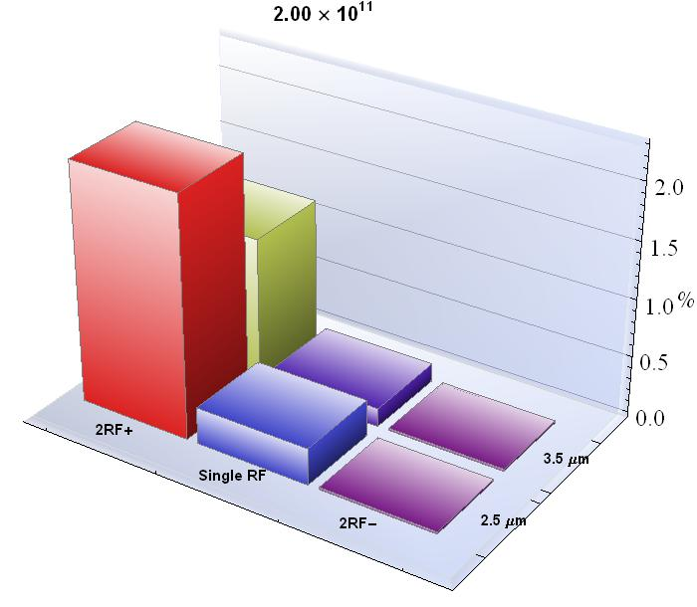
Protons 7 TeV
Debunching Losses (in % of initial beam) after 10 hour
Rougly 0.2-0.5 percent improvement of debunching losses.

Slide 14
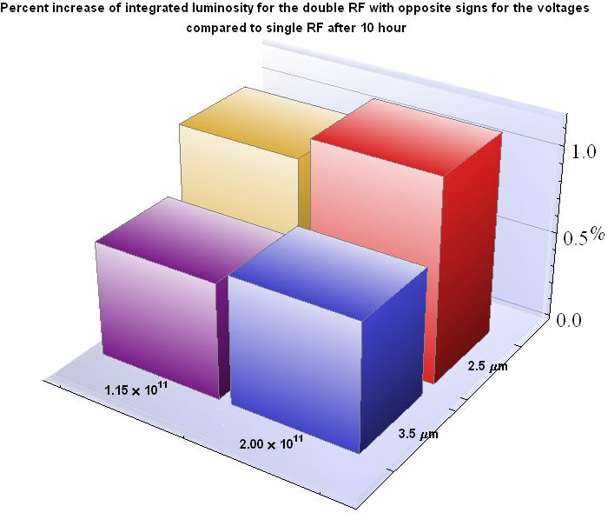
Protons 7 TeV

Slide 15
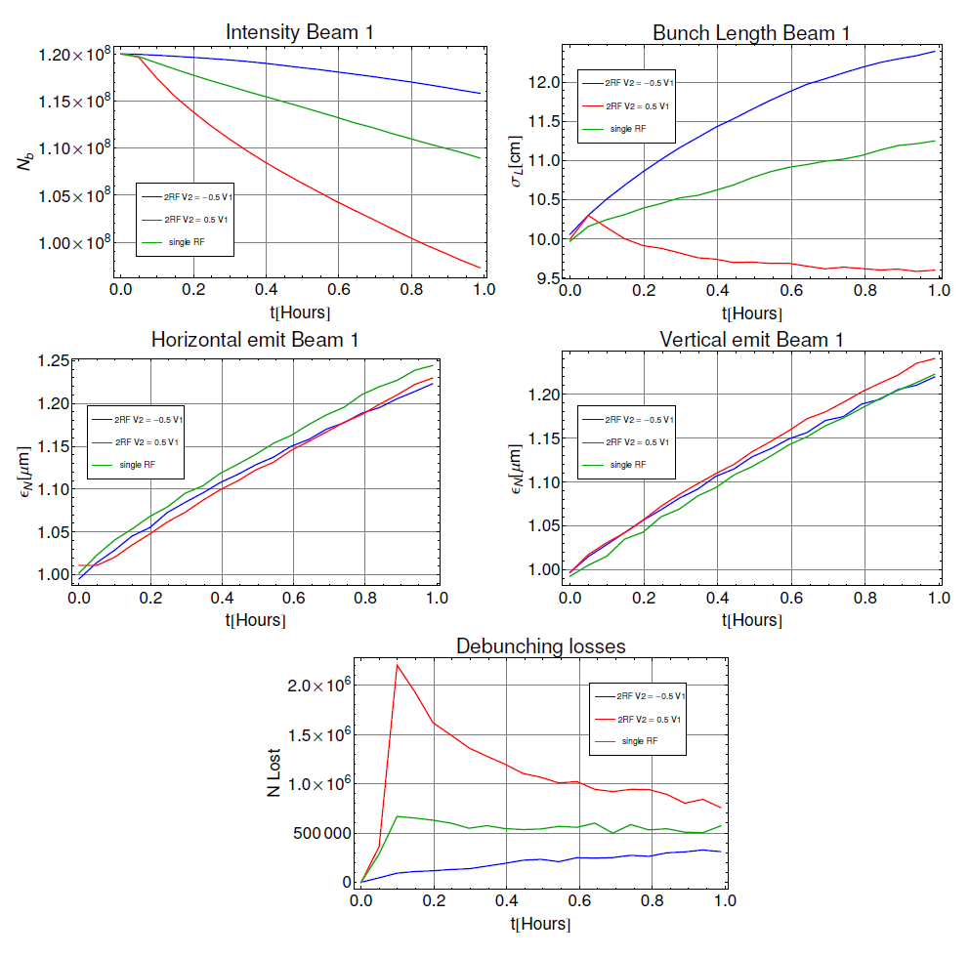
Ions at 450 Z GeV

Slide 16
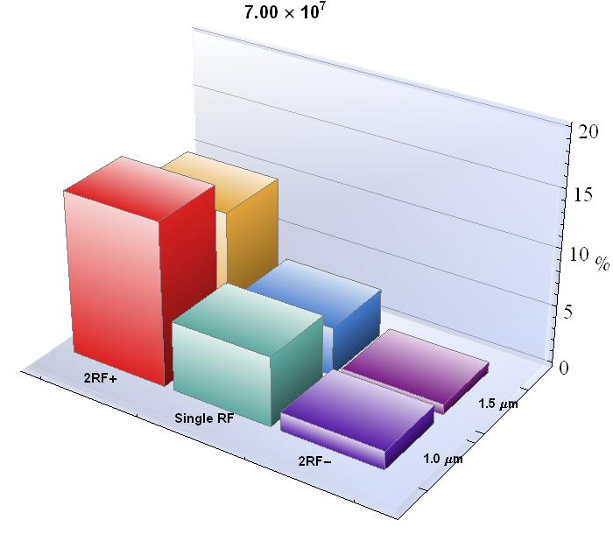
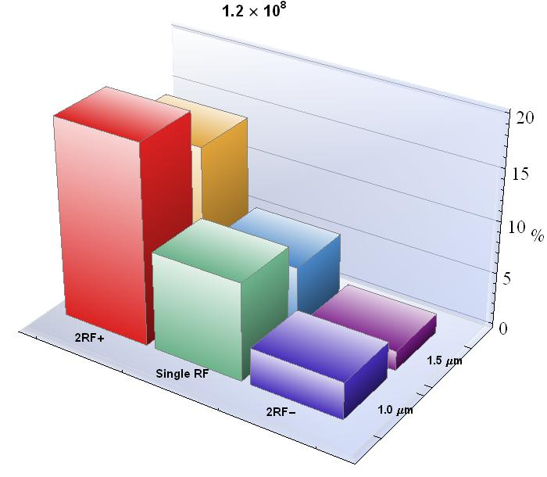
Ions 450 Z GeV Injection
Debunching Losses (in % of initial beam) after 1 hour
Roughly 3-4 percent improvement of debunching losses.

Slide 17
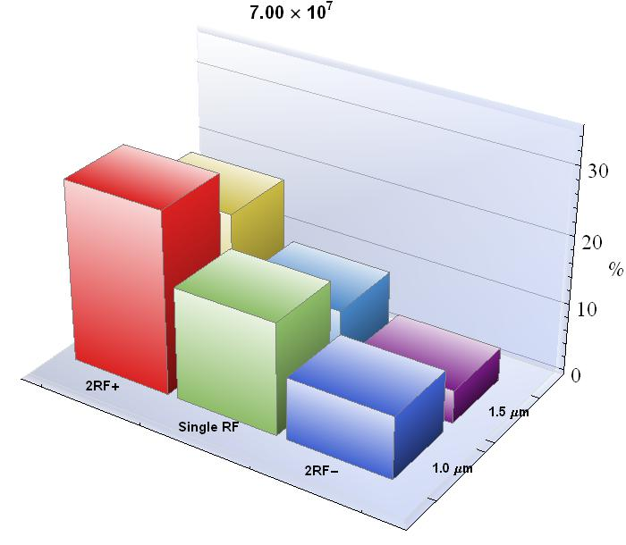
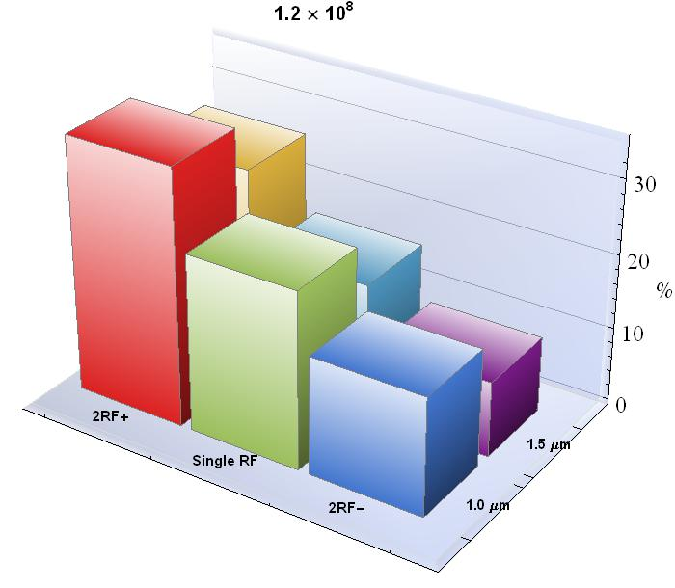
Ions 3.5 Z TeV
Debunching Losses (in % of initial beam) after 10 hour
Roughly 5-10 percent improvement of debunching losses.

Slide 18
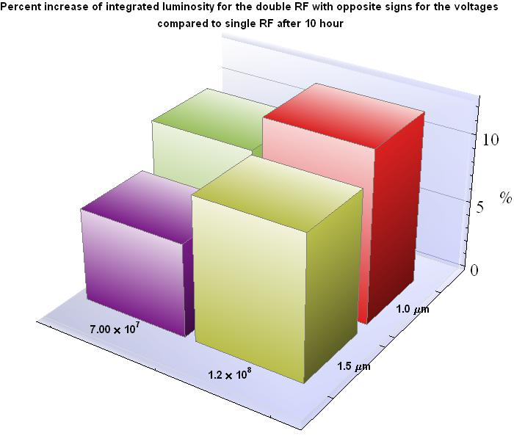
Ions 3.5 Z TeV
5-10 % increase!

Slide 19
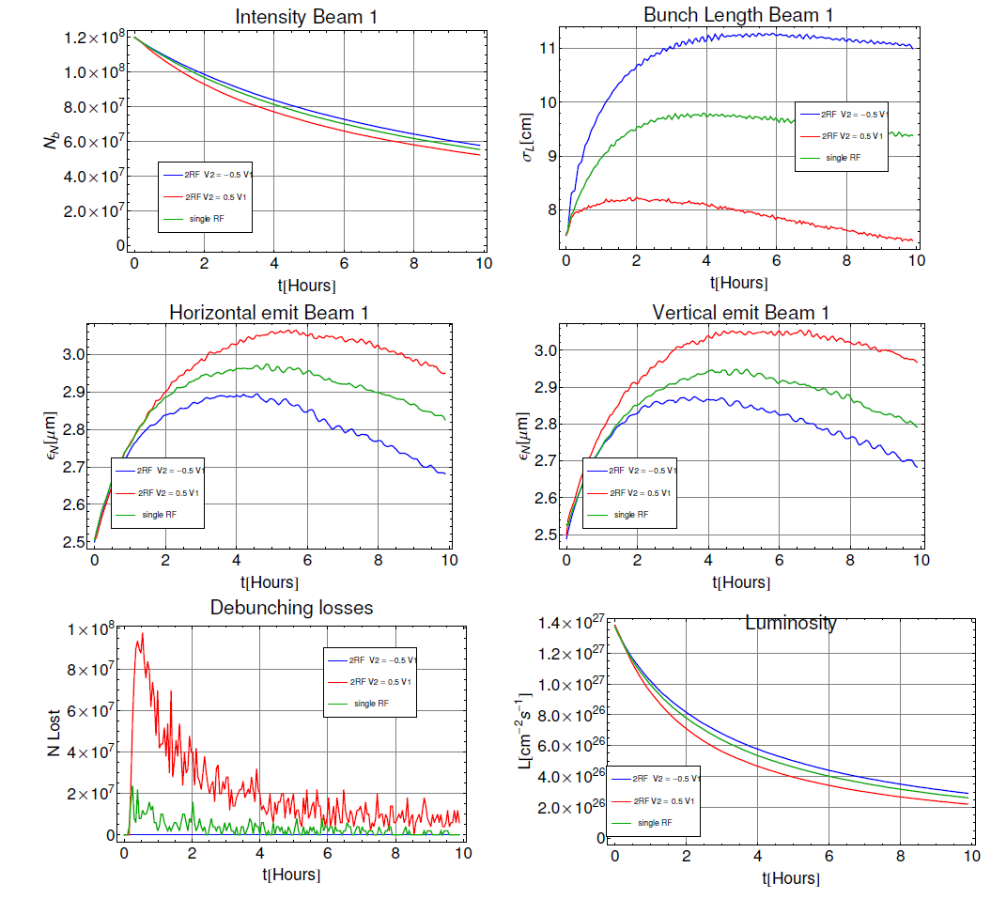
Ions at 7 Z TeV

Slide 20
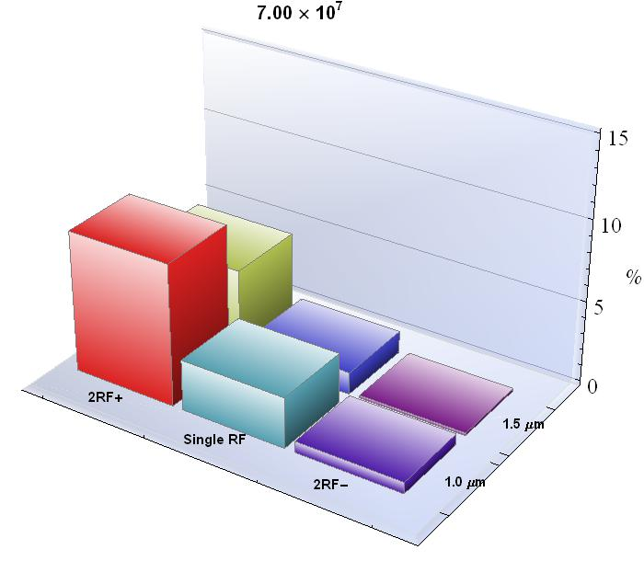
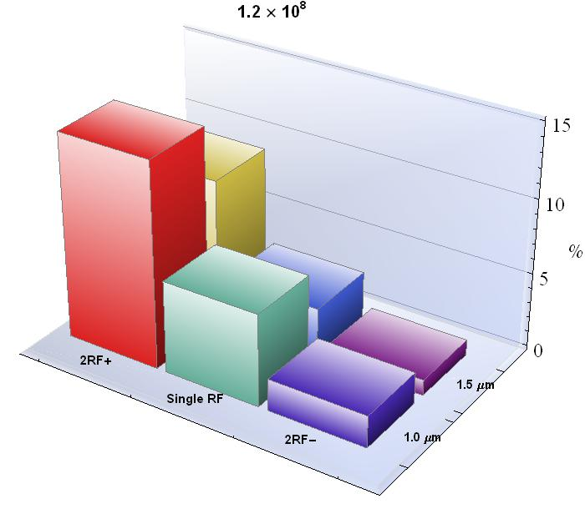
Ions 7 Z TeV
Debunching Losses (in % of initial beam) after 10 hour
Roughly 1-3 percent improvement of debunching losses.

Slide 21
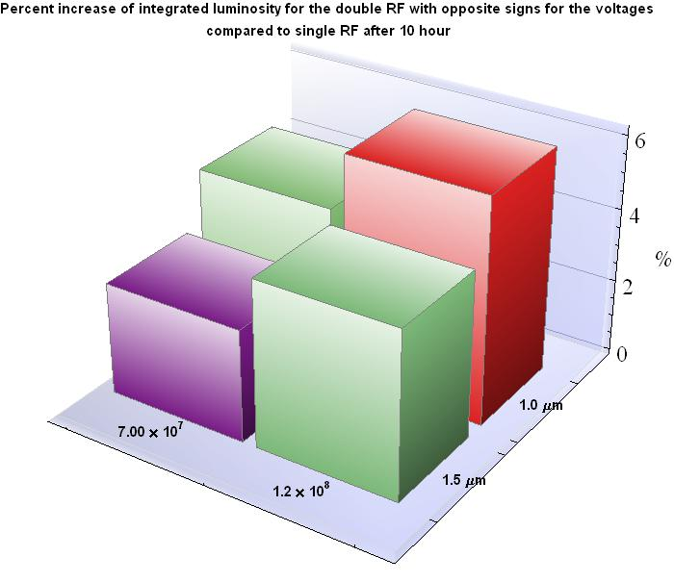
Ions 7 Z TeV
2-6 % increase!

Slide 22
Side note: (Integrated) Luminosity/ debunching losses vs initial longitudinal emittance (protons) in single RF
Not studied influence of initial longitudinal emittance on debunching losses or integrated luminosity with double RF.

Slide 23
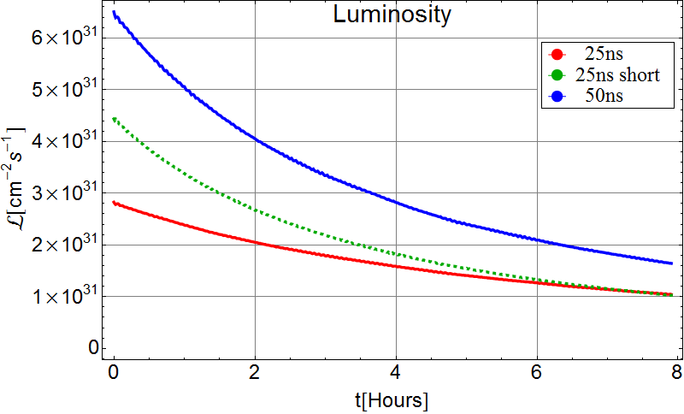
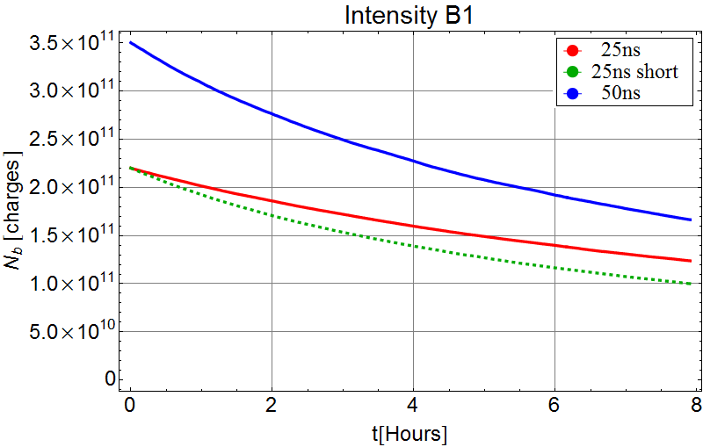
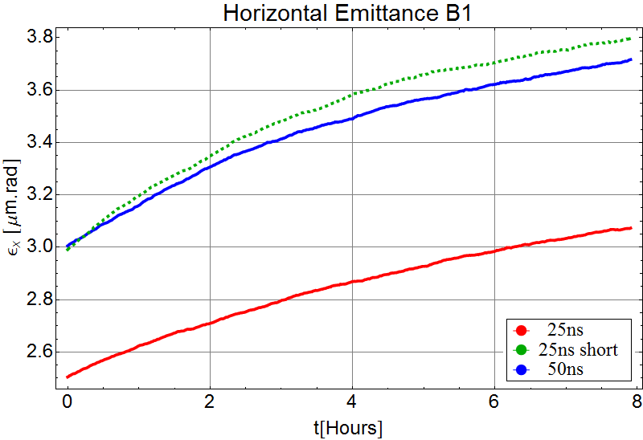
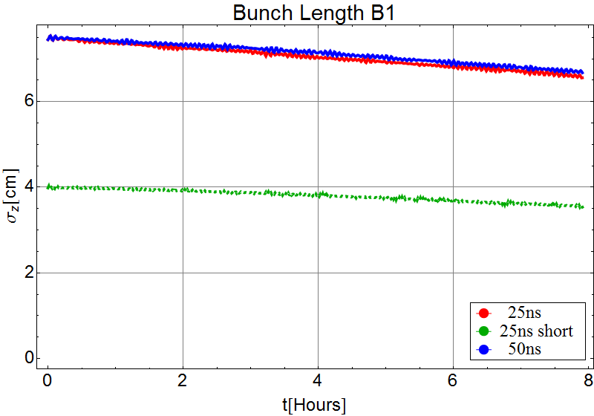
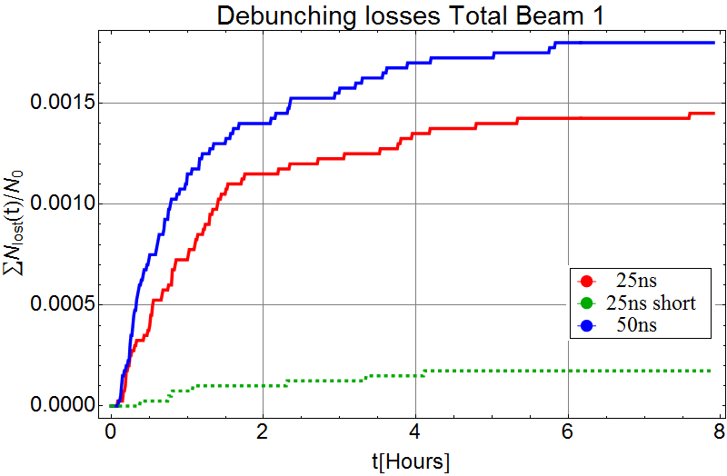
Beam and Luminosity Evolution
Michaela Schaumann
Luminosity/bunch
Simulations done with CTE [*].
Virtual luminosity evolution - no crab cavities and levelling.
Radiation damping has positive effect on emittance growth and leads to reduction of bunch length.
Intensity losses are dominated by luminosity burn off – debunching losses are negligible.
50ns beam produces more luminosity thanks to the higher initial bunch intensity.
Intensity
~50%
losses
Horizontal Emittance
Bunch Length
~25%
growth
~10%
decay
<1%
losses
Debunching
[*] R. Bruce and J.M. Jowett, Phys. Rev. ST Accel. Beams 13, 091001 (2010)

Slide 24
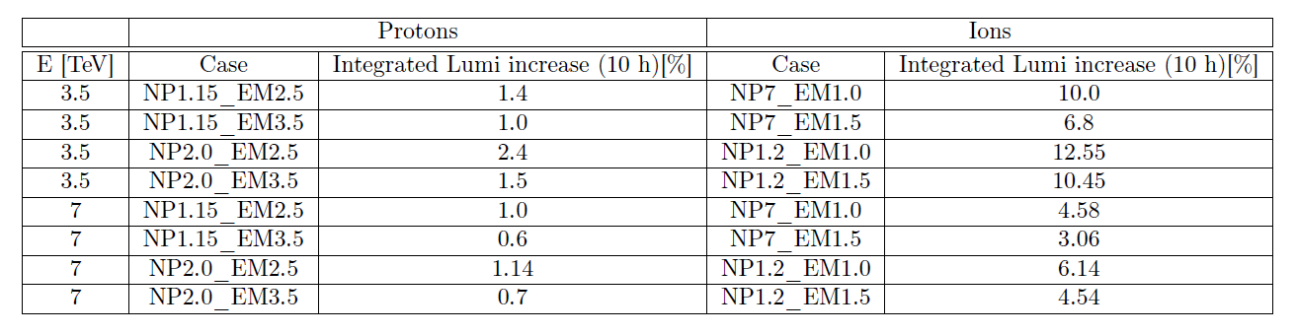
Conclusions
Decrease in debunching (stronger effects for ions)
Increase of integrated luminosity (significant for ions)

Slide 25
Added remarks by JMJ
Pb bunch intensities higher now and in future
  Expect effects seen in TM’s simulations to be much stronger with higher intensities we have now!
Gains from higher-harmonic RF come twice over
  More intensity at start of ramp
  Better integrated luminosity during collisions
Expect 5-25% gain in luminosity from HHRF for future Pb-Pb programme

