Slide 1



Silicon Photomultipliers
Principle, Performance and Some Applications
CLIC ECAL lab meeting
25 January 2013
Christian Joram
CERN / PH Department
This talk is largely based on a seminar I gave in Dec 2012 at …
I will skip many slides !!!!

Slide 2
Photodetection
The “classical” application domains of photodetectors in particle physics
Calorimetry
  Readout of organic and inorganic scintillators, lead glass, scint. or quartz fibres → Blue/VIS, usually 10s – 10000s of photons
Particle Identification
  Detection of Cherenkov light → UV/blue → single photons
  Time Of Flight → Usually readout of organic scintillators (not competitive at high momenta)
  Transition radiation (X-rays, not covered in this talk)
Tracking
  Readout of scintillating fibres, blue-green, few photons
158,000 photodetectors in the LHC experiments
4,45 M readout channels
35.4 m² photosensitive area
… and beyond particle physics
Medical imaging
  Nuclear Medicine: PET & SPECT (γ-camera) → Readout of inorganic scintillators
Analytical, industrial, …
C.J., Photodetection in the LHC experiments, NIM A 695 ( 2012) 13-22

Slide 3
A novel type of photodetector has emerged over the last ~15 years (too late for LHC!)
by now reached a reasonable level of maturity
a number of attractive features, but also some serious limitations.
It has many names like Silicon PM (SiPM), Geiger APD (G-APD), Metal Resistive layer Semiconductor (MRS-APD), Multi Photon Pixel Counter (MPPC), SiPM, SPM,…
SiPM is by now the most used name (I don’t like it).
Outline
Requirements on photodetectors
Principle of operation of the Silicon Photomultiplier
A few words on AX-PET – a demonstrator of an axial PET scanner
A few words on “The Digital SiPM” by Philips
SiPM R&D for a SciFi tracker for LHCb and Calorimetry for ILC

Slide 4
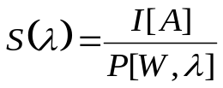
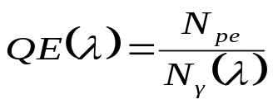
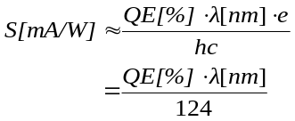

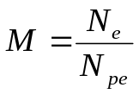
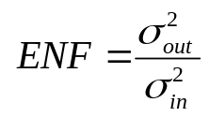
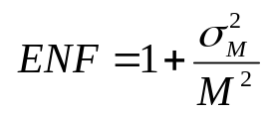
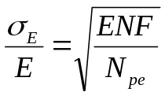
Requirements on photodetectors
”Typical” requirements on a photodetector
High sensitivity or
What really counts: Photon detection Efficiency
High gain M > 10⁵ → we have a chance to see single photons
Small signal fluctuations, low Excess Noise Factor F
ENF impacts energy resolution
Low dark noise / current
Fast timing properties (rise time, fall time, dead time)
Large dynamic range with good linearity
For certain applications: Radiation hardness, magnetic field compatibility, compactness, cost
general definition
(M = 1)
(M ≠ 1)

Slide 5
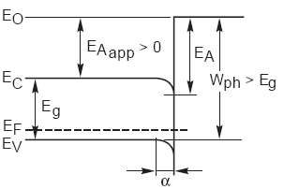
Basics of photodetection
Many photosensitive materials are semiconductors, but photoeffect can also be observed from gases and liquids.
P [W]
photodet
semiconductor →← vacuum
e⁻
Internal photoeffect
E_{A} = electron
affinity
I [A]
E_{γ}
h
(Photonis)
External photoeffect
N_{γ}
Internal photoeffect: E_{γ} > E_{g}
External photoeffect: E_{γ} > E_{g +} E_{A}
photodet
N_{pe}

Slide 6

Family tree of photo-detectors
Photodetectors
Gas
External photoeffect
“Vacuum”
External photoeffect
Solid state
Internal photoeffect
TMAE MWPC
TEA + GEM
CsI …
Avalanche gain
Process
Dynodes → PMT
Continuous dynode
Channeltron, MCP
Multi-Anode devices
Other gain process
= Hybrid tubes
PIN-diode
APD
SiPM
Digital SiPM
CMOS imager
CCD
Silicon
anode
HPD
HAPD
(G-APD-HPD)
Lumines-
cent anodes
SMART/Quasar
X-HPD
Doesn’t exist as ‘real’ device
Proposed by G. Barbarino et al., NIM A 594 (2008) 326–331
Proof of principle by CJ et al., NIM A 621 (2010) 171-176

Slide 7
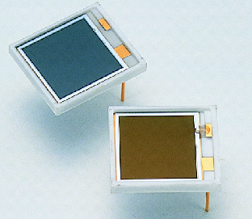
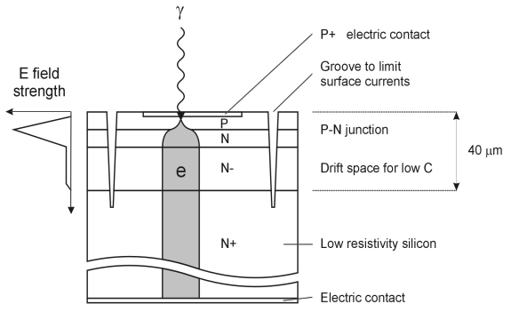
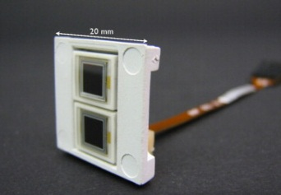
Solid-state photon detectors
(Si) – Photodiodes (PIN diode)
P(I)N type
p layer very thin (<1 μm), as visible light is rapidly absorbed by silicon
High QE (80% @ λ ≈ 700nm)
Gain = 1
Avalanche photodiode (APD)
High reverse bias voltage: typ. few 100 V
Special doping profile → high internal field (>10⁵ V/cm) → avalanche multiplication
Avalanche stops due to statistical fluctuations.
Gain: typ. O(100)
Rel. high gain fluctuations (excess noise from the avalanche). CMS ECAL APD: ENF = 2 @G=50.
Very high sensitivity on temp. and bias voltage ΔG = 3.1%/V and -2.4 %/K
p⁺ i(n) n⁺
e h
γ
Hamamatsu S8148.
(140.000 pieces used in CMS barrel ECAL).

Slide 8
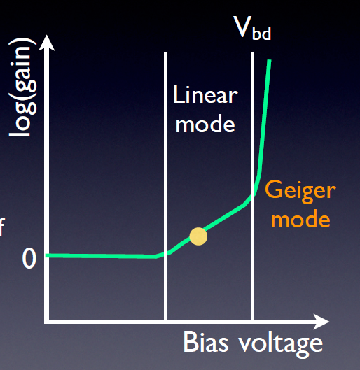
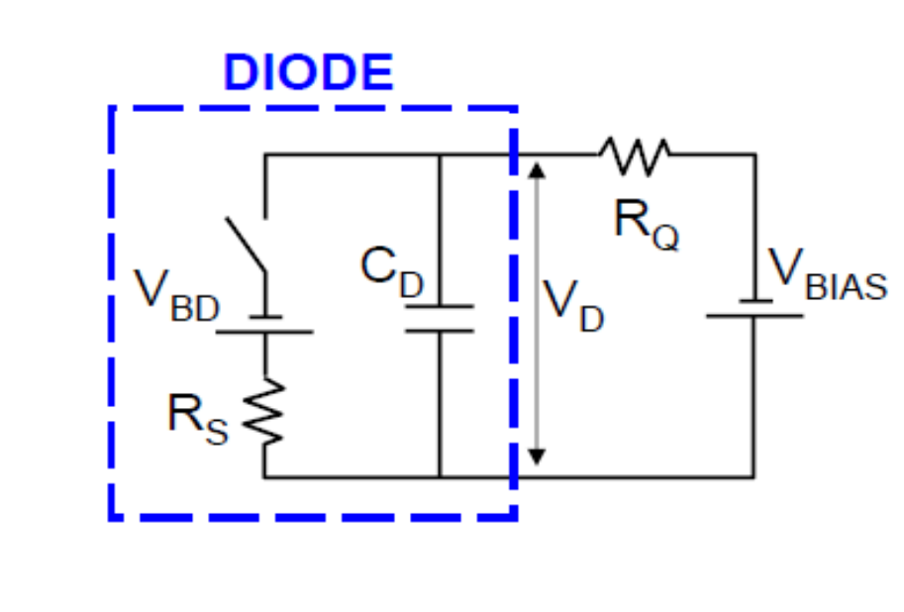
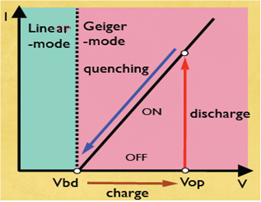
PIN → APD → Geiger mode Avalanche Photodiode (GM-APD)
How to obtain higher gain (= single photon detection) without suffering from excessive noise ?
Operate APD cell in Geiger mode (= full discharge),
however with (passive/active) quenching.
Photon conversion + avalanche short circuit the diode. A single photon (or anything else) is sufficient!
N_{γ}
J. Haba, RICH2007
J. Haba, RICH2007
A single-cell GM-APD is just a binary device (=switch).
Info on N_{γ} is lost by the Geiger avalanche.
It will become more interesting when we combine many cells in one device …
J. Haba, RICH2007

Slide 9
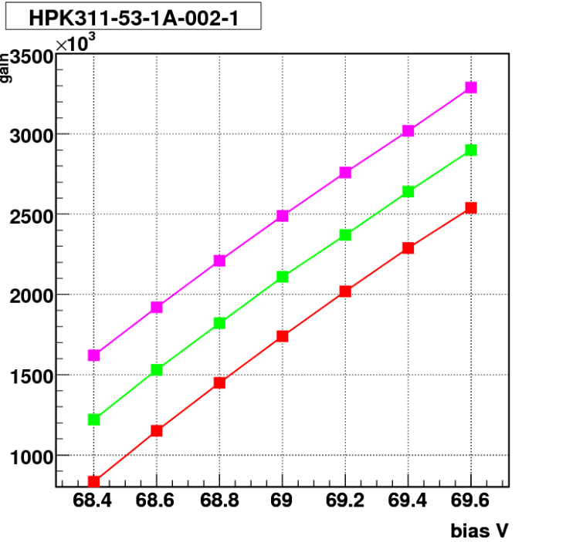
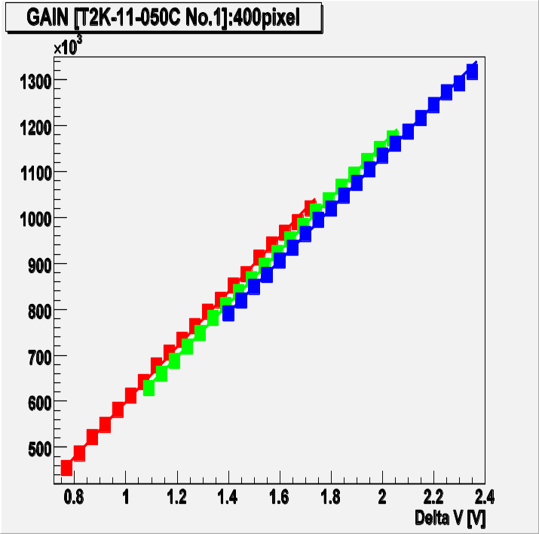
Signal characteristics and Gain of a GM-APD
I_{max}~(V_{BIAS}-V_{BD})/R_{Q}
Gain = Q / e
= I_{max}·τ / e
= (V_{BIAS}-V_{BD})C_{D} / e
The avalanche formation is intrinsically very fast, because confined to a small space.
  very fast spike
  τ_{s} = R_{Load}C_{total}
I_{D}
ΔV (overvoltage)
  τ_{f} = R_{Q}C_{D}
R_{Q} ~ >300 kΩ
◊ τ_{f} ~ 10ns
G ~ 10⁵ -10⁶ at rel. low bias voltage (<100 V)
dG/dT and dG/dV similarly critical as for APD.
τ_{r} = R_{S}C_{D}
R_{S} ~ kΩ
C_{D}~ 10 fF
→ τ_{r} < ns
Sample of 3 G-APDs
Sample of 3 G-APDs
J. Haba, RICH2007
J. Haba, RICH2007

Slide 10
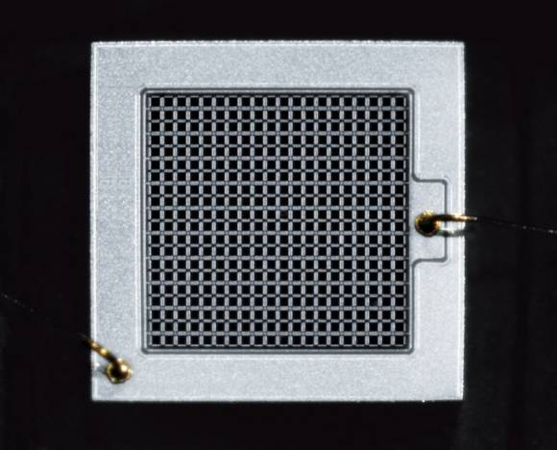
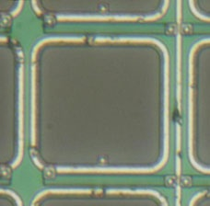
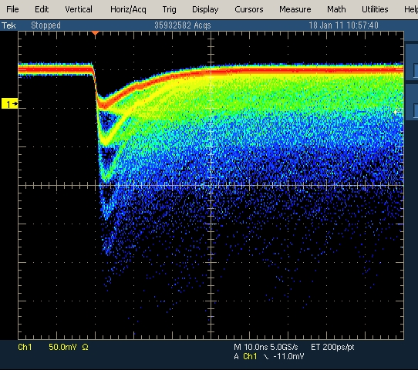
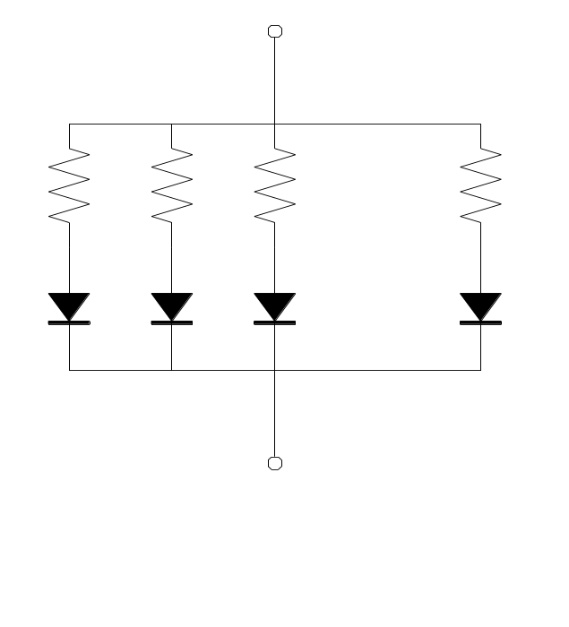
Multi pixel GM-APD, called SiPM, G-APD, MPPC, …
1mm
100 – several 1000 pix / mm²
GM-APD
Bias bus
Only part of surface is photosensitive!
Quench
resistor
Sizes up to 6×6 mm² now standard.
−V_{bias}
Quench
resistor
1 pixel fired
…
2 pixels fired
γ
γ
3 pixels fired
…
20 x 20 pix
Many GM-APDs
Q
Q
2Q
The operation of many binary devices in parallel leads to a quasi-analog detector with very
nice properties (photon counting).

Slide 11
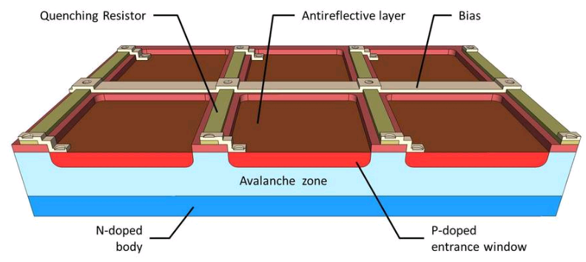
Schematic representation of a blue sensitive pn structrue
Source: http://www.ketek.net/products/sipm-technology/microcell-construction/

Slide 12
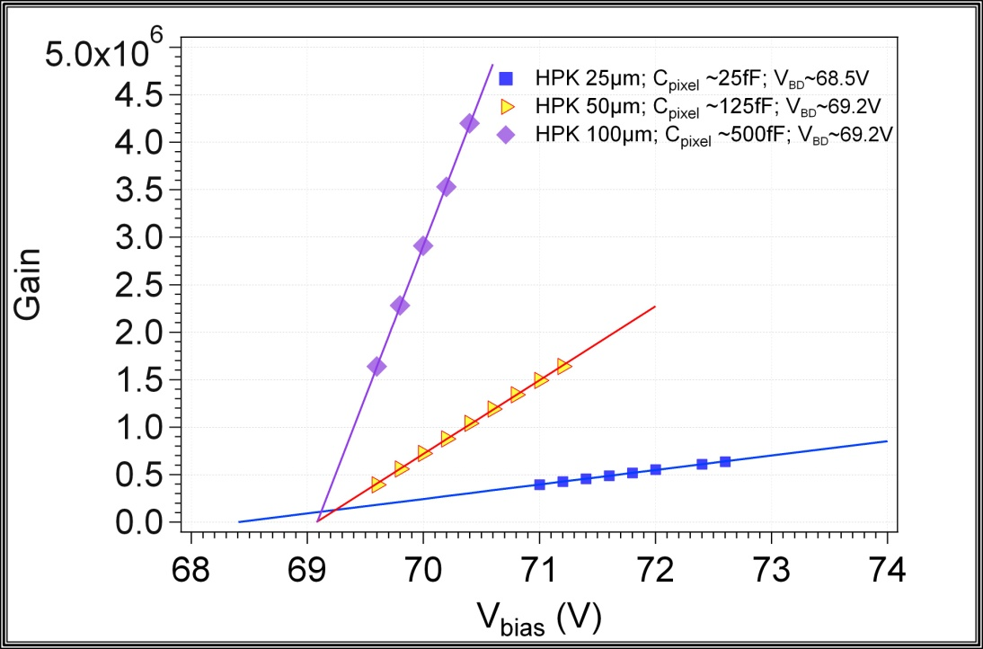
Gain of 3 Hamamatsu devices with 25, 50 and 100 mm cell size.
Gain = ΔV_{BD}· C_{D} / e
The slope of the linear fit of G(V_{bias}) is the pixel capacitance
C_{pixel} and hence G increase with the pixel geometrical dimensions and the depletion depth.
  C_{pixel} ~ ε₀ε_{r}S/d
    C_{pixel} = O(10-100 fF)
N. Dinu & al, NIM A 610 (2009) 423–426

Slide 13
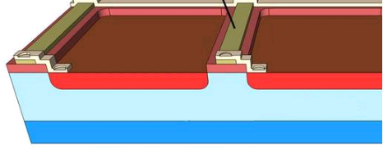
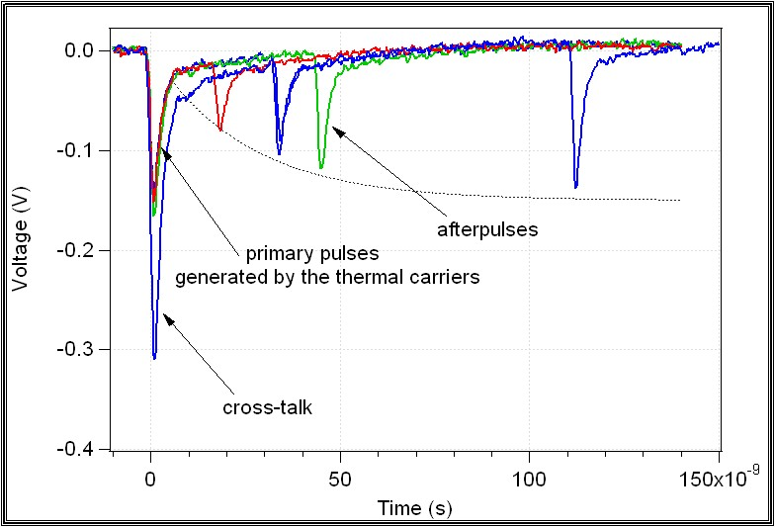
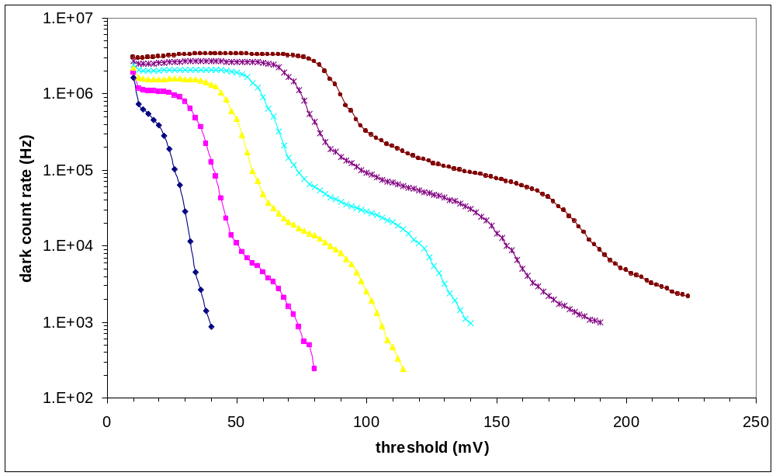

  Dark counts due to …
Thermal/tunneling : thermal/ tunneling carrier generation in the bulk or in the surface depleted region around the junction
After-pulses : carriers trapped during the avalanche discharging and then released triggering a new avalanche during a period of several 100 ns after the breakdown
Optical cross-talk: 10⁵ carriers in an avalanche plasma emit on average 3 photons with an energy higher than 1.14 eV (A. Lacaita et al. IEEE TED 1993). These photons can trigger an avalanche in an adjacent µcell.
Limit gain, increase threshold
add trenches btw μcells
N. Dinu & al, NIM A 572 (2007) 422–426
th=0.5pe
N. Dinu & al, NIM A 572 (2007) 422–426
FBK-irst device
2007 production
FBK-irst device
2007 production
ΔV=0.5V
ΔV=3 V
ΔV=1V
ΔV=1.5V
ΔV=2V
ΔV=2.5 V

Slide 14
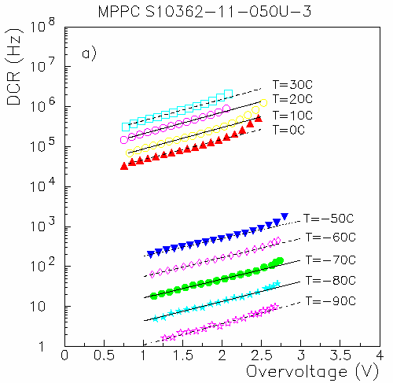
… and/or cool
Hamamatsu 1mm² device
Reduce noise by a factor ~2 every 8 K
Overvoltage must take into account the
T-dependence of V_{BD}
N. Dinu et al., NSS Conf Record (NSS/MIC), 2010 IEEE , vol., no., pp.215-219,

Slide 15
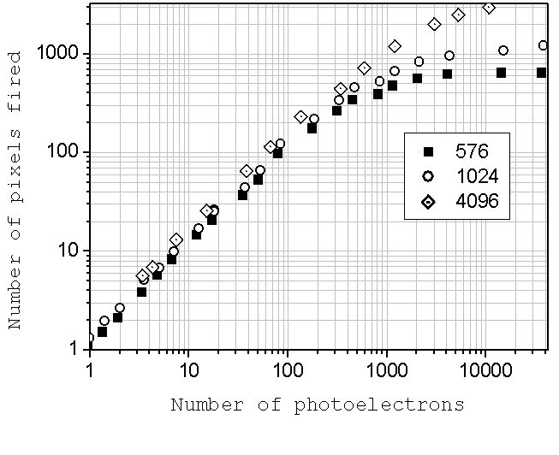

Limited linearity
is simply a consequence of the limited of available pixels. Some pixels get ≥2 hits.
$$N_{fired}=N_{available}\left(1−exp⁡(−\frac{Nγ,true}{Navailable})\right)$$
N_{true}/N_{available} ~ 0.5
→ N_{fired}/N_{true} ~ 0.8
B. Dolgoschein (Light06)

Slide 16



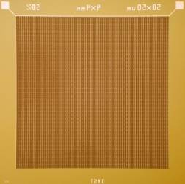
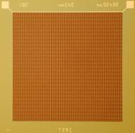
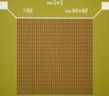



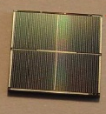
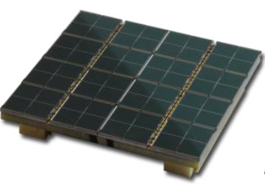
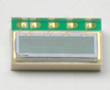
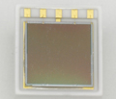
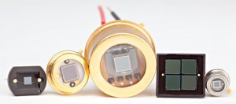
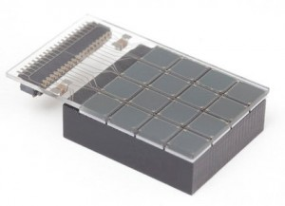
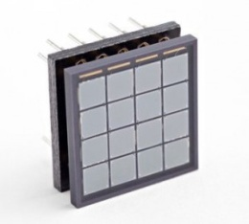
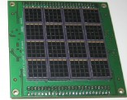
SiPM designs (just examples)
Hamamatsu HPK (http://jp.hamamatsu.com/)
25x25µm², 50x50µm², 100x100µm² pixel size
FBK-IRST
50x50µm² pixel size
4x4mm²
3x3mm²
1x1mm²
2x2mm²
1x1mm²
3x3mm²
Arrays
4x4mm²
2x2 channels
3x3 cm²
8x8 channels
1x4mm²
1x4 channels
6x6 mm²
2x2 channels
SensL (http://sensl.com/)
20x20µm², 35x35µm², 50x50µm², 100x100µm² pixel size
3.16x3.16mm²
4x4 channels
3.16x3.16mm²
4x4 channels
6 x 6 cm²
16x16 channels

Slide 17
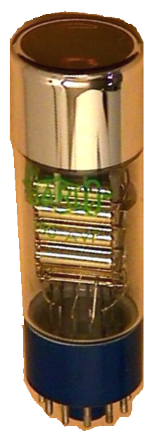
PM vs SiPM
 | PMT | SiPM
QE (VIS) | 0.2-0.4 | 0.2-0.7
Gain | 10⁶ @ O(kV) | 10⁶ @ O(50V)
Timing | T_{r} ~ O(1ns) TTS ~ O(100 ps) | T_{r} ~ O(1ns) TTS O(100 ps)
Dynamic range | O(10⁶) | O(10³)
ENF | 1.1-1.5 | ~1
Dark noise rate | O(kHz/cm²) | O(MHz/mm²)
Single photon sensitivity/ counting | 😐/☹ | ☺/☺
Magnetic field immunity | ☹ | ☺
Robustness & compactness | ☹☹ | ☺☺

Slide 18

A new geometrical concept for a PET scanner
with SiPM readout.
P. Beltrame et al., The AX-PET demonstrator—Design, construction and characterization, NIM A 654 (2011) 546-559
P. Beltrame et al., The AX-PET Concept: New Developments And Tomographic Imaging, 2011 IEEE NSS Conf. Rec. MIC22-5

Slide 19
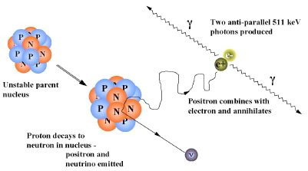
PET basics
Positron Emission : p → n + e⁺ ν_{e}
β⁺ decay of various radionuclides
Positron Annihilation : e⁺e⁻ → γγ (E_{γ} = 511 keV ). 2 photons emitted almost “back-to-back”
The above two processes define the fundamental limits to the spatial resolution of PET
‣ Finite positron range (ρ): annihilation position ≠ emission point, ρ depends on the energy of the positron (i.e. on the radioisotope). ρ ~ mm
‣ Non-collinearity of the 2 photons: residual momentum of the e⁺e⁻ at the annihilation => the 2 photons are emitted with a small deviation from 180° (Δθ ~ 0.5°) => blurring of the spatial resolution R_{FWHM} ~ 0.0022 x D [mm]
Radionuclide | Half life | E_{max}_e⁺(MeV)
¹¹C | 20.4 min | 0,96
¹⁵O | 122 sec | 1,73
¹⁸F | 109,8 min | 0,63
²²Na | 2.6 years | 0,55

Slide 20
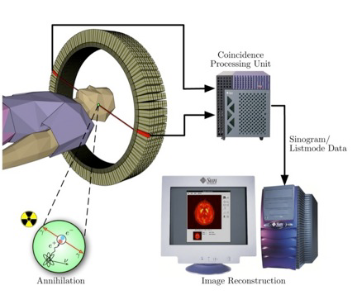
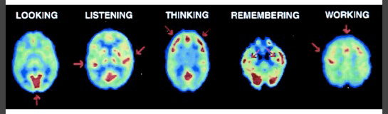
PET detector principle :
coincidence of two 511 keV photons define a line of record.
Take projections under all angle
(2/3D) Tomographic reconstruct of data
In practice…
Inject the radiotracer into the body (0.1-0.2 mCi per kg body weight)
Wait for up-taking period (~h)
Acquire data (~0.5 h for full body)
Feed the data into the reconstruction algorithms
(2/3D) image of the activity concentration
PET is an “in-vivo” functional imaging technique
It produces a (quantitative) image of the radio-tracer concentration
Use of F-18 labeled glucose → image of the bodies metabolism

Slide 21
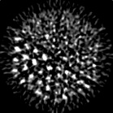
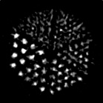


Quality of a PET image depends on
Detector resolution → crystal size and readout type)
Counting statistics → efficiency, detector thickness, scintillator material
Scatter fraction (Compton scattering in body and detector) → energy resolution
Accidental coincidences and pile-up → coincidence window
…
Statistics matters ….
A.Del Guerra, CERN Academic Training 2009
50000 counts 100000 counts 500000 counts 2M counts
The challenges in PET are today (and since a long time)
Improve resolution (approach physical limits)
Improve efficiency
Reduce background
Combine it with other imaging modalities, in particular MRI

Slide 22
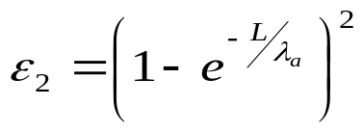


The parallax dilemma
The Axial PET concept was conceived to simultaneously optimize resolution and efficiency.
Crystals need to have a minimum thickness L
Efficiency for pair detection
λ_{a} = photon attenuation length of crystal
L = λ_{a} → ε₂ ~ 40%, L = 2 λ_{a} → ε₂ ~ 75%, …
λ_{a} = 1-2 cm (depending on material, see below)
L
A standard PET does not measure the depth of interaction (DOI) in the crystal.
This introduces a parallax error
The resolution in the off-center region degrades significantly
Solution: reduce L (→bad ε₂) OR measure DOI OR invent a different geometry
δ_{p}
α
“Standard” radial PET geometry

Slide 23
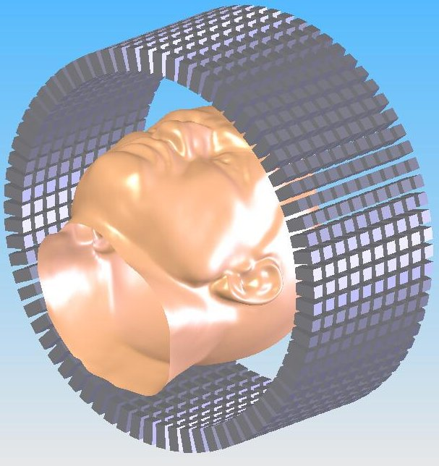
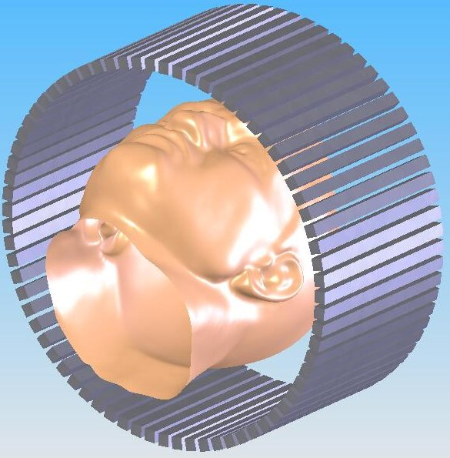
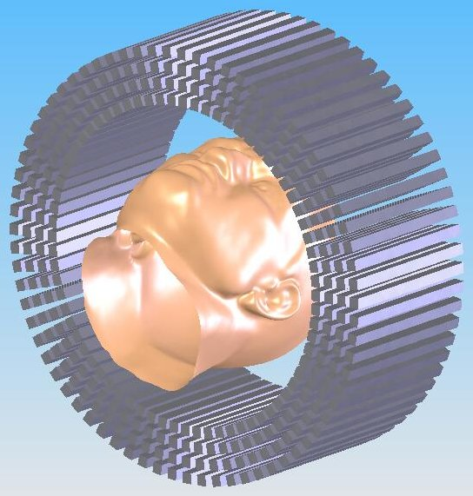
The AX-PET concept
PMT
2
PMT
1
PMT
4
PMT
3
From short radially oriented,
block readout crystals …
… to long, axially oriented, individually readout crystals

Slide 24
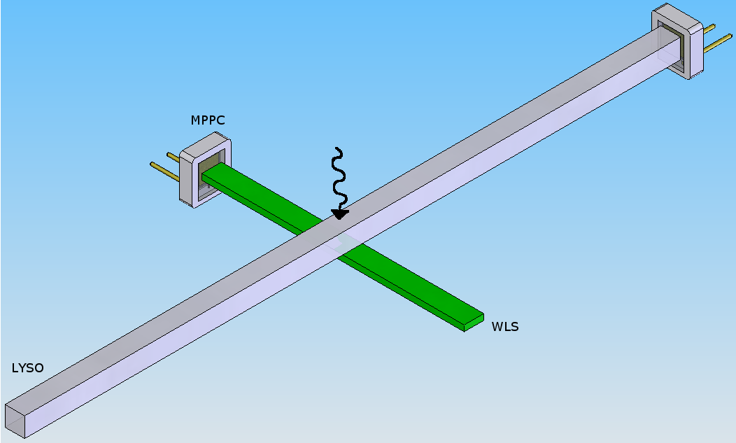
Our implementation of the AX-PET concept
x
z
SiPM
SiPM
y
scintillation light
Individual readout of crystals. Crystal address gives transverse coordinates (x,y)
Small crystal cross section → parallax error practically negligible !
Additional layers allow to increase sensitivity
→ Spatial resolution and sensitivity are decoupled and can be optimized independently
How to read crystals ?
How to measure axial coordinate ?
wavelength
shifted light
x
z
y

Slide 25

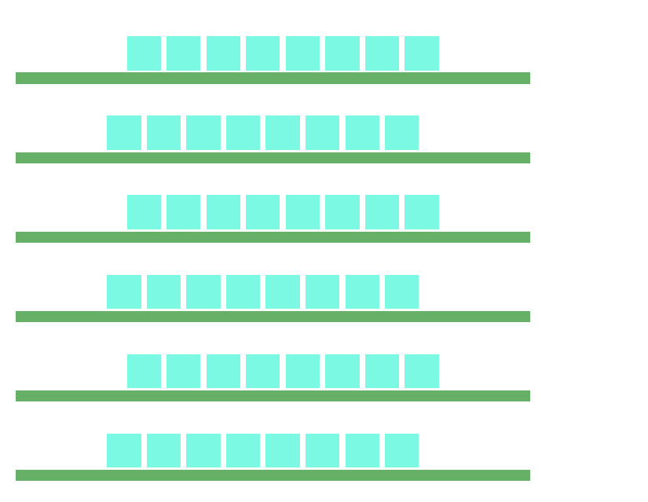


Since 2008, the AX-PET collaboration (Bari, Cagliari, CERN, Michigan, Ohio, Oslo, Tampere, Valencia, Zurich, < 10 FTE ) has built and tested a fully operational PET demonstrator scanner.
It consists only of two camera modules à
48 crystals (6 layers x 8 crystals)
156 WLS strips (6 layers x 26 strips)
7
The layers are optically separated from each other.
3.5
Crystals are staggered by 2 mm. Crystals and WLS strips are read out on alternate sides to allow maximum packing density.

Slide 26



AX-PET components
The scintillator crystals are Ce doped LYSO (Lu_{1.8}Y_{.2}SiO₅:Ce) single crystals, fabricated by Saint Gobain and commercialized under the trade name PreLude 420.
The main characteristics are:
Density [g/cm3] | 7.1
Attenuation length for 511 keV [cm] | 1.2
Wavelength of maximum emission [nm] | 420
Refractive index at W.L. of max. emission | 1.81
Light yield [photons/keV] | 32
Average temperature coefficient [%/K] | -0.28
Decay time [ns] | 41
Intrinsic energy resolution [%, FWHM] | ~8
Natural radioactivity [Bq/cm³] | ~300
Effective optical absorption length [mm] | ~ 420
One end is read out, the other end is mirror-coated (evaporated Al-film).
Hamamatsu SiPM (MPPC)
Dimensions: 3 x 3 x 100 mm³
PMT (with borosilicate window)
Emission / detection efficiency (a.u.)
This determines the transverse resolution (1 module).
Expect: σ_{x} = σ_{y} = 3/sqrt(12) ~ 0.86 mm
(2 mm FWHM)

Slide 27



The WLS strips are of type EJ-280-10x from Eljen Technologies
Shift light from blue to green
Density: 1.023 g/cm3
Absorption length for blue light: 0.4mm (10 x standard concentration)
Index of reflection: 1.58
Decay time: 8.5ns
Size: 0.9×3×40mm³
σ_{z} = 3/sqrt(12) ~ 0.86 mm
(2 mm FWHM).
Use COG algorithm on top.
One end is read out, the other end is mirror-coated (evaporated Al-film).

Slide 28




The photodetectors are SiPMs of type MPPC from Hamamatsu.
Two different types are used:
MPPC S10362-33-050C → Crystal readout
sensitive area: 3 × 3 mm².
pixel size: 50 × 50 μm² (60 × 60 = 3600 pixels)
typical operational voltage: 70 V.
Typical gain: 7·10⁵.
Photon detection efficiency: ~40 % (400 nm)
MPPC 3.22×1.19OCTAGON-SMD → WLS readout
custom specific device
sensitive area. 3.22 × 1.19 mm²
The pixel size is 70 × 70 μm²,(46 × 17 = 782 pixels).
Some MPPC ‘features’
Gain is temperature dependent (~5%/°K) → T monitoring
Limited dynamic range → saturation effects → correction
Thermal noise, O(100 kHz) at 1 photon level. → set threshold
The electrical connections to the MPPCs are made
via special Kapton cables soldered to the MPPCs.

Slide 29


Fully assembled module (48 crystals, 156 WLS stips)
+ lots of cables: 204 x (bias + signal out)

Slide 30



Front-end electronics
Fully analog, but relatively slow …
1 channel.
LL (50 keV)
Compton
HL (~450 keV)
photopeak
1275 keV
HHL (~550 keV)
Mod 1: Energy sum of all LYSO crystal of 1 module. ²²Na source
1 module.
Good hit in 1 module = LL × HL × HHL
GH1
Trigger
GH2
T_{coinc} = 20 ns
Max Readout rate ~ 20 kHz

Slide 31




Test set-ups
I. Single module characterization
II. Coincidence of 2 modules
III. Gantry for tomographic measurements
Rotating support
module
PMT
module 1
module 2
tagger
source
Na-22
Source
0.25 mm Ø
2-D moving station
Module in coincidence with a tagging scintillator
Use of different tagging crystals
Distance between modules = 15 cm

Slide 32




Single module characterization
Typical charge spectrum from 1 LYSO crystal
Energy resolution of all 96 LYSO crystals
<R_{E}> = 11.7 % (FWHM)
${In the ideal case: R}_{E}=R_{E}^{}$^{intr.}$⨁{\frac{1}{2.35·\sqrt{Npe}}}$
Separate calibration experiment:
511 keV ~ 1100 pe in SiPM
→ Expect R_{E} ~ 10.7 %

Slide 33

Energy calibration
First correct for possible temperature changes
SiPM gain drops by ~5% per degree K.

Slide 34




Energy calibration
Lutetium in LYSO is radioactive.
~ 250 Bq per crystal.
Small non-linearity due to limited pixel number
of SiPM (3600)
203 keV
511 keV
5% effect
55 keV
306 keV
Intrinsic radioactivity
¹⁷⁶Lu → ¹⁷⁶Hf* + ß⁻
The formula would predict a 15% effect
$$N_{fired}=N_{available}\left(1−exp⁡(−\frac{Nγ,true}{Navailable})\right)$$
306 keV
LYSO photons arrive over ~100 ns. Some hit
pixels will have recovered when the 2nd hit arrives.
203 keV
89 keV (IC)

Slide 35



The axial coordinate …
noise
centre-of-gravity
algorithm
511 keV
Cluster
σ_{z} ~ 0.75 mm
(average over whole module, after correction for e⁺ annihilation physics).
Calibration (separate set-up):
511 keV → 100 pe in WLS cluster

Slide 36


First coincidence measurements
Point-like ²²Na source
Photoelectric events only (1 hit crystal per module)
Draw “LOR” (pure geometrical, no tomographic reconstruction)

Slide 37

TRANS-AXIAL PLANE
AXIAL PLANE

Slide 38


Look at the YZ distribution at x=0 (“confocal reconstruction”)
RMS =
0.89 mm
σ_{z} = 0.63 mm (coincidence) is compatible with the single detector resolution.
After correction of the e⁺ annihilation physics:
σ_{z} (coinc.) ~ σ_{z} (detector) / sqrt(2)
y coordinate is quasi-discrete (crystal positions).

Slide 39


Experimental check: Are there parallax errors ?
Oblique
30○
30○
²²Na point-like source
Face-to-Face
As expected from the design, there is no noticeable parallax error, neither in the axial nor transaxial plane.
There is however an unavoidable degradation of the resolution, when the source is very close to one detector. The coincidence resolution looses the 1/sqrt(2) ‘bonus’

Slide 40





Ready for tomographic imaging
Basics of tomographic imaging (in AX-PET this is the speciality of the team from Valencia (M. Rafecas et al.)
A PET scanner measures projections of the activity distribution. Reconstruction means to calculate from these projections the actual 3D distribution of the activity. There are two groups of methods:
1. Analytical algorithms
(usually based on sinograms)
2. Iterative algorithms
(mainly used in AX-PET, see back-up slides)
(2D case)
“sinogram”
a 2D histogram
of all projections g(s,θ)
PET ring
1 angle
One doesn’t know where on the LOR the count occurred. Therefore, “back projection” means re-distributing the counts uniformly to all pixels which fall within the projection path.
θ
angle θ
4 angles
s
LOR
The more angles,
the better!
64 angles
(Filtered) Back Projection

Slide 41


How do we get all these angles with just 2 modules ?
20○
FOV
FOV
‘’Step and shoot”
Rotate object in 9 steps of 20 deg.
‘’Step and shoot”
1.) Rotate object in 9 steps of 20 deg.
2.) Rotate 1 module by 20 deg.
3.) Rotate object in 18 steps of 20 deg.
Price to pay:
Longer acquisition times (several h).
Decaying activity
Changing conditions (pile-up, dead time)
We mimic a 18-module scanner, however with a very limited FOV (width and length of 1 module). We allow only coincidences between opposite modules.
Now we allow coincidences between opposite ±1 modules. → Larger FOV.

Slide 42


The AX-PET set-up has exactly the size of a EURO palette. Very useful for measurement campaigns at other places
Measurements with phantoms or animals can’t be made at CERN!
ETH Zurich, PET lab, 2010
AAA (Saint GEnis), F) 2010
AAA (Saint GEnis), F) 2011
ETH Zurich, PET lab 2012
phantoms
animals

Slide 43

Phantoms are just containers which can be filled with a radiotracer. We usually work with F18 in aqueous solution. Some ink is added to see air bubbles.

Slide 44





capillaries :
L = 3 cm
∅ = 1.4 mm
pitch = 5 mm
ETH 2010
Profiling
counts [a.u.]
Resolution
FWHM [mm]

Slide 45








Three regions in the same phantom to address three different aspects
Hot & Cold rods for contrast
Homogeneous cylinder for assessing the ability to reconstruct homogeneous distributions
34 mm Ø
NEMA mouse phantom
← 63 mm →
Series of small rods for resolution
1 mm (i.e. < Resolution)
5 mm
2 mm
4 mm
3 mm
Reconstructed 1 mm rod
=> FWHM ~ 1.6 mm

Slide 46




Mini Deluxe phantom
Rods oriented parallel to Z axis
Rods oriented perpendicular to Z axis
(A)
(B)
High density resolution phantom
Diameter (75 mm) is larger than the extended FOV
(A)

Slide 47



Small Animal Tests
June 2012, small animals tests campaign at ETH Zurich, Radiopharmaceutical Inst.
Possibility to use their GE Explore Vista PET/CT scanner as reference. This is a dedicated small animal scanner with 1.45 x 1.45 mm crystals. Block readout. DOI via Phoswich approach.
one mouse, FDG
one (young) rat, FDG
one (young) rat, 18-F
=> organs structure
=> bones, skeleton structure
Rat, FDG - Details of the heart
AXPET
Explore Vista

Slide 48


Rat, F-18 - Details of the skeleton
AXPET reconstructed image
axial field of view
CT image from Explore Vista
(not enough activity left for the PET acquisition with Explore Vista)

Slide 49

Rendered F-18 image of rat
(click to animate)

Slide 50

And finally … Digital SiPM
With the GM-APD being a binary device…
one could also conceive a fully digital SiPM, where the output is just the digital count of the number of fired cells.
Philips

Slide 51


Digital SiPM
1 digital cell (area depends on type, e.g. 30 x 50 μm)
v
Philips
Different from analog SiPMs: Upon the detection of a photon, the avalanche is actively quenched using a dedicated transistor, and a different transistor is used to quickly recharge the diode back to its sensitive state.

Slide 52



Digital SiPM
Compared to the analog technology, the digital one (so far only offered by Philips) has a number of
advantages
Integration of bias supply, amp, TDC, counter…
Fast active quenching → no afterpulses
Possibility to de-activate noisy cells → potentially lower dark noise
Reduced sensitivity to voltage and temperature variations
Compactness
Possibility to add local intelligence
… problems shared with analog
High dark noise (a discharging cell doesn’t know whether it is digital or analog)
Signal saturation (limited number of cells)
… and also has some drawbacks
The local electronics is a source of heat → cooling advisable
The readout functionality is designed into the sensor. In case of mismatch with the needs, relatively expensive modifications of the sensor/FPGA may be required.
Front and back sides of a 64 channel digital tile (DPC6400-22-44) or (DPC3200-22-44)
Philips
Packaged module, as delivered to clients (DPC3400-22-44). Includes a 100 μm thick protective glass layer.
38.5 x 38.5 mm²

Slide 53

Digital SiPM Readout
Philips
trigger
Every non-validated trigger leads in principle to the recharging of all cells. Without cooling, the device can loose efficiency/availability.
Σ < 1 μs Expect readout rate up to O(1 MHz)

Slide 54





We got fascinated by the idea of a digital AX-PET module, mainly in view of a possible TOF-PET extension.
In reality, we have 2 x 8 WLS strips
Luckily, crystals and WLS would just fit (without big compromises) on the existing Philips 64 channel DSiPM modules DLS-6400
Aim for dual sided readout of long crystals to get rid of propagation delays

Slide 55

Principle of TOF-PET
Idea: use time information to localize annihilation along the line of response. LOR does no longer contribute uniformly to all pixels but according to the measured time and its resolution.
Images contain less noise and show better contrast (particularly noticeable for large scanners and big patients)
Δt = 2·Δx/c
Need δt = 66 ps
for δx = 1 cm
Gain of a TOF system over a non-TOF system is
G = 2D / c· δt
D = dimension of object being imaged.

Slide 56



Verification of normal AX-PET characteristics
Two modules setup. Single sided readout plus WLS strips.
2 x 8 WLS strips
dSiPM
4 LYSO crystals
Water cooling
Kapton
cable

Slide 57


Energy calibration and resolution
(single sided readout)
~25% effect
Saturation effect is much larger:
More detected p.e.
Fewer pixels (3200 vs 3600)
Recharging only after readout!
In the end we get a comparable
Energy resolution.
(analog AX-PET was 11.7 %).

Slide 58


Confocal reconstruction in axial direction (WLS array)
²²Na source of 250 microns diameter, 150 mm between the two modules
Slightly better than with the analog AX-PET set-up (1.48 mm)

Slide 59

Coincidence time resolution
(single sided readout)
This is only possible after correcting for light paths using WLS information
Aluminium coating
Δz
readout
readout
t₁
>
t₂

Slide 60


Energy calibration and resolution
(Double sided readout)
raw
saturation
corrected
ΔE = 10.45% (FWHM)
2250 → 2800
(25%)

Slide 61




Coincidence time resolution by mean timing
(Double sided readout)
Mean Timing corrects automatically for light propagation times in the crystals. The resolution becomes fully independent of the source position in the FOV.
$Δt=\left\langle t_{mod1}\right\rangle −\left\langle t_{mod2}\right\rangle = \frac{t_{1,up}−t_{1,down}}{2}$ - $\frac{t_{2,up}−t_{2,down}}{2}$
100 mm
Small differences in timing of pixels (offsets) can be eliminated.
300 mm
Vertical scan
(1 module +
small tagger)
= 96 ps
FWHM = 225 ps
Horizontal scan
TDC bins a 19.5 ps

Slide 62
Brief look at applications in particle physics
The SiPM technology wasn’t mature enough when the choices were made for LHC (>10 years ago).
But we start to see SiPMs in R&D for the LHC upgrade.
The obvious applications are readout of scintillators and scintillating fibres.
Also demonstrated: Detection of Cherenkov light (even with digital SiPM).
First major project was T2K (scintillator tracker + ECAL). ~65k SiPMs.
The CALICE collaboration builds HCAL and ECAL prototypes based on small scint. plastic tiles (ILC). ~8k SiPMs.
CMS is working on an upgrade of HCAL barrel (SiPMs replacing HPDs).
LHCb is working on a study of SciFi tracker to replace Si strips and gas straw tubes.
~ 300k SiPMs
CLIC detector study for a W/scint ECAL. Many 100k SiPMs.

Slide 63




SiPM in the ILC HCAL and ECAL (R&D)
High granularity hadronic calorimeter optimised for the Particle Flow measurement of multi-jets final state at the ILC
e⁺ e⁻ collider (1 TeV)
photo-detector requirements:
insensitive to magnetic field (~ 5T)
coupling with a scintillator (blue emission)
stability (T-control or T-monitoring)
rel. large dynamic range
low cost
CALICE tests with MePHI/PULSAR, HAMAMATSU, KETEK SiPMs
SiPM
1 mm²
PROTOTYPE
3 x 3 cm² plastic scintillator tile
with embedded WLS fiber + SiPM
Readout of SiPMs by the SPIROC ASIC (LAL)
216 tiles/layer (38 layers in total) ~8000 channels

Slide 64





SiPM in the ILC HCAL (R&D)
Calibration & monitoring
Different SiPM couplings to scintillator tile
test beam (absolute)
LED monitoring system (stability)
with WLS fiber (for MEPHI SiPM)
DESY 3 GeV electron testbeam
direct coupling (for MPPC)
hole (“dimple”) for more uniform light yield close to photodetector
Channel energy calibration by ~3 GeV electrons (MIPs).
Multi-photon peaks allow simple absolute calibration.

Slide 65




R&D for LHCb SciFi tracker
1 det. layer = 5 fibre layers
250 μm Ø scint fibres.
Npe
5 m
~20 pe, σ_{x} ~ 50 μm
Detector concept follows largely the work of the Aachen group
(S. Schael et al.)
NIM A 622 (2010) 542–554
~ 300 k SiPM channels
5 m
3 x ( X-U-V-X )
= 12 det. layers

Slide 66


R&D for LHCb SciFi tracker
Main challenges:
Rad hardness of SiPM (10 years ~ 6·10¹¹ n/cm²)
(Rad hardness of scint. Fibres (10 years ~ 30 kGy))
Main observation: dark current / dark rate increase linearly with the NIEL
In analogy to a standard pn detector…
But also gain starts to drop
Devices with smaller cell size and fast cell recovery survive longer
I_{d}~α·Φ_{(1 MeV n eq.)} ·V_{eff} ·G (α = 3·10¹⁷ A·cm)
~1 GHz/mm²
~100 MHz/mm²
~10 MHz/mm²
I. Musienko, SiPM workshop, CERN 2011.

Slide 67

increase due to scintillation of the glass window
time (ns)

Slide 68

Cooling helps a lot. Every 8K reduce the dark noise by a factor 2
But also reducing overvoltage, increase threshold, clustering, short shaping time, …
can save you ☺
+20°C
0°C
-20°C
-40°C
After 1·10¹¹ n/cm²
Current [uA]
Nominal operation point
2.5·10¹⁰ n/cm²
G. Häfeli, EPFL
(LHCb SciFi)
Non-irrad (20°C)
Bias Voltage [V] (corrected for 25ºC)
Dark current (Hamamatsu SiPM module of 128 ch à 0.25 × 1.1 mm² ~ 35 mm²)

Slide 69
Summary / Conclusions
SiPMs are photodetectors with great properties (sensitivity, gain, compactness, simplicity) and a few limitations (dark noise, rad. tolerance, dynamic range, rel. high cost).
In the past decade they have stimulated huge interest (by research teams, industry) and their properties improved a lot. They enabled new applications and will continue to do so.
Digital SiPM technology is a consequent next step. Their acceptance by the market depends on many other aspects.
AX-PET is an example of a detector concept which would be very difficult to implement without SiPMs. It overcomes the sensitivity-resolution dilemma of standard PET detectors. Its acceptance by the market …
Many thanks to my AX-PET colleagues Chiara Casella (ETH Zurich) and Matthieu Heller (CERN) for many plots and schematics used in this talk. Thanks also to Felix Sefkow for CALICE material.

Slide 70

Many thanks for your interest !

Slide 71

Light absorption in Silicon
At long λ, temperature effects dominate

Slide 72

… and its resolution
Extrapolation to d=0 reduces beam spot size to the true source size (250 μm) and also eliminates the effect of non-collinearity
σ_{z} ~ 0.75 mm (1 module)
(after subtraction of contribution of finite positron range (0.23 mm)).
! not to scale !
small
tagger
d

Slide 73

2. Iterative algorithms
The Forward projection
requires the knowledge of the so-called system matrix M_{ij}
Its elements describe the probability of the activity in the j-voxel to be detected by the i-LOR.
Geometry specific. Needs to be calculated only once, but ca be VERY large.
Compare
Converged ?
Calculate Forward Projection
Initial estimate of the activity distribution f(x,y)
M_{ij}

Slide 74
Correction matrix
Compare
Converged ?
Converged ?
Calculate Forward Projection
Initial estimate of the activity distribution f(x,y)

Slide 75
Iterative approaches are more accurate than FBP but very CPU consuming.
All AX-PET data shown in the following, is reconstructed by an iterative method.
Correction matrix
Compare
Converged ?
Converged ?
Calculate Forward Projection
Updated estimates of the activity distribution f(x,y)

