Slide 1

Getting started
DIRAC Project

Slide 2
Outline
DIRAC information system
  Documentation sources
DIRAC users and groups
  Registration with DIRAC
Getting DIRAC credentials
  Getting the certificates right
  Registering user proxies
Web portal interface
Hello world! job

Slide 3
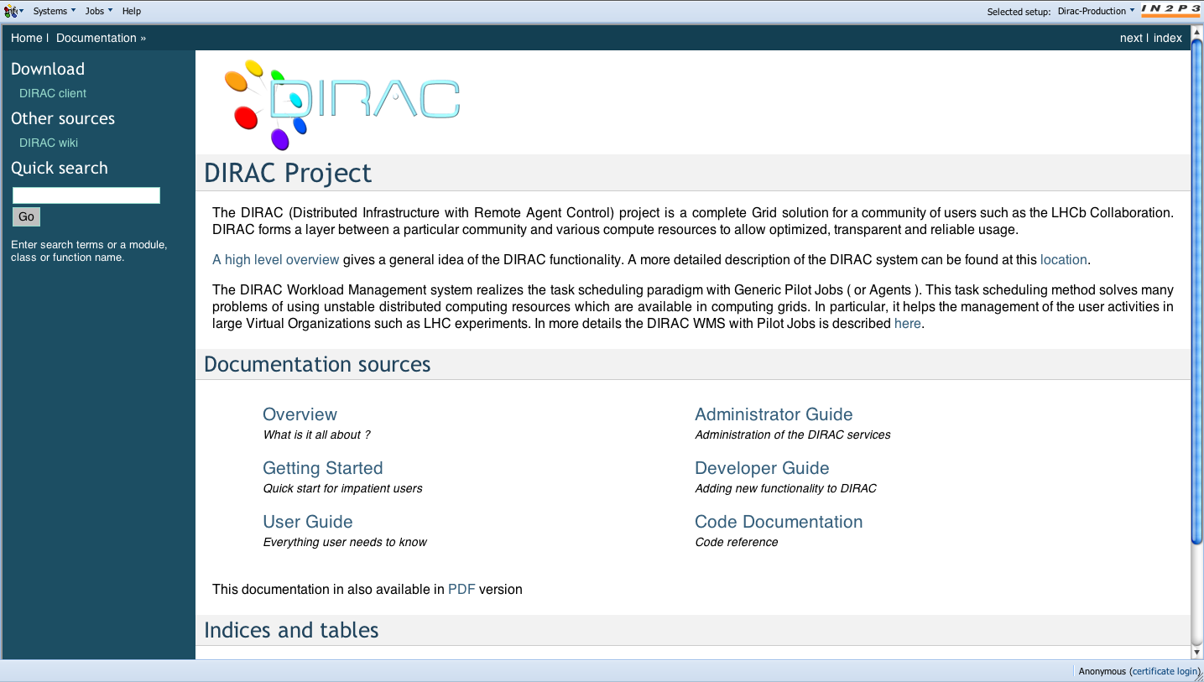
http://diracgrid.org
DIRAC Project Web site contains entry points to various docs
  This is being rapidly developed now, more info to come

Slide 4
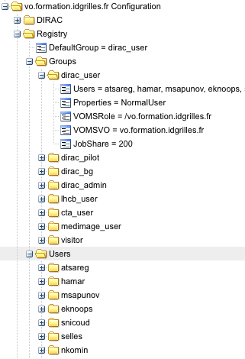
DIRAC users and groups
In order to work with DIRAC
users should be registered
  In one or several groups
  For traceability, accounting, etc
User’s rights are determined
by the Properties of the group
  E.g. NormalUser can submit jobs
  but can not change the DIRAC
  Configuration data
Each group has its share of
jobs that it can run
  Determines the group priority
Groups are mapped onto VOMS VO groups/roles

Slide 5
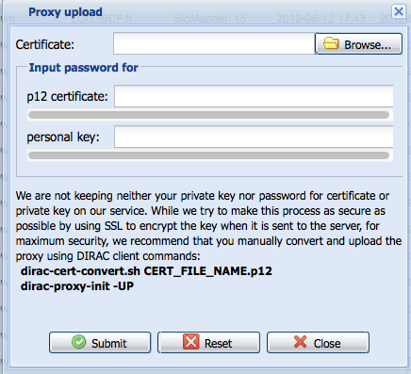
Proxy Management
DIRAC has a full featured Proxy Management system
  Secure Proxy repository – ProxyManager service
    Can be configured to use MyProxy server
  Supply user proxies to various components
    Automatic proxy renewal if necessary
Before using DIRAC a long living
proxy must be uploaded to the
Proxy Repository
In the Web Portal
  Tools > Upload Proxy
  Choose certificate file
  Provide password

Slide 6
DIRAC: user interfaces
Unix command line interface
  Historically the first one
  Suitable for unix addicts
    Easy to use in shell scripts
  Too many commands
    Even more switches
Python API
  Originally for DIRAC developers
  More users are starting to use it
  The most versatile
    Build your own DIRAC applications

Slide 7
DIRAC: user interfaces
Web interface – https://volcd01.cern.ch
  User friendliness is the goal
    That’s why we start with this one
  No security compromises
  Less flexibility than with other interfaces
  But still in rapid development
    More exciting functionalities
    More application specific extensions

Slide 8
Loading certificate into the browser
Before using the Web portal the user grid certificate must be loaded into the browser
  Used to authenticate the user to the DIRAC services
Firefox
  Preferences > Advanced > Encryption > View Certificates
  Import certificate
    From .p12 file
    Password required
Exporting certificate in Firefox
  Preferences > Advanced > Encryption > View Certificates
  Backup certificate

Slide 9
Web Portal: user tasks
Job submission
  Demonstrator
Job Monitoring
  Job status, access to the results
Data discovery
  E.g. LHCb Bookkeeping database interface
  Generic Catalog Browser to come
Administrative tasks
  Configuration management
  Users and groups, community policies
  Accounting, services monitoring
Specific application Web Portals can be derived
  Community Application Servers
    All the grid computational tasks steered on the web
    E.g. LHCb Production Management System

Slide 10
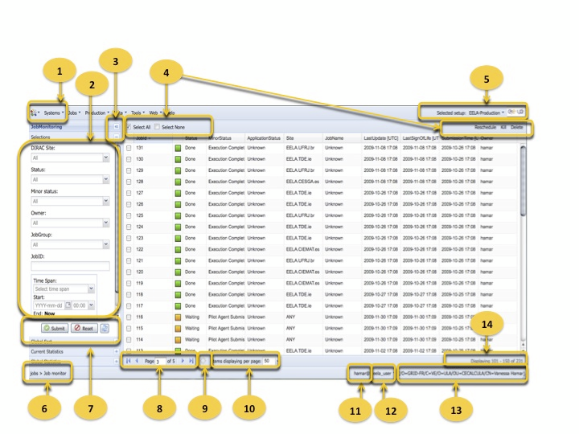
Web Portal: general layout

Slide 11
Web Portal: general layout
Main Menu: This menu offers options for systems, jobs, tools and help.
Selections: Shows a set of selectors than permits generate customs selections.
Buttons to open/collapse panels: Permit open or collapse left menu.
Actions to perform for job(s): These actions permits select all, select none, reset, kill or submit
Menu to change DIRAC setup: Users can change between different setups.
Current location: Indicates where the user is located inside the portal.
Buttons to submit or reset the form: After options are selected its possible to submit and execute the selection or reset the selectors.
Pagination controls: Permits navigate between the pages, and also show in which page the user is navigating.
Refresh table: Reload the page without loose the previous selection and show the new status.
Items per page: This option allow the users to specify how many items are going to be displayed by page.
User DIRAC login: Login assigned to the user connected to DIRAC web portal.
DIRAC Group: The user could belong to different groups and perform actions depending of the group previously selected.
Certificate DN: Web portal shows the distinguish name of user certificate what is being used to realize the connection.
Index items displayed: Display the range of items displayed in the page.

Slide 12
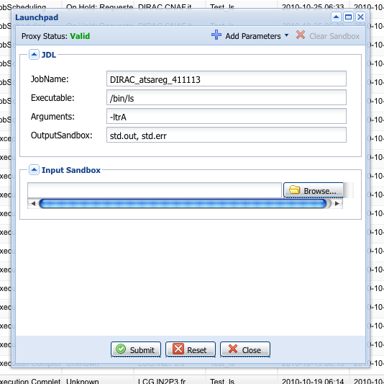
Web Portal: job submission
Launchpad applet
  Jobs > JobMonitoring > Tools
Job submission with the real owner credentials
Job description
  Executable, arguments
  Sandboxes
  Input/Output data
  Extra parameters
Input Sandbox
  Upload local files
Simple application
  Mostly for demonstration purposes

Slide 13
DIRAC job life cycle
checkData
Job
JDL
Job
Receiver
Data
Optimizer
Job
Receiver
Job
Receiver
Task
Queue
Job
Input
Job
JDL
Sandbox
JobDB
LFC/DFC
checkJob
Agent
Monitor
Agent
Director
Matcher
WMS
Admin
Job
Monitor
getReplicas
checkPilot
Pilot
Job
SE
getProxy
RB
RB
RB
CE
JDL
uploadData
DIRAC
services
getSandbox
VO-box
putRequest
LCG
services
CE
Pilot
Agent
Job
Wrapper
WN
execute
(glexec)
User
Application
Workload
On WN
fork

Slide 14
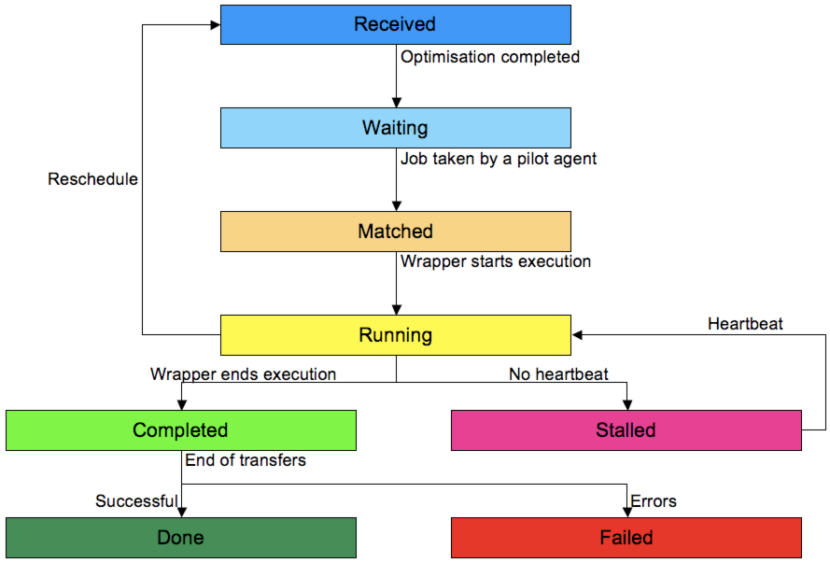
Job state machine

Slide 15
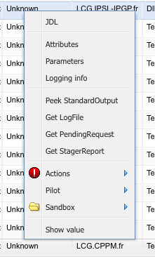
Job Monitoring
Job Monitoring page
  Everything you need to know about your jobs
  Use Help button for detailed explanations
Job Menu
  Job info
  Actions
    Reschedule, delete, kill
  Pilot output access
    Useful for debugging
  Sandbox download
Job selections

Slide 16
Tutorial
Submit “Hello, world!” job with Web Launchpad
  Basic job description
  Monitor it
  Get results
Submit job with Input and Output Sandbox
  Simple processing
  Getting results
Goals
  Understand job description
  Understanding job Web monitoring and manipulation tools

