Slide 1

Job Management
DIRAC Project

Slide 2
Overview
DIRAC JDL
DIRAC Commands
Tutorial Exercises
What do you have learned?

Slide 3
Job Description Language (JDL)
JDL is the language used to specify the characteristics and resources required by the job.
For example:
  Executable to run and its parameters.
  Files to be moved to and from the Worker Node
    Input files
    Grid files
  and any requirements.

Slide 4
Differences with gLite JDLs
DIRAC is not using JDLs internally, DIRAC transforms the user JDL to DIRAC internal conventions.
  Using DIRAC specific matching mechanism for job to resources mapping
Not all the JDLs attributes are allowed in DIRAC.
  In particular, there is no Requirements JDL attribute.
Some attributes are interpreted as requirements
    E.g. Site, CPUTime

Slide 5
JDLs
The JDL syntax consists of statements ended by a semicolon, like:
attribute = value;
Literal strings (for values) are enclosed in double quotes.
Site = “LCG.KEK.jp”;

Slide 6
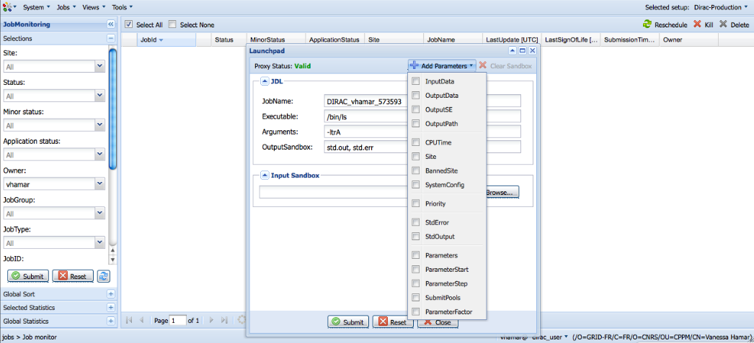
JDLs

Slide 7
Example
Simple JDL
JobName = "Simple_Job";
Executable = "/bin/ls"; *
Arguments = "-ltr";
StdOutput = "StdOut"; *
StdError = "StdErr"; *
OutputSandbox = {"StdOut","StdErr"}; *
* Mandatory attributes

Slide 8
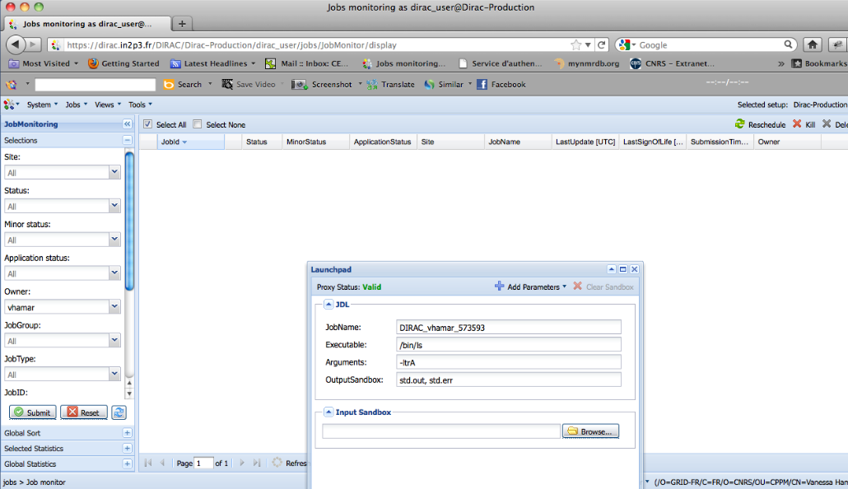
Example
Simple JDL

Slide 9
Sandboxes vs. Data
Sandbox files are stored in the DIRAC Workload Management Service and are only available for the time of life of the corresponding job.
  Volatile storage.
  Some grace period, typically 1 week for keeping sandboxes to allow their retrieval.
Data are stored in the Grid Storage
  Permanent storage
The size of the Sandboxes is limited to ~10MG per job
  Submitting a job with a large sandbox will result as an error
  Large output sandboxes are stored in the Grid Storage
    This is the user responsibility to clean up this storage

Slide 10
Example
Input and Output Sandbox
Simple.jdl
  Executable = "testJob.sh";
  StdOutput = "StdOut";
  StdError = "StdErr";
  InputSandbox = {"testJob.sh"};
  OutputSandbox = {"StdOut","StdErr"};
testJob.sh
  #!/bin/bash
  /bin/hostname
  /bin/date

Slide 11
Example
Input and Output Data
testJob.jdl
  Executable = "testJob.sh";
  StdOutput = "StdOut";
  StdError = "StdErr";
  InputSandbox = {"testJob.sh”,”LFN:/vo.formation.idgrilles.fr/user/v/vhamar/test.txt"};
  OutputSandbox = {"StdOut","StdErr"};
  OutputSE = "M3PEC-disk";
testJob.sh
  #!/bin/bash
  /bin/hostname
  cat test.txt

Slide 12
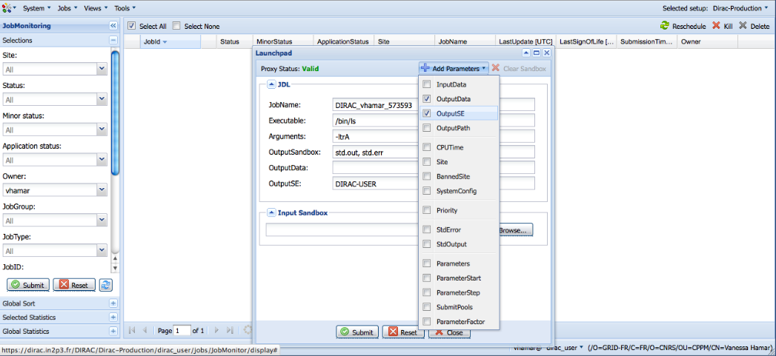
Example
Input and Output Data

Slide 13
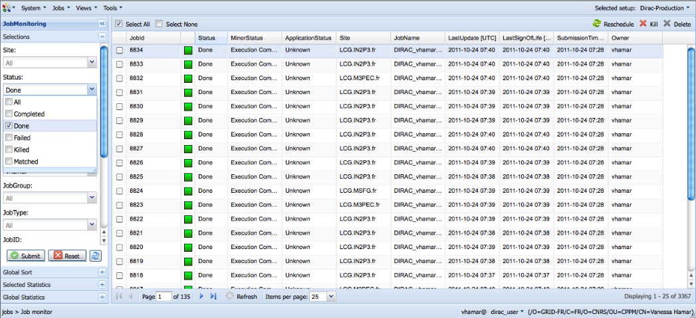
Job Monitoring

Slide 14
DIRAC Commands
In the directory scripts of your DIRAC installation there are a lot of commands that can be used for different purposes:
  Job Management
  Data Management
  Proxy Management
  Administration of the system

Slide 15
DIRAC Commands
DIRAC WMS
DIRAC ADMIN
dirac-wms-job-attributes
dirac-wms-job-delete
dirac-wms-job-get-input
dirac-wms-job-get-jdl
dirac-wms-job-get-output
dirac-wms-job-get-output-data
dirac-wms-job-kill
dirac-wms-job-logging-info
dirac-wms-job-parameters
dirac-wms-job-peek
dirac-wms-job-reschedule
dirac-wms-job-status
dirac-wms-job-submit
dirac-wms-jobs-select-output-search
dirac-wms-select-jobs
dirac-admin-add-group
dirac-admin-add-host
dirac-admin-add-site
dirac-admin-add-user
dirac-admin-allow-catalog
dirac-admin-allow-se
dirac-admin-allow-site
dirac-admin-ban-catalog
dirac-admin-ban-se
dirac-admin-ban-site
dirac-admin-bdii-ce
dirac-admin-bdii-site
dirac-admin-ce-info
dirac-admin-delete-user
dirac-admin-externals-versions

Slide 16
DIRAC Commands
DIRAC DMS
DIRAC PROXY
dirac-dms-catalog-metadata
dirac-dms-change-replica-status
dirac-dms-check-file-integrity
dirac-dms-clean-directory
dirac-dms-data-size
dirac-dms-filecatalog-cli
dirac-dms-fts-monitor
dirac-dms-fts-submit
dirac-dms-get-file
dirac-dms-get-storage-directories
dirac-dms-lfn-accessURL
dirac-dms-lfn-logging-info
dirac-dms-lfn-metadata
dirac-dms-lfn-replicas
dirac-dms-pfn-accessURL
dirac-dms-pfn-metadata
dirac-dms-remove-catalog-files
dirac-proxy-get-uploaded-info
dirac-proxy-info
dirac-proxy-init
dirac-proxy-upload
DIRAC UTILITIES
dirac-platform
dirac-rss-reassign-token
dirac-rss-renew-token
dirac-service

Slide 17
DIRAC Commands:
Sending Jobs
The command used to submit jobs using DIRAC is:
dirac-wms-job-submit <JDL>
$ dirac-wms-job-submit Simple.jdl
JobID = 11
Job ID

Slide 18
DIRAC Commands:
Common options
All the DIRAC commands are following the UNIX notation for passing arguments to the command
Some options are common to all the commands:
  -o to pass any configuration option, e.g.
    -o /DIRAC/Setup=DIRAC-Production
  -d, -dd, -ddd to choose various levels of the output verbosity
  -h to show help message for the command
In the following there are some examples of commonly used commands

Slide 19
Dirac Commands:
Job Status
The command used to get the job status is:
dirac-wms-job-status <Job_ID>
$ dirac-wms-job-status 11
JobID=11 Status=Waiting;
MinorStatus=Pilot Agent Submission;
Site=ANY;

Slide 20
Dirac Commands:
Job Retrieval
To retrieve job outputs use the command:
dirac-wms-job-get-output [ --Dir output_dir] <Job_ID> [<Job_ID>]
$ dirac-wms-job-get-output --Dir this_dir 470 469 468
$ ls -la this_dir/
total 20
drwxr-xr-x 5 hamar dirac 4096 Oct 26 19:02 .
drwxr-xr-x 3 hamar dirac 4096 Oct 26 19:02 ..
drwxr-xr-x 2 hamar dirac 4096 Oct 26 19:02 468
drwxr-xr-x 2 hamar dirac 4096 Oct 26 19:02 469
drwxr-xr-x 2 hamar dirac 4096 Oct 26 19:02 470

Slide 21
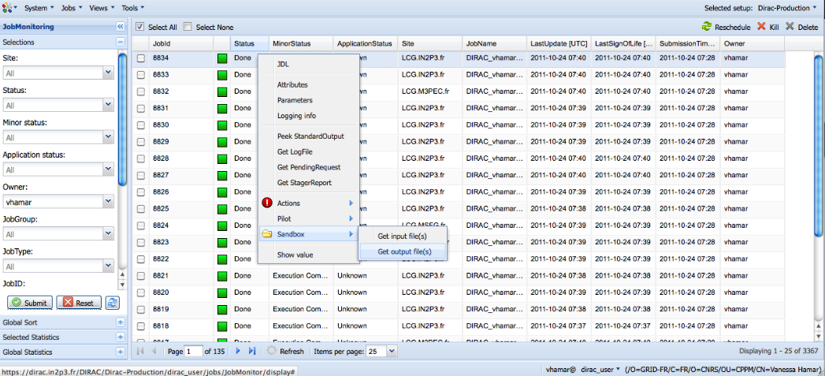
Dirac Commands:
Job Retrieval

Slide 22
Tutorial
Submit “Hello World” job with Web Launchpad
  Monitor it
  Get results in the Web browser
Submit “Hello World” job with command line tools
  Edit JDL
  Monitor it
  Get results with command line tools
Goals
  Understand job description
  Understanding job Web monitoring and manipulation tools

