Slide 1
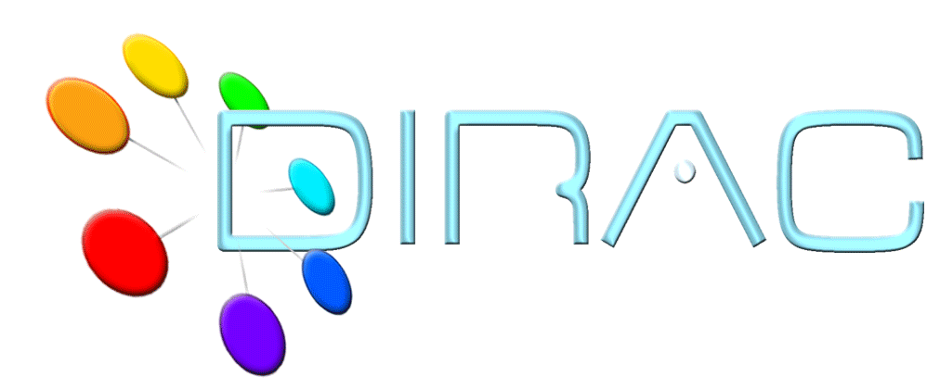
Client installation
DIRAC Project

Slide 2
DIRAC Client Software
Many operations can be performed through the Web interface
  Even more to come
However, certain things should be done using the DIRAC client software
  Obtaining proxies
  Intensive work with jobs, data – scripting tools
    E,g, using Ganga
Client software available for MacOS and various flavours of Linux
  Windows client was demonstrated but not maintained

Slide 3
Client installation
Installing DIRAC client
  Getting DIRAC installer dirac-install script from the web
  Run it with the France-Grilles default
    dirac-install –V ILCDIRAC
  Configure the DIRAC client installation
  Detailed instructions
    https://github.com/DIRACGrid/DIRAC/wiki/ClientInstallation
    If the user certificate is not yet set up, do that now
  Is needed to finish the DIRAC client configuration

Slide 4
Installing user certificate
Obtaining user grid certificate is specific for each Certification Authority
  Out of scope of this tutorial
  You are supposed to have your personal certificate or a temporary training certificate
    In p12 form
DIRAC is providing a dirac-cert-convert.sh tool to convert the certificate in p12 form into the form suitable for the Grid use
  dirac-cert-convert.sh <cert_file.p12>
  User cert and key files in PEM format are in ~/.globus

Slide 5
User proxy
Users must generate and upload long proxies to the ProxyManager before using DIRAC
  Single command, use it for any proxy generation
    Analogous to voms-proxy-init
    Gets also VOMS extensions if possible
    Checks the long proxy status and uploads as necessary
    Creates short working proxy
  dirac-proxy-init –g ilc_user

Slide 6
Tutorial
Tutorial page :
https://github.com/DIRACGrid/DIRAC/wiki/ClientInstallation
Client installation
Managing certificates and proxies
The goal is to get a fully functional DIRAC user environment ready for subsequent exercises

