Slide 1
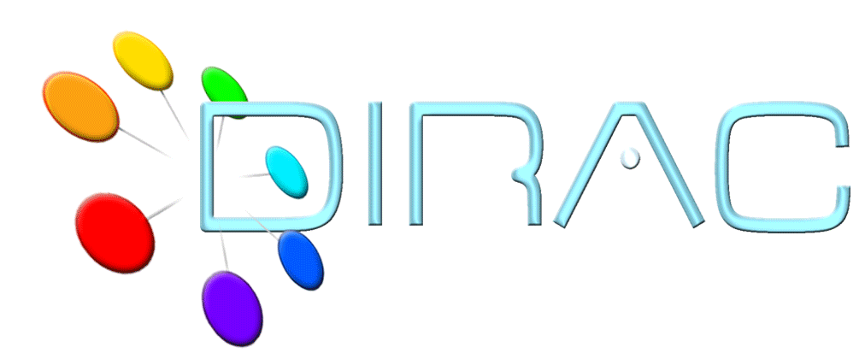
DIRAC Tutorial conclusions
DIRAC Project

Slide 2
What you have learnt
DIRAC Project architecture and capabilities
The basics of job submission
  Monitoring
  Getting results
More advanced job submission
  Multiple jobs
  Jobs with input and output data in the grid
Using various DIRAC interfaces
  Web Portal, API, command line tools

Slide 3
This is just a starting point
There are many more things that you can do with DIRAC
  Data management operations
    Using File Catalogs for describing your data
    Data replication across the grid
    Automation of the data operations
  Massive data production
    Automatic job submission
    Using complicated workflows
  Using various computing resources
    Grids
    But also
      clouds,
      desk top grids,
      clusters in your labs, etc

Slide 4
Conclusions
You have learnt enough to start using DIRAC for your practical tasks
In case of problems or questions visit the DIRAC project site at http://diracgrid.org:
  Use the user Forum to ask questions
The DIRAC experts will still be available for help
I hope that you have enjoyed the course and are ready now for even more exciting work on the grids !

Slide 5
Questions ?

