Slide 1
State-of-the-Art
Accelerator Technology
Peter McIntosh, STFC
HEPTech Environmental Applications of Accelerators
9th July 2013

Slide 2
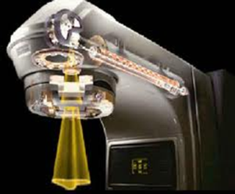
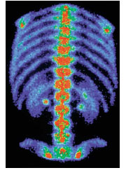
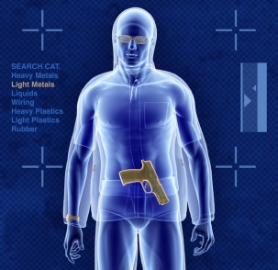
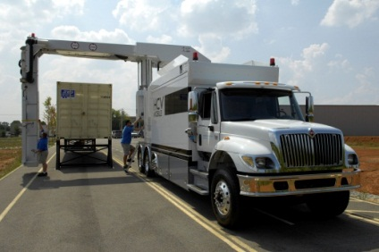
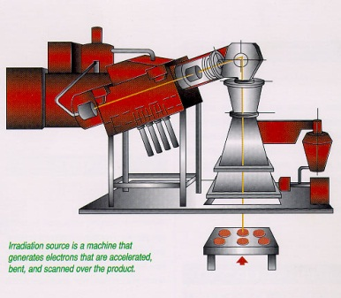
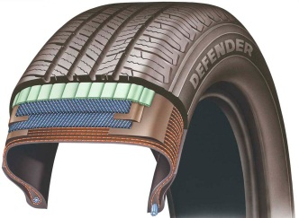
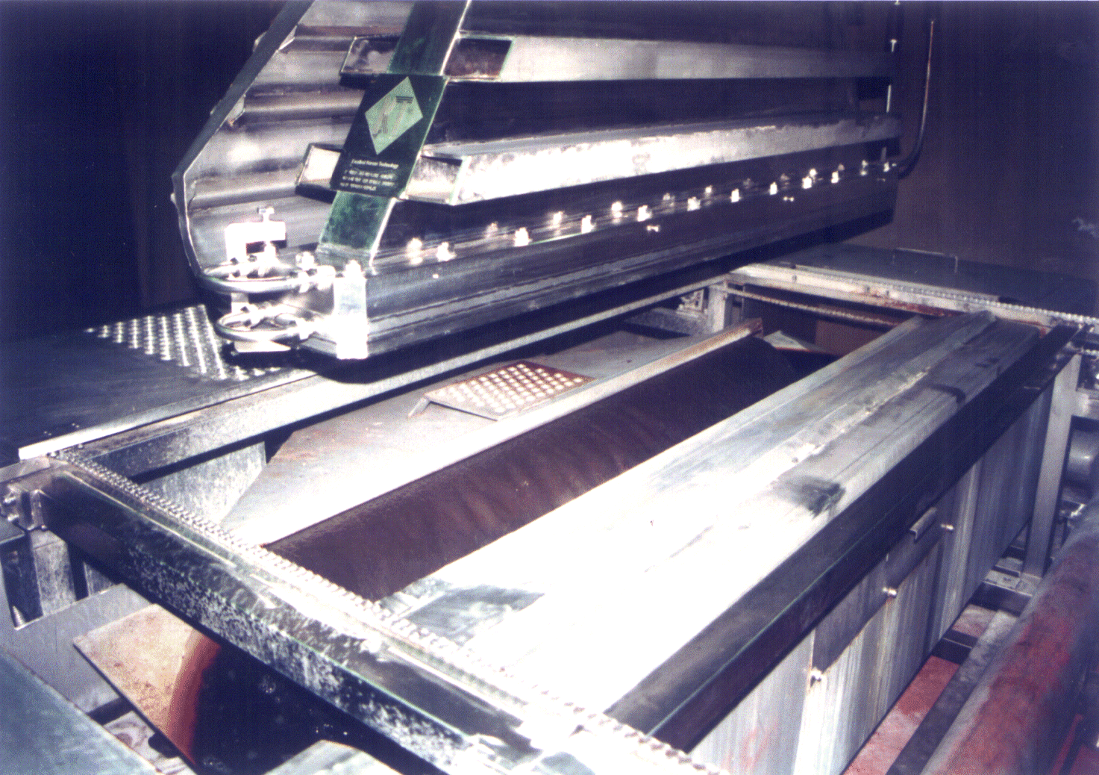
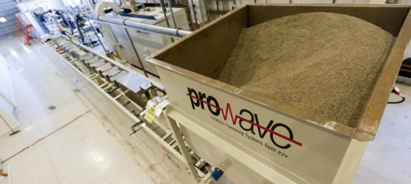
Accelerators Today
Estimated >30,000 accelerators globally:
  Only ~200 used for research – much less than 1%
Used in:
  Healthcare - radio-/hadron-therapy, radioisotope production, medical sterilisation
  Security - threat detection, cargo screening
  Manufacturing - polymer cross-linking (wires, cables, tyres etc.), ink curing, food irradiation
  Environment - waste water treatment, flue gas treatment
Notes:
Places accelerators in context.
Illustrates that other market sectors have embraced accelerator technology more readily than environmental sector, probably because of the power requirements and scale.

Slide 3
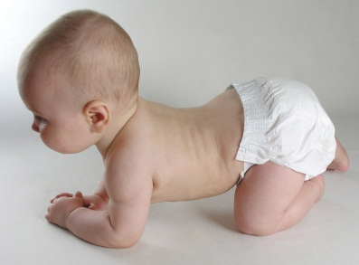

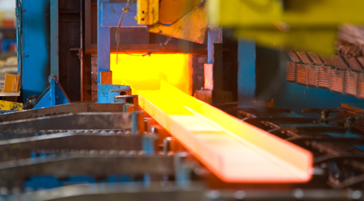
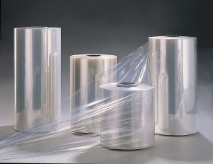
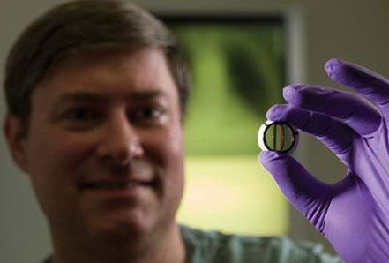
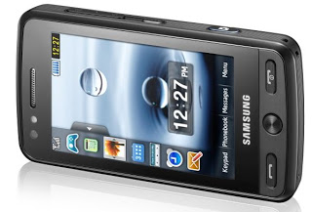
Impact of Accelerators
Pervasive technology (more than commonly realised):
  ~€400bn/yr of end products will have seen an accelerator.
Advances in technology therefore have huge potential for impact across range of sectors:
  We want to unlock the potential of technological advances for the benefit of UK industry.

Slide 4
Drivers for Increased Demand
To promote uptake in the environmental sector, we need to optimise technology solutions to commercial needs.
Smaller – often replacing pre-installed equipment, smaller footprint = reduced building and infrastructure costs.
Cheaper – reduced initial capital investment.
More efficient – reduced on-going operational costs.
More reliable – reduced Mean Time Between Failure, easier maintenance.
(Improved) performance – optimised to application.
Easier to operate – fits into standard protocols and operations.
Repeatable – confident that you get the same outcome every time.
Notes:
Thinking behind slide: If we can address some of the issues (real or perceived) we can promote accelerator solutions – which may then prove very effective and cost effective in the long term.
(Improved) performance – improved is in brackets because it may be that industry’s requirements are not cutting-edge – we just need to optimise the accelerator to the user requirements...

Slide 5
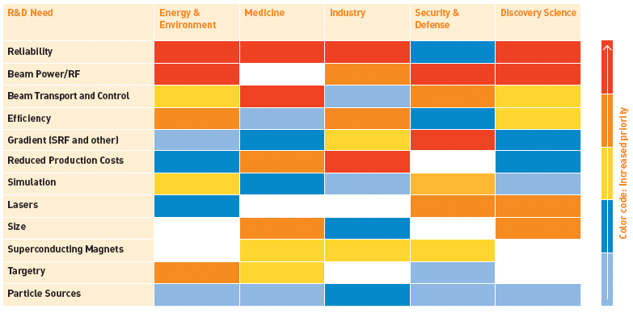
Technology Development Priorities
Ref: Accelerator for America’s Future, July 2010, US DoE
Reliability, Beam Power, Transport,
Efficiency, Gradient, Cost.
.

Slide 6
Key Technology Developments
Innovative accelerator technology and concepts
Radio Frequency Systems
Vacuum Systems
Magnet Systems
Photo-Cathodes
Modelling & Simulation
Visualisation
Collaborative Design
Notes:
Thinking behind slide: Illustrates that accelerators cut across a broad range of technology areas and we’re addressing them all.
Included Visualisation and Collaborative design as that may be more relevant to very large scale facility/ operating plant installations.

Slide 7
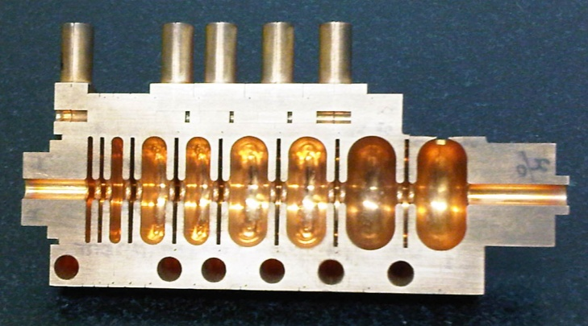
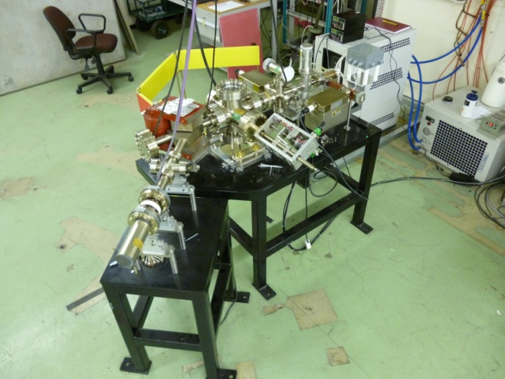
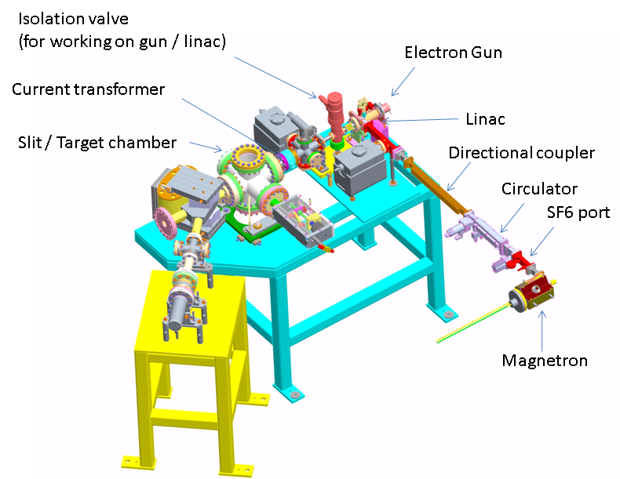
Compact Linacs
Compact linac system demonstrated, with potential to reduce the footprint and cost of systems across a broad range of applications. Higher energy system now under development.
Unique technology may open up the possibility of using cheaper RF power components, without degrading performance.
Notes:
Checked wording with Graeme – he’s happy. Stayed away from anything too specific...

Slide 8
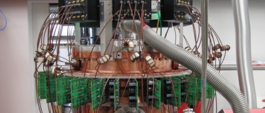
RF Power Developments
Semiconductor amplifiers close-coupled to the cavity:
  Possible substitute for expensive, customised klystrons (a significant proportion of the total accelerator system cost).
  Reduces transmission losses, more electrically efficient (>70%).
  Possible significant footprint reduction.
  Potential for user servicing and upgrades.
Similarly, higher peak and average power magnetrons are opening up new opportunities to replace klystrons and deliver higher average beam currents.
Notes:
Solid-state - next steps to raise the power rating (demonstrated to 160 kW) and investigate radiation hardening

Slide 9
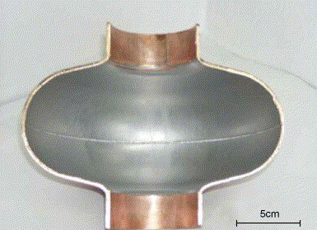
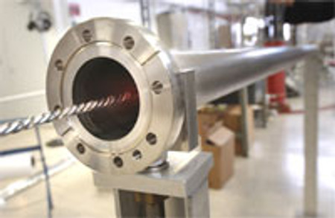
Material Developments
Superconducting multilayers to supplement or replace expensive bulk material (e.g. niobium).
High temperature superconductors may bring enhancements in the longer term.
Non-evaporable getter (NEG) coatings to enhance vacuum systems and reduce pumping system size, complexity and cost.

Slide 10
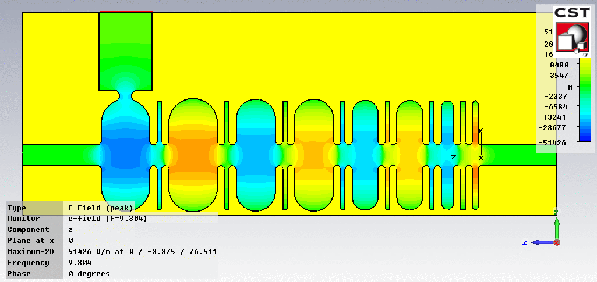
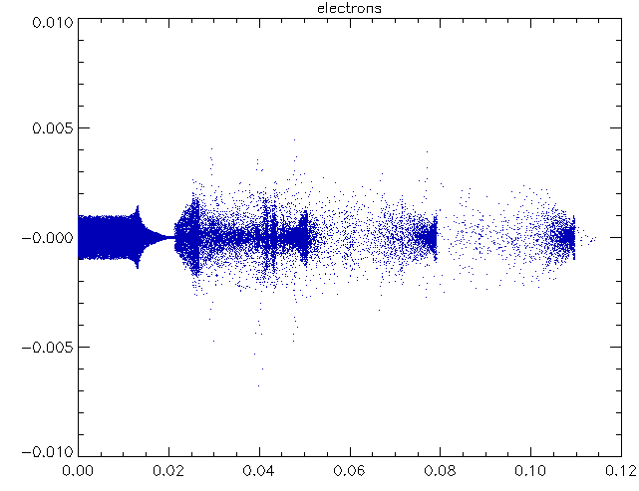
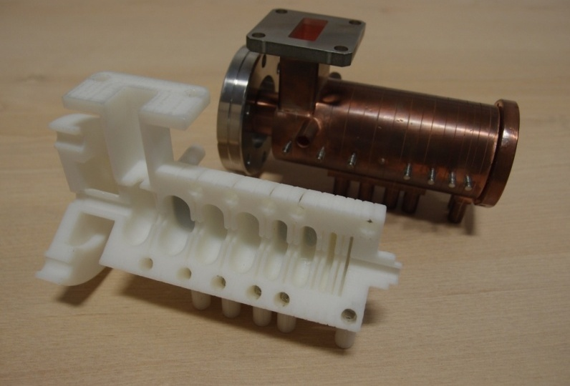
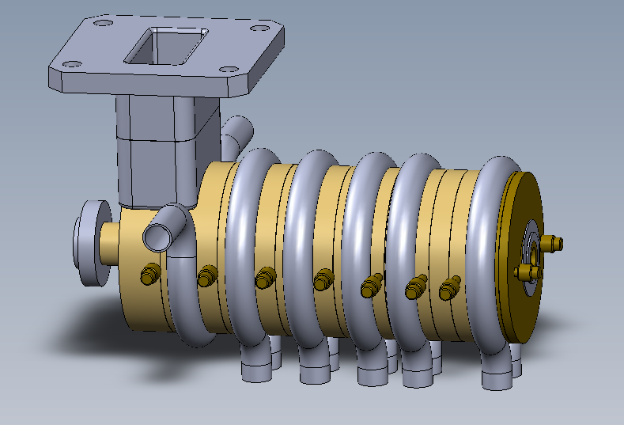
Fast Prototyping/Value Engineering
Modelling
Simulation
Rapid Prototyping
Engineering Design
Notes:
Thinking behind slide: This slide could be dropped if time is an issue. Just wanted to show that we can provide solutions from theory through to product.

Slide 11
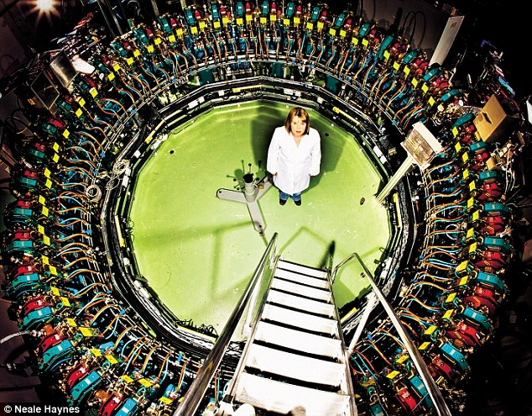
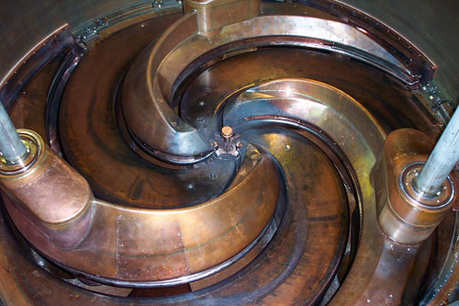

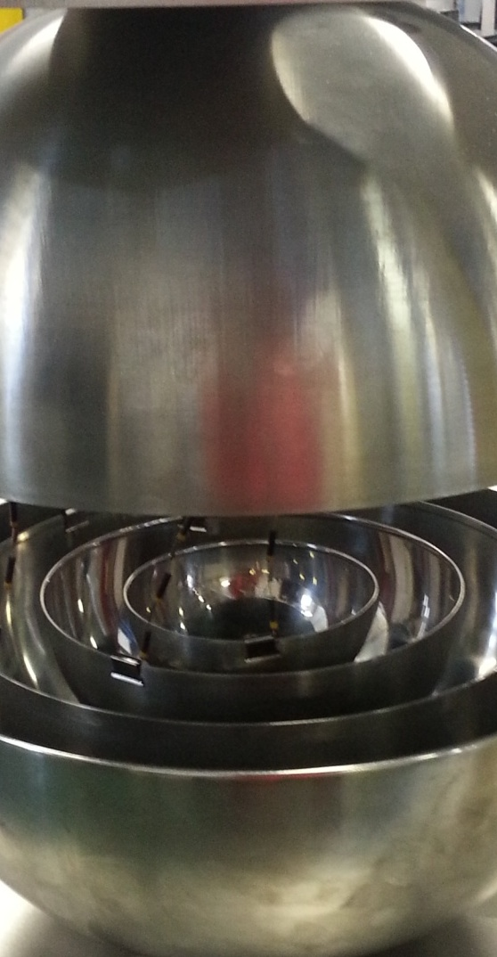
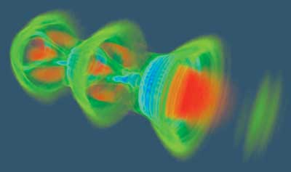
Novel Accelerators
FFAG
Superconducting Cyclotron
Laser Plasma Wakefield
Oniac
Notes:
Thinking behind slide: Future accelerators may provide a real step-change in performance and /or cost reduction. The sooner end users are engaged in the use of accelerated beams, the quicker they can exploit future developments.

Slide 12
Process Optimisation
Significant opportunities to reduce the dose (and therefore infrastructure investment) by optimising how the accelerated beams interact with other ‘conventional’ techniques in the clean-up process (e.g. filtration, reduction, oxidation, aggregation, disintegration etc.).
Therefore it is critical to promote dialogue between end users, technology suppliers and the academic base.
Notes:
Thinking behind slide: Accelerators are unlikely to be the sole component in an environmental clean up process. There is still a lot of fundamental work to be done to understand the optimal use of accelerated beams with conventional technology.

Slide 13
Summary
Accelerators are not just big R&D tools - commercial use of accelerators is widespread in many sectors.
Technology developments are underway which will reduce the size, cost and complexity of accelerators.
The expertise exists in the UK to translate these developments into commercial systems.
Open dialogue is the key to fully identifying user needs and finding optimal solutions.

