Slide 1
Environmental applications of accelerators
Industry challenges – sludge treatment
Martin Jolly
Technical director
Notes:
Why is the date not showing up?

Slide 2
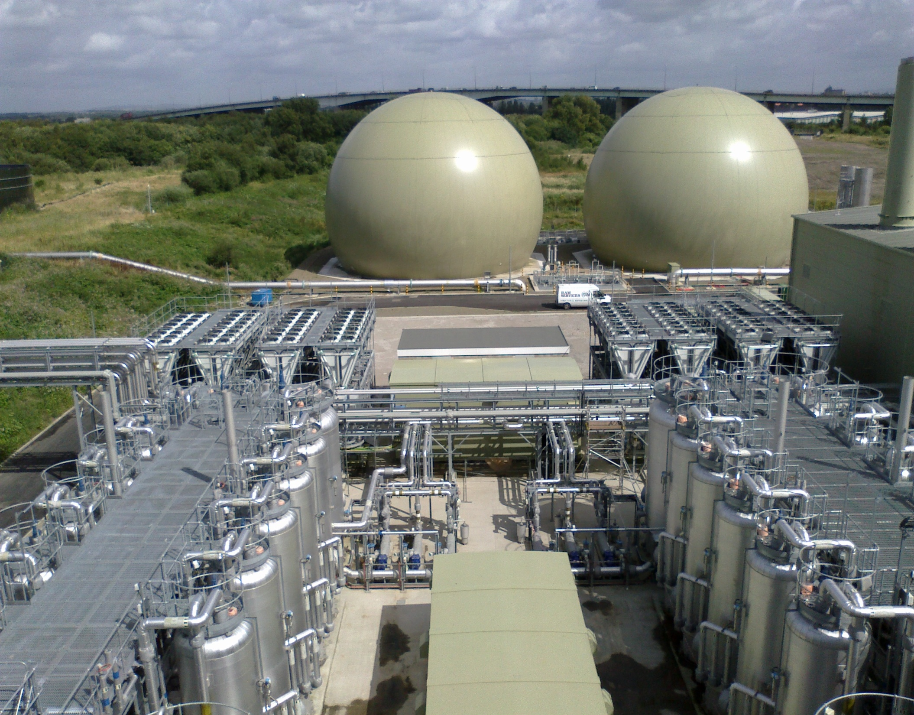

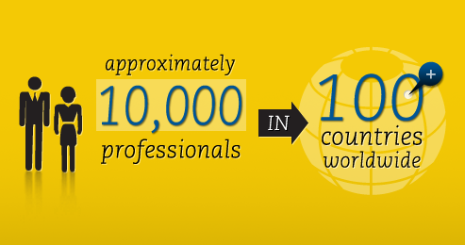
Employee-owned company, founded in 1915.
Engineering, consulting and construction.
  Energy
  Water
  Telecommunications
  Management Consulting

Slide 3
Typical UK Water Company Energy usage
1250Ml/d
1500Ml/d
191kWh/Ml
219kWh/Ml
Water Treatment Works
Sewage Treatment Works
447kWh/Ml
188kWh/Ml
219kWh/Ml
Total usage = 635GWh/a

Slide 4
Typical UK Water Company Energy usage
1250Ml/d
1500Ml/d
219kWh/Ml
191kWh/Ml
41kWh/Ml
Water Treatment Works
Sewage Treatment Works
447kWh/Ml
188kWh/Ml
45kWh/Ml
81kWh/Ml
40kWh/Ml
219kWh/Ml
45kWh/Ml
30kWh/Ml
Reduction
Total usage = 635GWh/a
22%
Total usage = 495GWh/a

Slide 5
Typical UK Water Company Energy usage
635
495
1990 Baseline
Apply significant energy saving & generation measures

Slide 6
Typical Sewage Treatment works
Aeration tank requires air to treat sewage by oxidising BOD & Ammonia
Primary settlement tank
Clean effluent to river
Air supplied by a blower through a network of pipes.
SAS
Biogas for electricity generation
Primary sludge
Sludge for disposal or recycling
Digestion

Slide 7
Digestion- Covert organic Matter to methane
Nitrogen Rich Organic Matter (sewage sludge)
Rapid (Hydrolysis)
Volatile Fatty Acids & Other Compounds
Ammonia
CO₂
Methane
Slow (Methanogenesis)
Ammonium Bicarbonate Alkalinity (Buffering)
Equilibrium is required

Slide 8
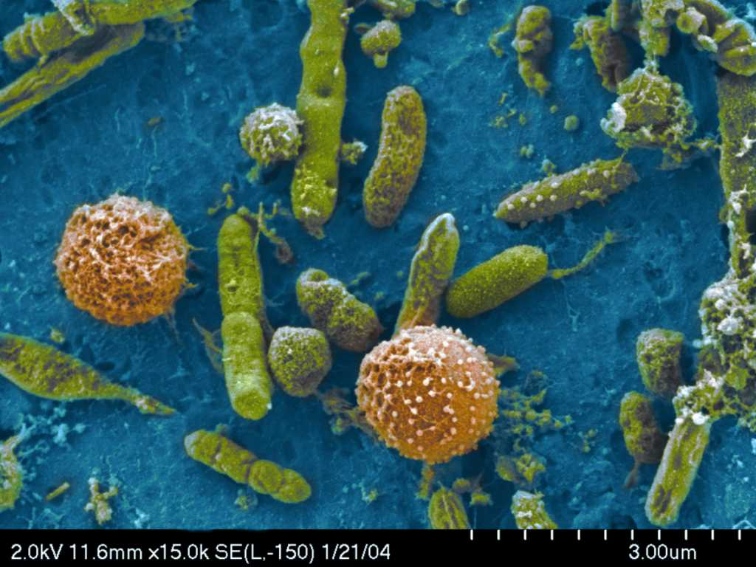
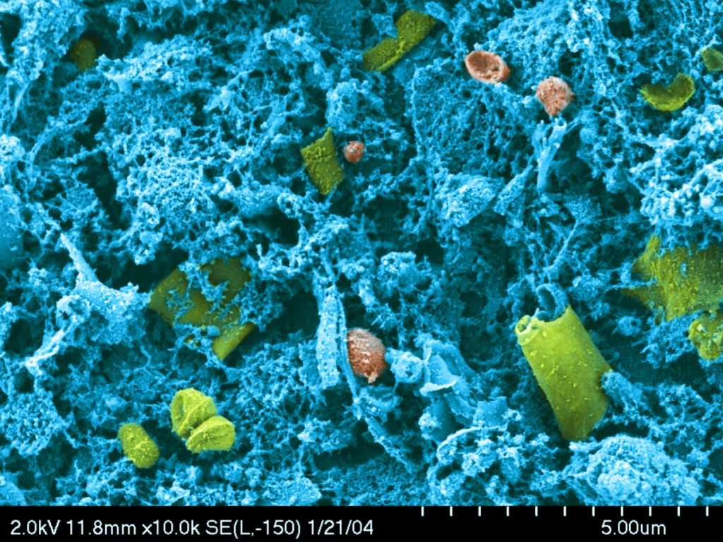
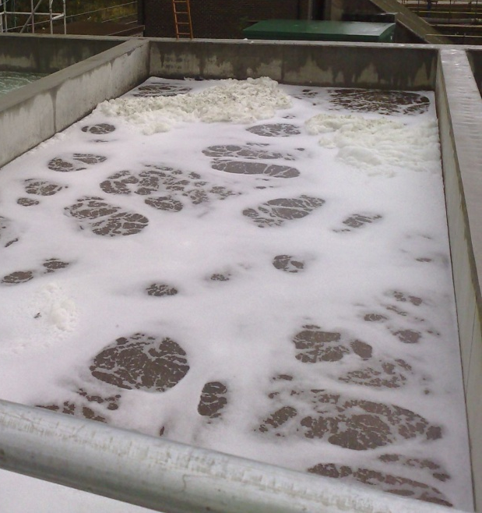
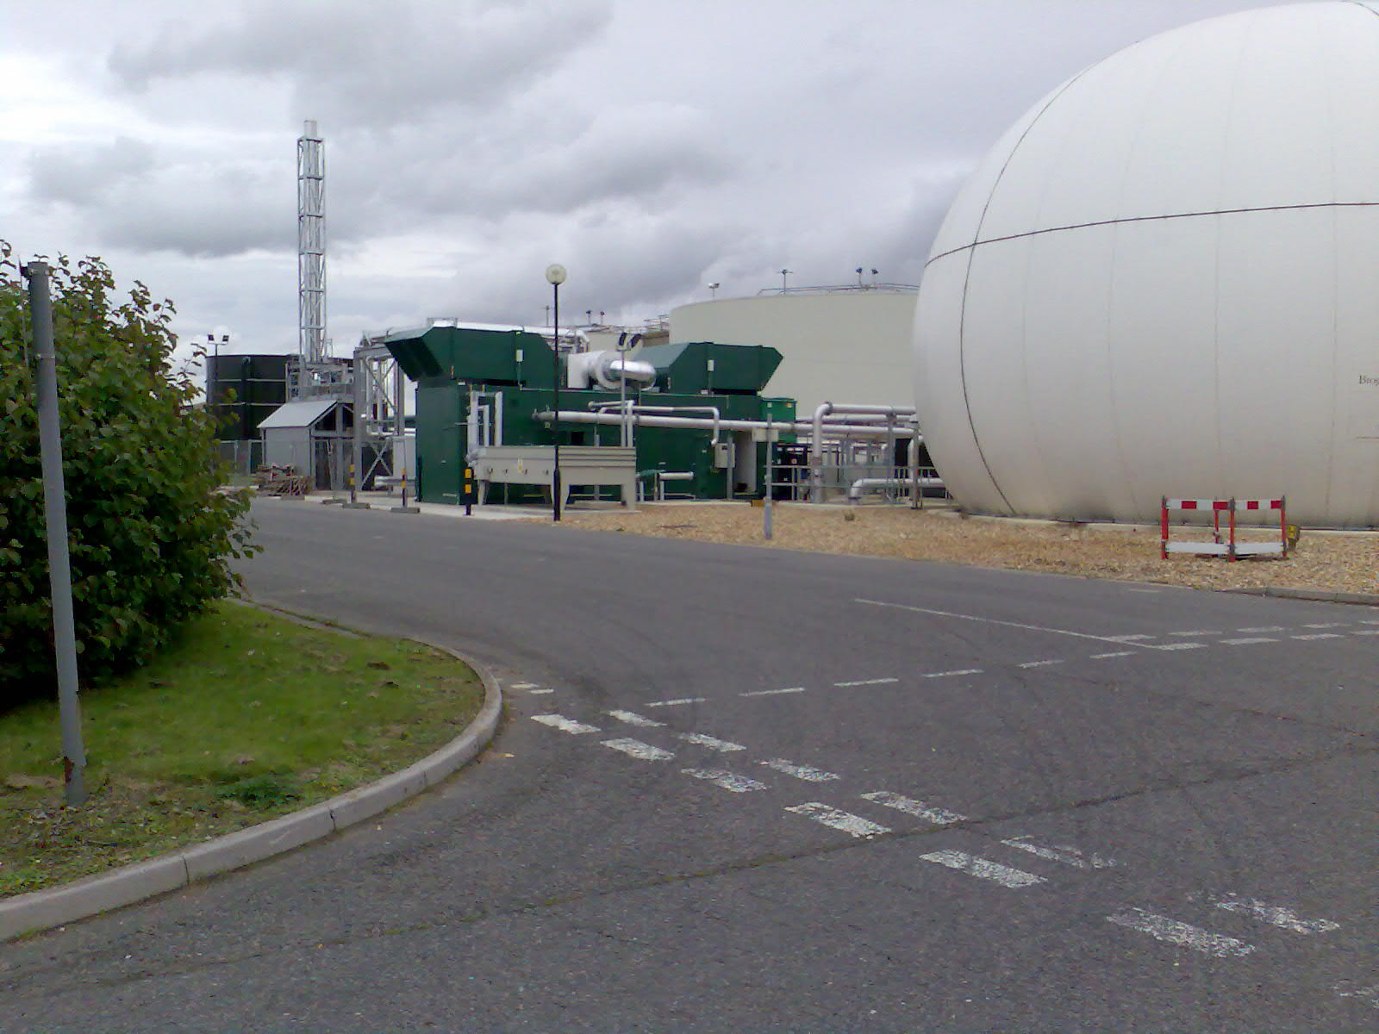
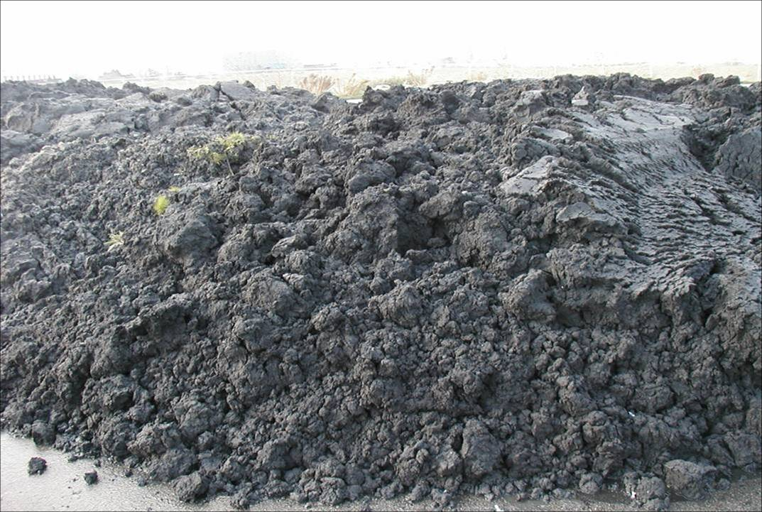
SLUDGE Treatment
Liquors
Power
Biogas
Sludge
Notes:
So let’s look at what happen to the microbes.
These are scanning electron microscope images of the WAS before and after MicroSludge.
The image on the left shows intact bacterial microbes magnified 20,000 times. The small holes in the paper are 0.2 microns.
The image on the right shows the same microbes following the MicroSludge process. The cell membranes have been destroyed and the liquid cellular contents have been released for easier digestion.
And it is worth noting that no other pre-treatment technology can show you something like this. They may achieve some disruption for cell flocks, but they cannot show you this kind of cell lysis on a microbial level.
If you are going to take any one concept away from this presentation, this is it. Methane producing bacteria can only eat what is in the liquid phase, not in the solids. MicroSludge solubilizes the microbes in WAS and enables conversion to biogas.

Slide 9

2. Enzyme Hydrolysis
3.Thermophilic digestion
1. Thermal Hydrolysis
Advanced Digestion
4. Ultrasound
7. Cell Rupture
5. Microsludge
6. OpenCEL

Slide 10
The rise of Advanced Digestion
Technology | First trial | First Full scale plant | Number of full scale plants
Thermal Hydrolysis | Early 1990 | 1996 | 24
Enzyme Hydrolysis | Late 1990s | 2002 | 11
Thermophilic digestion | 1950s | 1954 | >20
Ultrasound | 1990s | 2000 | >10
Microsludge | 2000 | 2004 | 3
OpenCEL | 2000 | 2007 | 1
Cell Rupture | 2004 | N/A | 0

Slide 11




Advanced digestion process flow sheet
CHP
Power out
Excess
biogas
burner
Gas holder
Sludge
In
Cake
Out
Sludge
feed tank
Advanced digestion pre-treatment
Digested sludge
dewatering
Thickening
Sludge storage
Cake storage
Digestion
Liquor treatment

Slide 12
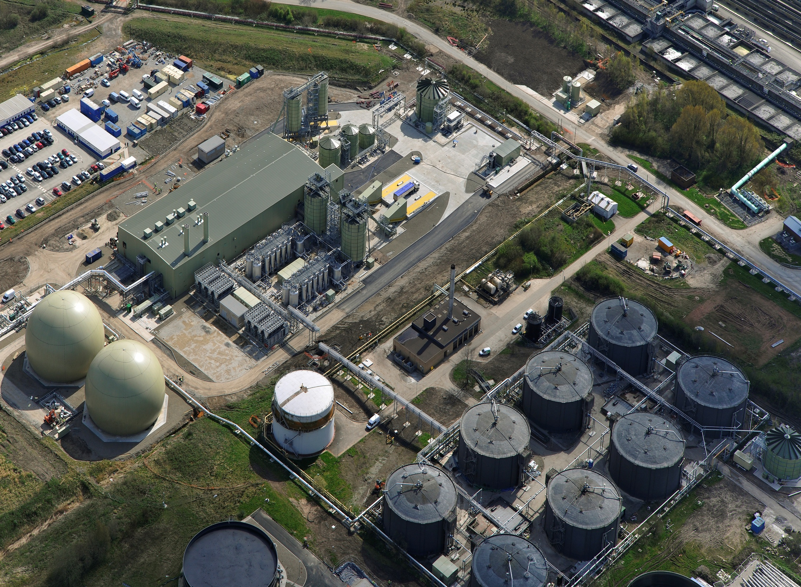
Manchester wastewater plant
Description | Units | Existing | New
Capacity of plant | tds/a | 39 000 | 91 000
Maximum energy production | Mw | 3.7 | 11.5
Digester volume | m³ | 60 000 | 60 000
Feed to digester | Dry solids (%) | 5-6 | 11
Photo courtesy of Cambi

Slide 13
Volatile solids destruction vs sludge composition
58
45
Heat treatment blended sludge
Electrical & mechanical treat SAS only
32
100% SAS
100% Primary
Notes:
SAS only 32%, Primary only 58%, 50/50 mix 45%. SAS only moves SAS line , thermal treatment moves whole line.

Slide 14
Empirical cake dry solids vs Volatile solids
Thermal treatment – 5 sites
Conventional treatment – 45 sites

Slide 15
Feed & Cake dry solids
All processes improve dewaterability, thermal more than others
6%
6%
6%
6%
Thermal
6%
Part Thermal
7%
Thermal
11%
6%

Slide 16
Ammonia concentration in digester
Ammonia concentration in digester is a function of :
Feed dry solids
Digester performance
Sludge nitrogen content
Up to 3000mg/l ammonia compared to conventional MAD – 1000mg/l

Slide 17
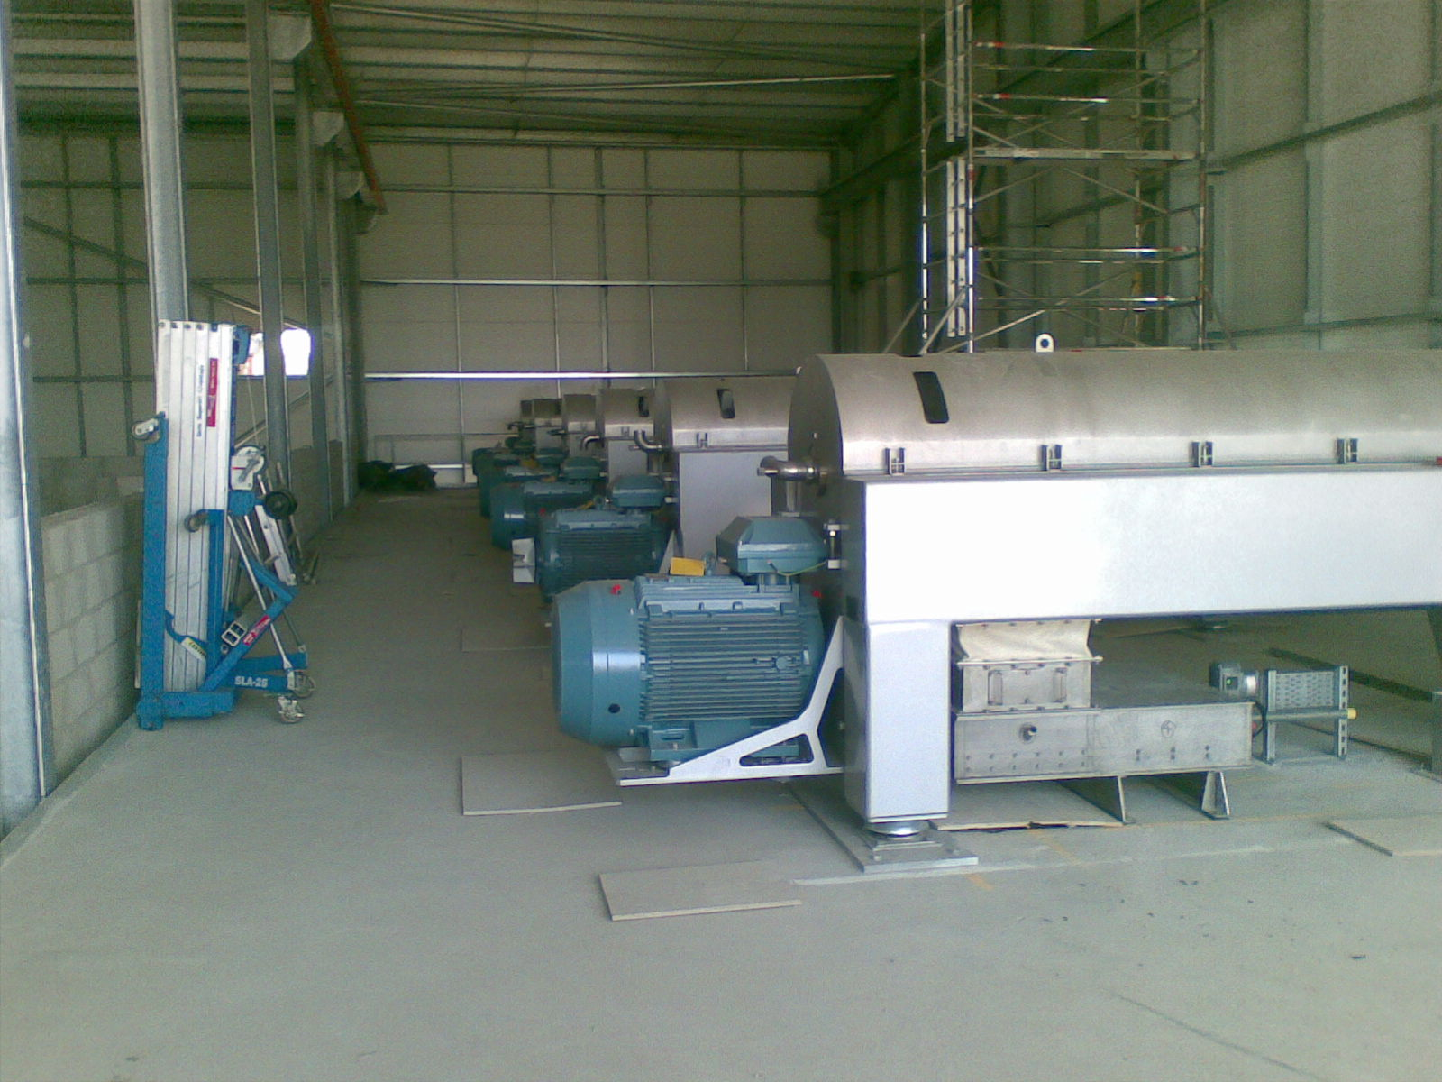
Liquors from digested sludge
Dewatering centrifuges used to produce a cake
Liquors need to be treated

Slide 18
Liquor treatment
However loads from all process similar as lower flow from thermal hydrolysis dewatering
High concentration of ammonia from thermal hydrolysis as digesters fed at 11% dry solids

Slide 19
Value for money
Relative operating cost benefit to mesophilic digestion
Generally, you get what you pay for, with 1 possible exception
Relative capital cost to mesophilic digestion

Slide 20
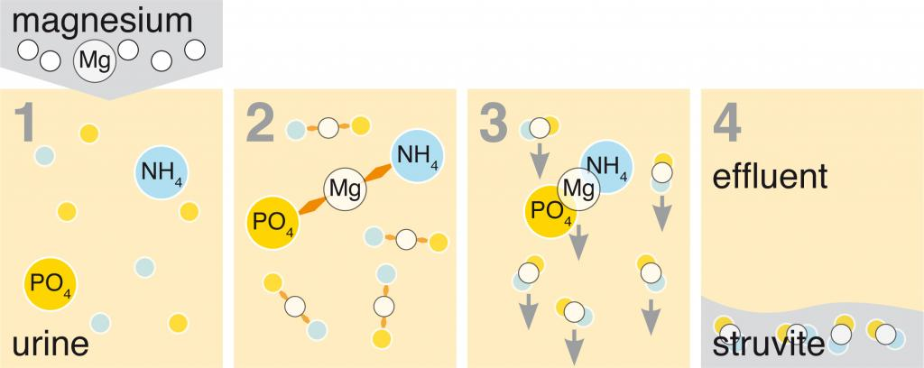
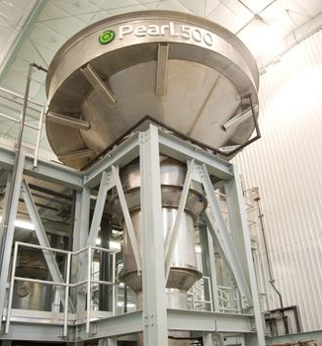
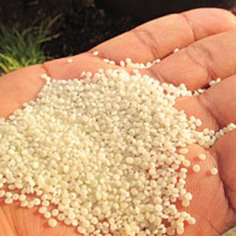
Struvite: (NH4)MgPO4·6(H2O)

Slide 21
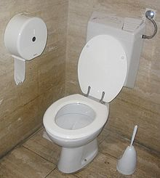
Challenges
Energy – Water companies need to reduce from 495GWh/year to less than 100GWh/year.
Organic matter - only able to convert a maximum of 60% to methane.
Nitrogen – some recovery in bulk as a natural fertiliser.
Phosphorus – recovery possible but not widespread.
This is a resource

Slide 22
Notes:
All slide presentations should end with Building a world of difference. Together

